Slide 2
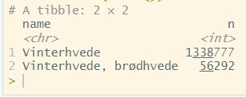
Winter wheat data
Two types of winter wheat crops, both included

