Slide 1
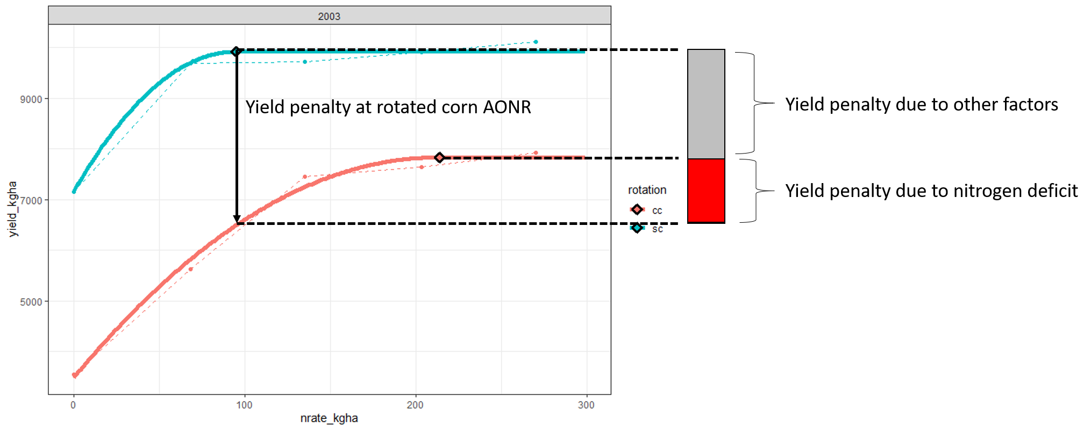
Ames 2003 example

Slide 2
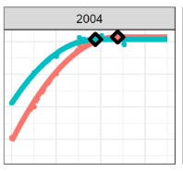
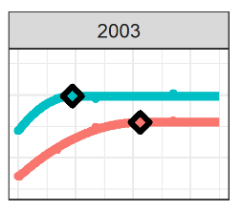
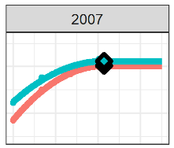
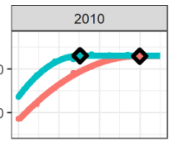
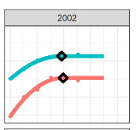
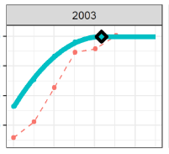
Highly
N-derived gaps
Not
N-derived gaps
Orcc
Ames
Ames
Gap = 501 kg/ha
%N = 0%
Gap = 153 kg/ha
%N = 100%
Gap = 2084 kg/ha
%N = 40%
Suth
Monm
Orcc
Gap = 1819 kg/ha
%N = 98%
Gap = 3043 kg/ha
%N = 0.001%
Gap = NA
%N = 100%

Slide 3
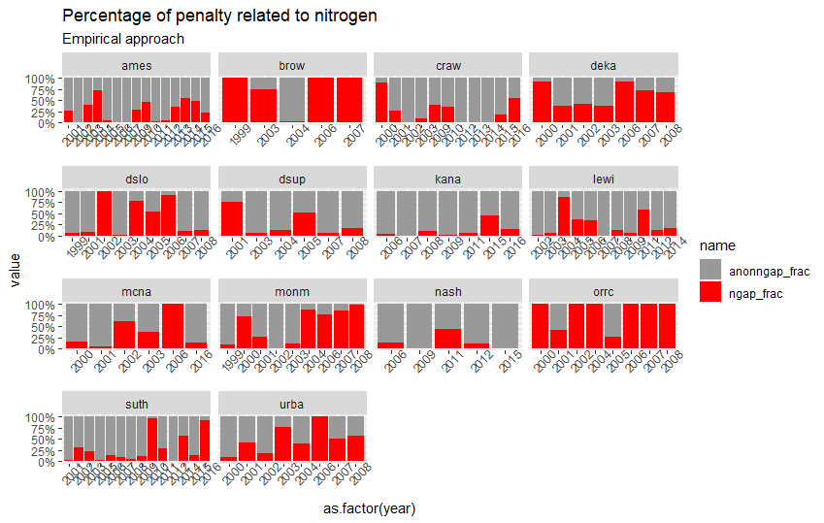

Slide 4
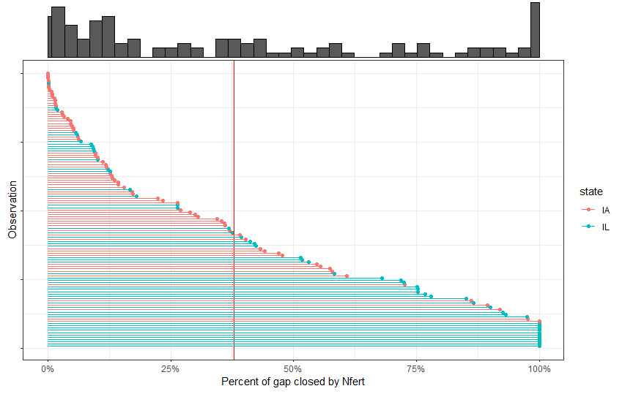

Slide 5
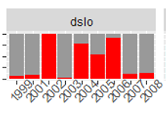
37% of the variability is between sites
The rest (63%) is within site (ie lots of variability within a site)

Slide 6
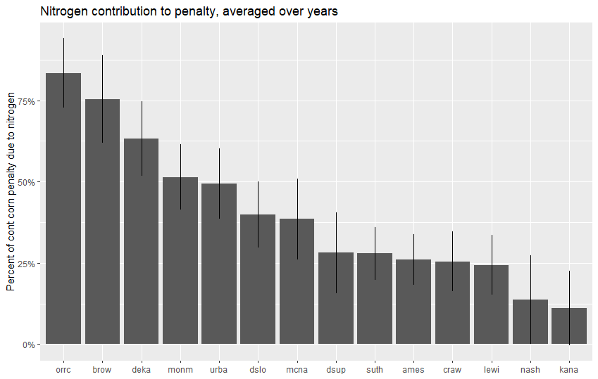

Slide 7
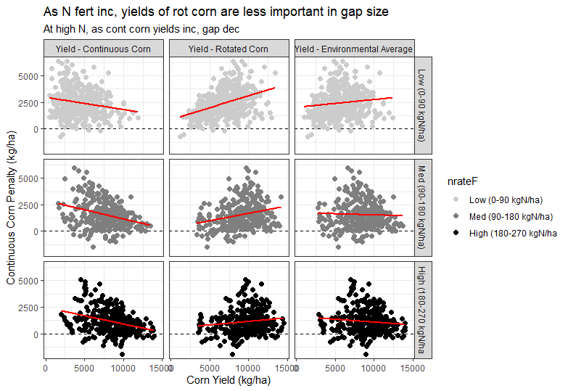
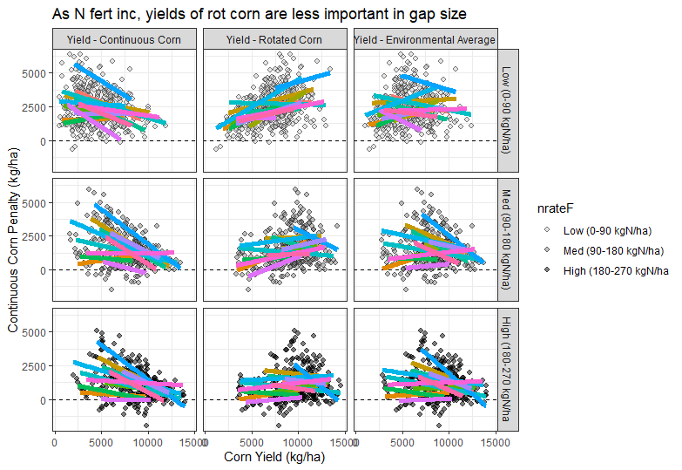
Is gap driven by rot corn yield, or cont corn yield? Within site and across site patterns are the same.

Slide 8
Is N-contribution relate to size of gap?

Slide 9
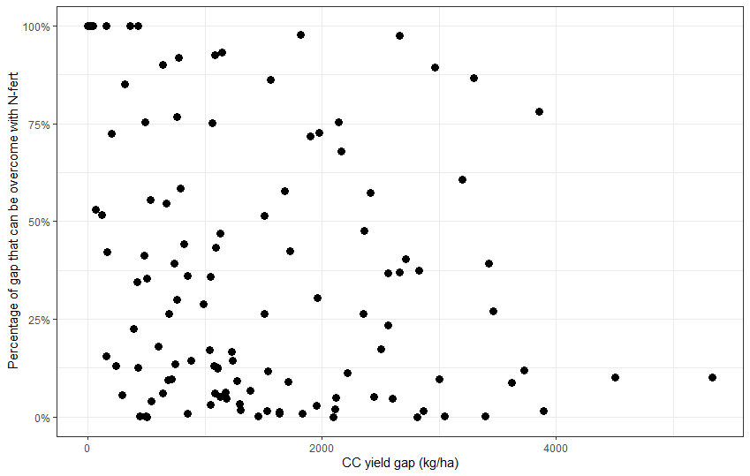

Slide 10
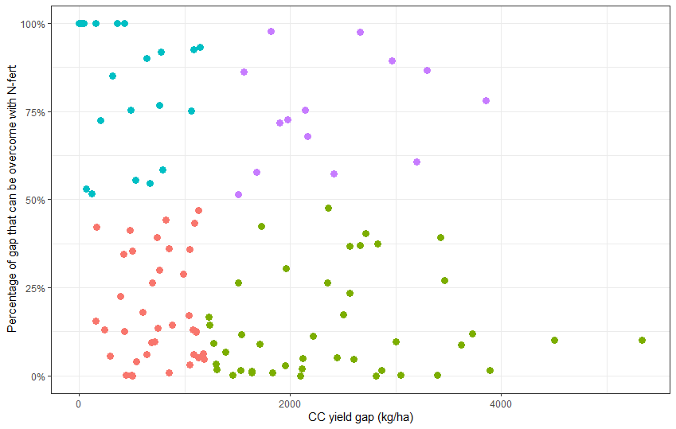
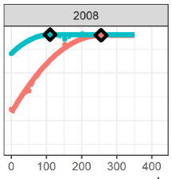
Large gaps, over-come with fertilization
Monm
Gap = 2663 kg/ha
%N = 97%

Slide 11
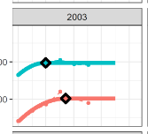
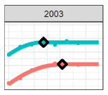
Large gaps, NOT over-come with fertilization
Monm
Craw
Gap = 5331 kg/ha
%N = 10%
Gap = 4502 kg/ha
%N = 10%

Slide 12
N overcomes 50% of gap roughly half of the time at lower penalties
N overcomes 50% of gap a quarter of the time at higher penalties
26
14
38
43

Slide 13
Larger gaps are less likely to be addressed with N-fert
Higher production potential = larger gaps
→ Areas with high production potential are less likely to close continuous corn gaps with N-fert

Slide 14
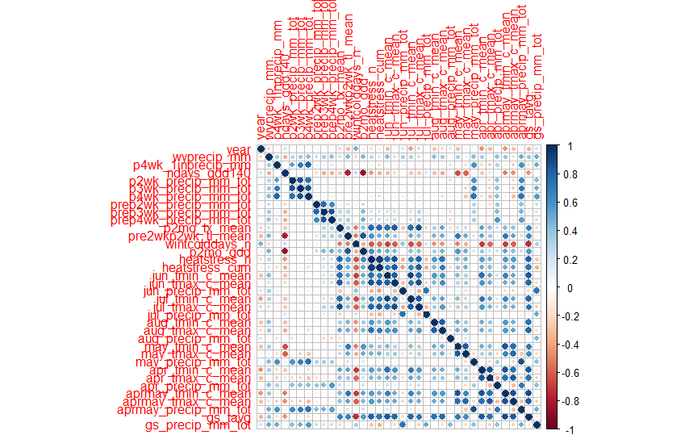
I get different answers, depending on what I include for weather
Want variables that are not correlated
ex precip at planting and GDDs 2 weeks after planting are correlated
Want meaningful things
Ex July precip, might mean something different in IL?

Slide 15
Previous Crop
Above-ground OM
Below-ground OM
Organic C and N
Tillage
Foliar Disease
Plant Population
Soil temperature
Soil Moisture
Soil N Pool
Organic N
Emergence Speed
Root Disease
Mineral N
Emergence Day
Root Structure
Leaching
Corn Yield

Slide 16
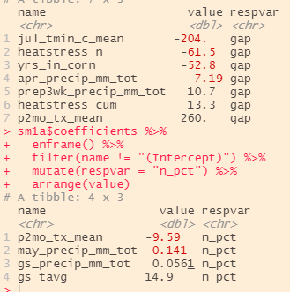
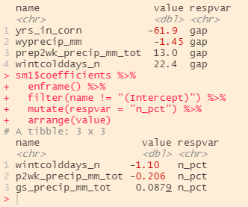
Remove correlated ones/things I don’t like
Throw everything at it

Slide 17
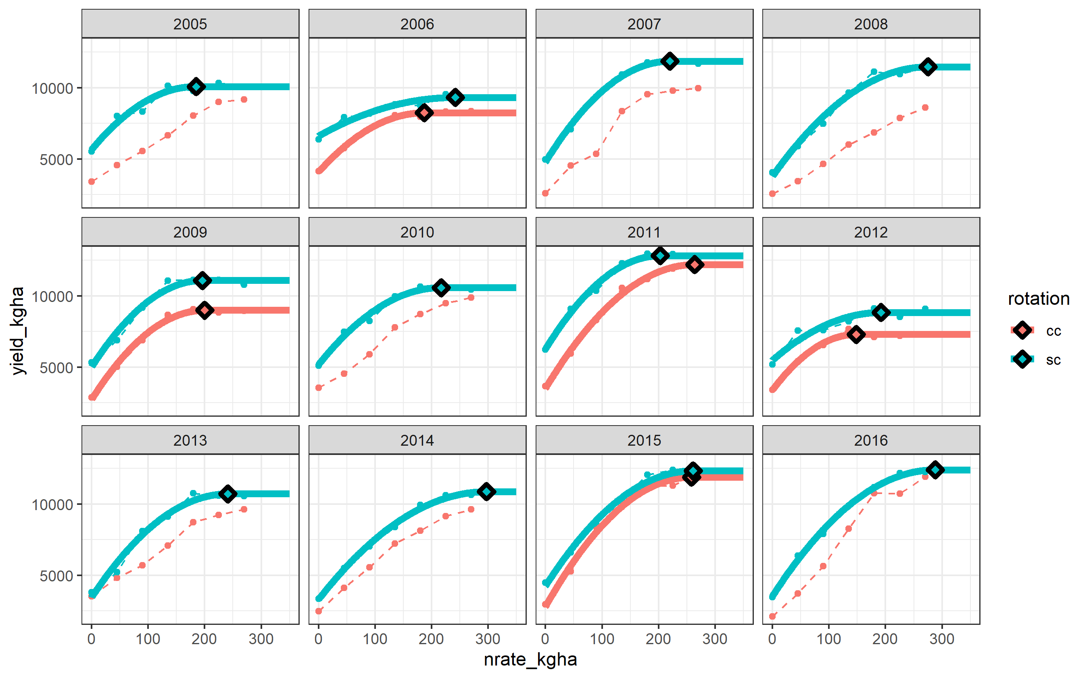
Gap = ??
%N = 0%
Gap = ??
%N = 100%
Gap = ??
%N = 100%

