Slide 1
Previous Crop
Above-ground OM
Below-ground OM
Organic C and N
Tillage
Foliar Disease
Plant Population
Soil temperature
Soil Moisture
Soil N Pool
Organic N
Emergence Speed
Root Disease
Mineral N
Emergence Day
Root Structure
Leaching
Corn Yield

Slide 2
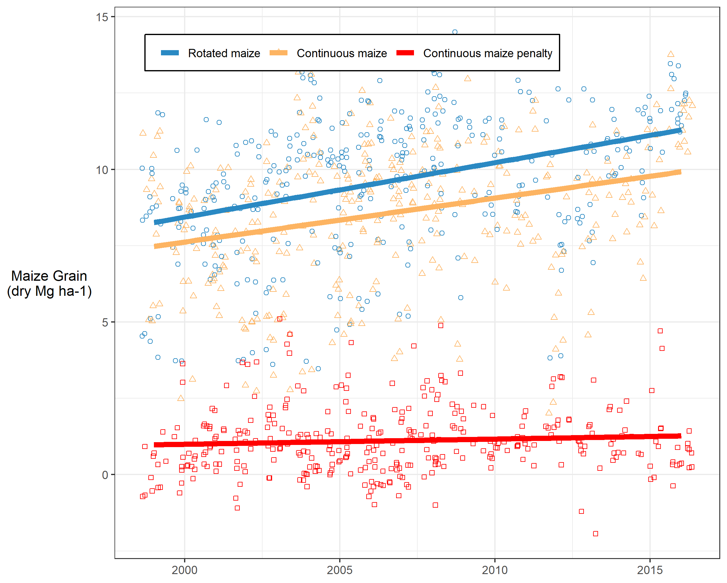
Previous Crop
Above-ground OM
Below-ground OM
Organic C and N
Tillage
Foliar Disease
Plant Population
Soil temperature
Soil Moisture
Soil N Pool
Organic N
Emergence Speed
Root Disease
Mineral N
Emergence Day
Root Structure
Leaching
Corn Yield

Slide 3
Previous Crop
Above-ground Biomass
Below-ground Biomass
Organic C and N
Tillage
Foliar Disease
Plant Population
Soil temperature
Soil Moisture
Soil N Pool
Organic N
Emergence Speed
Root Disease
Mineral N
Emergence Day
Root Structure
Leaching
Maize Yield

Slide 4
Maize Crop (Previous Year)
Above-ground Biomass
Below-ground Biomass
Organic C and N
Tillage
Foliar Disease
Plant Population
Soil temperature
Soil Moisture
Soil N Pool
Organic N
Emergence Speed
Root Disease
Mineral N
Emergence Day
Root Structure
Leaching
Maize Yield

Slide 5
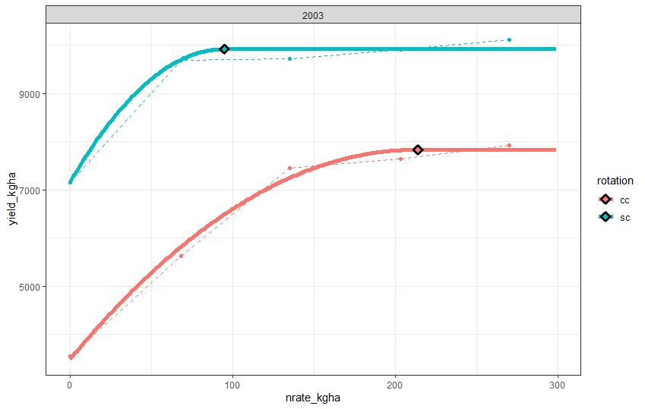
Yield penalty at rotated corn AONR
Yield penalty due to other factors
Yield penalty due to nitrogen deficit

Slide 6
Maize Crop
Previous year’s maize yield
Residue
Modelled residue at planting
Surface Residue
Soil Moisture & Temp
Foliar Disease
Continuous maize
yields at 0 N
Soil N Pool
Root Disease
Root resource uptake
Continuous Maize Penalty

Slide 7
Residue
0.22
Soil N Pool
Surface Residue
-0.29
Continuous Maize Penalty

