Slide 1
Previous Crop
Above-ground OM
Below-ground OM
Organic C and N
Tillage
Foliar Disease
Plant Population
Soil temperature
Soil Moisture
Soil N Pool
Organic N
Emergence Speed
Root Disease
Mineral N
Emergence Day
Root Structure
Leaching
Corn Yield

Slide 2
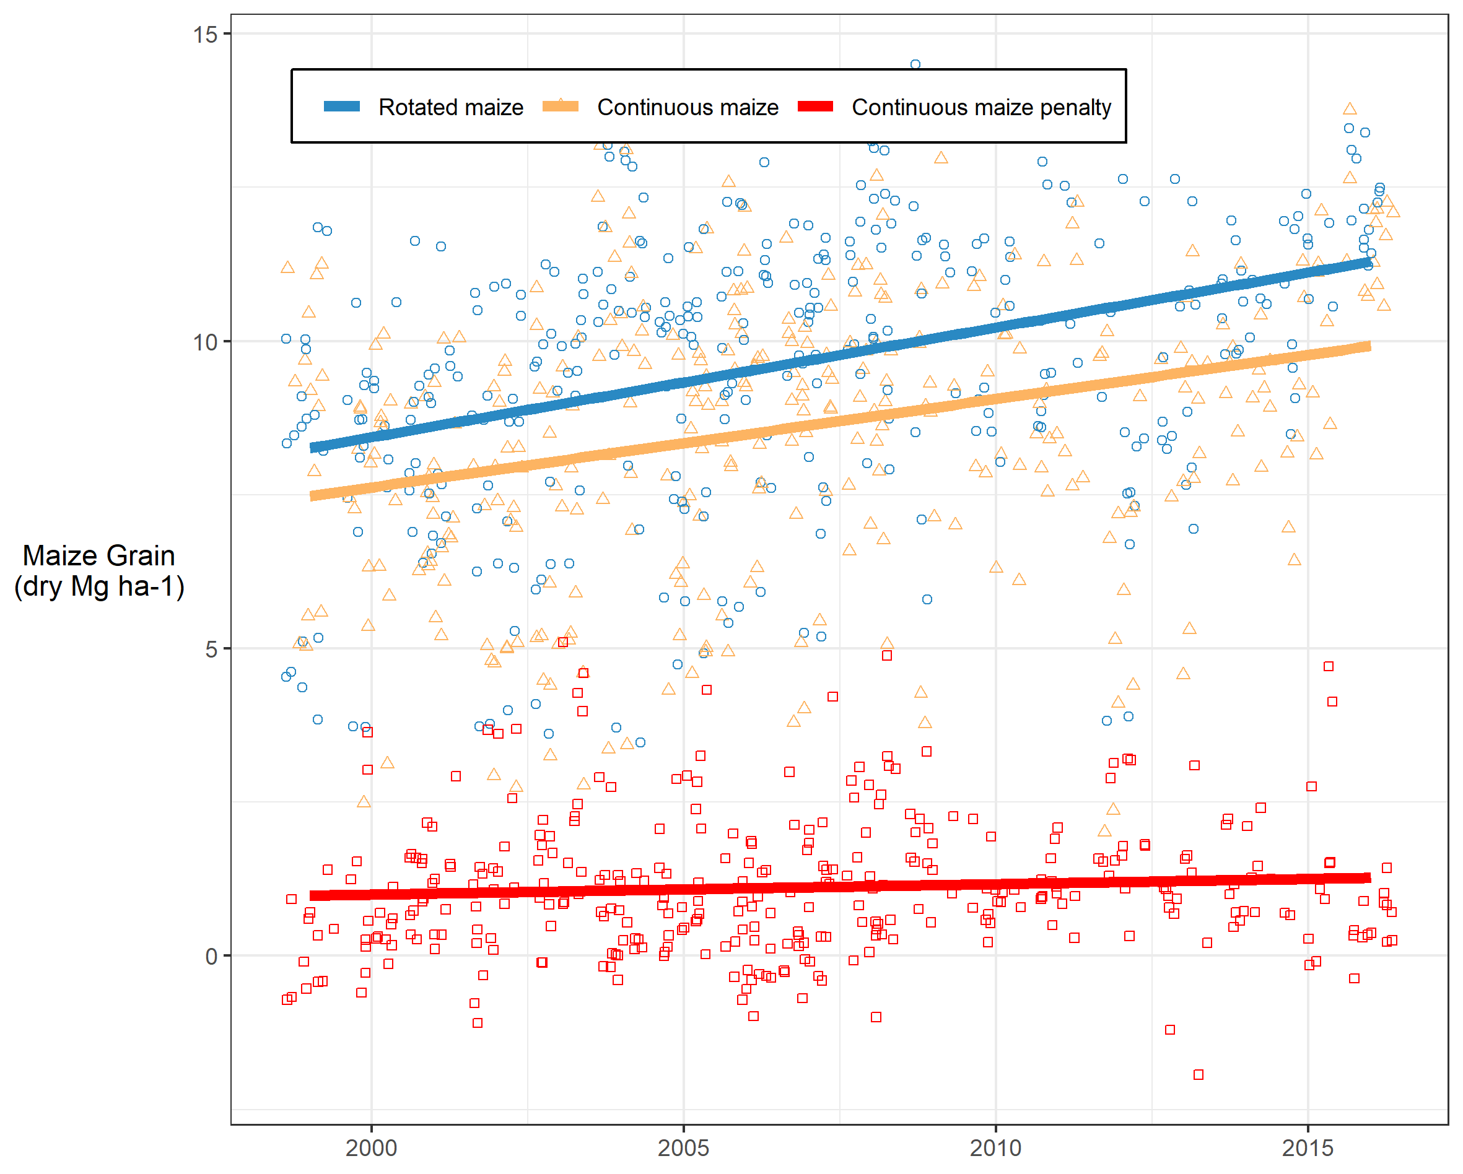
Previous Crop
Above-ground OM
Below-ground OM
Organic C and N
Tillage
Foliar Disease
Plant Population
Soil temperature
Soil Moisture
Soil N Pool
Organic N
Emergence Speed
Root Disease
Mineral N
Emergence Day
Root Structure
Leaching
Corn Yield

Slide 3
Previous Crop
Above-ground Biomass
Below-ground Biomass
Organic C and N
Tillage
Foliar Disease
Plant Population
Soil temperature
Soil Moisture
Soil N Pool
Organic N
Emergence Speed
Root Disease
Mineral N
Emergence Day
Root Structure
Leaching
Maize Yield

Slide 4
Maize Crop (Previous Year)
Above-ground Biomass
Below-ground Biomass
Organic C and N
Tillage
Foliar Disease
Plant Population
Soil temperature
Soil Moisture
Soil N Pool
Organic N
Emergence Speed
Root Disease
Mineral N
Emergence Day
Root Structure
Leaching
Maize Yield

Slide 5
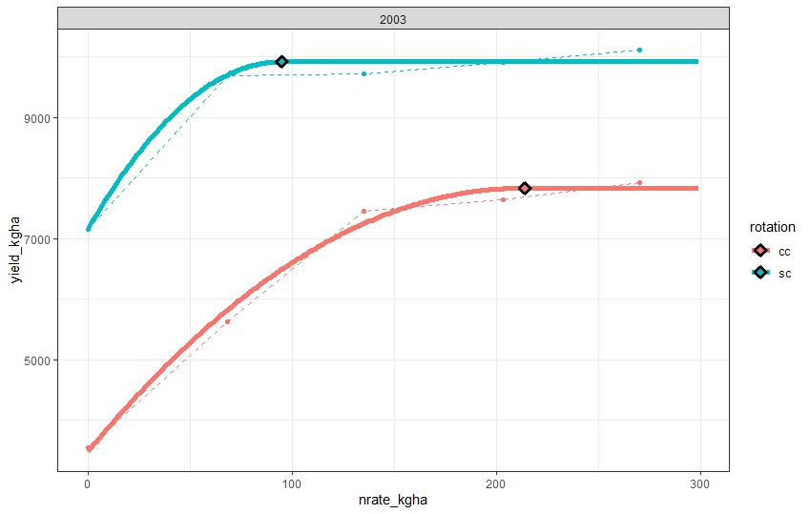
Yield penalty at rotated corn AONR
Yield penalty due to other factors
Yield penalty due to nitrogen deficit

Slide 6
Corn Crop
Modelled residue
HI assumption
SC yields@0
Residue
N-closable gap?
Modelled residue at planting
Surface Residue
Soil N Pool
Soil Moisture & Temp
Foliar Disease
In tilled systems, maybe we can ignore these connections
Root Disease
Corn Yield Penalty
Root resource uptake

Slide 7
Corn Crop
Modelled residue
HI assumption
SC yields@0
Residue
N-closable gap?
Modelled residue at planting
Surface Residue
Soil N Pool
Foliar Disease
Root Disease
Corn Yield Penalty
Root resource uptake

