Slide 1
Slope c
Slope b
xs, pivot point
a, intercept

Slide 2
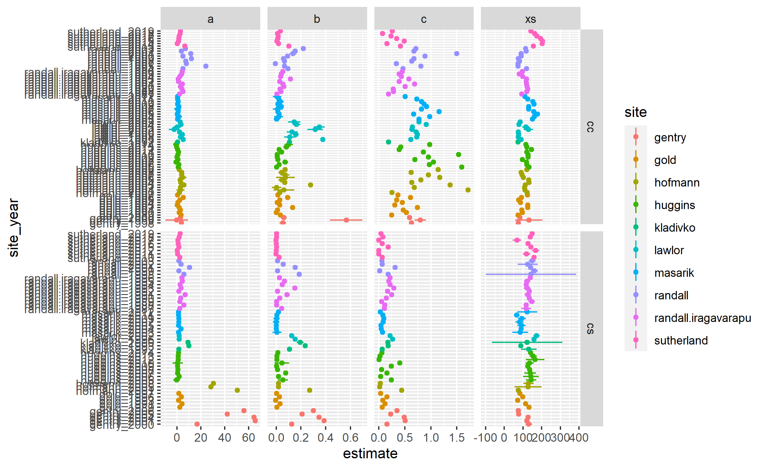
intercept, leaching at 0N
pivot point
Slope c
Slope b
xs, pivot point
a, intercept

Slide 3
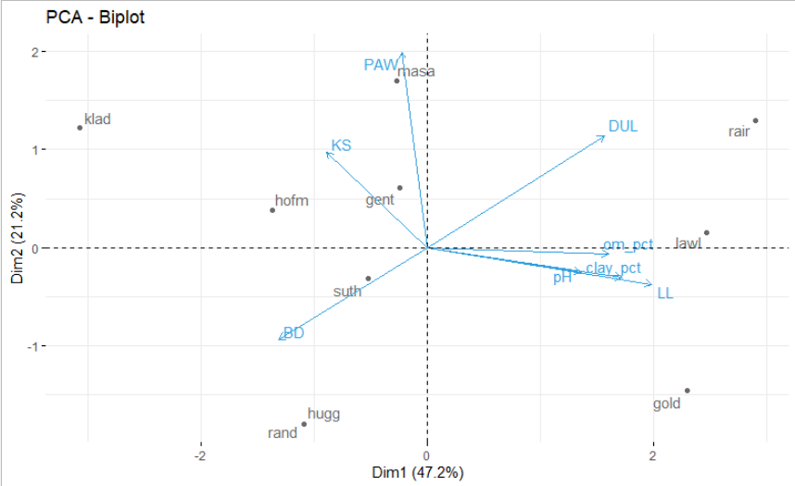
What constitutes a ‘site’?

Slide 4
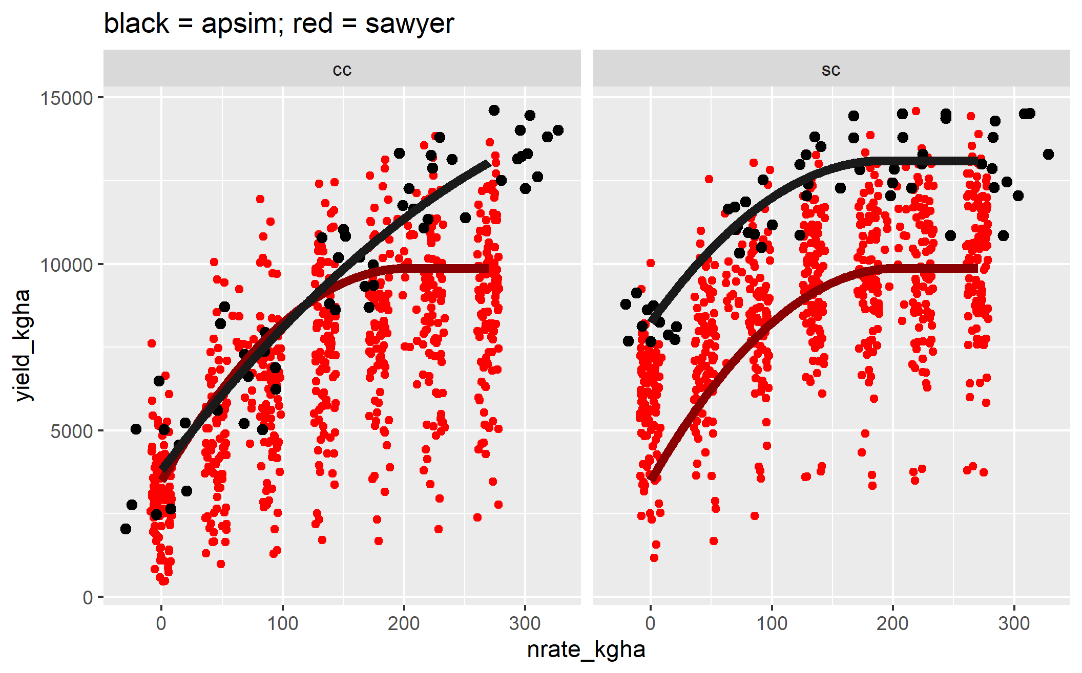
A continuous corn penalty needs to be modelled.

Slide 5
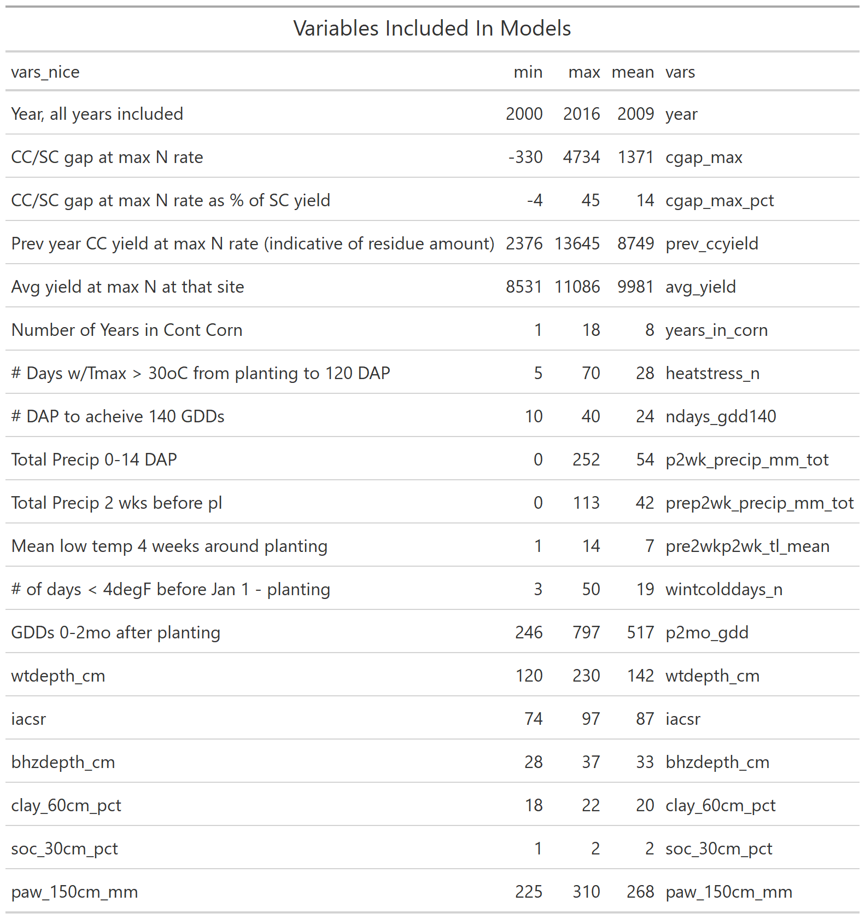

Slide 6
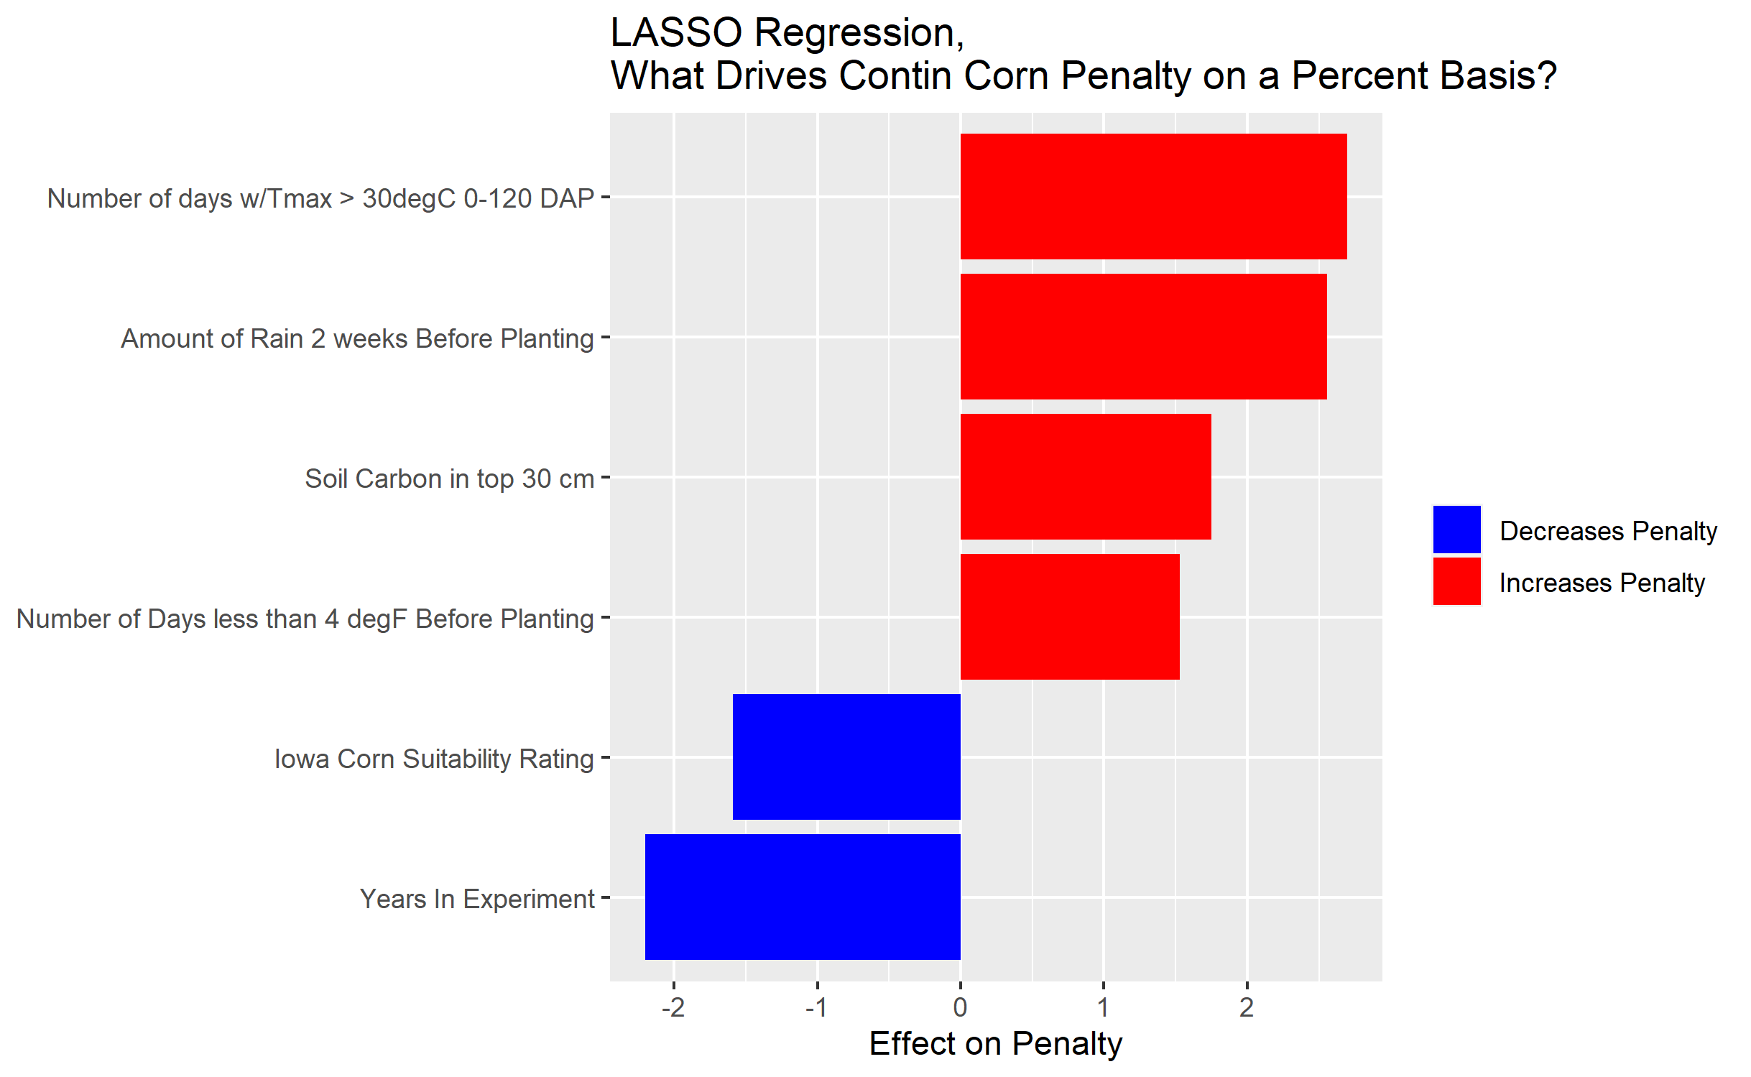

Slide 7
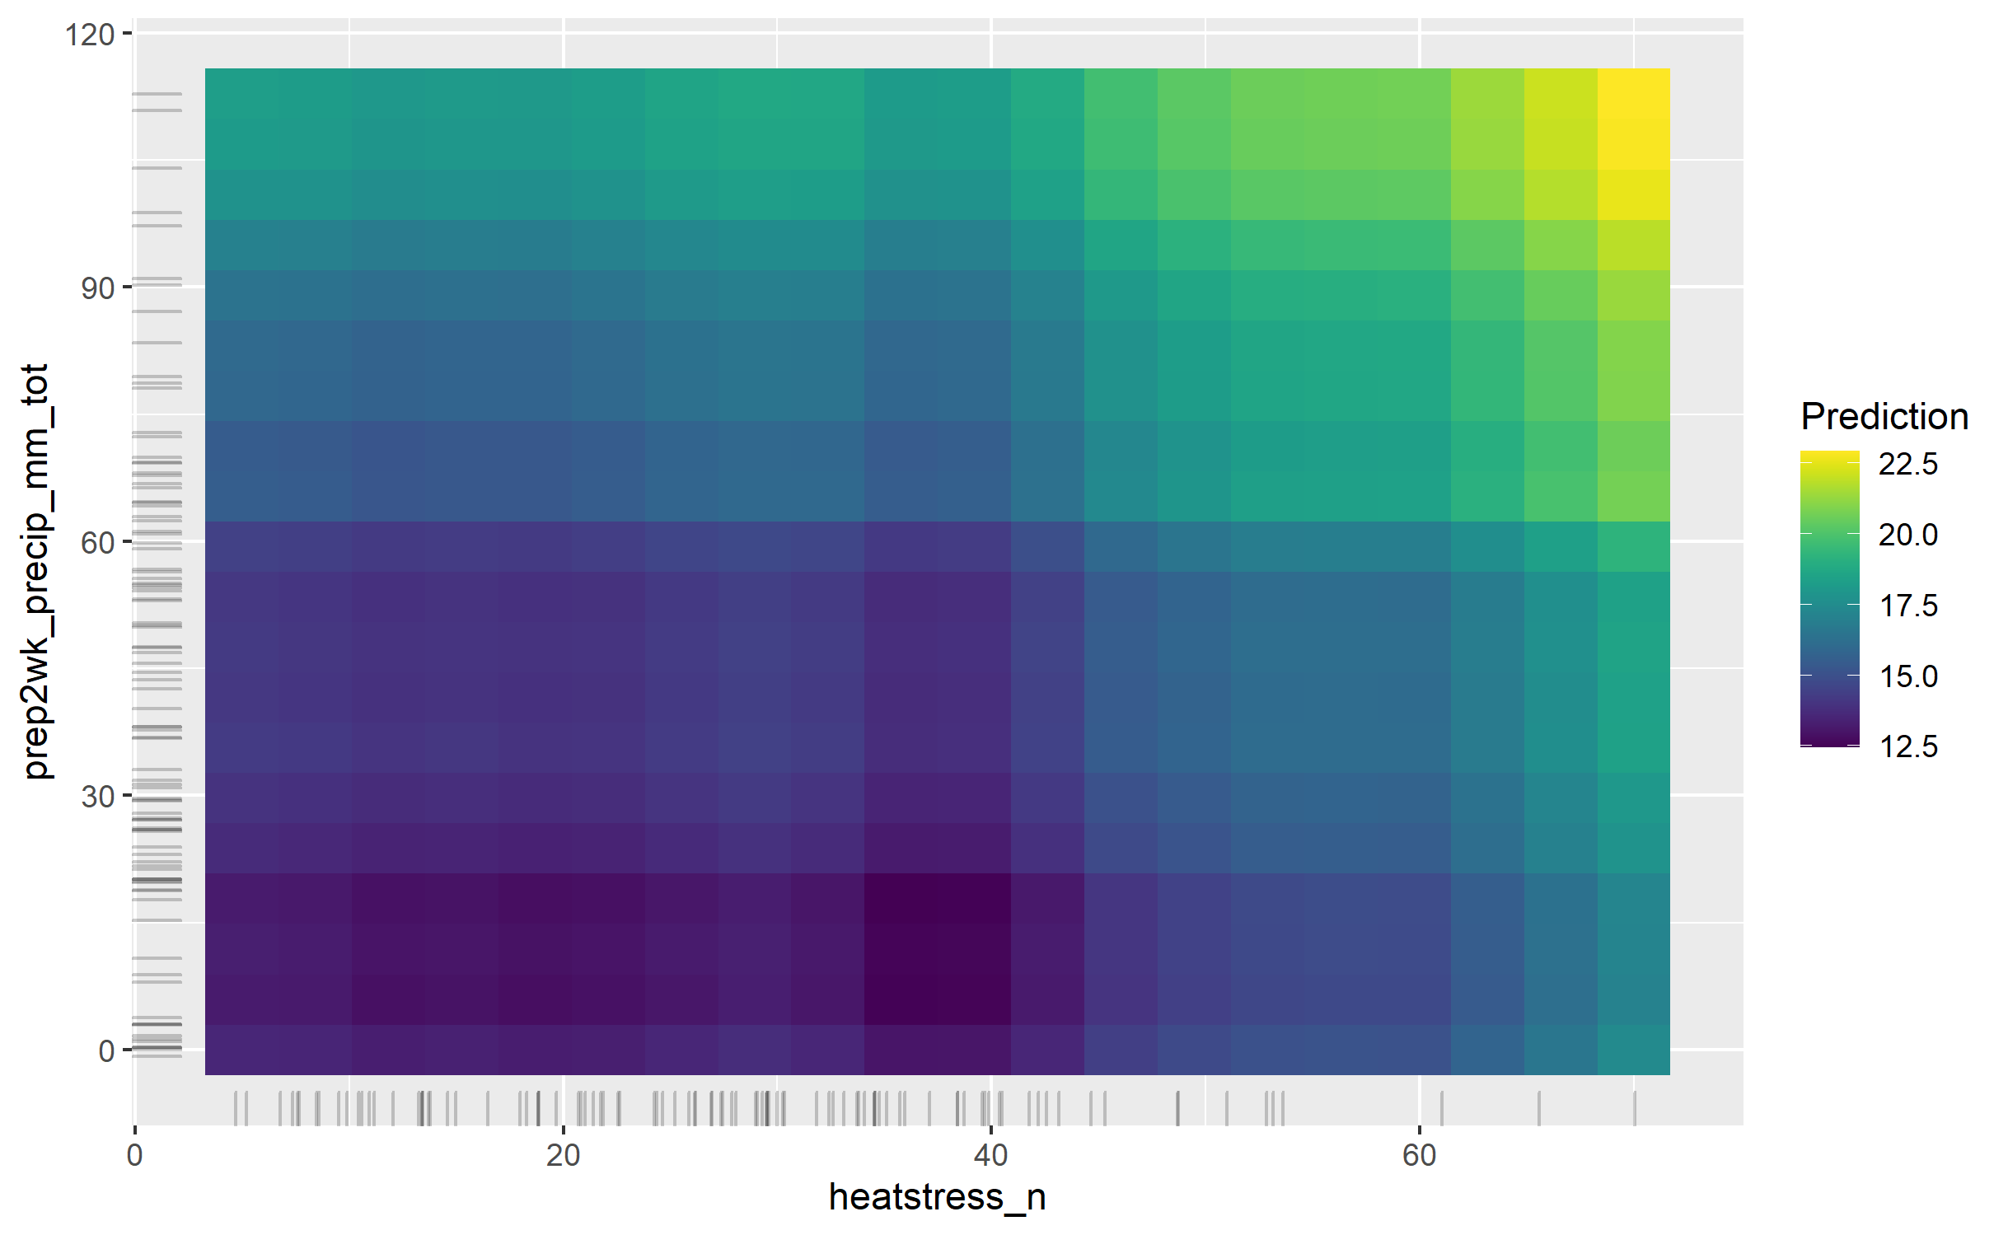

Slide 8
A rule that calculates # days
w/max T > 30, and applies a ‘in-season’ penalty?
Ex lower potential grain size X for
Every day > 30?
A rule that calculates # days
w/soil mois > XX, and if it reaches
a threshold, apply our ‘at planting’
penalties? i.e binary penalty, reduce
root extraction coeff 20%. Reduce pot.
grain number X%.

