Slide 1
1. Are rotated corn yields, or continuous corn yields driving gaps?
2. What is the role of nitrogen in the gap?

Slide 2
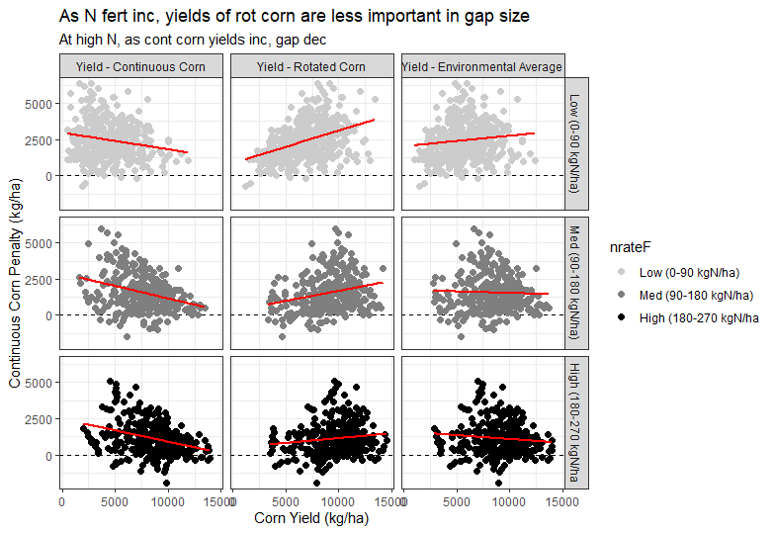
Is gap driven by rot corn yield, or cont corn yield? Within site and across site patterns are the same.

Slide 3
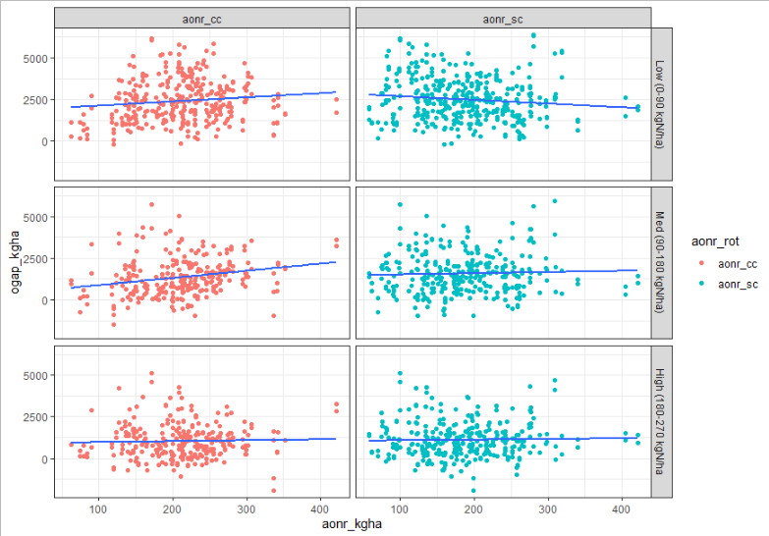
AONR is not a good predictor for gap size

Slide 4
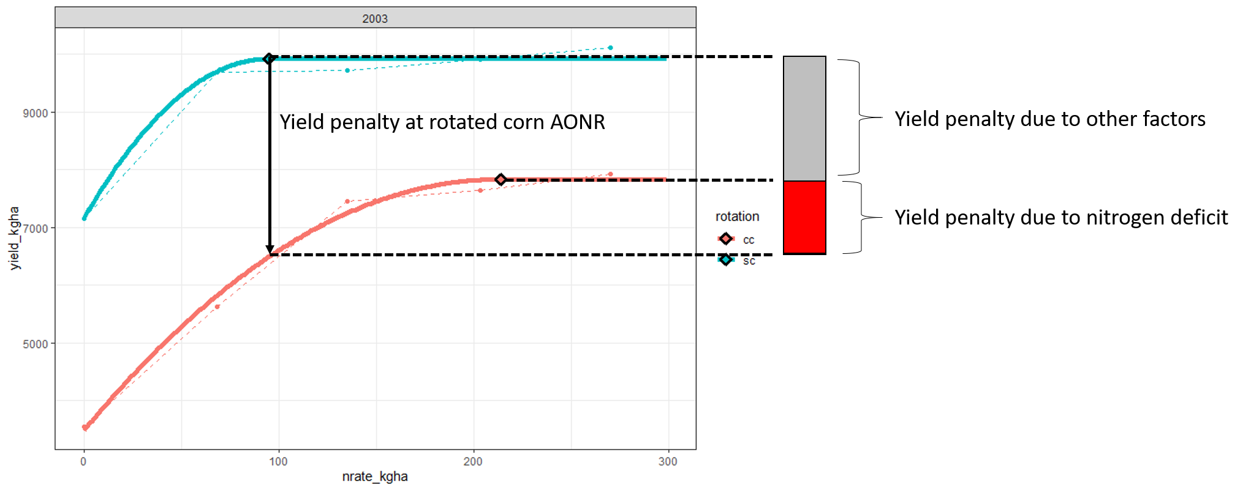
Ames 2003 example

Slide 5
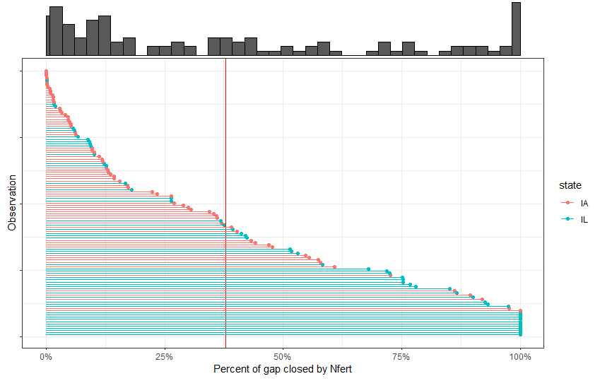

Slide 6
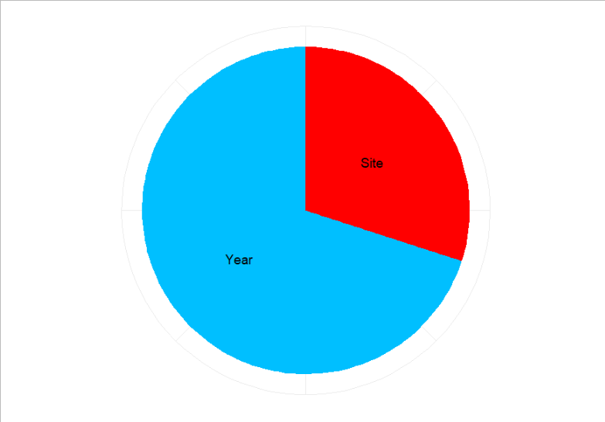
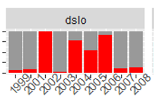
Variation in pctNgap – ‘Heritability’

Slide 7
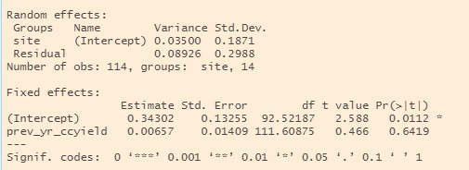
Variation in pctNgap – ‘Heritability’

Slide 8
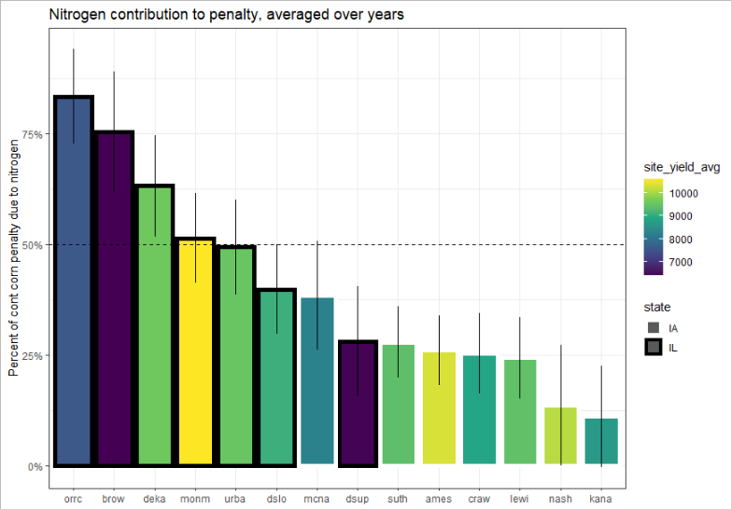
Variation in pctNgap

Slide 9
Is N-contribution related to size of gap?

Slide 10
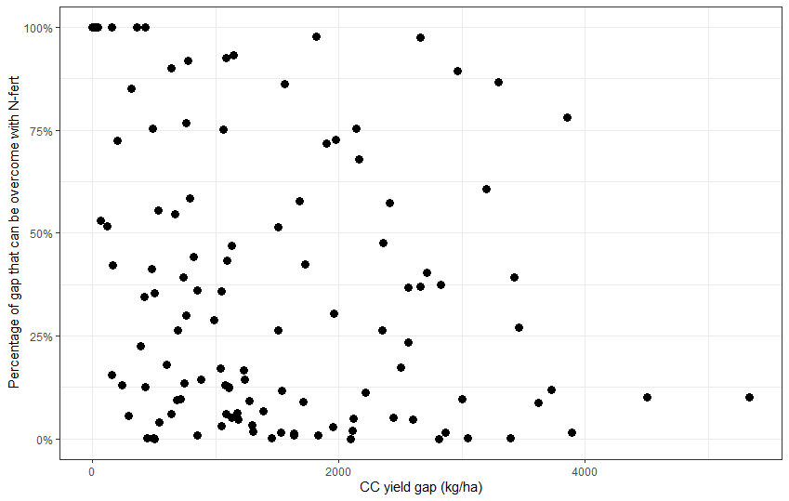

Slide 11
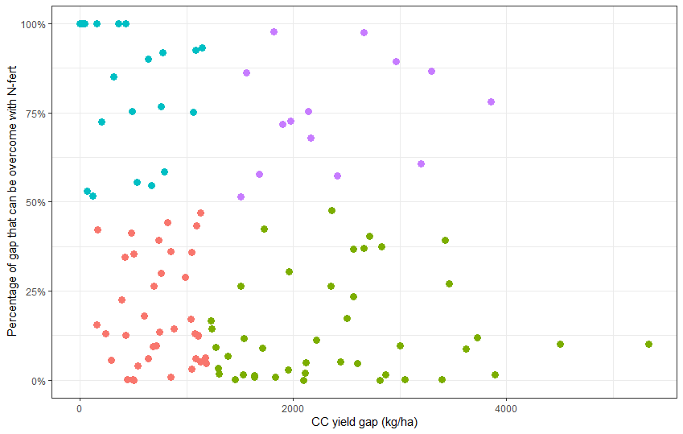
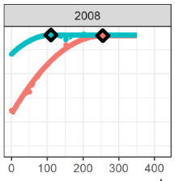
Large gaps, over-come with fertilization
Monm
Gap = 2663 kg/ha
%N = 97%

Slide 12
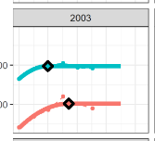
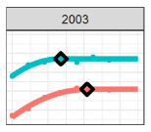
Large gaps, NOT over-come with fertilization
Monm
Craw
Gap = 5331 kg/ha
%N = 10%
Gap = 4502 kg/ha
%N = 10%

Slide 13
N overcomes 50% of gap roughly half of the time at lower penalties
N overcomes 50% of gap a quarter of the time at higher penalties
26
14
38
43

Slide 14
At normal nitrogen rates, yield of rotated corn is not a good predictor of penalty. It’s how badly the continuous corn FAILS to achieve it’s yield potential.
Larger gaps (>1200 kg/ha) are less likely to be addressed with N-fert
What makes a site more likely to have gap closed by N-fert?
…
Nebraska data would be great to add

Slide 15
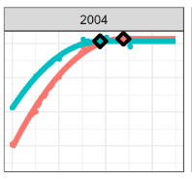
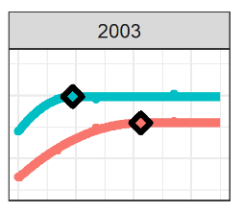
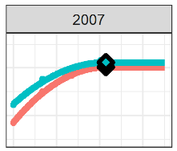
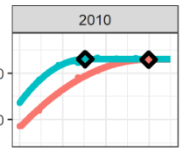
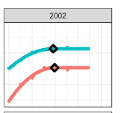
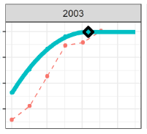
Highly
N-derived gaps
Not
N-derived gaps
Orcc
Ames
Ames
Gap = 501 kg/ha
%N = 0%
Gap = 153 kg/ha
%N = 100%
Gap = 2084 kg/ha
%N = 40%
Suth
Monm
Orcc
Gap = 1819 kg/ha
%N = 98%
Gap = 3043 kg/ha
%N = 0.001%
Gap = NA
%N = 100%

Slide 16
