Slide 1
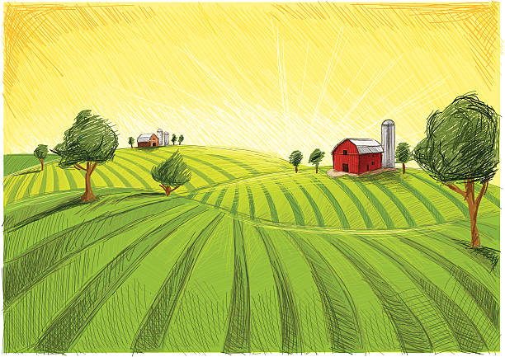
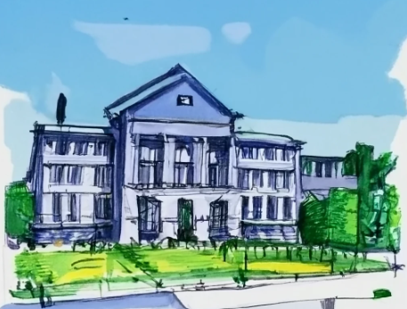
A
Time, resources, land
Time, resources, ‘knowledge’
B
Time, resources, land
Time, resources, money
Trust
Trust
Learning
Learning
Transformation
Transformation

Slide 2
a
Time, resources, land
Time, resources, ‘knowledge’
b
Time, resources, land
Time, resources, money
Trust
Trust
Learning
Learning
Transformation
Transformation

Slide 3
a
Time, resources, land
Time, resources, ‘knowledge’
b
Time, resources, land
Time, resources, money
Trust
Trust
Learning
Learning
Transformation
Transformation

