Slide 1
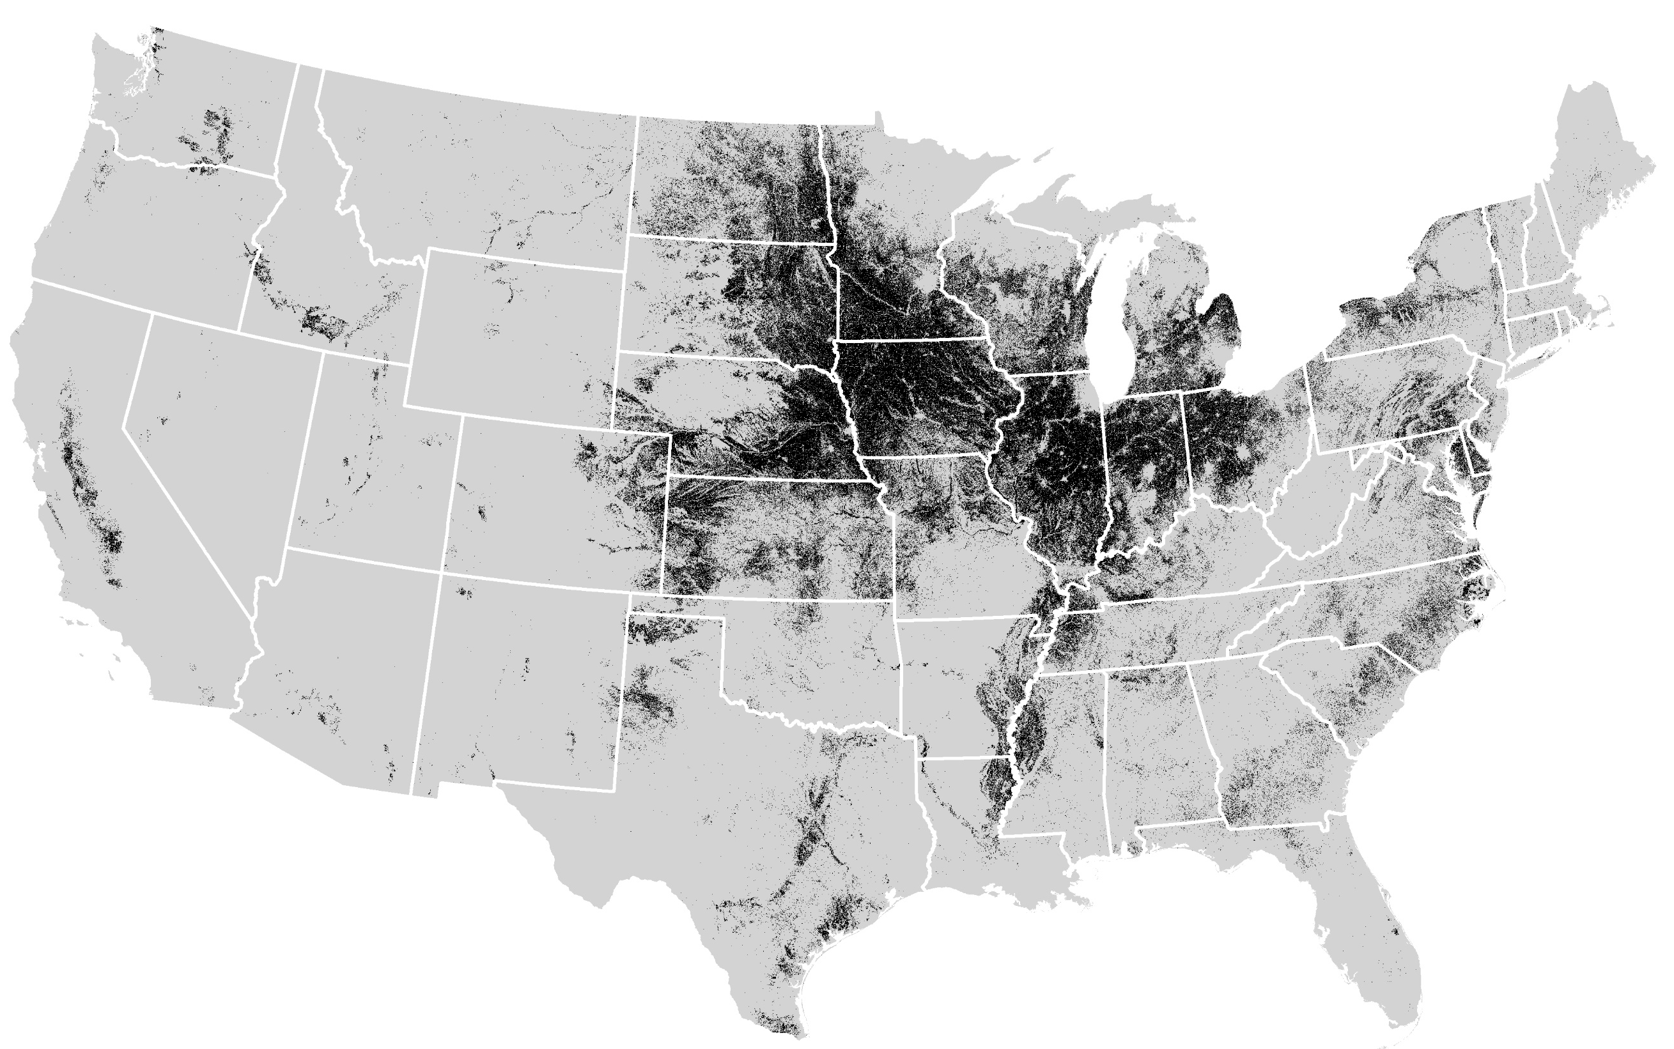
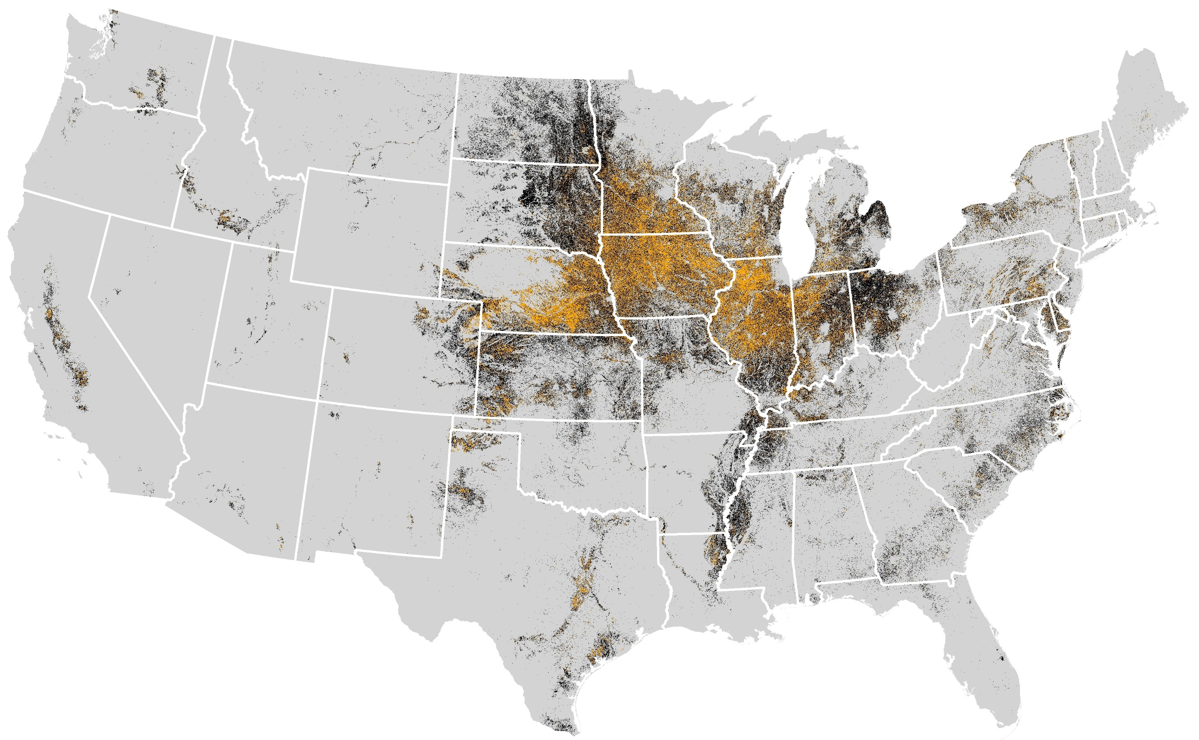
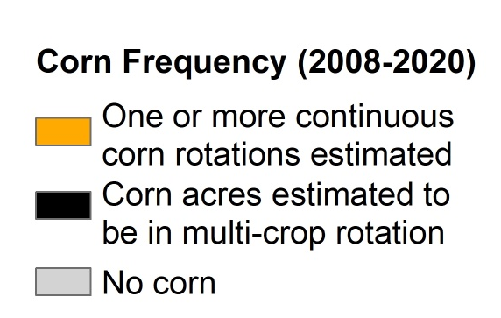
Notes:
Data Source: https://www.nass.usda.gov/Research_and_Science/Cropland/Release/index.php

