Slide 1
Help

Slide 2
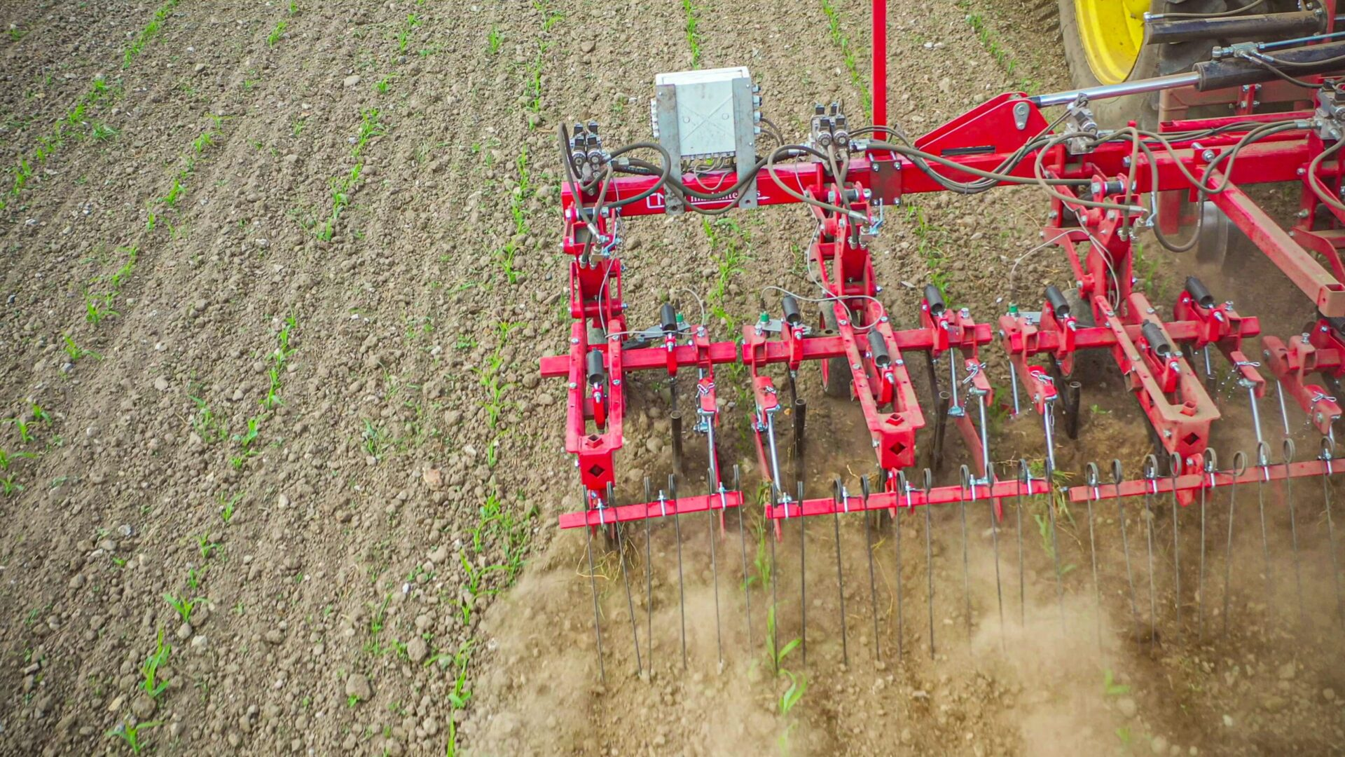

Slide 3
Mechanical control of weeds
Harrow disturbs soil and rips out little weeds
It also throws around soil and can cover the crop

Slide 4
How aggressively should I harrow my crop? i.e. How much soil should cover my crop after I harrow?
~f(
how to do the weeds respond to harrowing (field msmt),
how does that harrowing impact my crop coverage (field msmt),
how does that crop coverage impact yields (weed-free field msmt),
how would yield have responded to the remaining weeds (Cousen’s model)
)

Slide 5
Treatment = Harrowing intensity
0 passes
1 pass
2 passes
3 passes
4 passes

Slide 6
Treatment = Harrowing intensity
0 passes
1 pass
2 passes
3 passes
4 passes

Slide 7
Treatment = Harrowing intensity
0 passes
1 pass
2 passes
3 passes
4 passes
Control all weeds, measure weed-free yields.

Slide 9
My take-away from this would be that if you can cover 20% of your crop, you’re good. That would be an ANOVA-style analysis…

Slide 10
“Using ANOVA, you’d decide there is no impact of harrowing intensity”
“Using HarrowSim, you see the optimal crop coverage under an aggressive weed community is 35%*, while under weak weed communities it is 18%*”
*He calculates this number by using 9 different harrowing intensities, which is a LOT. In another pub he claims it is more important to have more harrowing intensities than replicates.

Slide 11
Therefore, if yield response to harrowing is considered relevant, as it should be, experiments designed for ANOVA provide limited insight into harrowing, as yield responses below 10% are generally not measurable. Experiments based on regression analysis have much stronger statistical power and may reveal small, but important yield impacts.

Slide 12
Therefore, if yield response to harrowing is considered relevant, as it should be, experiments designed for ANOVA provide limited insight into harrowing, as yield responses below 10% are generally not measurable. Experiments based on regression analysis have much stronger statistical power and may reveal small, but important yield impacts.
Is this true?

Slide 13
Therefore, if yield response to harrowing is considered relevant, as it should be, experiments designed for ANOVA provide limited insight into harrowing, as yield responses below 10% are generally not measurable. Experiments based on regression analysis have much stronger statistical power and may reveal small, but important yield impacts.
My feeling is that if they are very small, they are not important. They are not meaningful. If I tell a producer you will reduce your yields by 14% instead of 15% if you cover your crop by 44% instead of 60%, I don’t think they will find that useful.

Slide 14
Crop soil coverage will vary between replicates
The yield lost from crop soil coverage will have some uncertainty
Estimating the theoretical yield lost from the remaining weeds has uncertainty
Number of replicates versus number of ‘intensities’ (which create crop soil coverages)?

Slide 15
To me, the point is to figure out the relationship between:
aggressiveness of harrowing and crop soil coverage
crop soil coverage and yield losses
What is the best experimental design to achieve that goal?
Estimating the damage that could result from the weeds that are left
should be done separately? And should account for uncertainty?
I am not sure how to go about approaching this…

