Slide 1
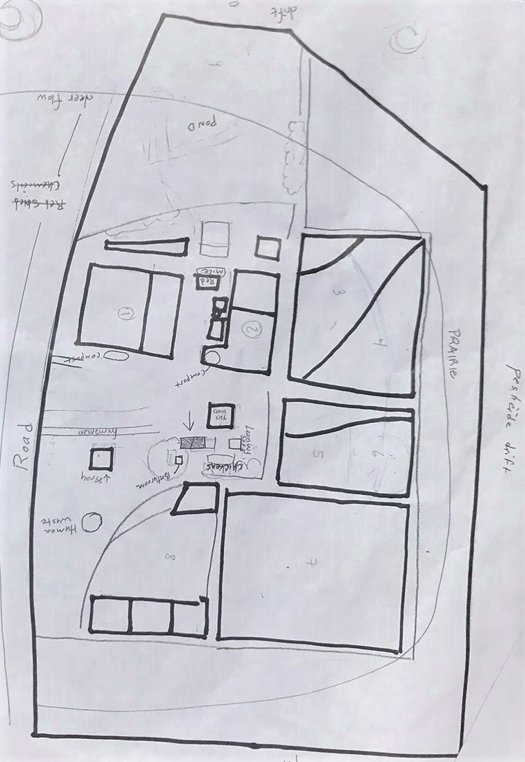

Vineyard
OG (Original Garden)
Leafbag
Broccoli
Berries
Prairie Trees

