Slide 1
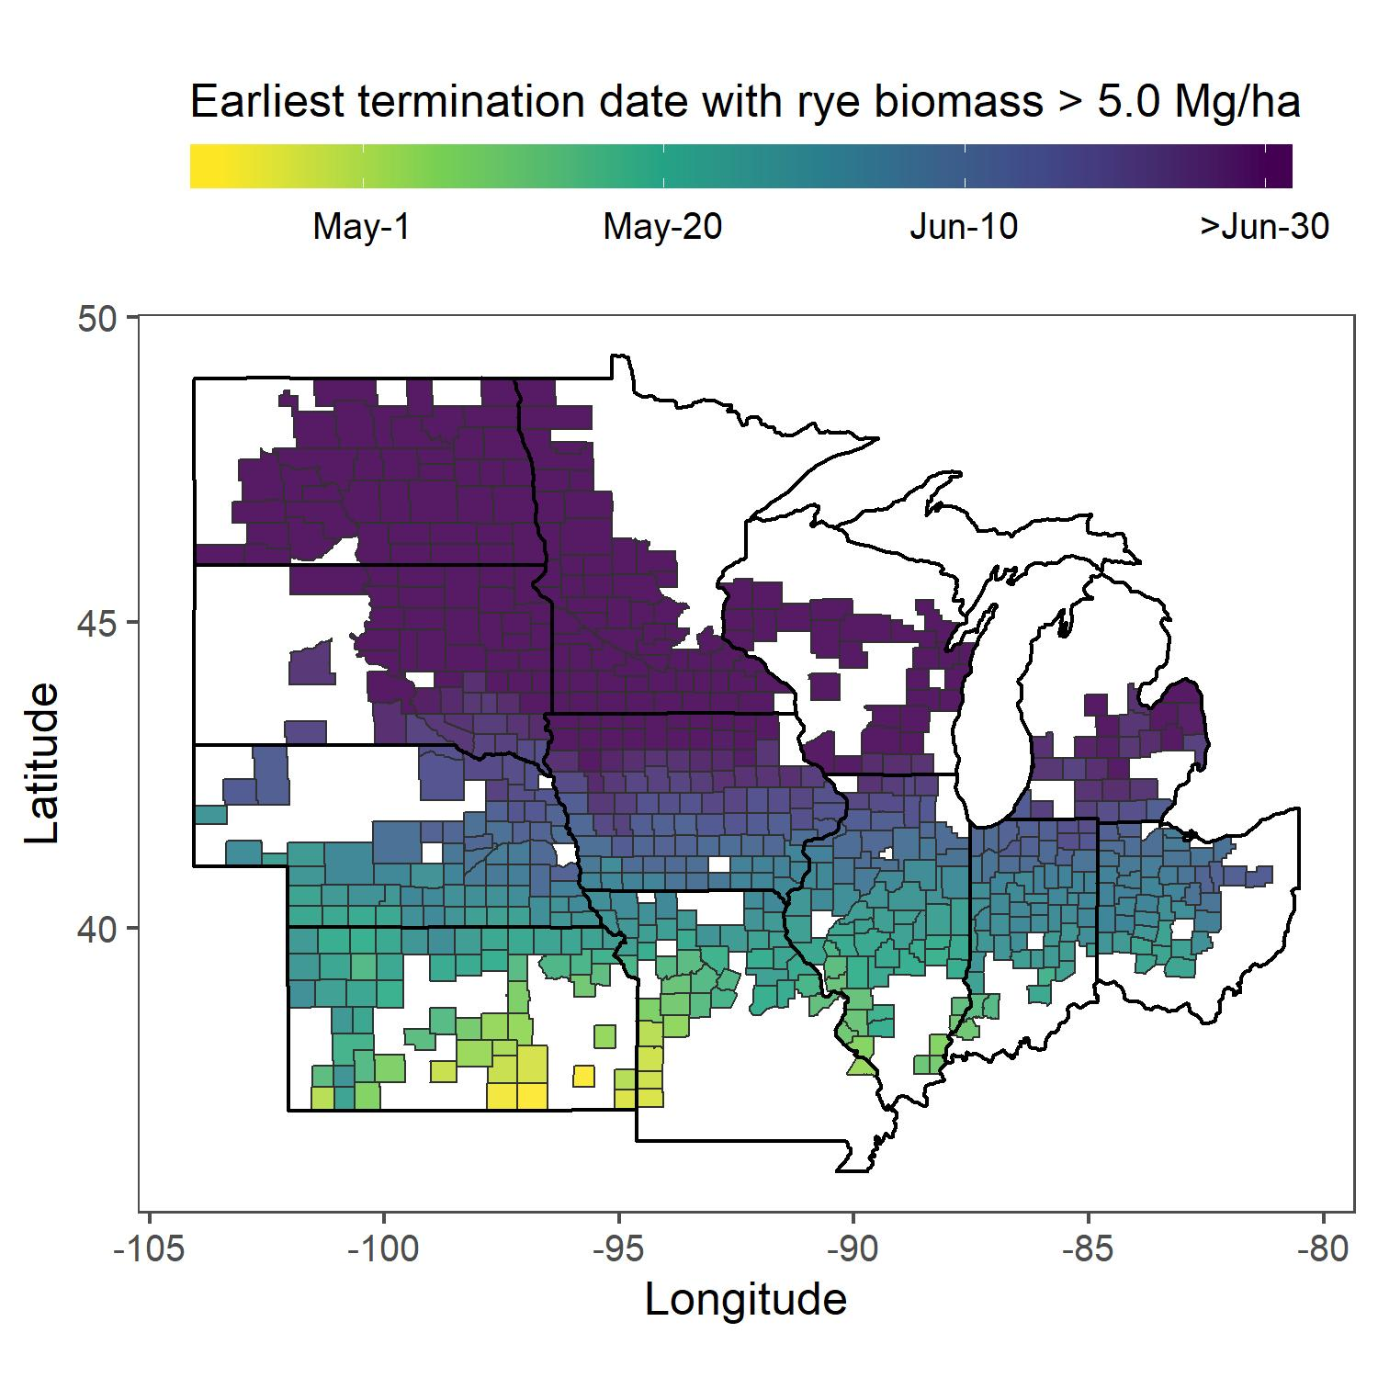
(a)
(b)
 | Planting Date
 | 15-Sep | 7-Oct | 1-Nov
 | (optimistic) | (realistic) | (late)
ND | 25-Jun | 16-Jul | 29-Jul
MN | 16-Jun | 9-Jul | 20-Jul
WI | 16-Jun | 6-Jul | 21-Jul
SD | 4-Jun | 1-Jul | 15-Jul
MI | 31-May | 24-Jun | 12-Jul
IA | 23-May | 17-Jun | 1-Jul
NE | 6-May | 3-Jun | 20-Jun
OH | 5-May | 2-Jun | 21-Jun
IN | 5-May | 31-May | 17-Jun
IL | 28-Apr | 27-May | 18-Jun
MO | 22-Apr | 17-May | 5-Jun
KS | 14-Apr | 13-May | 3-Jun

