Slide 1
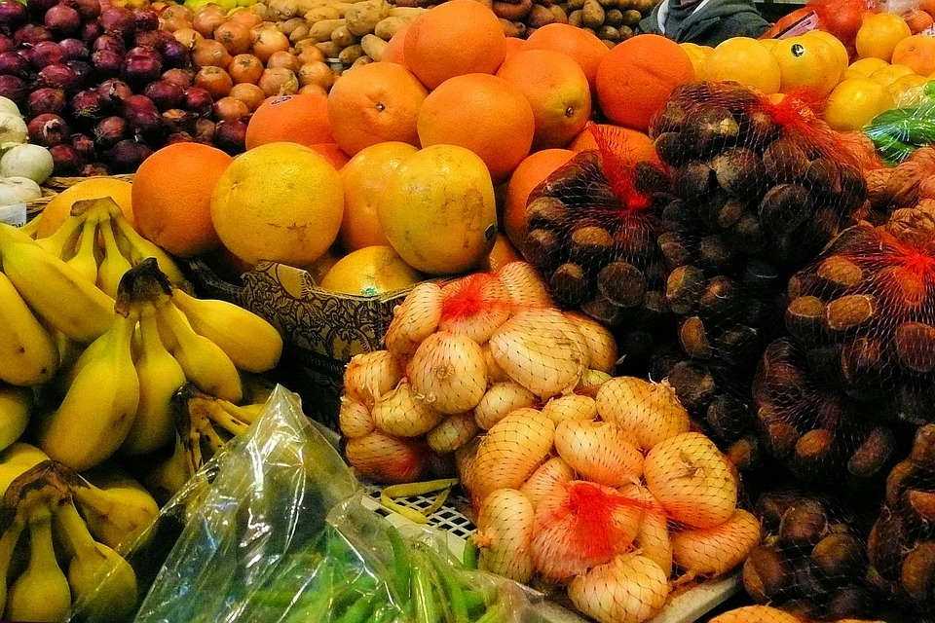
Sorting System of Fruits Using AI & ML

Slide 2
Introduction
• Importance of fruit sorting in agriculture and food industry
• Challenges in manual sorting:
✓ Time-consuming
✓ Inconsistency
✓ Human error

Slide 3
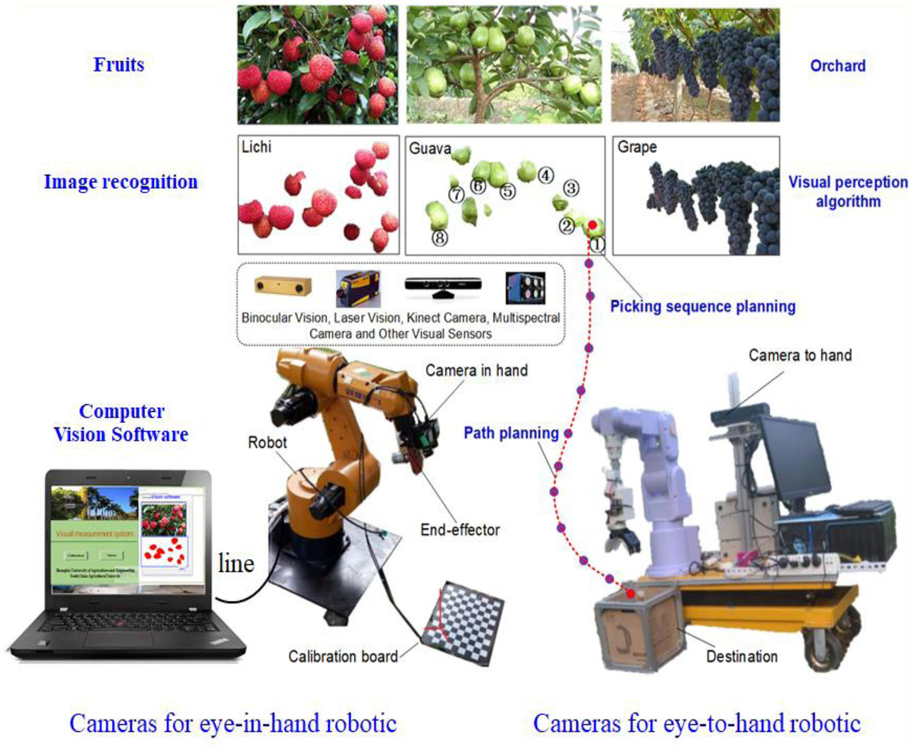
Need for Automated Fruit Sorting
• Increasing demand for quality control
• High efficiency and accuracy
• Reduction in operational costs
• Real-time processing capability

Slide 4

Role of AI & ML in Fruit Sorting
• AI & ML for visual inspection and classification
• Computer vision for detecting fruit characteristics
• ML models trained to identify:
✓ Size
✓ Shape
✓ Color
✓ Ripeness
✓ Defects

Slide 5
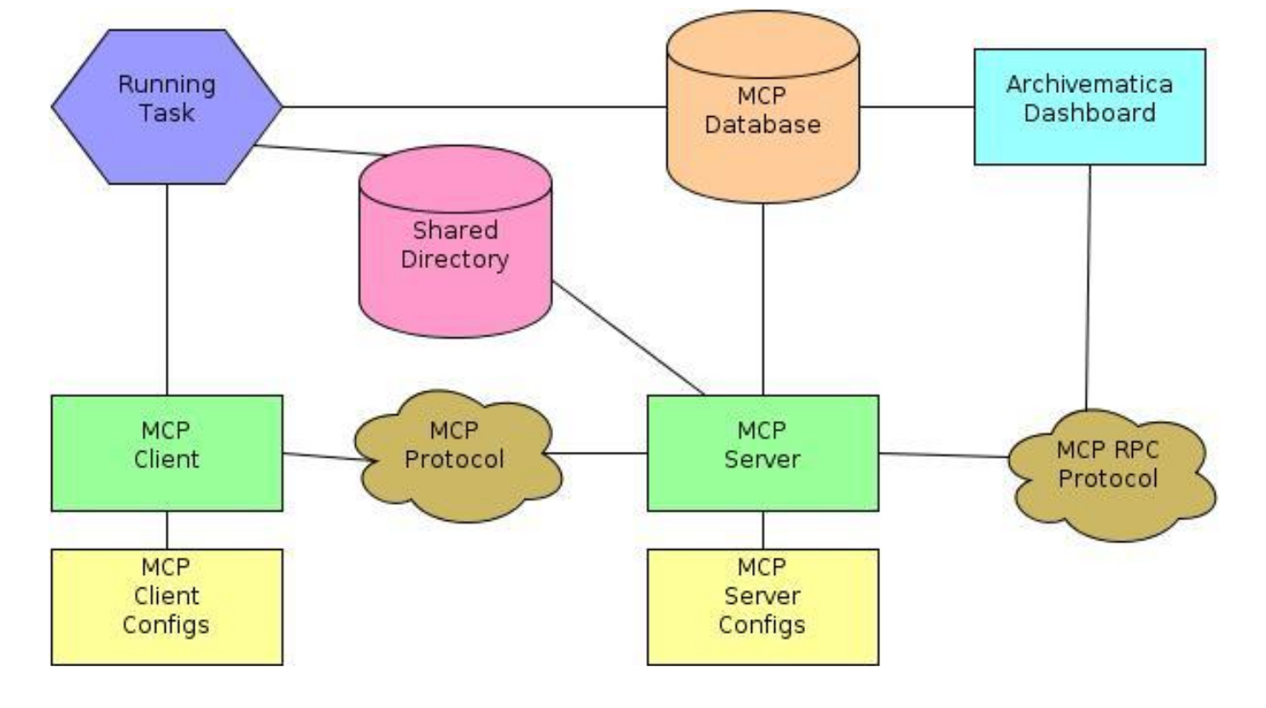
System Architecture
Key Components:
• Camera / Sensors
• Image Processing Module
• ML Classification Model
• Sorting Mechanism (Robotic arms, conveyors)

Slide 6
Machine Learning Process
• Data Collection: Fruit images
• Data Preprocessing: Noise removal, resizing
• Model Training: Using CNN (Convolutional Neural Networks)
• Model Evaluation: Accuracy, precision, recall
• Deployment: Real-time sorting in production line

Slide 7
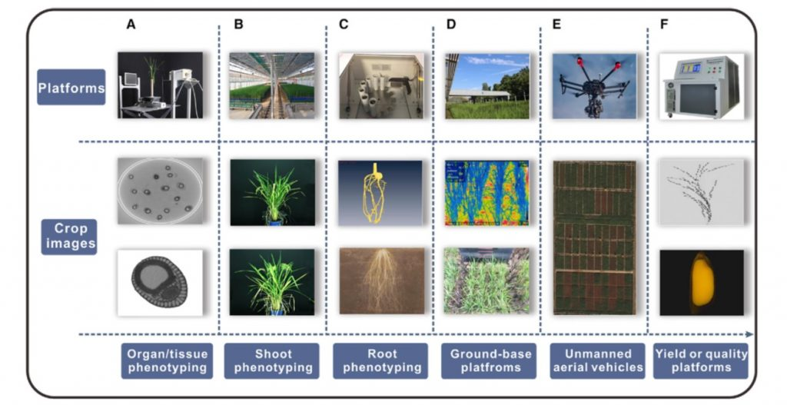
Technologies Used
• AI Techniques: Deep Learning (CNN)
• Image Processing: OpenCV
• ML Frameworks: TensorFlow / PyTorch
• Hardware: High-resolution cameras, microcontrollers, actuators

Slide 8
Benefits of AI & ML Based Sorting
• High-speed sorting
• Increased accuracy and consistency
• Quality assurance
• Reduced labor costs
• Adaptability to different fruit types

Slide 9
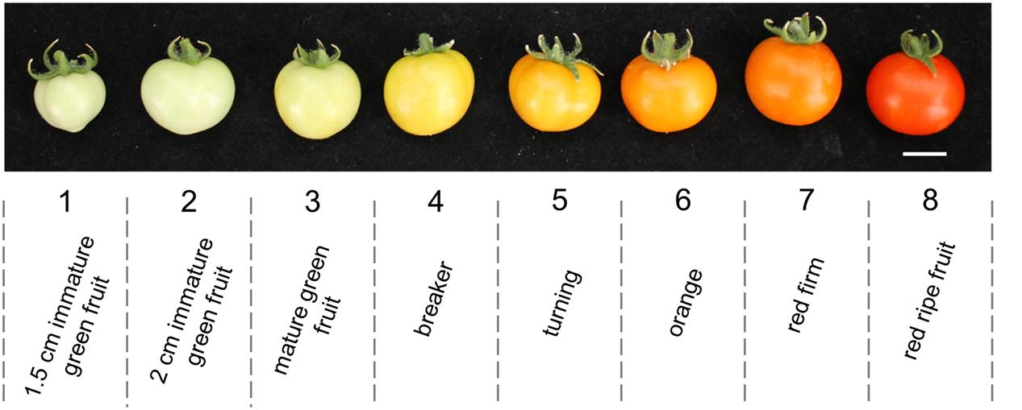
Case Studies / Examples
• Apple sorting using color and defect detection
• Tomato ripeness detection using AI
• Sorting of citrus fruits based on size and blemishes

Slide 10
Future Scope
• Integration with IoT for remote monitoring
• AI models for more complex defect detection
• Self-learning models for continuous improvement
• Expansion to other agricultural products

Slide 11
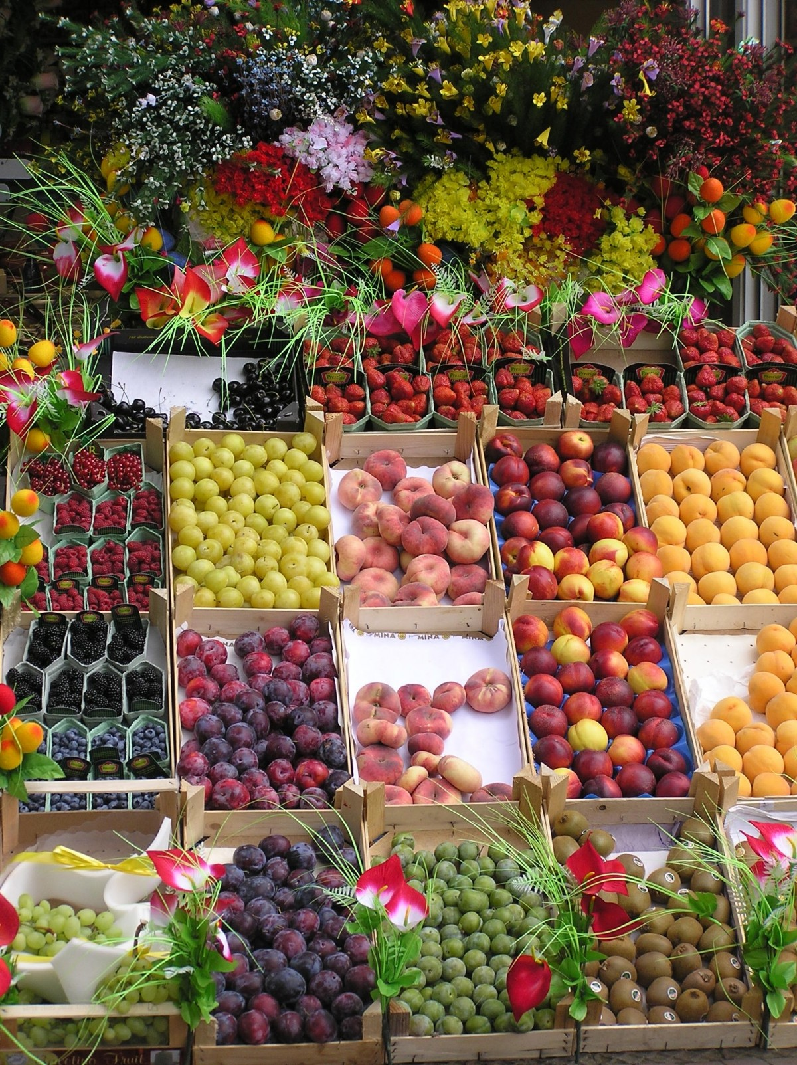
Conclusion
• AI & ML revolutionizing fruit sorting
• Improved efficiency, quality, and profitability
• Promising future for smart agriculture solutions

