Slide 1
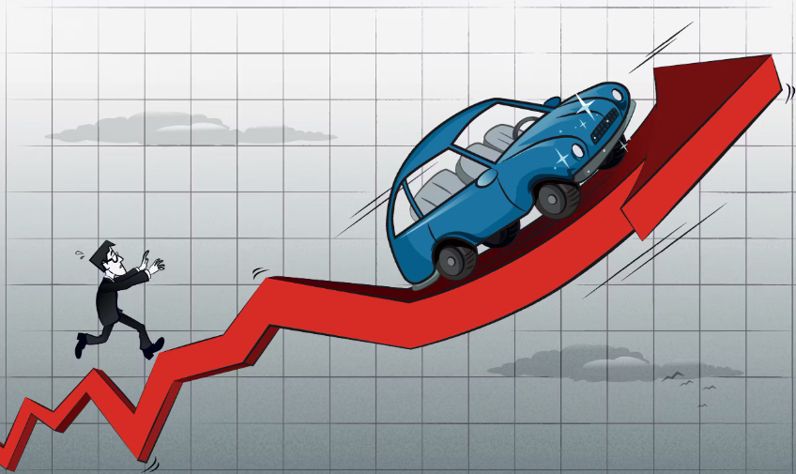
Impact of Inflation & Interest Rates on Auto Sales
By:
Saiful Emon
Vanita Mehra

Slide 2
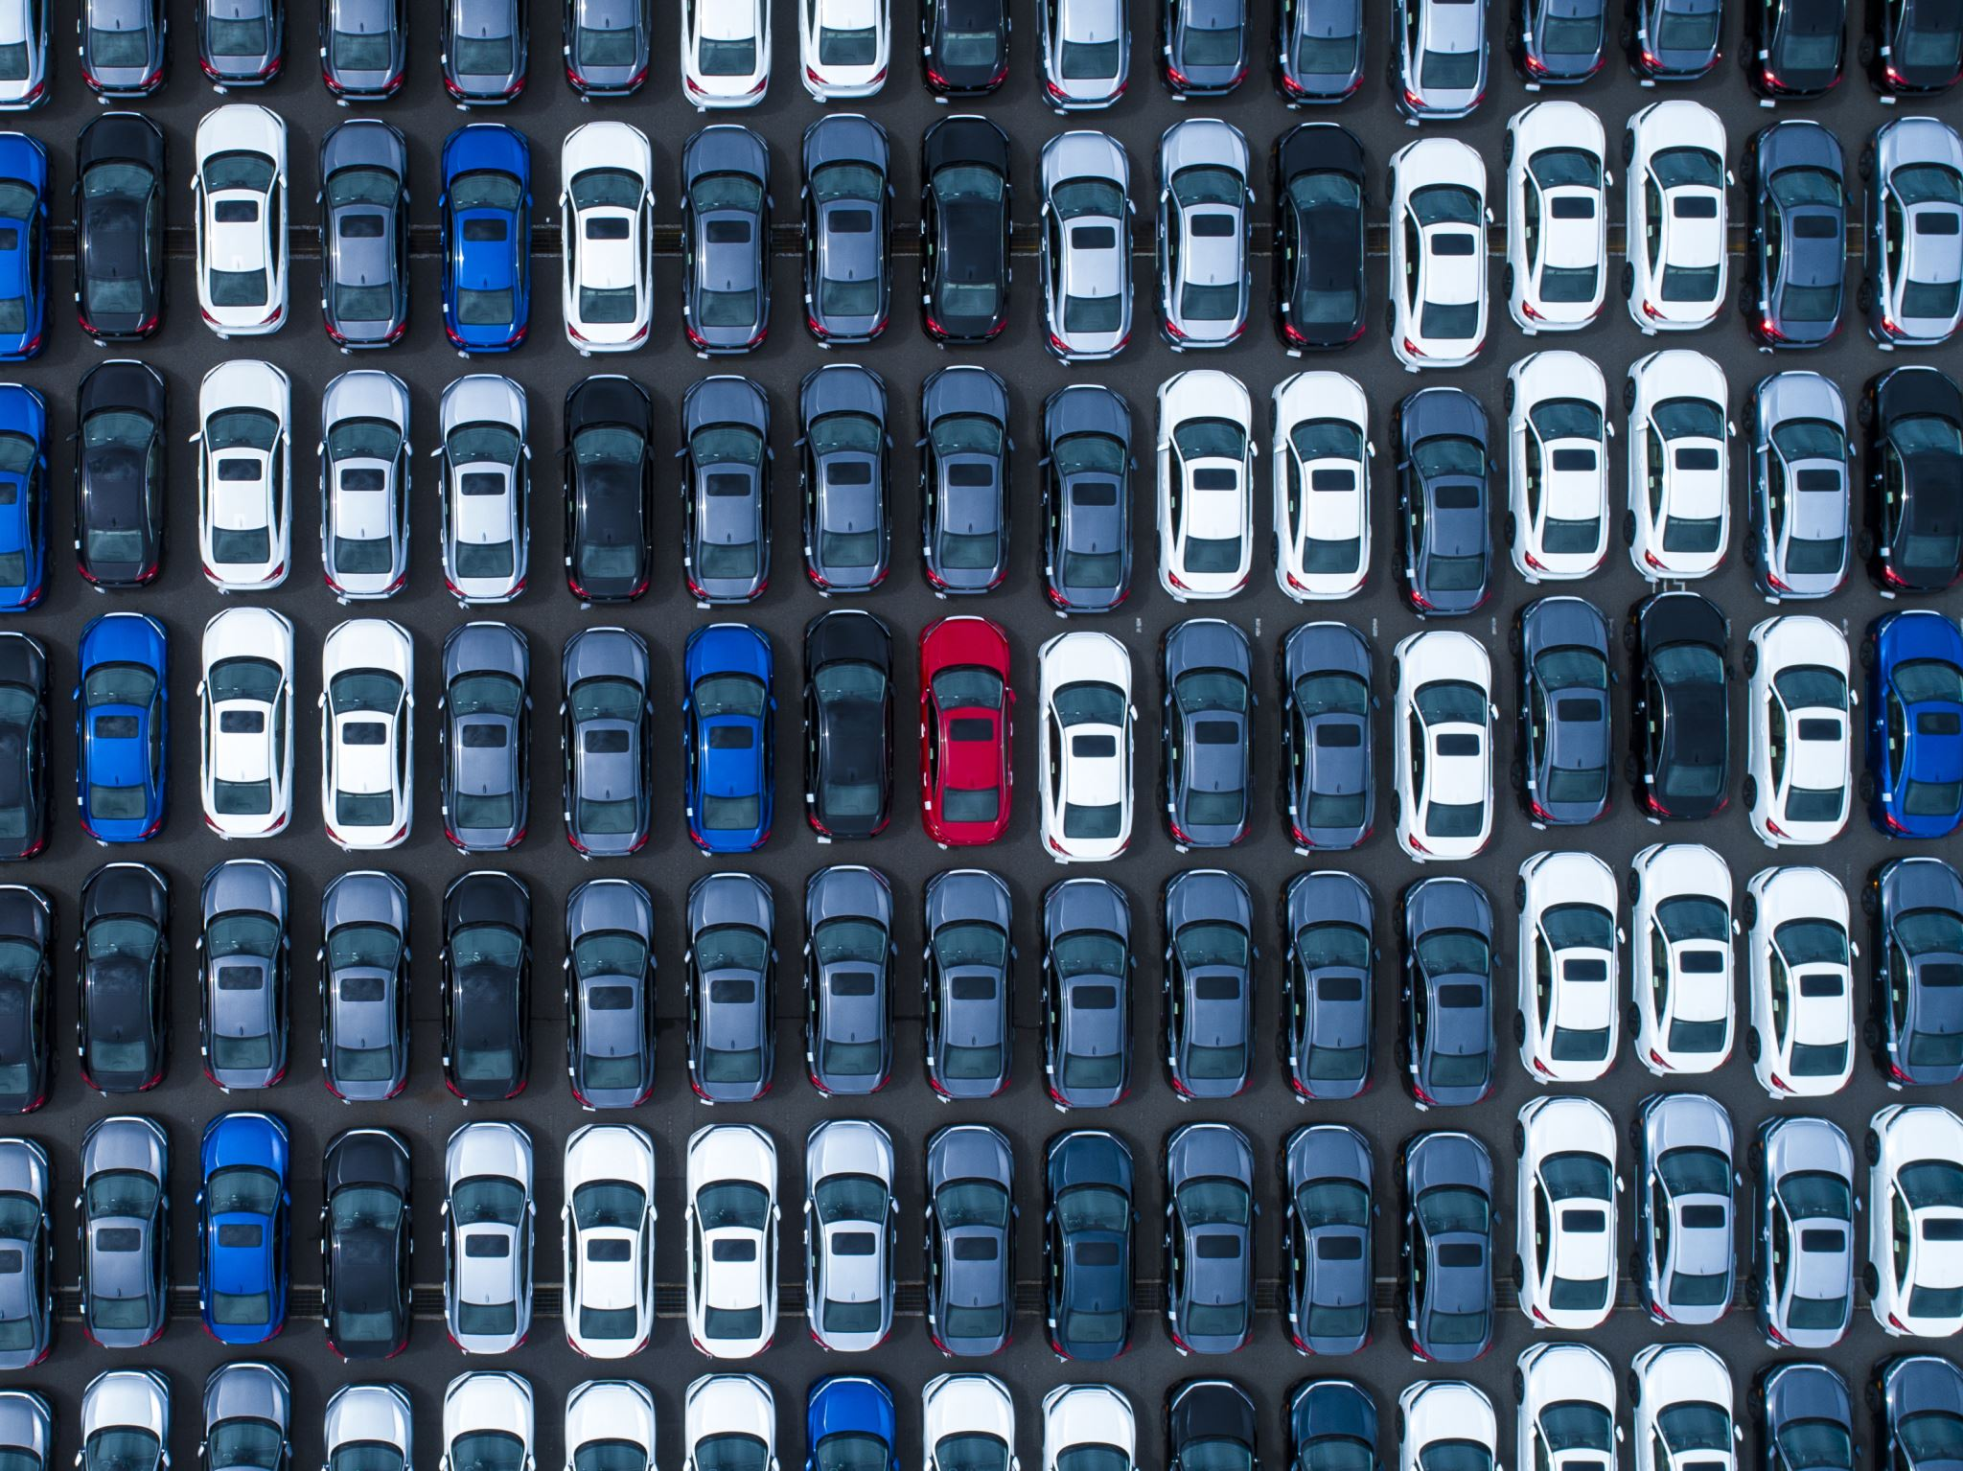
Introduction
Interest rates and inflation directly affect car buyers' purchasing power and loan affordability.
Our project aims to analyze this relationship using statistical analysis and historical data.

Slide 3

Research Question & Hypotheses
Main Question:
How do changes in interest and inflation rates affect car sales?
Hypotheses: H₀: No significant relationship between car sales and economic indicators
H₁: Car sales are negatively affected by high interest and inflation rates

Slide 4
Datasets Used
Car Sales Data – Statista (1951 onwards)
Interest Rates Data – Kaggle (Federal Reserve rates)

Slide 5
Data Preprocessing Steps
Removed missing/inconsistent data
Filtered relevant columns
Merged datasets for correlation analysis
Ran exploratory data analysis (EDA)

Slide 6
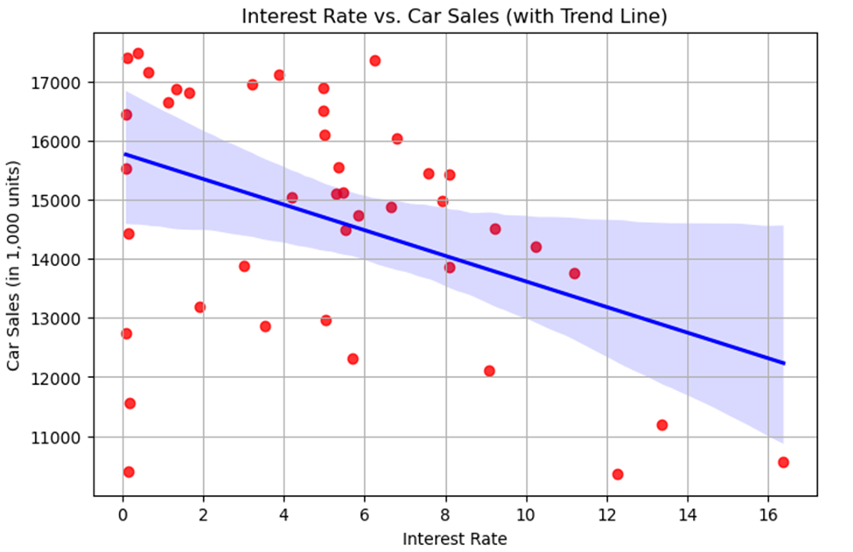
Scatter Plot: Interest Rates vs. Car Sales
There is a clear negative relationship between interest rates and car sales.
Higher interest rates lead to more expensive auto loans, discouraging consumers from purchasing vehicles.
The downward trend line confirms that as borrowing becomes costly, fewer people buy cars.

Slide 7
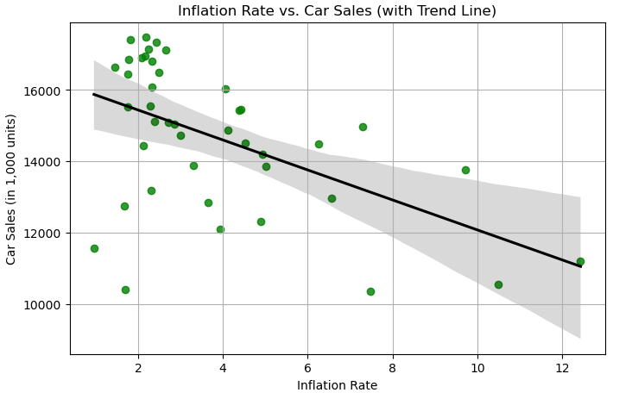
Scatter Plot – Inflation vs. Car Sales
Car sales tend to decrease as inflation increases.
Inflation lowers the value of money, reducing people’s ability to make large purchases like cars.
Despite some data variation, the negative trend line supports the idea that inflation impacts car buying decisions.

Slide 8
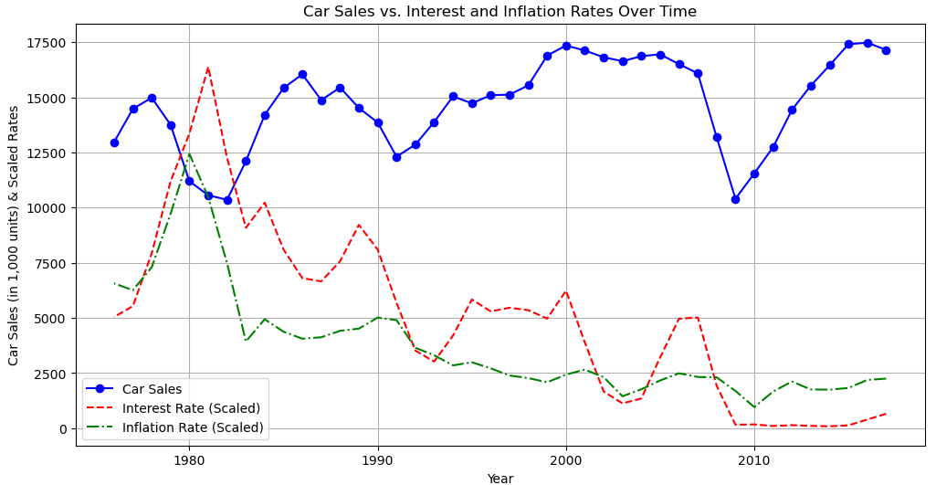
Line Plot – Trends Over Time
Long-term visualization shows how all three variables behave together over the years.
When both interest and inflation rates are high, car sales noticeably drop.
Lower rates generally align with spikes in car purchases, showing consumers react strongly to economic changes.

Slide 9
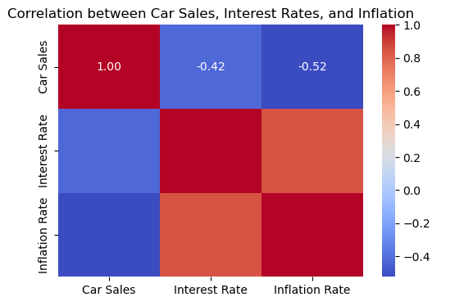
Correlation Heatmap
Negative correlation values confirm inverse relationships between economic indicators and car sales.
While not extremely strong, the consistent negative pattern supports our hypothesis.

Slide 10
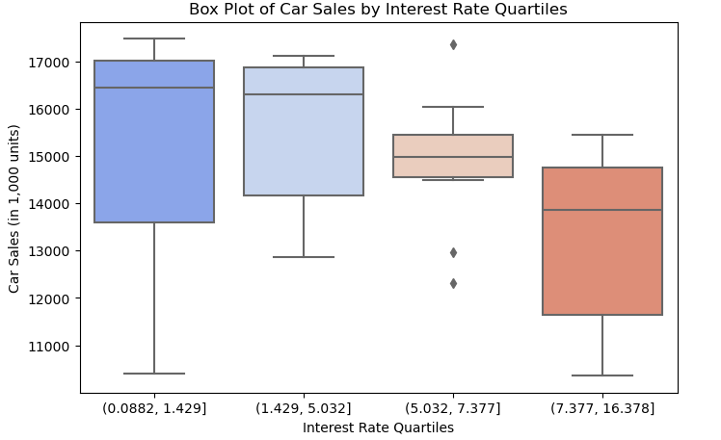
Box Plot – Car Sales by Interest Rate Quartiles
Dividing interest rates into quartiles shows the distribution of car sales under different rate levels.
Car sales are significantly higher when interest rates are in the lowest quartile.
As rates rise, the median car sales value declines, reinforcing how borrowing cost impacts decisions.

Slide 11
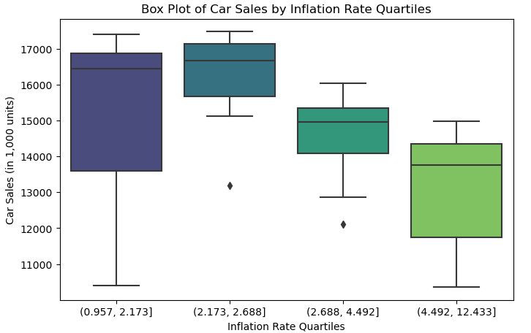
Box Plot – Car Sales by Inflation Rate Quartiles
Similar to interest rates, inflation quartiles help us observe how car sales shift with inflation levels.
The highest car sales occur under the lowest inflation conditions.
High inflation appears to weaken consumer confidence, especially for major purchases like vehicles.

Slide 12
Challenges & Limitations
Data quality and missing values.
Outliers influenced visual accuracy.
Visualization-based analysis needs deeper statistical
tests for proof.

Slide 13
Conclusion
There is a clear negative relationship between car sales and both interest rates and inflation—when these rates rise, car sales tend to fall.
The visualizations consistently support our alternative hypothesis, showing that economic conditions directly affect consumer buying behavior.

Slide 14
Recommendations & Future Work
Conduct regression analysis
Expand dataset for more robust trends
Try machine learning models for predictions
Create an interactive dashboard

Slide 15


Slide 16
Thank You

