Slide 1

School of Computer Science & Engineering
AI Application Development – IA1
Audit Defense Kit

Slide 2
Team members & roles
Team member name | Role
Trisha Srinivas | Team Lead
Vanitha B | Developer
Thanushree S | Marketing Lead
Uma Maheshwari | Development Lead
Usha Rani | Test Lead
Susmitha | Customer Contact Lead
Shrusti | Tester
Notes:
Talk about how they are managing their documents, how google docs does automatic versioning
As them what they know about Android and IoS versions

Slide 3
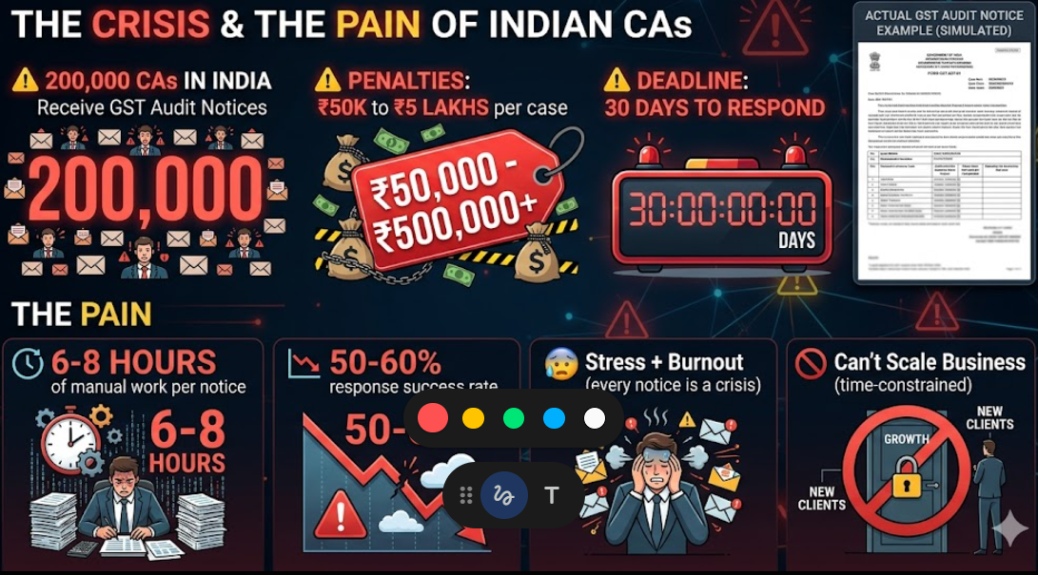
Modified Problem Statement
THE PROBLEM: GST Audit Notices Are A CA's Nightmare
Chartered Accountants handling GST notices face a manual, time-intensive, and error-prone process. They must interpret complex legal language, reconcile fragmented data, and draft responses under strict deadlines.
Each notice takes 4–6 hours with high penalty risk (₹50K–₹5L+) if mistakes occur.
Tools like Tally Solutions and ClearTax focus on compliance, not end-to-end notice resolution. This leads to inefficiencies, inconsistent quality, and lower success rates in audit defense.
Notes:
Talk about how they are managing their documents, how google docs does automatic versioning
As them what they know about Android and IoS versions

Slide 4
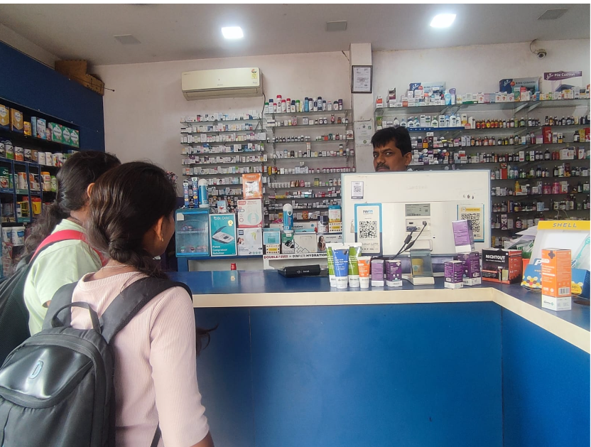
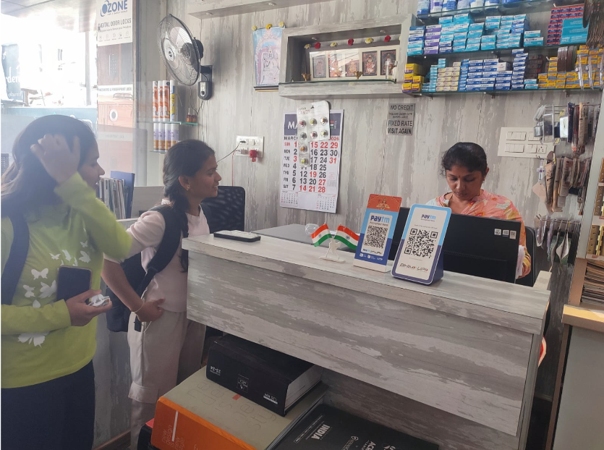
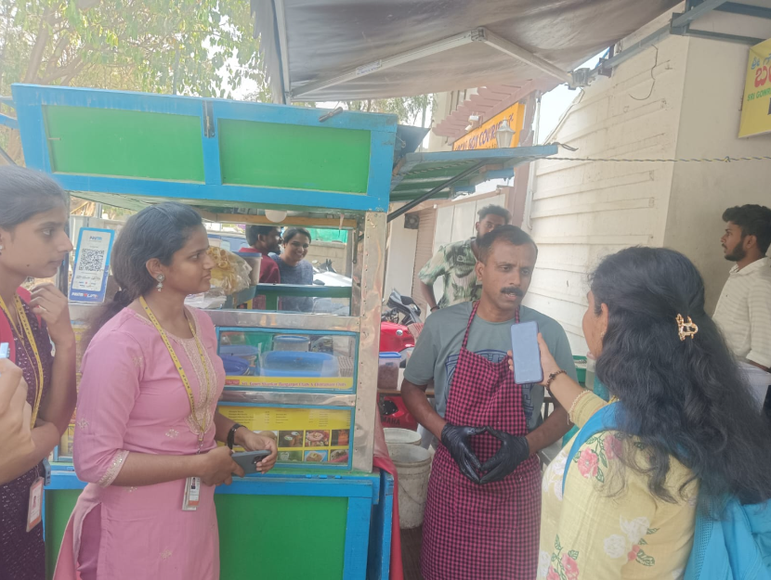
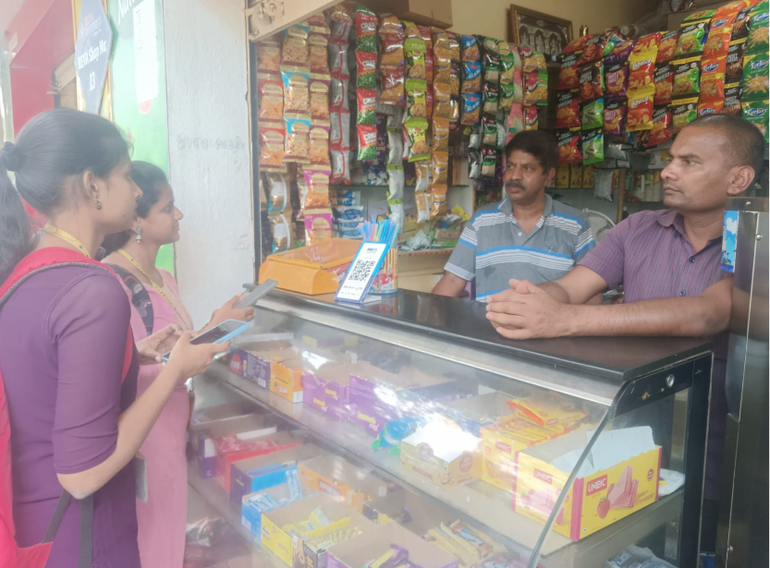
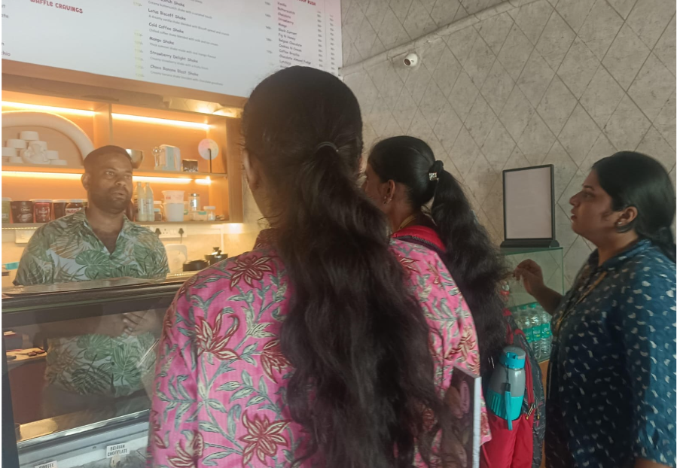
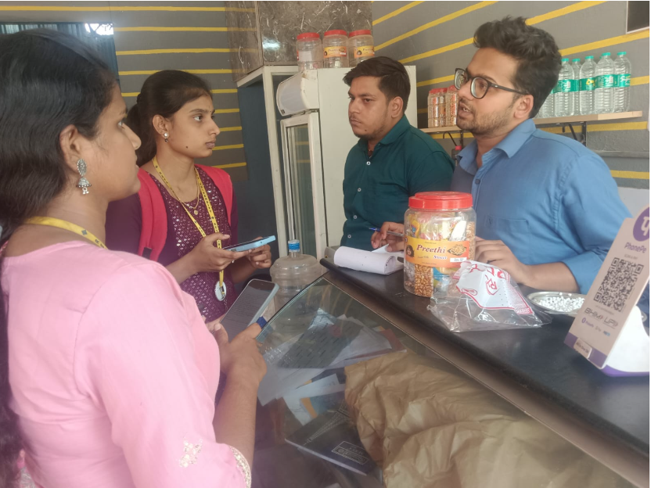
User/ Customer Understanding
Notes:
Talk about how they are managing their documents, how google docs does automatic versioning
As them what they know about Android and IoS versions

Slide 5

Ideal Customer Profile (ICP)
Notes:
Only stress on the 1st sentence – the definition
Come back to the 2nd sentence in the end as part of revision

Slide 6
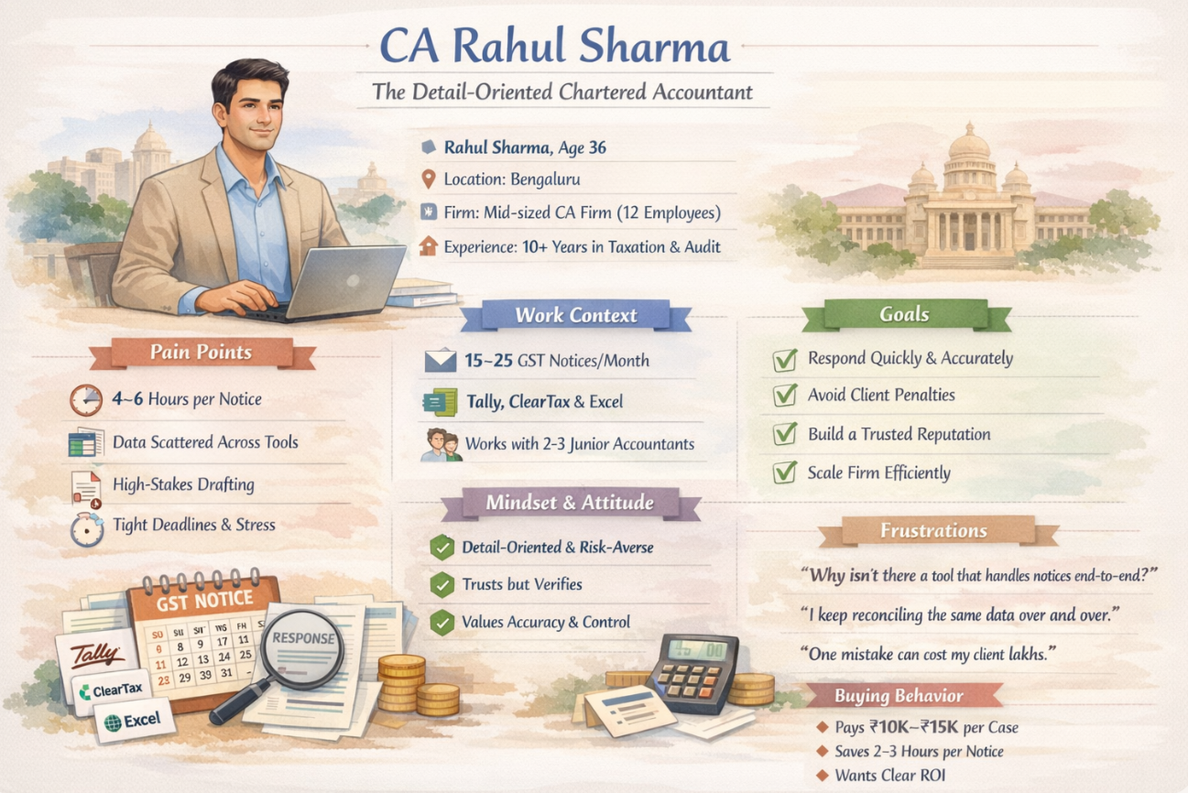
Customer Persona (CP)
Notes:
Only stress on the 1st sentence – the definition
Come back to the 2nd sentence in the end as part of revision

Slide 7
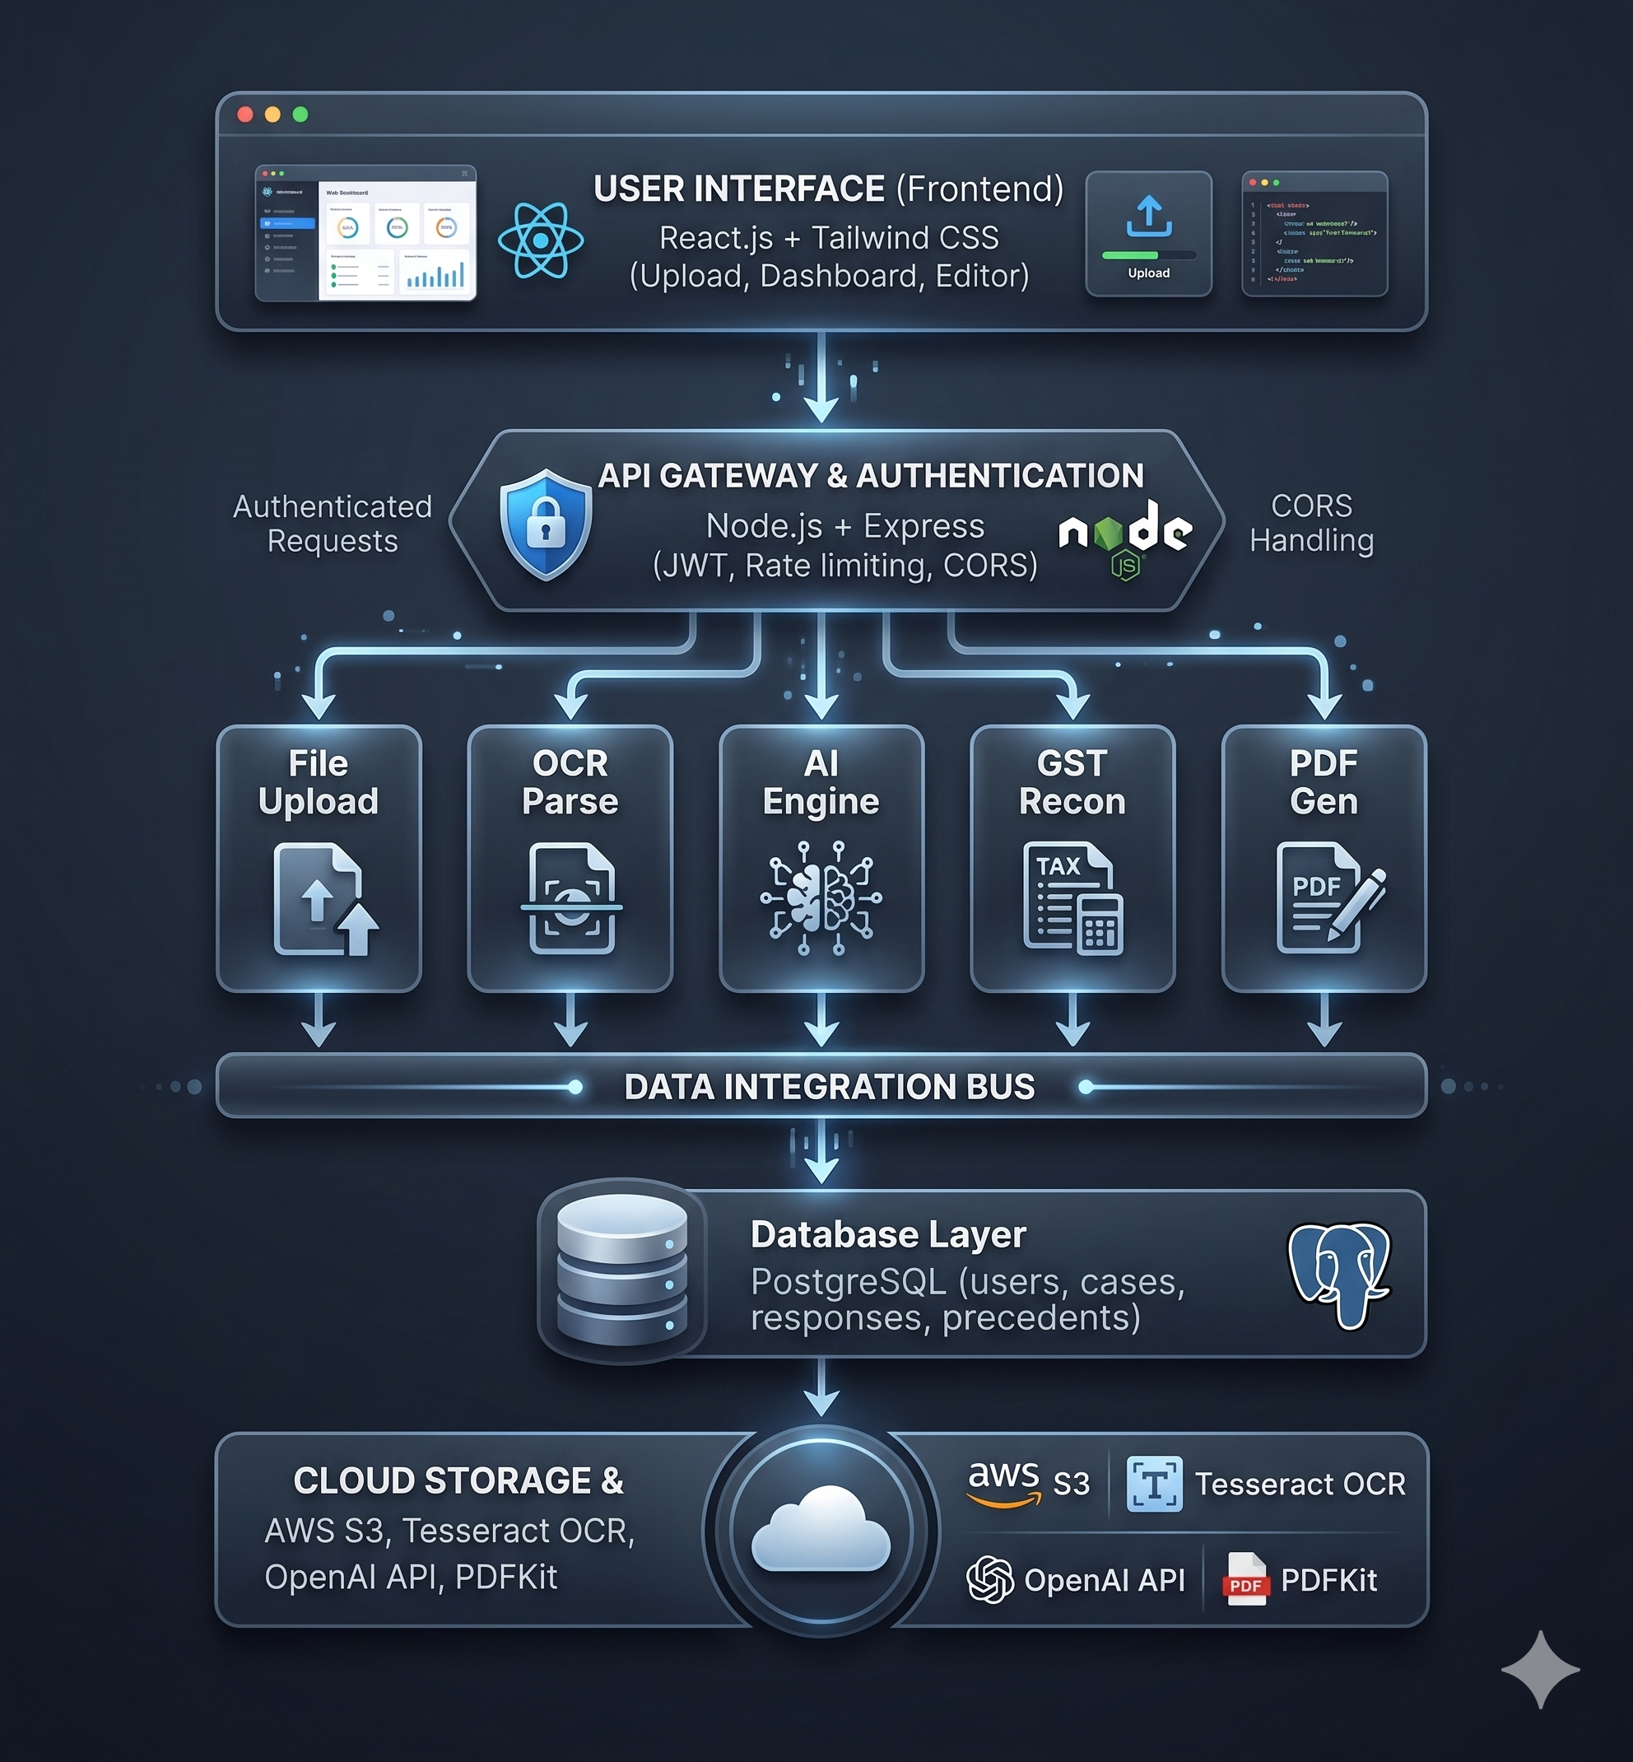

Slide 8
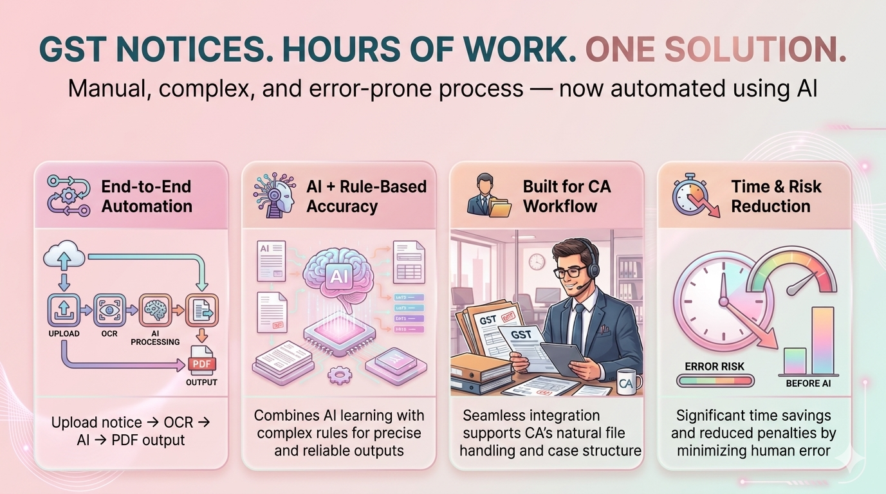
Product USP
Notes:
Only stress on the 1st sentence – the definition
Come back to the 2nd sentence in the end as part of revision

Slide 9
Use Cases & High level Requirements
I. Invoice Processing & Automation
Use Case 1: Invoice OCR & Data Extraction
Extract data from PDF/Image invoices using OCR
Captures: GSTIN, Invoice No, Date, Amount, Table data
Use Case 2: Accounting Automation
Automatically digitizes invoices
Reduces manual entry and human errors
Speeds up financial processing
Use Case 3: Business Operations
Helps companies manage large volumes of invoices
Useful for finance teams & ERP systems
Benefits:
Faster processing
High accuracy
Supports multiple invoice formats
Notes:
Only stress on the 1st sentence – the definition
Come back to the 2nd sentence in the end as part of revision

Slide 10
II.GST Reconciliation, Compliance & Fraud Detection
Compare GSTR-1 (outward supplies) with GSTR-3B (filed returns)
Detect mismatches automatically
Use Case 1: Mismatch Detection
Amount mismatch
GST mismatch
Missing invoices (GSTR-1 not in GSTR-3B)
Extra invoices (wrong reporting)
Use Case 2: Compliance Monitoring
Ensures correct GST filing
Helps avoid penalties
Use Case 3: Fraud Detection
Identifies suspicious or incorrect entries
Detects unreported or duplicate invoices
Flow: Upload → OCR / Excel Parsing → Reconciliation → Mismatch Report
Users:
Chartered Accountants (CA)
Businesses & Finance teams
Tax auditors
Notes:
Only stress on the 1st sentence – the definition
Come back to the 2nd sentence in the end as part of revision

Slide 11
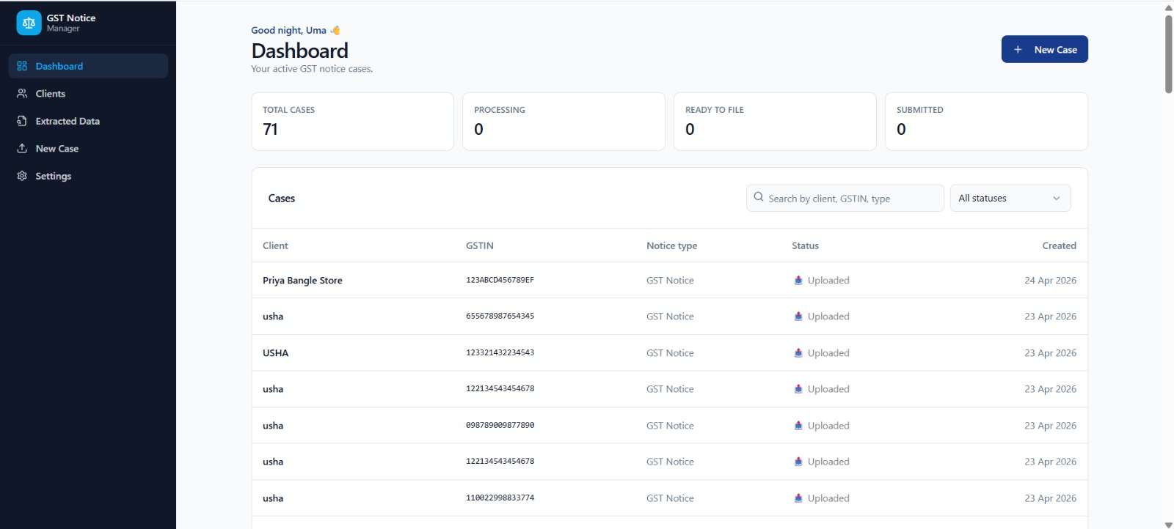
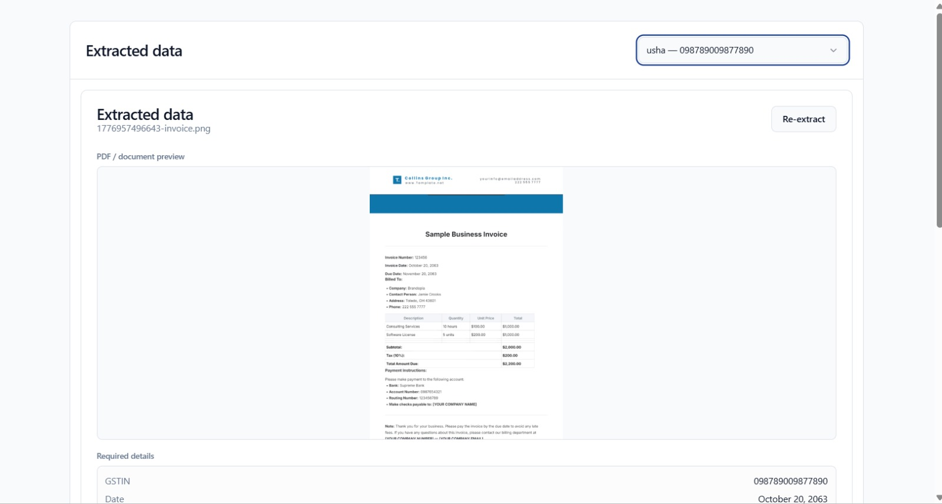
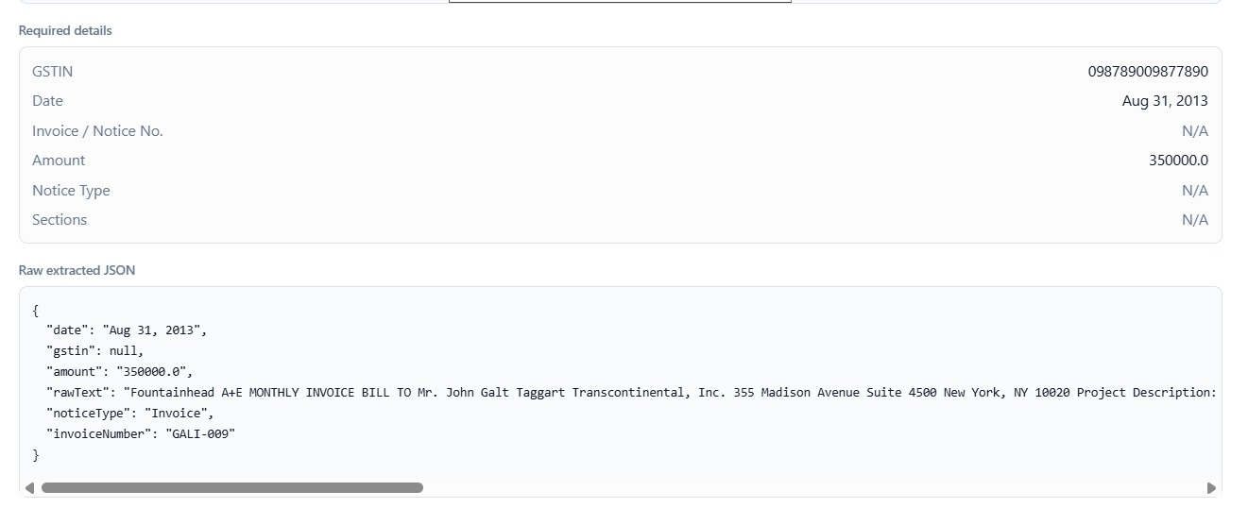
Prototype Demo
Notes:
Only stress on the 1st sentence – the definition
Come back to the 2nd sentence in the end as part of revision

Slide 12
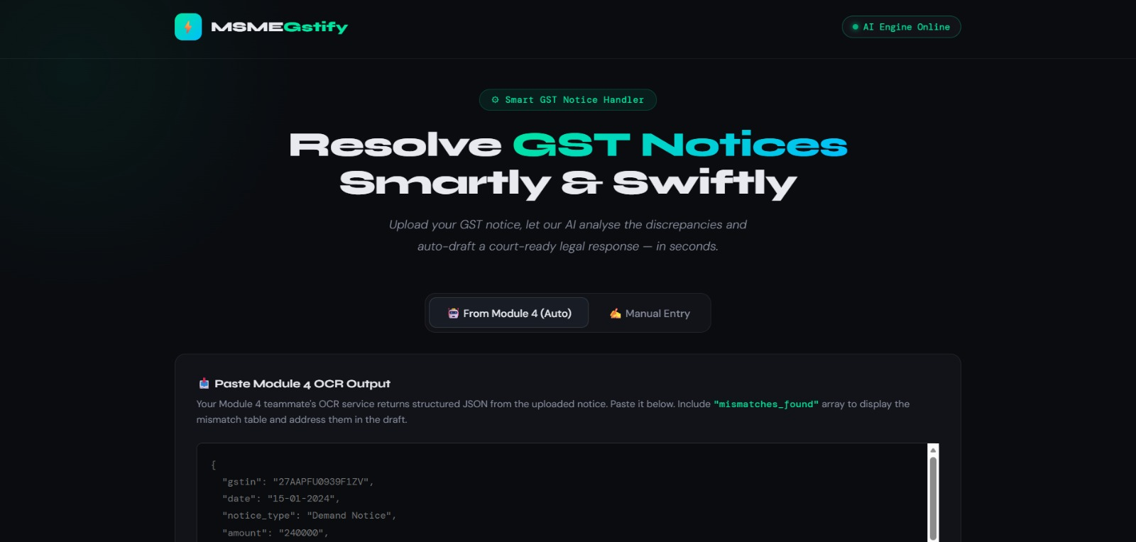
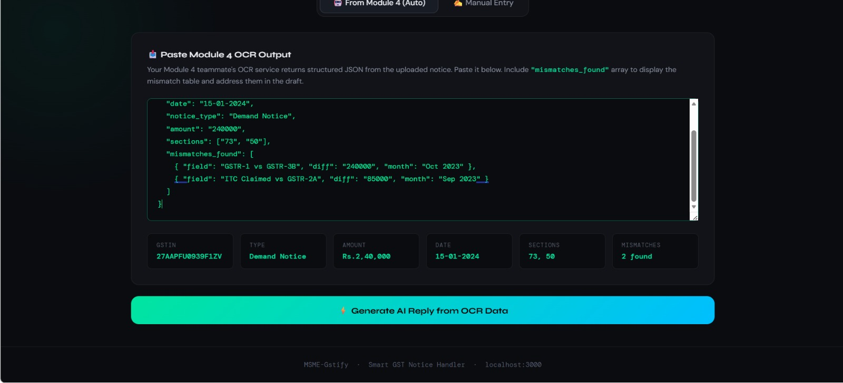
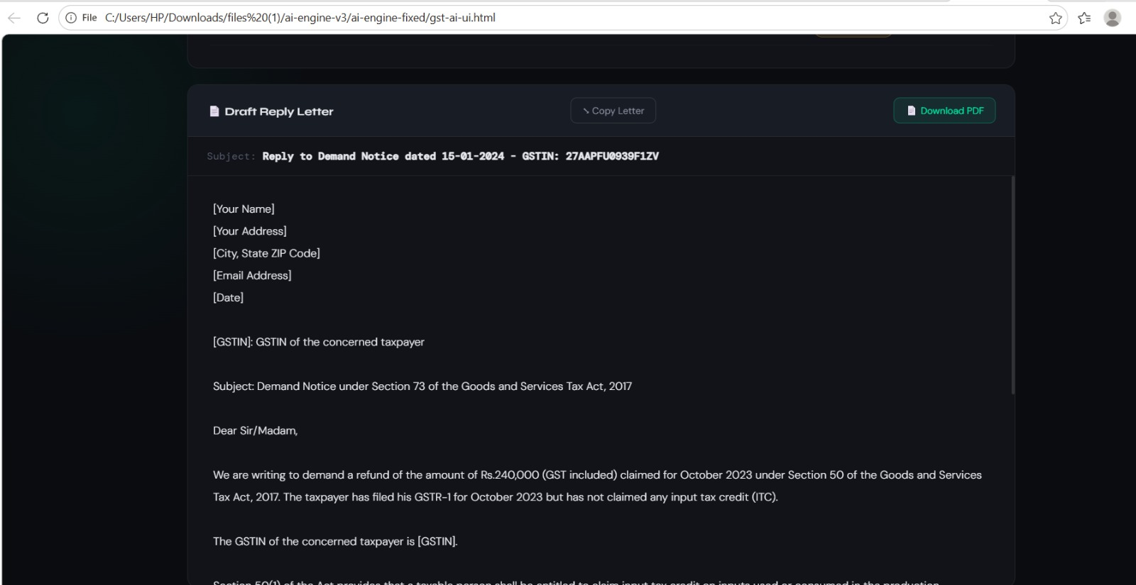
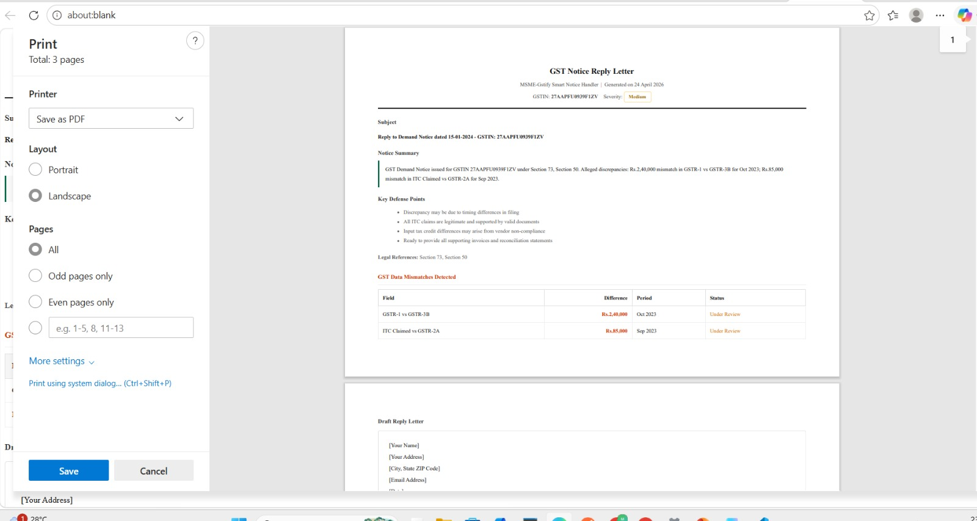
Prototype Demo
Notes:
Only stress on the 1st sentence – the definition
Come back to the 2nd sentence in the end as part of revision

