Slide 1
Visualizing Airbnb - Denver
Travel Plan Visualization
- Denver Neighborhood
Harika Dammalapati and Vanitha Himagirish
Professor : Dr. Sam Ramanujan
University of Central Missouri

Slide 2
Inside - Airbnb
Airbnb Hosts, Accommodations, Amenities, Reviews, Neighborhood, zip code and location details
Yelp
Restaurant details like Name, address etc.
Transportation Statistics
Availability of Mode of transportation like air, ferry, rail and bus details
Population Density
Population by Neighborhood

Slide 3
Features
Various host listings categorized by average price
Monthly average price analysis
Review count and review rates by neighborhood are available
Availability of transportation facilities(air, ferry, bus or rail) for neighborhood in Denver, Colorado
Population density of neighborhood in Denver, Colorado
Restaurants in neighborhood in Denver, Colorado

Slide 4
Challenges
Huge data set of airbnb – Lot of cleaning required
Mapping each dataset with Zip code and corresponding Neighborhoods
Yelp scrapper tool to gather specific data for Denver Neighborhood

Slide 5
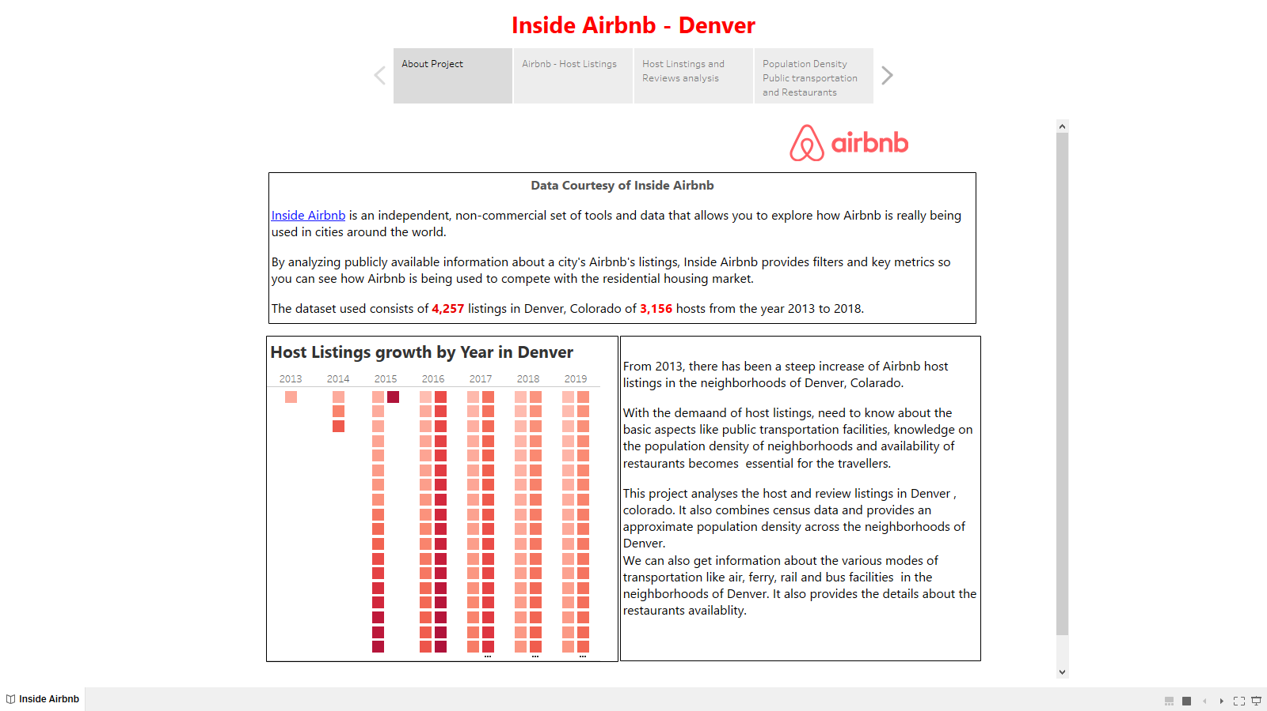
Navigate through the visualization – About the Project

Slide 6
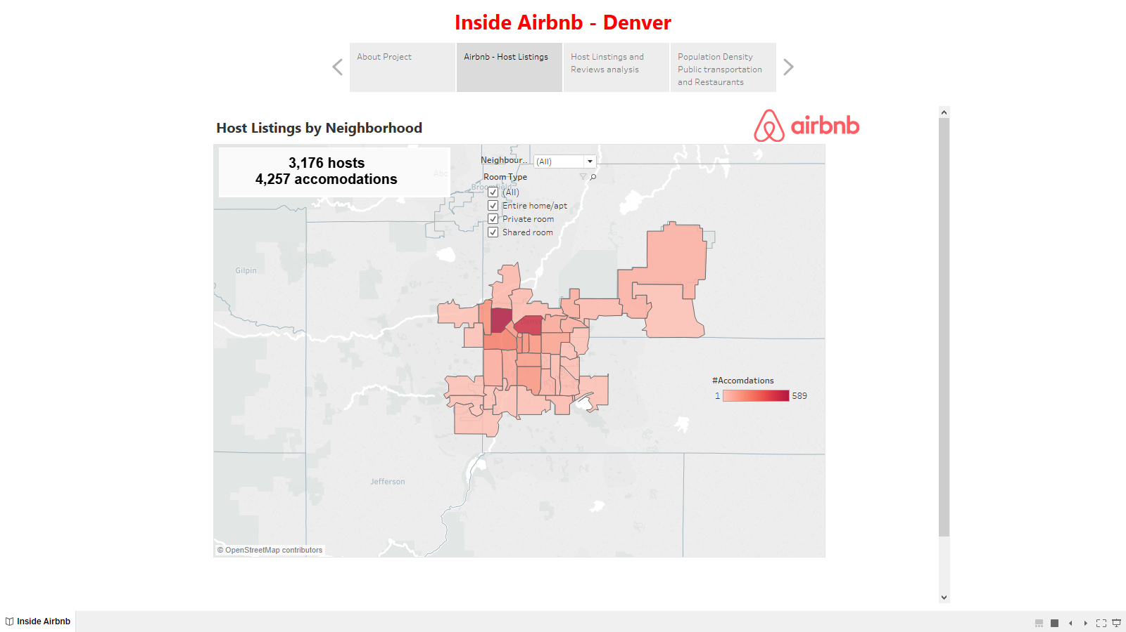
Navigate through the visualization – Lists #Accommodations

Slide 7
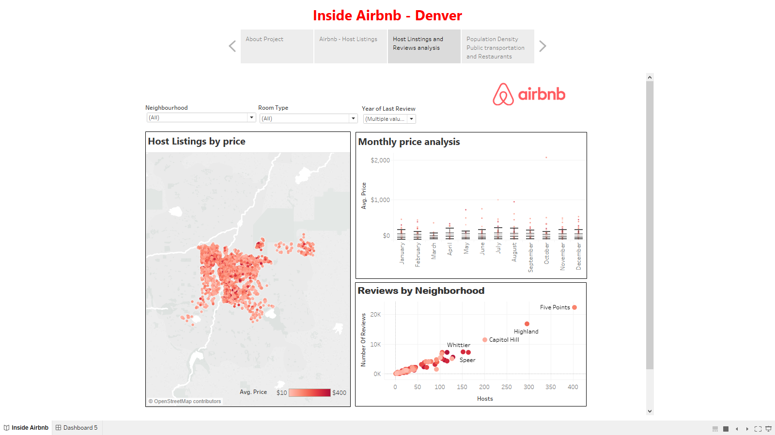
Navigate through the visualization – Host Listings and Price Analysis

Slide 8
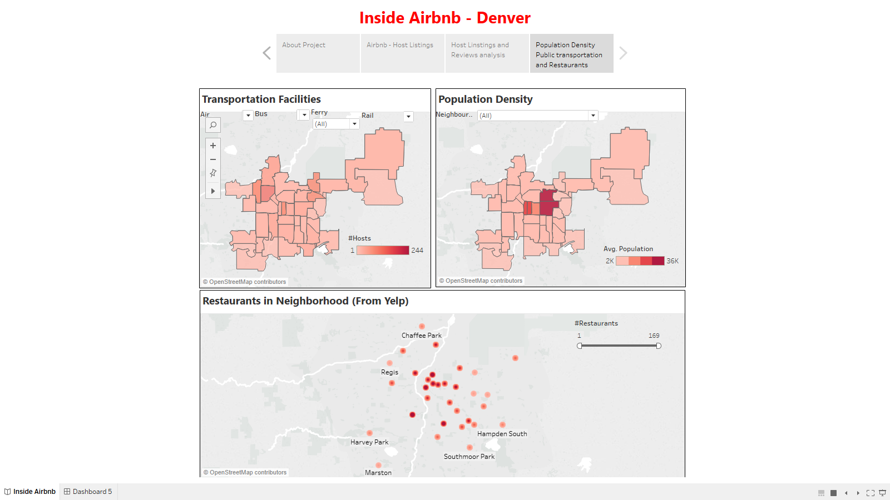
Navigate through the visualization – Restaurant , Transport and Population details of Host Accomdations

Slide 9
Source
Airbnb - http://insideairbnb.com/get-the-data.html
listings_denver.csv
neighbourhoods_denver.csv
Yelp - https://www.yelp.com/dataset/challenge
http://www.yelpdatascraper.com/
Yelp_Denver.csv
Transportation Statistics - https://www.bts.gov/
Transportation_Denver.csv
Population Density - https://statisticalatlas.com/place/Colorado/Denver/Population
Yelp_Denver.csv

