Slide 1
JUNIT
IRP Learning Program
2016
Notes:
© 2006 Capgemini - All rights reserved

Slide 2
Objectives
Purpose:
  To learnt the Unit testing by this tool
Product:
  Introduction
  Basic Annotations
  Avanced Testing
  Integration Testing
  Beyond JUnit
Process:
  Basic Junit strategy
  Advanced Level Testing.
© 2013 Capgemini - All rights reserved

Slide 3
Table of Contents
Module 1: Junit Overview
  What Junit is and unit testing
  Setting up Junit
Module 2: Junit Basics
  The stuff you NEED to know
Module 3: Advanced Junit
  Optional features that can be very useful
Module 4: Integration Junit
  Working with build tools
  Reporting results, etc
Module 5: Beyond Junit
  Complementary tools
  Other uses besides unit testing
© 2013 Capgemini - All rights reserved

Slide 4
Junit Overview
Junit Overview
Manual Testing - Automated Testing
JUnit is a unit testing framework for the Java Programming Language.
© 2013 Capgemini - All rights reserved

Slide 5
Junit Overview
Features:
open source framework
Annotations
Asserts
Test setup and teardown
Exception testing
Test suites
Parameterized testing
Assumptions
Rules
Theories
Integration with popular build systems
Test Runners
Simple and elegant
© 2011 Capgemini - All rights reserved

Slide 6
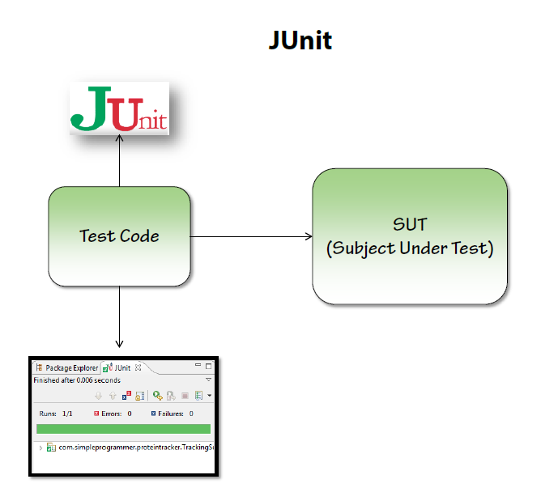
Junit Overview
Unit Test Case
© 2011 Capgemini - All rights reserved

Slide 7
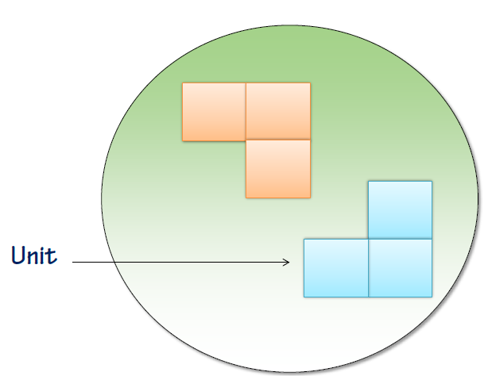
Junit Overview
What is Unit Testing?
© 2011 Capgemini - All rights reserved

Slide 8
Junit Overview
History of Junit:
Introduced by “Kent Beck”
The origin of the elite fighting force known as “J Unit”
Creator of Sunit which led to Junit and all the derivatives thereof
  1994 → Sunit
  1997 → Junit
  2000 → Junit.org
  2002 → Eclipse supports
Junit still continues to evolve
© 2011 Capgemini - All rights reserved

Slide 9
Junit Overview
  Setting up Junit
  Directly use from IDE (Eclipse)
  Download the jars and manually include it in IDE.
© 2011 Capgemini - All rights reserved

Slide 10
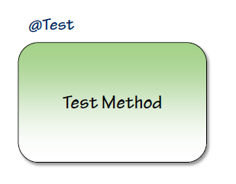
Junit Basics
JUnit Test Methods
© 2011 Capgemini - All rights reserved

Slide 11
Junit Basics
JUnit Annotations (Basic)
@Test
@Before - setUp
@After - tearDown
@BeforeClass
@AfterClass
@Ignore
@Test(expected = Exception.class)
@Test(timeout = 100)
© 2011 Capgemini - All rights reserved

Slide 12
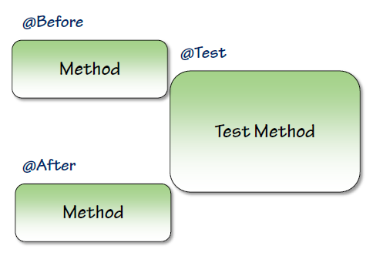
Junit Basics
Before And After:
© 2011 Capgemini - All rights reserved

Slide 13
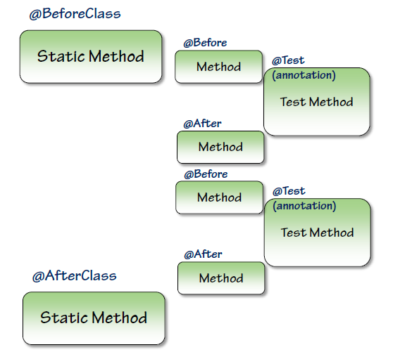
Junit Basics
BeforeClassand AfterClass
© 2011 Capgemini - All rights reserved

Slide 14
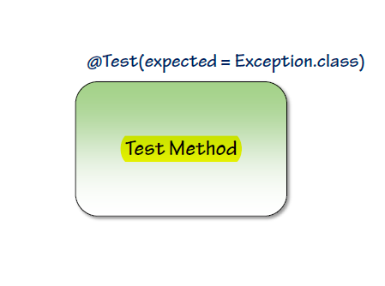
Junit Basics
Exception Testing
© 2011 Capgemini - All rights reserved

Slide 15
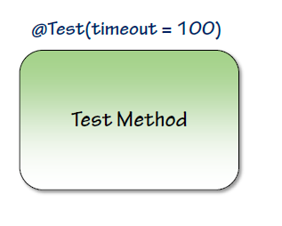
Junit Basics
Timing Out:
© 2011 Capgemini - All rights reserved

Slide 16
Junit Basics
Assertions (Basic)
assertArrayEquals
assertEquals
assertTrue
assertFalse
assertNull
assertNotNull
assertSame
assertNotSame
fail
© 2011 Capgemini - All rights reserved

Slide 17
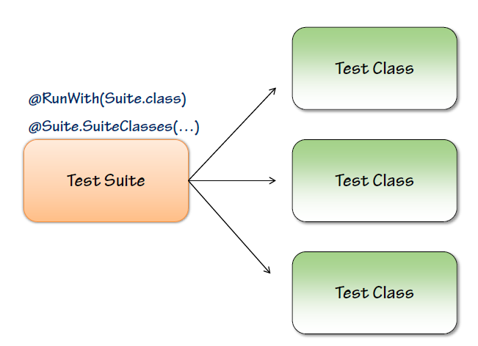
Advanced Junit
Test Suites
© 2011 Capgemini - All rights reserved
Notes:
Test suites are sweet!
© 2006 Capgemini - All rights reserved

Slide 18
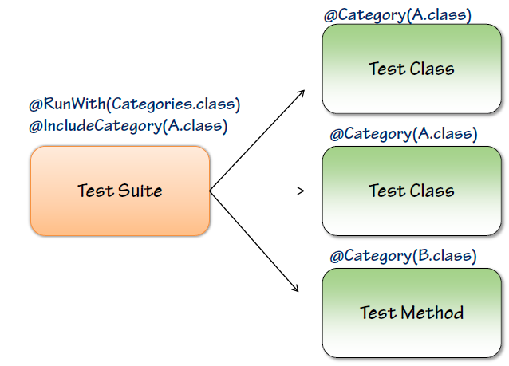
Advanced Junit
Categories
© 2011 Capgemini - All rights reserved

Slide 19
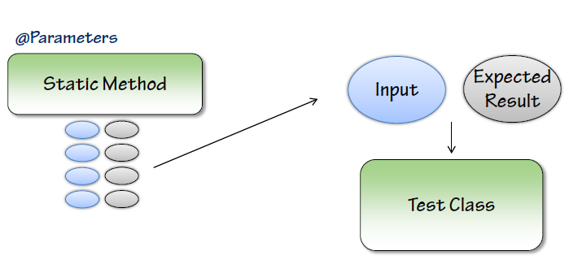
Advanced Junit
Parameterized Tests
© 2011 Capgemini - All rights reserved
Notes:
Now you don’t need 50 tests to test all your data!
© 2006 Capgemini - All rights reserved

Slide 20
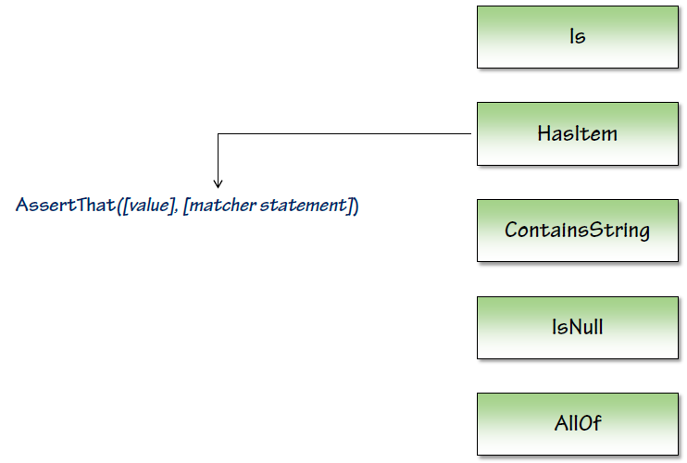
Advanced Junit
Advanced Assertions
© 2011 Capgemini - All rights reserved

Slide 21
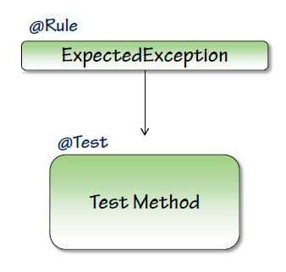
Advanced Junit
Advanced Exception Testing
© 2011 Capgemini - All rights reserved

Slide 22
Advanced Junit
Rules - @ClassRule
TemporaryFolder
ExternalResource
ErrorCollector
Verifier
TestWatcher
TestName
Timeout
ExpectedException
RuleChain
© 2011 Capgemini - All rights reserved
Notes:
Rules let you extend the functionality of JUnit
© 2006 Capgemini - All rights reserved

Slide 23
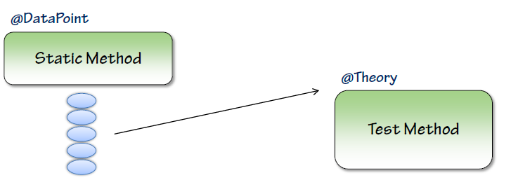
Advanced Junit
Theories
© 2011 Capgemini - All rights reserved
Notes:
Until it is proven, it is just a theory
© 2006 Capgemini - All rights reserved

Slide 24

Integrating JUnit
© 2011 Capgemini - All rights reserved

Slide 25
Integrating JUnit
Console Runners
Command Prompt Runners
Org.junit.core.JUnitCore class used to start the runners.
© 2011 Capgemini - All rights reserved

Slide 26

Integrating JUnit
Junit And Ant
© 2011 Capgemini - All rights reserved

Slide 27
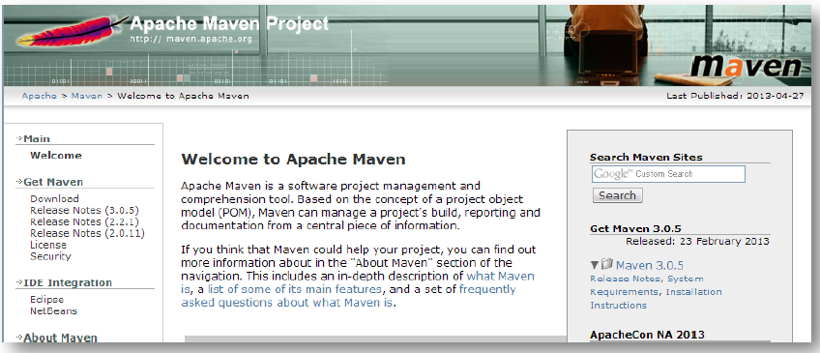
Integrating JUnit
Junit And Maven
© 2011 Capgemini - All rights reserved

Slide 28

Integrating JUnit
Eclemma - CodeCoverage
© 2011 Capgemini - All rights reserved

Slide 29
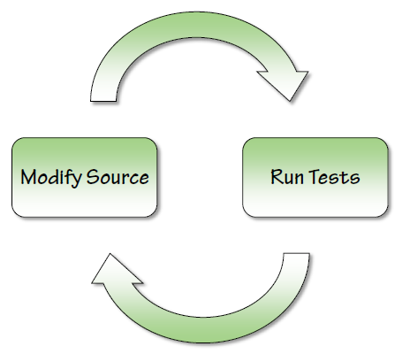
Beyond JUnit
© 2011 Capgemini - All rights reserved
Notes:
It’s all about the feedback loop, baby
© 2006 Capgemini - All rights reserved

Slide 30
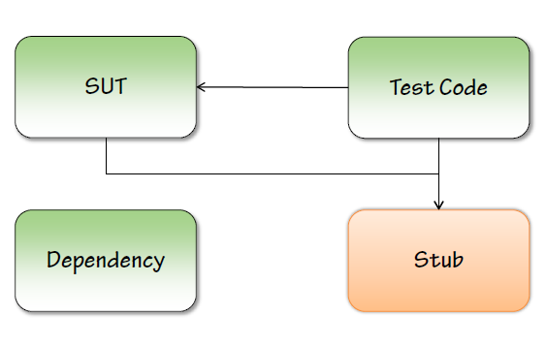
Beyond JUnit
Dependencies
Stubs
© 2011 Capgemini - All rights reserved

Slide 31
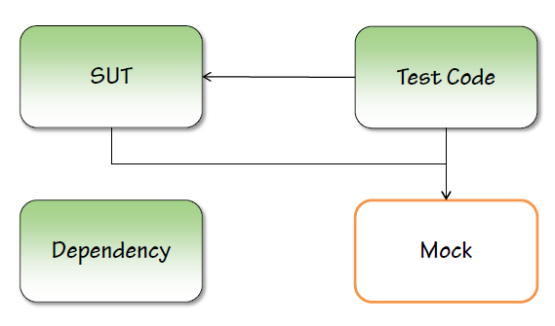
Beyond JUnit
Mocks
© 2011 Capgemini - All rights reserved

Slide 32
Mock
A dummy object is passed around but never used, i.e., its methods are never called. Such an object can for example be used to fill the parameter list of a method.
Fake objects have working implementations, but are usually simplified. For example, they use an in memory database and not a real database.
A mock object is a dummy implementation for an interface or a class in which you define the output of certain method calls.
© 2011 Capgemini - All rights reserved

Slide 33
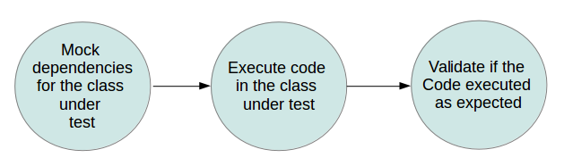
Mock
© 2011 Capgemini - All rights reserved

Slide 34
Mock
Mockito has certain limitations. It can not test the following constructs:
final classes
anonymous classes
primitive types
© 2011 Capgemini - All rights reserved

Slide 35
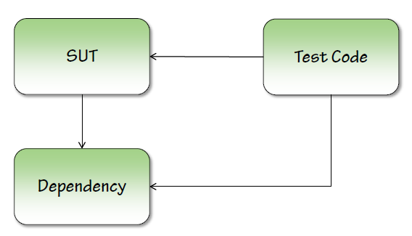
Beyond JUnit
Integration Testing
© 2011 Capgemini - All rights reserved

Slide 36
Beyond JUnit
SMS notifier
Selenium
© 2011 Capgemini - All rights reserved

Slide 37
Recap
timeout
Annotations
Assertions
JUnit
SUnit
Test-Case Exception
TestSuite
© 2013 Capgemini - All rights reserved
Notes:
Recap – tips : To make it further lighter, many facilitator ask participant that they were allow to leave only if they will answer say 12 correct answers out of 15 questions. And then produce all recaps as questions.
© 2006 Capgemini - All rights reserved

Slide 38
Thank You For Your Time
Notes:
© 2006 Capgemini - All rights reserved

