Slide 1
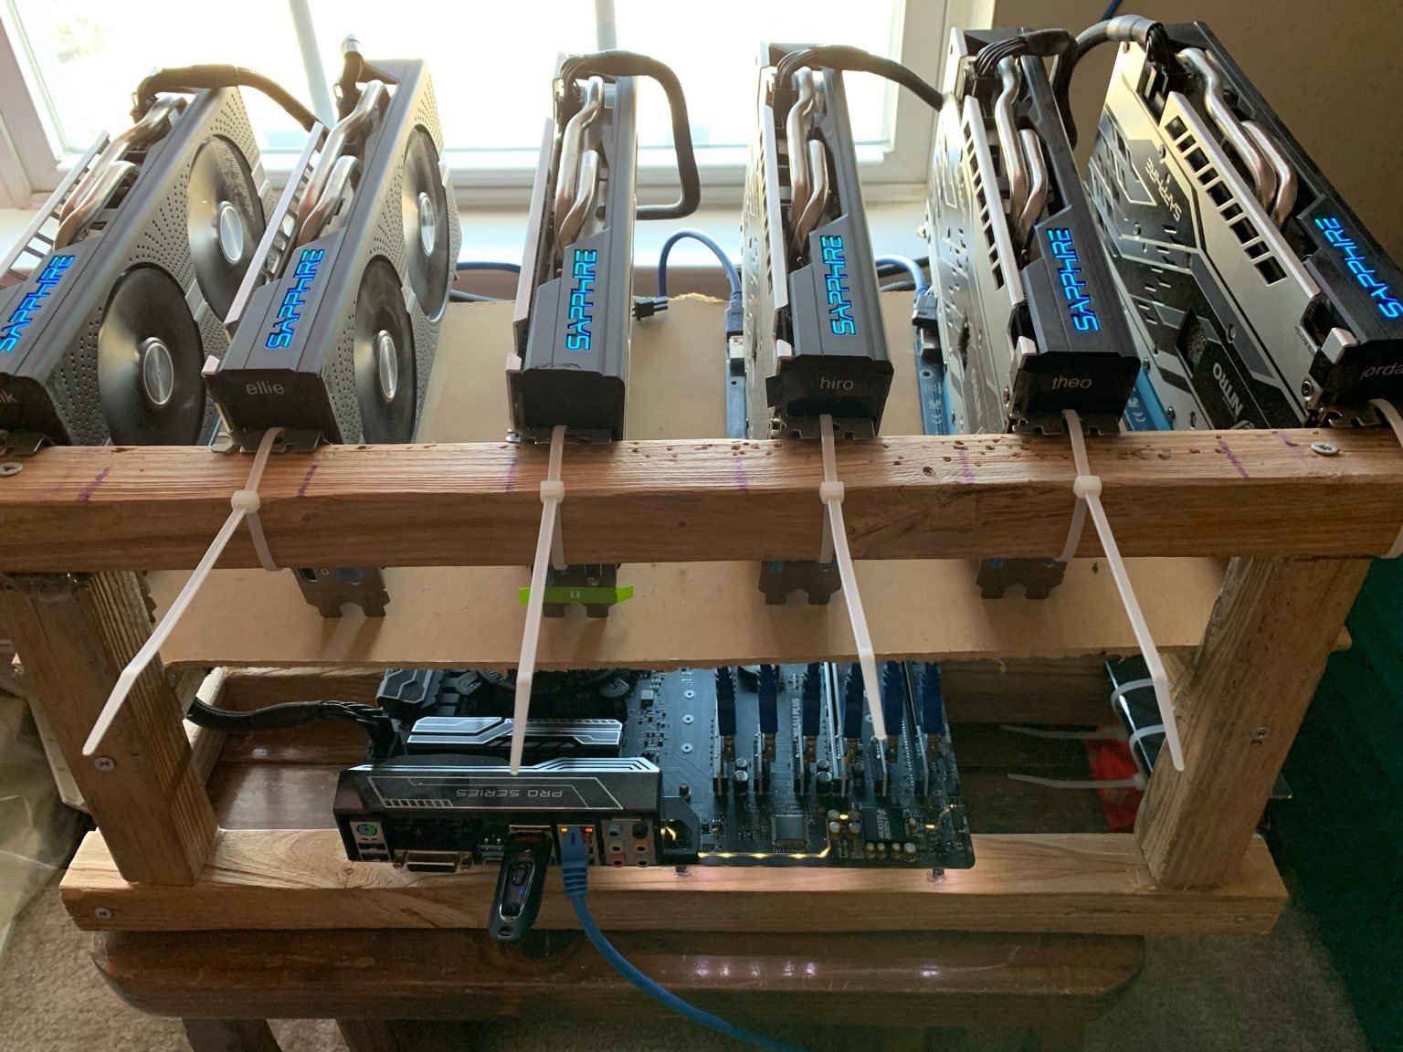
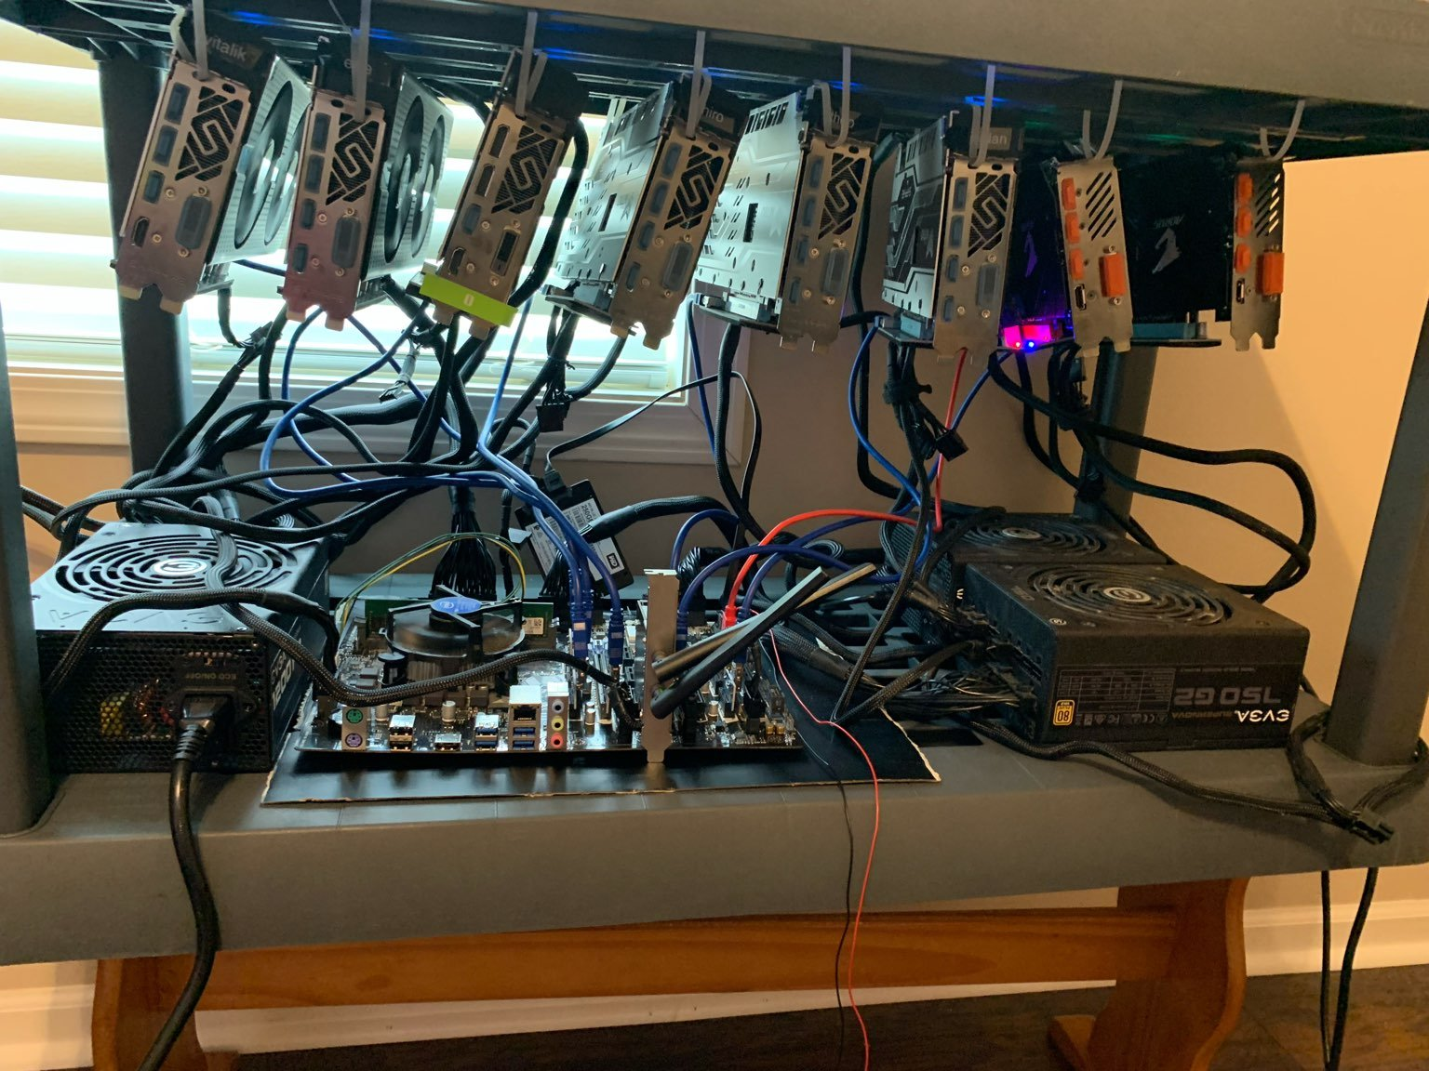
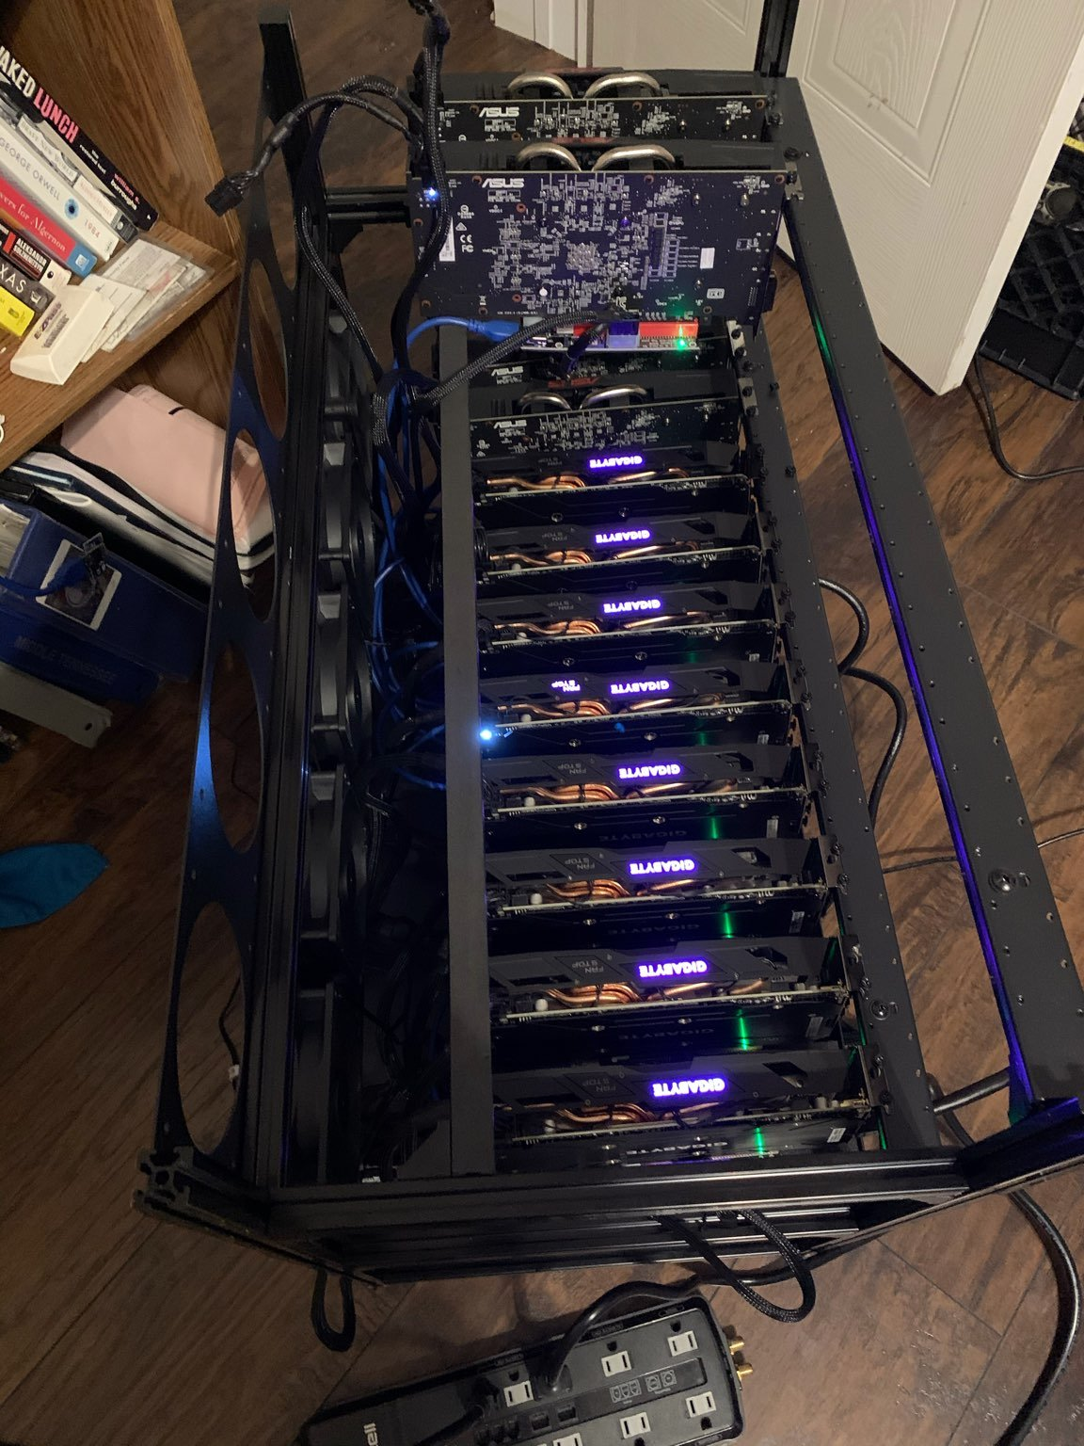
mining

Slide 2
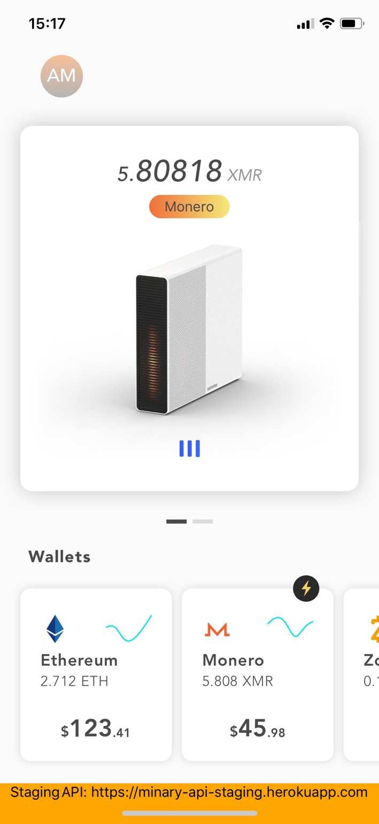
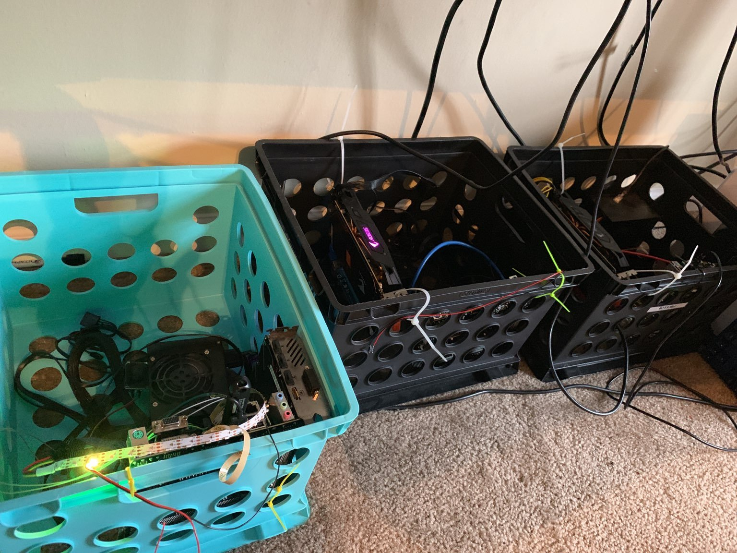
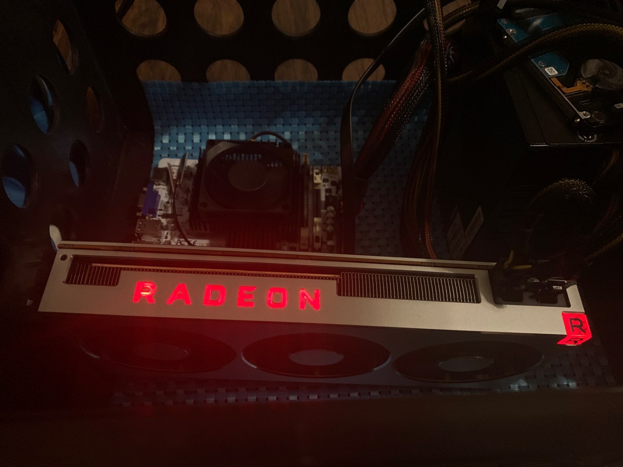
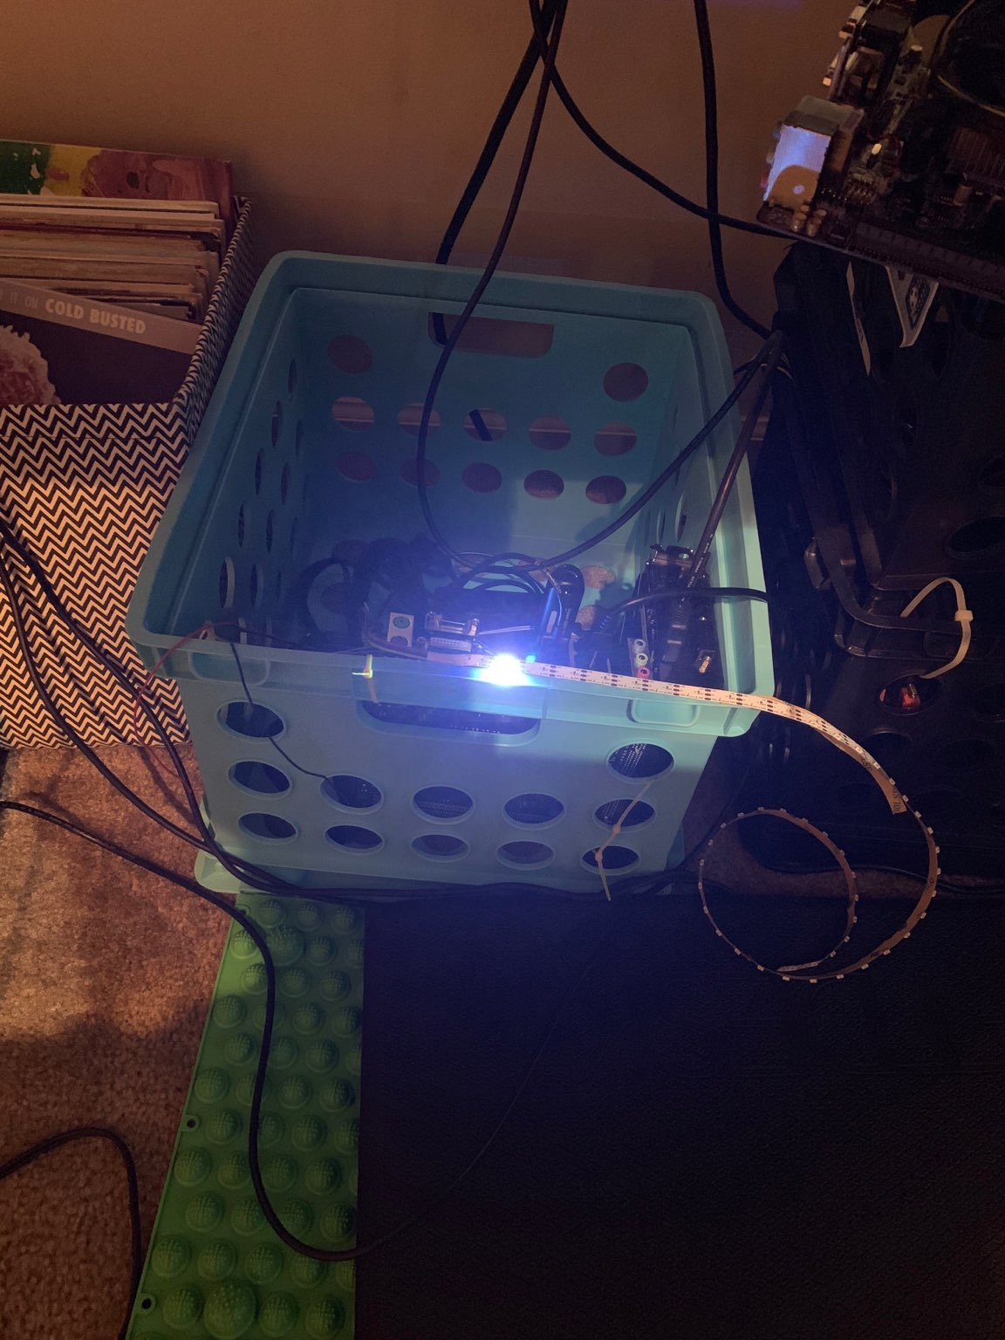
Coinmine

Slide 3
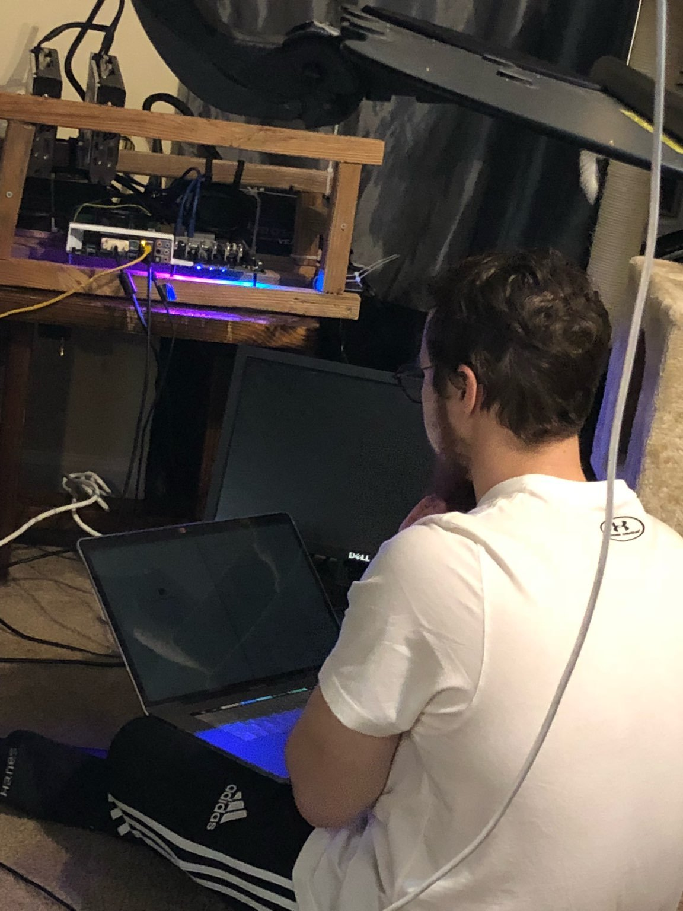
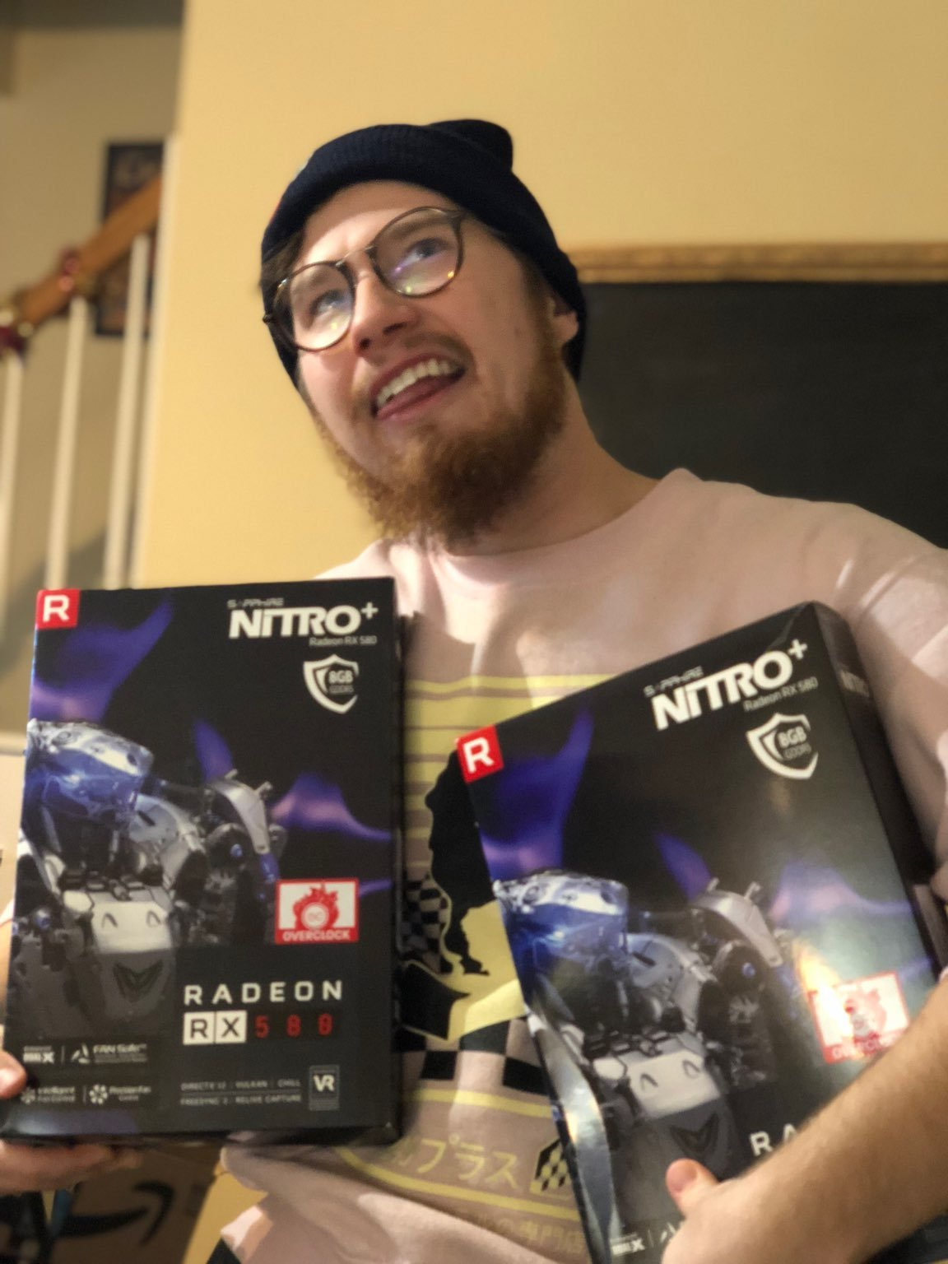
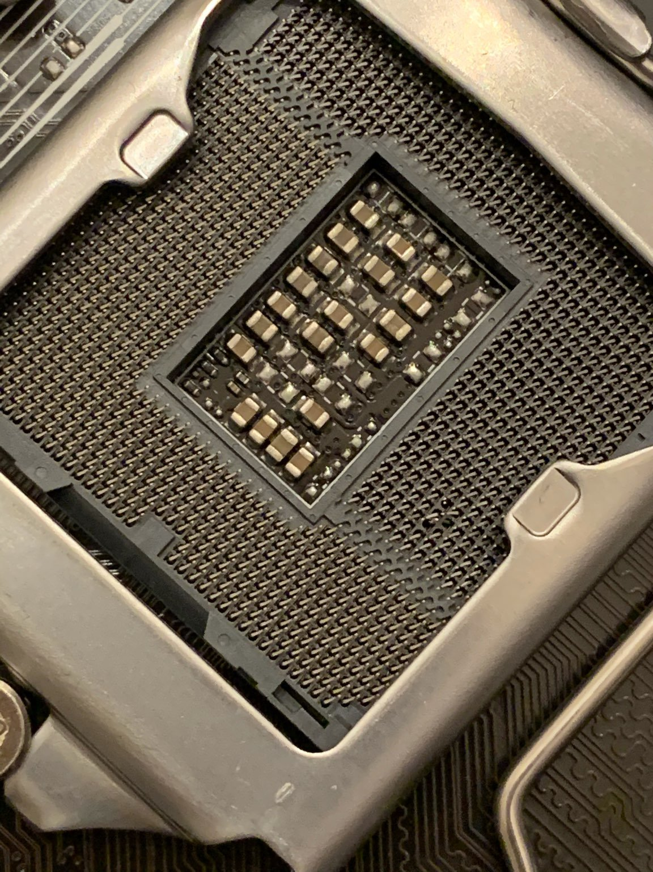
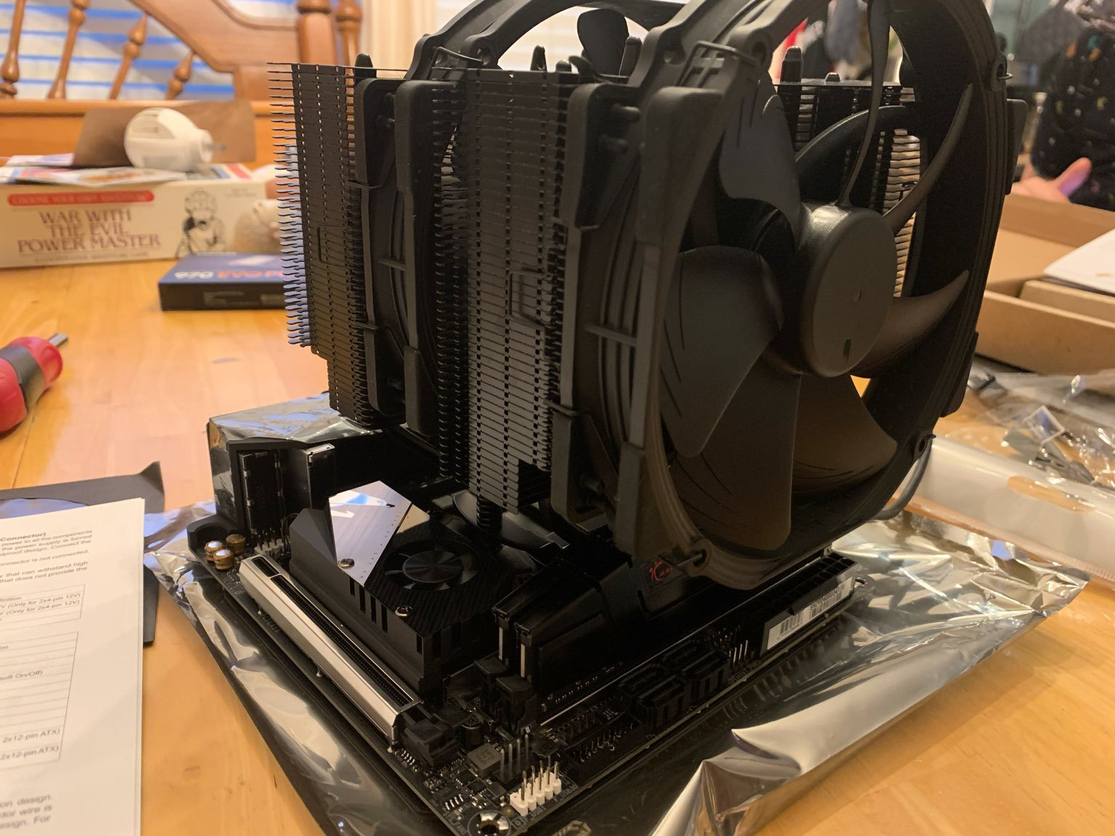
Me

Slide 4

ELI5
Proof of Work (PoW) is a term for the rules dictating who gets to update transactions on the Bitcoin blockchain.
In order for a miner to gain the right to update the ledger, he will have to provide an answer, also known as a proof, to a specific challenge. This proof is difficult to produce but is very easily validated.
For example – guessing a combination to a lock is a proof to a challenge. It’s very hard to produce this since you will need to guess many different combinations – but once produced it’s easy to validate. Just enter the combination and see if the lock opens.
Another example could be solving a Rubik’s cube – again, very hard to produce, very easy to validate that the solution is correct.
In Bitcoin’s case, the challenge is finding a random number (nonce), that when you add it to your block of transactions and hash it (i.e. run some sort of mathematical formula on it), the result will be smaller than the target number set by the system.
It’s impossible to calculate this number, the only way to find it is through trial and error (i.e. guessing). So miners spend all day long guessing numbers until one of them finds the right one. Once that happens, the miner will present his solution to the network (i.e. his proof) and everyone will agree that his block will be the next block of transactions.

Slide 5
Bitcoin – Early Days
On Jan. 3, 2009, pseudonymous creator Satoshi Nakamoto mined the first bitcoin block. As the only miner on the bitcoin network at the time, Nakamoto didn't need specialized equipment to launch the bitcoin blockchain. He was able to create bitcoin blocks using an average personal computer

Slide 6
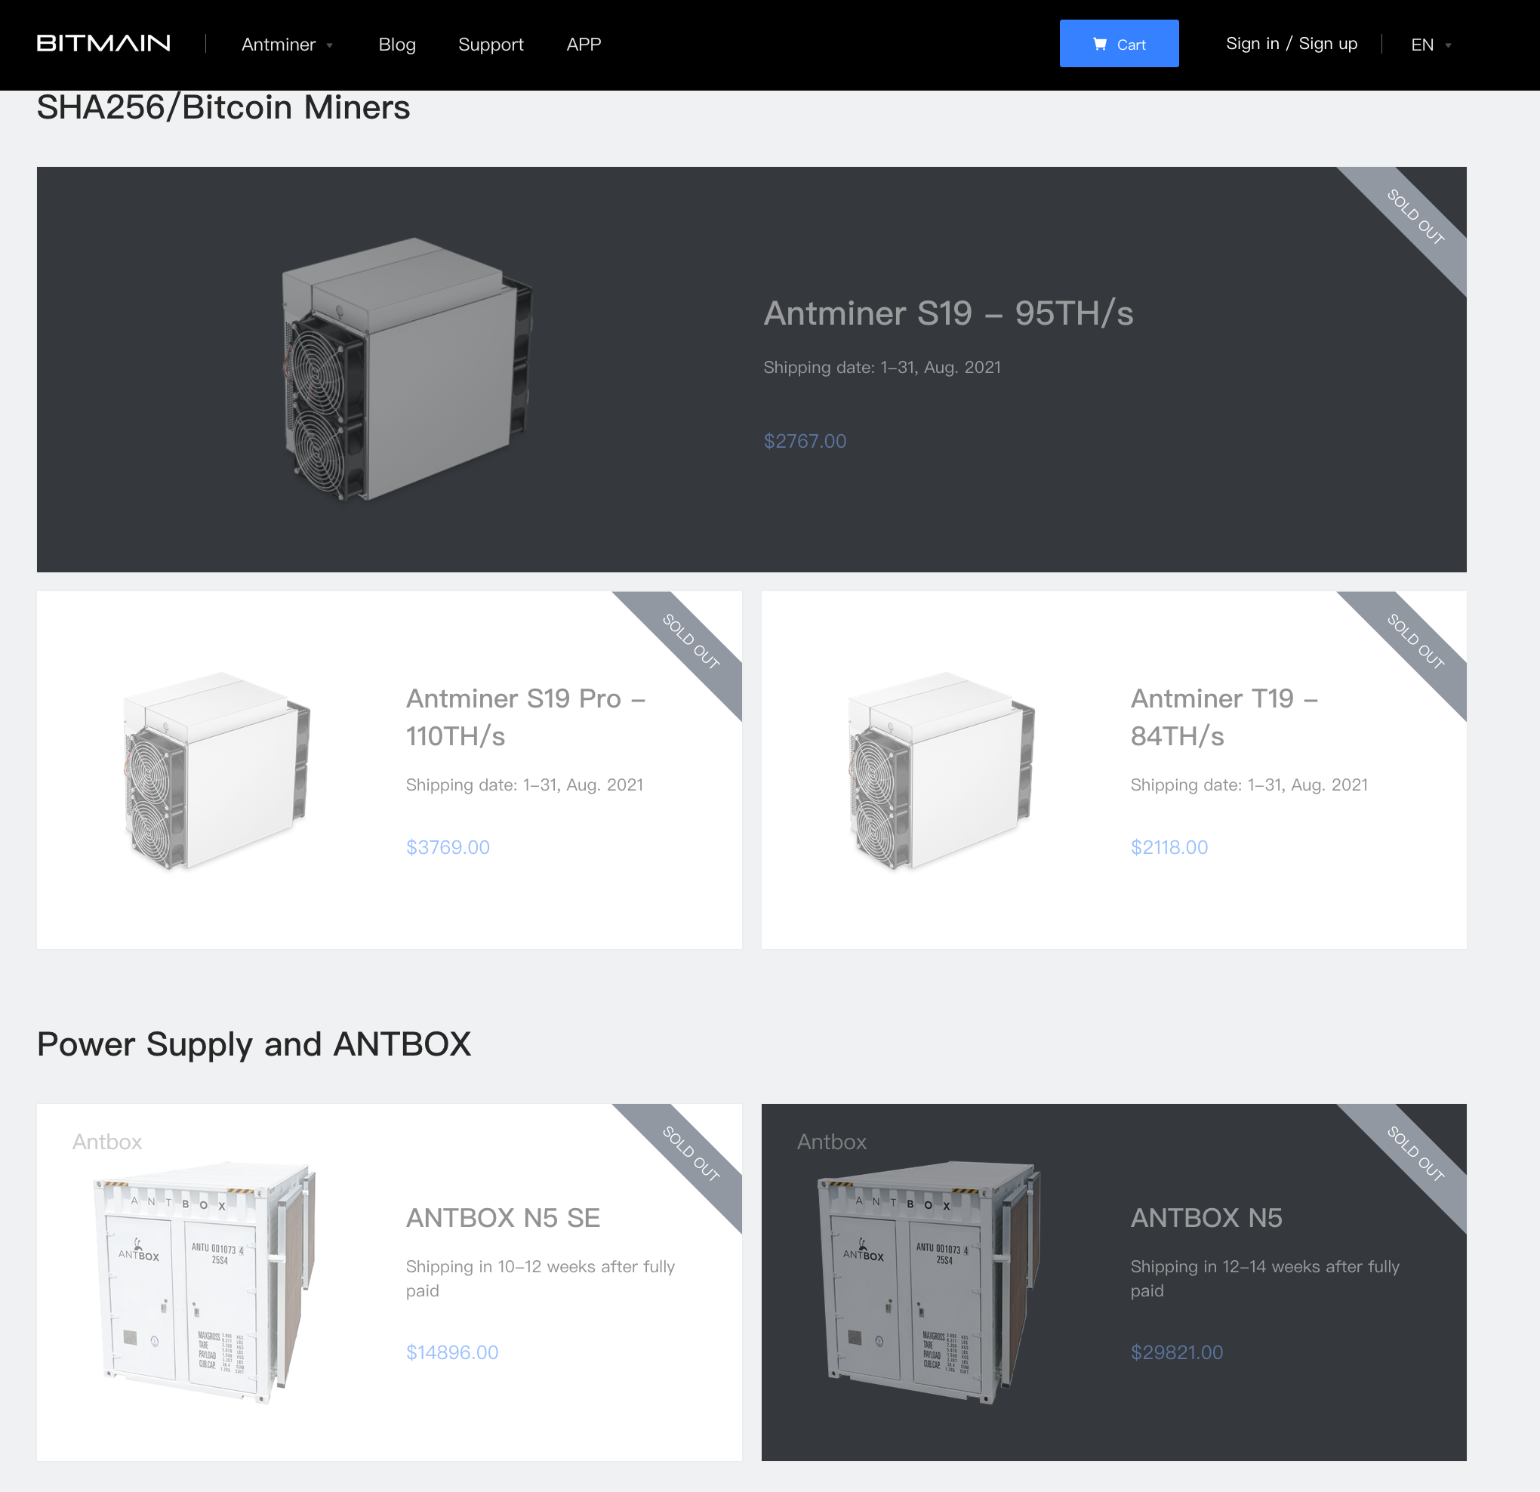
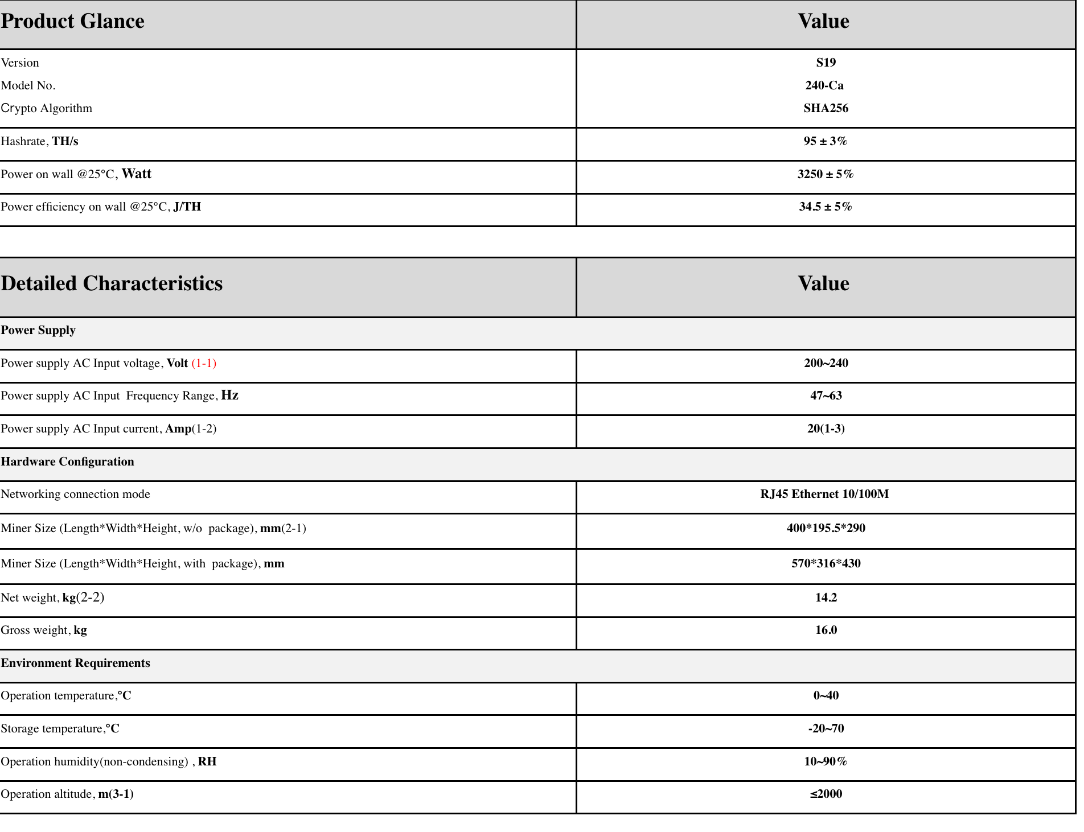
Bitcoin – Now
application-specific integrated circuit (ASIC)

Slide 7
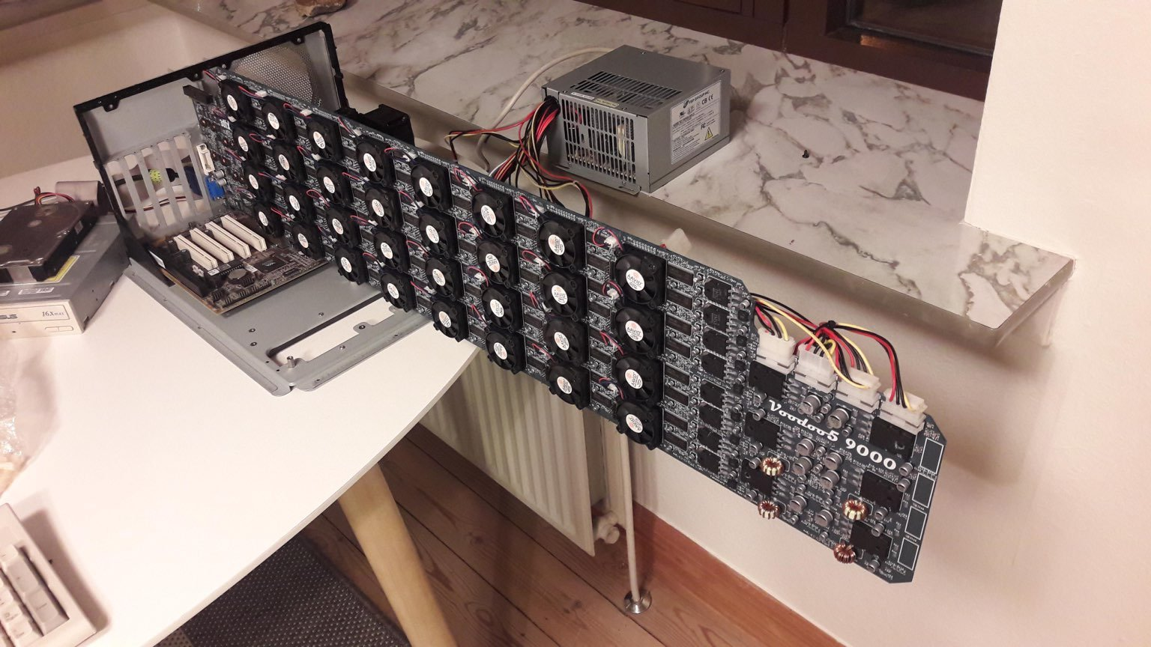
Ethereum - Now
PoW mining will be effective until 2023. Ethereum 2.0 may launch at the end of 2021 or early 2022.
Need 4GB+ RAM to fit DAG
whattomine

Slide 8
Ethereum - Future
PoW mining will be effective until 2023. Ethereum 2.0 may launch at the end of 2021 or early 2022.
Proof-of-stake (PoS)
Costs 32 ETH ~$56,000
Need a computer to be online 24/7 or get slashed
~10% APY
Rocketpool & CreamFinance

Slide 9
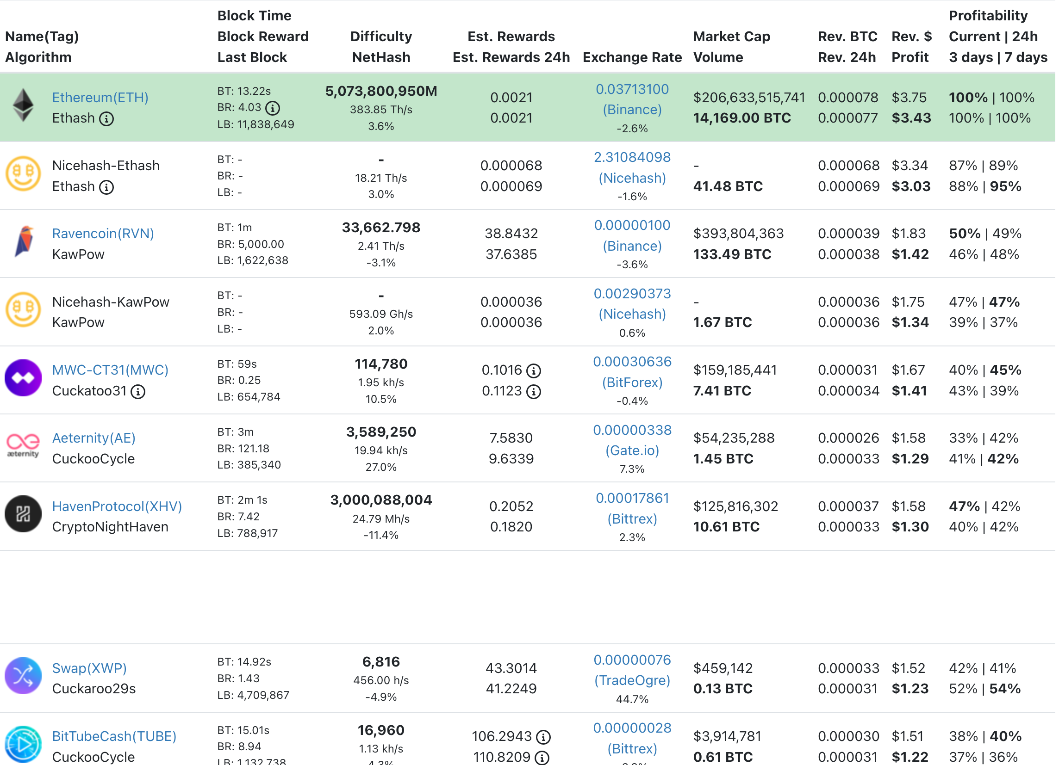
Other GPU mineable coins - Now
Other Algorithms
Kawpow
Mimblewimble
ProgPow :(

Slide 10
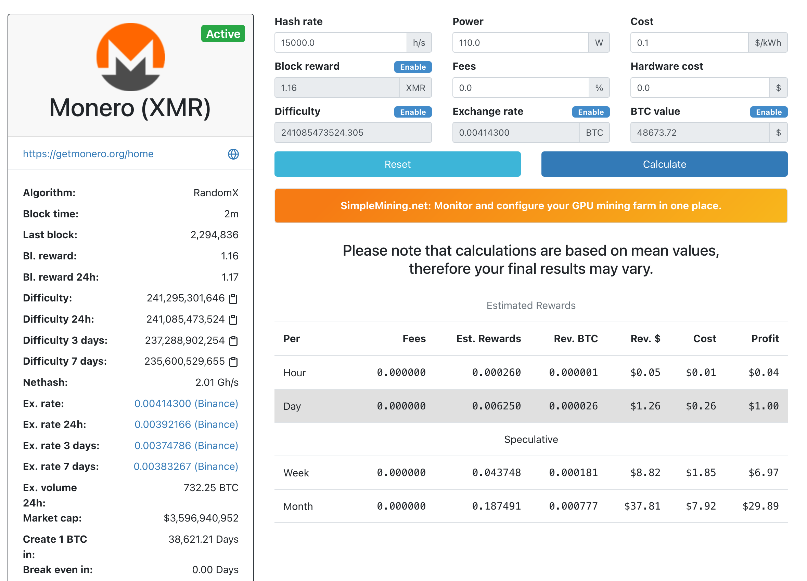

CPU mineable coins
RandomX
Ryzen
3200MHz CL14

Slide 11

Ok how do I mine
Get an address
Find a pool
Download a miner
Configure the miner
Run it
Optimize

Slide 12
Ethereum mining
Fees: lolMiner: 0.7 teamredminer: 0.75 Pheonixminer: 0.65 flexpool: 0%-?%
Miners: lolMiner, Teamredminer, Pheonixminer
Pools: flexpool, nanopool
How to get an address: Coinbase, metamask, ethereum node (~250GB)

Slide 13

Monero miner
Fees: xmrig: (compile yourself) 0% - 1%, nanopool: 1%
Miners: xmrig
Pools: nanopool
How to find an address: Kraken, Host a node (100GB)

Slide 14
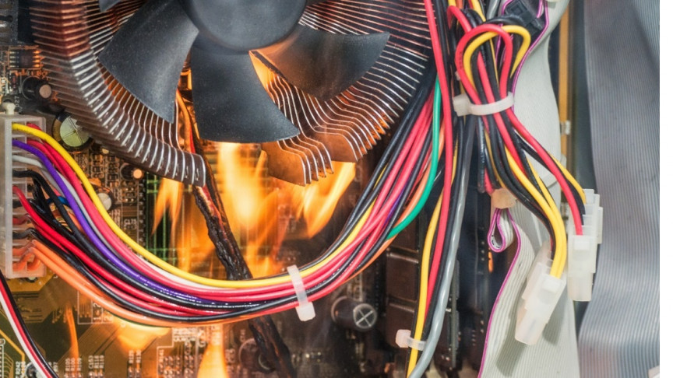
Optimizing
Overclock & Undervolt GPU (check whattomine)
Overclock CPU (standard)
Overclock CPU (check DRAM timings)
Ask me

