Slide 1




QA Automation Teamwork
Blog Testing – team Feijoa
Spring 2017
Project presentation
Ivan Deianov
Mario Georgiev
www.github.com/vankatabe
Software University
http://softuni.bg
v 2.3.1

Slide 2

General Requirements:
Register a GitHub account; Write and assign tasks in ‘GitHub issues’ for each tasks
Software Requirements Specification – description of each functionality and use case of the project
Test plan
Test scenarios with test cases
Automation with Selenium WebDriver test framework
Test framework – similar to the one built throughout the course
Build Continuous Integration with TeamCity
Make full test automation for the blog
Test the project
Continuous Integration – upon commit changes to the code, the test project should run all tests on the new version
The test project should be easily extended.

Slide 3


Expectations:
Reality:
A complete team to work on the project
Ivan Deianov
Mario Georgiev

Slide 4
What has been done 1 – Docs and VCS
Register a GitHub account
Create tasks and issues:
GitHub Issues (http://github.com/vankatabe/Feijoa)
Waffle.io board for better management (https://waffle.io/vankatabe/Feijoa)
Full documentation:
SRS – contains requirements even for the Comment Article – a functionality still not implemented
Test Plan (only Regression Testing and System Testing chapters were created)
Test Scenarios and Test Cases – contain tests even for the Comment Article – a functionality still not implemented
Readme file and Issues in GitHub
Waffle.io board
Project presentation

Slide 5
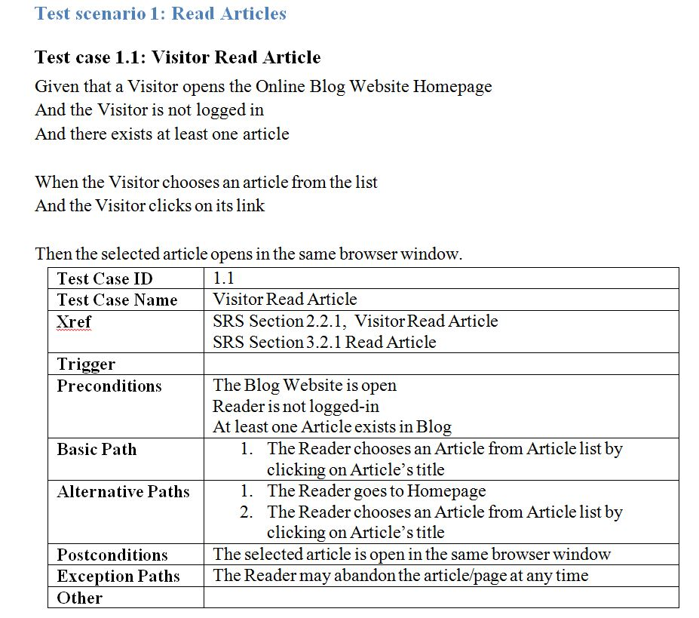
What has been done 2
Gherkin-type tests in the documentation – a better read for the business people
Optimisation of the code by Gherkin tests in it: several tests in *.feature file run on one and the same test code in *Steps.cs

Slide 6
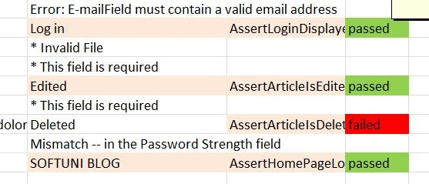
What has been done 3 – Data Driven Testing
Automatic input in the .xlsx file the last result of every test and makes it green/red
The Gherkin test uses the exact same data row in .xlsx as its “normal” test counterpart;
also matching properties to run a test suite (e.g.: @Regression (Gherkin) matches Property("Category", "Regression")(“normal” test))
Automatic get of the test method name and test result using it to access the respective row in the .xlsx file (incl. in Gherkin tests)
Two different ways of Data-Driven Asserter (incl. in Gherkin tests)

Slide 7
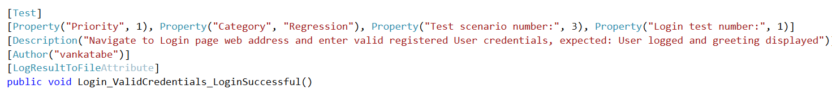
What has been done 4 – Features
Run tests from command prompt using NUnit ConsoleRunner (example code: packages\NUnit.ConsoleRunner.3.6.1\tools\nunit3-console.exe --labels=All --out=Blog.UI.Tests\TestResult.txt --result=Blog.UI.Tests\TestResult.xml;format=nunit2 Blog.UI.Tests\bin\Debug\Blog.UI.Tests.dll) – see \\TestsRun.bat
Absolutely relative paths everywhere - incl. in the command line tests and results (example code: packages\NUnit.ConsoleRunner.3.6.1\tools\nunit3-console.exe --labels=All --out=Blog.UI.Tests\TestResult.txt --result=Blog.UI.Tests\TestResult.xml; format=nunit2 Blog.UI.Tests\bin\Debug\Blog.UI.Tests.dll)
Choice of which test of the class to be run from command line according to criteria, e.g.: --where "Category == Regression“ – see \\TestsRun-TeamCity.bat

Slide 8
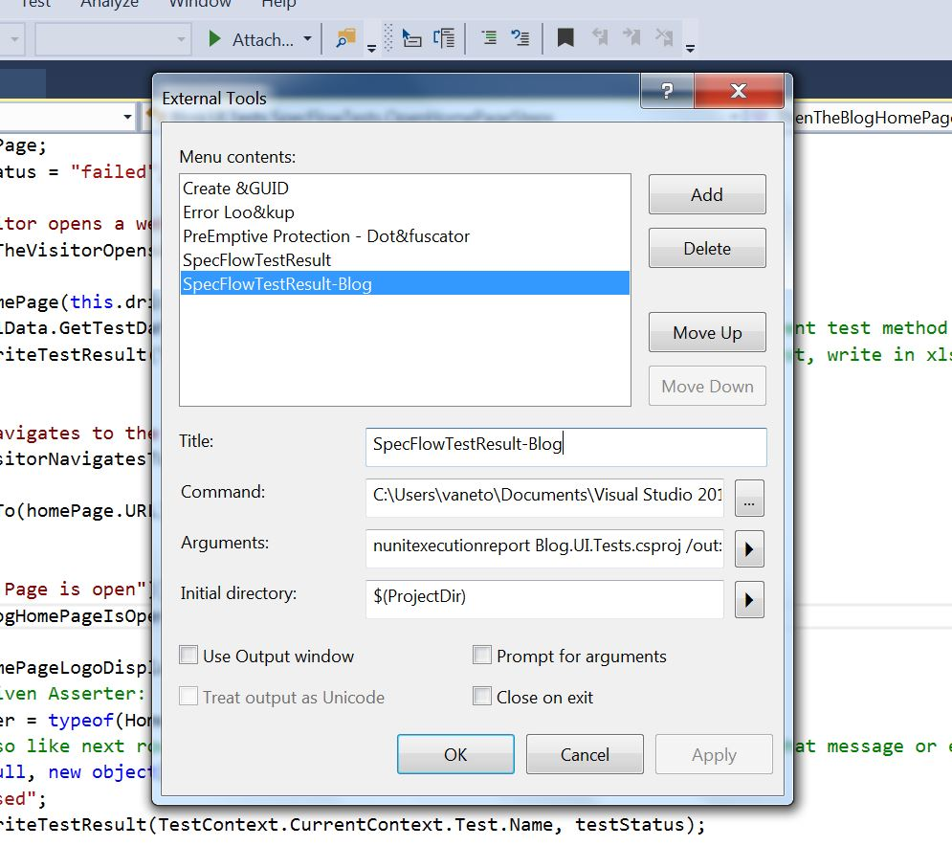
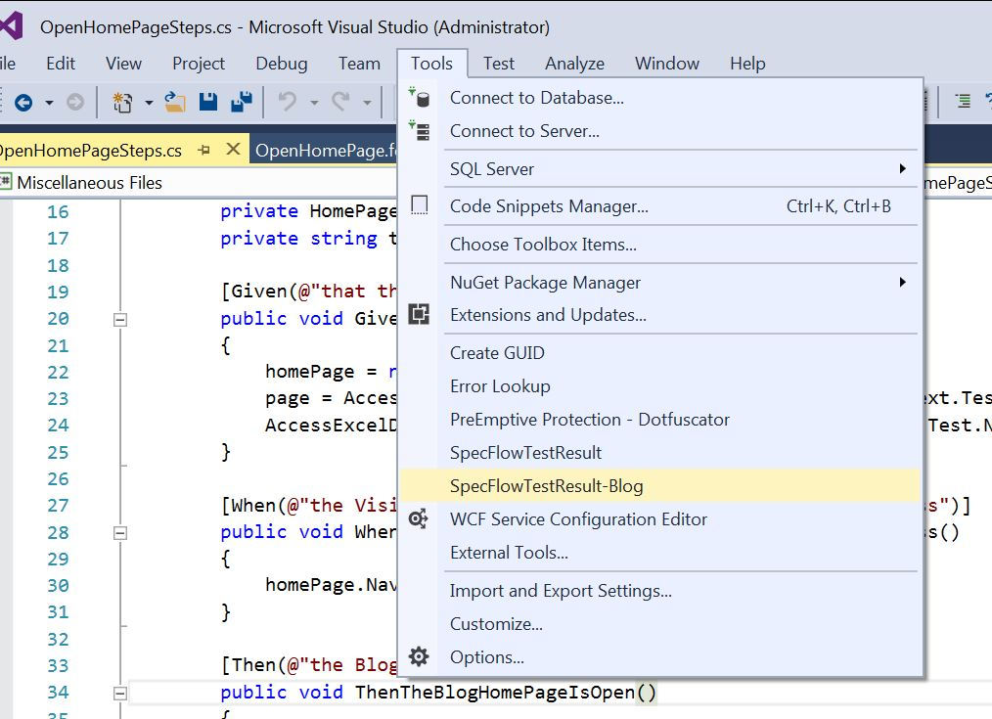
What has been done 5 – Optimisation
Time save: Run all tests in a class in one Blog instance
Database independent: Creates unique user / article every test
VS Menu item to generate SpecFlow test report

Slide 9
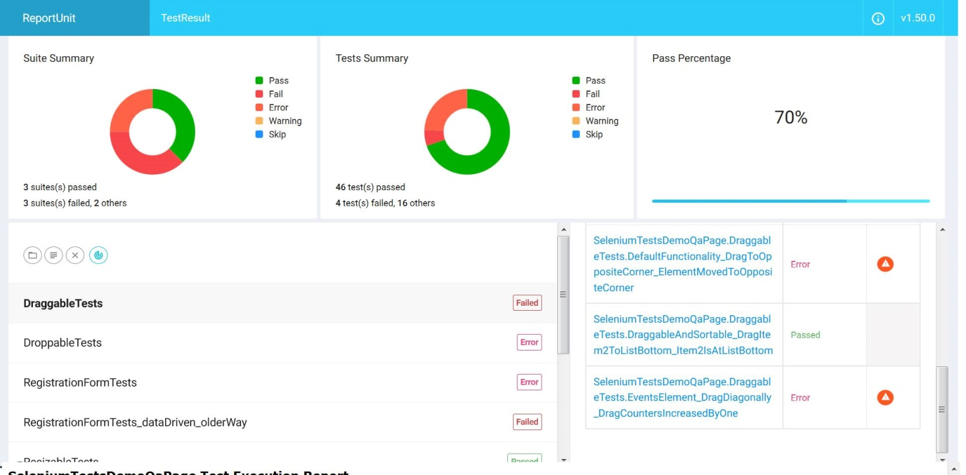
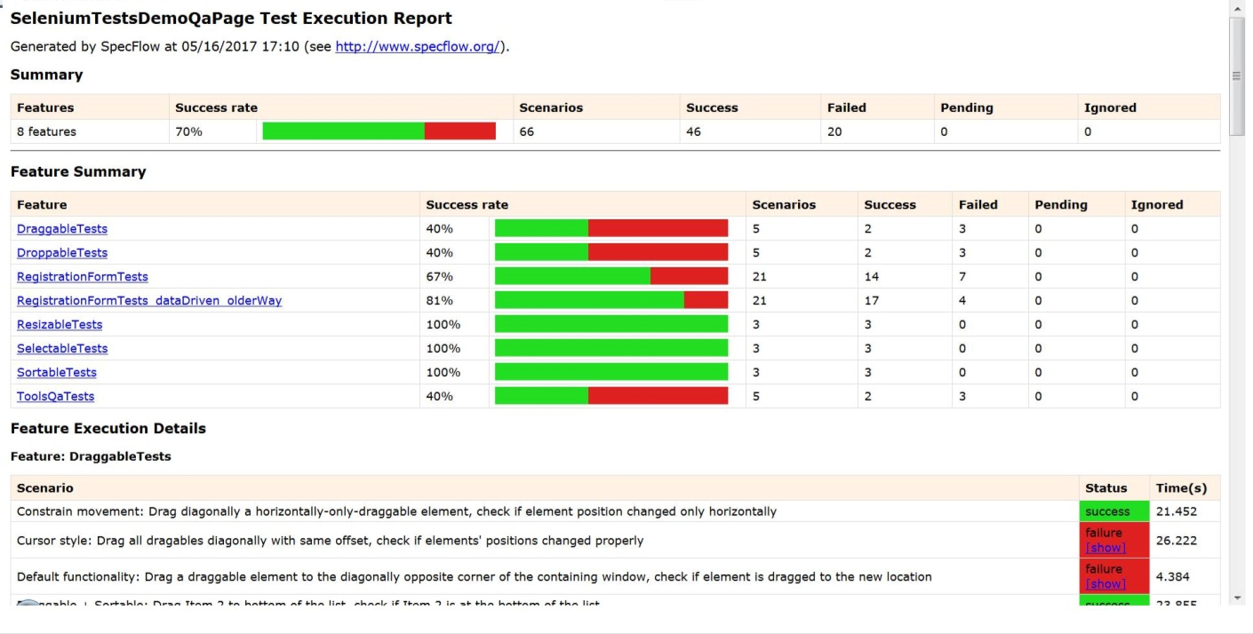
What has been done 6 – Reporting
Two different kinds of html test reports (see in \Blog-Skeleton\Blog.UI.Tests\ directory):
ReportUnit - TestResult.html
SpecFlow - TestResult.htm

Slide 10
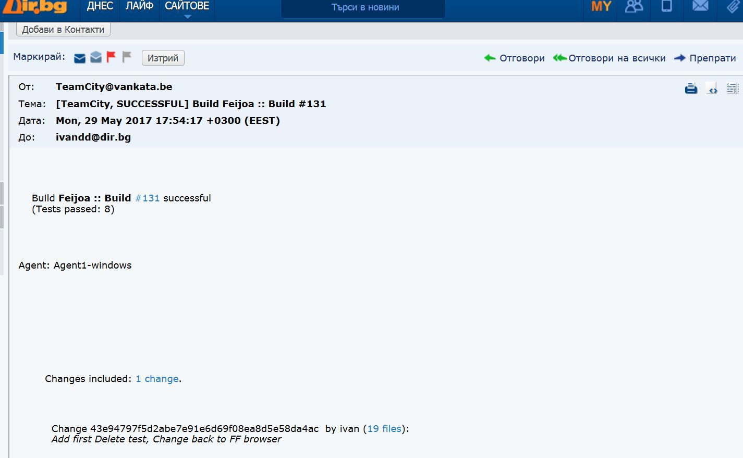
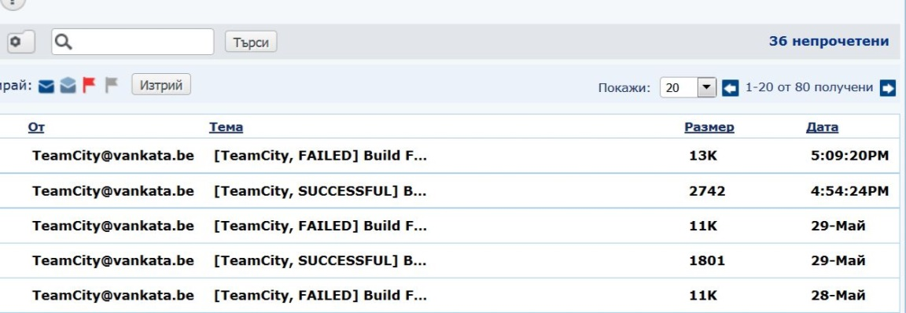
What has been done 7 – More Reporting
Team City sends build/tests results emails to ivandd@dir.bg
Other types of reporting implemented in-code:
\\TestResult.txt – single info file for all tests run
\\Logs\Log.txt – a single file for all tests divided per suite
\\Log\ *.txt report file and *.jpg screenshot for every failed test (see the YeOldeFailedTestsLogger in BasePage.cs called from [TearDown] section of every *Tests.cs)

Slide 11

Summary
A job passionately done!

Slide 12
http://softuni.org/courses

Slide 13
License
This course (slides, examples, demos, videos, homework, etc.) is licensed under the "Creative Commons Attribution-NonCommercial-ShareAlike 4.0 International" license
Attribution: this work may contain portions from
"Fundamentals of Computer Programming with C#" book by Svetlin Nakov & Co. under CC-BY-SA license
"C# Part I" course by Telerik Academy under CC-BY-NC-SA license

Slide 14





Free Trainings @ Software University
Software University Foundation – softuni.org
Software University – High-Quality Education, Profession and Job for Software Developers
softuni.bg
Software University @ Facebook
facebook.com/SoftwareUniversity
Software University @ YouTube
youtube.com/SoftwareUniversity
Software University Forums – forum.softuni.bg

