Slide 1

Predicting Bank Marketing Campaign Results
Amish Faldu
Jaishnav Kapadia
Akaash Thawani
Naga Ramya Vankayala
Submitted to:
Dr. Arashdeep Kaur
Notes:
Link: https://colab.research.google.com/drive/1WLOExhJ2LJUD-YrdxNo5eekuh5trBGqG#scrollTo=cSxOrCt9-VWE

Slide 2
Project Objectives
1. Understanding Business Objective 2. Data set details 3. Exploratory Data Analysis
4. Feature Engineering 5. Model Building 6. Evaluate the model 7. Conclusion
Notes:
Link: https://colab.research.google.com/drive/1WLOExhJ2LJUD-YrdxNo5eekuh5trBGqG#scrollTo=cSxOrCt9-VWE

Slide 3
Problem Statement
The information in the dataset pertains to the direct marketing efforts of a bank in Portugal. They reached out to potential clients via phone calls.
Sometimes, they needed to contact the same person multiple times to find out whether they were interested in signing up for a bank term deposit or not.
The main aim is to predict whether a client will say 'yes' or 'no' to subscribing to a term deposit.
Notes:
Link: https://colab.research.google.com/drive/1WLOExhJ2LJUD-YrdxNo5eekuh5trBGqG#scrollTo=cSxOrCt9-VWE

Slide 4
Project Objectives
1. Understanding Business Objective 2. Data set details 3. Exploratory Data Analysis
4. Feature Engineering 5. Model Building 6. Evaluate the model 7. Conclusion
Notes:
Link: https://colab.research.google.com/drive/1WLOExhJ2LJUD-YrdxNo5eekuh5trBGqG#scrollTo=cSxOrCt9-VWE

Slide 5
Dataset Description
Instances - 41188
Attributes - 21
The dataset details are as follows:
age - Age in years
job - Type of job
marital - Marital status
education - Education level of individual
default - Has credit in default
housing - Has housing loan
loan - Has personal loan
contact - Contact communication service
month - Last contact month of year
dayofweek - Last contact day of the week
duration - Last contact duration, in weeks
campaign - Number of contacts performed during this campaign and for this client.
pdays - Number of days that passed by after the client was last contacted from previous campaign
previous - Number of contacts performed before this campaign and for this client
poutcome - Outcome of previous marketing campaign
emp.var.rate - Employment variation rate
cons.price.idx - Consumer price index
cons.conf.idx - Consumer confidence index
euribor3m - Euribor 3 month rate
nr.employed - Number of employees
y - Has the client subscribed to term deposit
Notes:
Link: https://colab.research.google.com/drive/1WLOExhJ2LJUD-YrdxNo5eekuh5trBGqG#scrollTo=cSxOrCt9-VWE

Slide 6
Literature Review
Evolution of Customer Response Prediction:
Progression from classical machine learning models to deep learning architectures and ensemble learning techniques.
Previous Approaches and Limitations:
Use of various models including Naive Bayes, Logistic Regression, Decision Trees, ANN, and SVM, with challenges such as unreliable results due to lack of evaluation metrics and data splitting details.
Issues like class imbalance and lack of additional processing affecting model performance, as seen in studies utilizing artificial neural networks.
Proposed Techniques for Class Imbalance:
Introduction of SMOTE as an advanced technique addressing class imbalance, mitigating risks of overfitting while improving generalization ability.
SMOTE's method of generating synthetic samples along line segments between minority class instances enhances model robustness and performance on imbalanced datasets.
Notes:
Link: https://colab.research.google.com/drive/1WLOExhJ2LJUD-YrdxNo5eekuh5trBGqG#scrollTo=cSxOrCt9-VWE

Slide 7
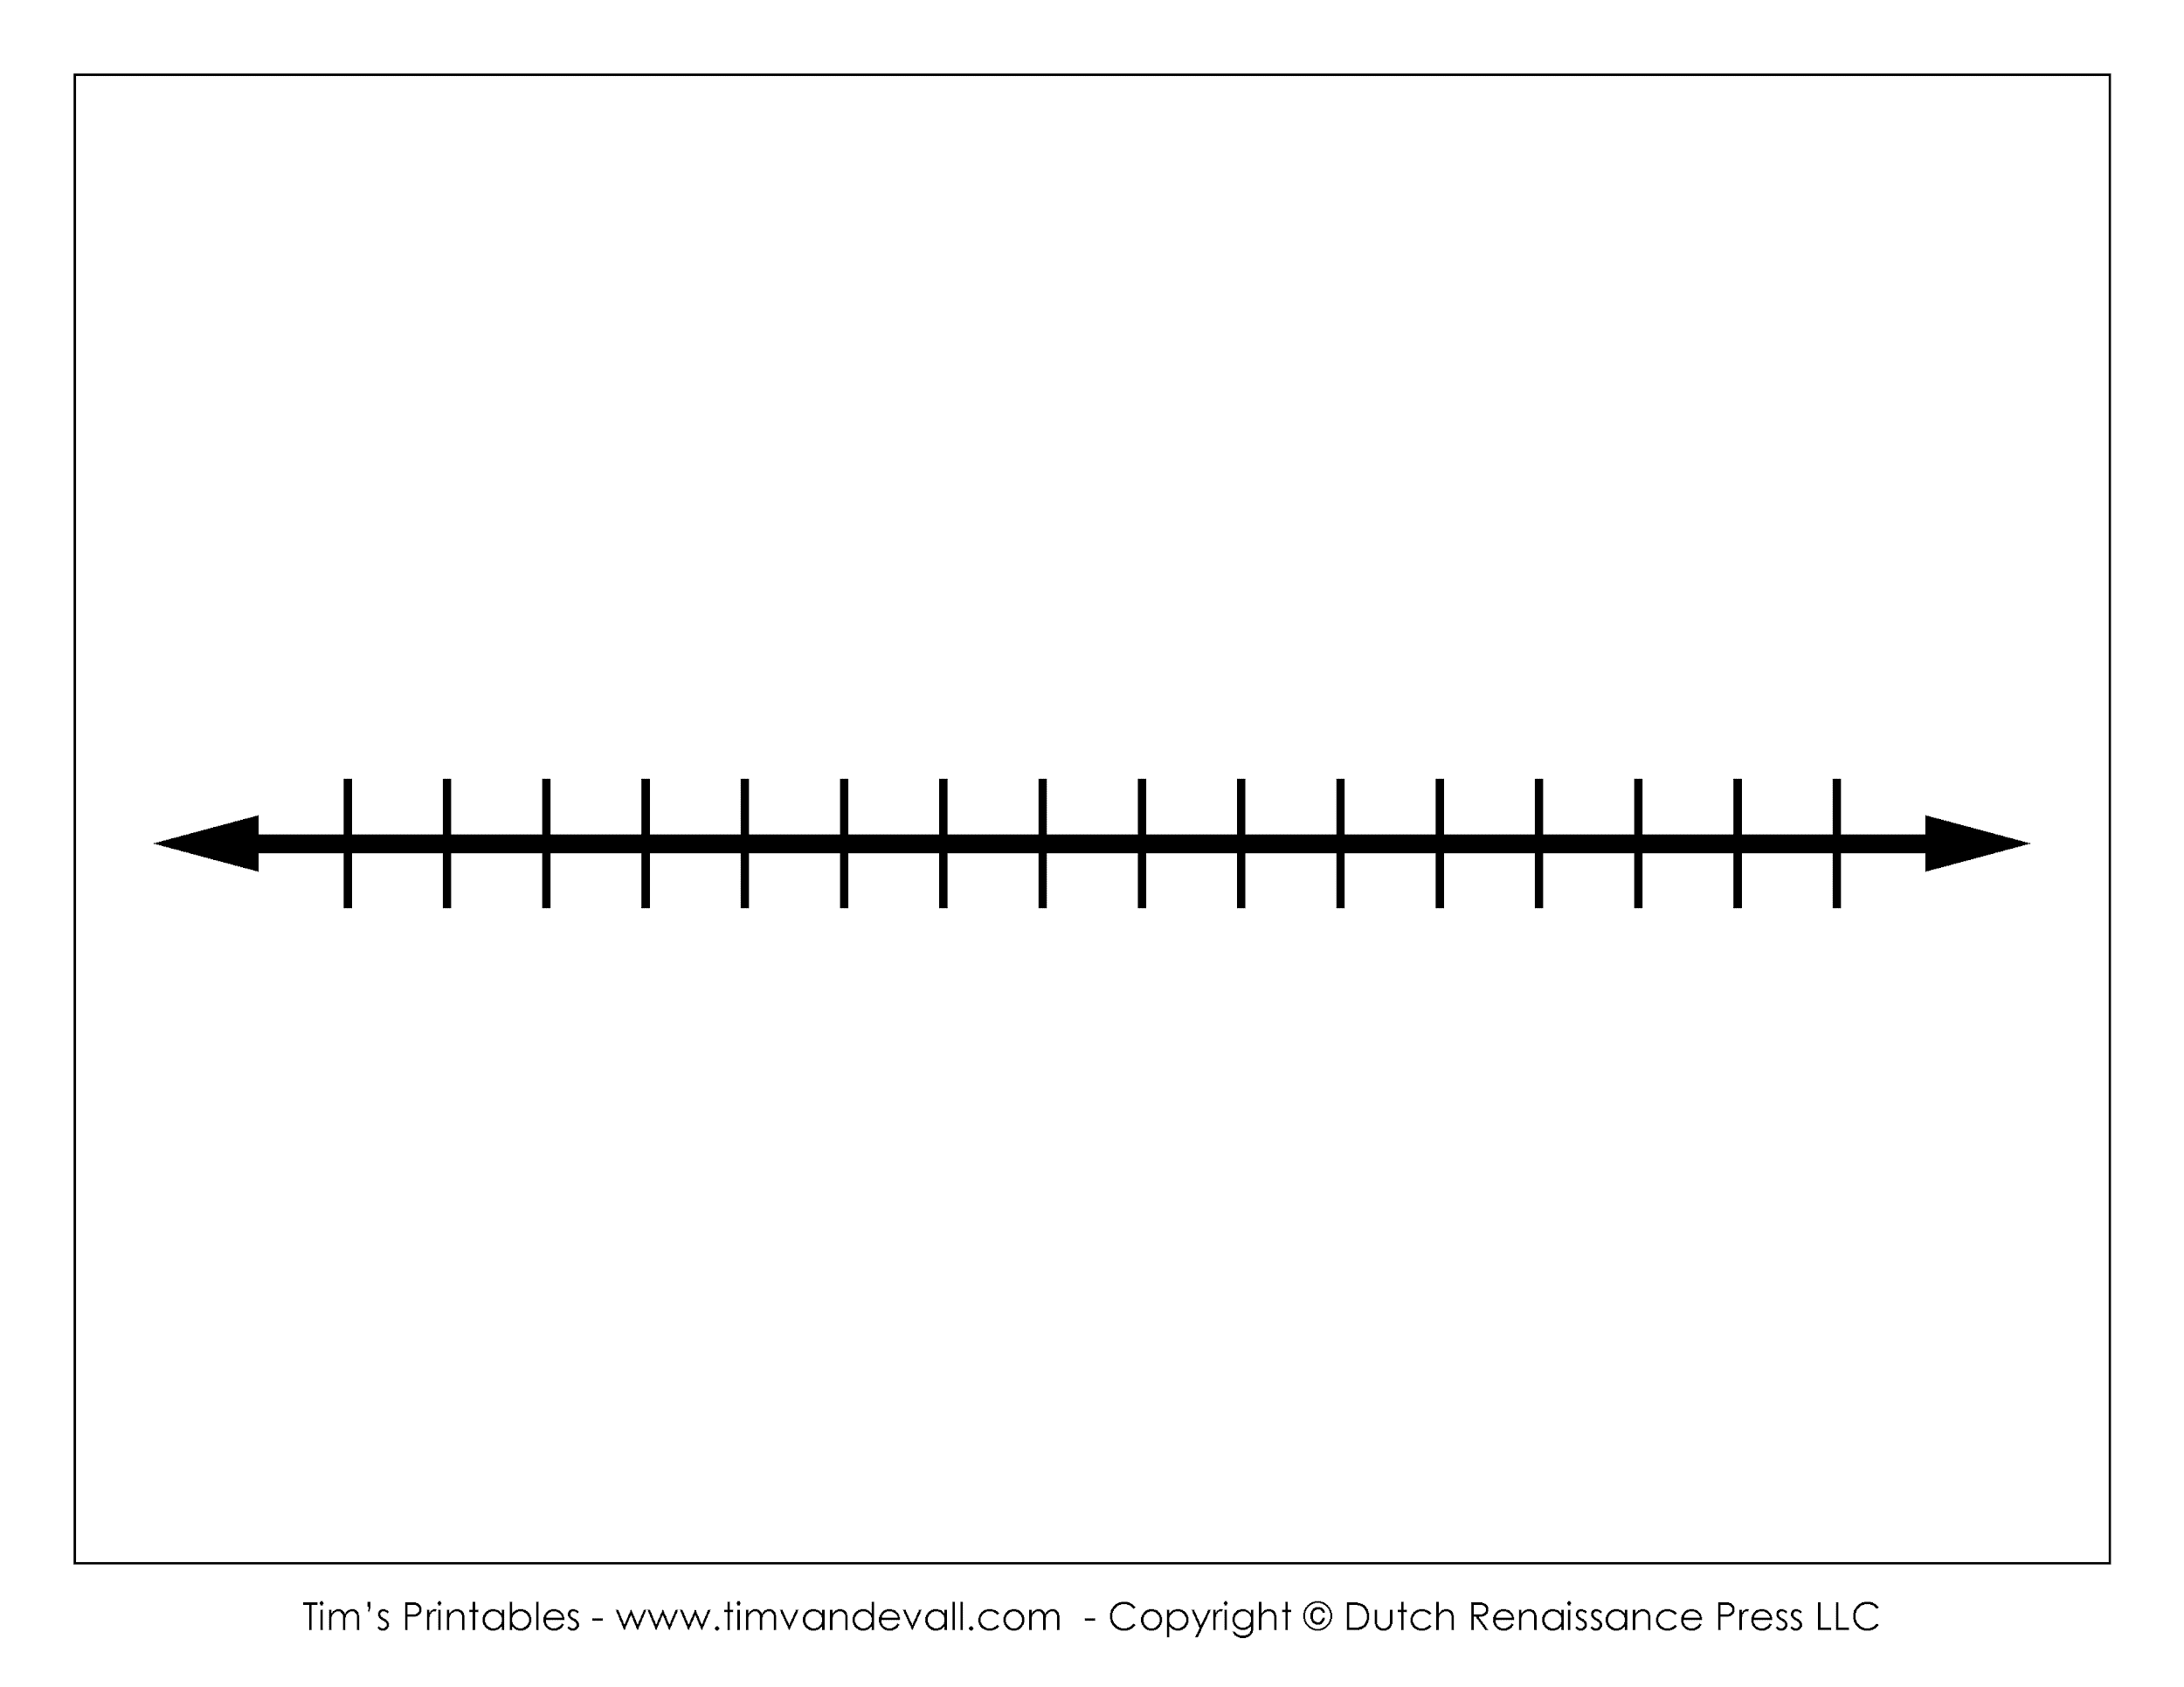
Related Works Timeline
2019 IEEE
Feng et. al
Dynamic model based on ensemble
Learning
longer computational timings
and did not solve class imbalance problem.
Dataset: Bank Direct Telemarketing Campaign
2018 IEEE
Muneeb Asif
Params:
LR,LASSO,RF,ANN
Imbalance not Addressed
Dataset: Bank Direct Telemarketing Campaign
2019 IEEE
Farooqi et. al
Params:
DT, NB, KNN and ANN
(No Train test split)
Dataset: Bank Direct Telemarketing Campaign
2019 IEEE
Selma et. al
Params:
MLP
Not identified the problem of class imbalance in the dataset
Dataset: Bank Direct Telemarketing Campaign
2017 IEEE
Params:
(MLPNN), DT, LR
RF
classical machine learning models
Dataset: Bank Direct Telemarketing Campaign
2019 IEEE
Tekouabou et. al
Params:
NB, LR, DT,
ANN and (SVM)
No Confusion Matrix, 100% accuracy(Overfit)
Dataset:Bank Direct Telemarketing Campaign
2019 IEEE
Moro et. al
Feature Selection Focus
Reduced features from 150 to 22
Dataset: Bank Direct Telemarketing Campaign
2019 IEEE
Lahmiri et. al
Params:
deep learning framework
was created using several ANNs
required processing many NN simultaneously increasing the computational complexity of the system
Dataset: Bank Direct Telemarketing Campaign
2022 IEEE
Saaed et. al
Balanced data with classical undersampling and oversampling
(spread-subsample)
Dataset: Bank Direct Telemarketing Campaign
Notes:
Link: https://colab.research.google.com/drive/1WLOExhJ2LJUD-YrdxNo5eekuh5trBGqG#scrollTo=cSxOrCt9-VWE

Slide 8
Project Objectives
1. Understanding Business Objective 2. Data set details 3. Exploratory Data Analysis
4. Feature Engineering 5. Model Building 6. Evaluate the model 7. Conclusion
Notes:
Link: https://colab.research.google.com/drive/1WLOExhJ2LJUD-YrdxNo5eekuh5trBGqG#scrollTo=cSxOrCt9-VWE

Slide 9
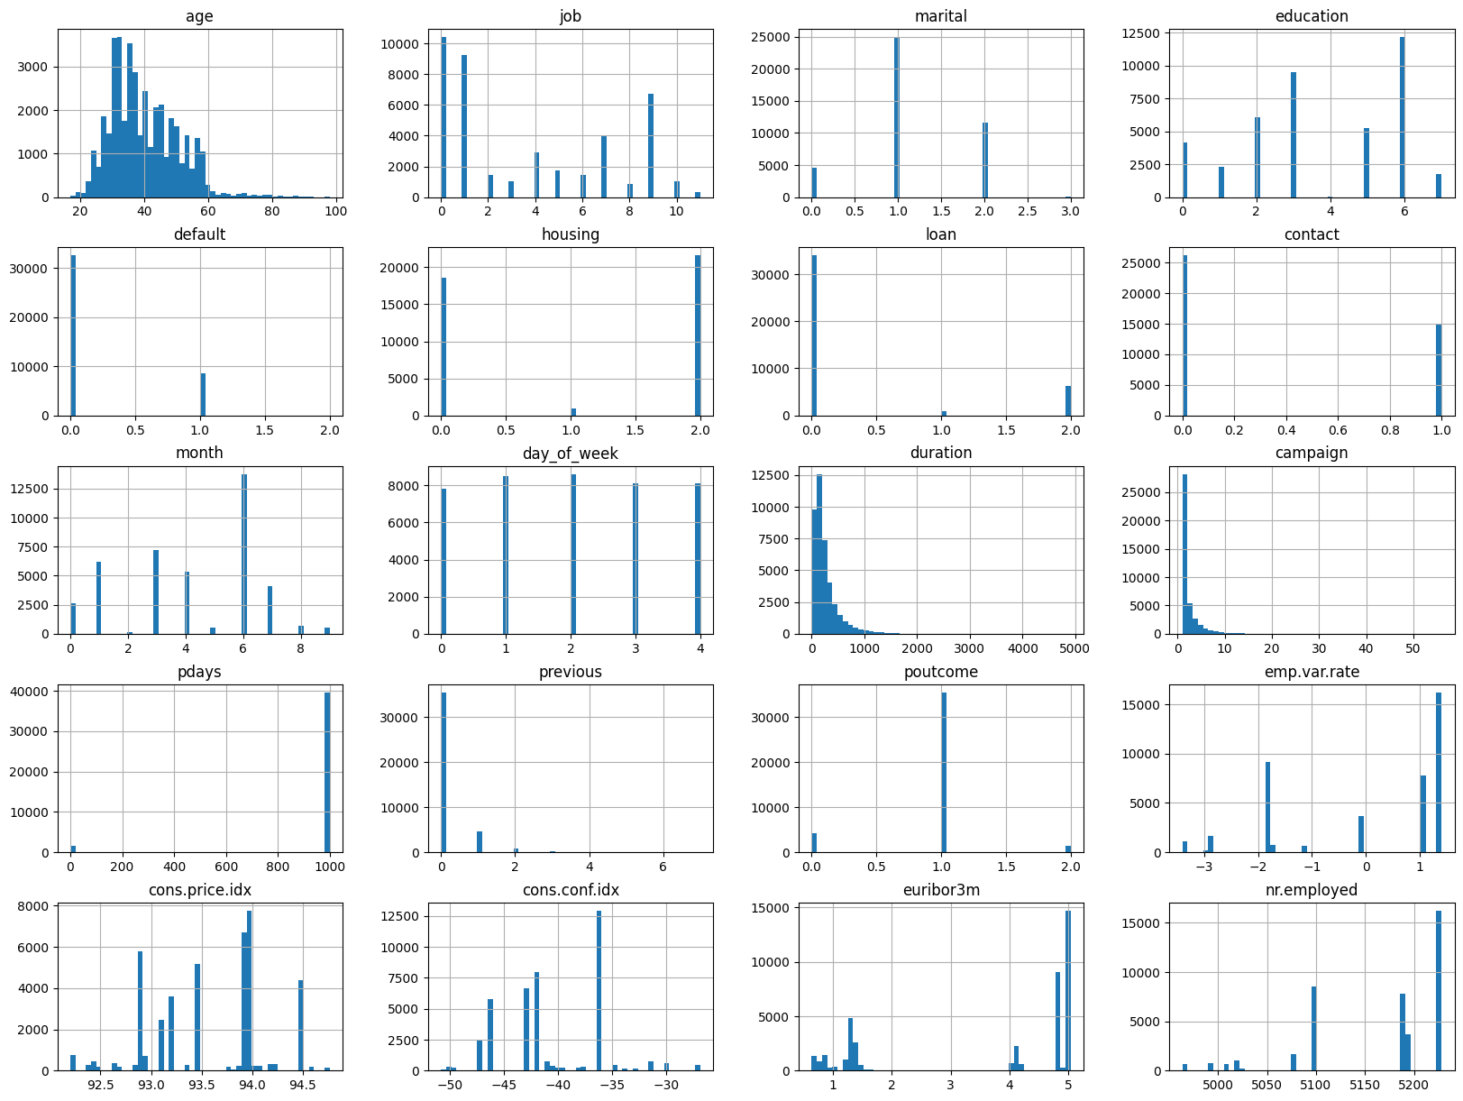
Analyzing dataset
Points inferred from the histograms
Attributes are not standard scaled.
‘pdays’ and ‘previous’ doesn’t contribute much to the final outcome.
Notes:
Link: https://colab.research.google.com/drive/1WLOExhJ2LJUD-YrdxNo5eekuh5trBGqG#scrollTo=cSxOrCt9-VWE

Slide 10
Project Objectives
1. Understanding Business Objective 2. Data set details 3. Exploratory Data Analysis
4. Feature Engineering 5. Model Building 6. Evaluate the model 7. Conclusion
Notes:
Link: https://colab.research.google.com/drive/1WLOExhJ2LJUD-YrdxNo5eekuh5trBGqG#scrollTo=cSxOrCt9-VWE

Slide 11
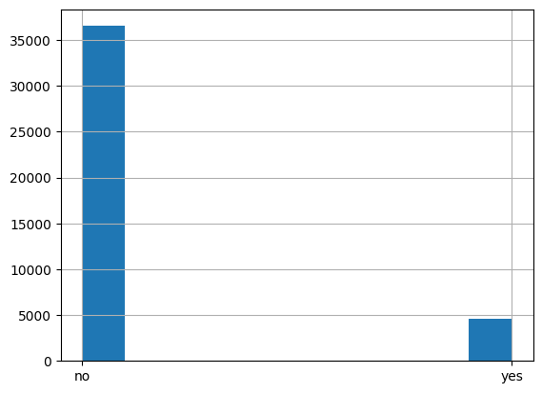
Handling Class Imbalance
Label distribution shows large class imbalance.
Technique used to solve this is SMOTEENN.
SMOTEENN functions:
It combines downsampling and upsampling of class.
It combines 2 techniques SMOTE for upsampling of minority class and ENN for downsampling
It preserves the variance of the dataset.
Before SMOTEENN
Notes:
More info can be found here - https://towardsdatascience.com/imbalanced-classification-in-python-smote-enn-method-db5db06b8d50

Slide 12
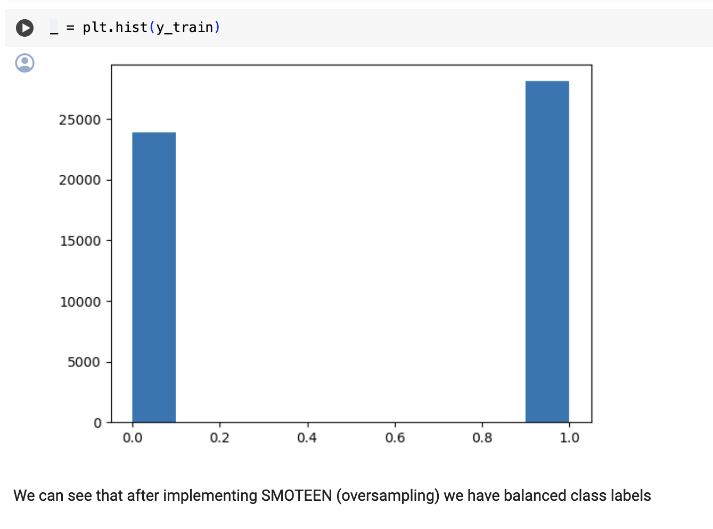
Handling Class Imbalance
Label distribution shows large class imbalance.
Technique used to solve this is SMOTEENN.
SMOTEENN functions:
It combines downsampling and upsampling of class.
It combines 2 techniques SMOTE for upsampling of minority class and ENN for downsampling
It preserves the variance of the dataset.
After SMOTEENN
Notes:
More info can be found here - https://towardsdatascience.com/imbalanced-classification-in-python-smote-enn-method-db5db06b8d50

Slide 13
Data Pre-processing
Converted following categorical variables to numerical:
Job
Marital
Education
Default
Housing
Loan
Contact
Month
Poutcome
Standard Scaling dataset to have mean of 0 and standard deviation of 1
Notes:
Link: https://colab.research.google.com/drive/1WLOExhJ2LJUD-YrdxNo5eekuh5trBGqG#scrollTo=cSxOrCt9-VWE

Slide 14
Project Objectives
1. Understanding Business Objective 2. Data set details 3. Exploratory Data Analysis
4. Feature Engineering 5. Model Building 6. Evaluate the model 7. Conclusion
Notes:
Link: https://colab.research.google.com/drive/1WLOExhJ2LJUD-YrdxNo5eekuh5trBGqG#scrollTo=cSxOrCt9-VWE

Slide 15
Model Training
Models trained are:
Convolution 1D Neural Network
Random Forest Classifier
Decision Tree Classifier
XGBoost Classifier
KNN Classifier
Notes:
Link: https://colab.research.google.com/drive/1WLOExhJ2LJUD-YrdxNo5eekuh5trBGqG#scrollTo=cSxOrCt9-VWE

Slide 16
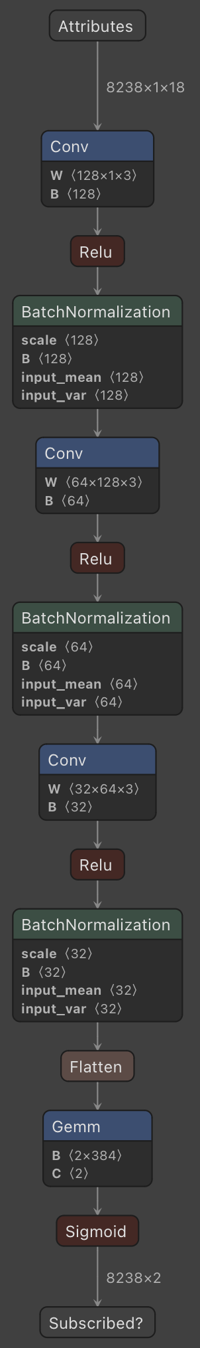
Convolution 1D Neural Network
Used Convolution 1D layer followed by ReLU activation, Batch Normalization and Dropout layers.
One hot encoded the label.
Saving model at each iteration, if the validation loss improves.
Used SGD optimizer and Cross entropy loss.
Implemented learning rate annealing by setting high learning rate for initial epochs and reducing it using step learning rate scheduler.
Notes:
Link: https://colab.research.google.com/drive/1WLOExhJ2LJUD-YrdxNo5eekuh5trBGqG#scrollTo=cSxOrCt9-VWE

Slide 17
Random Forest Classifier
Random Forest is ensemble model combining decisions of multiple trees
Utilized grid search with 10 fold cross validation for hyper-parameter tuning using scikit-learn package
Best parameters found were
ccp_alpha - 0.0005
max_depth - 12
n_estimators - 200
Notes:
Link: https://colab.research.google.com/drive/1WLOExhJ2LJUD-YrdxNo5eekuh5trBGqG#scrollTo=cSxOrCt9-VWE

Slide 18
Decision Tree Classifier
Decision Tree is a tree based model making predictions from different conditional questions.
Utilized grid search with 10 fold cross validation for hyper-parameter tuning using scikit-learn package
Best parameters found were
criterion - gini
max_depth - 40
splitter - best
Notes:
Link: https://colab.research.google.com/drive/1WLOExhJ2LJUD-YrdxNo5eekuh5trBGqG#scrollTo=cSxOrCt9-VWE

Slide 19
XGBoost Classifier
XGBoost is ensemble model employing gradient boosting with multiple trees.
Utilized grid search with 10 fold cross validation for hyper-parameter tuning using xgboost package.
Best parameters found were
eta - 0.3
max_depth - 12
sampling_method - uniform
grow_policy - depthwise
Notes:
Link: https://colab.research.google.com/drive/1WLOExhJ2LJUD-YrdxNo5eekuh5trBGqG#scrollTo=cSxOrCt9-VWE

Slide 20
KNN Classifier
KNN is nearest neighbors classifier making decision based on closest neighbors.
Utilized grid search with 2 fold cross validation for hyper-parameter tuning using xgboost package.
Best parameters found were
n_neighbors - 3
weights - distance
p - 1
Notes:
Link: https://colab.research.google.com/drive/1WLOExhJ2LJUD-YrdxNo5eekuh5trBGqG#scrollTo=cSxOrCt9-VWE

Slide 21
Model Hyperparameter Tuning
Aggregated best hyper-parameters for different models
Model | Hyperparameter 1 | Hyperparameter 2 | Hyperparameter 3 | Hyperparameter 4
XGBoost Classifier | eta = 0.3 | max_depth = 12 | sampling_method = uniform | grow_policy = depthwise
Decision Tree Classifier | criterion = gini | max_depth = 40 | splitter = best
KNN Classifier | n_neighbors = 3 | weights = distance | p = 1
Random Forest Classifier | ccp_alpha = 0.0005 | max_depth = 12 | n_estimators = 200
Notes:
Link: https://colab.research.google.com/drive/1WLOExhJ2LJUD-YrdxNo5eekuh5trBGqG#scrollTo=cSxOrCt9-VWE

Slide 22
Project Objectives
1. Understanding Business Objective 2. Data set details 3. Exploratory Data Analysis
4. Feature Engineering 5. Model Building 6. Evaluate the model 7. Conclusion
Notes:
Link: https://colab.research.google.com/drive/1WLOExhJ2LJUD-YrdxNo5eekuh5trBGqG#scrollTo=cSxOrCt9-VWE

Slide 23
Model Evaluation
Models were evaluated on different metrics like Accuracy, Precision, Recall, F1-Score, AUC
Evaluation of models are:
Model | Accuracy | Precision | Recall | F1 Score | AUC
Convolution 1D NN | 0.82 | 0.37 | 0.91 | 0.53 | 0.86
XGBoost Classifier | 0.89 | 0.50 | 0.88 | 0.63 | 0.88
Decision Tree Classifier | 0.88 | 0.47 | 0.85 | 0.61 | 0.86
KNN Classifier | 0.88 | 0.47 | 0.70 | 0.56 | 0.80
Random Forest Classifier | 0.90 | 0.42 | 0.95 | 0.58 | 0.89
Notes:
Link: https://colab.research.google.com/drive/1WLOExhJ2LJUD-YrdxNo5eekuh5trBGqG#scrollTo=cSxOrCt9-VWE

Slide 24
Project Objectives
1. Understanding Business Objective 2. Data set details 3. Exploratory Data Analysis
4. Feature Engineering 5. Model Building 6. Evaluate the model 7. Conclusion
Notes:
Link: https://colab.research.google.com/drive/1WLOExhJ2LJUD-YrdxNo5eekuh5trBGqG#scrollTo=cSxOrCt9-VWE

Slide 25
Conclusion
Final rundown based on different metrics
Random forest model successfully predicted around 90% accuracy for the clients’ subscription of banking campaign
Despite challenges like varying execution times, particularly with Random Forest, our optimizations ensured project efficiency.
In terms of Recall(0.95) and AUC(0.89), RF is the best model
Notes:
Link: https://colab.research.google.com/drive/1WLOExhJ2LJUD-YrdxNo5eekuh5trBGqG#scrollTo=cSxOrCt9-VWE

Slide 26
Thank You
Any Questions?
Notes:
Link: https://colab.research.google.com/drive/1WLOExhJ2LJUD-YrdxNo5eekuh5trBGqG#scrollTo=cSxOrCt9-VWE

