Slide 1
StreamEase
Media & Entertainment Subscriber Self-Service Platform
Project Review 2
Technology
Frontend prototype with subscriber login, browsing, recommendations, watchlist, history and subscription management.
HTML • CSS • JavaScript
Responsive single-page interface
1

Slide 2
2. Problem Statement
• Subscribers need one place to discover Telugu entertainment and manage their viewing experience.
• Common tasks such as browsing, searching, saving titles and checking viewing history can be scattered across services.
• Subscription and profile actions should be easy to access without depending on customer support.
• StreamEase addresses this with a self-service entertainment dashboard.
2

Slide 3
3. Objectives
Discover
Personalize
Self-Service
Browse Telugu movies, web series, TV shows and music.
Use genre, mood, ratings and viewing history for recommendations.
Manage profile, preferences, watchlist, history and subscription.
Search
Responsive UI
Demonstrate
Search by title, genre or content category.
Support desktop, tablet and mobile layouts.
Show actual frontend interactions suitable for Review 2.
3

Slide 4
4. Proposed System
• StreamEase is a browser-based self-service platform for entertainment subscribers.
• Users can register or log in and reach a centralized dashboard.
• Core flow: Login → Home Dashboard → Discover/Search → Watchlist/History → Recommendations → Subscription/Profile.
• Frontend interactions are implemented in JavaScript; the current prototype uses in-memory demo state and sample records.
• External OTT links are provided for Netflix, Prime Video, aha and JioHotstar.
4

Slide 5
5. System Architecture
Frontend prototype architecture shown at a level suitable for Review 2
User / Browser
Login • Register • Dashboard • Forms • Navigation
Presentation Layer
HTML pages/sections • CSS responsive UI • Cards • Tables • Modals
Application Logic
JavaScript functions • Search • Filters • Recommendations • Watchlist • History
Data Layer (Prototype)
JavaScript arrays/state • movies[] • user state • notifications • transactions
5

Slide 6
6. Modules / Functionalities
Authentication
Home
Login, registration, forgot-password demo
Dashboard, watch time, completed titles, recommendations
Browse & Search
Watchlist & History
Category/genre filters, sorting, keyword search
Save titles, continue watching, remove/clear history
Recommendations
Subscription
Preference-, mood-, rating- and history-based ranking
Plans, active plan, renewal/cancel demo, transaction history
Profile & Preferences
Notifications
Edit profile, password demo, genres, language, notifications
Alerts, mark read, mark all read, clear notifications
6

Slide 7
7. Frontend Design
Home Page
Login / Registration
Forms
Dashboard
Welcome dashboard
Quick stats
Continue Watching
Recommended for You
Time-based content finder
Email + password login
Username/email/mobile registration
Forgot-password confirmation
Search input
Time input
Profile edit
Preferences
Subscription actions
Sidebar navigation
Top search
Alerts
Profile access
Responsive mobile navigation
• Dark, professional visual theme with consistent cards and buttons.
• Responsive CSS changes navigation and layouts for smaller screens.
7

Slide 8
8. Frontend Implementation – Screenshots
• Insert your actual screenshots from the running DBSE2.html prototype on this slide.
• Recommended evidence: Login screen, Home dashboard, Browse/Search, Subscription, Watchlist/History, Profile/Preferences.
• Also capture one interaction: filtering, adding to watchlist, editing profile, or marking a notification as read.
• Do not use placeholder images in the final review PPT.
SCREENSHOT 1
Login / Registration
SCREENSHOT 2
Home Dashboard
SCREENSHOT 3
Browse / Search
8

Slide 9
9. Database Design
Current uploaded implementation uses JavaScript demo state rather than a persistent database.
• Prototype data is stored in JavaScript arrays/objects inside the frontend.
• movies[] stores content metadata such as title, genre, category, rating, year, runtime and description.
• state stores watchlist IDs, viewing history, selected mood, preferences and notifications.
• Subscription plans and transaction records are generated by frontend functions.
• For Review 2, present this as the current prototype data design—not as a completed backend database.
9

Slide 10
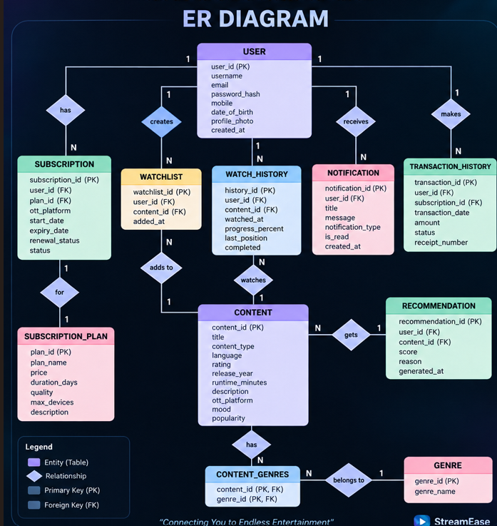
10. ER Diagram
Conceptual ER model for the planned persistent database
USER
CONTENT
SUBSCRIPTION
PLAN
user_id (PK)
name, email, mobile
content_id (PK)
title, genre, rating
subscription_id (PK)
plan, start, expiry
plan_id (PK)
name, price, features
WATCHLIST
WATCH_HISTORY
PREFERENCE
watchlist_id (PK)
user_id, content_id
history_id (PK)
user_id, content_id, progress
preference_id (PK)
user_id, genre, language
10

Slide 11
11. Database Tables / Schema
Conceptual schema for future persistent implementation
TABLE
KEY FIELDS
USER
CONTENT
user_id PK, name, email, mobile, password
SUBSCRIPTION
content_id PK, title, genre, category, rating, year, runtime
PLAN
subscription_id PK, user_id FK, plan_id FK, start_date, expiry_date, status
WATCHLIST
plan_id PK, plan_name, price, device_limit, quality
WATCH_HISTORY
watchlist_id PK, user_id FK, content_id FK
PREFERENCE
history_id PK, user_id FK, content_id FK, progress, watched_date
NOTIFICATION
preference_id PK, user_id FK, genre, content_type, language
TRANSACTION
notification_id PK, user_id FK, type, message, read_status
transaction_id PK, user_id FK, plan_id FK, date, amount, status
11

Slide 12
12. Sample Database Records
Use these as sample records when a real database is connected
Table
ID
User/Content ID
Key value
Status / Detail
USER
1
User
user@streamease.com
+91 90000 00000
CONTENT
1
RRR
Action, Drama
4.8
CONTENT
8
Sita Ramam
Romance, Drama
4.7
SUBSCRIPTION
1
1
Premium
Active
WATCHLIST
1
1
8
Saved
HISTORY
1
1
9
72%
PREFERENCE
1
1
Action, Thriller, Romance
Telugu
NOTIFICATION
1
1
Recommendation
Unread
12

Slide 13
13. Current Progress
Authentication UI
Implemented
Responsive frontend & navigation
Implemented
Browse, search, filters & sorting
Implemented
Watchlist & viewing history
Implemented
Recommendations & time-based finder
Implemented
Subscription/profile/preferences UI
Implemented
Persistent backend database
Not shown in current prototype
Real payment gateway / real streaming
Not implemented; demo interactions only
13

Slide 14
14. Challenges / Issues Faced
• Keeping navigation and multiple dashboard modules consistent inside a single-page frontend.
• Managing shared frontend state for watchlist, history, preferences and notifications.
• Designing recommendation ranking from multiple signals such as rating, genre, mood and viewing history.
• Making the interface responsive for desktop, tablet and mobile screen sizes.
• Current limitation: data and account actions are demo/frontend state; persistence and secure authentication require backend integration.
14

Slide 15
15. Future Work & Conclusion
Future Work
Conclusion
• Connect a persistent SQL/NoSQL database
• Implement secure backend authentication
• Store users, preferences, watchlist and history persistently
• Add real subscription/payment integration
• Integrate real content/catalog APIs
• Improve recommendation model with usage data
• StreamEase provides a centralized self-service entertainment experience.
• The current prototype demonstrates major frontend flows and interactions.
• The design is modular and responsive.
• The next step is connecting the prototype to a secure backend and persistent database.
• Review 2 focus: demonstrate the working UI, interactions, ER model and current implementation evidence.
15

