Slide 1


Apollo SDK Driver Develop SOP
  2011/09/05
  Happa Lin

Slide 2
Outline
Apollo Code Arch
ASIC driver coding utility
Coding Example
How to make your Driver code
RTK API Code code-gen tool

Slide 3
Source Code Path
Source code path
http://cadinfo.realtek.com.tw/svn/CN/Switch/trunk/dumb/apollo

Slide 4
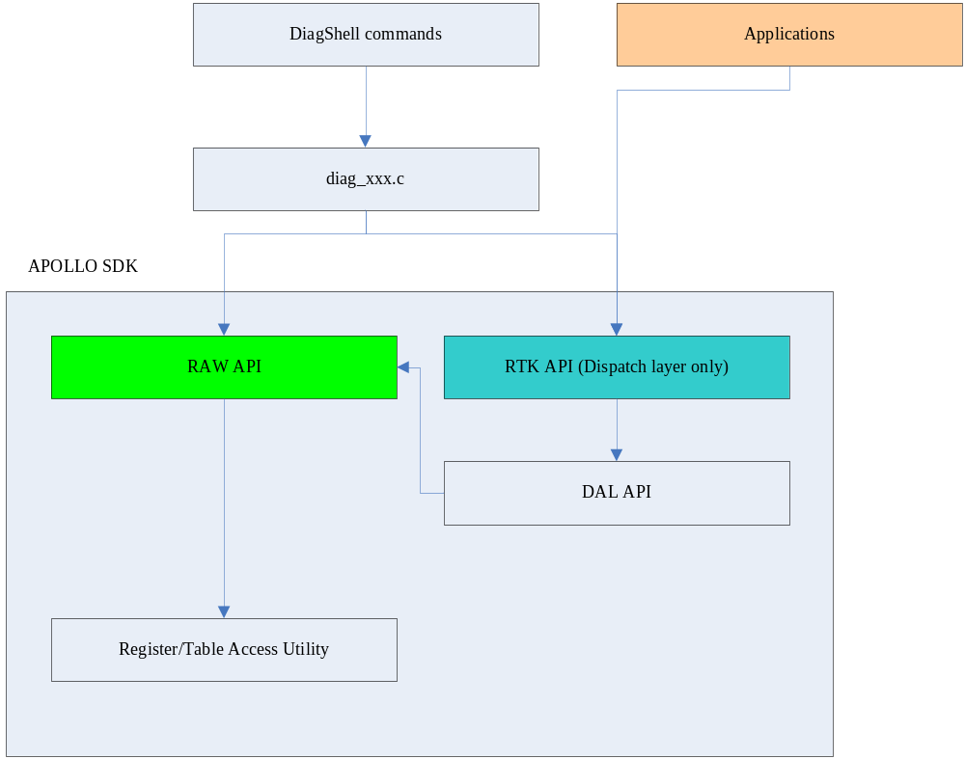
Apollo SDK Basic Concept

Slide 5
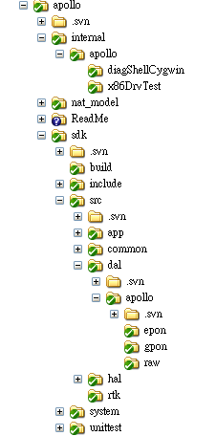
SDK 檔案架構
Diagshell
RAW DRIVER

Slide 6
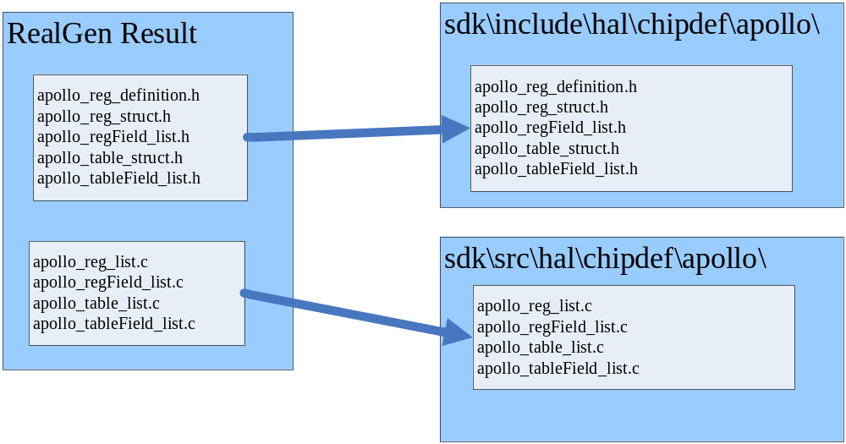
ASIC driver coding utility
Register Access Utility
Table Access Utility
Utility is base on RealGen output

Slide 7
Register Access Utility
Direct ASIC Access
int32 reg_field_read(uint32 reg,uint32 field,uint32 *pValue)
int32 reg_field_write(uint32 reg,uint32 field,uint32 *pValue)
int32 reg_read(uint32 reg, uint32 *pValue)
int32 reg_write(uint32 reg, uint32 *pValue)
RAM Buffer Access
int32 reg_field_get(uint32 reg, uint32 field, uint32 *pValue, uint32 *pData)
int32 reg_field_set(uint32 reg,uint32 field,uint32 *pValue, uint32 *pData)
Register and field define in “apollo_reg_struct.h”
or using PDF file
apollo\sdk\include\hal\chipdef\apollo\APOLLO_RegisterFile.pdf
API 的填法
reg → REGISTER_NAMEr
field → FILED_NAMEf

Slide 8
Register Array Access
Direct ASIC Access
int32 reg_array_read(uint32 reg, int32 index_1, int32 index_2, uint32 *pValue)
int32 reg_array_write(uint32 reg, int32 index_1, int32 index_2, uint32 *pValue)
int32 reg_array_field_read(uint32 reg,
int32 index_1,
int32 index_2,
uint32 field,
uint32 *pValue)
int32 reg_array_field_write(uint32 reg,
int32 index_1,
int32 index_2,
uint32 field,
uint32 *pValue)
若為 一維array 其中一個index 請填, REG_ARRAY_INDEX_NONE

Slide 9
Register Access notice!!
正常使方式
(a)
reg_array_read(&data)
reg_field_set(fieldX,&data,&val)
reg_field_set(fieldY,&data,&val)
reg_array_write(&data)
(b)
reg_array_read(&data)
reg_field_get(fieldX,&data,&val)
reg_field_get(fieldY,&data,&val)
因為register array 不一定是 32bit, 所以使用上 data 宣告的size 必須視register 真正大小而有不同,避免不必要的錯誤
RAW driver coding 對於register access請用
reg_array_field_read/ reg_field_read
reg_array_field_write/reg_field_write
雖然在多個field 的運用上會浪費I/O 但比較保險.
(不需要為了省I/O 次數)

Slide 10
Register Access Apollo raw driver coding 準則:
若同時對同一個register 讀多個field
請直接用 reg_array_field_read/ reg_field_read
直接對ASIC 做多次讀的動作
若同時對同一個register 讀多個field
請直接用 reg_array_field_write/ reg_field_write
直接對ASIC 做多次寫的動作
(note:有valid bit 觀念的register RAW driver 在coding 時需特別注意!!)

Slide 11
Table Access Utility
Direct ASIC Access
int32 table_read(uint32 table,uint32 addr,uint32 *pData)
int32 table_write(uint32 table,uint32 addr,uint32 *pData)
RAM Buffer Access
int32 table_field_get(uint32 table,uint32 field,uint32 *pValue,uint32 *pData)
int32 table_field_set(uint32 table,uint32 field,uint32 *pValue,uint32 *pData)
int32 table_field_byte_get(uint32 table,uint32 field,uint8 *pValue,uint32 *pData)
int32 table_field_byte_set(uint32 table,uint32 field,uint8 *pValue,uint32 *pData)
int32 table_field_mac_get(uint32 table,uint32 field,uint8 *pValue,uint32 *pData)
int32 table_field_mac_set(uint32 table,uint32 field,uint8 *pValue,uint32 *pData)
int32 table_size_get(uint32 table,uint32 *pSize)
Table and field define in “apollo_table_struct.h”
API 的填法
table → TABLE_NAMEt
field → TABLE_NAME_FILED_NAMEtf

Slide 12
Table entry size define
Add table entry define in
  apollo\sdk\include\hal\chipdef\allmem.h
Ex:
  MEM_ENTRY_DECLARE(vlan_entry_t, 2);
32bits x 2

Slide 13
Error code
Common error
  apollo\sdk\system\include\common\error.h
Module error
  apollo\sdk\include\common\rt_error.h
  Module 特有的 error code
增加error code 時也要增加error string
  apollo\sdk\src\common\rt_error.c
  rt_error_numToStr

Slide 14
Coding Guide for RAW Driver – data type
Common type → rt_type.h
  apollo\sdk\system\include\common\type.h
  apollo\sdk\include\common\rt_type.h
  apollo\sdk\include\dal\apollo\raw\apollo_raw.h
若 data structure type 與 RTK API 相同, 請define 在 RTK layer (module).h
RAW driver 與 RTK API 共用此 data type
Naming 請用 apollo_raw_XXX 開頭
若RAW driver 特有, 直接define 於 apollo_raw_(module).h
enum 內容請加 RAW_ prefix
Data structure 內的 member 請全部用 unit32, 方便coding

Slide 15
Entry index
Index 是否放在 structure 中
  RAW driver index 放在裡面
RTK API 另議

Slide 16
RAW Driver Coding Style
Please Follow SD6 coding convention
\\rtdomain\fs\CN_Switch\Project\新手懶人包\V0.0.7\02_CodingConvention.pdf
Register Access driver
  Register access
  Register array access
  Example code: apollo\ReadMe\sdk_coding\sample code\reg_access.c
Table Access driver
  Example code: apollo\ReadMe\sdk_coding\sample code\table_access.c
Do not add “printf” in your source code!!
temp debug you can use “osal_printf”

Slide 17
Special Mode
EX: HAS HSB
利用 Table Utility讀寫Register Data
利用 Register Access API 讀寫 ASIC Register 的內容
Example:
int32 apollo_raw_l34_hsaData_get(apollo_raw_l34_hsa_t *hsaData)

Slide 18
How to Make your Driver Code[Diag Shell]
Add file in apollo\sdk\src\dal\apollo\raw\apollo_raw_[your_module].c
Edit apollo\internal\apollo\diagShellCygwin\build\Makefile.rtk
Add apollo_raw_[your_module].o
  增加到相對位置
Make your code via Cygwin
  Set path to “apollo\internal\apollo\diagShellCygwin\”
  make all

Slide 19
RTK API Auto Code Generator
See
  apollo\sdk\sdk_autogen\readme.txt

