Slide 1
Estimating the causal effect
ITS & Synthetic control method

Slide 2
In this part
More sophisticated methods for causal policy evaluation
First: interrupted time series
Last: Synthetic control
Practical: synthetic control using tidysynth

Slide 3
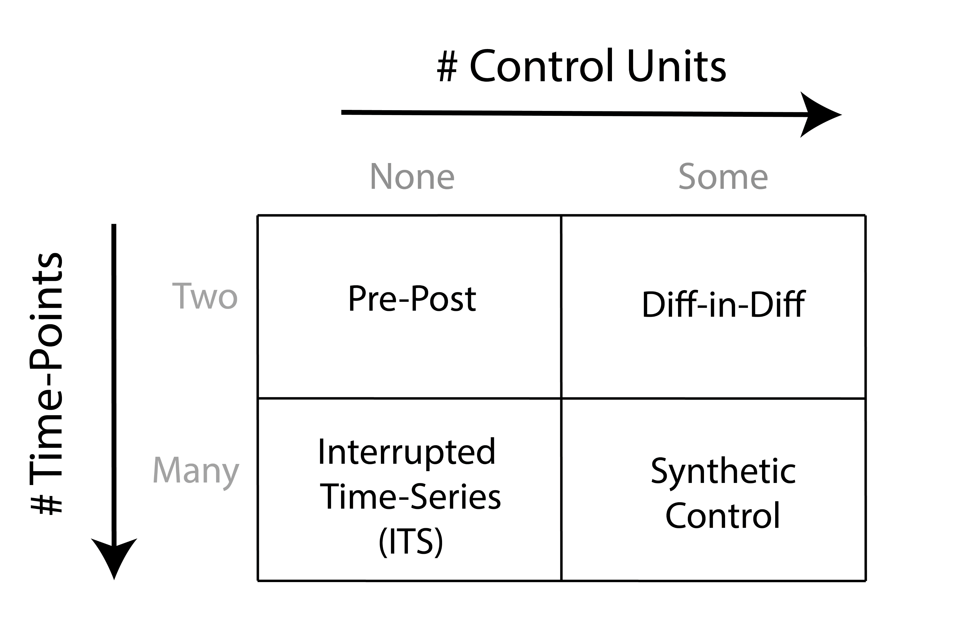

Slide 4
Interrupted Time Series (in brief)

Slide 6
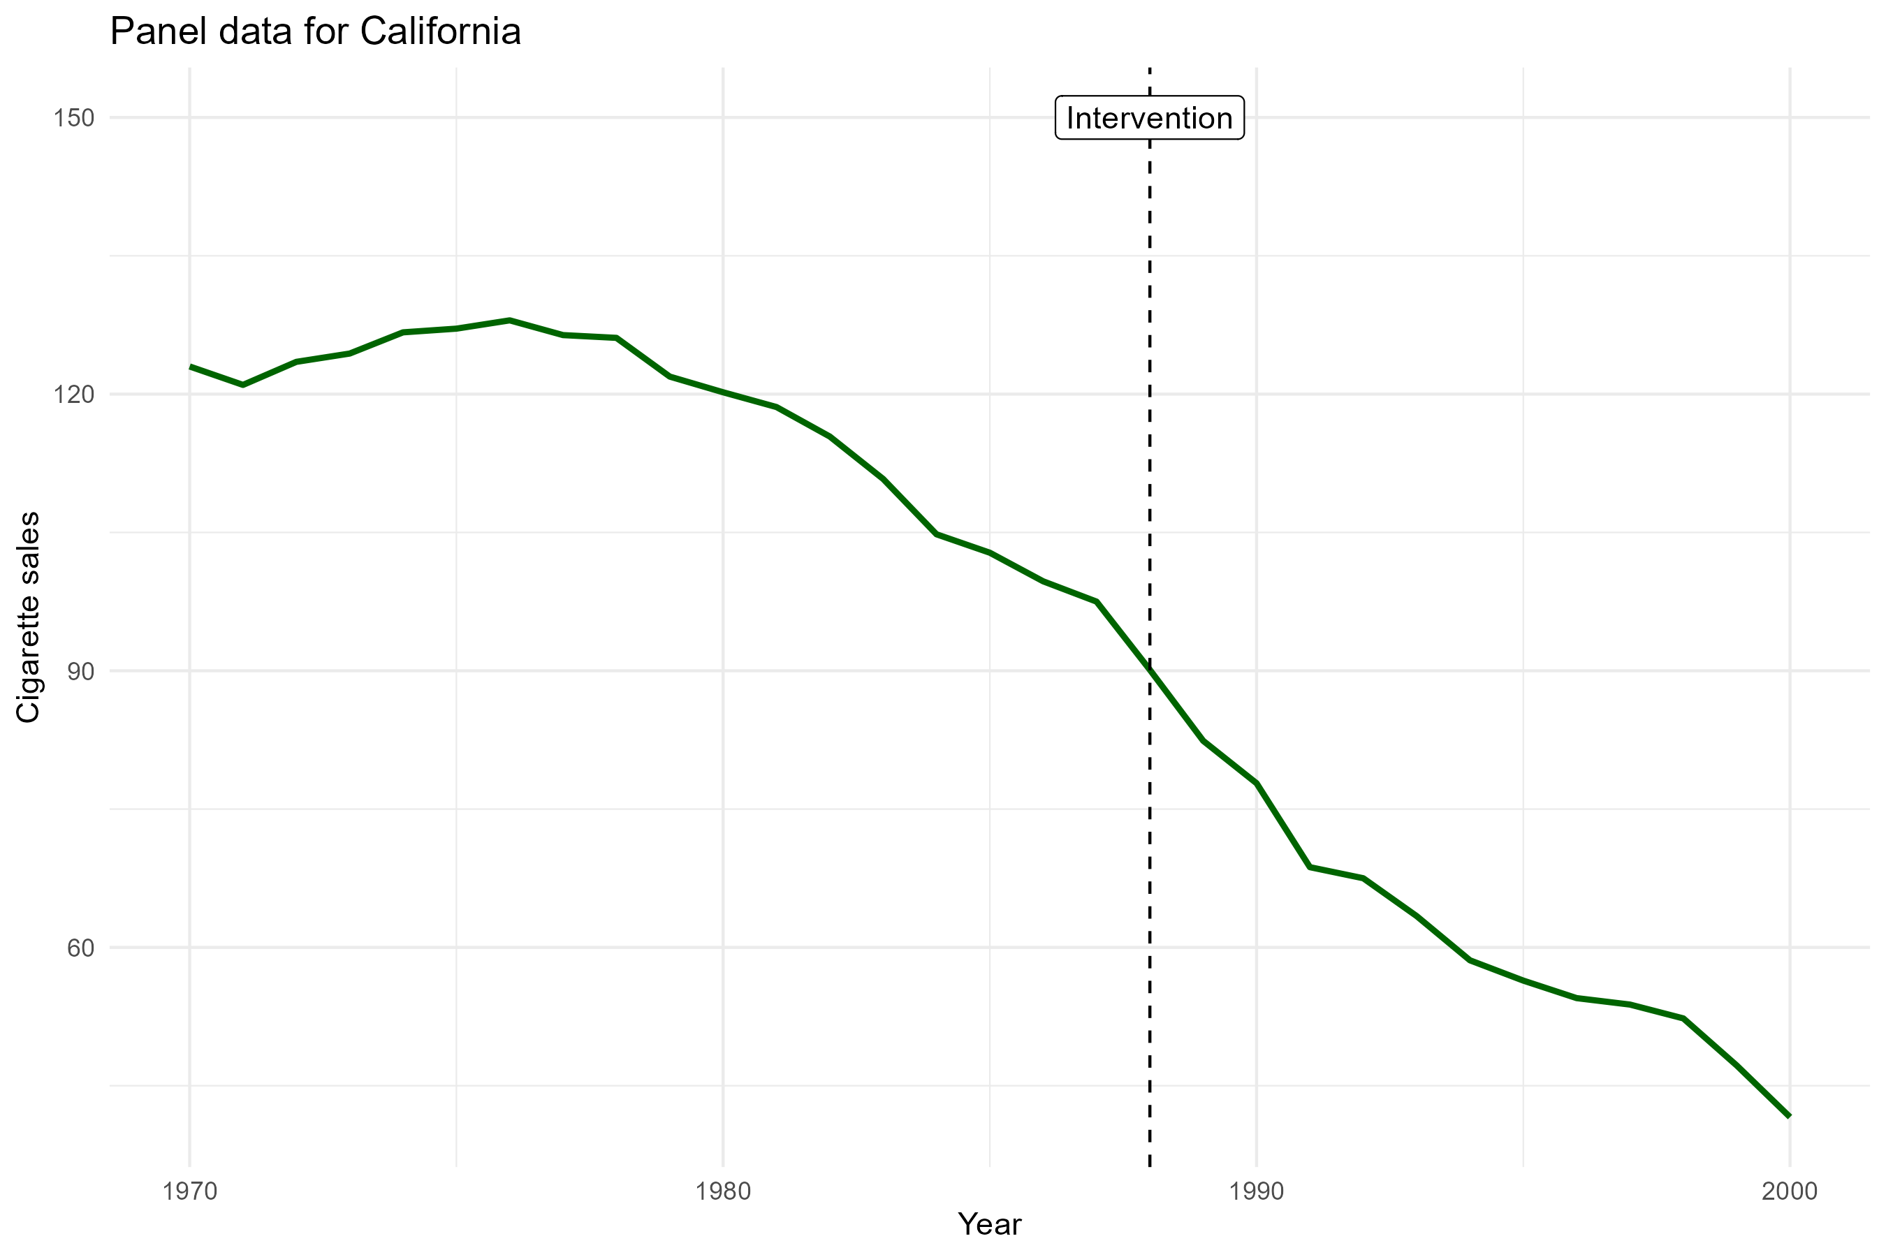

Slide 7
Interrupted Time Series
Main idea: predicting the counterfactual
Using time-forward or forecasting model
i.e., use past pre-intervention data to impute the missing counterfactual at each point in time

Slide 8

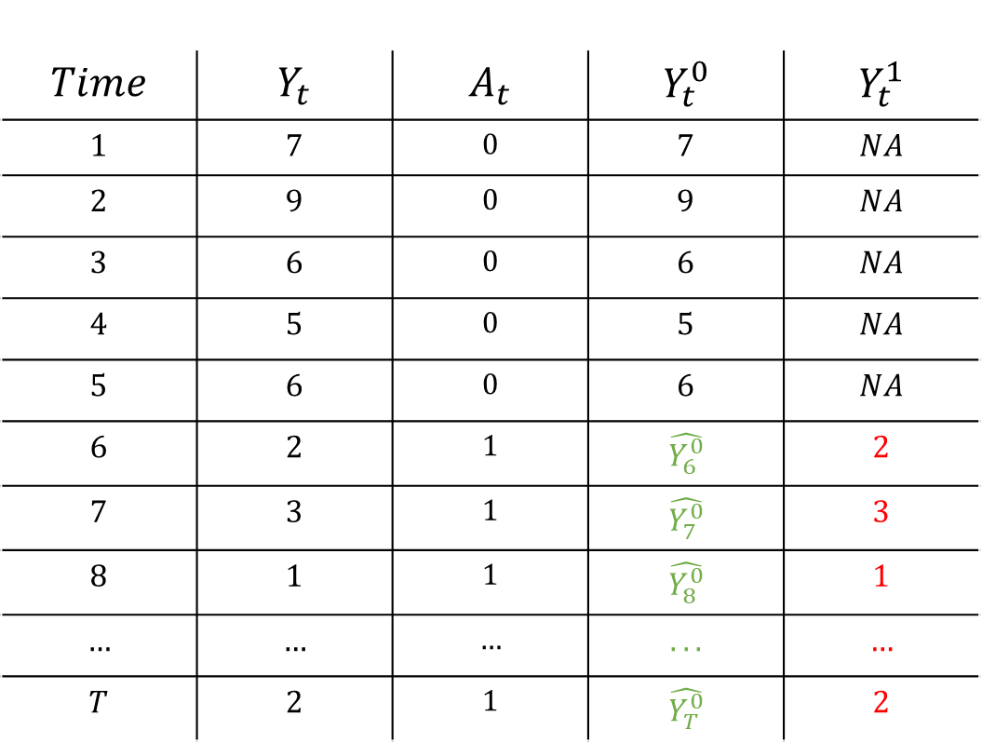

Interrupted Time Series
$$Time$$ | $$Y_{t}$$ | $$A_{t}$$ | $$Y_{t}^{0}$$ | $$Y_{t}^{1}$$
$$1$$ | $$7$$ | $$0$$ | $$7$$ | $$NA$$
$$2$$ | $$9$$ | $$0$$ | $$9$$ | $$NA$$
$$3$$ | $$6$$ | $$0$$ | $$6$$ | $$NA$$
$$4$$ | $$5$$ | $$0$$ | $$5$$ | $$NA$$
$$5$$ | $$6$$ | $$0$$ | $$6$$ | $$NA$$
$$6$$ | $$2$$ | $$1$$ | $$\hat{Y_{6}^{0}}$$ | $$2$$
$$7$$ | $$3$$ | $$1$$ | $$\hat{Y_{7}^{0}}$$ | $$3$$
$$8$$ | $$1$$ | $$1$$ | $$\hat{Y_{8}^{0}}$$ | $$1$$
$$…$$ | $$…$$ | $$…$$ | $$...$$ | $$…$$
$$T$$ | $$2$$ | $$1$$ | $$\hat{Y_{T}^{0}}$$ | $$2$$
Train a forecasting model, e.g.
$$\hat{Y_{t}}=φ_{1}Y_{t−1}+φ_{2}Y_{t−2}+…β ∗ Time$$
Make forecasts
$$\hat{CE_{t}}=Y_{t}^{1} −\hat{Y_{t}^{0}}$$

Slide 9

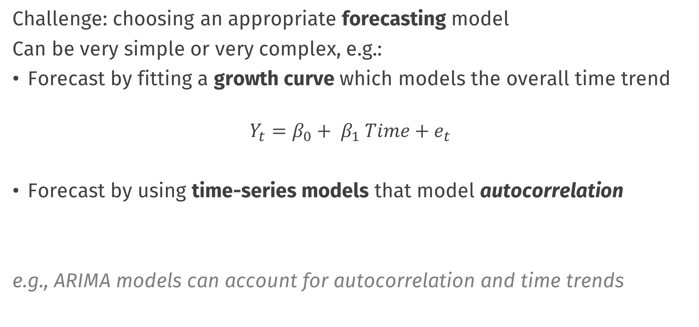


Building a forecasting model
Challenge: choosing an appropriate forecasting model
Can be very simple or very complex, e.g.:
Forecast by fitting a growth curve which models the overall time trend
$$Y_{t}=β_{0}+ β_{1} Time+e_{t}$$
Forecast by using time-series models that model autocorrelation
e.g., ARIMA models can account for autocorrelation and time trends
$$Y_{t}=φ_{1}Y_{t−1 }+e_{t}$$
$$Y_{t}=φ_{1}Y_{t−1 }+φ_{2}Y_{t−2}+e_{t}$$
$$Y_{t}−Y_{t−1}=γe_{t−1} +e_{t}$$

Slide 10
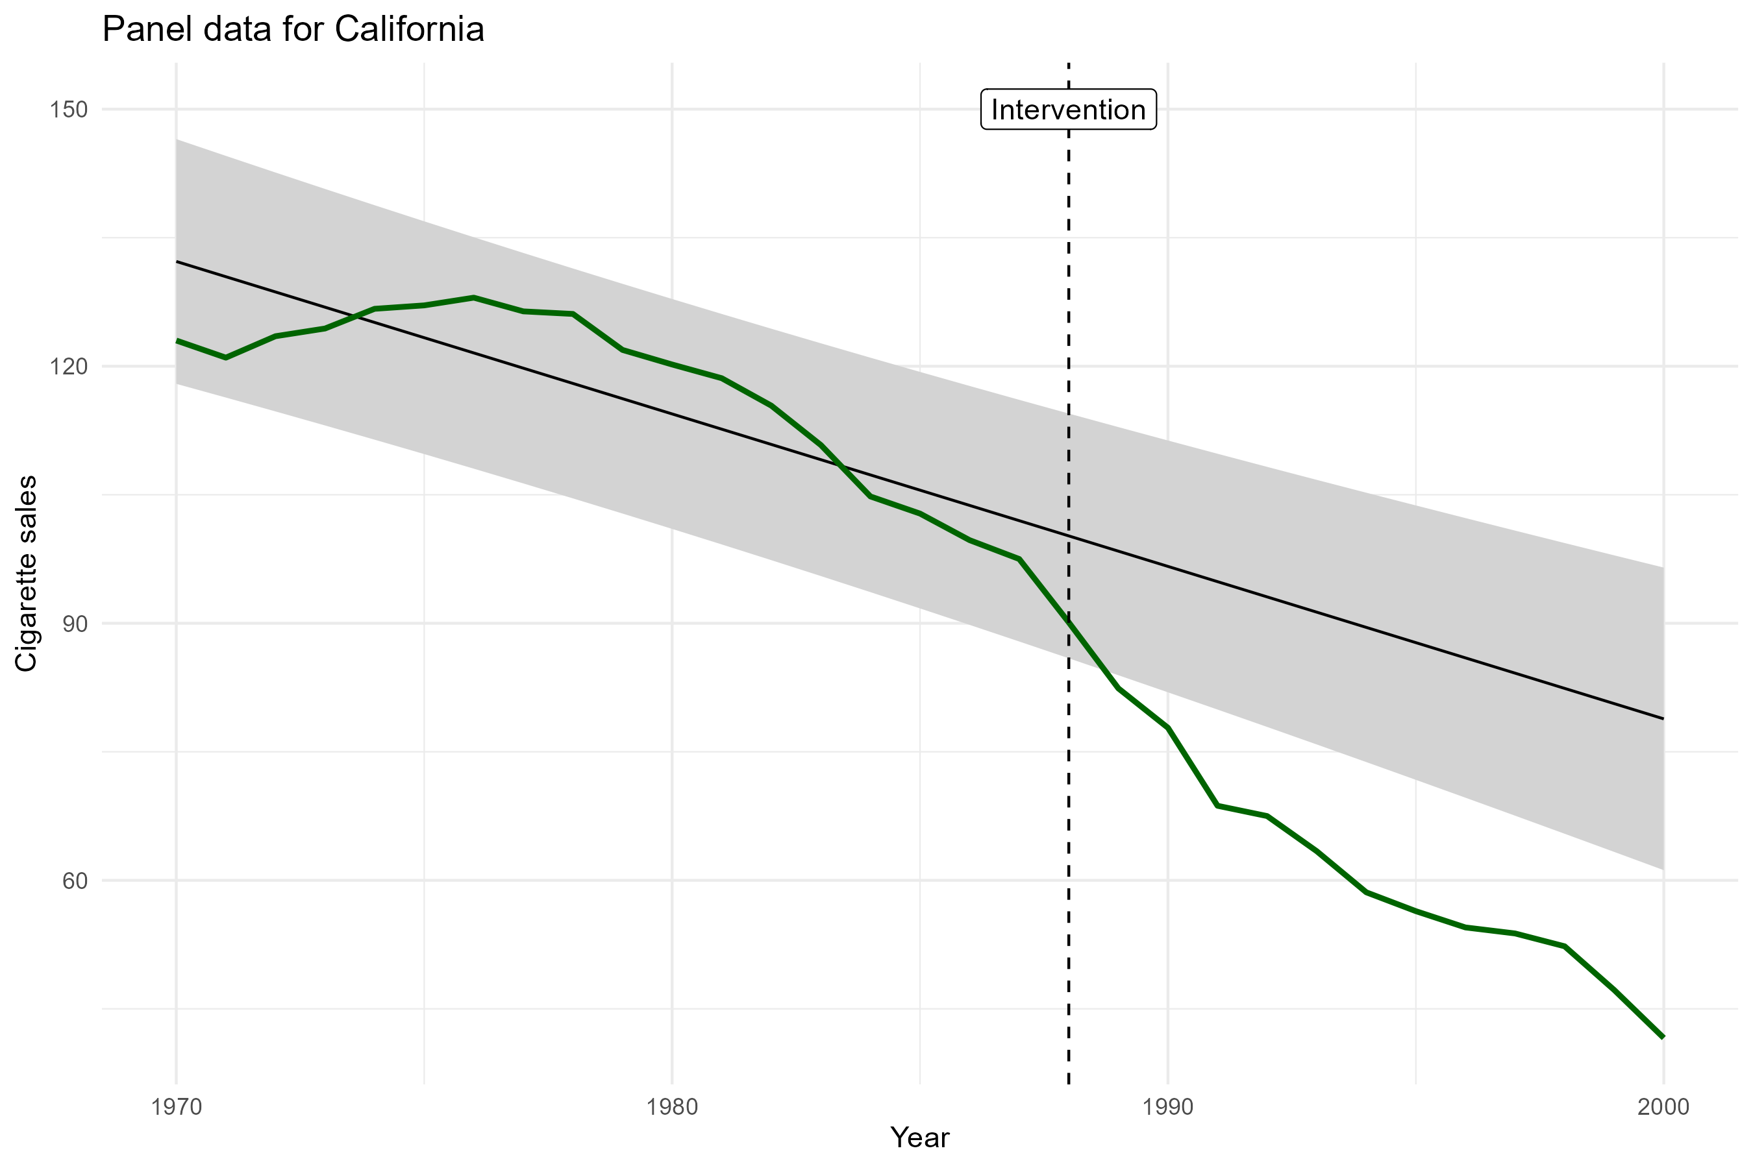

Slide 11
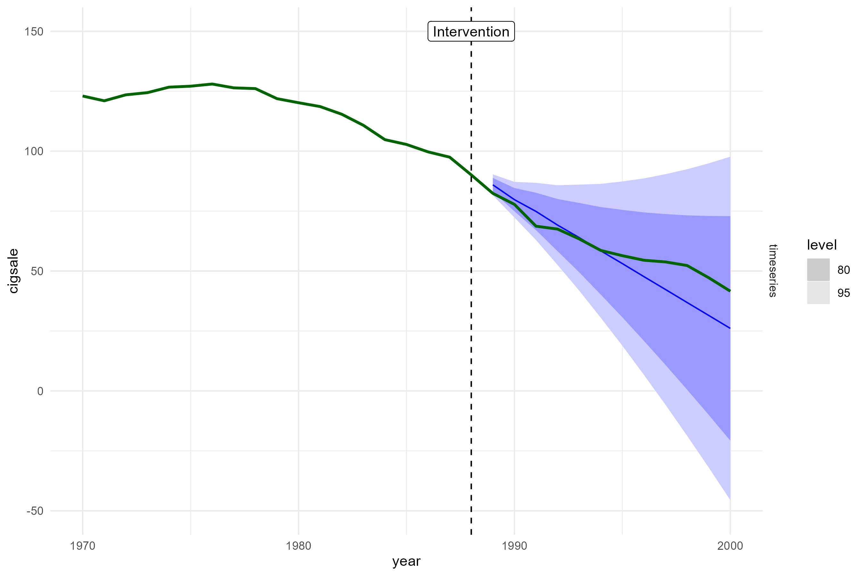

Slide 12
Key Assumptions
In contrast to to pre-post, we model the trend
But: inferences about causal effect entirely dependent on ability to fit an appropriate forecasting model
i.e., one that correctly captures the trend(s) and autocorrelation structures in the data
In practice, this may be very difficult

Slide 13
Synthetic control

Slide 14
,,arguably the most important innovation in the policy evaluation literature in the last 15 years”
Athey, S., & Imbens, G. W. (2017). The state of applied econometrics: Causality and policy evaluation. Journal of Economic perspectives, 31(2), 3-32.

Slide 16
Basic idea
With diff-in-diff we used a control unit to attempt a correction for unmeasured time-varying confounders (e.g., macroeconomic situation in U.S.A.)
You need a good control unit!
How much is Utah like California?
We can instead use a weighted average of a donor pool of control units to create a synthetic control unit
Choose the weights such that control is like California

Slide 17
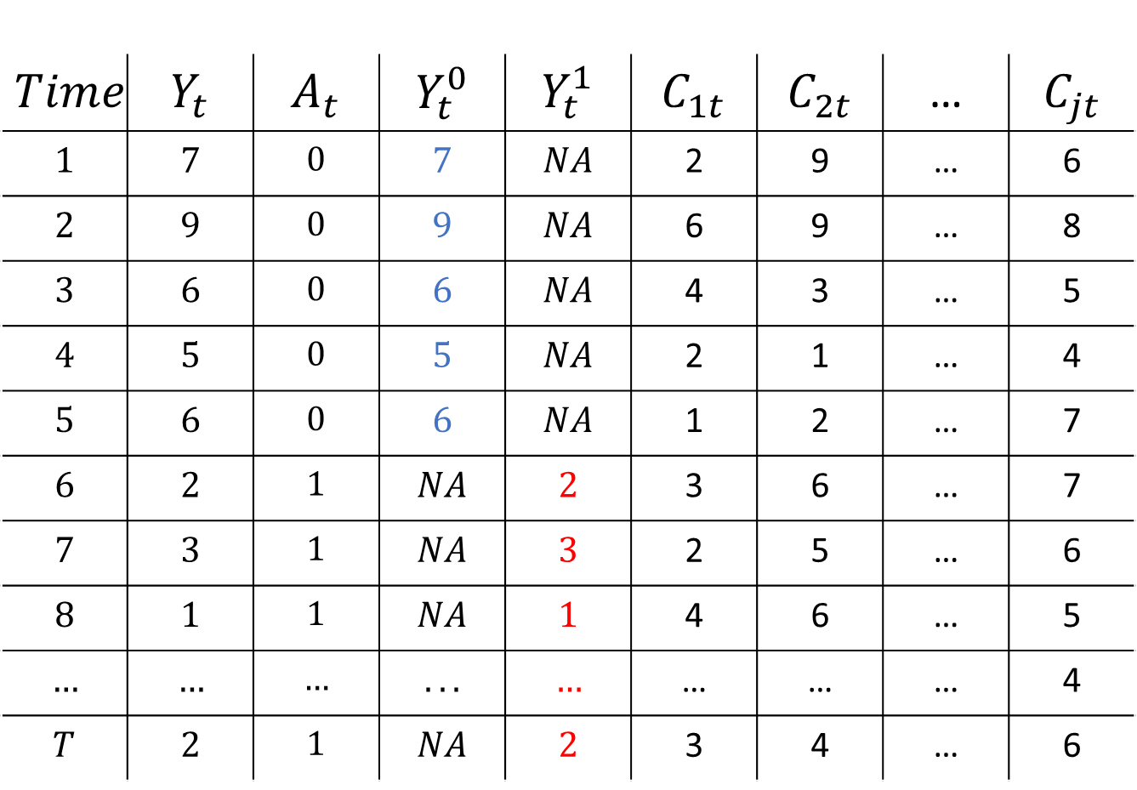
$$Time$$ | $$Y_{t}$$ | $$A_{t}$$ | $$Y_{t}^{0}$$ | $$Y_{t}^{1}$$ | $$C_{1t}$$ | $$C_{2t}$$ | … | $$C_{jt}$$
$$1$$ | $$7$$ | $$0$$ | $$7$$ | $$NA$$ | 2 | 9 | … | 6
$$2$$ | $$9$$ | $$0$$ | $$9$$ | $$NA$$ | 6 | 9 | … | 8
$$3$$ | $$6$$ | $$0$$ | $$6$$ | $$NA$$ | 4 | 3 | … | 5
$$4$$ | $$5$$ | $$0$$ | $$5$$ | $$NA$$ | 2 | 1 | … | 4
$$5$$ | $$6$$ | $$0$$ | $$6$$ | $$NA$$ | 1 | 2 | … | 7
$$6$$ | $$2$$ | $$1$$ | $$NA$$ | $$2$$ | 3 | 6 | … | 7
$$7$$ | $$3$$ | $$1$$ | $$NA$$ | $$3$$ | 2 | 5 | … | 6
$$8$$ | $$1$$ | $$1$$ | $$NA$$ | $$1$$ | 4 | 6 | … | 5
$$…$$ | $$…$$ | $$…$$ | $$...$$ | $$…$$ | … | … | … | 4
$$T$$ | $$2$$ | $$1$$ | $$NA$$ | $$2$$ | 3 | 4 | … | 6

Slide 18
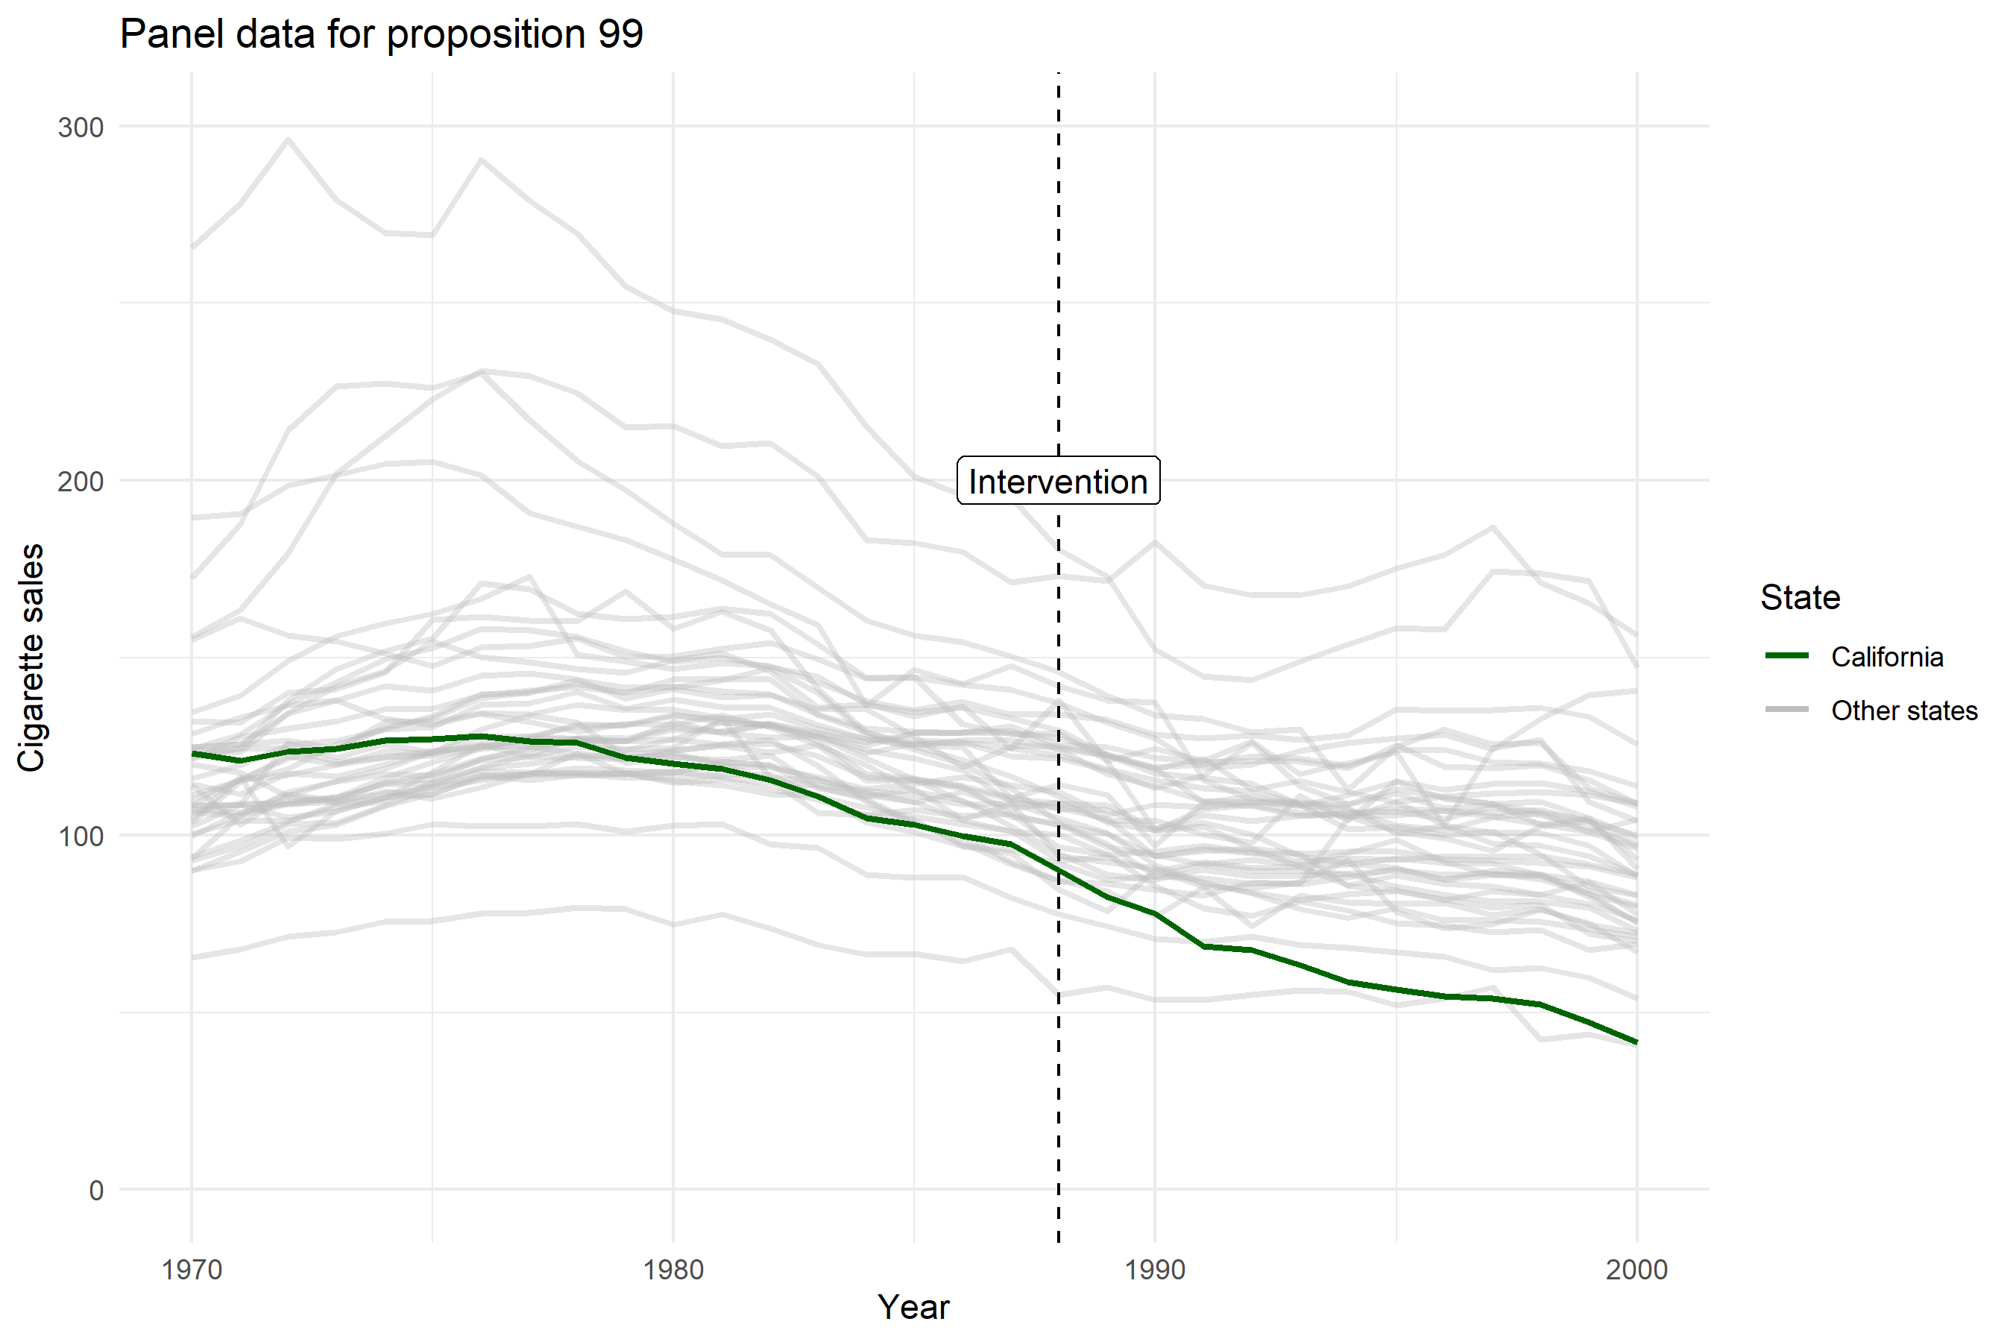

Slide 19
Synthetic control
Introduced in 2000s
Abadie, A., & Gardeazabal, J. (2003). The economic costs of conflict: A case study of the Basque Country. American Economic Review, 93(1), 113-132.
Abadie, A., Diamond, A., & Hainmueller, J. (2010). Synthetic control methods for comparative case studies: Estimating the effect of California’s tobacco control program. Journal of the American Statistical Association, 105(490), 493-505.
An R package with JSS paper in 2011
Abadie, A., Diamond, A., & Hainmueller, J. (2011). Synth: An R package for synthetic control methods in comparative case studies. Journal of Statistical Software, 42(13).
A great overview paper with recent learnings in 2021
Abadie, A. (2021). Using synthetic controls: Feasibility, data requirements, and methodological aspects. Journal of Economic Literature, 59(2), 391-425.

Slide 20
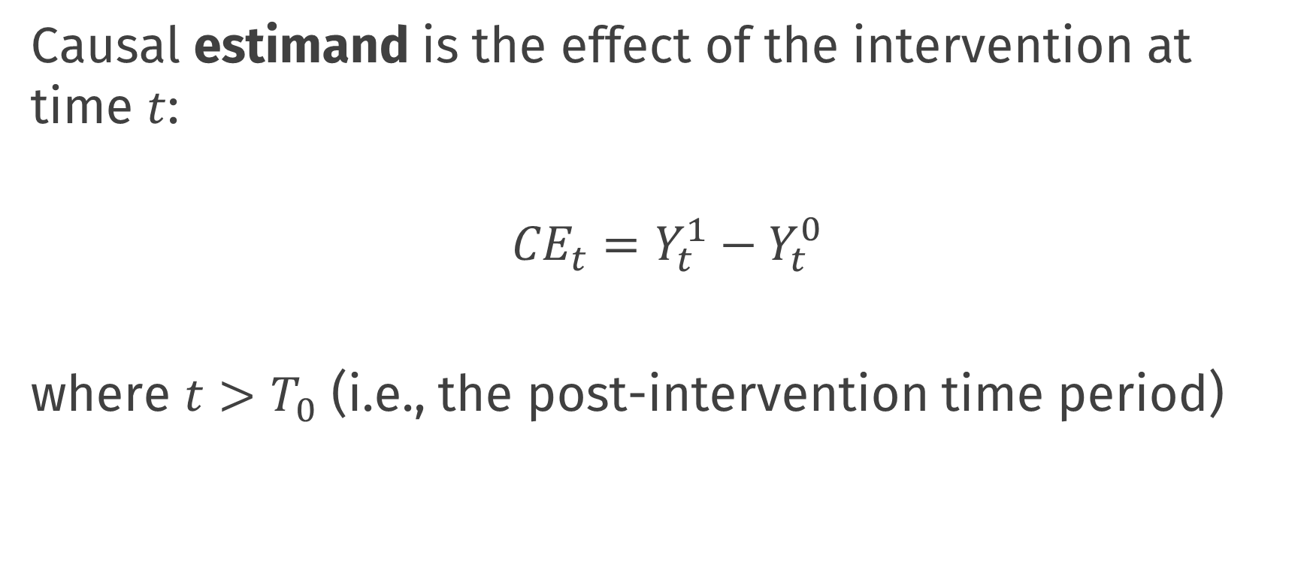
Synthetic control
Causal estimand is the effect of the intervention at time $t$:
$${CE}_{t}=Y_{t}^{1}−Y_{t}^{0}$$
where $t>T_{0}$ (i.e., the post-intervention time period)

Slide 21
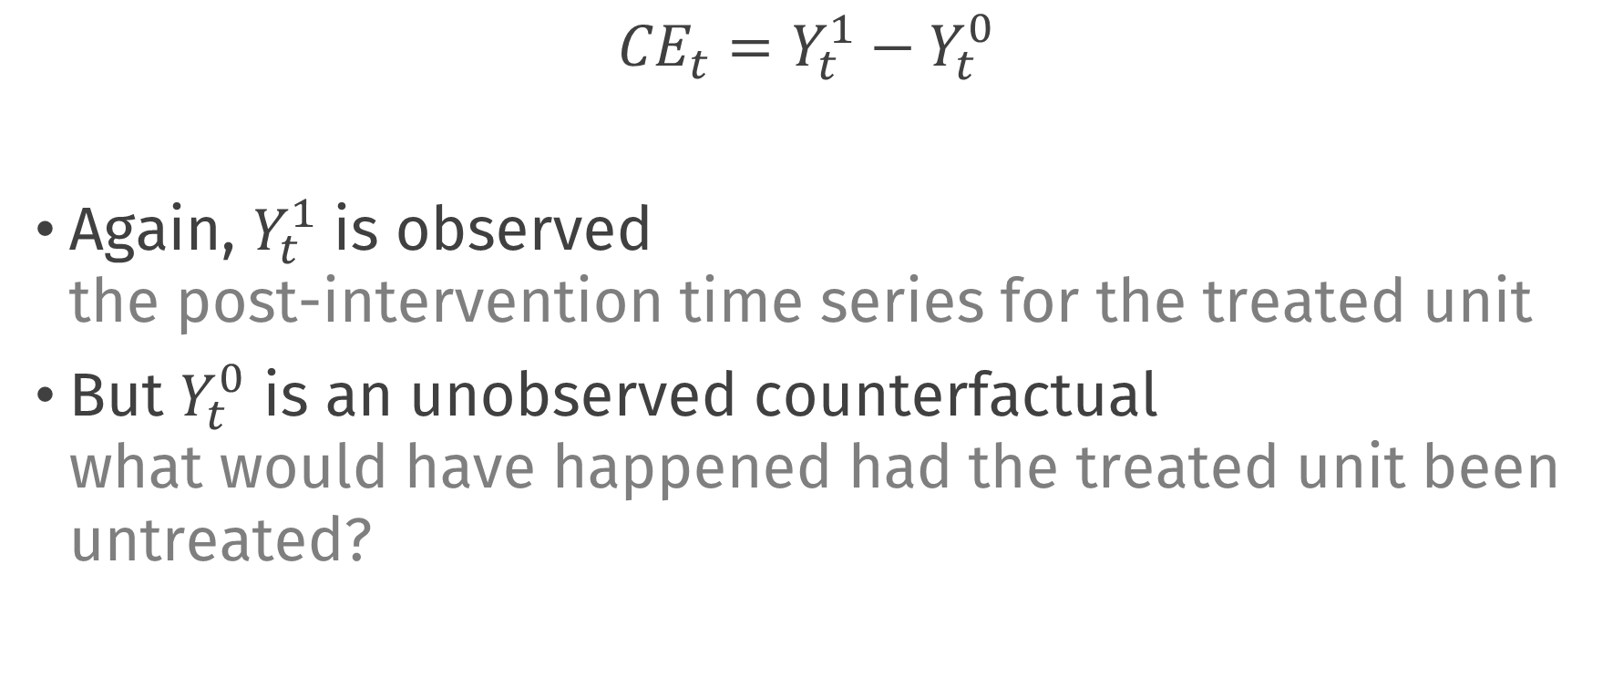
Synthetic control
$${CE}_{t}=Y_{t}^{1}−Y_{t}^{0}$$
Again, $Y_{t}^{1}$ is observed the post-intervention time series for the treated unit
But $Y_{t}^{0}$ is an unobserved counterfactual what would have happened had the treated unit been untreated?

Slide 22
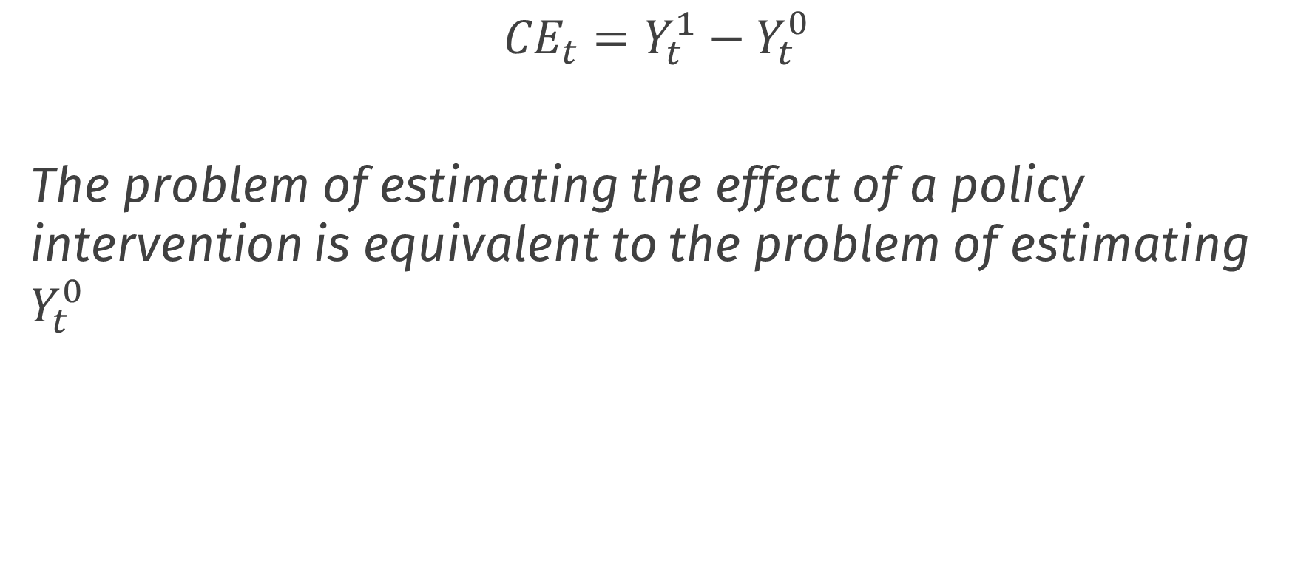
Synthetic control
$${CE}_{t}=Y_{t}^{1}−Y_{t}^{0}$$
The problem of estimating the effect of a policy intervention is equivalent to the problem of estimating $Y_{t}^{0}$
Abadie, A. (2021). Using synthetic controls: Feasibility, data requirements, and methodological aspects. Journal of Economic Literature, 59(2), 391-425.

Slide 23
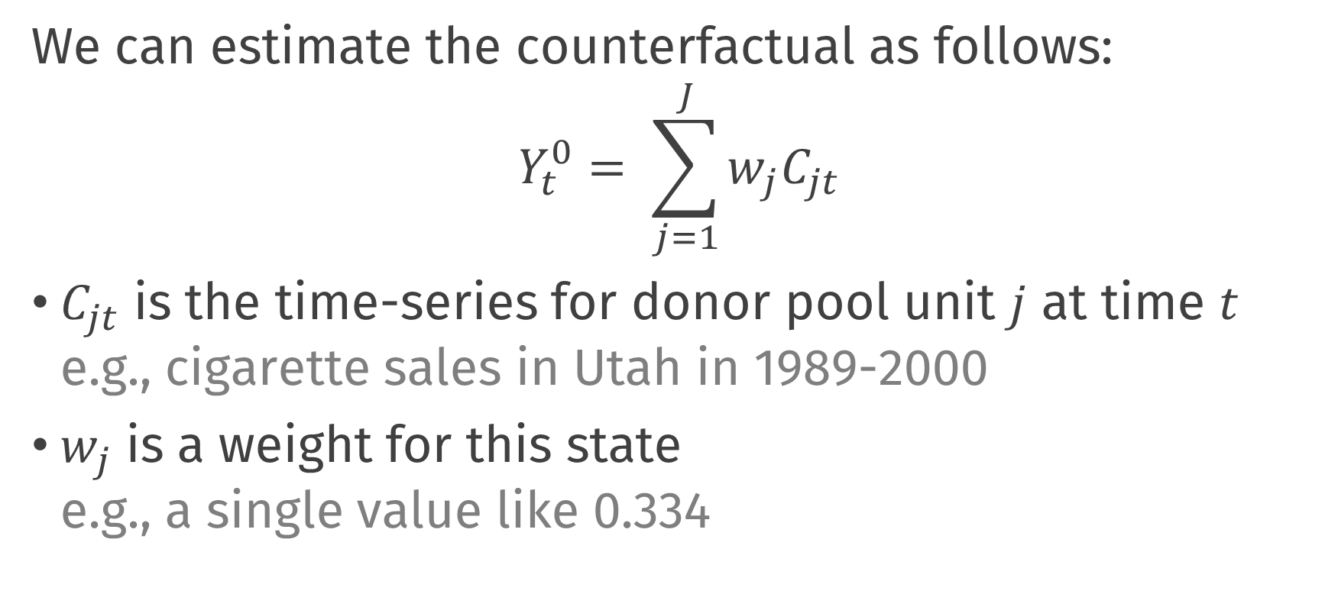
Synthetic control
We can estimate the counterfactual as follows:
$$Y_{t}^{0}= \sum_{j=1}^{J}{w_{j}C_{jt}}$$
$C_{jt}$ is the time-series for donor pool unit $j$ at time $t$ e.g., cigarette sales in Utah in 1989-2000
$w_{j}$ is a weight for this state e.g., a single value like 0.334

Slide 24

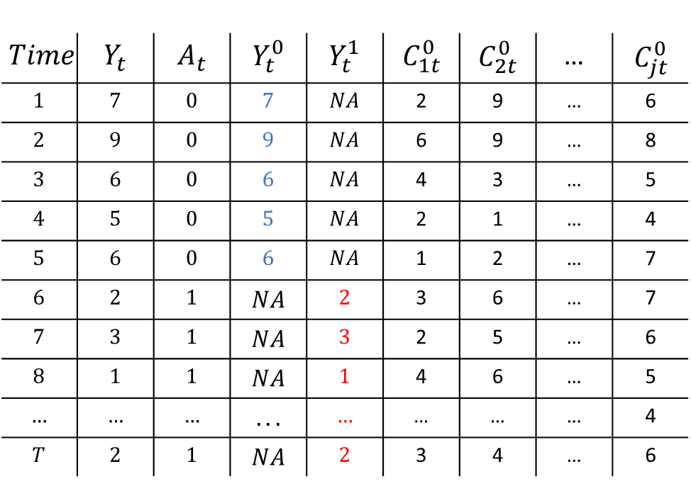

Synthetic Control
$$Time$$ | $$Y_{t}$$ | $$A_{t}$$ | $$Y_{t}^{0}$$ | $$Y_{t}^{1}$$ | $$C_{1t}^{0}$$ | $$C_{2t}^{0}$$ | … | $$C_{jt}^{0}$$
$$1$$ | $$7$$ | $$0$$ | $$7$$ | $$NA$$ | 2 | 9 | … | 6
$$2$$ | $$9$$ | $$0$$ | $$9$$ | $$NA$$ | 6 | 9 | … | 8
$$3$$ | $$6$$ | $$0$$ | $$6$$ | $$NA$$ | 4 | 3 | … | 5
$$4$$ | $$5$$ | $$0$$ | $$5$$ | $$NA$$ | 2 | 1 | … | 4
$$5$$ | $$6$$ | $$0$$ | $$6$$ | $$NA$$ | 1 | 2 | … | 7
$$6$$ | $$2$$ | $$1$$ | $$NA$$ | $$2$$ | 3 | 6 | … | 7
$$7$$ | $$3$$ | $$1$$ | $$NA$$ | $$3$$ | 2 | 5 | … | 6
$$8$$ | $$1$$ | $$1$$ | $$NA$$ | $$1$$ | 4 | 6 | … | 5
$$…$$ | $$…$$ | $$…$$ | $$...$$ | $$…$$ | … | … | … | 4
$$T$$ | $$2$$ | $$1$$ | $$NA$$ | $$2$$ | 3 | 4 | … | 6
Estimate Weights
$$Y_{t}= \sum_{j=1}^{J}{\hat{w_{j}}C_{jt}}$$
$$t<T_{0}$$

Slide 25

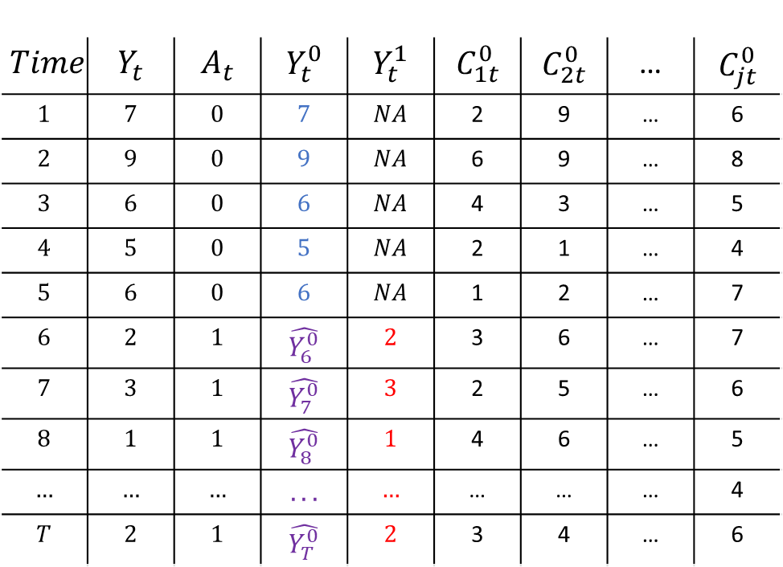


Synthetic Control
$$Time$$ | $$Y_{t}$$ | $$A_{t}$$ | $$Y_{t}^{0}$$ | $$Y_{t}^{1}$$ | $$C_{1t}^{0}$$ | $$C_{2t}^{0}$$ | … | $$C_{jt}^{0}$$
$$1$$ | $$7$$ | $$0$$ | $$7$$ | $$NA$$ | 2 | 9 | … | 6
$$2$$ | $$9$$ | $$0$$ | $$9$$ | $$NA$$ | 6 | 9 | … | 8
$$3$$ | $$6$$ | $$0$$ | $$6$$ | $$NA$$ | 4 | 3 | … | 5
$$4$$ | $$5$$ | $$0$$ | $$5$$ | $$NA$$ | 2 | 1 | … | 4
$$5$$ | $$6$$ | $$0$$ | $$6$$ | $$NA$$ | 1 | 2 | … | 7
$$6$$ | $$2$$ | $$1$$ | $$\hat{Y_{6}^{0}}$$ | $$2$$ | 3 | 6 | … | 7
$$7$$ | $$3$$ | $$1$$ | $$\hat{Y_{7}^{0}}$$ | $$3$$ | 2 | 5 | … | 6
$$8$$ | $$1$$ | $$1$$ | $$\hat{Y_{8}^{0}}$$ | $$1$$ | 4 | 6 | … | 5
$$…$$ | $$…$$ | $$…$$ | $$...$$ | $$…$$ | … | … | … | 4
$$T$$ | $$2$$ | $$1$$ | $$\hat{Y_{T}^{0}}$$ | $$2$$ | 3 | 4 | … | 6
Estimate Weights
$$Y_{t}= \sum_{j=1}^{J}{\hat{w_{j}}C_{jt}}$$
$$t<T_{0}$$
$$\hat{Y_{t}^{0}}= \sum_{j=1}^{J}{\hat{w_{j}}C_{jt}}$$
$$t>T_{0}$$
Impute counterfactual
$$\hat{CE_{t}}=Y_{t}^{1} −\hat{Y_{t}^{0}}$$

Slide 26
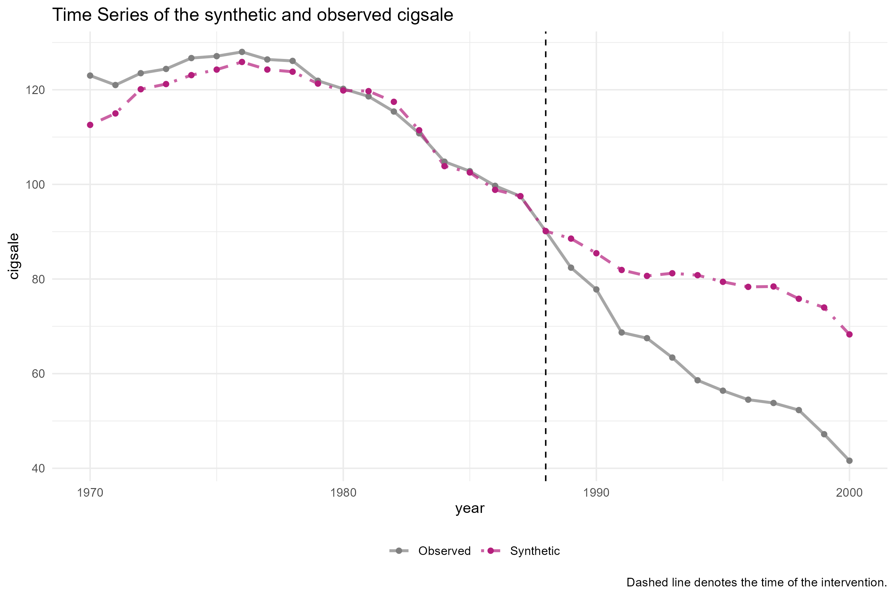


$$Y_{t}^{0}$$
$$Y_{t}^{1}$$

Slide 27
Three questions
How to choose the weights?
Which units can go in the donor pool?
How to make sure that the synthetic control is interpretable?

Slide 28
Estimating weights

Slide 29
Estimating weights
Choose weights such that the synthetic control looks like the treated unit
Use only pre-intervention data for this
Weights should be positive and sum to one Interpolation constraint / convex hull

Slide 30
Estimating weights
What does it mean to looks like California? This is a choice by the researcher!
Pre-intervention target variables
Cigarette sales
Pre-intervention covariates
Population composition
Average income of population
Price of cigarettes
Beer consumption

Slide 31
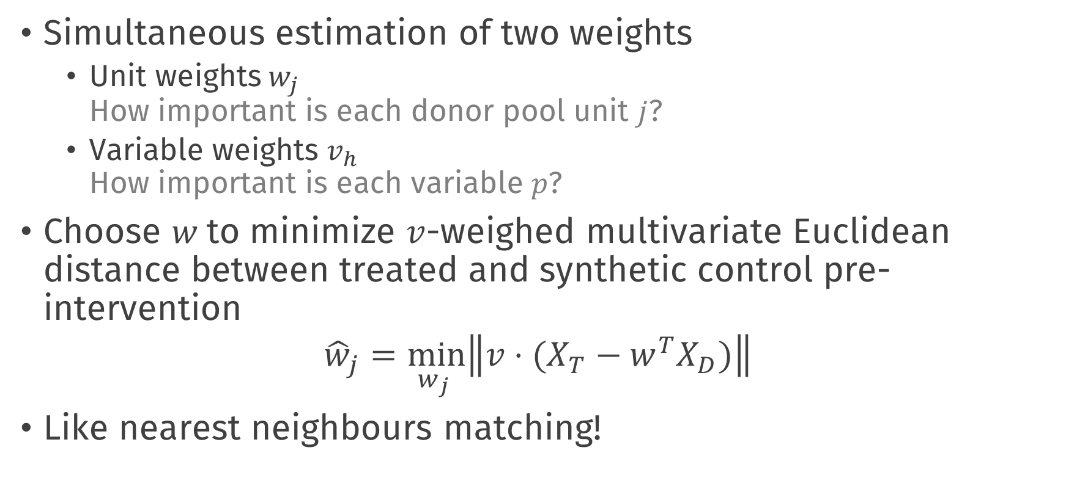
Estimating weights
Simultaneous estimation of two weights
Unit weights$w_{j}$ How important is each donor pool unit $j$?
Variable weights $v_{h}$ How important is each variable $p$?
Choose $w$to minimize $v$-weighed multivariate Euclidean distance between treated and synthetic control pre-intervention
$${\hat{w}}_{j}=\min_{w_{j} }\left\|v⋅(\left.X_{T}−w^{T}X_{D})\right\|\right.$$
Like nearest neighbours matching!

Slide 32
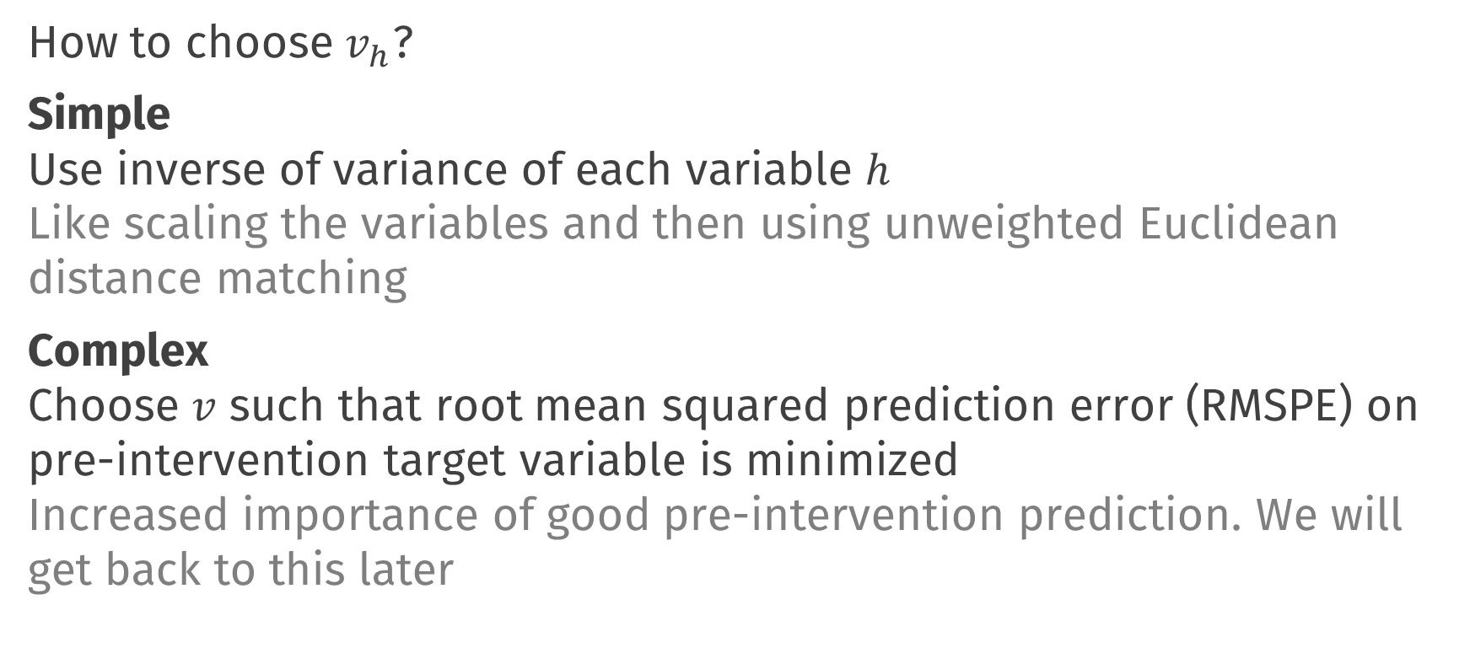
Estimating weights
How to choose $v_{h}$?
Simple Use inverse of variance of each variable $h$ Like scaling the variables and then using unweighted Euclidean distance matching
Complex Choose $v$ such that root mean squared prediction error (RMSPE) on pre-intervention target variable is minimized Increased importance of good pre-intervention prediction. We will get back to this later

Slide 33
Choosing donor pool

Slide 34
No interference / spillover
The donor pool unit does not receive any intervention effect
Example spillover effects
Californians living near the border may buy their cigarettes in states across the border
Other states may pass laws similar to on California

Slide 35
Measurement
Measure control variables and target variable in the donor pool unit before and after the intervention
Ideally, large pre-intervention time window Otherwise, risk overfitting pre-intervention; bad prediction for counterfactual
Be able to measure target variable after intervention counterfactual is weighted average of this

Slide 36
Convex hull condition
Distribution of control and target variables in donor pool should cover treated unit
It should be possible to interpolate the target unit values pre-intervention using the donor pool units
If donor pool units all have much higher cigarette sales, it is impossible to represent cigarette sales in California using positive weights which sum to 1

Slide 37
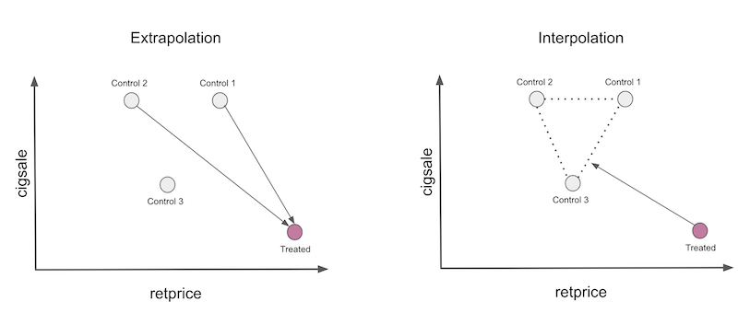
Interpolation
Alves, M. F. (2022). Causal inference for the brave and true.

Slide 38
Interpretability

Slide 39
Interpretability
If donor pool is large, synthetic control can be combination of many units
Hard to interpret what the synthetic control unit is!
Therefore: sparse estimation of weights
Additional penalty such that most weights are 0
The units belonging to nonzero weights can be manually inspected

Slide 40
Synthetic control using tidysynth

Slide 41
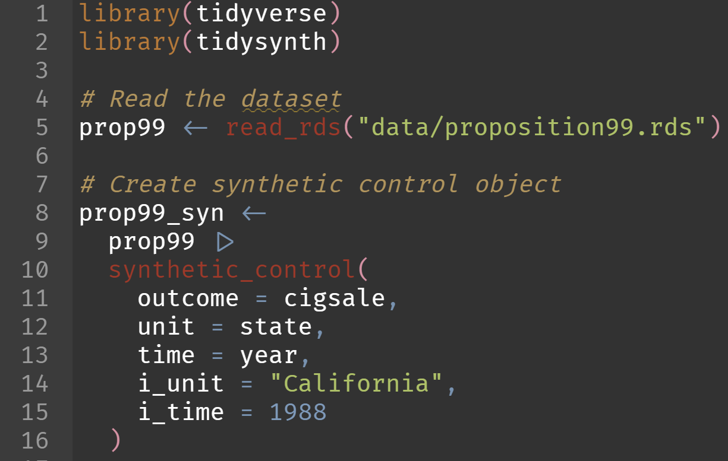
Synthetic control in practice

Slide 42
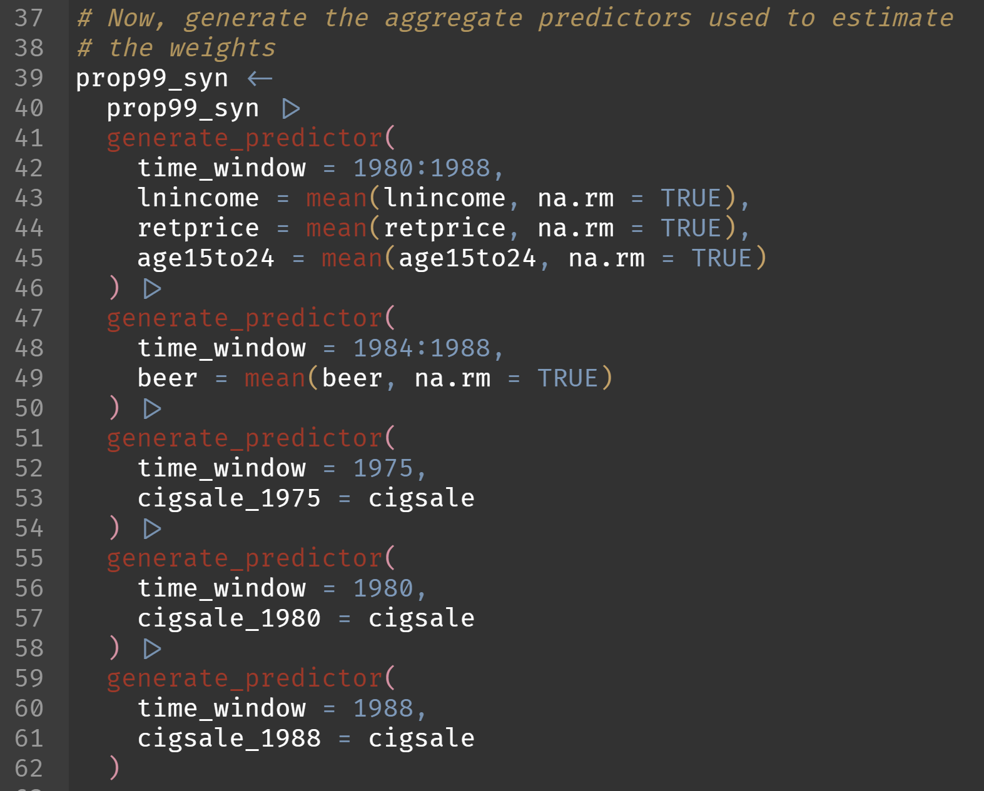

Slide 43
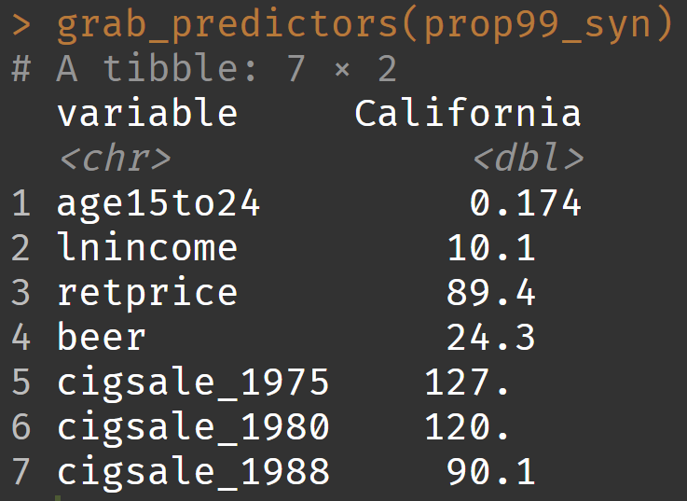
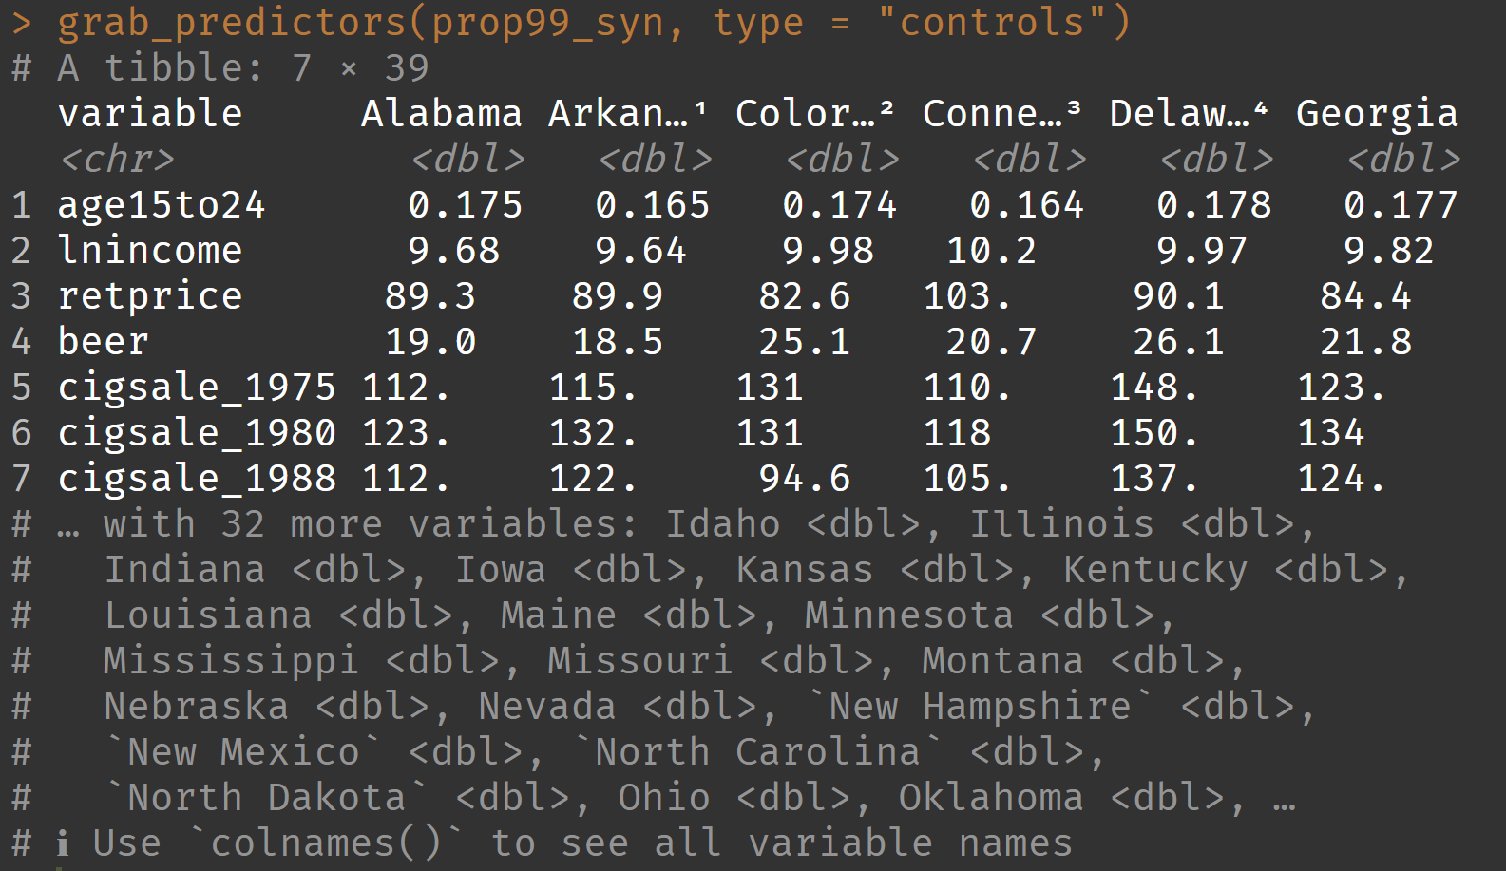
Inspecting predictors

Slide 44
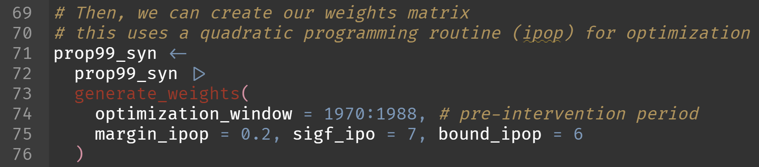
Estimating weights (magic!)

Slide 45
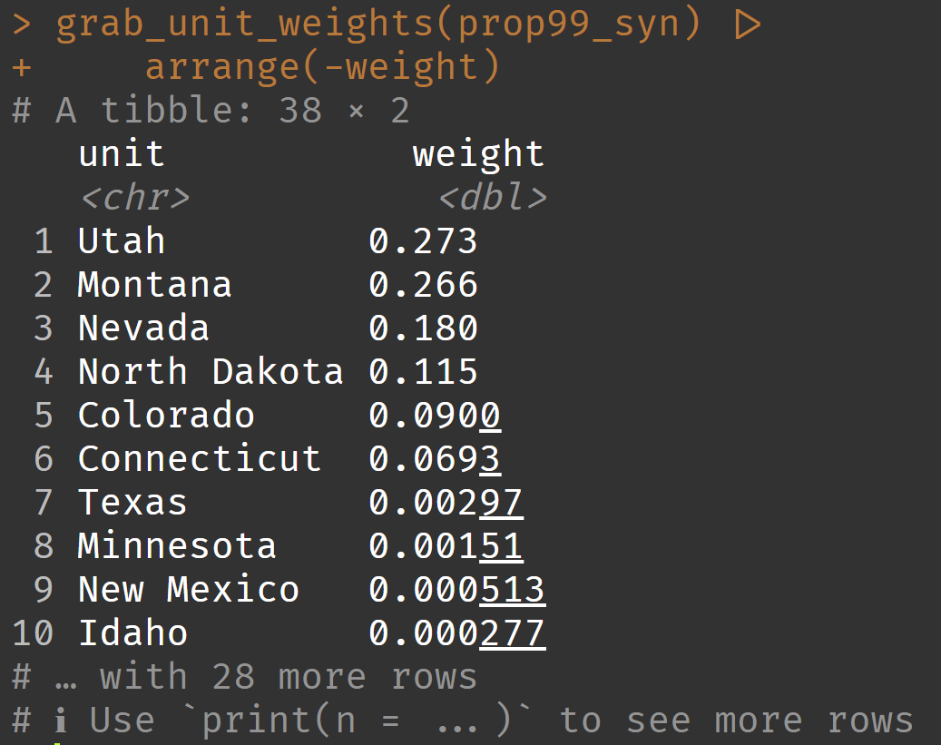
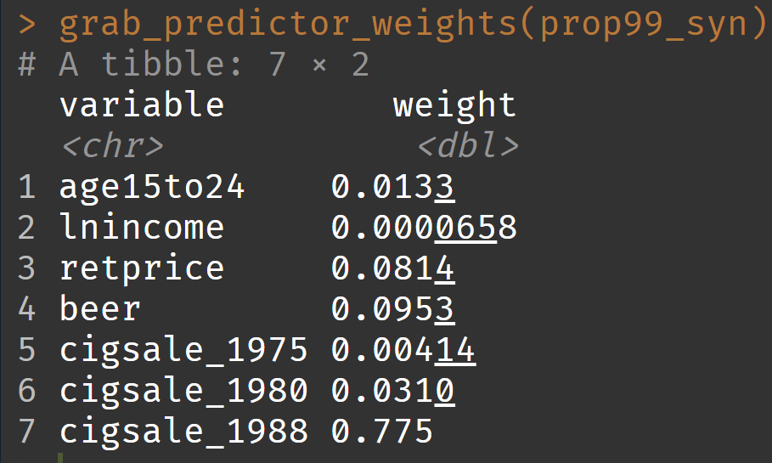
Inspecting weights

Slide 46
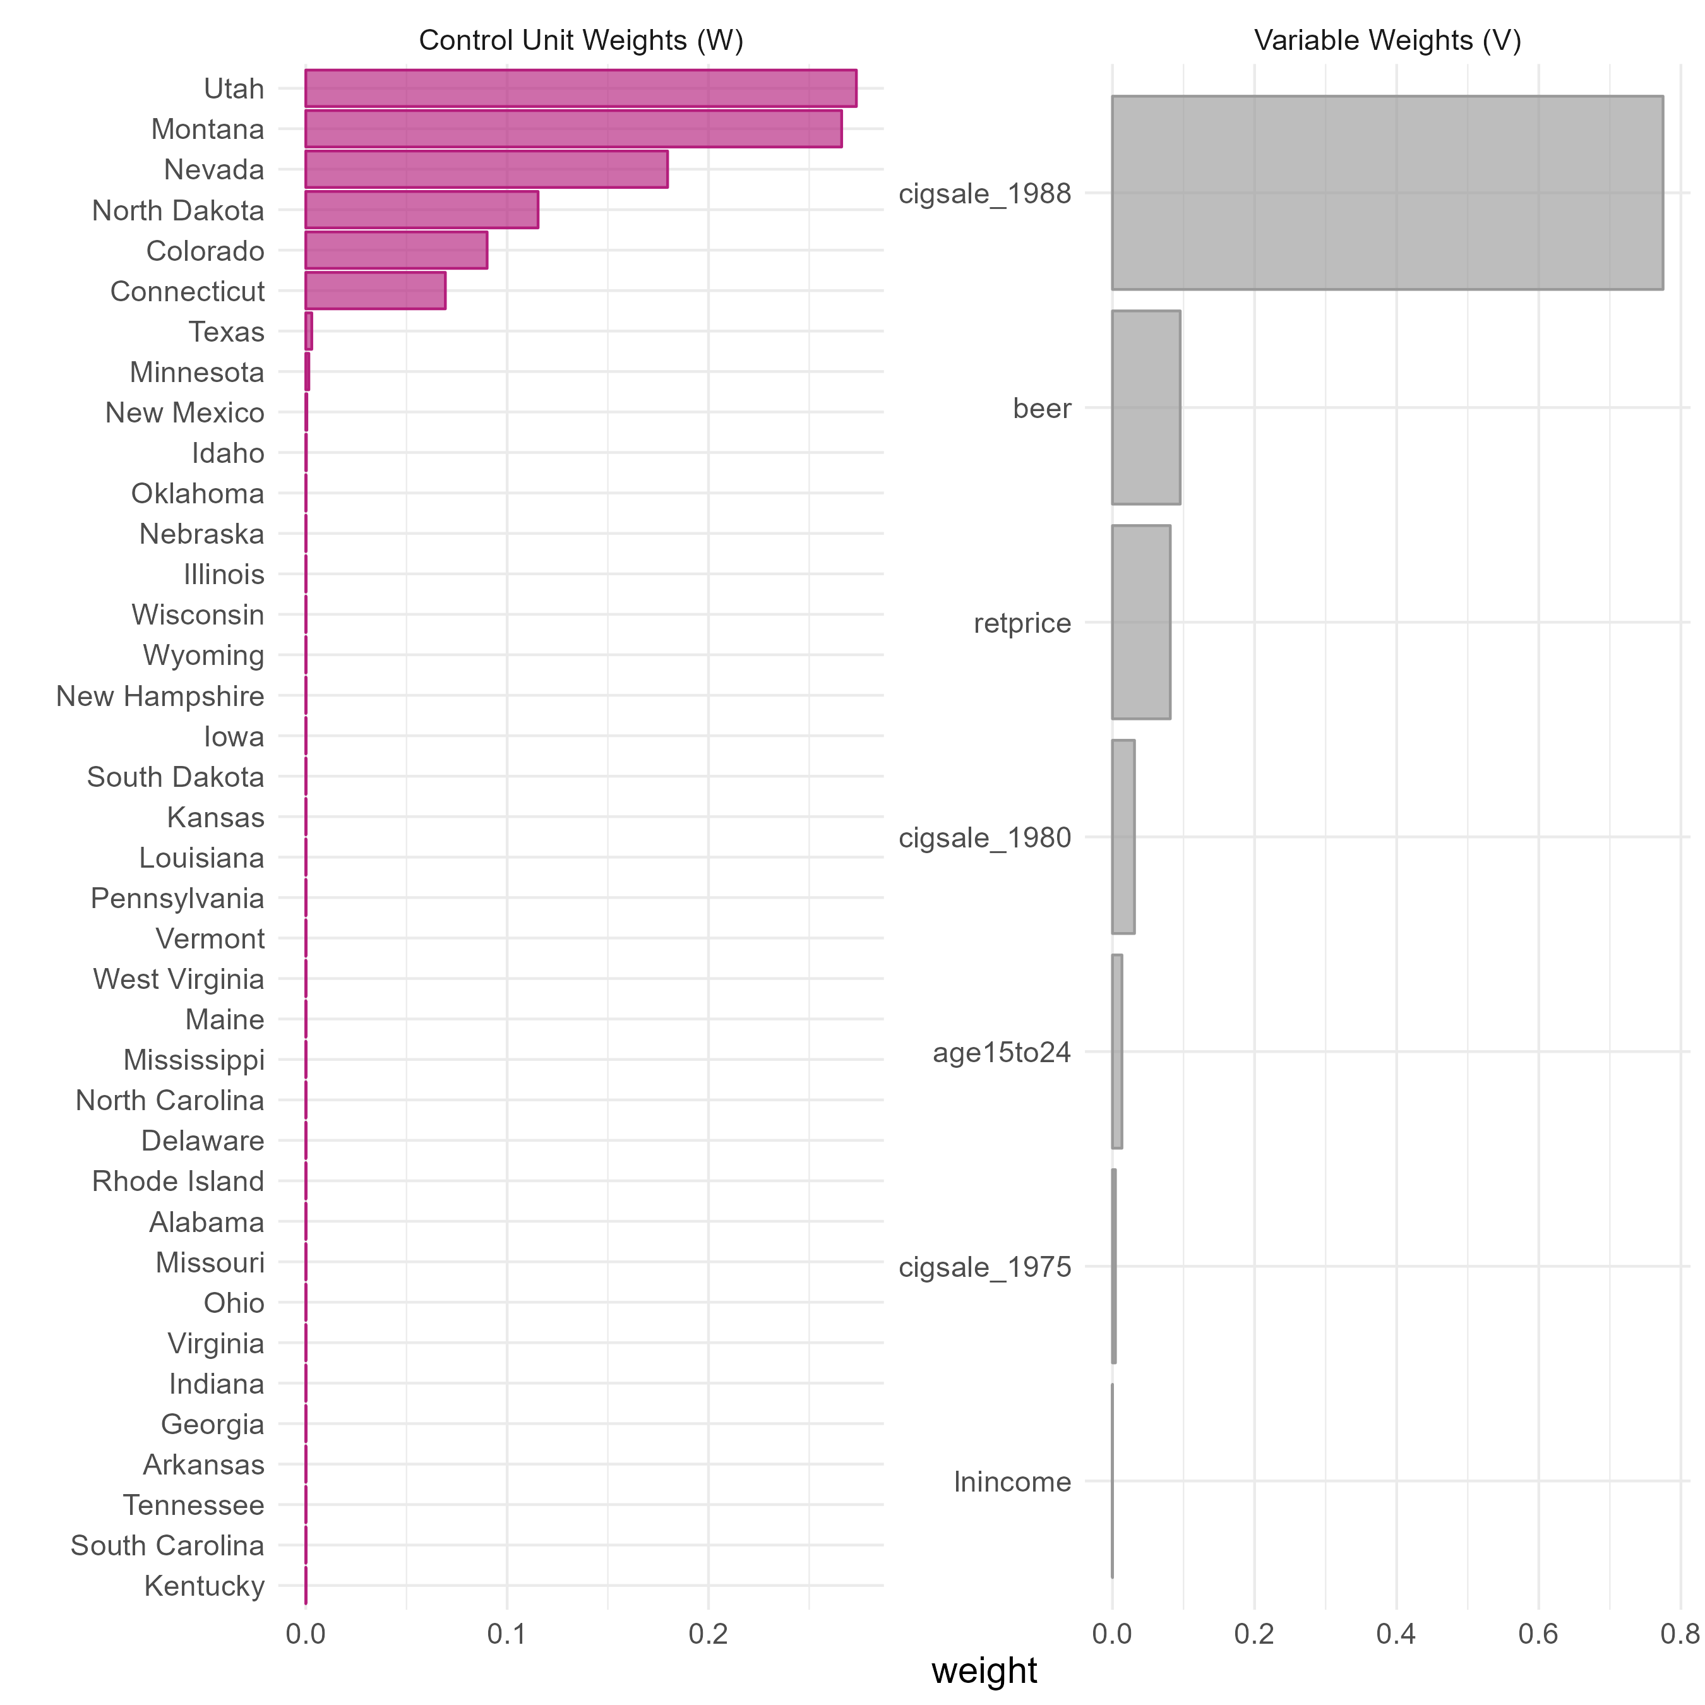

Slide 47
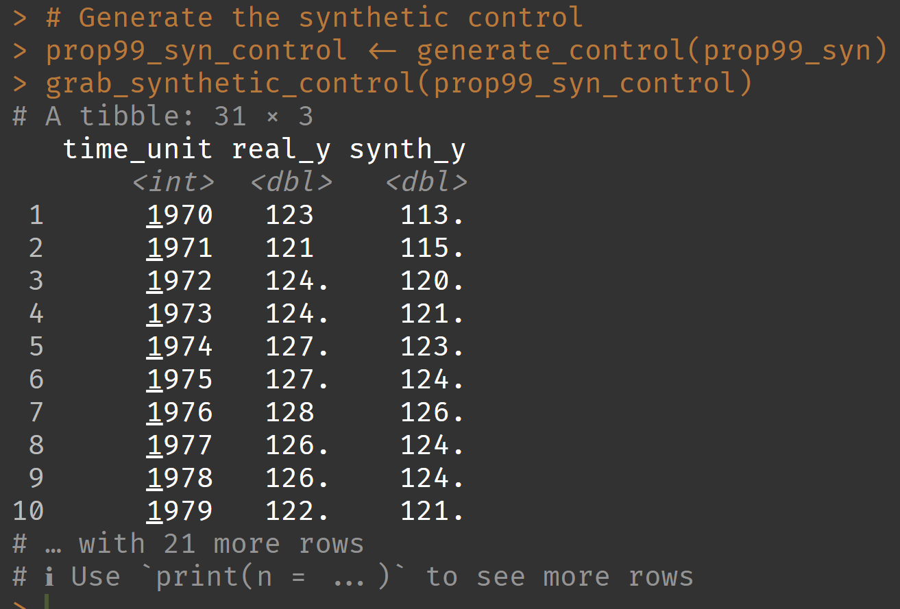
Creating synthetic control

Slide 49
Inference

Slide 51
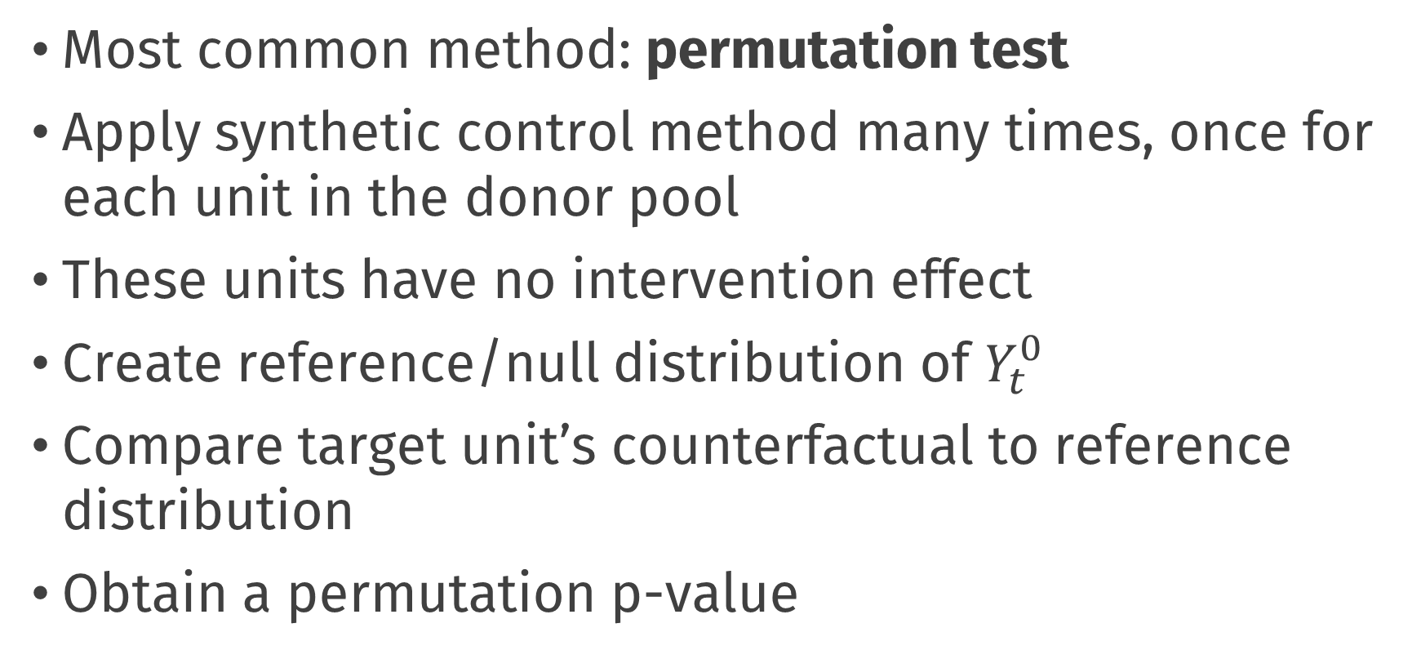
How to quantify uncertainty?
Most common method: permutation test
Apply synthetic control method many times, once for each unit in the donor pool
These units have no intervention effect
Create reference/null distribution of $Y_{t}^{0}$
Compare target unit’s counterfactual to reference distribution
Obtain a permutation p-value

Slide 52
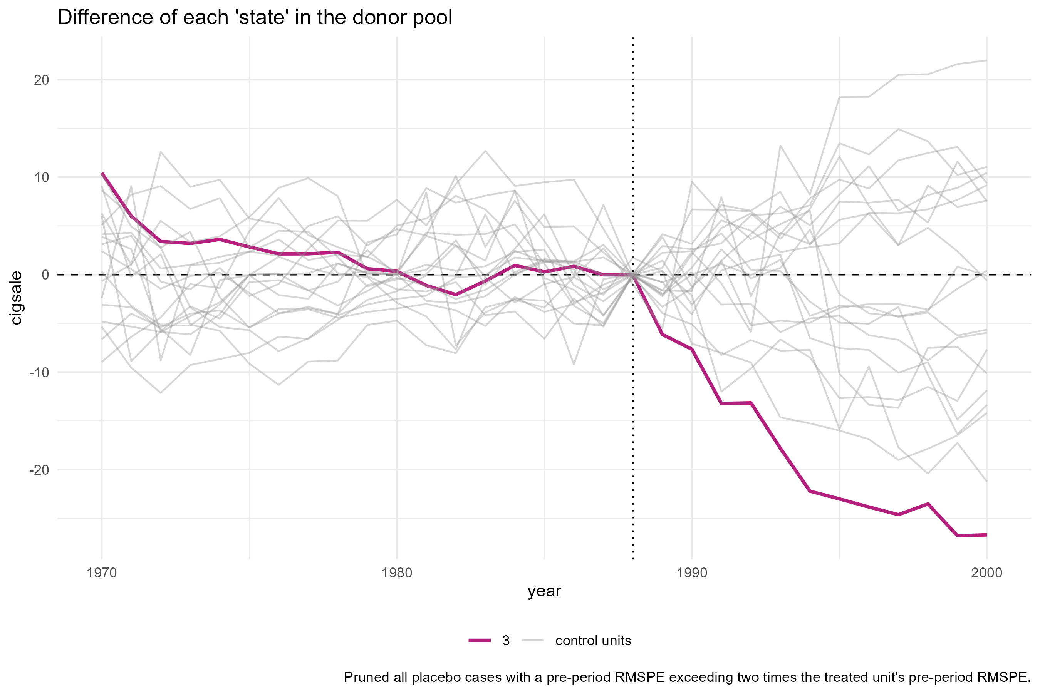

Slide 53
Choices, choices …

Slide 54
There are many choices
Which units in the donor pool?
Which control variables?
What should my weights optimize?
How many nonzero unit weights should I get?
What settings do I give to the nonlinear optimizer?
“researcher degrees of freedom”

Slide 55
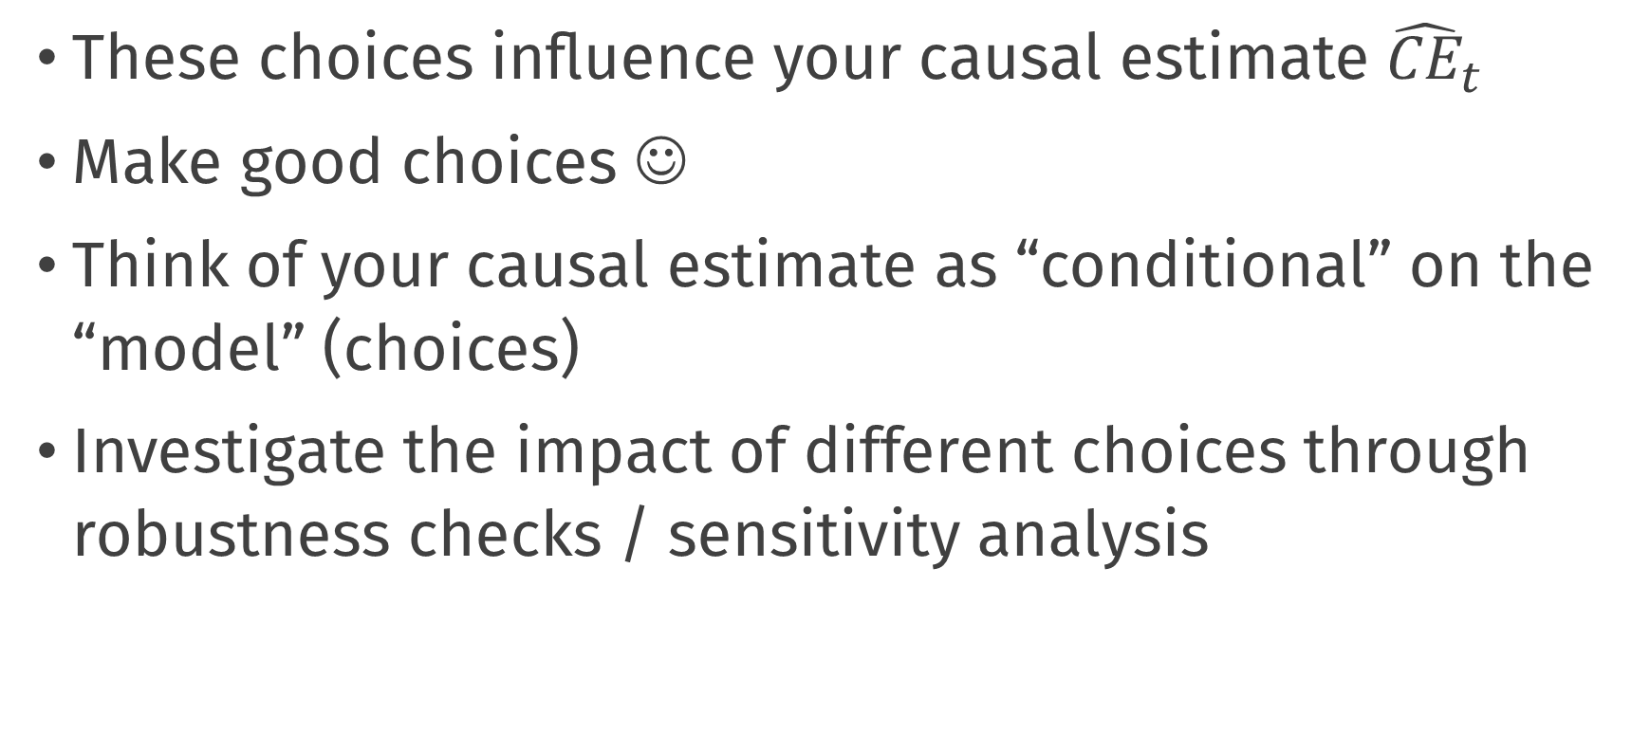
There are many choices
These choices influence your causal estimate ${\hat{CE}}_{t}$
Make good choices ☺
Think of your causal estimate as “conditional” on the “model” (choices)
Investigate the impact of different choices through robustness checks / sensitivity analysis

Slide 56
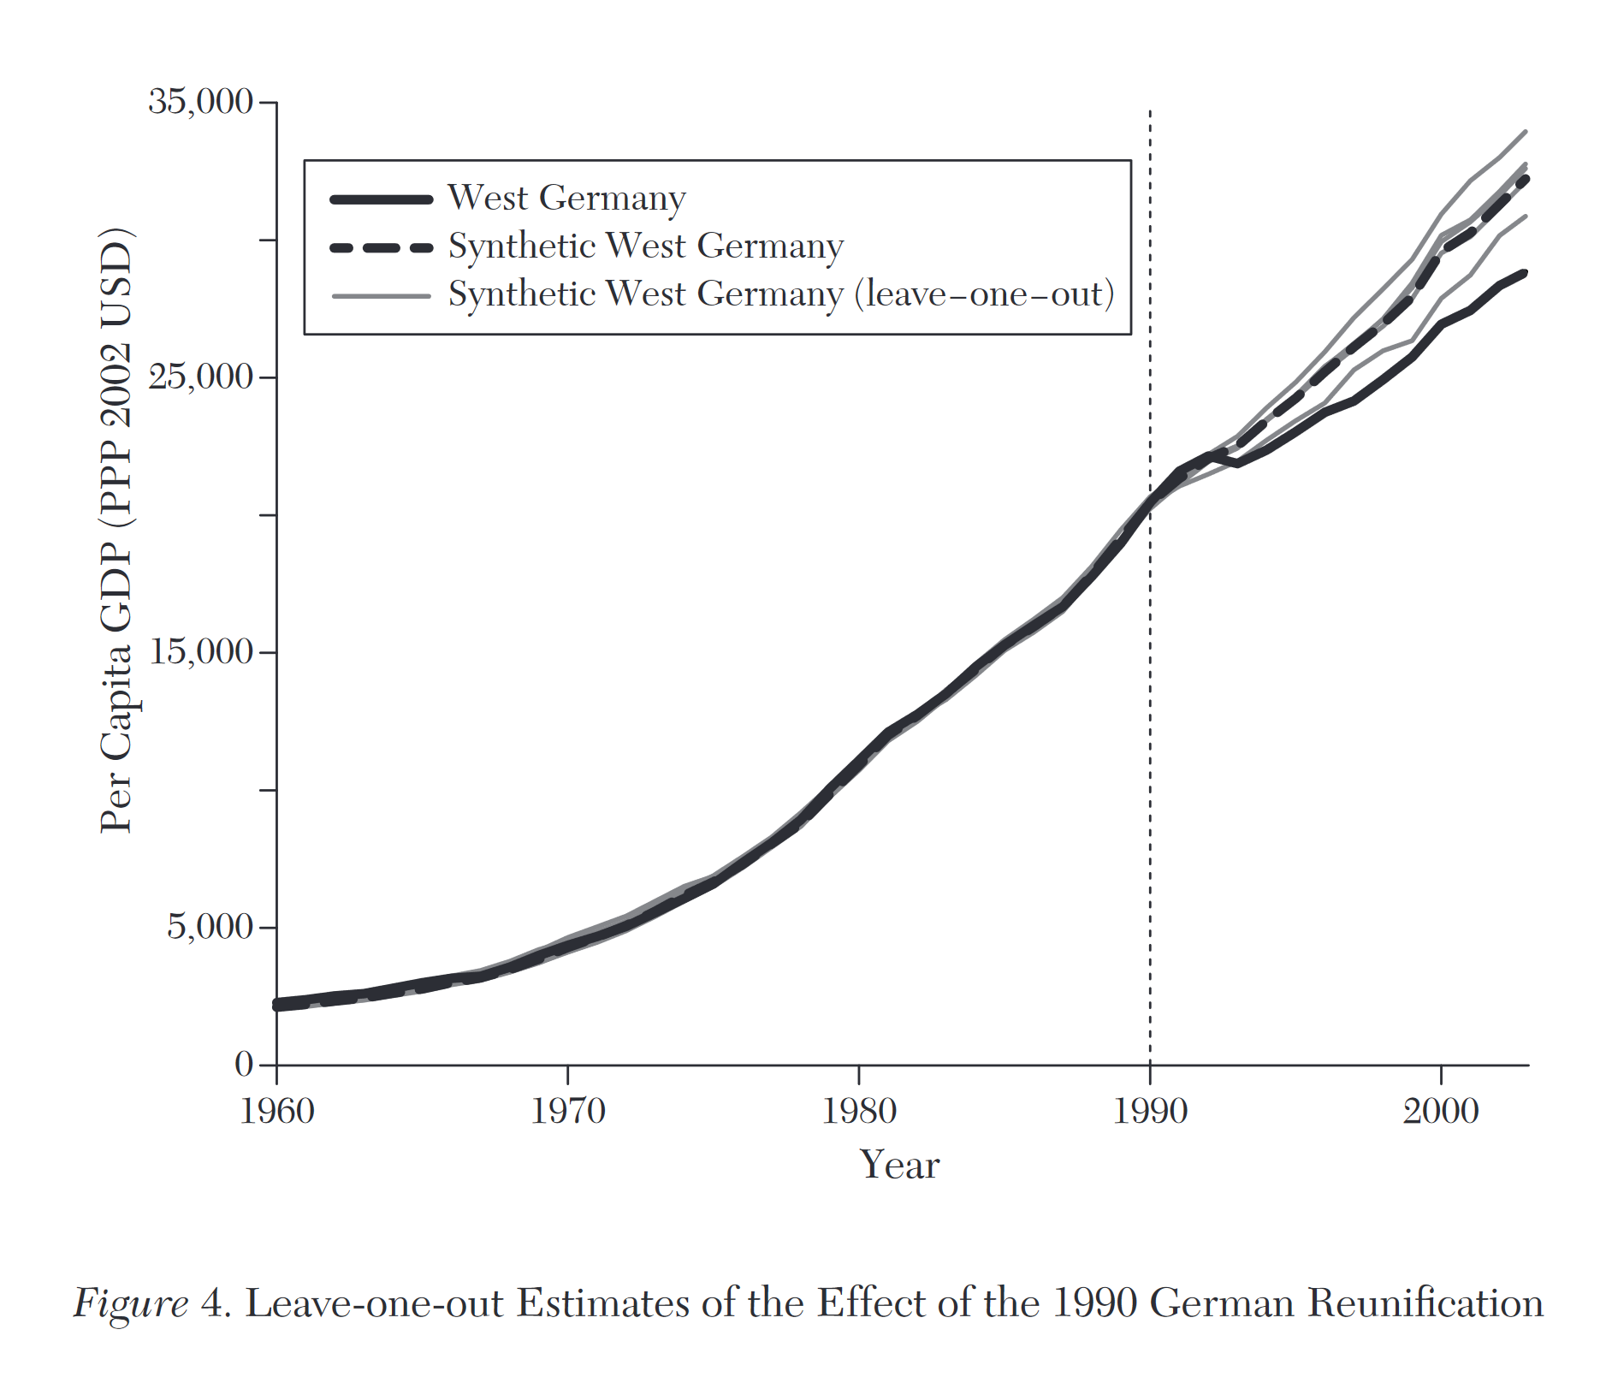
Leave-one-unit-out validation

Slide 57
More of this in the practical

Slide 58
Practical

Slide 59
Default light slide
Default subheading
This is the body of the text
Default subheading
Note that the text is not black, but “black, text 1, lighter 25%”
Default subheading
This makes things easier on the eyes
Default subheading
This is the body of the text

Slide 60
Default dark slide
Default subheading
The dark slide brings some variation
Default subheading
It can highlight important aspects of the presentation.
Default subheading
This is the body of the text
Default subheading
This is the body of the text

Slide 61
impact slide

Slide 62
Here is an impactful slide with a sentence on it.
Here is a topic related to the aforementioned question.

