Slide 1
Interrupted Time Series & Regression Discontinuity

Slide 2
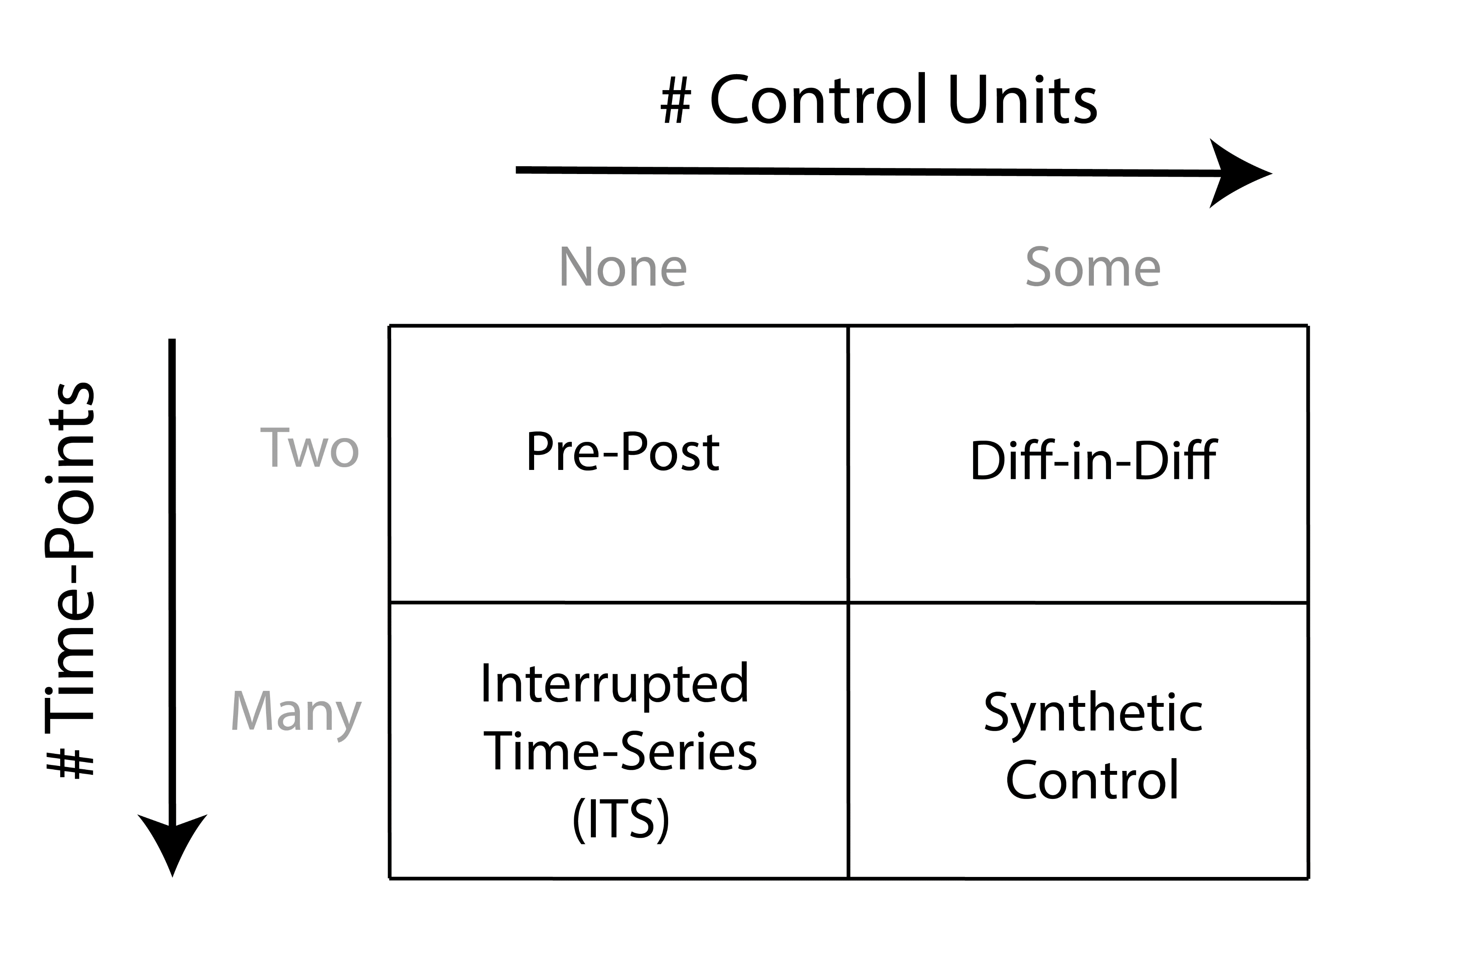

Slide 3
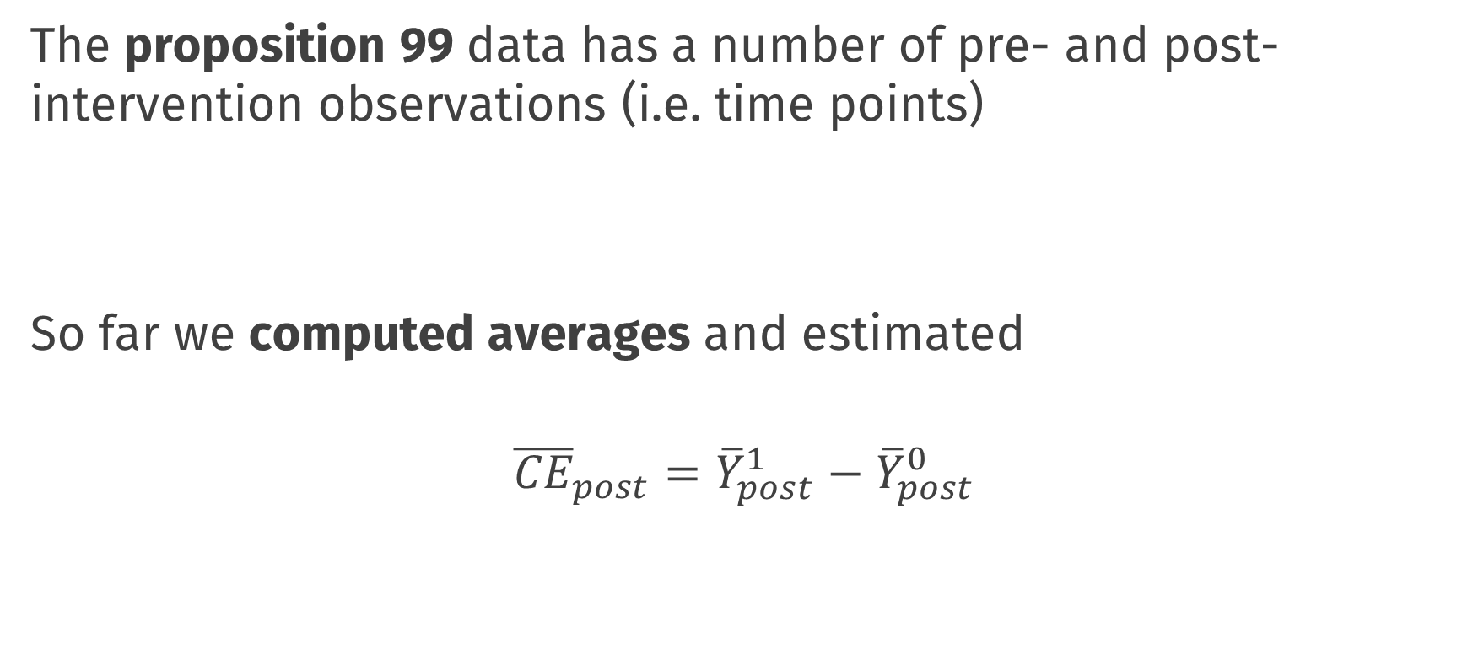
The story so far
The proposition 99 data has a number of pre- and post- intervention observations (i.e. time points)
So far we computed averages and estimated
$${\overline{CE}}_{post}={\overline{Y}}_{post}^{1}−{\overline{Y}}_{post}^{0}$$

Slide 4
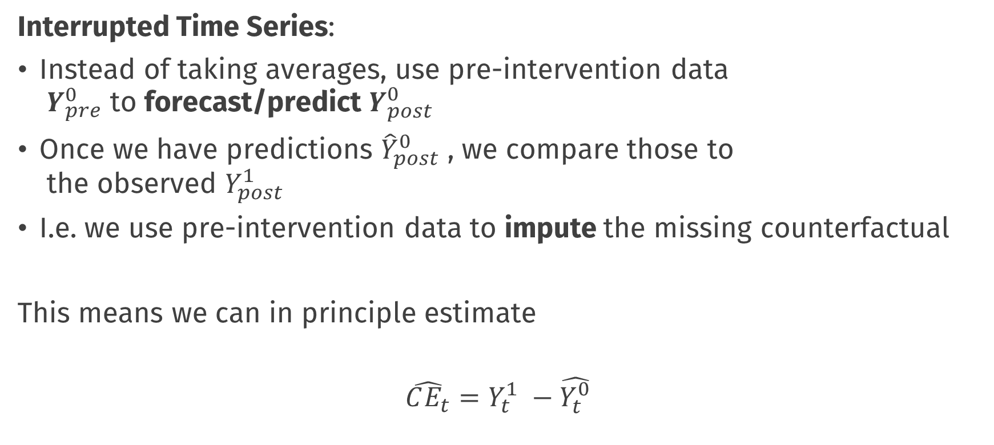
Interrupted Time Series
Interrupted Time Series:
Instead of taking averages, use pre-intervention data $Y_{pre}^{0}$ to forecast/predict $Y_{post}^{0}$
Once we have predictions ${\hat{Y}}_{post}^{0}$ , we compare those to the observed $Y_{post}^{1}$
I.e. we use pre-intervention data to impute the missing counterfactual
This means we can in principle estimate
$$\hat{CE_{t}}=Y_{t}^{1} −\hat{Y_{t}^{0}}$$

Slide 5
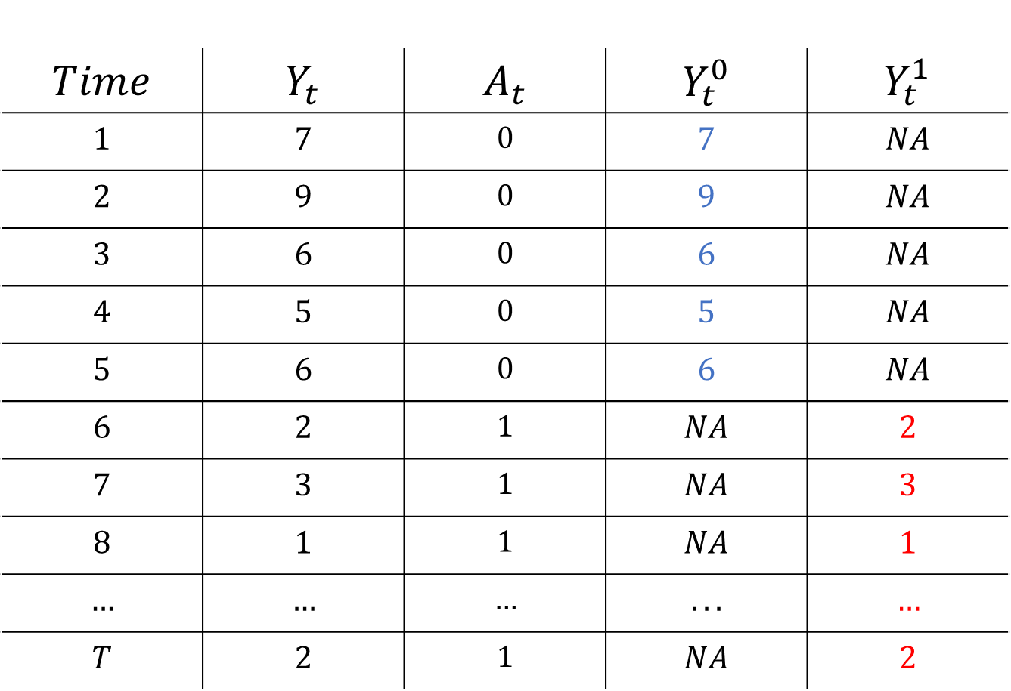
$$Time$$ | $$Y_{t}$$ | $$A_{t}$$ | $$Y_{t}^{0}$$ | $$Y_{t}^{1}$$
$$1$$ | $$7$$ | $$0$$ | $$7$$ | $$NA$$
$$2$$ | $$9$$ | $$0$$ | $$9$$ | $$NA$$
$$3$$ | $$6$$ | $$0$$ | $$6$$ | $$NA$$
$$4$$ | $$5$$ | $$0$$ | $$5$$ | $$NA$$
$$5$$ | $$6$$ | $$0$$ | $$6$$ | $$NA$$
$$6$$ | $$2$$ | $$1$$ | $$NA$$ | $$2$$
$$7$$ | $$3$$ | $$1$$ | $$NA$$ | $$3$$
$$8$$ | $$1$$ | $$1$$ | $$NA$$ | $$1$$
$$…$$ | $$…$$ | $$…$$ | $$...$$ | $$…$$
$$T$$ | $$2$$ | $$1$$ | $$NA$$ | $$2$$

Slide 6

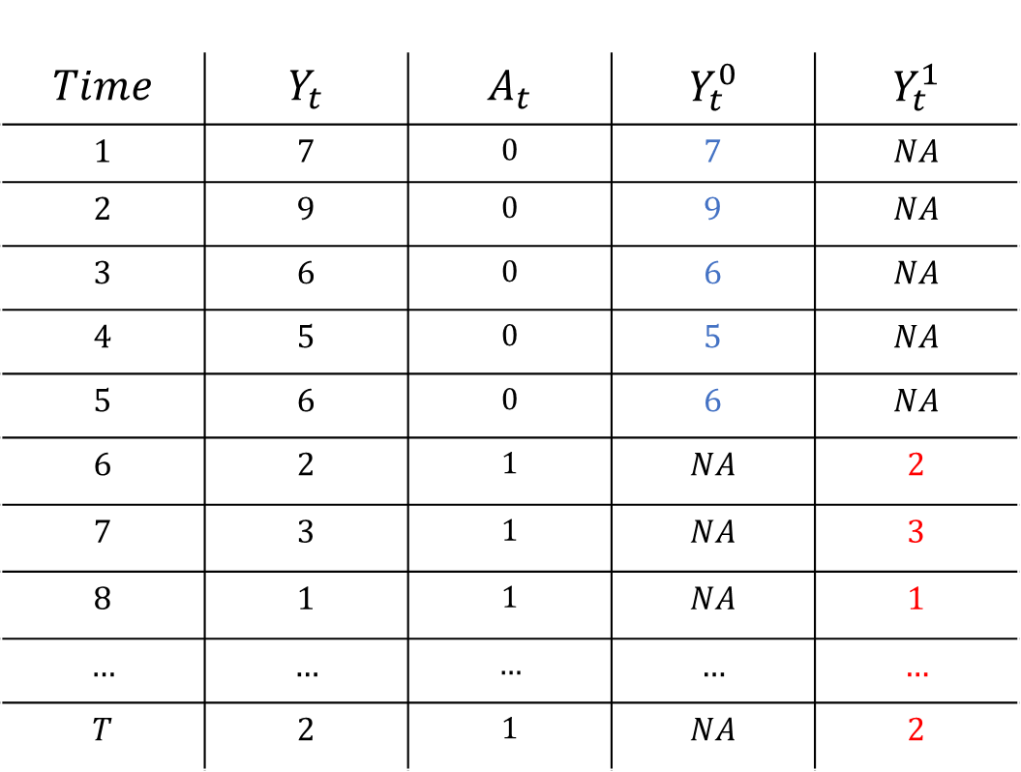
Interrupted Time Series
$$Time$$ | $$Y_{t}$$ | $$A_{t}$$ | $$Y_{t}^{0}$$ | $$Y_{t}^{1}$$
$$1$$ | $$7$$ | $$0$$ | $$7$$ | $$NA$$
$$2$$ | $$9$$ | $$0$$ | $$9$$ | $$NA$$
$$3$$ | $$6$$ | $$0$$ | $$6$$ | $$NA$$
$$4$$ | $$5$$ | $$0$$ | $$5$$ | $$NA$$
$$5$$ | $$6$$ | $$0$$ | $$6$$ | $$NA$$
$$6$$ | $$2$$ | $$1$$ | $$NA$$ | $$2$$
$$7$$ | $$3$$ | $$1$$ | $$NA$$ | $$3$$
$$8$$ | $$1$$ | $$1$$ | $$NA$$ | $$1$$
$$…$$ | $$…$$ | $$…$$ | $$…$$ | $$…$$
$$T$$ | $$2$$ | $$1$$ | $$NA$$ | $$2$$
Fit a forecasting Model
$$\hat{Y_{t}}=φ_{1}Y_{t−1}+φ_{2}Y_{t−2}+…β ∗ Time$$

Slide 7
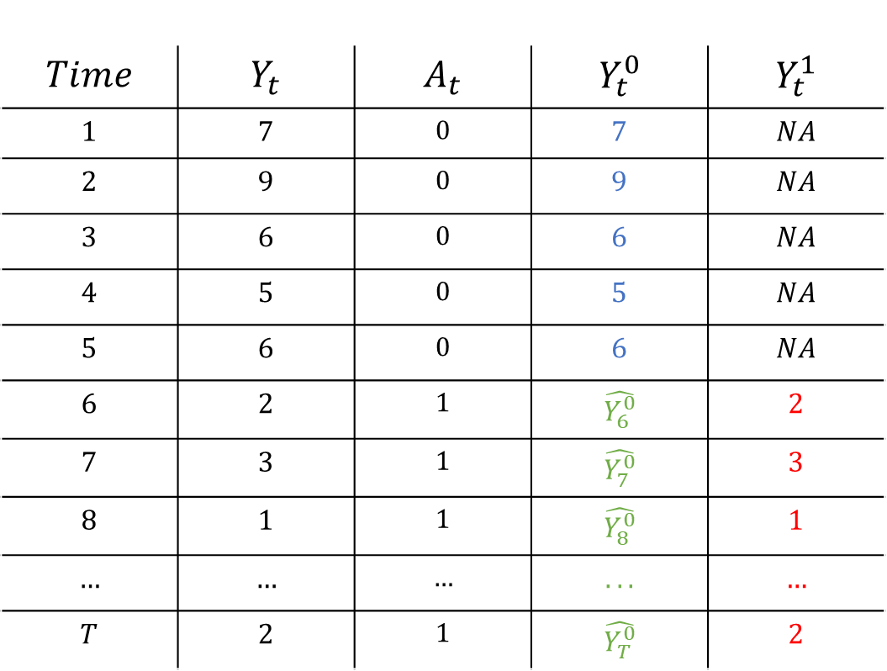
Interrupted Time Series
$$Time$$ | $$Y_{t}$$ | $$A_{t}$$ | $$Y_{t}^{0}$$ | $$Y_{t}^{1}$$
$$1$$ | $$7$$ | $$0$$ | $$7$$ | $$NA$$
$$2$$ | $$9$$ | $$0$$ | $$9$$ | $$NA$$
$$3$$ | $$6$$ | $$0$$ | $$6$$ | $$NA$$
$$4$$ | $$5$$ | $$0$$ | $$5$$ | $$NA$$
$$5$$ | $$6$$ | $$0$$ | $$6$$ | $$NA$$
$$6$$ | $$2$$ | $$1$$ | $$\hat{Y_{6}^{0}}$$ | $$2$$
$$7$$ | $$3$$ | $$1$$ | $$\hat{Y_{7}^{0}}$$ | $$3$$
$$8$$ | $$1$$ | $$1$$ | $$\hat{Y_{8}^{0}}$$ | $$1$$
$$…$$ | $$…$$ | $$…$$ | $$...$$ | $$…$$
$$T$$ | $$2$$ | $$1$$ | $$\hat{Y_{T}^{0}}$$ | $$2$$
Fit a forecasting Model
$$\hat{Y_{t}}=φ_{1}Y_{t−1}+φ_{2}Y_{t−2}+…β ∗ Time$$
Make forecasts

Slide 8


Interrupted Time Series
$$Time$$ | $$Y_{t}$$ | $$A_{t}$$ | $$Y_{t}^{0}$$ | $$Y_{t}^{1}$$
$$1$$ | $$7$$ | $$0$$ | $$7$$ | $$NA$$
$$2$$ | $$9$$ | $$0$$ | $$9$$ | $$NA$$
$$3$$ | $$6$$ | $$0$$ | $$6$$ | $$NA$$
$$4$$ | $$5$$ | $$0$$ | $$5$$ | $$NA$$
$$5$$ | $$6$$ | $$0$$ | $$6$$ | $$NA$$
$$6$$ | $$2$$ | $$1$$ | $$\hat{Y_{6}^{0}}$$ | $$2$$
$$7$$ | $$3$$ | $$1$$ | $$\hat{Y_{7}^{0}}$$ | $$3$$
$$8$$ | $$1$$ | $$1$$ | $$\hat{Y_{8}^{0}}$$ | $$1$$
$$…$$ | $$…$$ | $$…$$ | $$...$$ | $$…$$
$$T$$ | $$2$$ | $$1$$ | $$\hat{Y_{T}^{0}}$$ | $$2$$
Fit a forecasting Model
$$\hat{Y_{t}}=φ_{1}Y_{t−1}+φ_{2}Y_{t−2}+…β ∗ Time$$
Make forecasts
$$\hat{CE_{t}}=Y_{t}^{1} −\hat{Y_{t}^{0}}$$

Slide 9
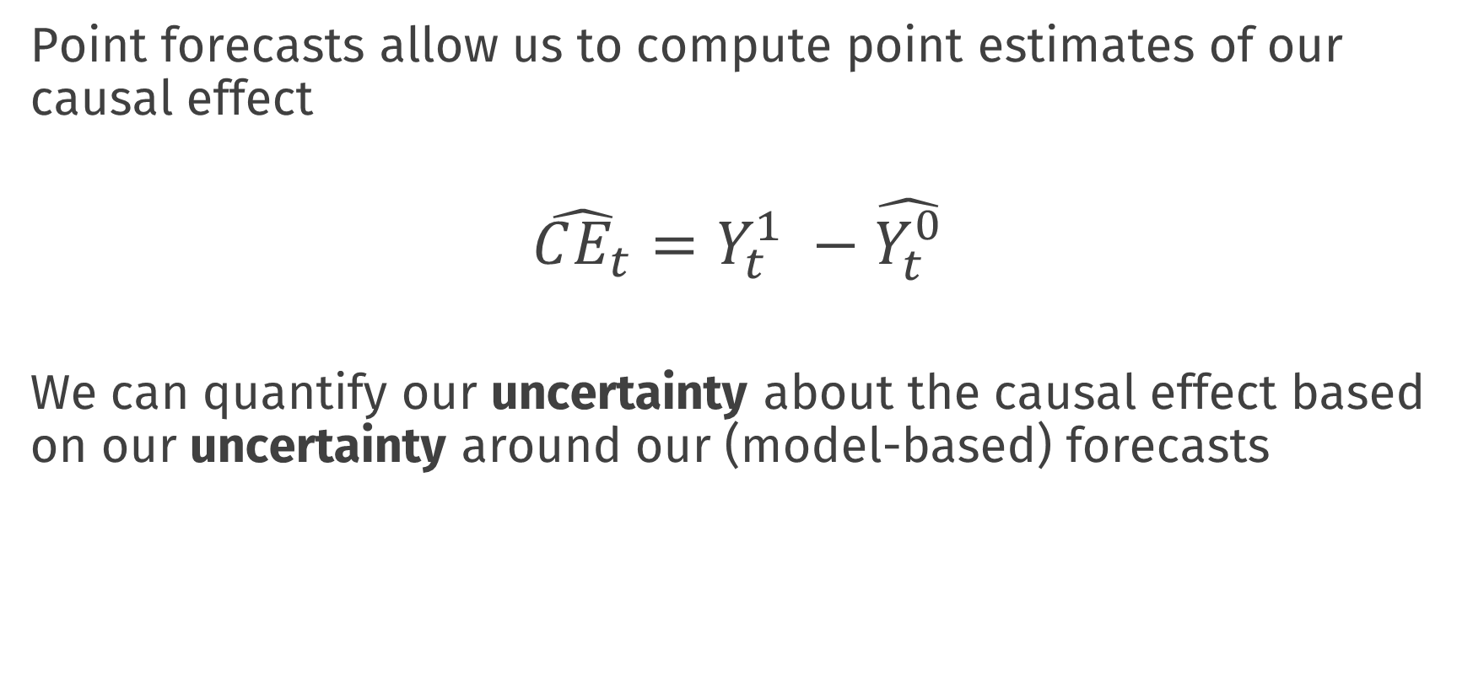
Interrupted Time Series
Point forecasts allow us to compute point estimates of our causal effect
$$\hat{CE_{t}}=Y_{t}^{1} −\hat{Y_{t}^{0}}$$
We can quantify our uncertainty about the causal effect based on our uncertainty around our (model-based) forecasts

Slide 10

Building a forecasting model
Much of the challenge of this approach is in choosing an appropriate forecasting model
These can be very simple or very complex, e.g.:
If we forecast with the mean we are very close to the post – pre analysis
$$Y_{t}=μ_{pre}+e_{t}$$

Slide 11


Building a forecasting model
Much of the challenge of this approach is in choosing an appropriate forecasting model
These can be very simple or very complex, e.g.:
If we forecast with the mean we are very close to the post – pre analysis
$$Y_{t}=μ_{pre}+e_{t}$$
If we forecast with a growth curve we would model the overall time trend
$$Y_{t}=β_{0}+ β_{1} Time+e_{t}$$

Slide 12
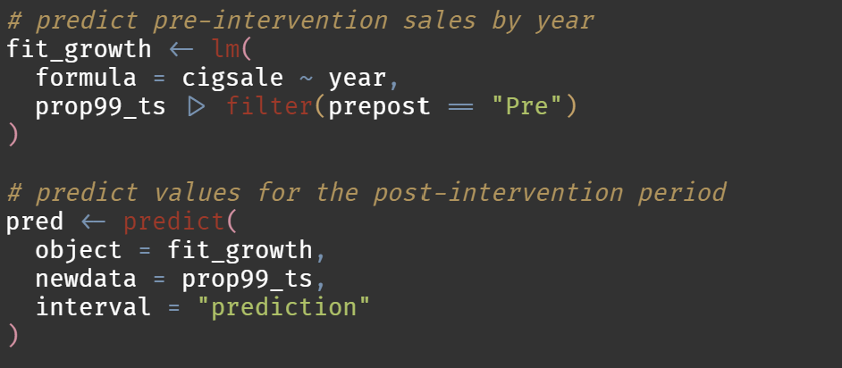
Forecasting with growth curves

Slide 13
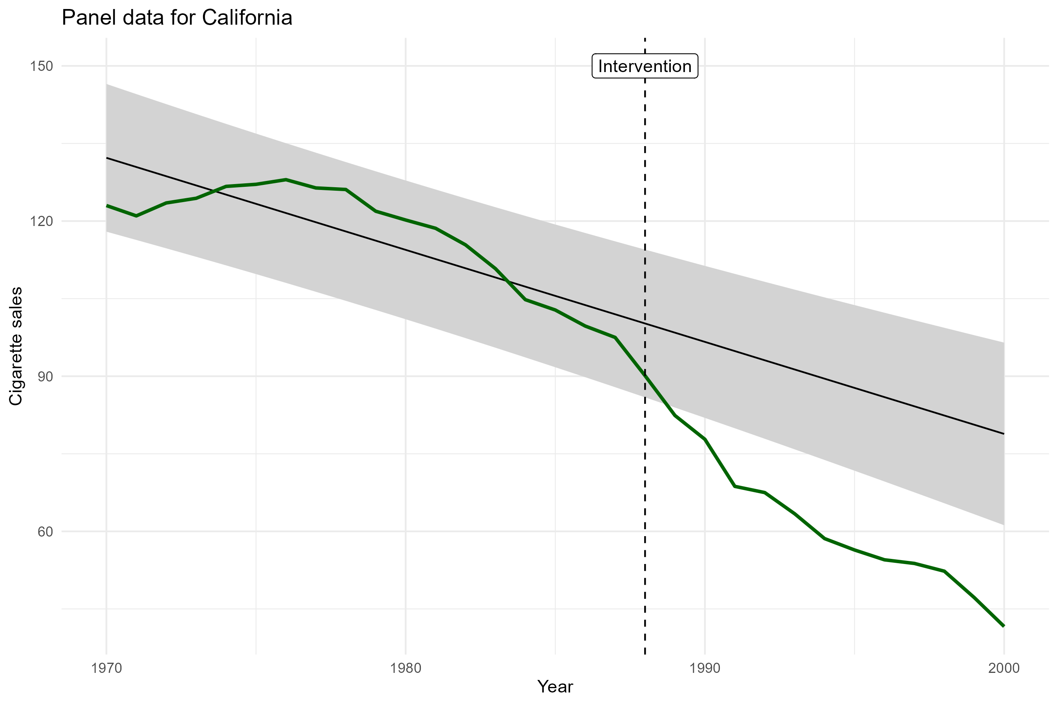

Slide 14




Building a forecasting model
Much of the challenge of this approach is in choosing an appropriate forecasting model
These can be very simple or very complex, e.g.:
If we forecast with the mean we are very close to the post – pre analysis
$$Y_{t}=μ_{pre}+e_{t}$$
If we forecast with a growth curve we would model the overall time trend
$$Y_{t}=β_{0}+ β_{1} Time+e_{t}$$
We can also forecast by using time-series models that model autocorrelation
e.g. ARIMA models can account for autocorrelation and time trends
$$Y_{t}=φ_{1}Y_{t−1 }+e_{t}$$
$$Y_{t}=φ_{1}Y_{t−1 }+φ_{2}Y_{t−2}+e_{t}$$
$$Y_{t}−Y_{t−1}=γe_{t−1} +e_{t}$$

Slide 15
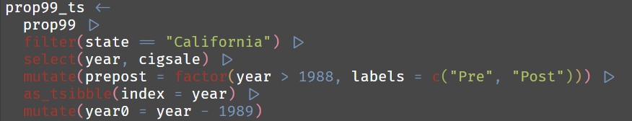
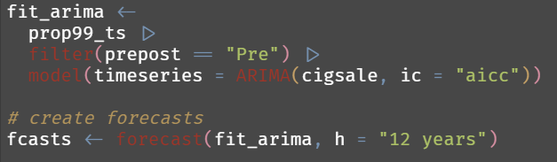
Fitting time-series models fpp3
Prep data as tsibble object
Fit a model (automatic model selection on AR, differencing, and MA components) and produce forecasts

Slide 16
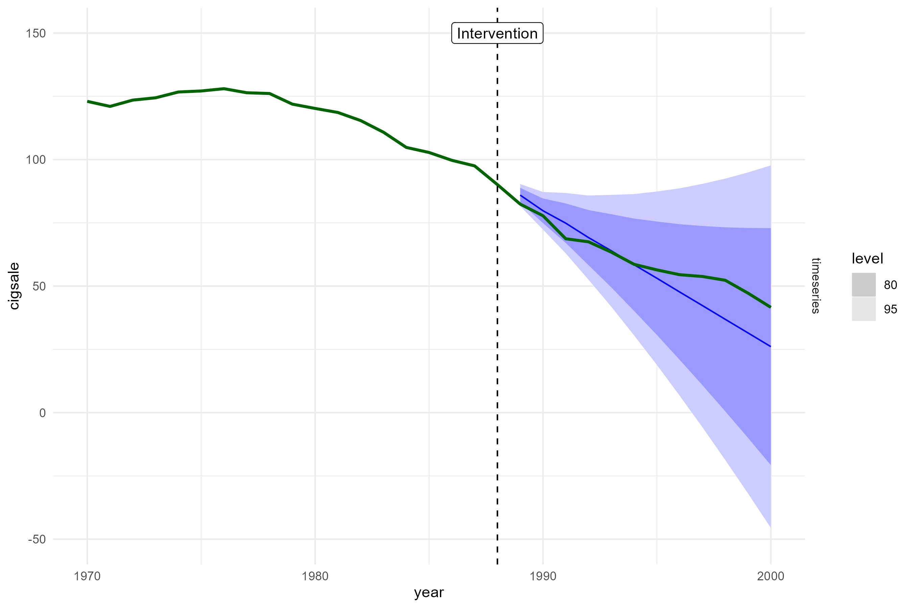

Slide 17
Key Assumptions
Our inferences about the causal effect are entirely dependent on being able to fit an appropriate forecasting model
i.e. one that correctly captures the trend and autocorrelation structures in the data
In practice, this may be very difficult

Slide 18
Key Assumptions
Data driven approaches can be applied, but may only be feasible with a large amount of pre-intervention training data
We use information criteria for model selection
See also: cross-validation
In addition, different forecasting models come with their own assumptions,
- E.g. constant trend or time-invariant relationships
Poor forecasts = Poor estimates (and uncertainty) of causal effects

Slide 19
Key Assumptions
When comparing to the pre-post design;
We relax the no-trend assumption: we model any trend / serial dependence
No-confounding assumption:
- We still assume that any changes can be attributed to the intervention
And not, e.g., something else that happened around the same time
To tackle that we need control units + other assumptions

Slide 20
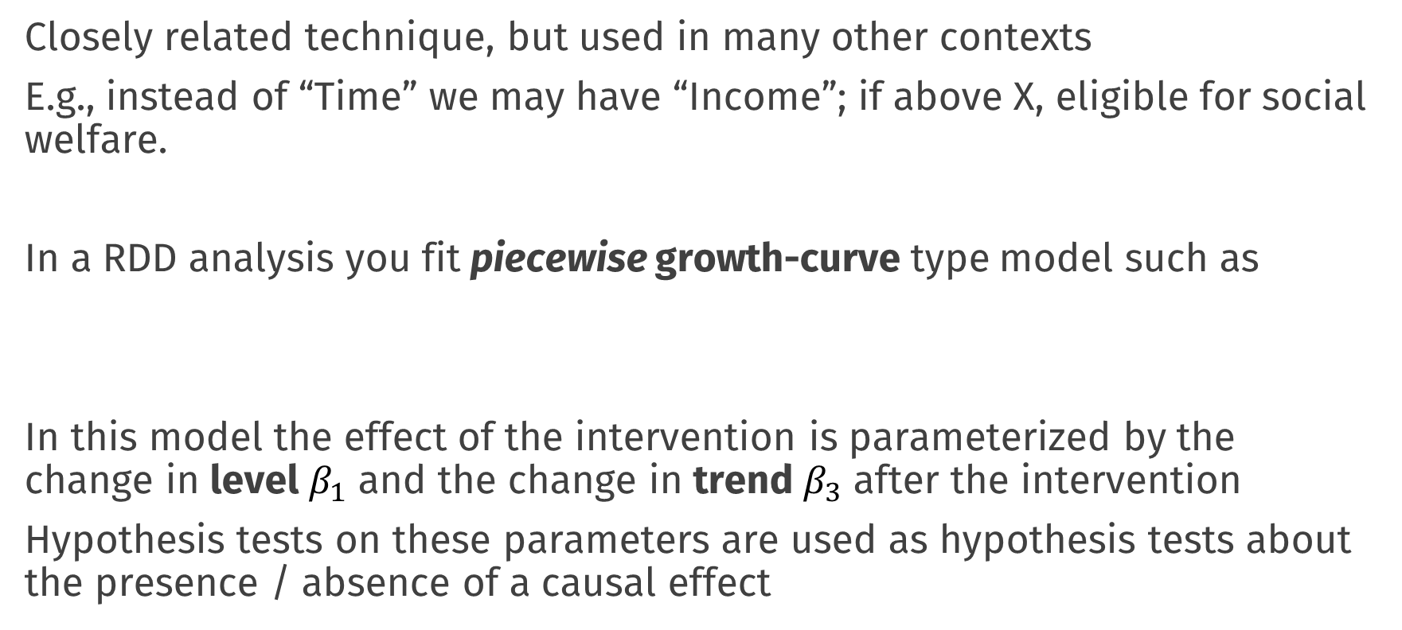
Regression Discontinuity (RDD)
Closely related technique, but used in many other contexts
E.g., instead of “Time” we may have “Income”; if above X, eligible for social welfare.
In a RDD analysis you fit piecewise growth-curve type model such as
In this model the effect of the intervention is parameterized by the change in level $β_{1}$ and the change in trend $β_{3}$ after the intervention
Hypothesis tests on these parameters are used as hypothesis tests about the presence / absence of a causal effect
$$Y_{t}=β_{0}+β_{1}A_{t}{+ β}_{2} Time+β_{3}∗Time ∗A_{t}+e_{t}$$

Slide 21
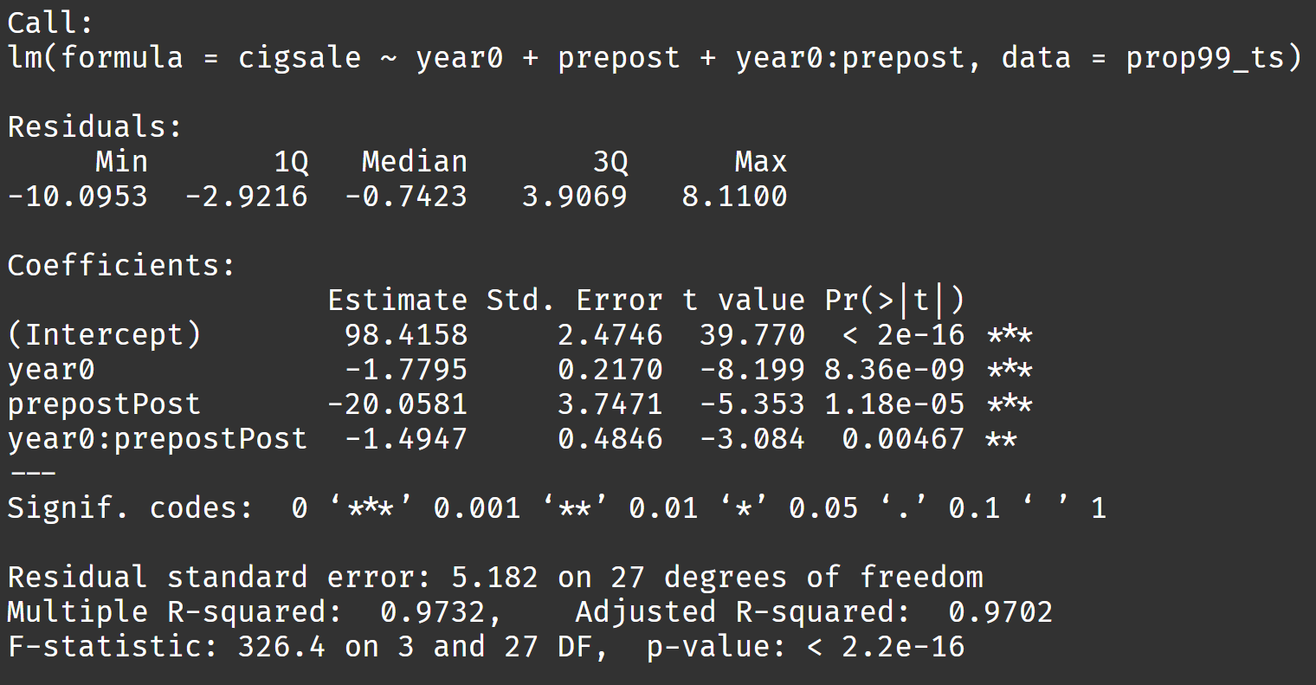
Regression Discontinuity in Practice

Slide 22
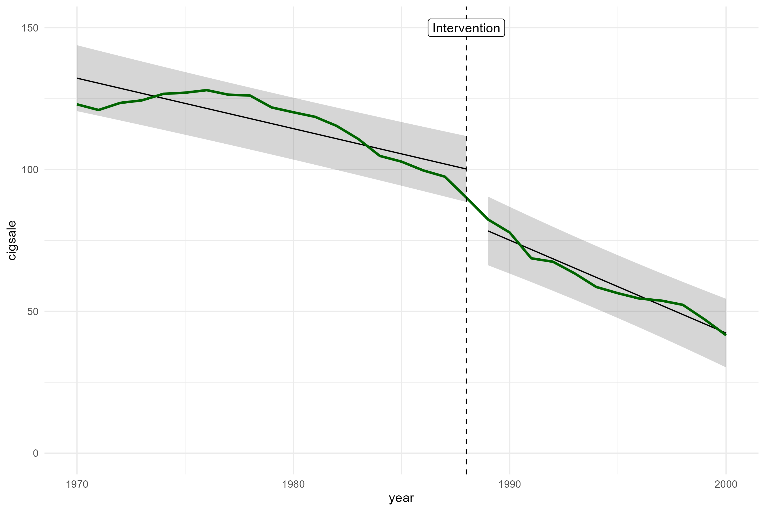
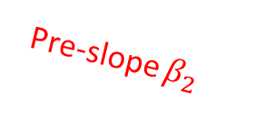
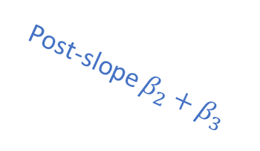
Pre-slope $β_{2}$
Post-slope $β_{2}+β_{3}$

Slide 23
Regression Discontinuity
Basic Idea:
Directly model whatever changes you think happen to the target process
Instead of making forecasts/predictions of the counterfactual directly
Advantages
More direct. Inference about CE based on significance tests on “change” parameters
Many extensions and theory to deal with, e.g., “sharp” vs “fuzzy” designs
Disadvantages
Strongly rely on correct model specification and interpretability; specify where or how the intervention has an effect
Notes:
In ITS; model itself not as interesting, focus only on if post-observations are “unusual” relative to what you would expect

Slide 24
Practical
Work in your groups!

Slide 25
Lunch

Slide 26
Default light slide
Default subheading
This is the body of the text
Default subheading
Note that the text is not black, but “black, text 1, lighter 25%”
Default subheading
This makes things easier on the eyes
Default subheading
This is the body of the text

