Slide 1
Hierarchical Beta regression
Inference for proportions with the brms package in R
Erik-Jan van Kesteren

Slide 2
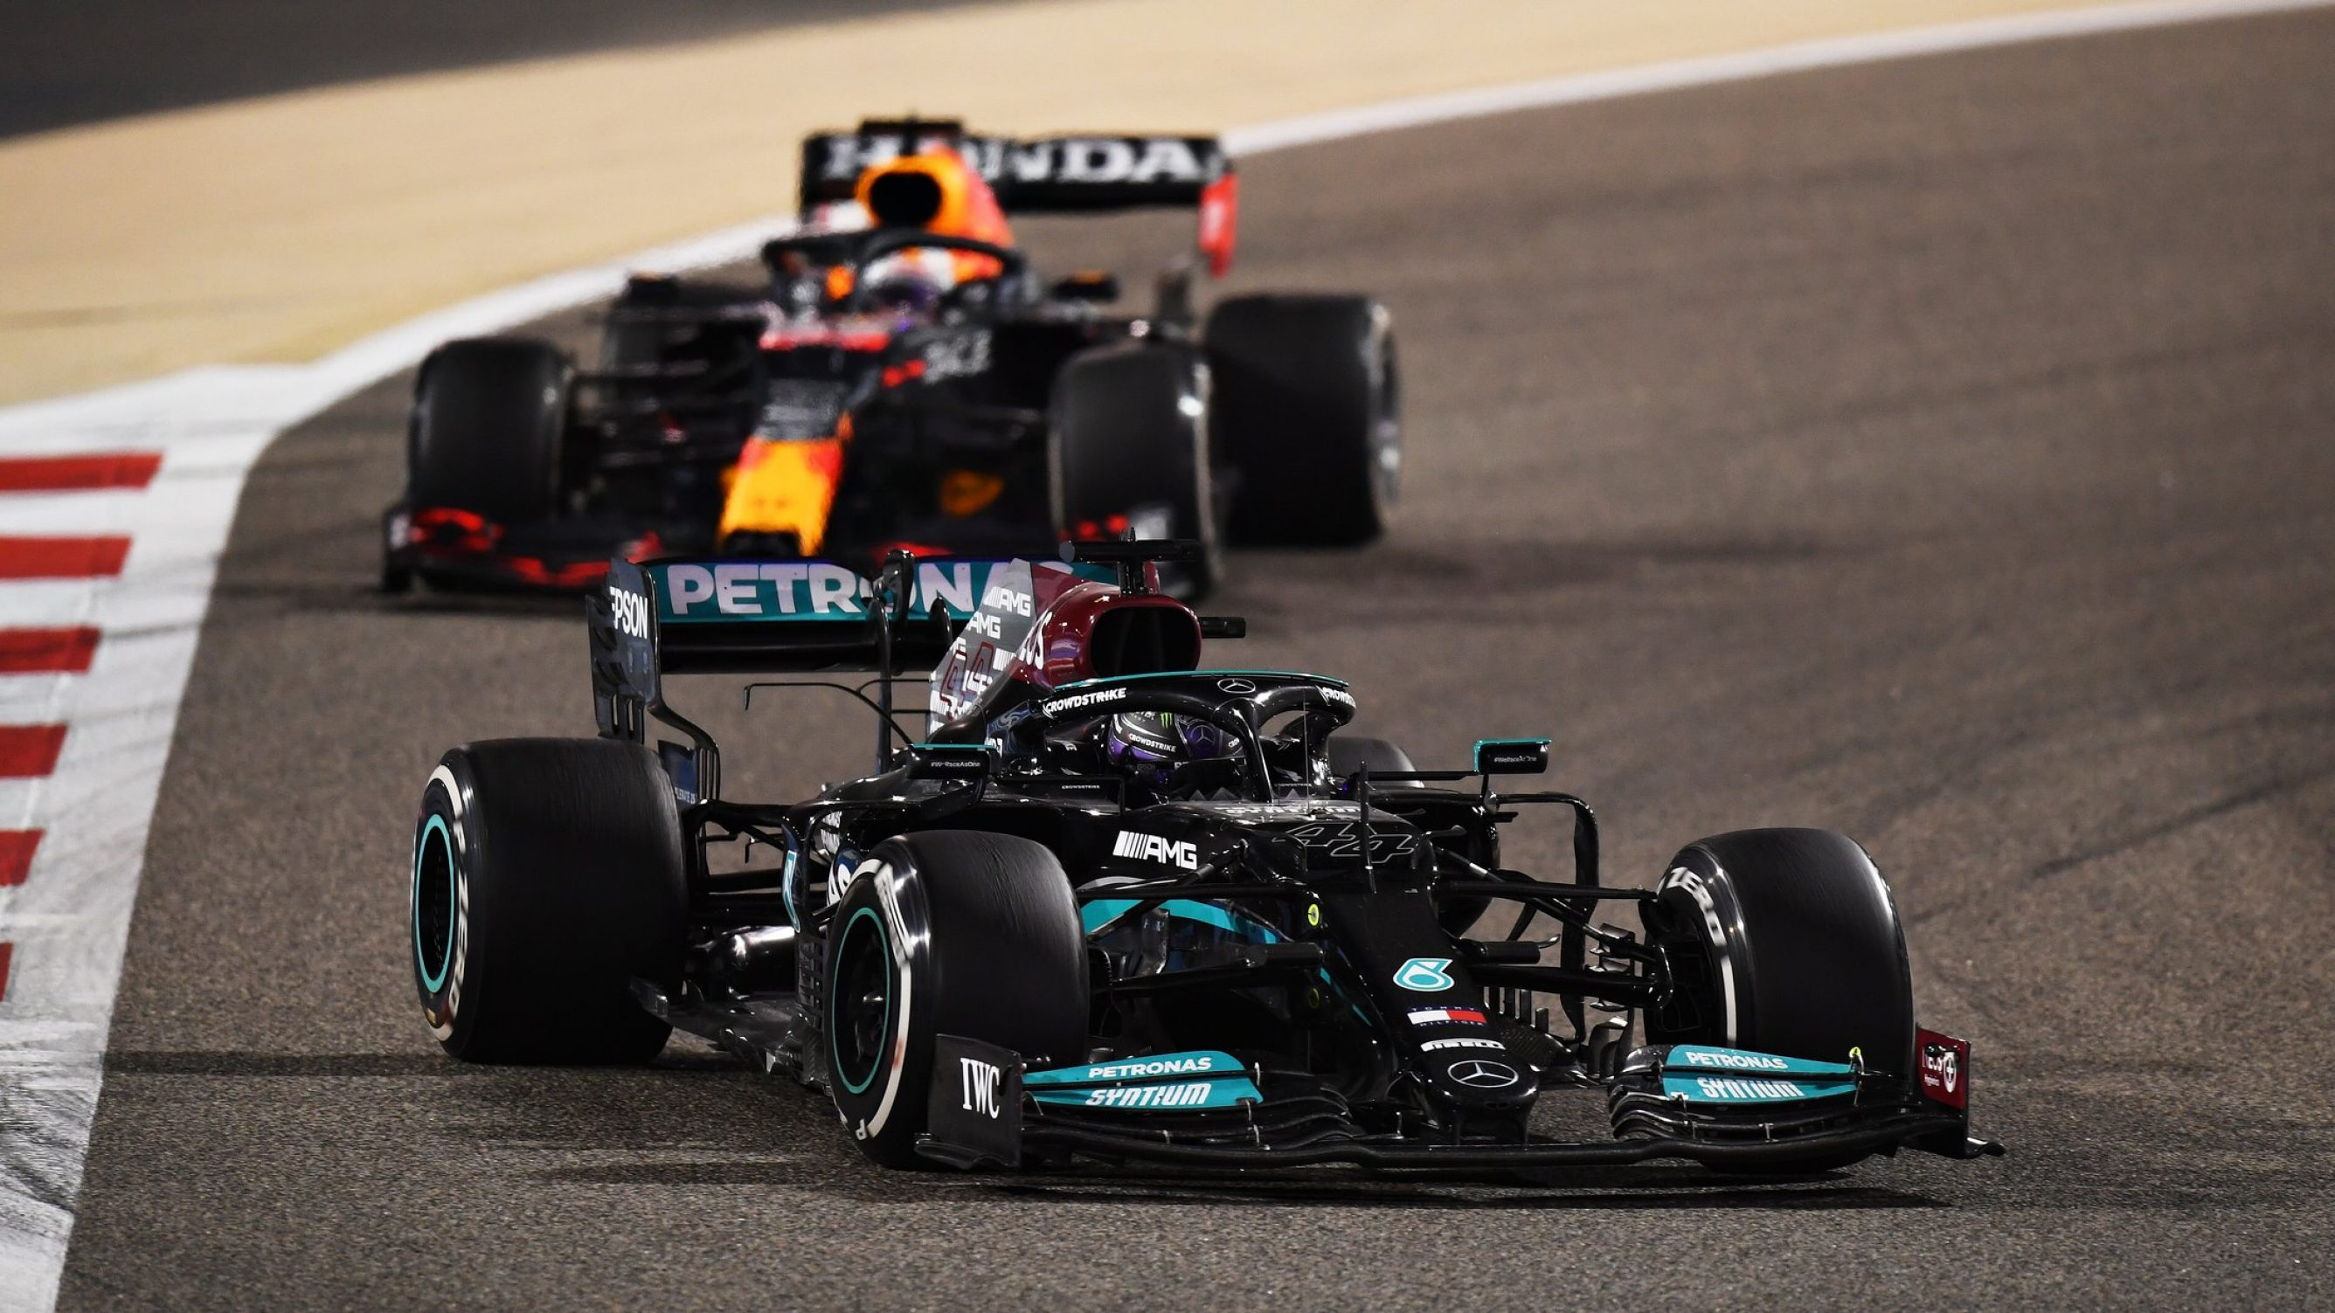
Clive Mason - Formula 1/Formula 1 via Getty Images
Notes:
https://www.formula1.com/content/dam/fom-website/sutton/2021/Bahrain/Sunday/1309596249.jpg.transform/9col-retina/image.jpg
(Photo by Clive Mason - Formula 1/Formula 1 via Getty Images)

Slide 3
Who’s the best F1 driver?
Disentangling driver talent & constructor advantage using Bayesian
beta regression
Erik-Jan van Kesteren

Slide 4
Outline
The data
F1 eras, seasons, constructors, and drivers.
The model
Bayesian multilevel beta regression model
Posterior predictive checks
Comparing generated data from the model to true observations
Inferences
Investigating driver talent & constructor advantage

Slide 5
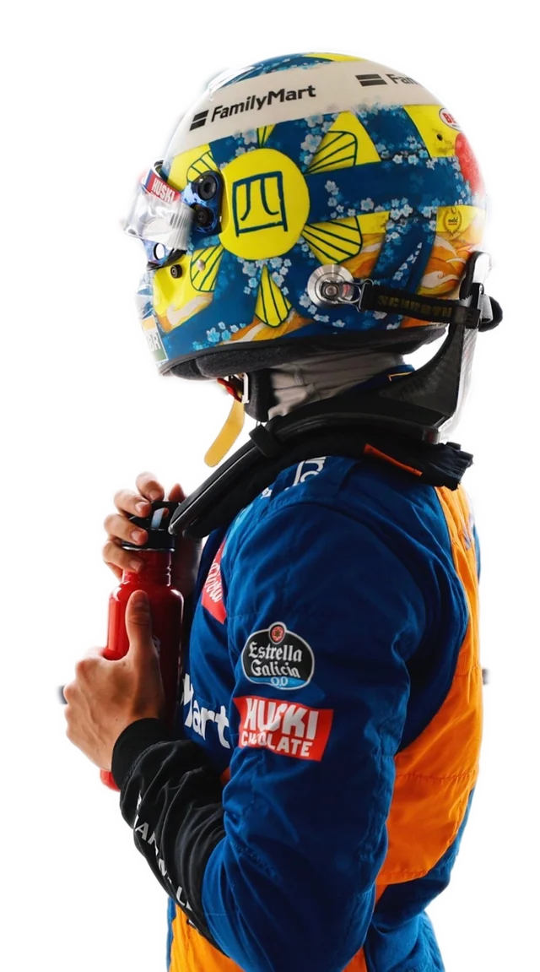
The data: Formula 1
The hybrid era of F1
Rules & regulations change
Most notably: engine regulations
2014-2021 is known as the “hybrid era”
Every year/season has around 21 races
The constructors
There are around 10 teams
Two cars each, new cars each year
Teams change owners & name
New teams enter sometimes
Ferrari, Mercedes & Red Bull are rich
The drivers
Drivers usually enter F1 with a “junior” team
They change team: everyone wants to go to the best teams
Drivers are compared to their teammates a lot
Being a good driver means:
  Driving really fast
  Managing tires
  Being consistent
  Overtaking others
Notes:
https://www.reddit.com/r/formula1/comments/dgu0gr/lando_wearing_his_handpainted_helmet_at_suzuka/?utm_source=share&utm_medium=web2x&context=3

Slide 6
The data: Ergast API
An open API to request data from motorsports races
I’m not really sure who maintains it but it’s free for non-commercial use
library(httr)
library(tidyverse)
library(glue)
get_result_table <- function(year, round) {
url <- parse_url("http://ergast.com")
url$path <- glue("api/f1/{year}/{round}/results.json")
res <- GET(url)
res_json <- fromJSON(rawToChar(res$content))
dat <- res_json[["MRData"]][["RaceTable"]][["Races"]][["Results"]][[1]] # much nesting
return(as_tibble(dat))
}

Slide 7
The data: Ergast API
# A tibble: 2,827 x 7
driver driver_no position status constructor year round
<chr> <int> <int> <chr> <chr> <int> <int>
1 rosberg 6 1 Finished mercedes 2014 1
2 kevin_magnussen 20 2 Finished mclaren 2014 1
3 button 22 3 Finished mclaren 2014 1
4 alonso 14 4 Finished ferrari 2014 1
5 bottas 77 5 Finished williams 2014 1
6 hulkenberg 27 6 Finished force_india 2014 1
7 raikkonen 7 7 Finished ferrari 2014 1
8 vergne 25 8 Finished toro_rosso 2014 1
9 kvyat 26 9 Finished toro_rosso 2014 1
10 perez 11 10 Finished force_india 2014 1
# ... with 2,817 more rows

Slide 8
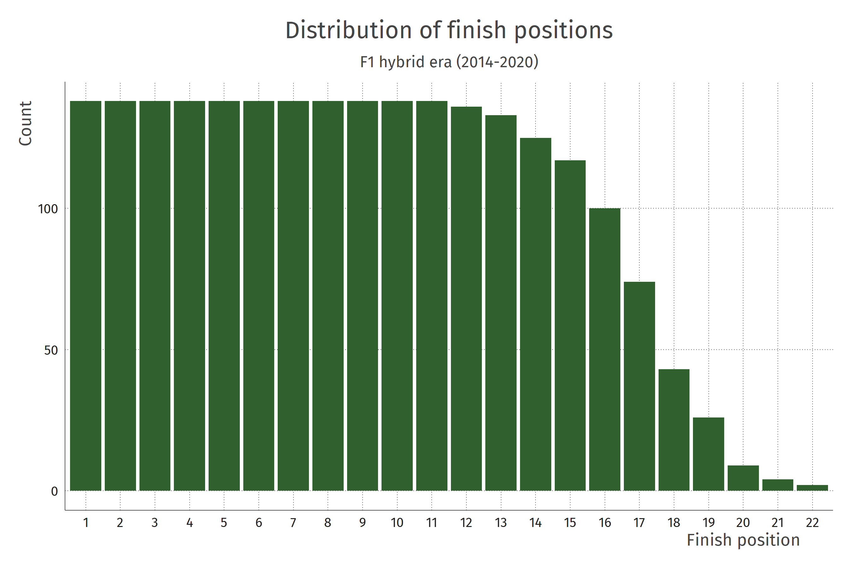
Data processing
There are many accidents
Drivers may make a mistake
Constructors may tune the engine wrong
Random stuff may happen
The world is complicated
SIMPLIFYING ASSUMPTION
Look only at finished races

Slide 9
Is doing well due to the driver or due to the constructor?
Disentangling driver and constructor contribution to the finish position

Slide 10
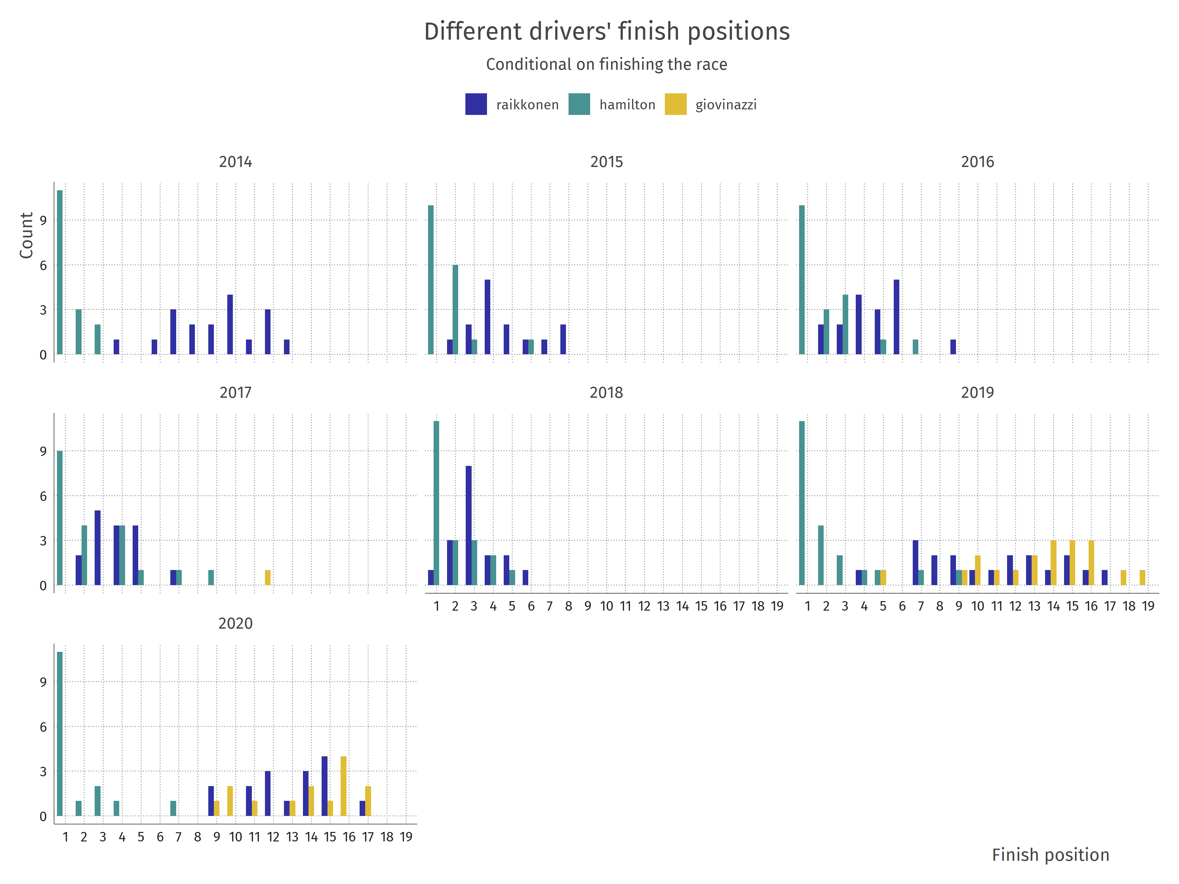

Slide 11
Data processing
I will model the proportion of drivers beaten
For each driver for each race, the proportion of drivers who finished behind the driver’s position
Smooth out this estimate using recommended procedure from the R package betareg
f1_dat %>%
group_by(year, round) %>%
mutate(
position_prop = (n() - position) / (n() - 1),
prop_trans = (position_prop * (n() - 1) + 0.5) / n()
)
Empirical probability (estimate) of beating an average driver driving for an average team

Slide 12
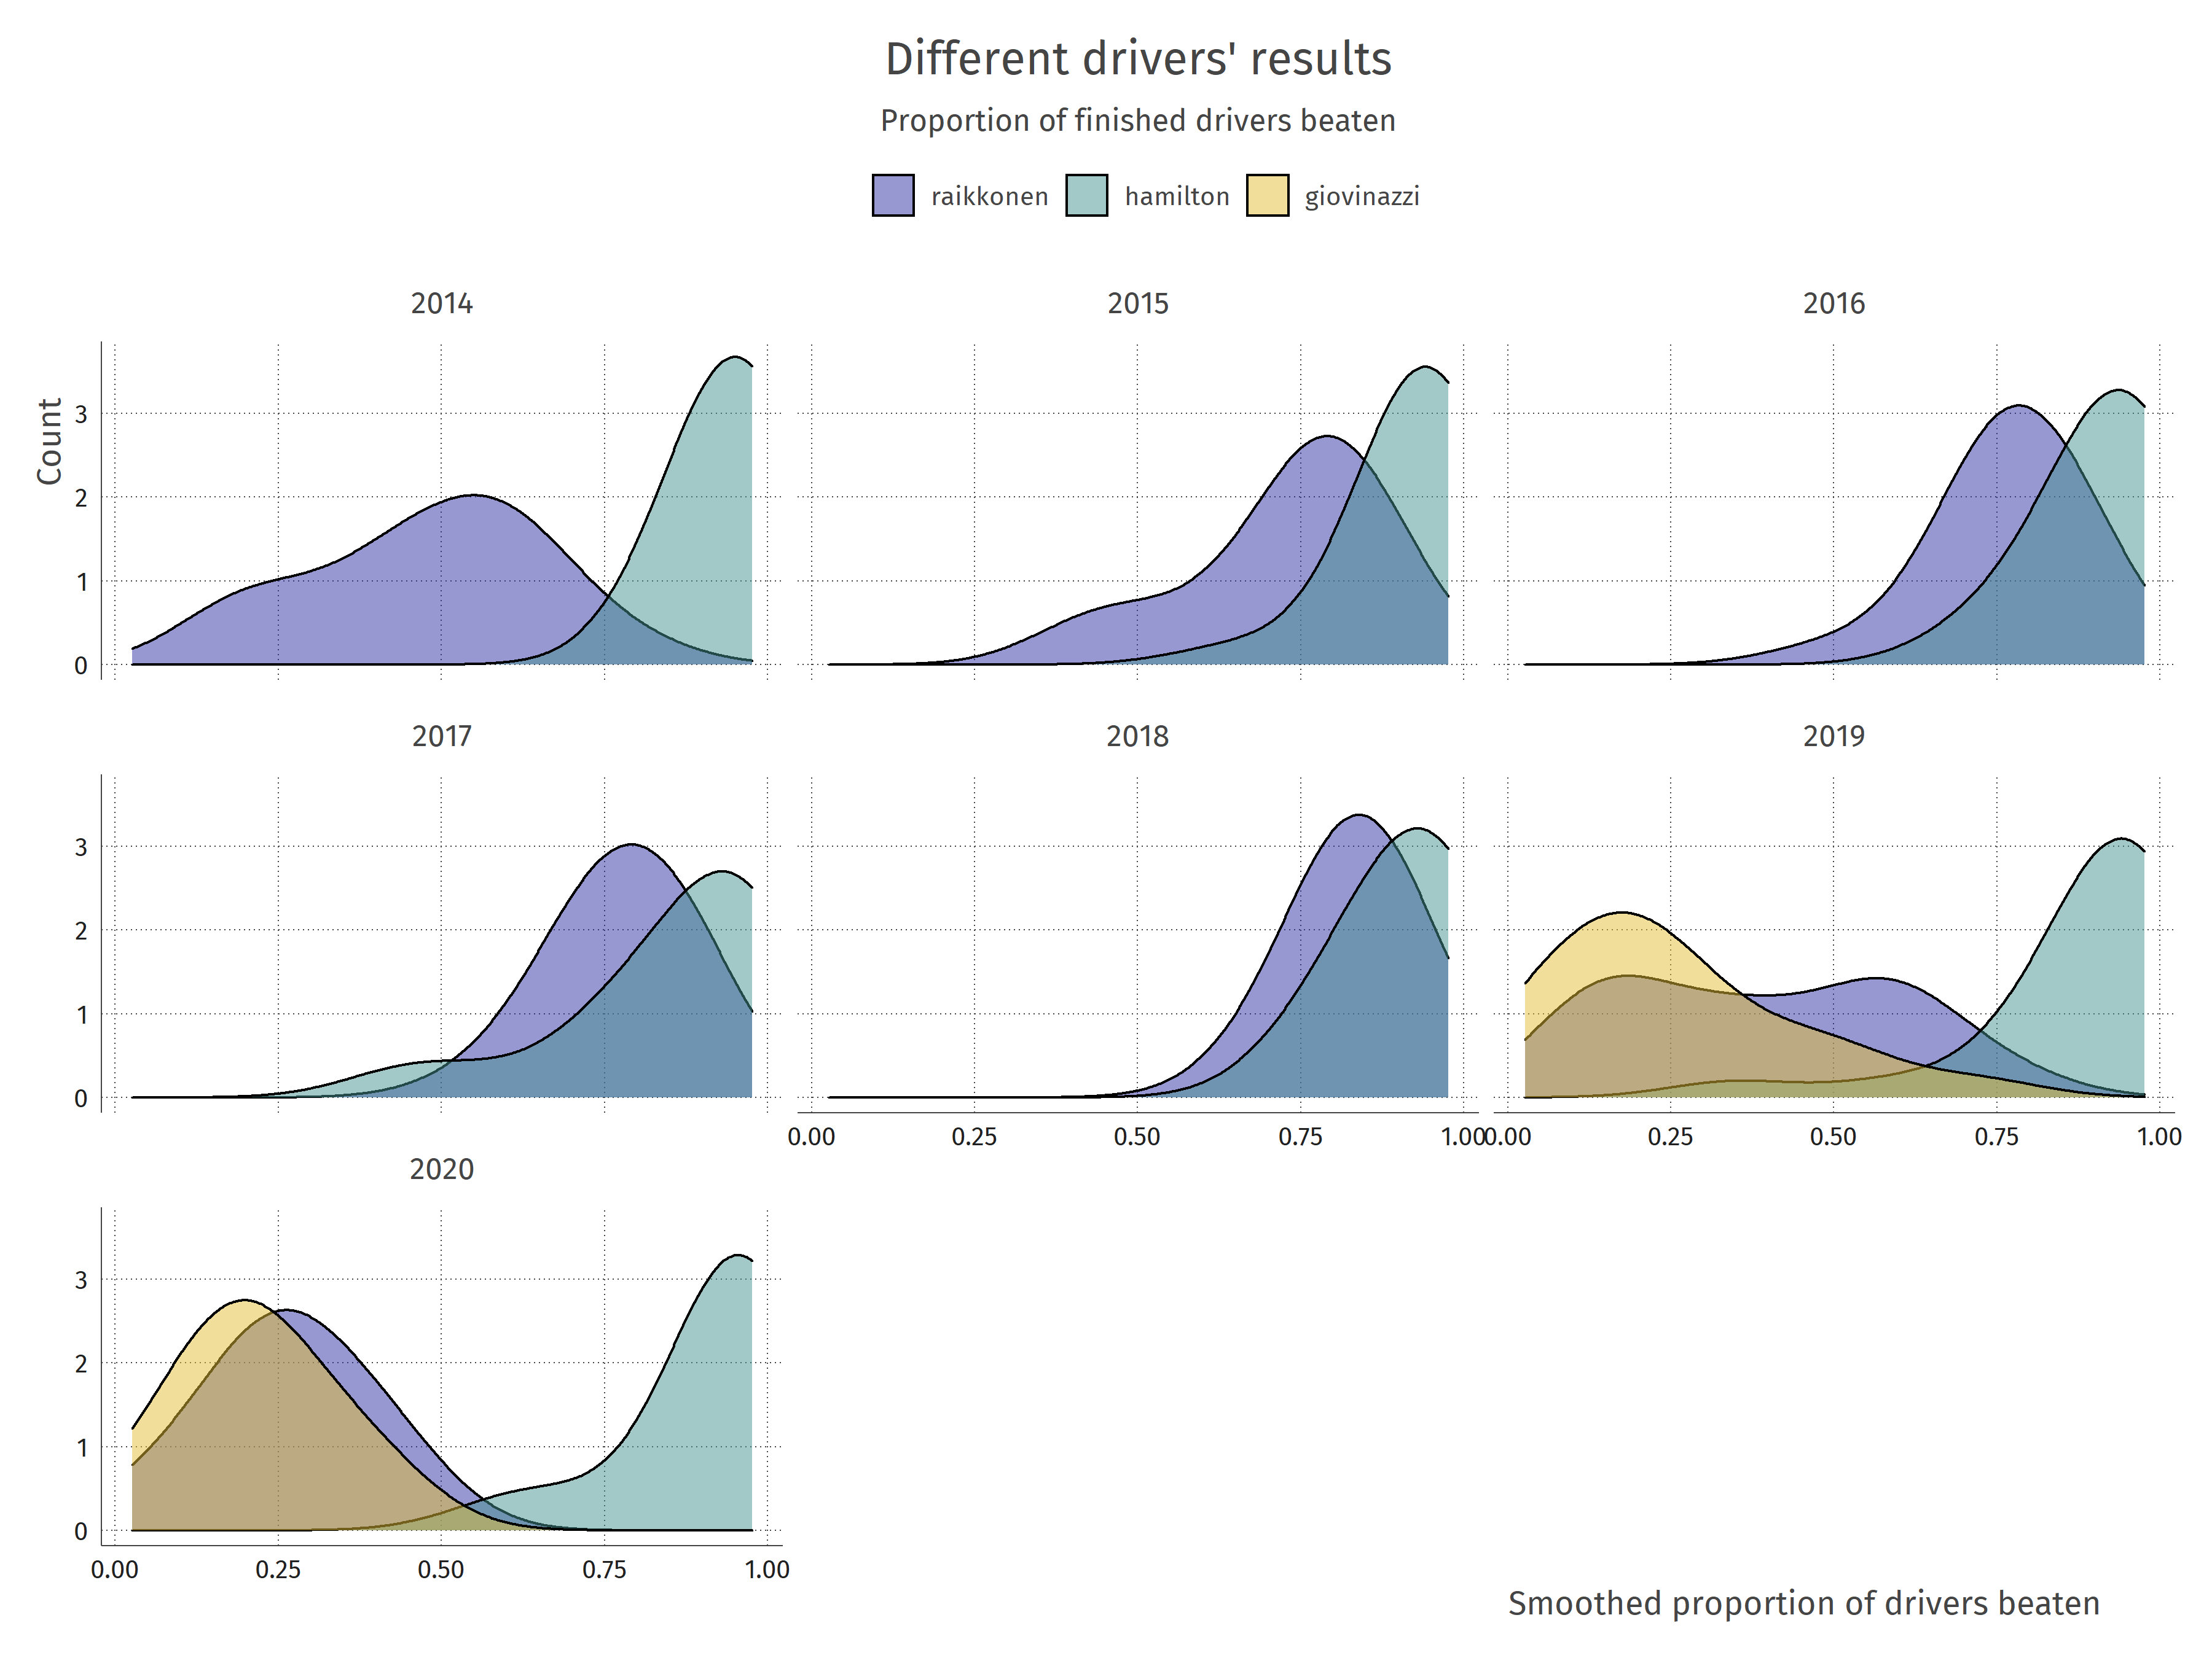

Slide 13
Model for a proportion
Hierarchical beta regression

Slide 14
Model for a proportion
for driver d, constructor c, in year y
logit link function
driver talent
average constructor advantage
yearly constructor form
Note that driver talent is assumed to be independent of constructor advantage!
Assumption: constructors do not “improve” or “destroy” talent of their drivers

Slide 15
Model for a proportion
fit <- brm(
formula = prop_trans ~ 0 + (1 | driver + constructor / year),
family = Beta(),
data = f1_dat,
backend = "cmdstanr",
cores = 4,
threads = 3
)
> prior_summary(fit)
prior class coef group
gamma(0.01, 0.01) phi
student_t(3, 0, 2.5) sd Intercept constructor
student_t(3, 0, 2.5) sd Intercept constructor:year
student_t(3, 0, 2.5) sd Intercept driver

Slide 16
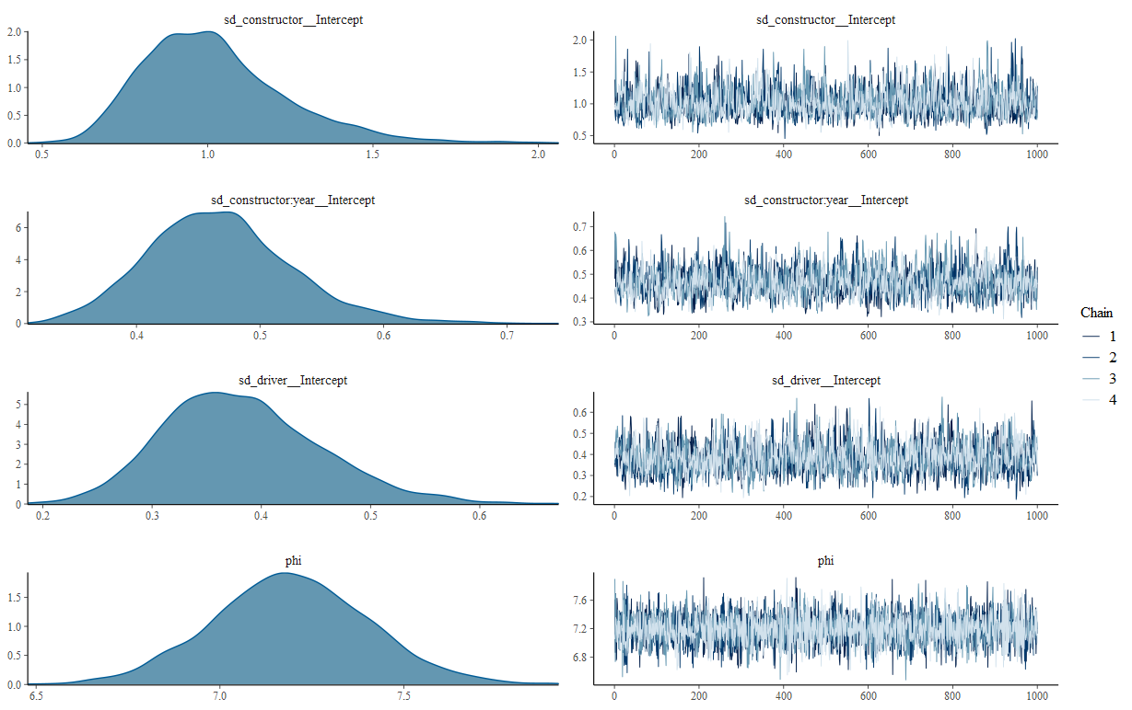
Model for a proportion

Slide 17
Does the model make sense?

Slide 18
Posterior predictive checks
For seasons 2015 and 2019
Compare observed proportion & model-implied proportion
Compare observed position (original untransformed variable) to model-implied position

Slide 19
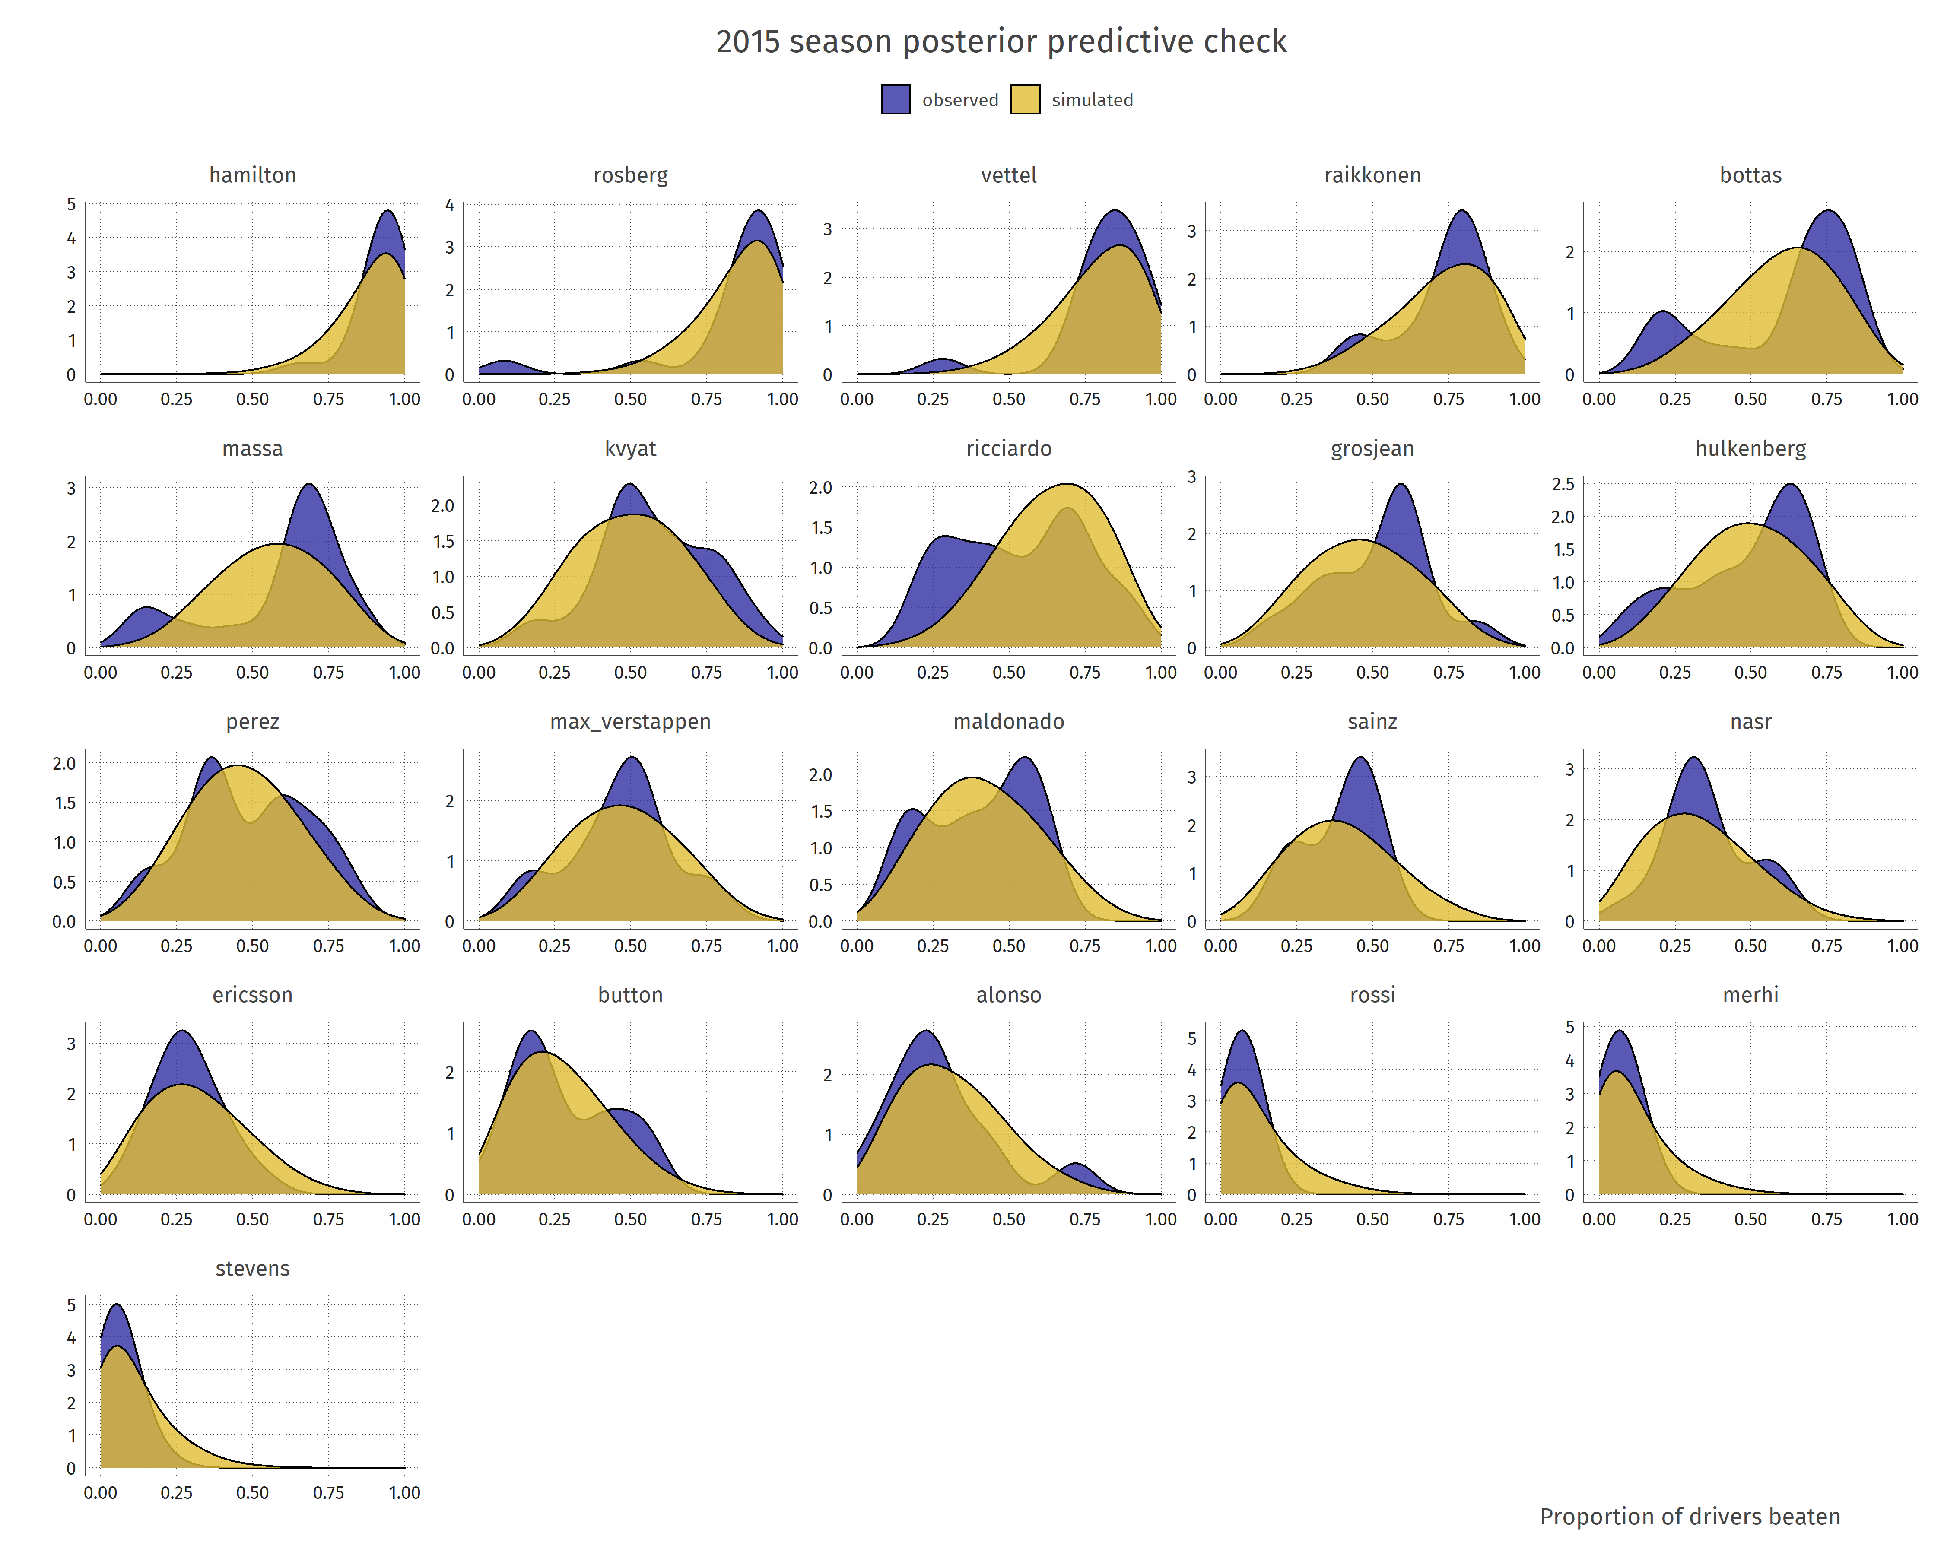

Slide 20
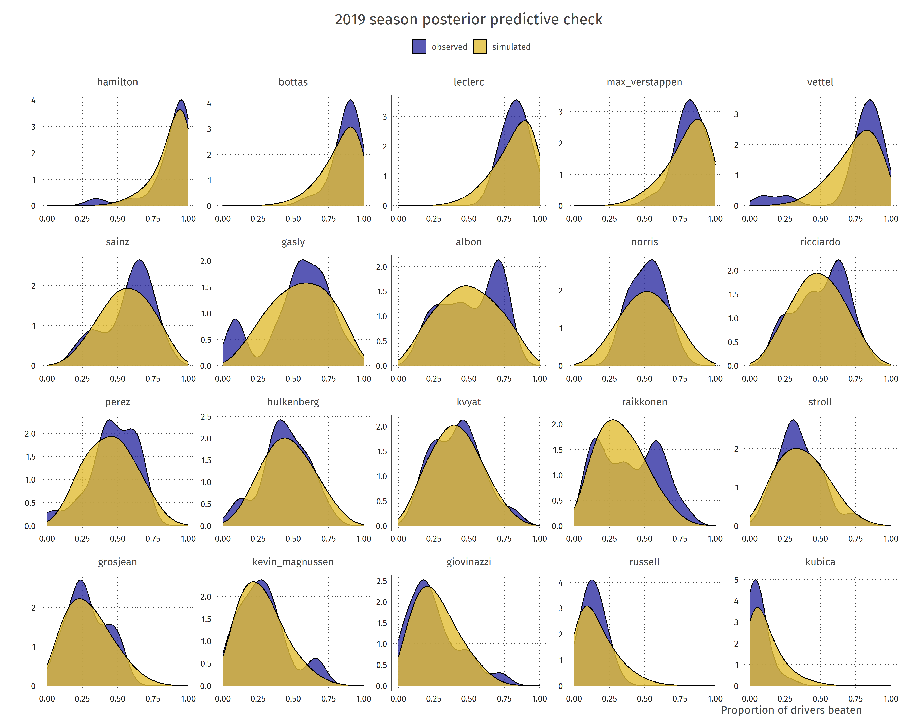

Slide 21
Model-implied position
A.K.A. MCMC is beautiful
For each of 4000 posterior samples:
  Obtain predicted proportion of drivers beaten for each driver
  Rank the proportions
  Result: finish position in a hypothetical race where all drivers finish
For each driver
  Resample ranks weighted by →
  Result: sample of finish position
  Assumes this distribution holds
  for each driver

Slide 22
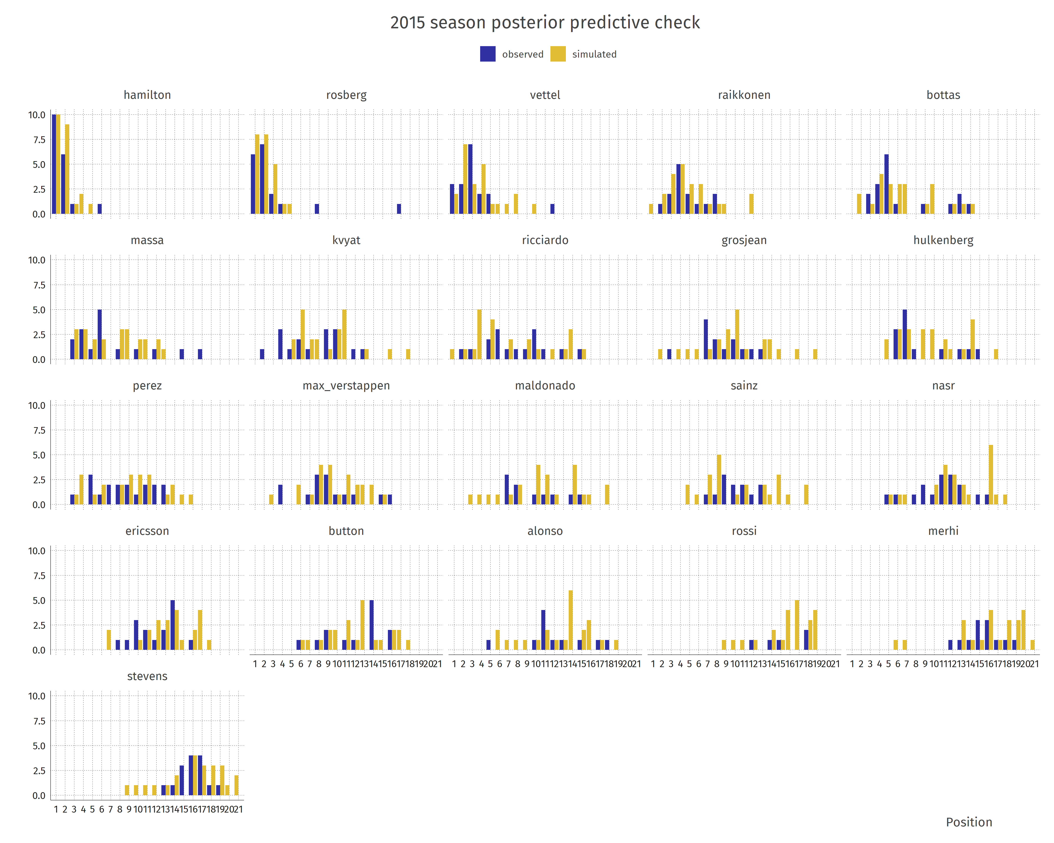

Slide 23
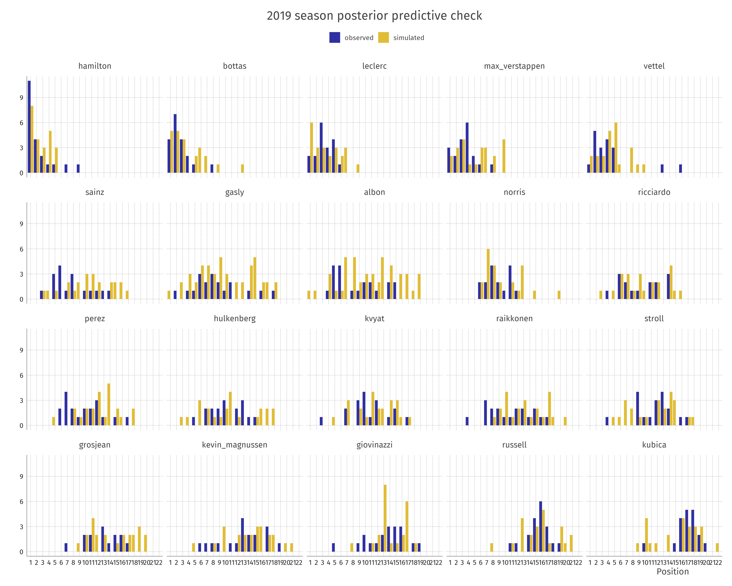

Slide 24
Inference
According to the model:
Who is the most talented driver in the hybrid era?
Which constructor is the most advantageous to drive for in the hybrid era?
How does the constructors’ form relative to its competitors change over time?

Slide 25
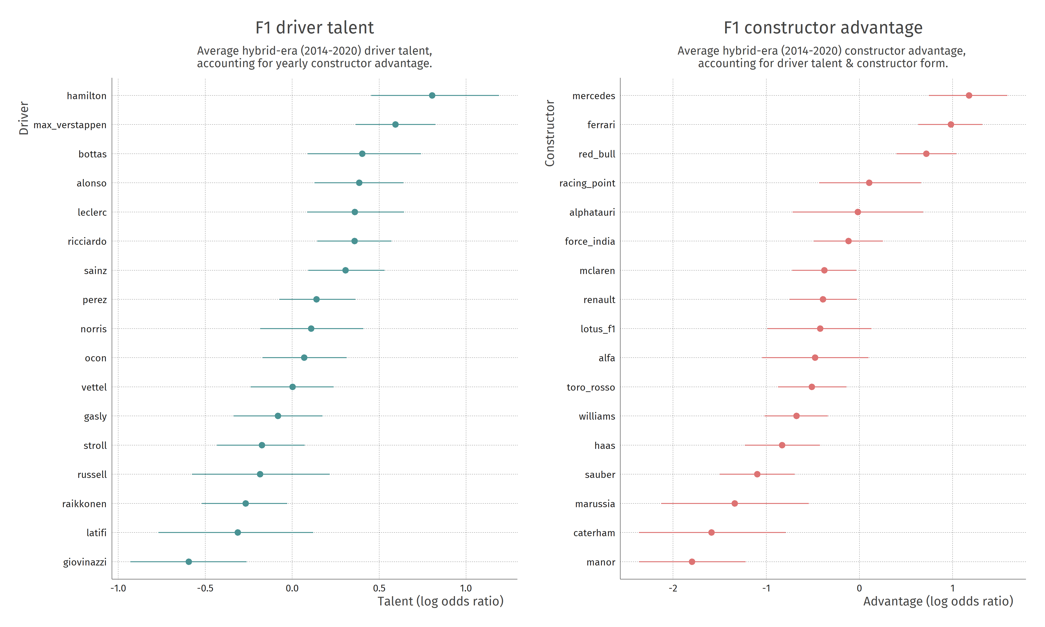
Notes:
89% pdi

Slide 26
Parameter interpretation
Hiring Hamilton as opposed to an average driver yields an odds-ratio of defeating other drivers of 2.24 [1.57 – 3.28]
If your team with an average driver has a probability of 0.5 to beat other drivers, then with Hamilton you will have a probability of 2.24 / (1 + 2.24) = 0.69 [0.61 – 0.77]
If you are an average driver at an average team, moving to hybrid-era Mercedes yields an odds-ratio of 3.24 [2.11 – 4.89]
If you placed middle-of-the road before, you will now on average beat three-quarters of the field: 3.24 / (1 + 3.24) = 0.76 [0.68 – 0.83]

Slide 27
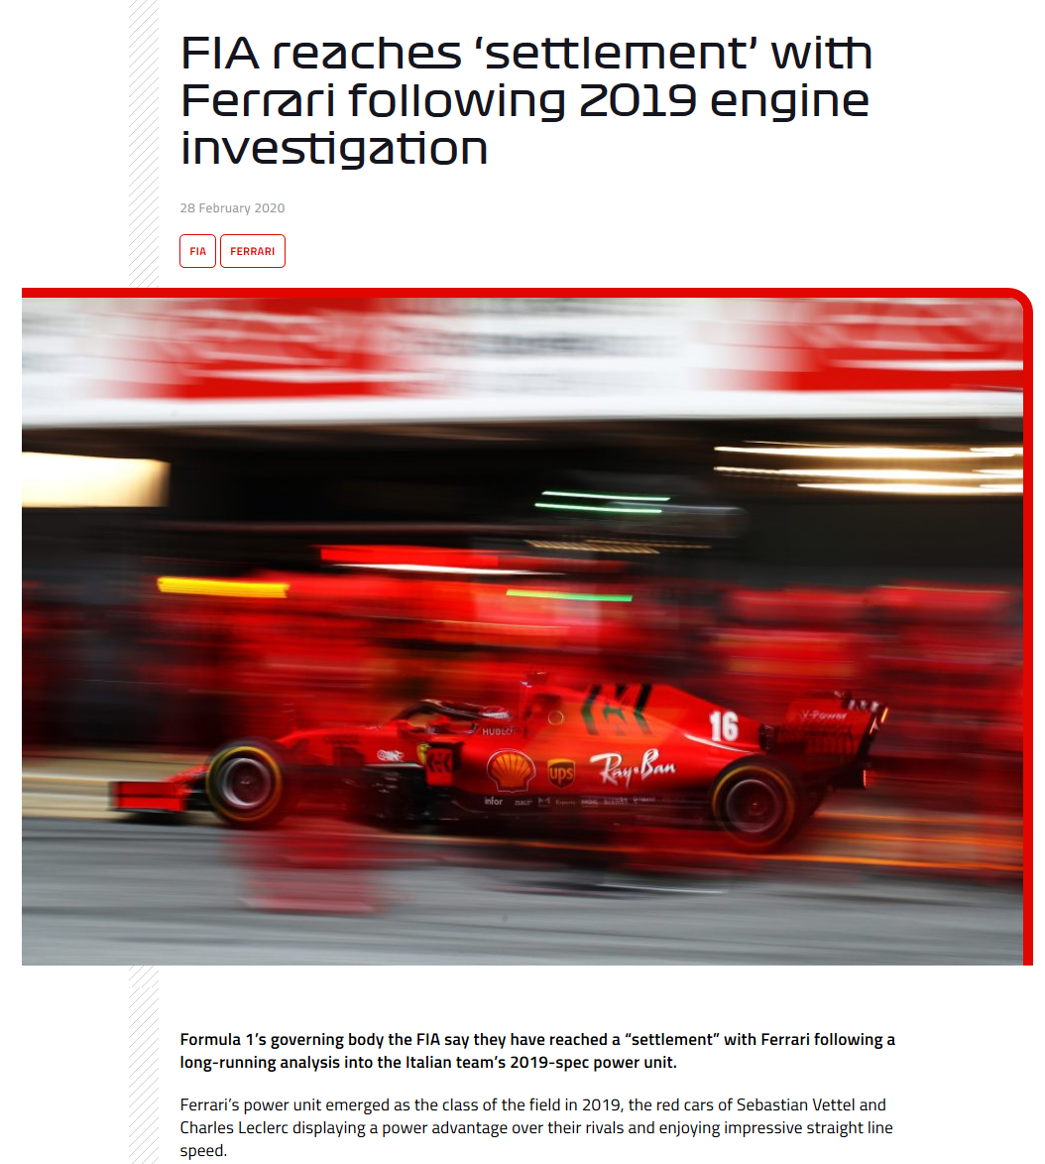
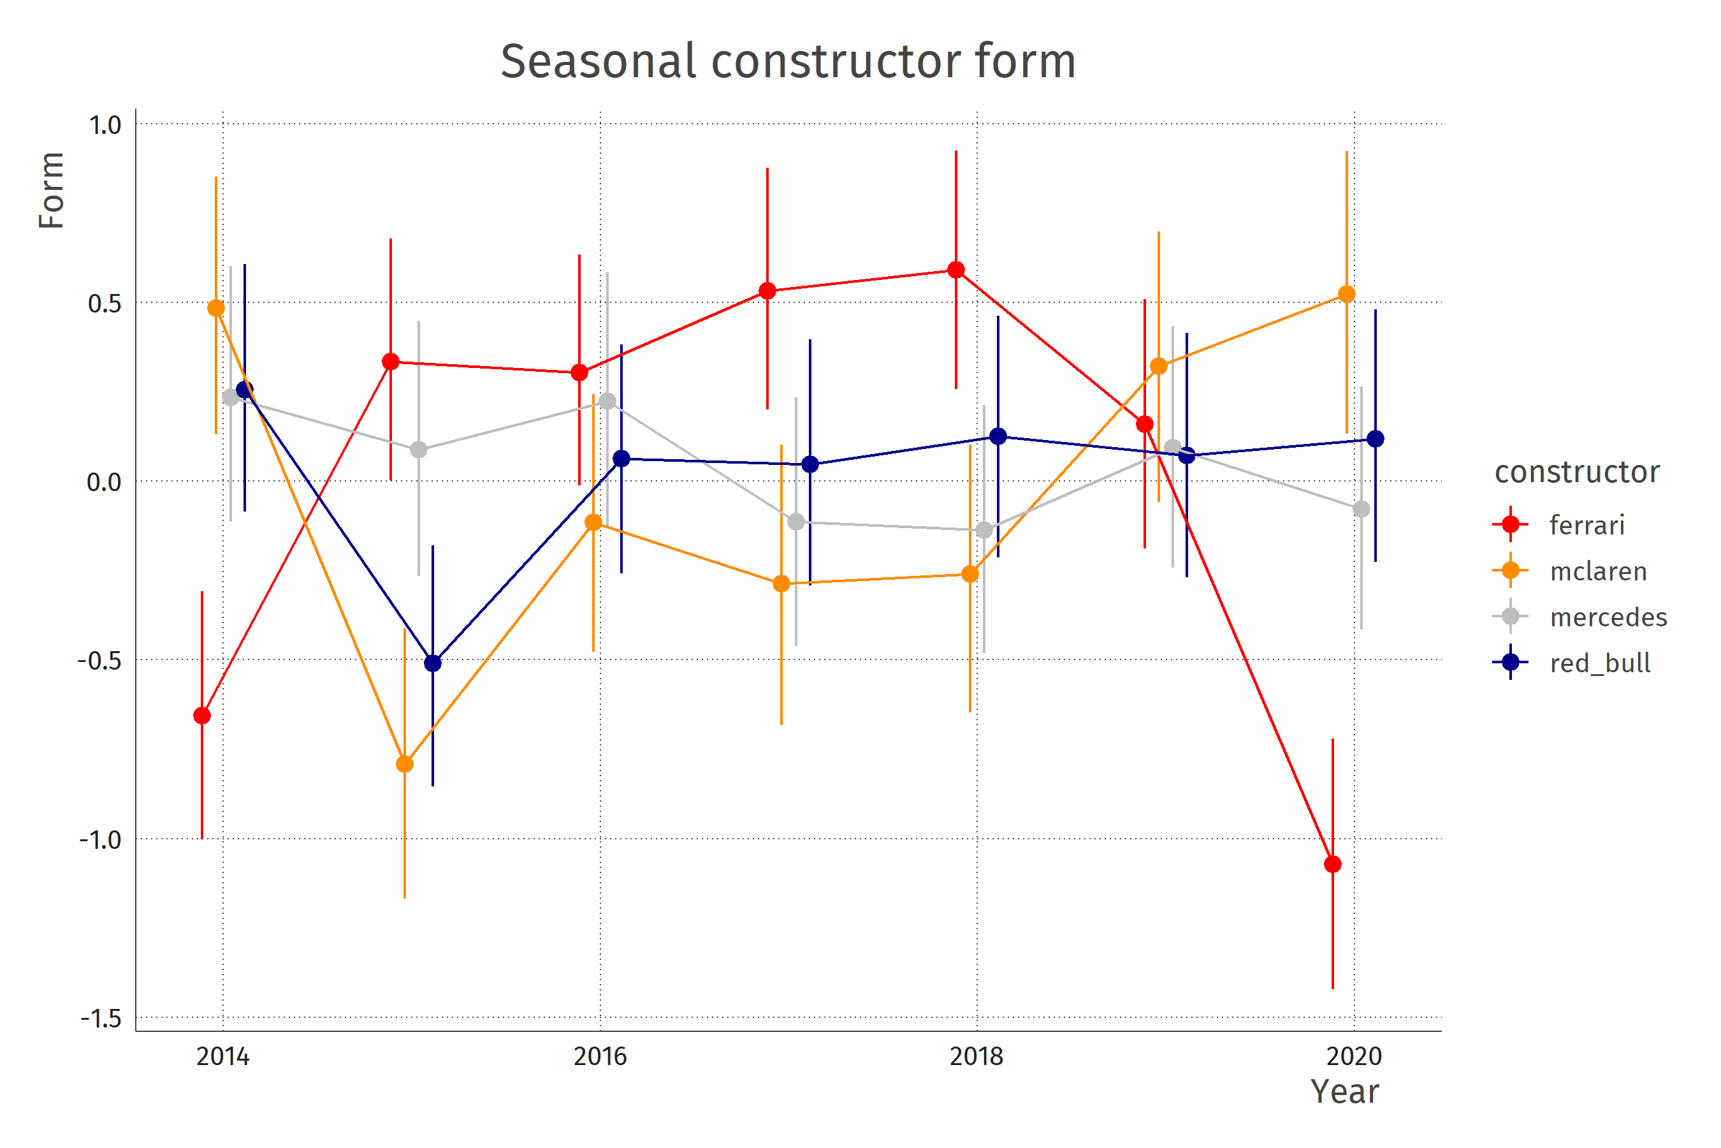

Slide 28
Thoughts & issues
Everything is relative & on logit scale just as with Elo score in chess
Assumptions of stationarity:
  No trend in constructors’ advantage within hybrid era
  (maybe ok because money & team stays approx. the same)
  No trend in drivers’ talent within hybrid era
  (probably wrong because starting drivers need time to develop)
Are parameters actually identified?
  If driver stays with same team & teammate the whole time, we cannot disentangle !
  How do the priors affect these?

Slide 29
Questions?

Slide 30
Default dark slide
Default subheading
The dark slide brings some variation
Default subheading
It can highlight important aspects of the presentation.
Default subheading
This is the body of the text
Default subheading
This is the body of the text

Slide 31
Is this an impact slide?

Slide 32
Here is an impactful slide with a sentence on it.
Here is a topic related to the aforementioned question.

Slide 33
Thank you!

