Slide 1
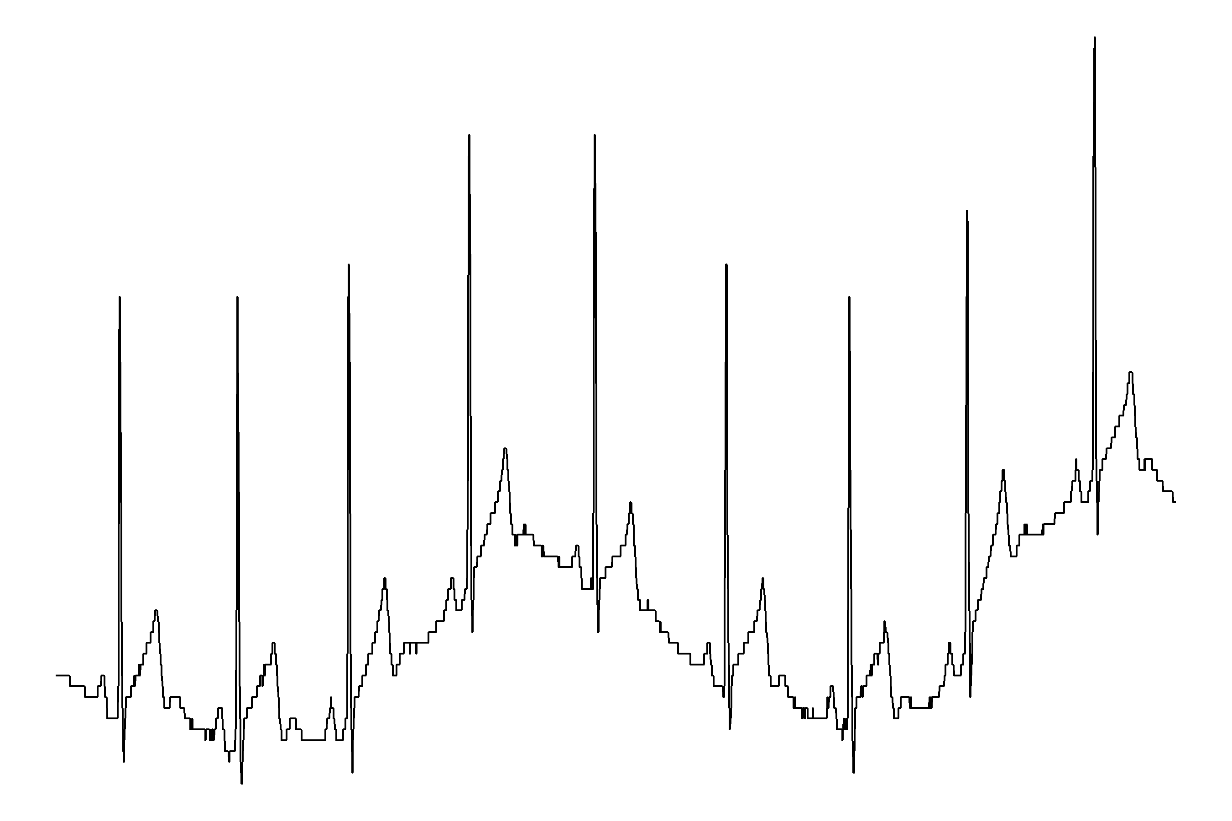
Signal Processing in a Heartbeat
Erik-Jan van Kesteren
Methodology & Statistics, UU

Slide 2
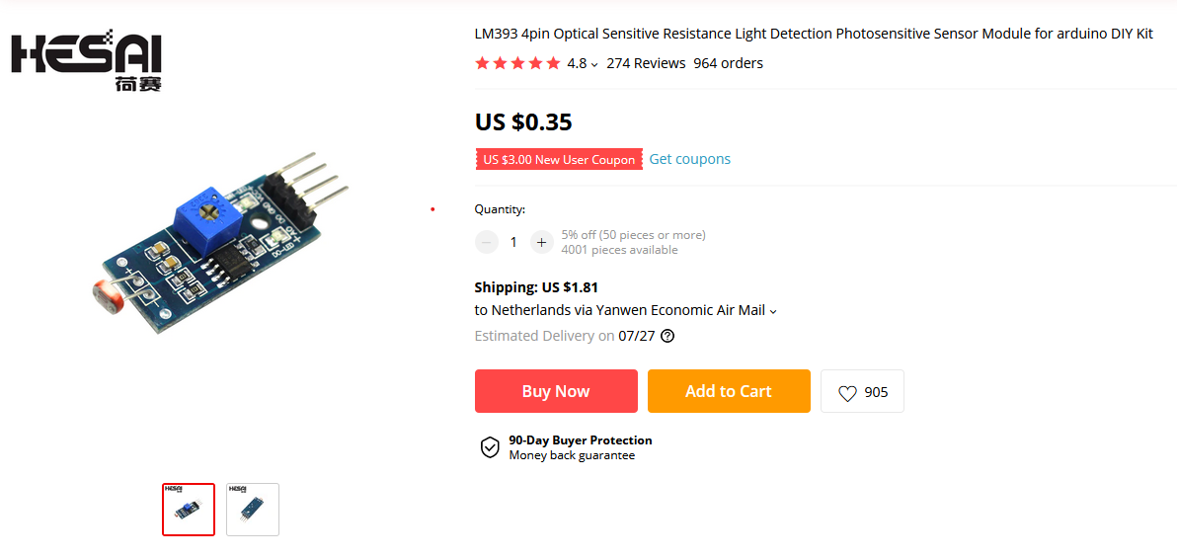
Signals everywhere
It is easy & cheap to measure all kinds of signals

Slide 3

Signals everywhere
It is easy & cheap to measure all kinds of signals

Slide 4

Signals everywhere
It is easy & cheap to measure all kinds of signals

Slide 5
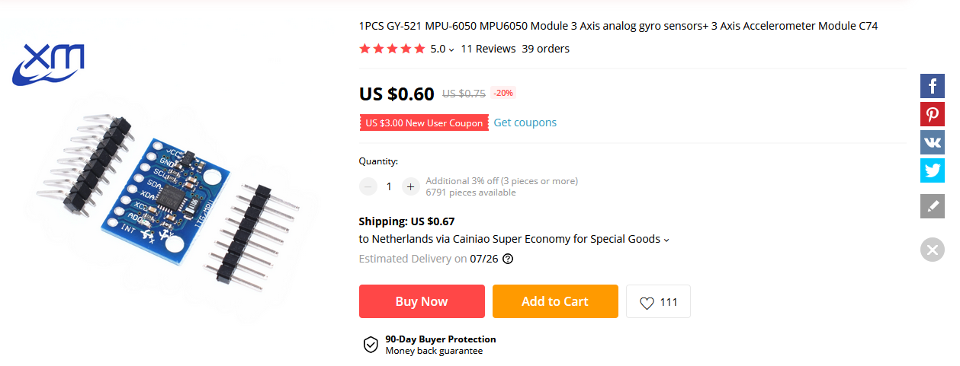
Signals everywhere
It is easy & cheap to measure all kinds of signals

Slide 6

Signals everywhere
It is easy & cheap to measure all kinds of signals

Slide 7
Signal =/= information
Information from signals:
  Light signal -> What was today’s total sun power?
  Distance signal -> Is someone passing by?
  Soil moisture signal -> Why do my plants keep dying?
  Accelerometer signal -> Is this person travelling by bicycle?
  Electrocardiogram (ECG) -> What is my heart rate?

Slide 8
In this presentation
Motivating example: heart rate measurement
Extracting heart beat locations (R peaks) from ECG signal
The (famous) Pan-Tompkins algorithm

Slide 9
WARNING
I am not an expert
I am not an engineer
I am not a medical professional
This presentation is for illustration purposes only

Slide 10
Motivating example
Heart rate is affected by / related to stress / anxiety
Measure heart rate & variation -> measure stress / anxiety levels
Can be used in further research, e.g. in sleep or insomnia
With wearable sensors: long-term (ambulant) ECG

Slide 11
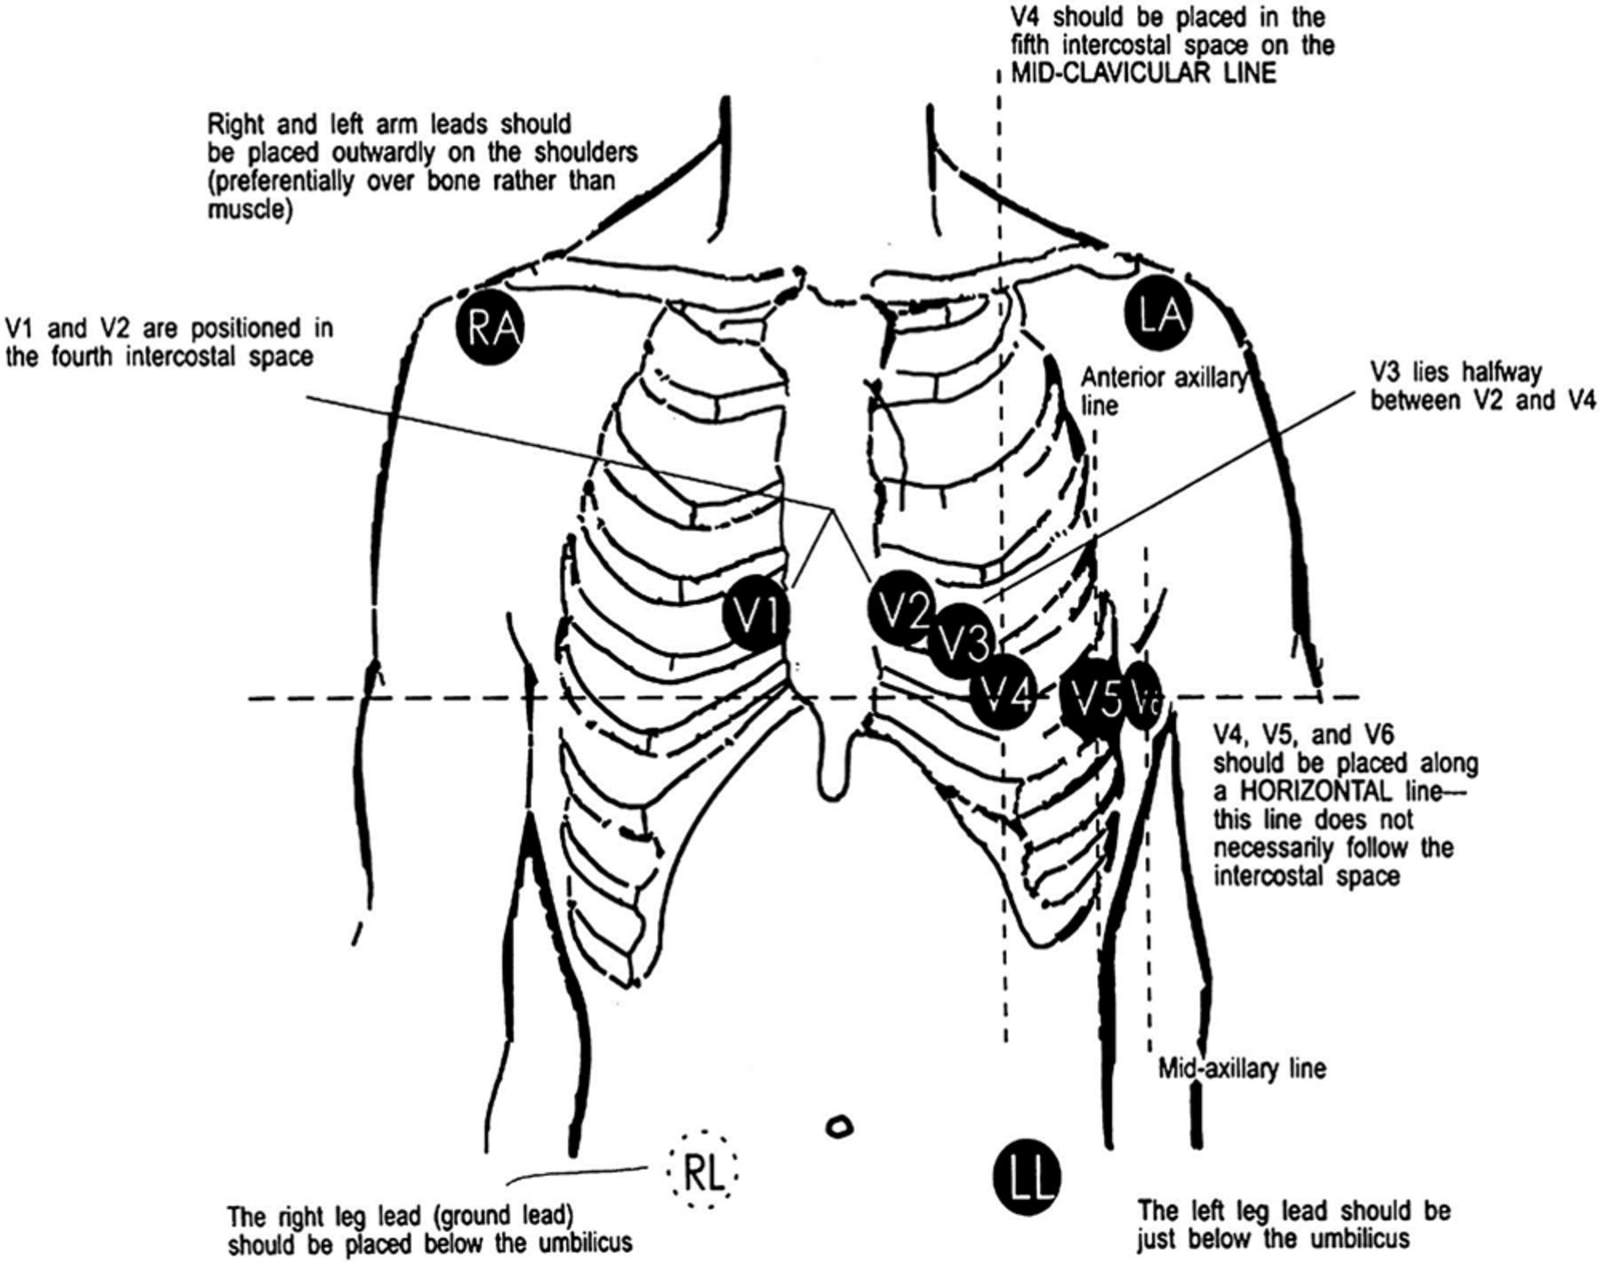
The ECG signal
Measure voltage (mV range) at the skin
Voltage changes due to heart muscle activity

Slide 12
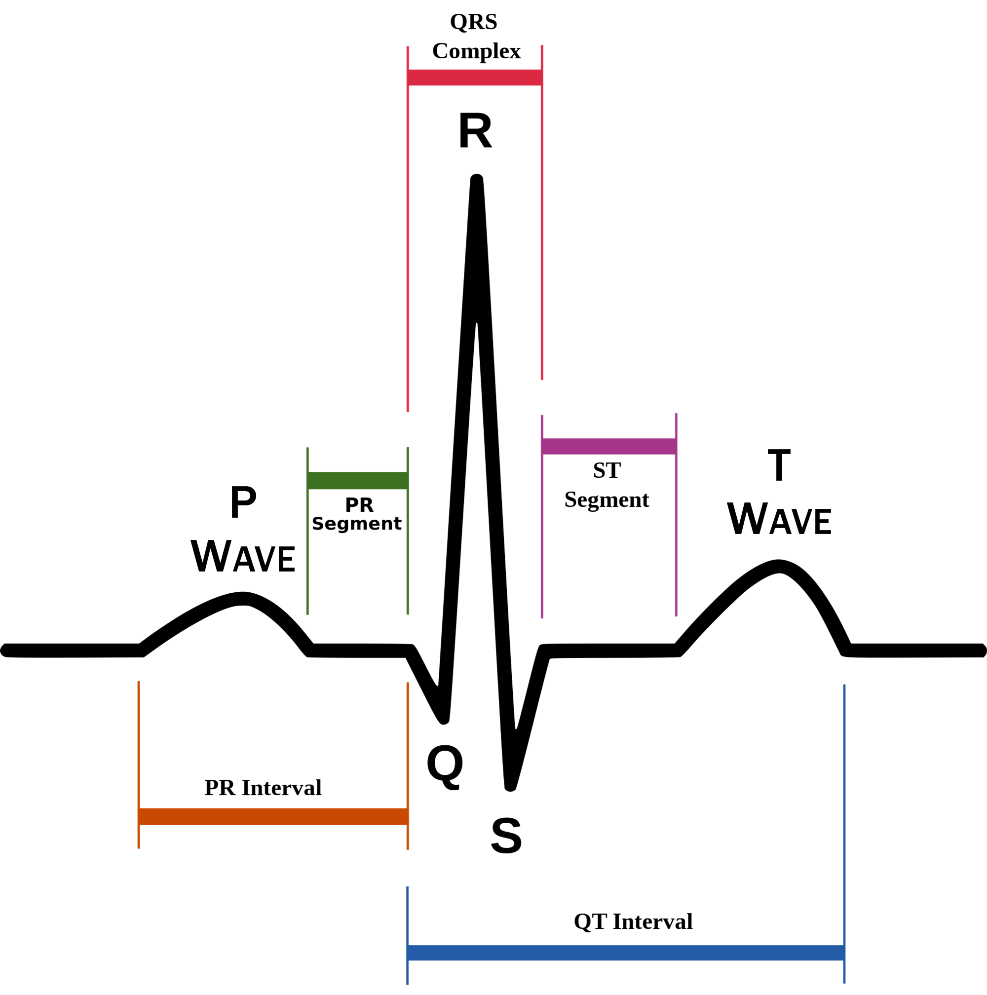
The ECG signal

Slide 13
The ECG signal
We know exactly what we are looking for!

Slide 14
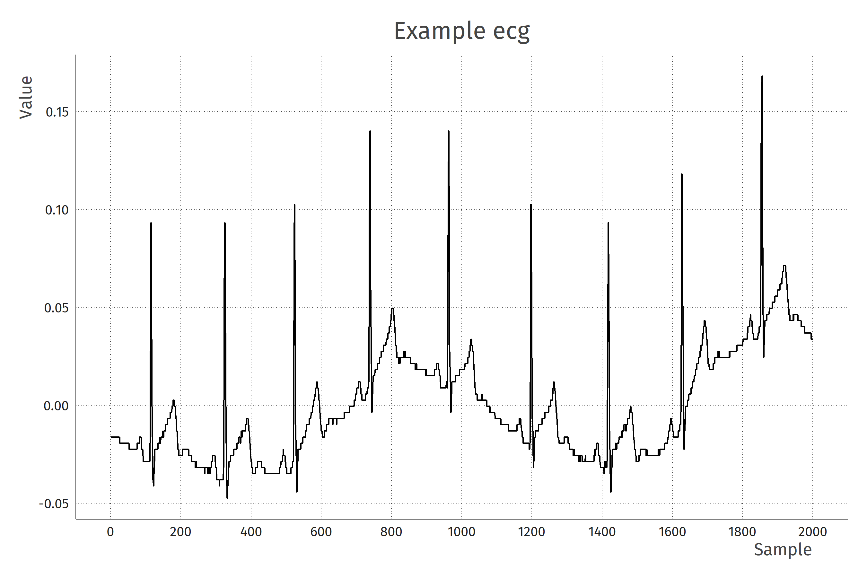
The ECG signal
Example signal from rsleep package
200 Hz
Y-axis: mV

Slide 15
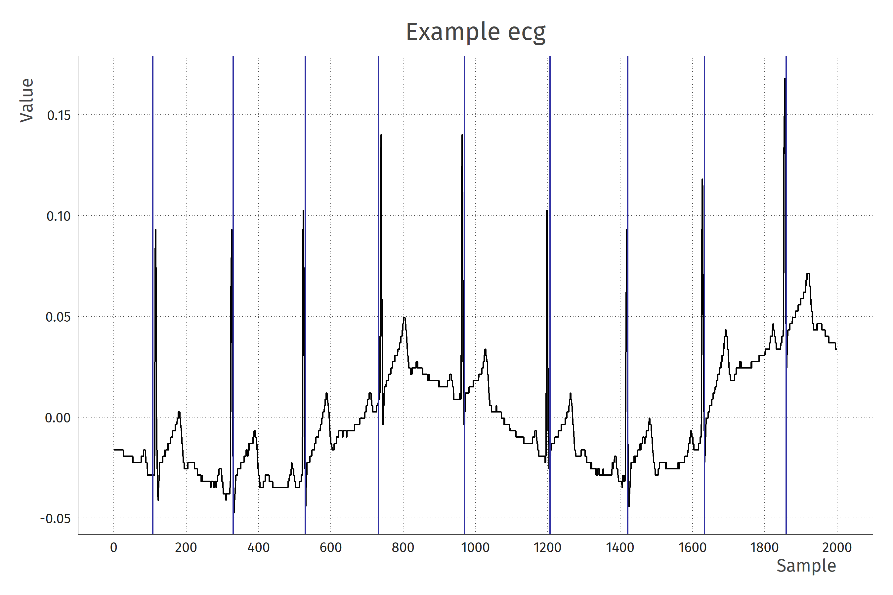
The goal: detecting R-peaks
Detecting
R-peaks
Heartrate (bpm): number of R-peaks (beats) per minute

Slide 16

But…
Real-world data is rarely clean
Voltage changes are really small!
Noise sources:
Wandering baseline (drift)
Electromagnetic interference (from mains power)
Muscle tremors
Weird artefacts (moving electrodes?)

Slide 17
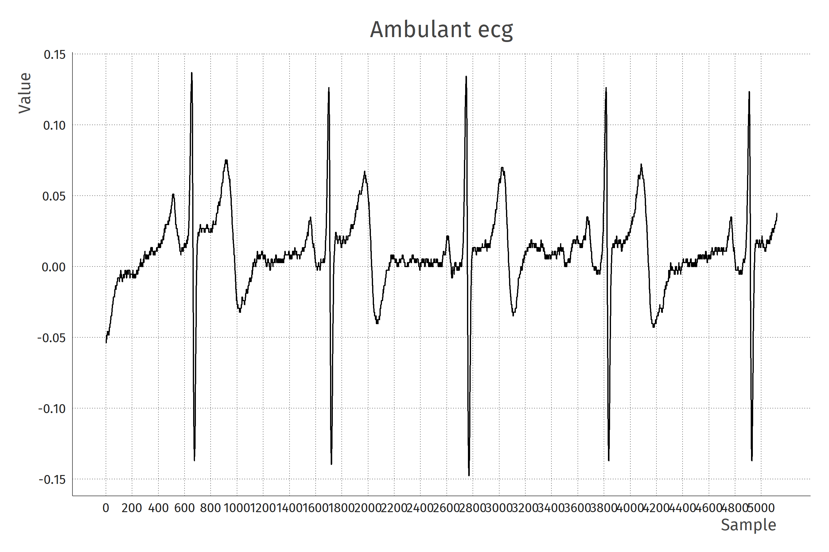
Ambulant ECG example
Example signal from movisens device
1024 Hz
Y-axis: mV

Slide 18
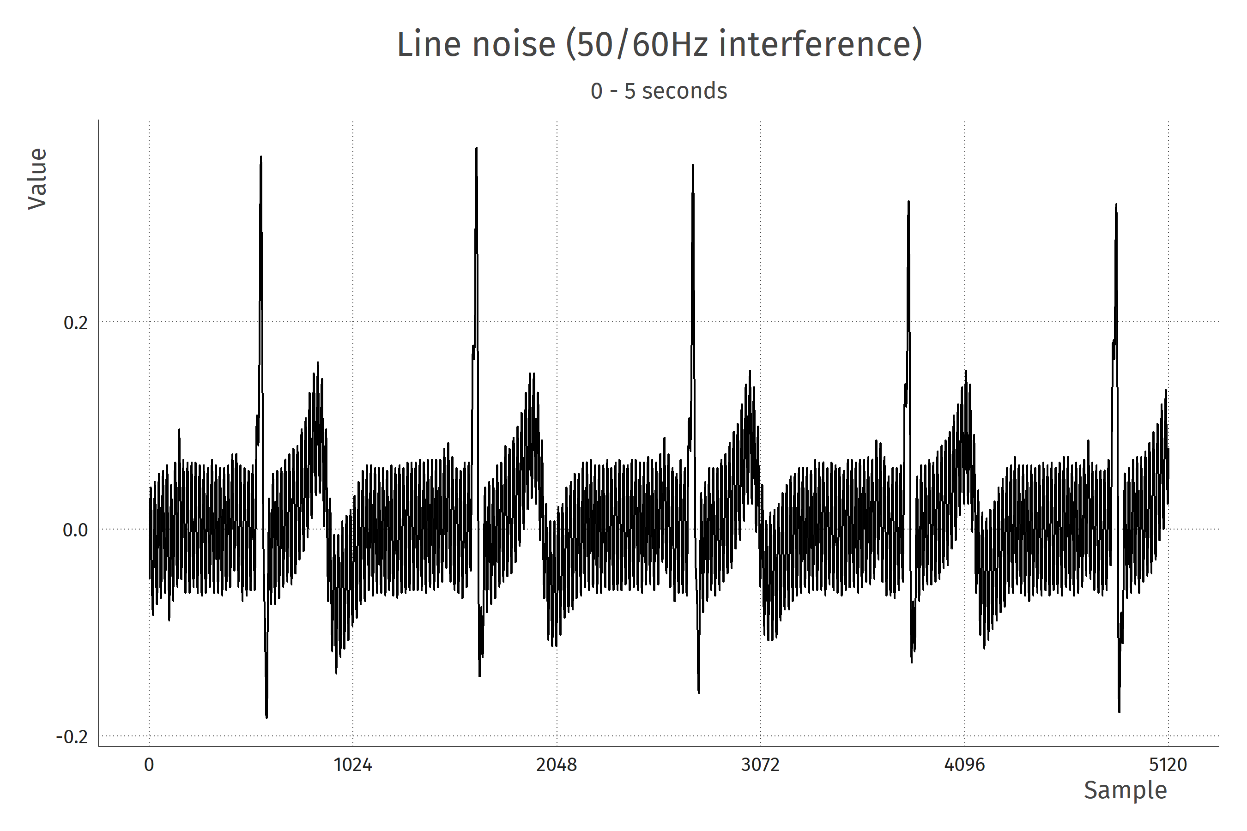
Line noise

Slide 19
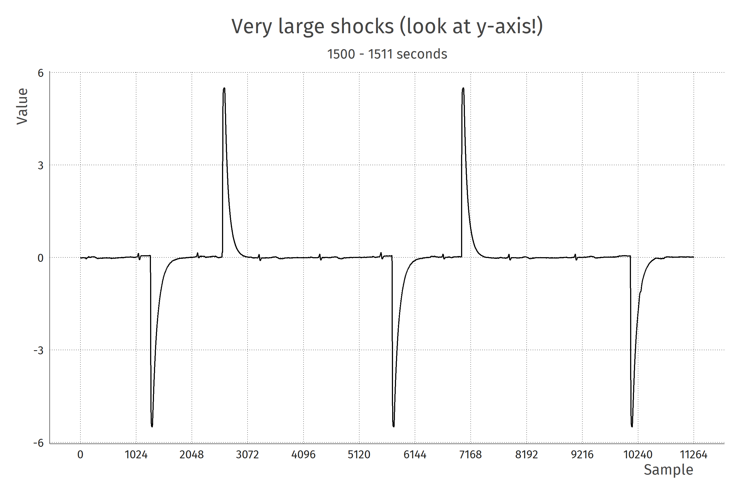
Weird artefacts

Slide 20
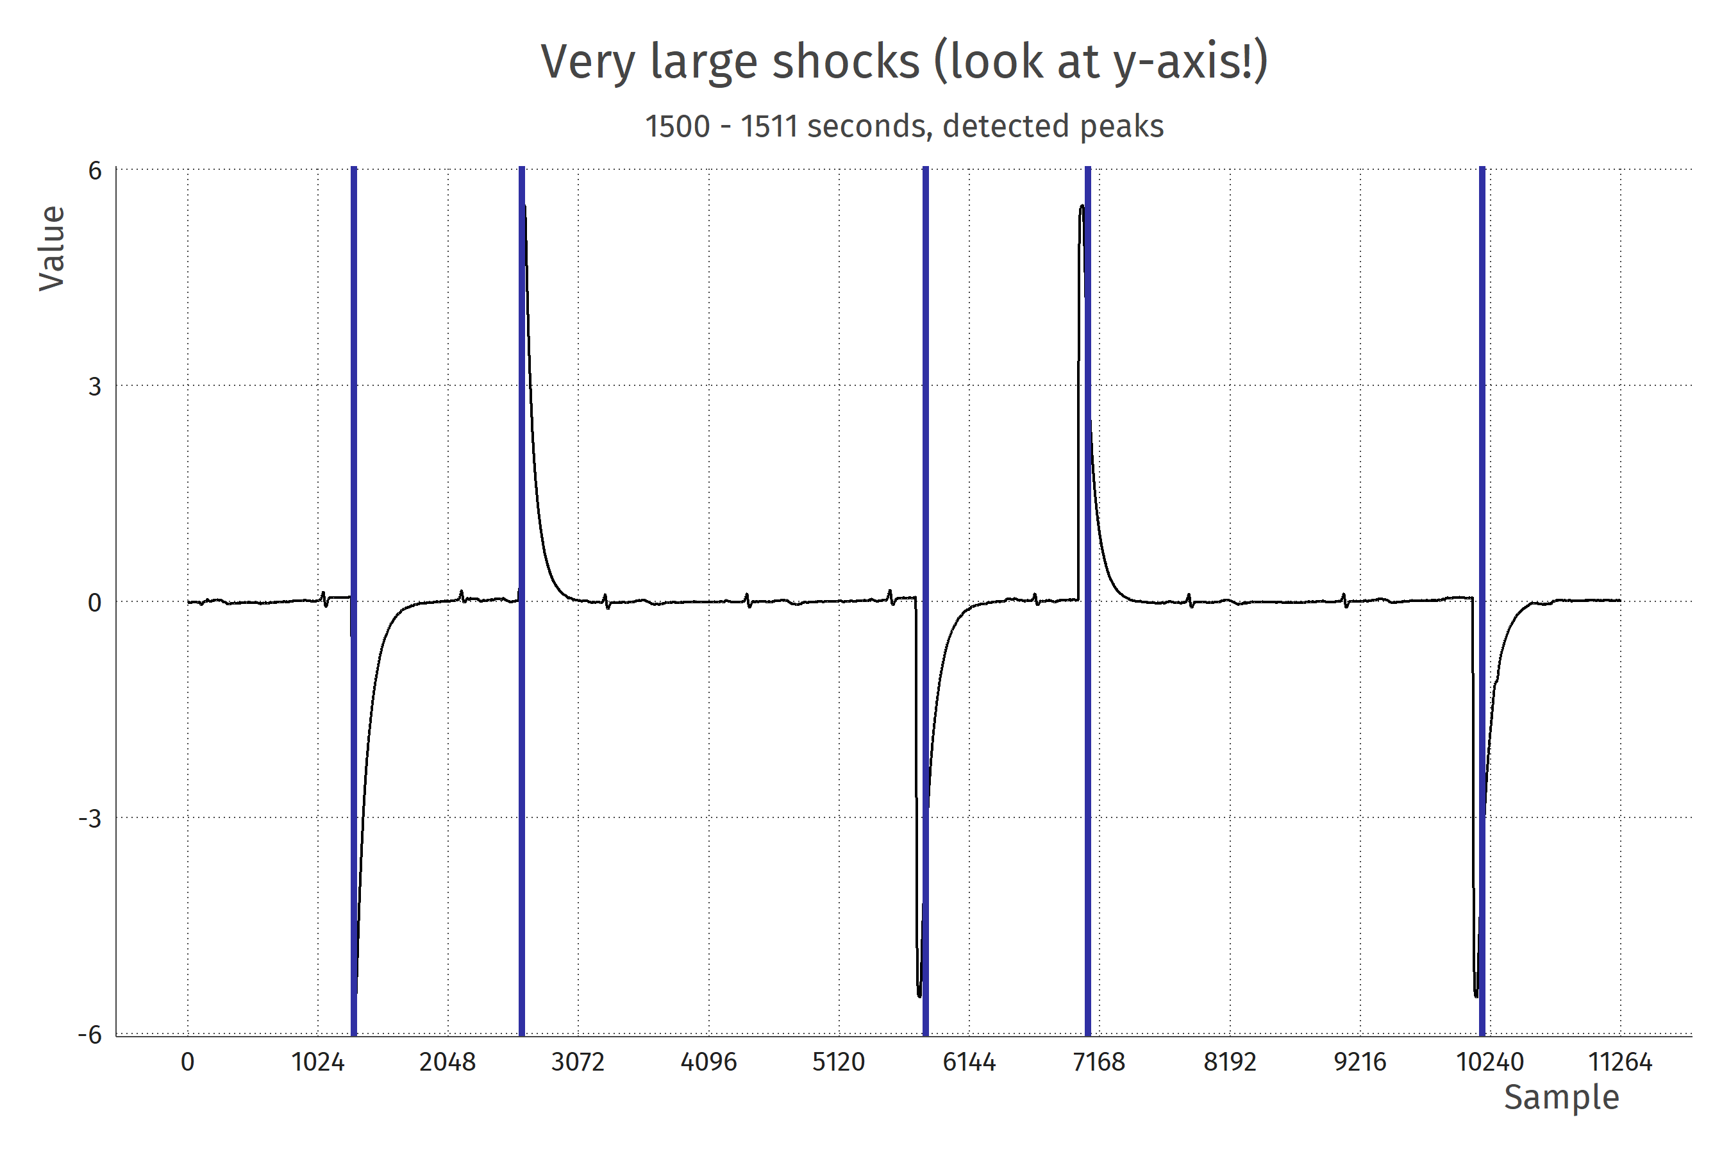
Weird artefacts

Slide 21
Luckily we have prior information
We know the properties of the signal we are interested in: QRS complex
We know the properties of common noise sources (e.g., line noise is 50-60 Hz)
We can create a procedure to filter the signal from the noise

Slide 22
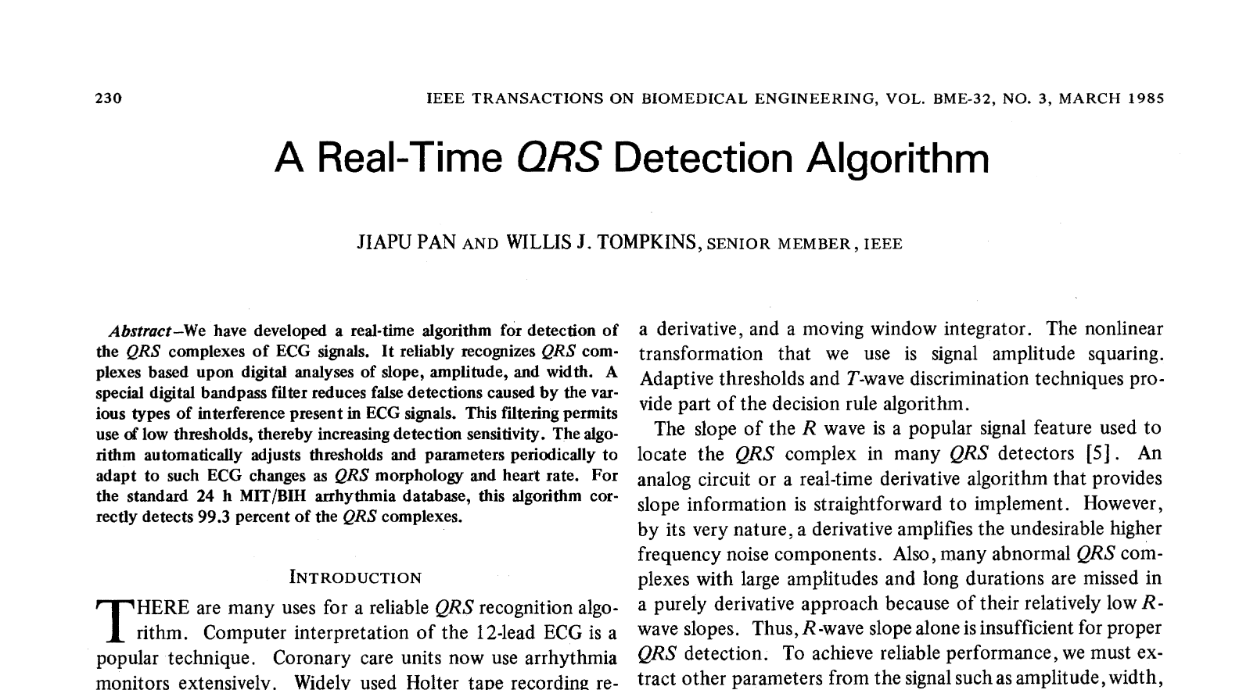

Slide 23
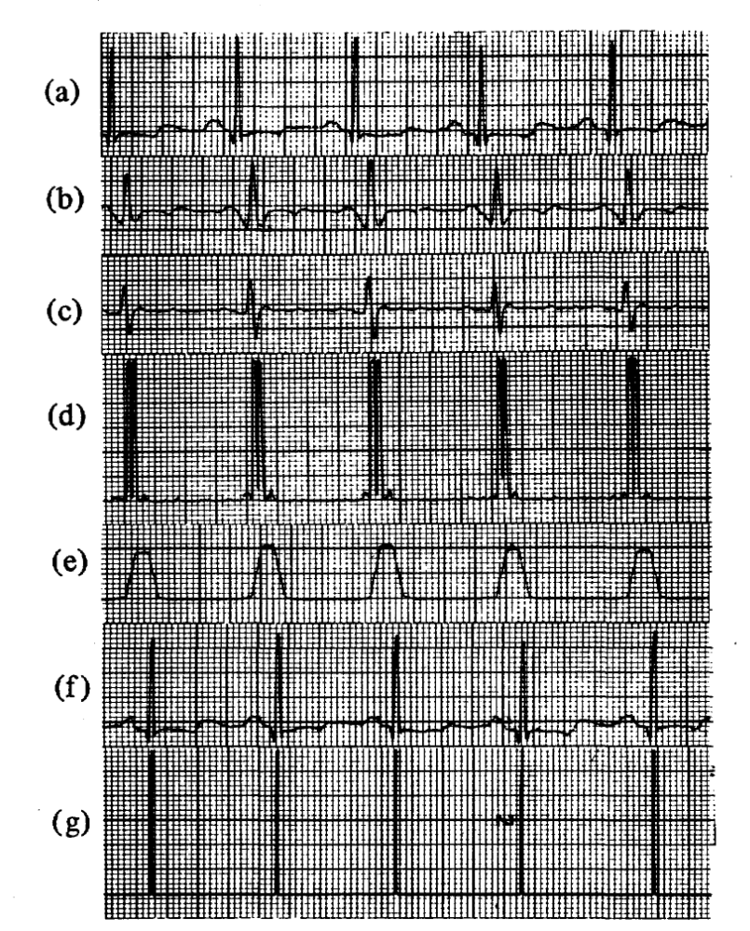
The Pan-Tompkins algorithm
Bandpass filter (5-15Hz)
Compute derivative
Square
Boxcar integration (150ms support)
Detect peaks in resulting signal

Slide 24
1. Bandpass filter

Slide 25
Bandpass filter
Only allow those frequencies where the target signal is
The filter lets through (passes) a range (band) of frequencies, and blocks all others
There are many ways of doing it but most of them achieve similar (imperfect) results
I will use a butterworth filter of order 2

Slide 26
High frequency (EMI) example

Slide 28
Frequency domain: fourier transform

Slide 29
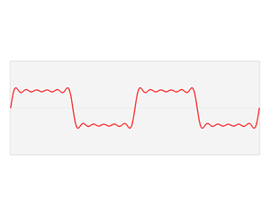
Frequency domain: fourier transform

Slide 31
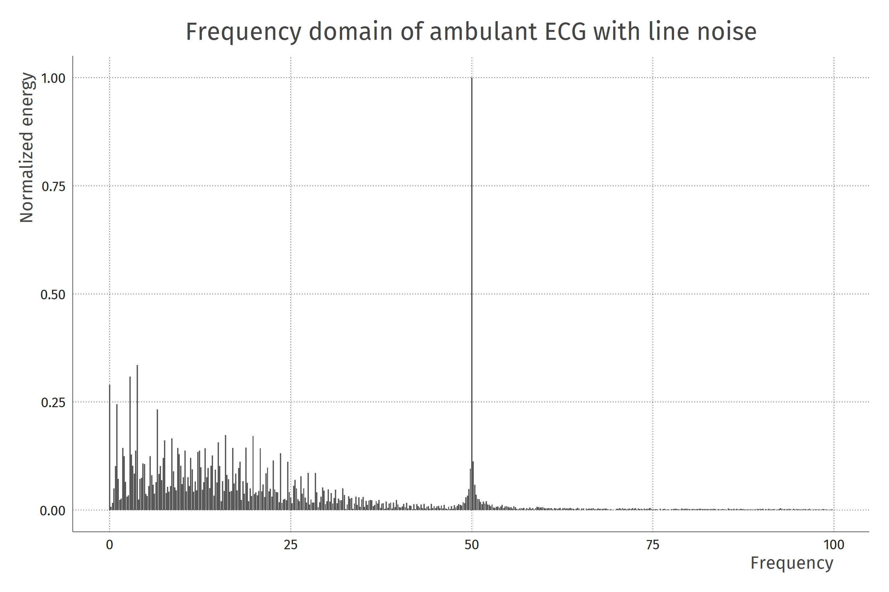

Slide 32
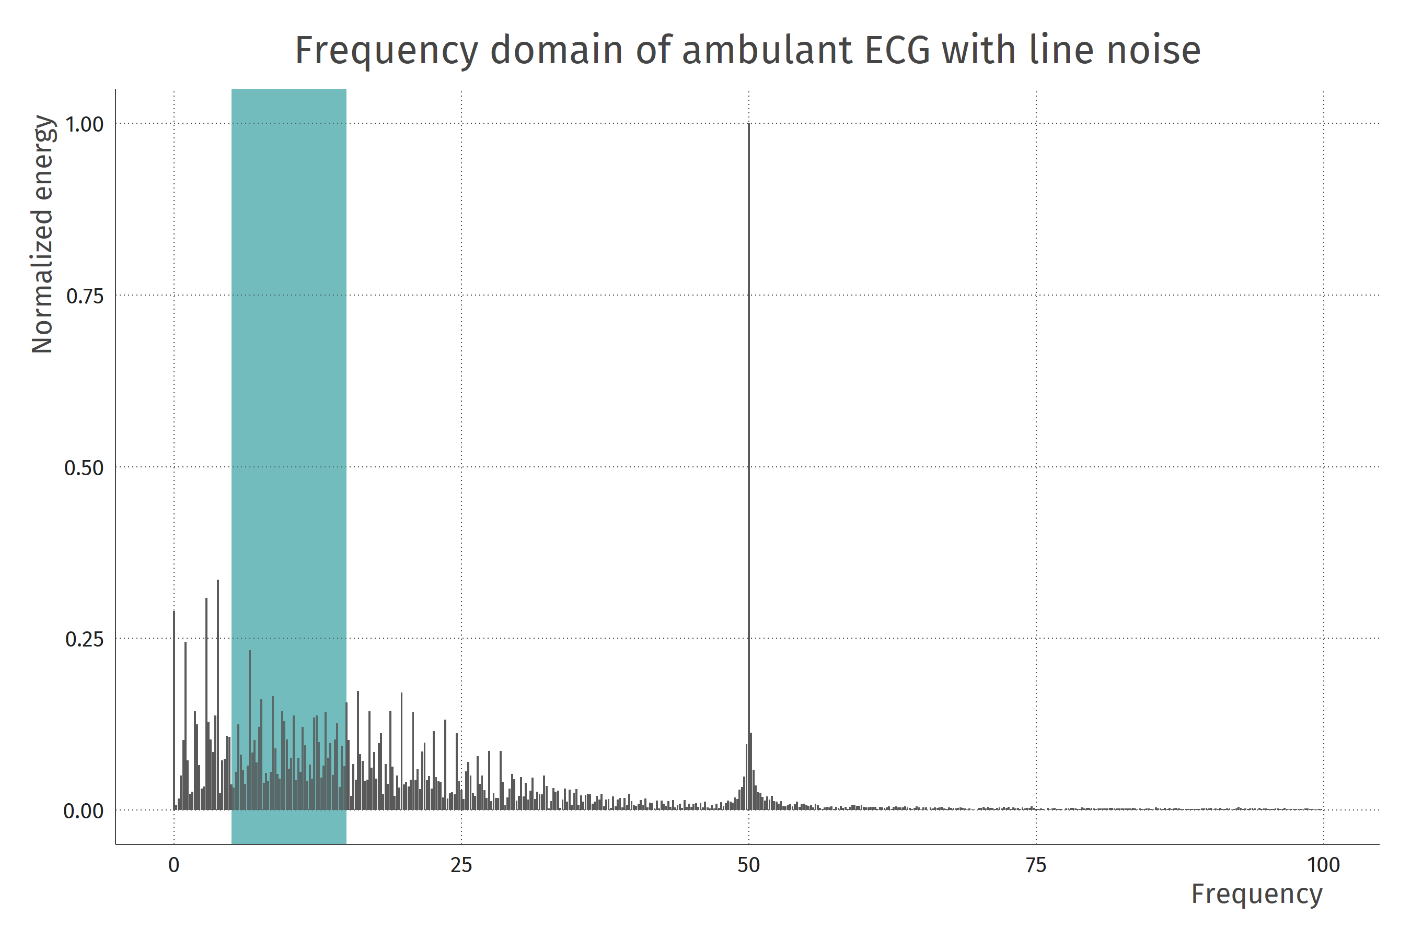

Slide 34
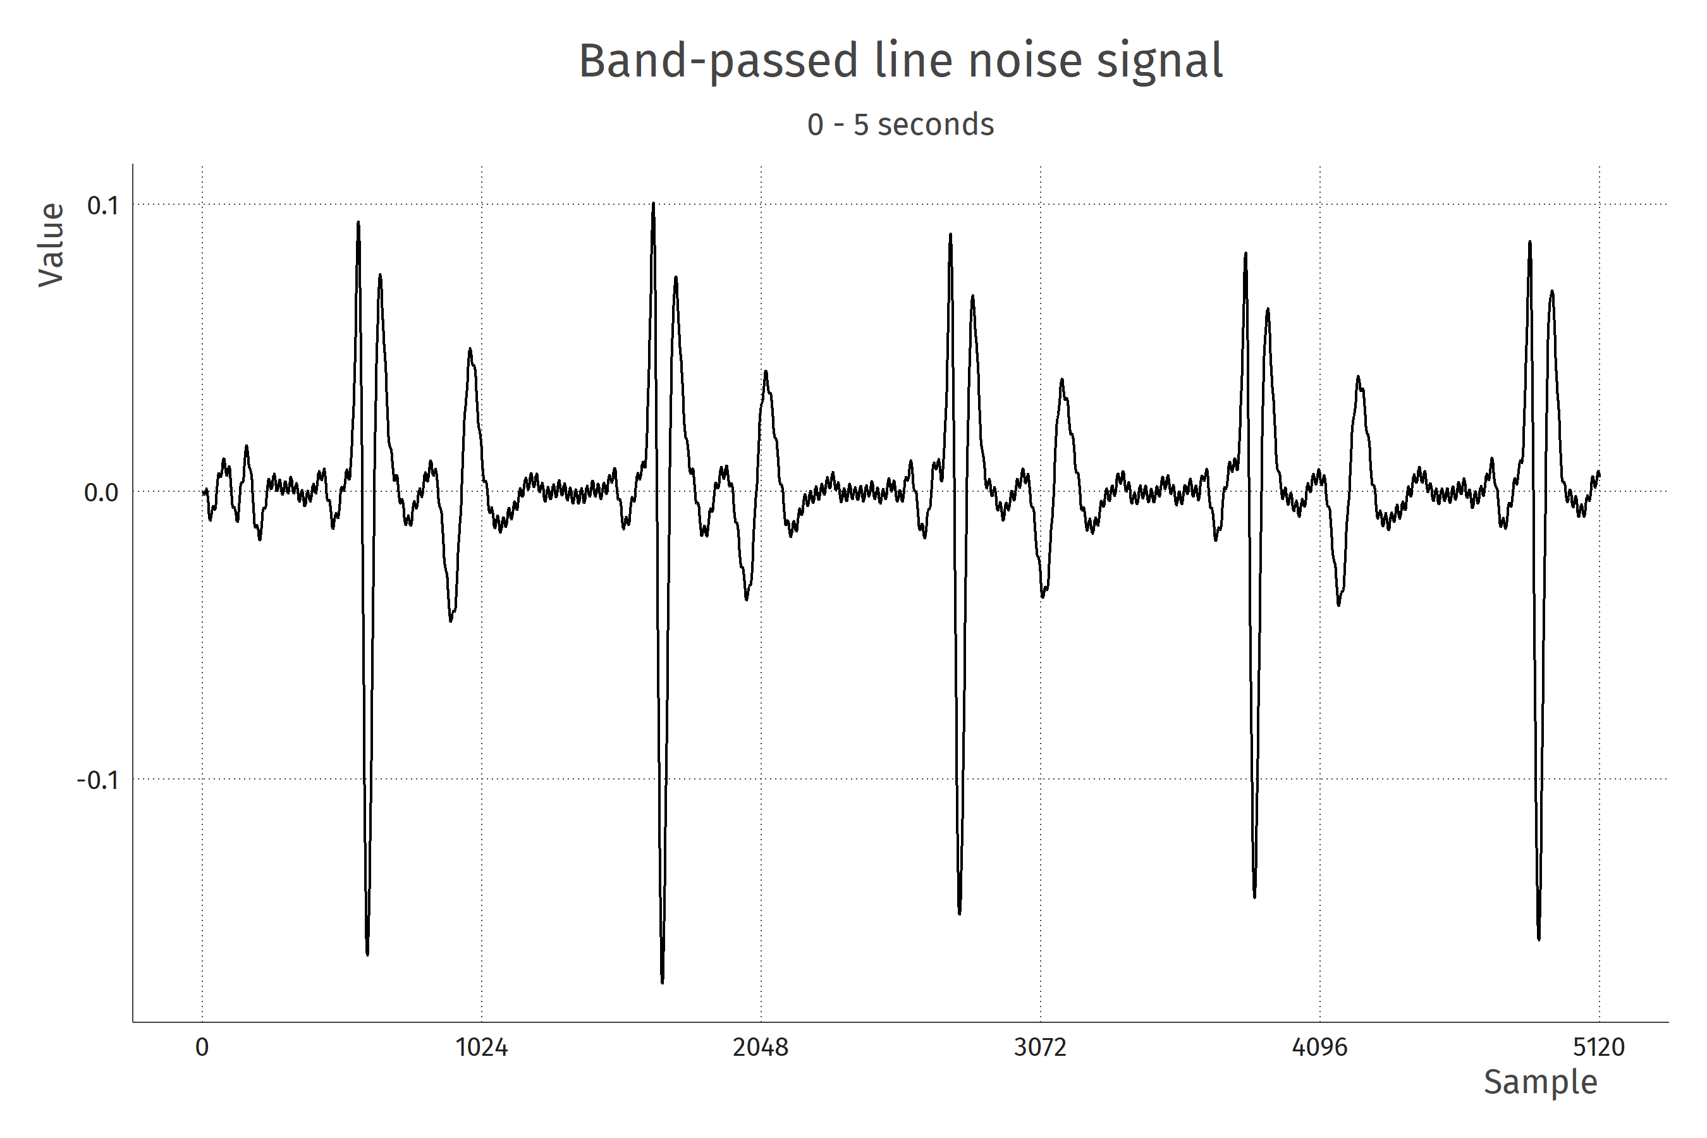

Slide 35
Low frequency (drift) example

Slide 37
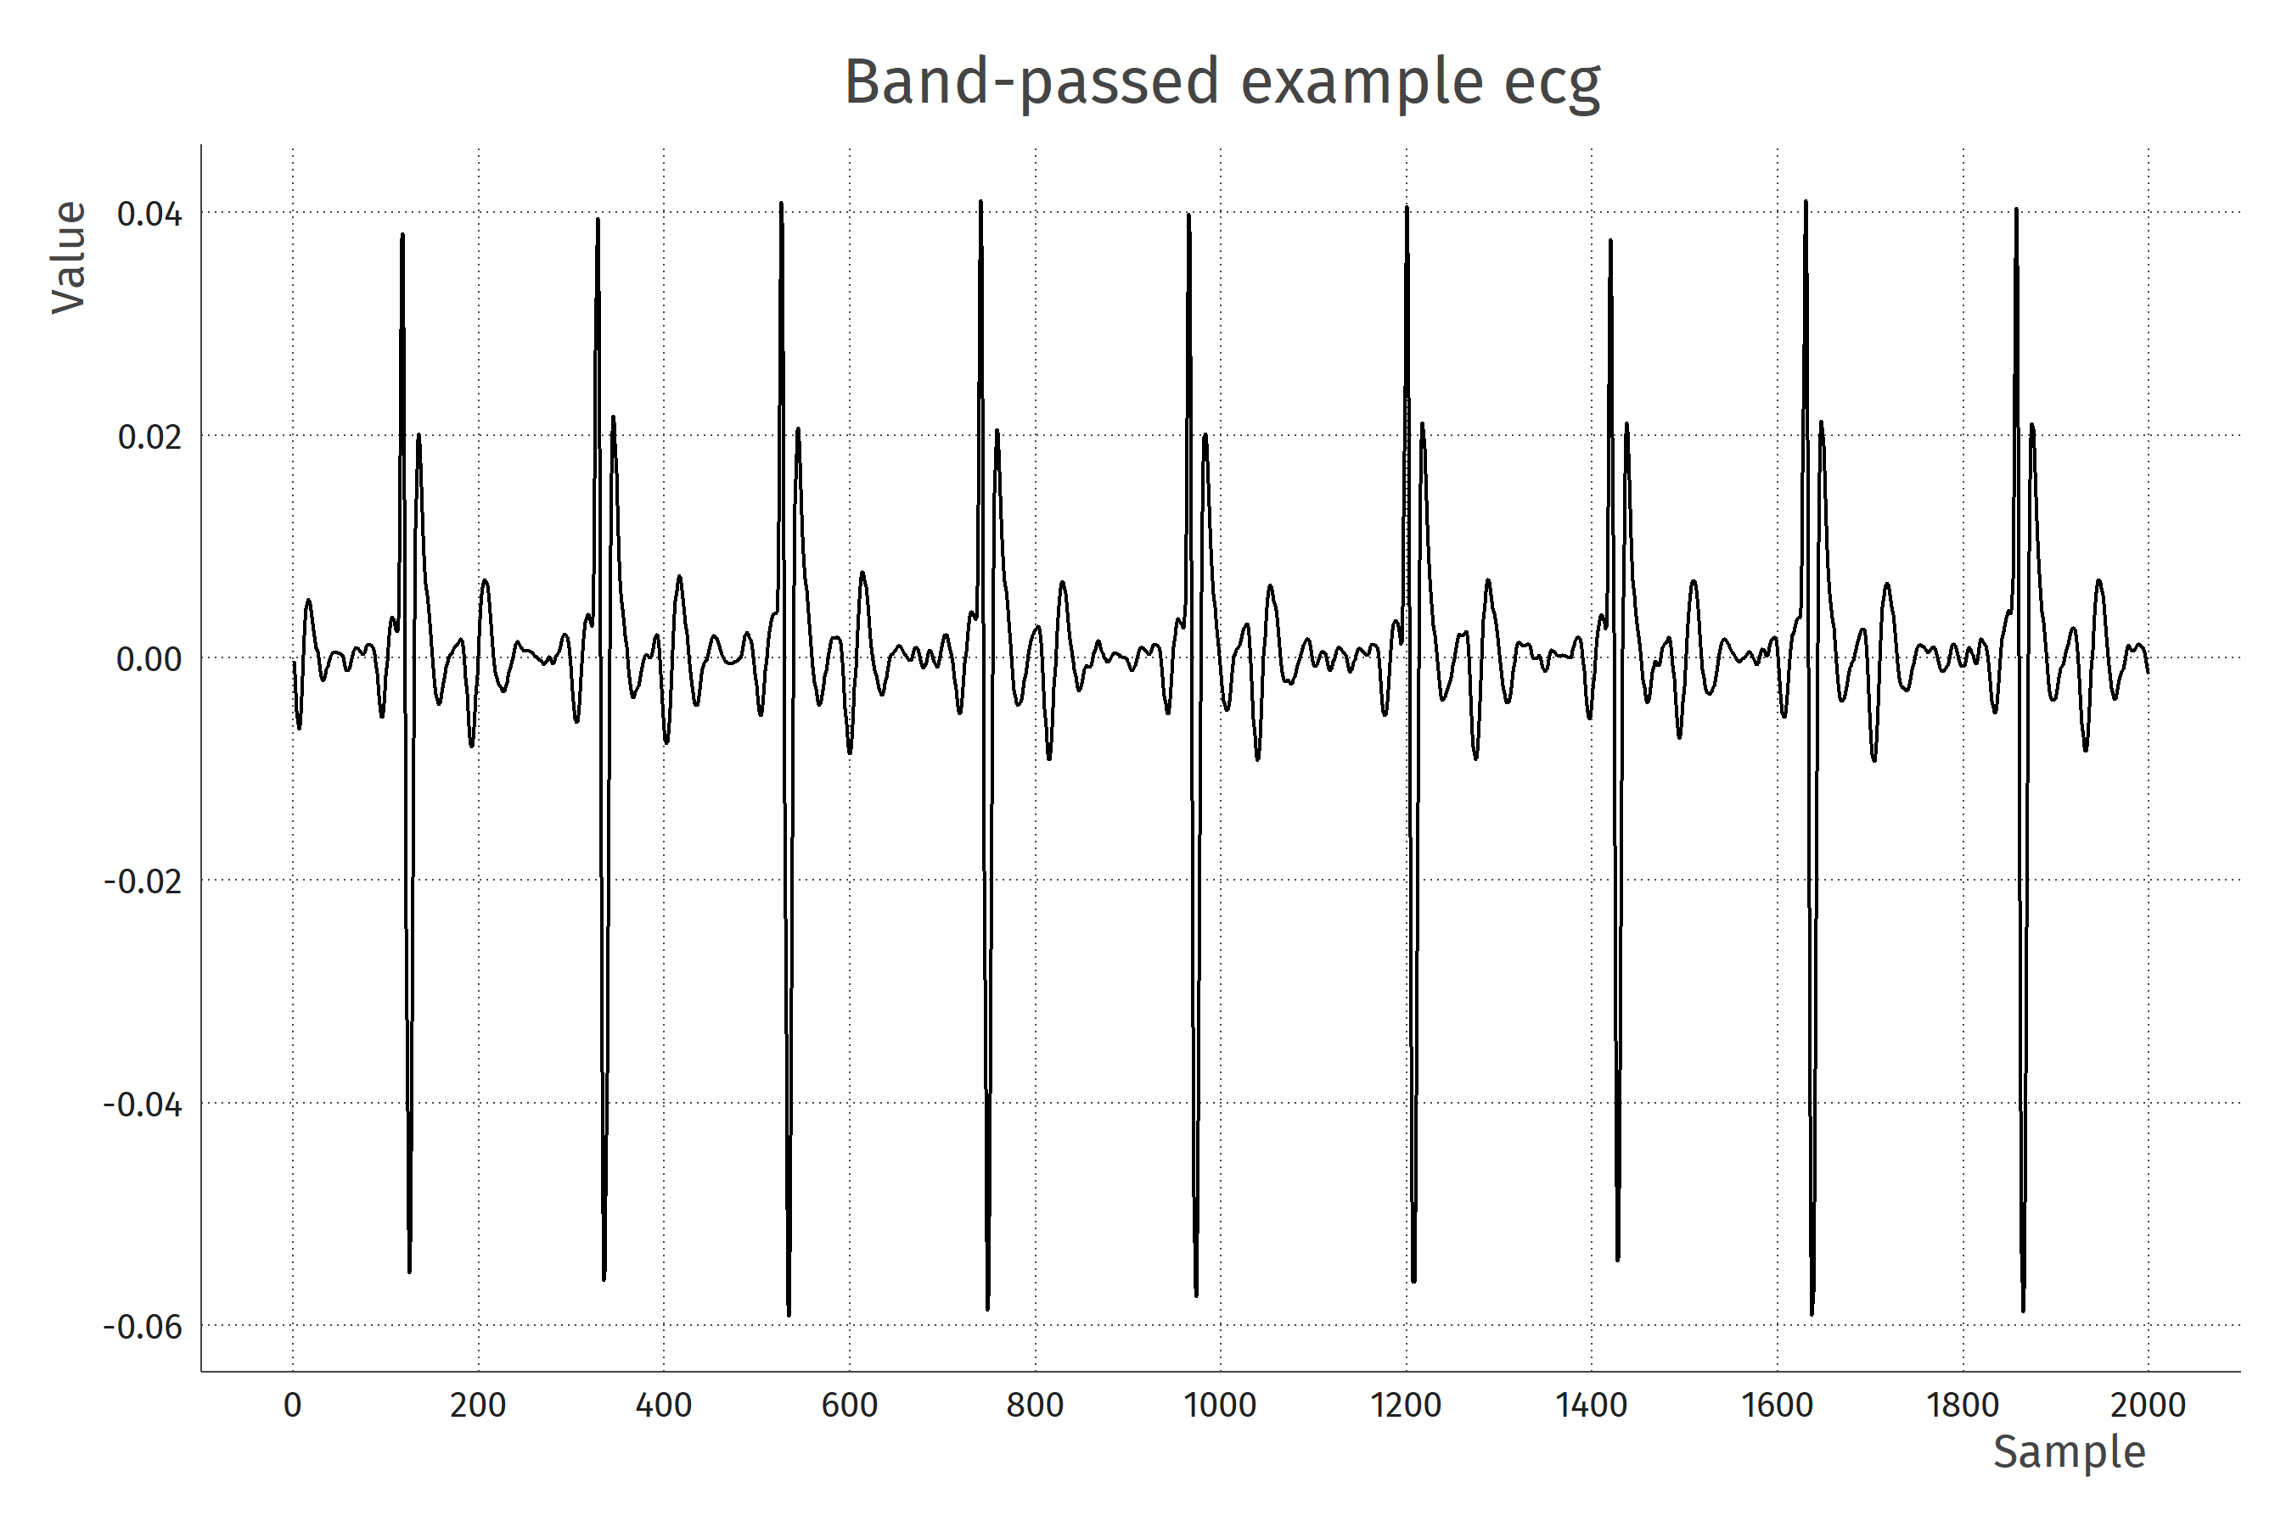

Slide 38
2. Compute derivative

Slide 39
Compute derivative
The QRS complex has a strong change in voltage relative to its surroundings
At the R-peak, the derivative is briefly 0, before becoming strongly negative

Slide 40
Compute derivative
Why derivative?
Sometimes the baseline relative to the R-peak is different

Slide 41
Compute derivative
Again, many ways of doing this
The easiest discrete way: compute the differences between signal values. In R:
ecg_deriv = diff(ecg)
I use a Savitsky-Golay filter, to achieve a smooth derivative

Slide 43
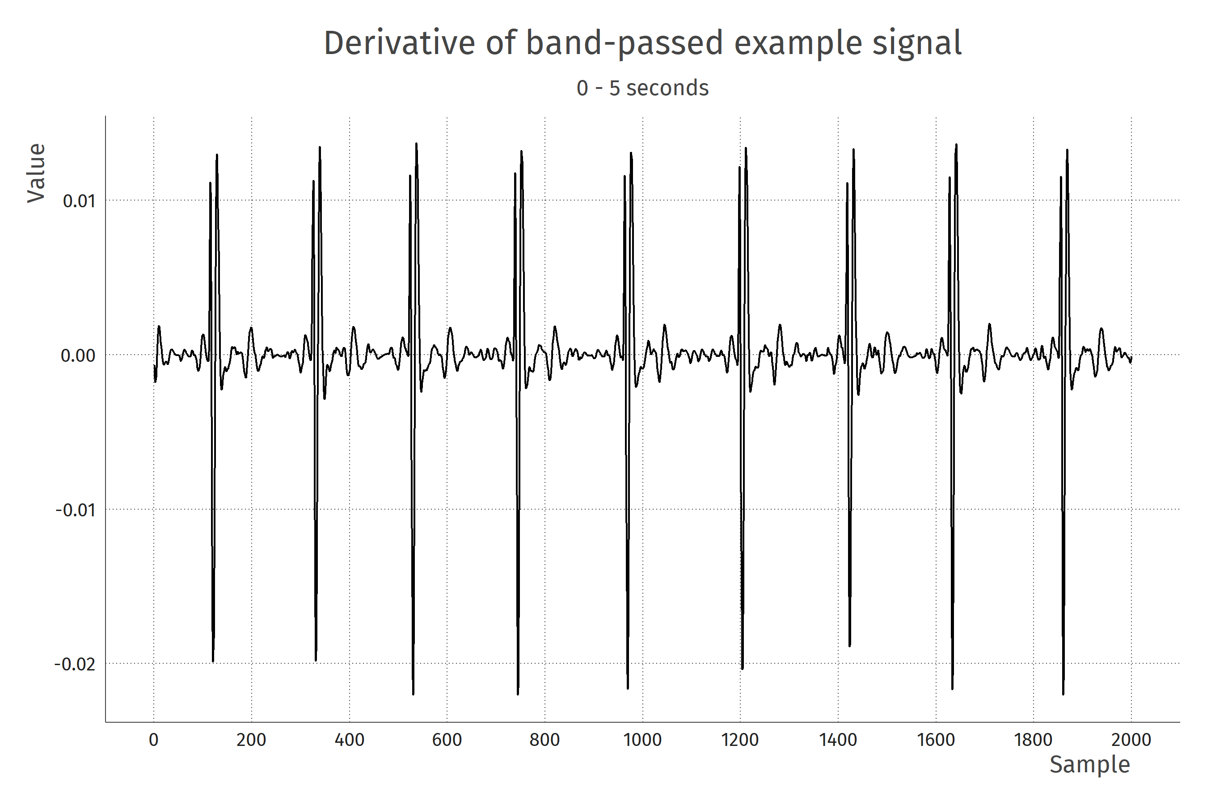

Slide 44
3. Square

Slide 45
Square
Squaring is simple: just multiply signal by itself
Greatly improves the signal-to-noise by giving large values more weight

Slide 47
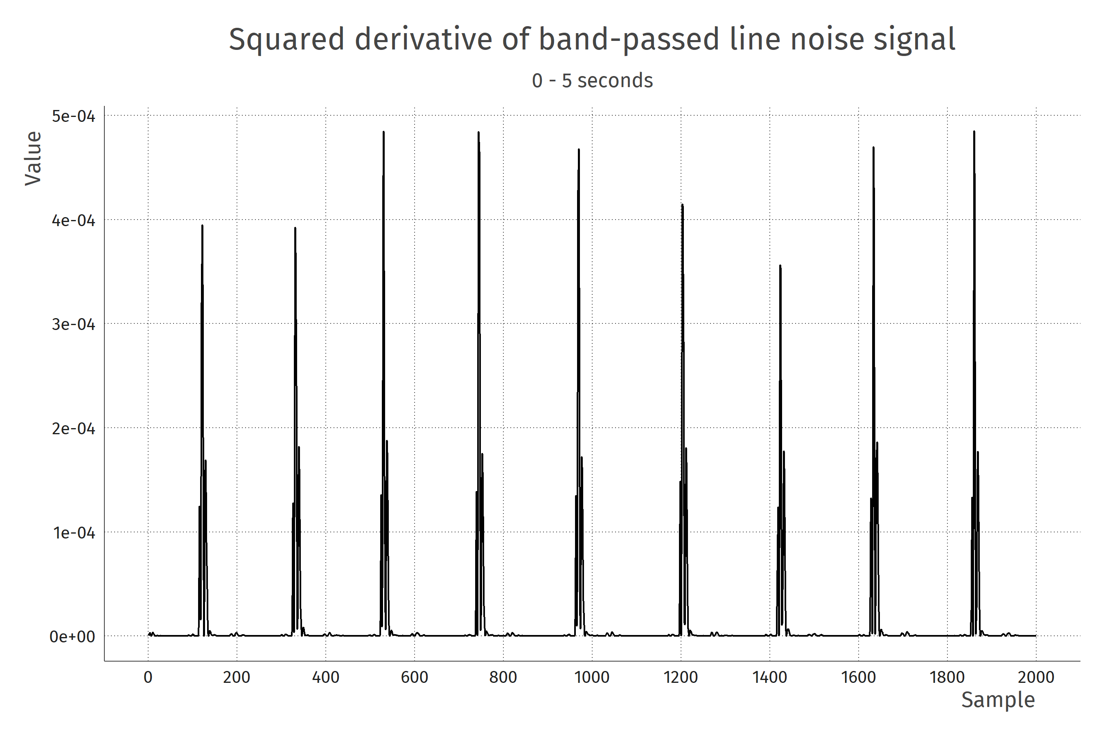

Slide 48
4. Boxcar integration

Slide 49

Boxcar integration
Go over the signal with a moving window, summing all values in the window
Equal to convolving the signal with a boxcar function
Pan-Tompkins suggest a window width of 150 ms

Slide 51
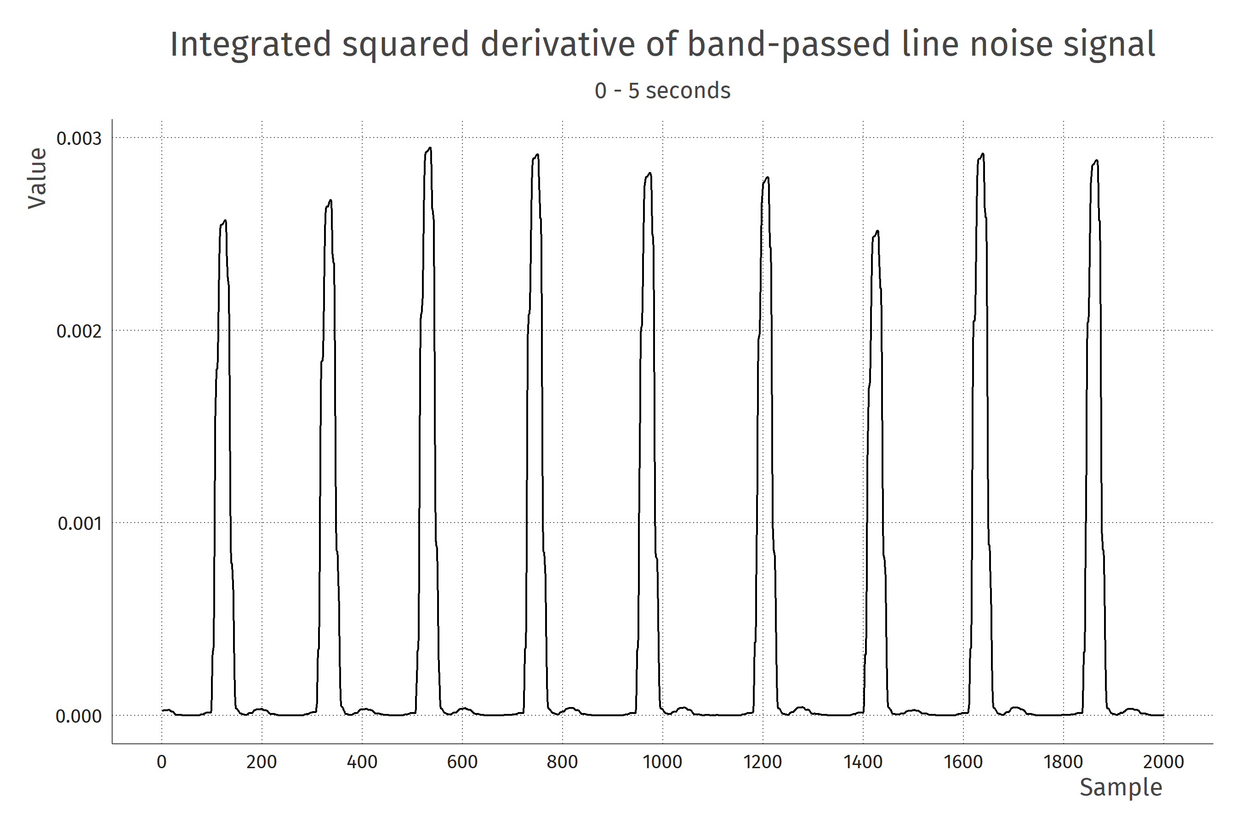

Slide 52
5. Detect peaks

Slide 53
Detecting peaks
Detecting peaks in this processed signal is now easy
Draw a horizontal line at a reasonable location
Anything above that line is a peak

Slide 54
Detecting peaks
Pan+Tompkins also suggest a refractory period
We know that heartbeats need at least 0.2 seconds between them
Code this information in the detector

Slide 56
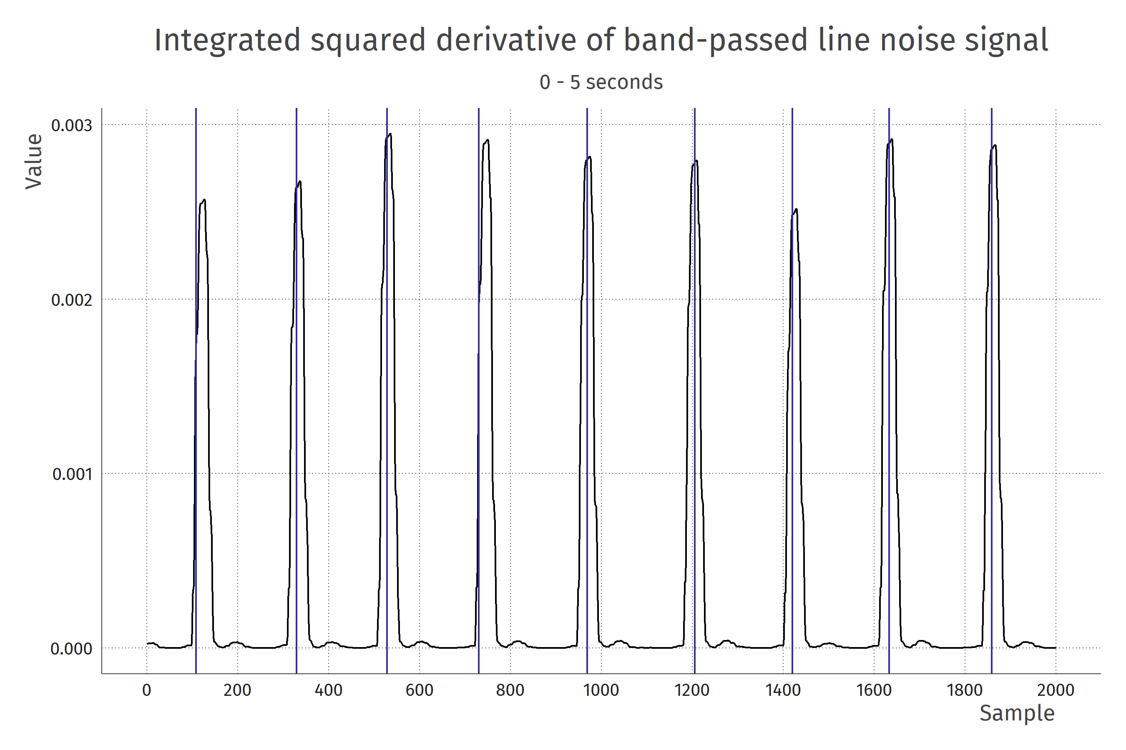

Slide 58
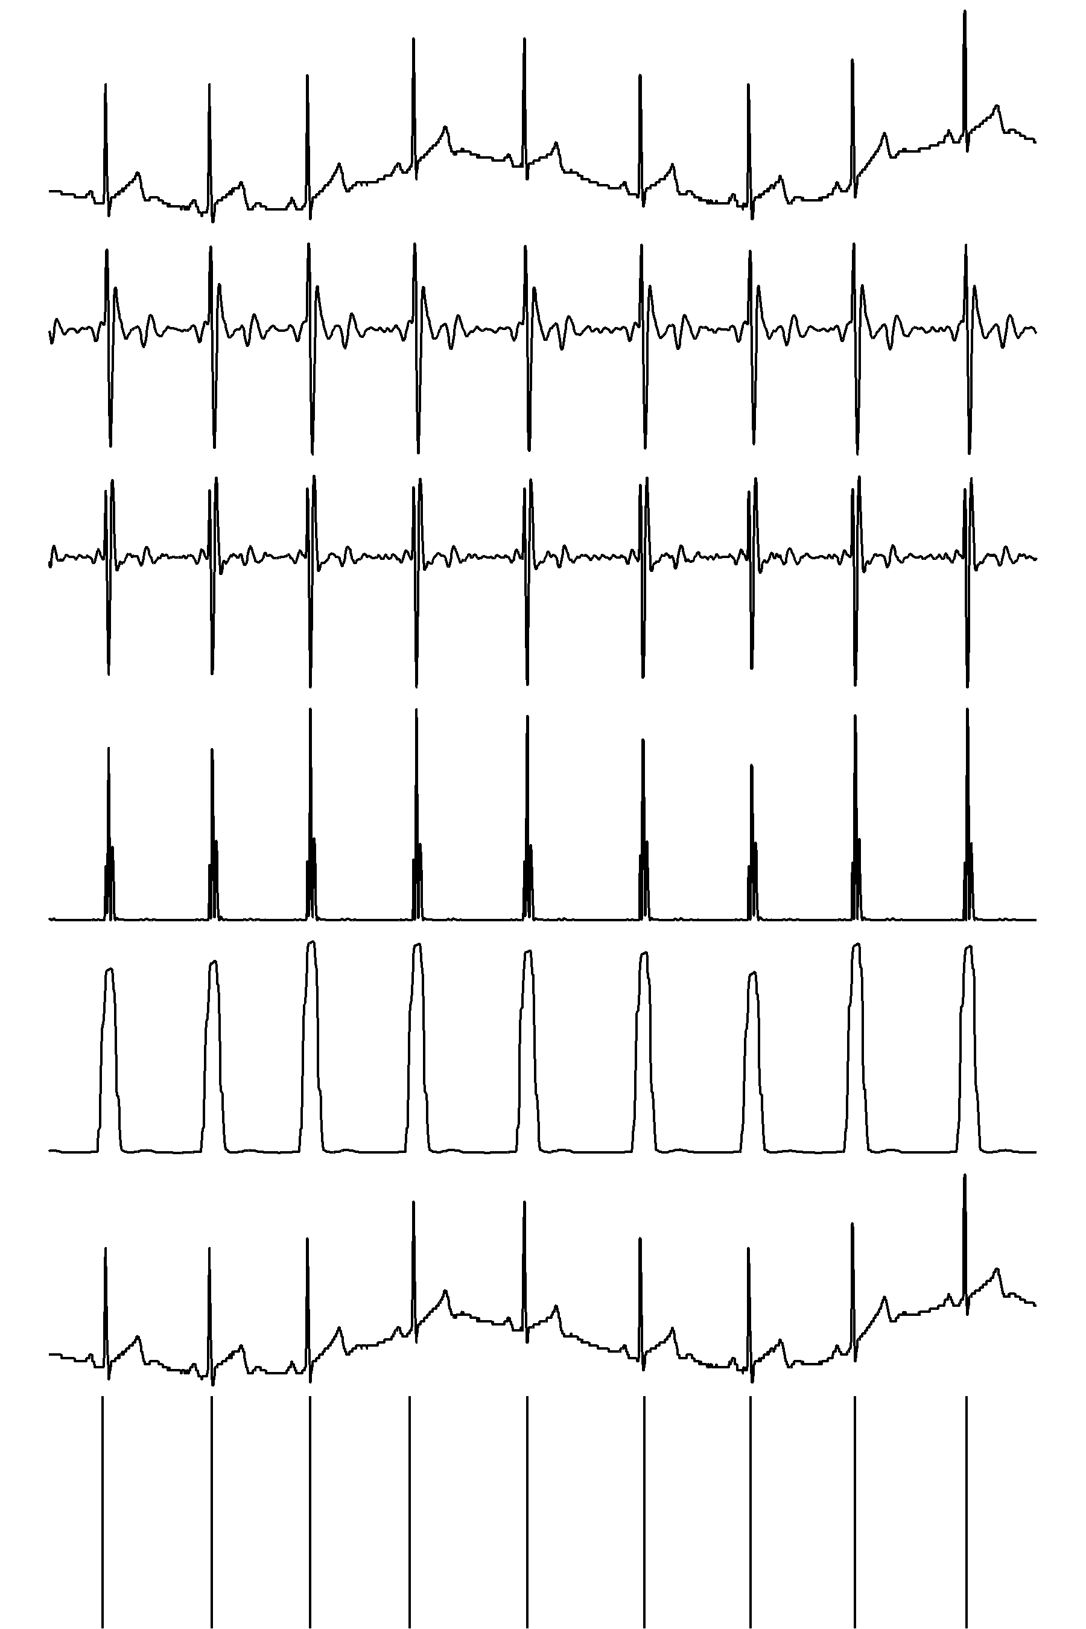

Slide 59
Conclusion
Signals are everywhere and easy to measure
Measurements have noise
Using signal processing, we can increase the S/N ratio
Use prior knowledge about the noise (bandpass filter) and about the signal of interest (derivative, refractory period) to extract information

Slide 60
References
Pan, J., & Tompkins, W. J. (1985). A real-time QRS detection algorithm. IEEE transactions on biomedical engineering, (3), 230-236.
Das, S., & Chakraborty, M. (2012). QRS detection algorithm using Savitzky-Golay filter. Aceee International Journal on signal & Image processing, 3(1).
Paul Bouchequet (2019). rsleep: Analysis of Sleep Data. R package version 1.0.1. https://CRAN.R-project.org/package=rsleep
Ambulant ECG example data provided by Lara Rösler of The Netherlands Institute for Neuroscience

