Slide 1
Chapter 8: Data Storage, Indexing Structures for Files

Slide 2

Overview of Database Design Process
Miniworld
REQUIREMENTS - COLLECTION & ANALYSIS
Functional requirements
Data requirements
FUNCTIONAL ANALYSIS
CONCEPTUAL DESIGN
DBMS–independent
High-level transaction specification
Conceptual schema
LOGICAL DESIGN
(DATA MODEL MAPPING)
APPLICATION PROGRAM DESIGN
Database schema
DBMS–specific
PHYSICAL DESIGN
TRANSACTION IMPLEMENTATION
Internal schema
Application program
Application Design
Database Design
Notes:
Two main activities:
- Database design: design the conceptual schema for a database application
- Applications design: focuses on the programs and interfaces that access the database
>>Requirements collection and analysis
The database designers interview prospective (tương lai, sắp đến) database users to understand and document their data requirements. The result of this step is a concisely (ngắn gọn, súc tích) written set of users’ requirements. These requirements should be specified in as detailed and complete a form as possible.
In parallel with specifying the data requirements, it is useful to specify the known functional requirements of the application. These consist of the user-defined operations (or transactions) that will be applied to the database, including both retrievals and updates.
>>Conceptual design: Create a conceptual schema for the database, using a high-level conceptual data model
The conceptual schema is a concise description of the data requirements of the users and includes detailed descriptions of the entity types, relationships, and constraints; these are expressed using the concepts provided by the high-level data model. Because these concepts do not include implementation details, they are usually easier to understand and can be used to communicate with nontechnical users. The high-level conceptual schema can also be used as a reference to ensure that all users’ data requirements are met and that the requirements do not conflict. This approach enables database designers to concentrate on specifying the properties of the data, without being concerned with storage and implementation details. This makes it is easier to create a good conceptual database design.
During or after the conceptual schema design, the basic data model operations can be used to specify the high-level user queries and operations identified during functional analysis. This also serves to confirm that the conceptual schema meets all the identified functional requirements. Modifications to the conceptual schema can be introduced if some functional requirements cannot be specified using the initial schema.
>>Logical design or data model mapping:
The next step in database design is the actual implementation of the database, using a commercial DBMS. Most current commercial DBMSs use an implementation data model - such as the relational or the object-relational database model - so the conceptual schema is transformed from the high-level data model into the implementation data model. This step is called logical design or data model mapping; its result is a database schema in the implementation data model of the DBMS. Data model mapping is often automated or semi-automated within the database design tool.
>>Physical design phase
The internal storage structures, file organizations, indexes, access paths, and physical design parameters for the database files are specified. In parallel with these activities, application programs are designed and implemented as database transactions corresponding to the high-level transaction specifications.

Slide 3
Outline
Data Storage
Disk Storage Devices
Files of Records
Operations on Files
Unordered Files
Ordered Files
Hashed Files
RAID Technology
Indexing Structures for Files
Types of Single-level Ordered Indexes
Multilevel Indexes
Dynamic Multilevel Indexes Using B-Trees and B+-Trees
Indexes on Multiple Keys

Slide 4
Disk Storage Devices
Preferred secondary storage device for high storage capacity and low cost.
Data stored as magnetized areas on magnetic disk surfaces.
A disk pack contains several magnetic disks connected to a rotating spindle.
Disks are divided into concentric circular tracks on each disk surface.
Track capacities vary typically from 4 to 50 Kbytes or more

Slide 5
Disk Storage Devices (contd.)
A track is divided into smaller blocks or sectors
because it usually contains a large amount of information
A track is divided into blocks.
The block size B is fixed for each system.
Typical block sizes range from B=512 bytes to B=4096 bytes.
Whole blocks are transferred between disk and main memory for processing.

Slide 6
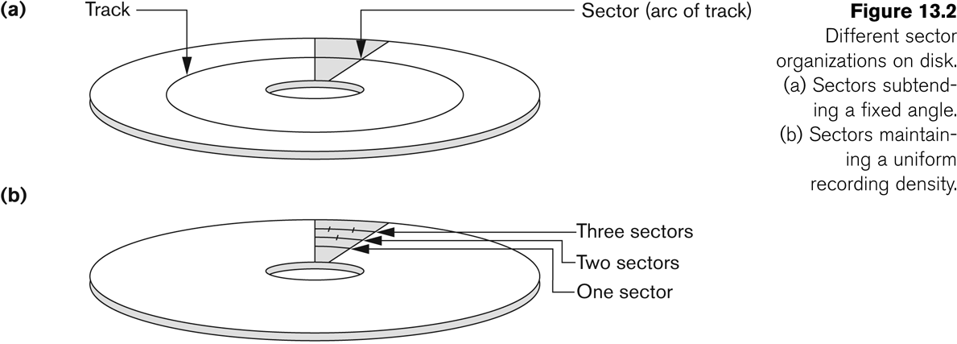
Disk Storage Devices (contd.)

Slide 7
Disk Storage Devices (contd.)
A read-write head moves to the track that contains the block to be transferred.
Disk rotation moves the block under the read-write head for reading or writing.
A physical disk block (hardware) address consists of:
a cylinder number (imaginary collection of tracks of same radius from all recorded surfaces)
the track number or surface number (within the cylinder)
and block number (within track).
Reading or writing a disk block is time consuming because of the seek time s and rotational delay (latency) rd.
Double buffering can be used to speed up the transfer of contiguous disk blocks.

Slide 8
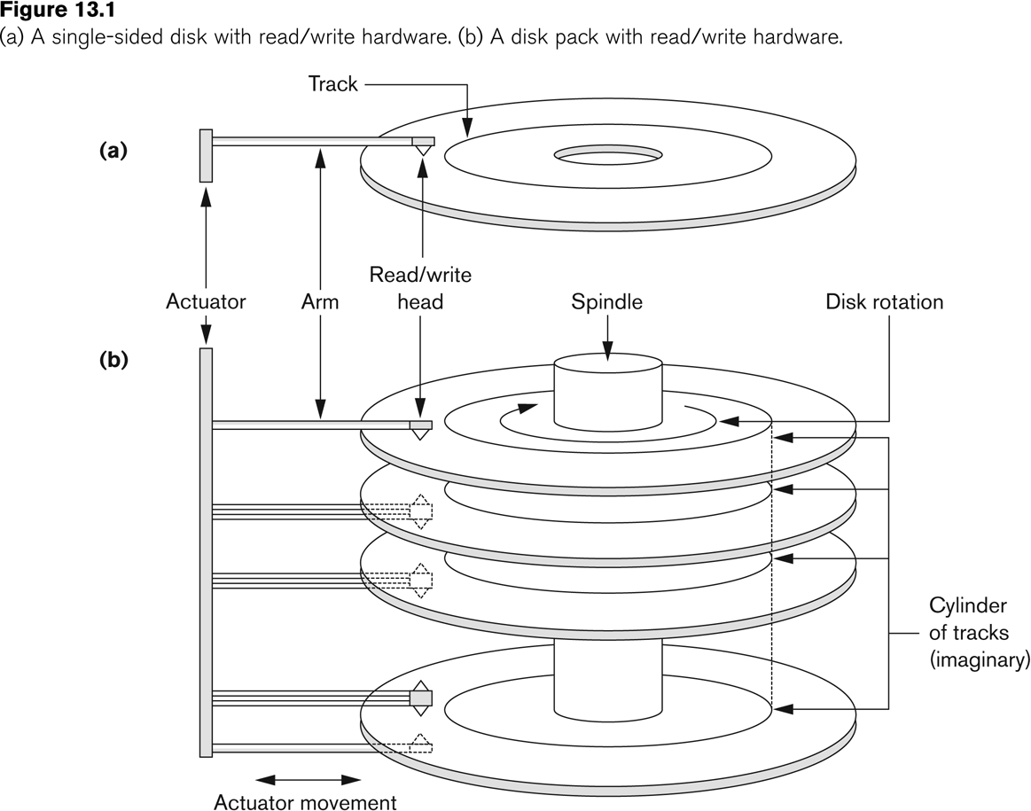
Disk Storage Devices (contd.)

Slide 9
Records
Fixed and variable length records
Records contain fields which have values of a particular type
E.g., amount, date, time, age
Fields themselves may be fixed length or variable length
Variable length fields can be mixed into one record:
Separator characters or length fields are needed so that the record can be “parsed.”

Slide 10
Blocking
Blocking:
Refers to storing a number of records in one block on the disk.
Blocking factor (bfr) refers to the number of records per block.
There may be empty space in a block if an integral number of records do not fit in one block.
Spanned Records:
Refers to records that exceed the size of one or more blocks and hence span a number of blocks.

Slide 11
Files of Records
A file is a sequence of records, where each record is a collection of data values (or data items).
A file descriptor (or file header) includes information that describes the file, such as the field names and their data types, and the addresses of the file blocks on disk.
Records are stored on disk blocks.
The blocking factor bfr for a file is the (average) number of file records stored in a disk block.
A file can have fixed-length records or variable-length records.

Slide 12
Files of Records (contd.)
File records can be unspanned or spanned
Unspanned: no record can span two blocks
Spanned: a record can be stored in more than one block
The physical disk blocks that are allocated to hold the records of a file can be contiguous, linked, or indexed.
In a file of fixed-length records, all records have the same format. Usually, unspanned blocking is used with such files.
Files of variable-length records require additional information to be stored in each record, such as separator characters and field types.
Usually spanned blocking is used with such files.

Slide 13
Operation on Files
Typical file operations include:
OPEN: Readies the file for access, and associates a pointer that will refer to a current file record at each point in time.
FIND: Searches for the first file record that satisfies a certain condition, and makes it the current file record.
FINDNEXT: Searches for the next file record (from the current record) that satisfies a certain condition, and makes it the current file record.
READ: Reads the current file record into a program variable.
INSERT: Inserts a new record into the file & makes it the current file record.
DELETE: Removes the current file record from the file, usually by marking the record to indicate that it is no longer valid.
MODIFY: Changes the values of some fields of the current file record.
CLOSE: Terminates access to the file.
REORGANIZE: Reorganizes the file records.
For example, the records marked deleted are physically removed from the file or a new organization of the file records is created.
READ_ORDERED: Read the file blocks in order of a specific field of the file.

Slide 14
Unordered Files
Also called a heap or a pile file.
New records are inserted at the end of the file.
A linear search through the file records is necessary to search for a record.
This requires reading and searching half the file blocks on the average, and is hence quite expensive.
Record insertion is quite efficient.
Reading the records in order of a particular field requires sorting the file records.

Slide 15
Ordered Files
Also called a sequential file.
File records are kept sorted by the values of an ordering field.
Insertion is expensive: records must be inserted in the correct order.
It is common to keep a separate unordered overflow (or transaction) file for new records to improve insertion efficiency; this is periodically merged with the main ordered file.
A binary search can be used to search for a record on its ordering field value.
This requires reading and searching log₂ of the file blocks on the average, an improvement over linear search.
Reading the records in order of the ordering field is quite efficient.

Slide 16
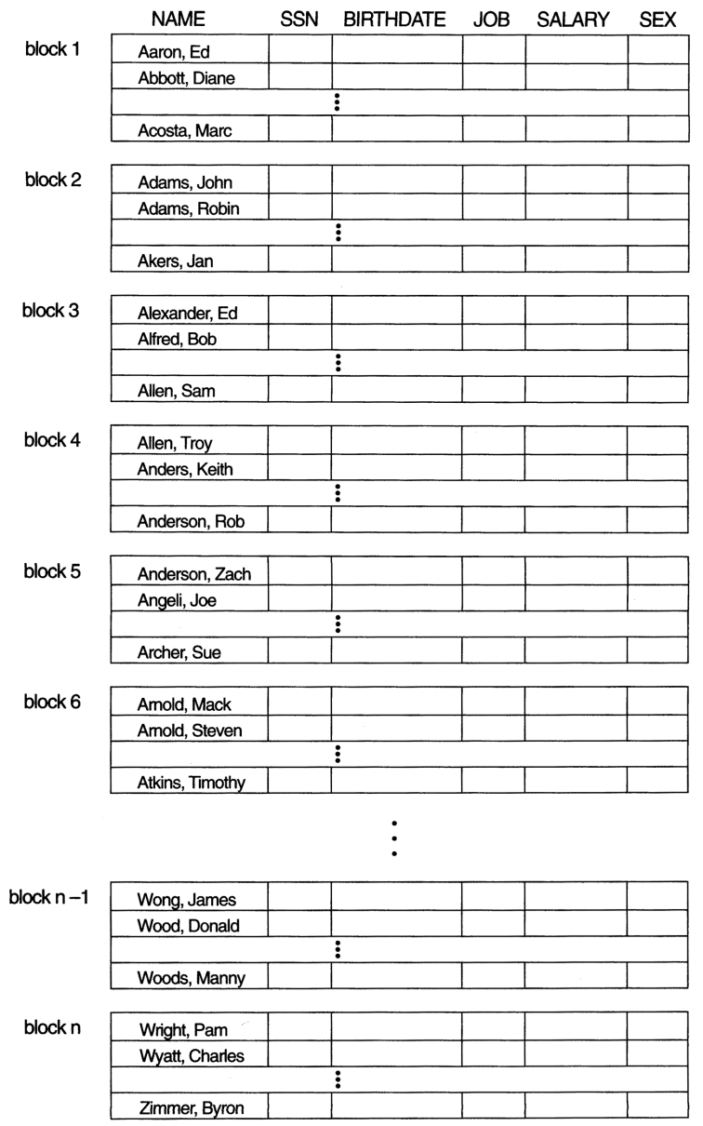
Ordered Files (contd.)

Slide 17
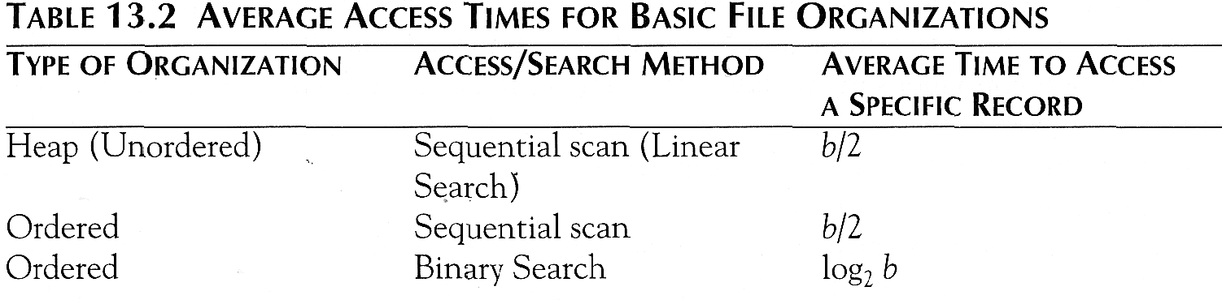
Average Access Times
The following table shows the average access time to access a specific record for a given type of file

Slide 18
Hashed Files
Hashing for disk files is called External Hashing
The file blocks are divided into M equal-sized buckets, numbered bucket₀, bucket₁, ..., bucket_{M-1}.
Typically, a bucket corresponds to one (or a fixed number of) disk block.
One of the file fields is designated to be the hash key of the file.
The record with hash key value K is stored in bucket i, where i=h(K), and h is the hashing function.
Search is very efficient on the hash key.
Collisions occur when a new record hashes to a bucket that is already full.
An overflow file is kept for storing such records.
Overflow records that hash to each bucket can be linked together.

Slide 19
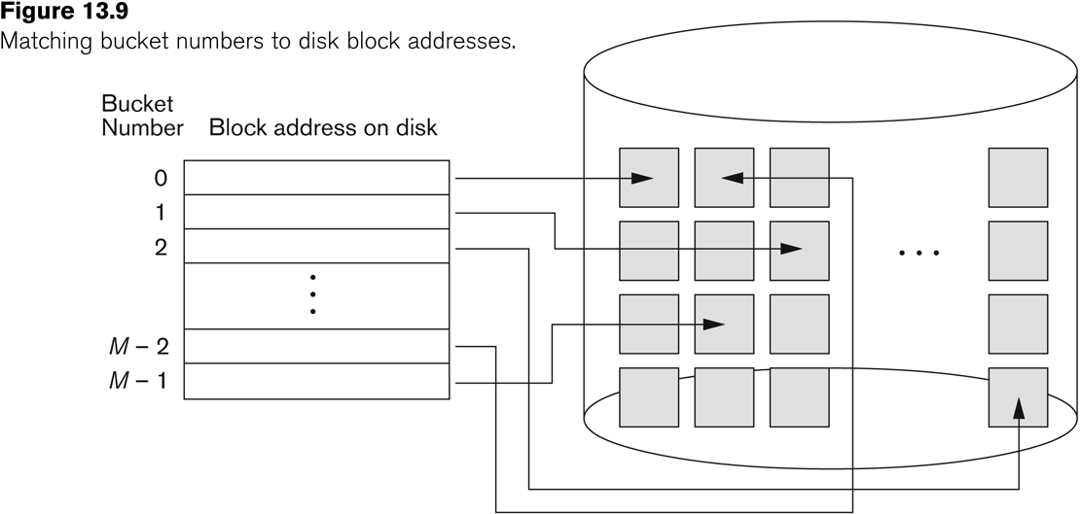
Hashed Files (contd.)

Slide 20
Hashed Files (contd.)
To reduce overflow records, a hash file is typically kept 70-80% full.
The hash function h should distribute the records uniformly among the buckets
Otherwise, search time will be increased because many overflow records will exist.
Main disadvantages of static external hashing:
Fixed number of buckets M is a problem if the number of records in the file grows or shrinks.
Ordered access on the hash key is quite inefficient (requires sorting the records).

Slide 21
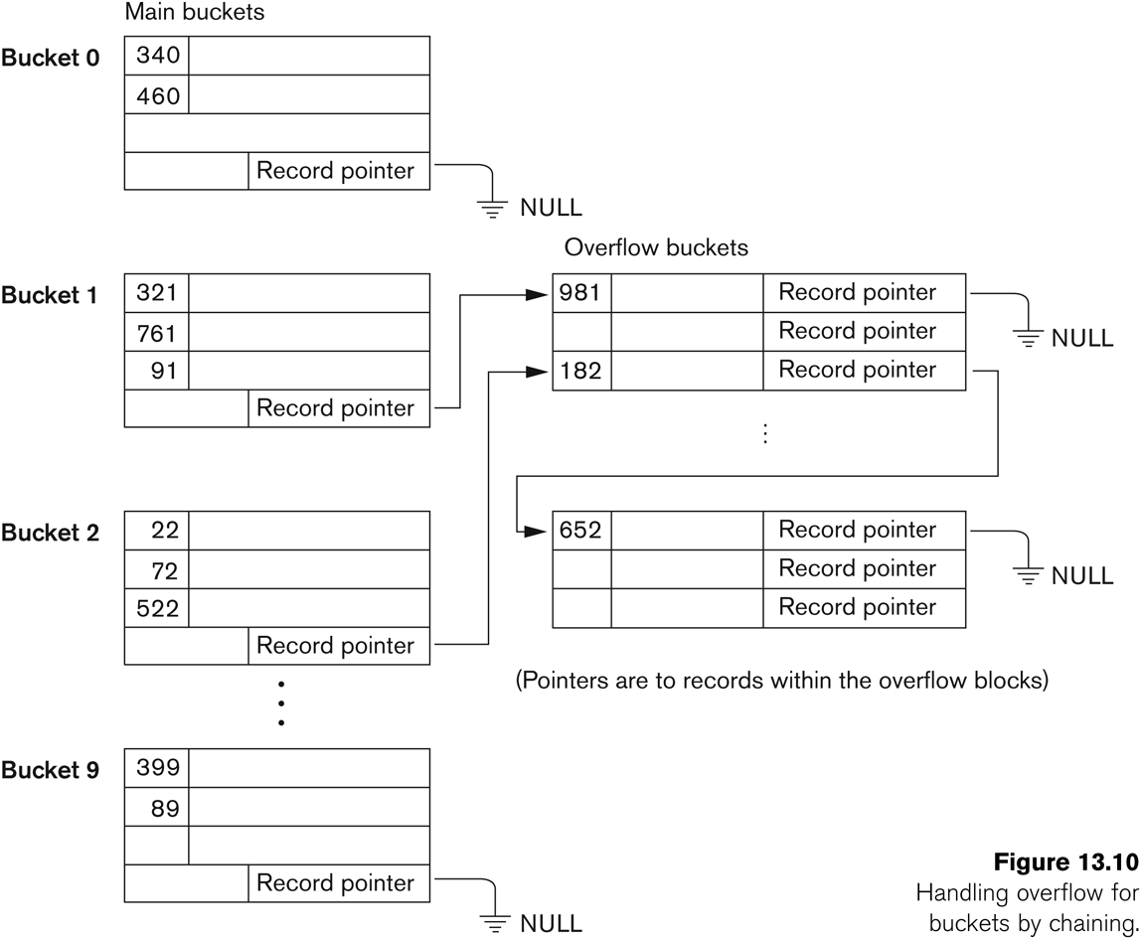
Hashed Files - Overflow handling

Slide 22
Parallelizing Disk Access using RAID Technology.
Secondary storage technology must take steps to keep up in performance and reliability with processor technology.
A major advance in secondary storage technology is represented by the development of RAID, which originally stood for Redundant Arrays of Inexpensive Disks.
The main goal of RAID is to even out the widely different rates of performance improvement of disks against those in memory and microprocessors.

Slide 23
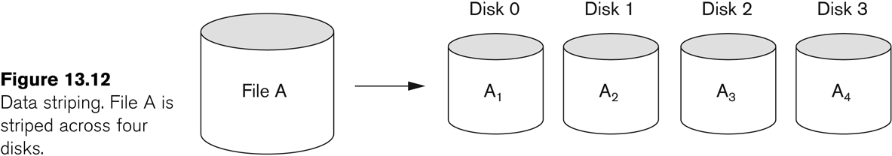
RAID Technology (contd.)
A natural solution is a large array of small independent disks acting as a single higher-performance logical disk.
A concept called data striping is used, which utilizes parallelism to improve disk performance.
Data striping distributes data transparently over multiple disks to make them appear as a single large, fast disk.

Slide 24
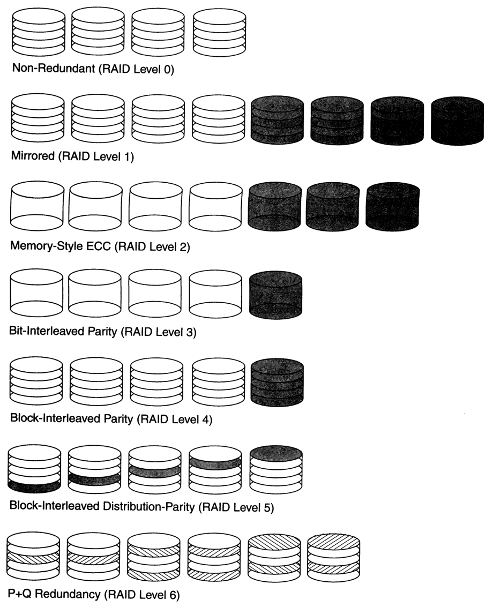
Use of RAID Technology (contd.)

Slide 25
Storage Area Networks
The demand for higher storage has risen considerably in recent times.
Organizations have a need to move from a static fixed data center oriented operation to a more flexible and dynamic infrastructure for information processing.
Thus they are moving to a concept of Storage Area Networks (SANs).
In a SAN, online storage peripherals are configured as nodes on a high-speed network and can be attached and detached from servers in a very flexible manner.
This allows storage systems to be placed at longer distances from the servers and provide different performance and connectivity options.
Notes:
Trong tin học, mạng lưu trữ (Storage Area Network hay SAN) là một kiến trúc gắn kết các thiết bị lưu trữ bên ngoài (như dãy đĩa, [|thư viên băng từ]] và các thư viện ổ quang) tới các máy chủ theo cách mà đối với hệ điều hànhcác thiết bị lưu trữ này xuất hiện giống như các thiết bị lắp trong.

Slide 26
Storage Area Networks (contd.)
Advantages of SANs are:
Flexible many-to-many connectivity among servers and storage devices using fiber channel hubs and switches.
Up to 10km separation between a server and a storage system using appropriate fiber optic cables.
Better isolation capabilities allowing non-disruptive addition of new peripherals and servers.
SANs face the problem of combining storage options from multiple vendors and dealing with evolving standards of storage management software and hardware.

Slide 27
Outline
Disk Storage, Basic File Structures, and Hashing
Disk Storage Devices
Files of Records
Operations on Files
Unordered Files
Ordered Files
Hashed Files
RAID Technology
Indexing Structures for Files
Types of Single-level Ordered Indexes
Multilevel Indexes
Dynamic Multilevel Indexes Using B-Trees and B+-Trees
Indexes on Multiple Keys

Slide 28
Indexes as Access Paths
A single-level index is an auxiliary file that makes it more efficient to search for a record in the data file.
The index is usually specified on one field of the file (although it could be specified on several fields)
One form of an index is a file of entries <field value, pointer to record>, which is ordered by field value
The index is called an access path on the field.

Slide 29
Indexes as Access Paths (contd.)
The index file usually occupies considerably less disk blocks than the data file because its entries are much smaller
A binary search on the index yields a pointer to the file record
Indexes can also be characterized as dense or sparse
A dense index has an index entry for every search key value (and hence every record) in the data file.
A sparse (or nondense) index, on the other hand, has index entries for only some of the search values

Slide 30
Types of Single-Level Indexes
Primary Index
Defined on an ordered data file
The data file is ordered on a key field
Includes one index entry for each block in the data file; the index entry has the key field value for the first record in the block, which is called the block anchor
A similar scheme can use the last record in a block.
A primary index is a nondense (sparse) index, since it includes an entry for each disk block of the data file and the keys of its anchor record rather than for every search value.

Slide 31
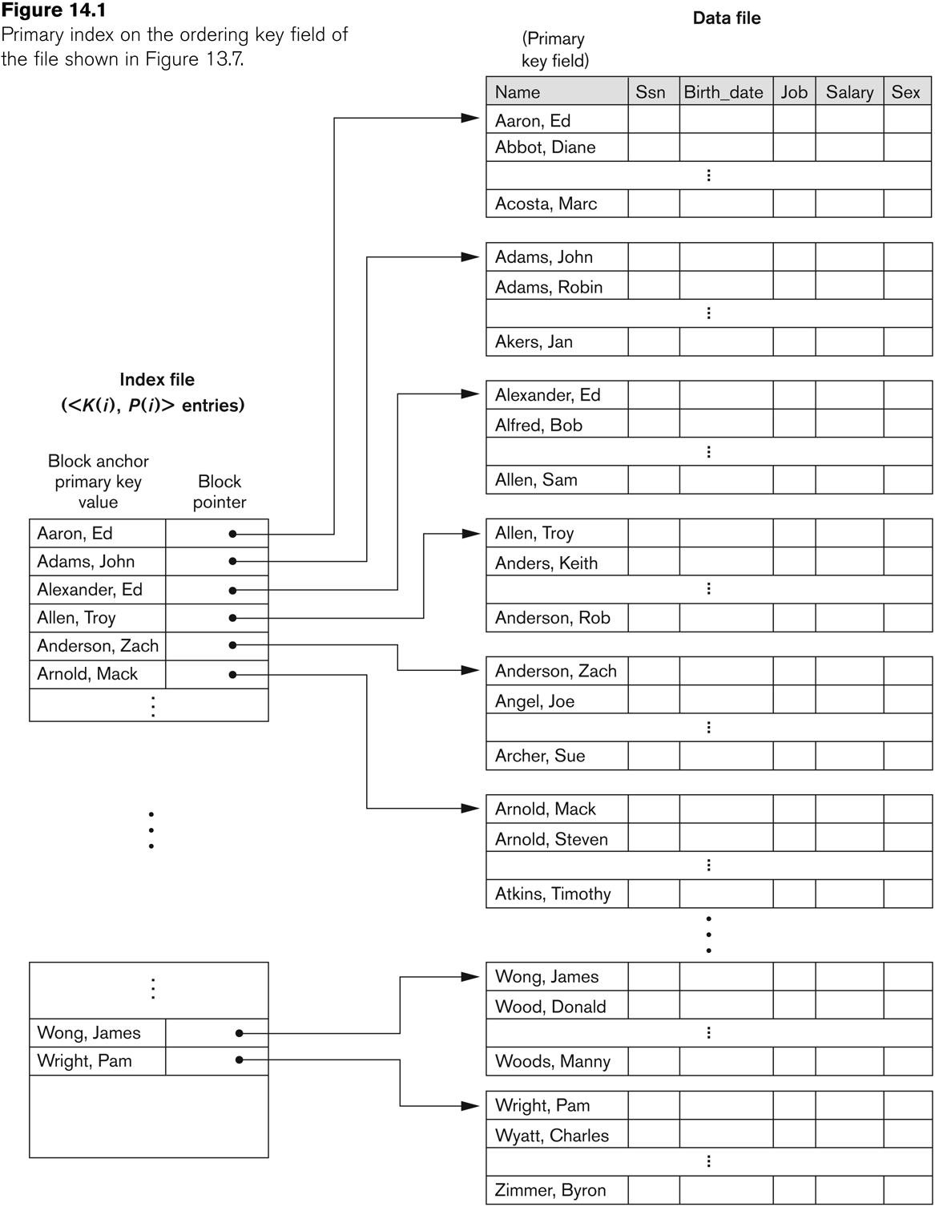
Primary index on the ordering key field

Slide 32
Types of Single-Level Indexes
Example: Given the following data file:
EMPLOYEE(NAME,SSN, ADDRESS,JOB,SAL,... )
Suppose that:
record size: R= 150 bytes
block size: B= 512 bytes
Number of records: r = 30000 records
Then, we get:
blocking factor Bfr = (B/R) = (512/150) = 3 records/block
number of file blocks b= (r/Bfr) = (30000/3) =10000 blocks

Slide 33
Types of Single-Level Indexes
For a primary index on the ordering key field SSN, assume the field size V_{SSN}= 9 bytes and the block pointer size P = 6 bytes. Then:
index entry size R_{I}=(V_{SSN}+ P)=(9+6)=15 bytes
index blocking factor Bfr_{I}= (B/R_{I}) = (512/15) =34 entries/block
number of index blocks b_{I}= (b/Bfr_{I}) = (10000/34) = 295 blocks
binary search needs log₂b_{I}= log₂295= 9 block accesses
To search for a record using the index, we need one additional block access to the data file for a
total of 9+1 = 10 block accesses
This is compared to an average cost of:
Linear search:(b/2)= 10000/2 = 5000 block accesses
The binary search: log₂b= log₂10000 =14 block accesses

Slide 34
Types of Single-Level Indexes
Clustering Index
Defined on an ordered data file
The data file is ordered on a non-key field unlike primary index, which requires that the ordering field of the data file have a distinct value for each record.
Includes one index entry for each distinct value of the field; the index entry points to the first data block that contains records with that field value.
It is another example of nondense index where Insertion and Deletion is relatively straightforward with a clustering index.

Slide 35
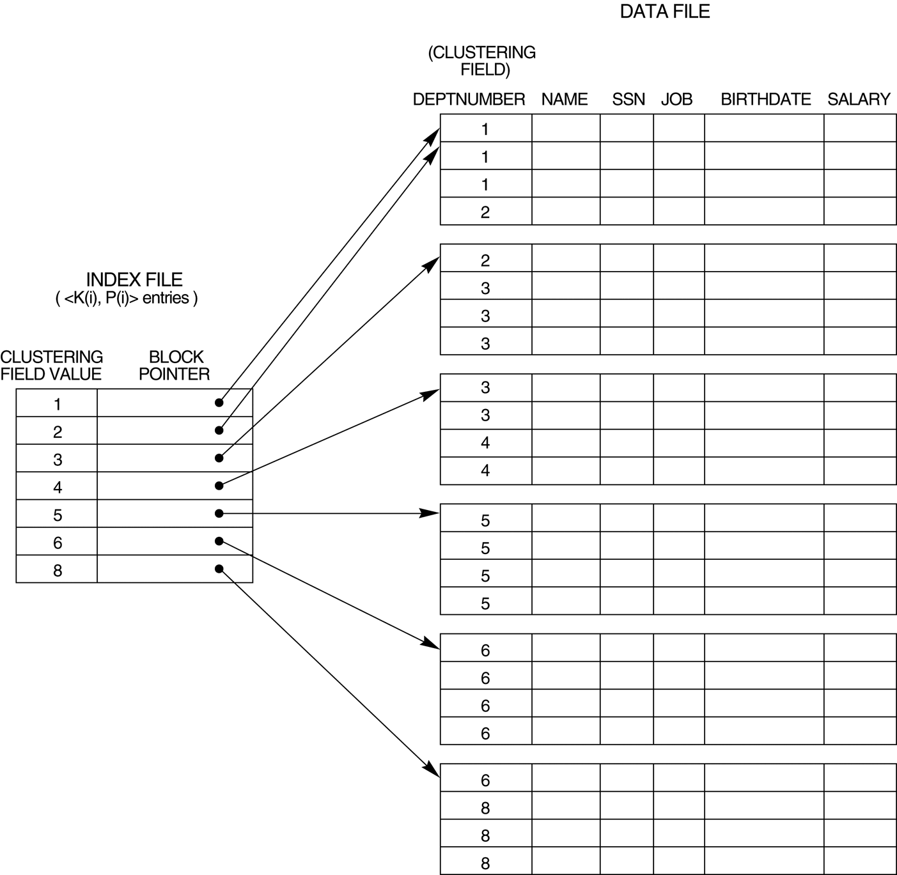
A Clustering Index Example
FIGURE 14.2 A clustering index on the DEPTNUMBER ordering non-key field of an EMPLOYEE file.

Slide 36
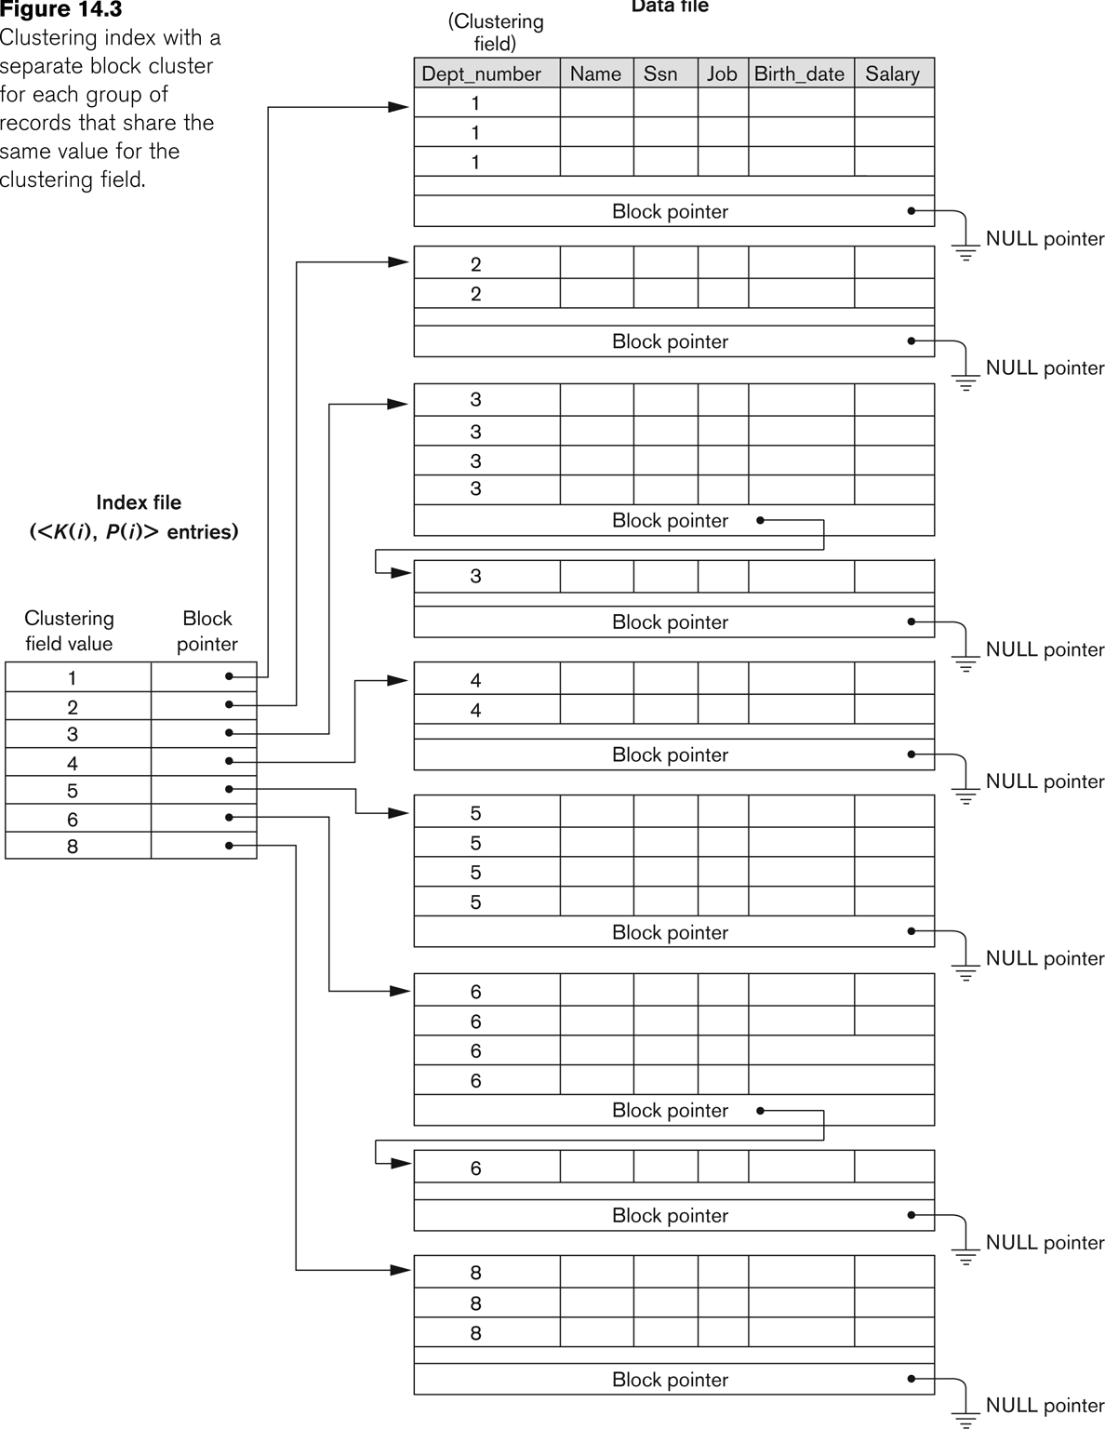
Another Clustering Index Example

Slide 37
Types of Single-Level Indexes
Secondary Index
A secondary index provides a secondary means of accessing a file for which some primary access already exists.
The secondary index may be on a field which is a candidate key and has a unique value in every record, or a non-key with duplicate values.
The index is an ordered file with two fields.
The first field is of the same data type as some non-ordering field of the data file that is an indexing field.
The second field is either a block pointer or a record pointer.
There can be many secondary indexes (and hence, indexing fields) for the same file.
Includes one entry for each record in the data file; hence, it is a dense index

Slide 38
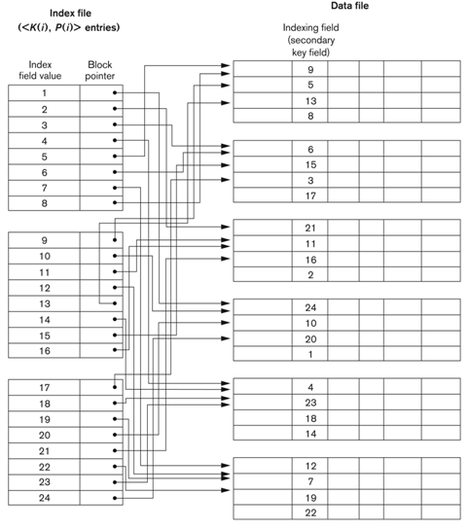
Example of a Dense Secondary Index

Slide 39
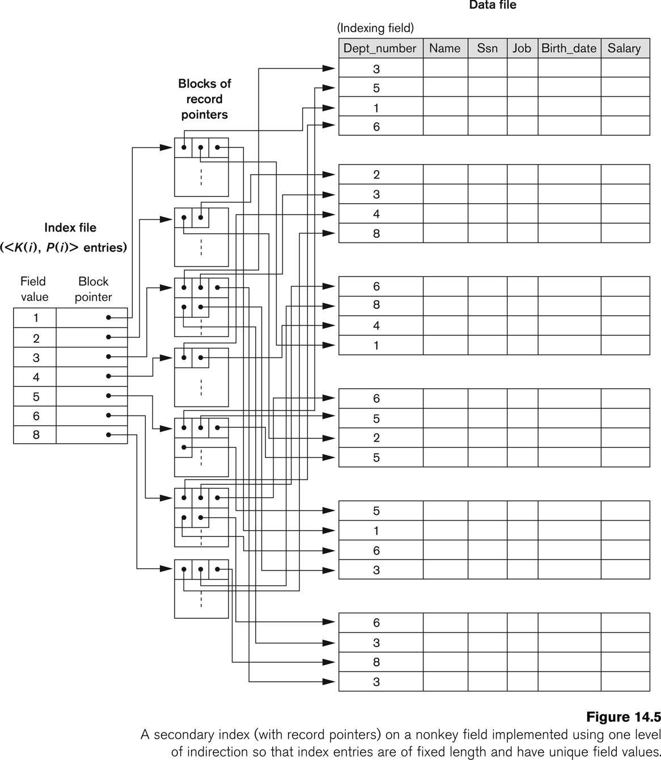
An Example of a Secondary Index

Slide 40
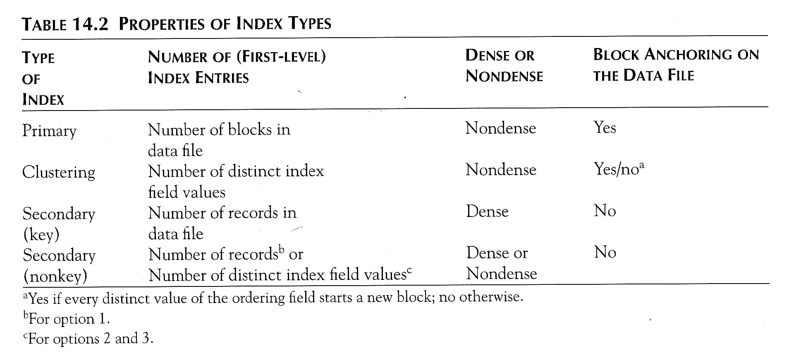
Properties of Index Types

Slide 41
Multi-Level Indexes
Because a single-level index is an ordered file, we can create a primary index to the index itself;
In this case, the original index file is called the first-level index and the index to the index is called the second-level index.
We can repeat the process, creating a third, fourth, ..., top level until all entries of the top level fit in one disk block
A multi-level index can be created for any type of first-level index (primary, secondary, clustering) as long as the first-level index consists of more than one disk block

Slide 42
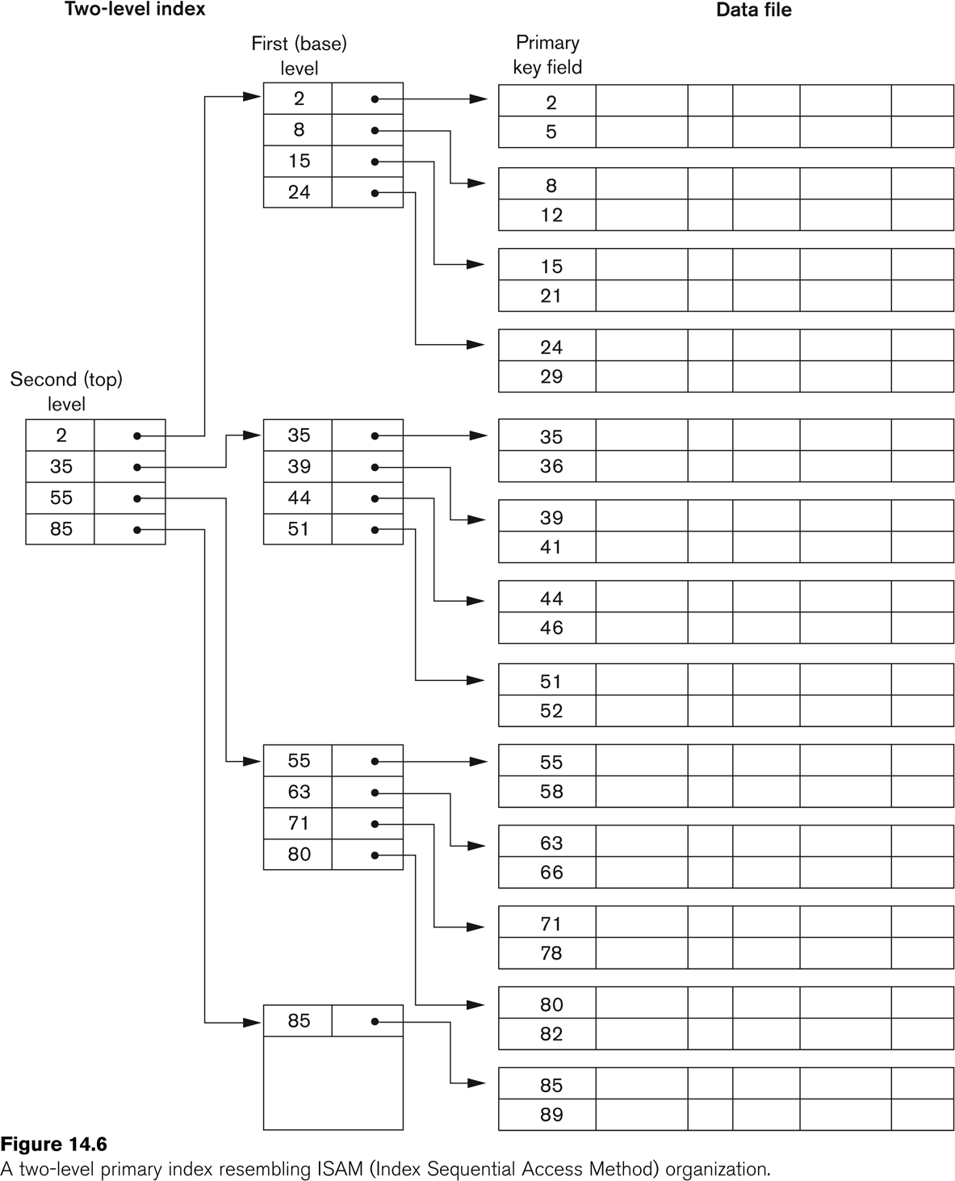
A Two-level Primary Index

Slide 43
Multi-Level Indexes
Such a multi-level index is a form of search tree
However, insertion and deletion of new index entries is a severe problem because every level of the index is an ordered file.

Slide 44
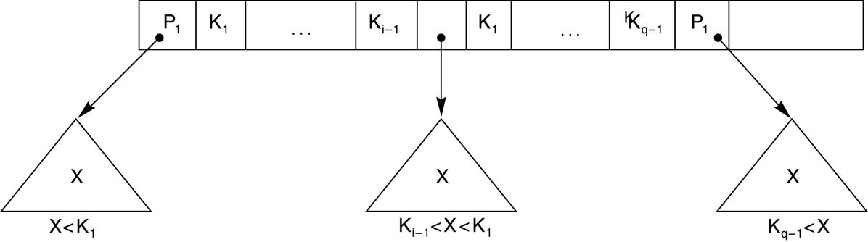
A Node in a Search Tree with Pointers to Subtrees below It

Slide 45
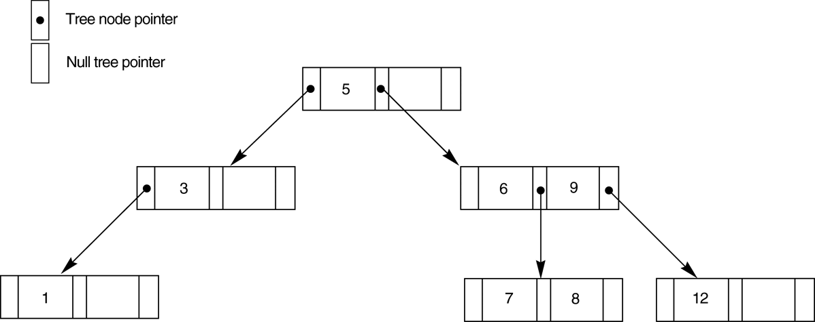
FIGURE 14.9 A search tree of order p = 3.

Slide 46
Dynamic Multilevel Indexes Using B-Trees and B+-Trees
Most multi-level indexes use B-tree or B+-tree data structures because of the insertion and deletion problem
This leaves space in each tree node (disk block) to allow for new index entries
These data structures are variations of search trees that allow efficient insertion and deletion of new search values.
In B-Tree and B+-Tree data structures, each node corresponds to a disk block
Each node is kept between half-full and completely full

Slide 47
Dynamic Multilevel Indexes Using B-Trees and B+-Trees (contd.)
An insertion into a node that is not full is quite efficient
If a node is full the insertion causes a split into two nodes
Splitting may propagate to other tree levels
A deletion is quite efficient if a node does not become less than half full
If a deletion causes a node to become less than half full, it must be merged with neighboring nodes

Slide 48
Difference between B-tree and B+-tree
In a B-tree, pointers to data records exist at all levels of the tree
In a B+-tree, all pointers to data records exists at the leaf-level nodes
A B+-tree can have less levels (or higher capacity of search values) than the corresponding B-tree

Slide 49
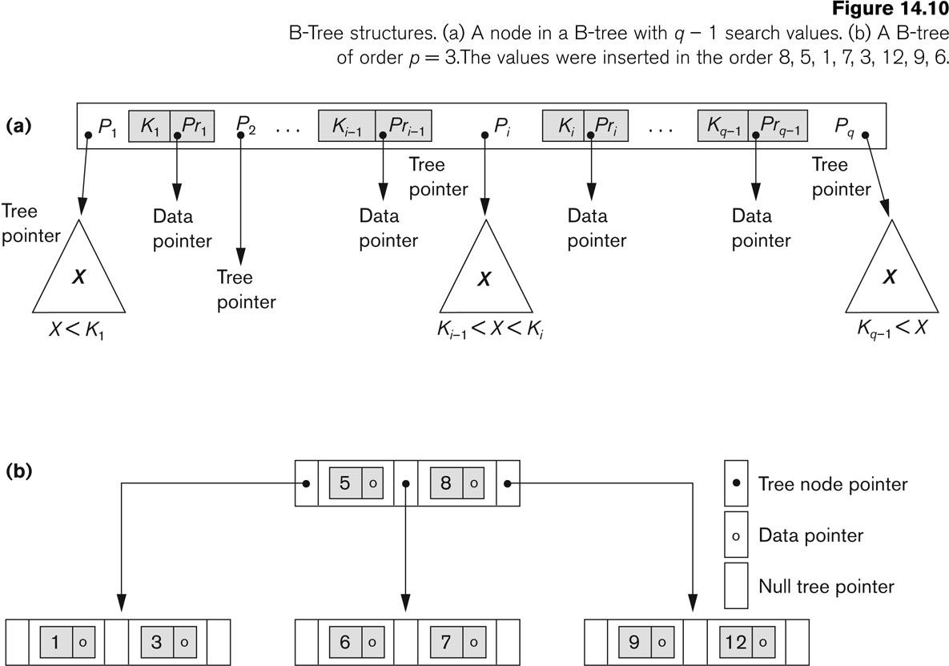
B-tree Structures

Slide 50
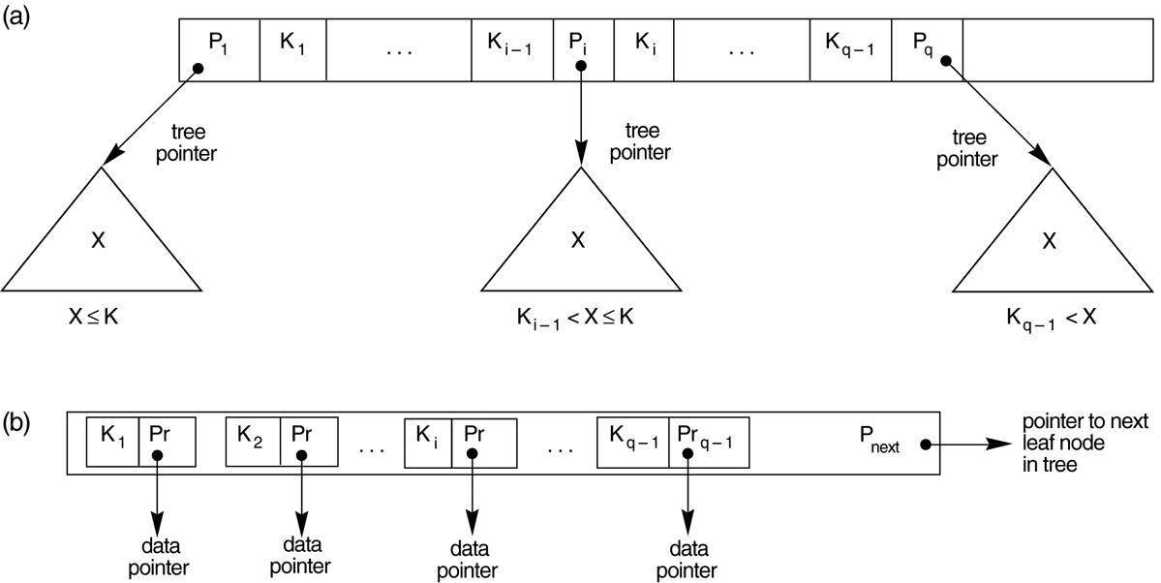
The Nodes of a B+-tree
FIGURE 14.11 The nodes of a B+-tree
(a) Internal node of a B+-tree with q –1 search values.
(b) Leaf node of a B+-tree with q – 1 search values and q – 1 data pointers.

Slide 51
Summary
Data Storage
Disk Storage Devices
Files of Records
Operations on Files
Unordered Files
Ordered Files
Hashed Files
RAID Technology
Indexing Structures for Files
Types of Single-level Ordered Indexes
Multilevel Indexes
Dynamic Multilevel Indexes Using B-Trees and B+-Trees
Indexes on Multiple Keys

Slide 52



Slide 53
Consider a disk with block size B = 512 bytes. A block pointer is P = 6 bytes long, and a record pointer is PR = 7 bytes long. A file has r = 30,000 EMPLOYEE records of fixed length. Each record has the following fields: Name (30 bytes), Ssn (9 bytes), Department_code (9 bytes), Address (40 bytes), Phone (10 bytes), Birth_date (8 bytes), Sex (1 byte), Job_code (4 bytes), and Salary (4 bytes, real number).An additional byte is used as a deletion marker.
1. Calculate the record size R in bytes.
2. Calculate the blocking factor bfr and the number of file blocks b, assuming an unspanned organization.
Notes:
R = 116
Bfr = 4
b = 7500
Log2(7500) = 13
1st index:
Bfri = 34
ri = 7500
bi = 221
Log2(221) + 1 = 9

Slide 54
Consider a disk with block size B = 512 bytes. A block pointer is P = 6 bytes long, and a record pointer is PR = 7 bytes long. A file has r = 30,000 EMPLOYEE records of fixed length. Each record has the following fields: Name (30 bytes), Ssn (9 bytes), Department_code (9 bytes), Address (40 bytes), Phone (10 bytes), Birth_date (8 bytes), Sex (1 byte), Job_code (4 bytes), and Salary (4 bytes, real number).An additional byte is used as a deletion marker.
3. Suppose that the file is ordered by the key field Ssn Calculate
the number of block accesses needed to search for and retrieve a record from the file—given its Ssn value
Notes:
R = 116
Bfr = 4
b = 7500
Log2(7500) = 13
1st index:
Bfri = 34
ri = 7500
bi = 221
Log2(221) + 1 = 9

Slide 55
Consider a disk with block size B = 512 bytes. A block pointer is P = 6 bytes long, and a record pointer is PR = 7 bytes long. A file has r = 30,000 EMPLOYEE records of fixed length. Each record has the following fields: Name (30 bytes), Ssn (9 bytes), Department_code (9 bytes), Address (40 bytes), Phone (10 bytes), Birth_date (8 bytes), Sex (1 byte), Job_code (4 bytes), and Salary (4 bytes, real number).An additional byte is used as a deletion marker.
4. Suppose that the file is ordered by the key field Ssn and we want to construct a primary index on Ssn. Calculate
The index blocking factor bfri
the number of first-level index entries and the number of first-level index blocks
Notes:
R = 116
Bfr = 4
b = 7500
Log2(7500) = 13
1st index:
Bfri = 34
ri = 7500
bi = 221
Log2(221) + 1 = 9

Slide 56
Consider a disk with block size B = 512 bytes. A block pointer is P = 6 bytes long, and a record pointer is PR = 7 bytes long. A file has r = 30,000 EMPLOYEE records of fixed length. Each record has the following fields: Name (30 bytes), Ssn (9 bytes), Department_code (9 bytes), Address (40 bytes), Phone (10 bytes), Birth_date (8 bytes), Sex (1 byte), Job_code (4 bytes), and Salary (4 bytes, real number).An additional byte is used as a deletion marker.
4. Suppose that the file is ordered by the key field Ssn and we want to construct a primary index on Ssn. Calculate
the number of block accesses needed to search for and retrieve a record from the file—given its Ssn value
Notes:
R = 116
Bfr = 4
b = 7500
Log2(7500) = 13
1st index:
Bfri = 34
ri = 7500
bi = 221
Log2(221) + 1 = 9

Slide 57
Consider a disk with block size B = 512 bytes. A block pointer is P = 6 bytes long, and a record pointer is PR = 7 bytes long. A file has r = 30,000 EMPLOYEE records of fixed length. Each record has the following fields: Name (30 bytes), Ssn (9 bytes), Department_code (9 bytes), Address (40 bytes), Phone (10 bytes), Birth_date (8 bytes), Sex (1 byte), Job_code (4 bytes), and Salary (4 bytes, real number).An additional byte is used as a deletion marker.
5. If we make it into a multilevel index (two levels).
Calculate the total number of blocks required by the second index;
the number of block accesses needed to search for and retrieve a record from the file—given its Ssn value
Notes:
2nd index
Ri2 = 16
Bfri2 = 34
Bi2 = 7
Log2(7) + 1 + 1 = 5

