Slide 1
Convolutional Neural Network (CNN)
Lecturer: Van Khoa LE
Notes:
https://pub.towardsai.net/convolutional-neural-networks-cnns-tutorial-with-python-417c29f0403f

Slide 2
Convolutional

Slide 3
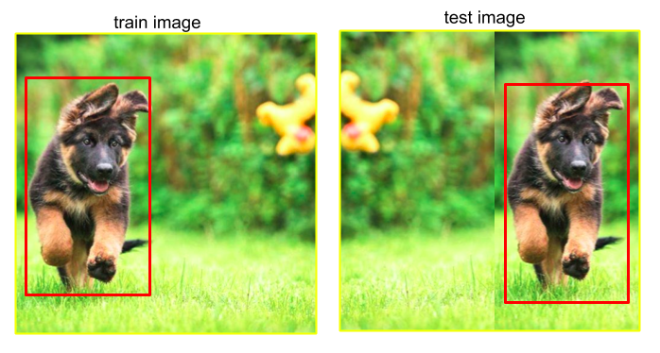
Translation invariance and locality
Pigs usually do not fly and planes usually do not swim. Nonetheless, we should still recognize a pig were one to appear at the top of the image
In the earliest layers, our network should respond similarly to the same patch, regardless of where it appears in the image. This principle is called translation invariance.
The earliest layers of the network should focus on local regions, without regard for the contents of the image in distant regions. This is the locality principle. Eventually, these local representations can be aggregated to make predictions at the whole image level.
Notes:
https://d2l.ai/chapter_convolutional-neural-networks/why-conv.html

Slide 4
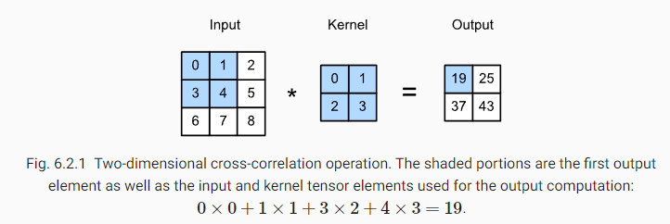

Convolution

Slide 5
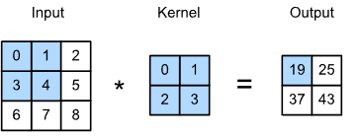
Learning kernel
Example code training CNN
Feature map
Receptive field

Slide 6
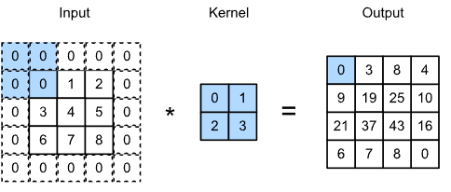
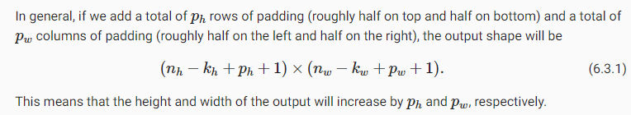
Padding
lose pixels on the perimeter of our image
Output shape:
Example code

Slide 7
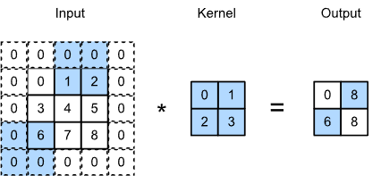
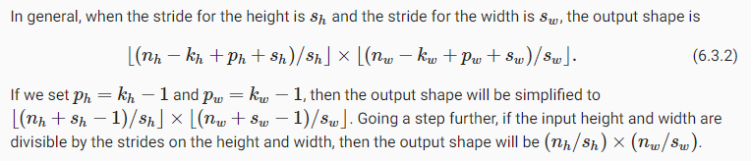
Stride
Output shape
Example code

Slide 8
Padding and stride
Example code

Slide 9
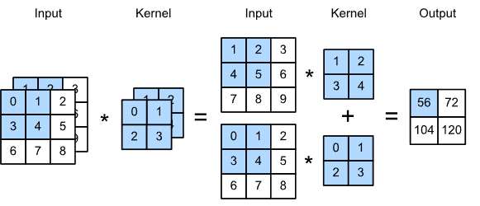
Multi input/output channels
TODO: keep output shape

Slide 10
Multi channels
Example code

Slide 11
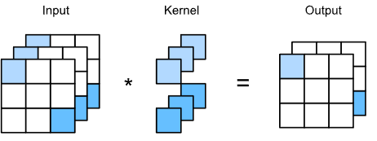
1x1 convolutional layer
The 1×1 convolutional layer is equivalent to the fully-connected layer, when applied on a per pixel basis.
The 1×1 convolutional layer is typically used to adjust the number of channels between network layers and to control model complexity.

Slide 12
Pooling

Slide 13
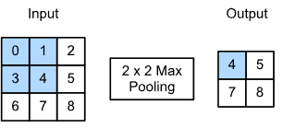
Pooling
reduce the spatial resolution of our hidden representations, aggregating information so that the higher up we go in the network, the larger the receptive field.
Example code
Notes:
https://d2l.ai/chapter_convolutional-neural-networks/pooling.html
That is to say, using the 2×22×2 maximum pooling layer, we can still detect if the pattern recognized by the convolutional layer moves no more than one element in height or width.

Slide 14
Architecture

Slide 15
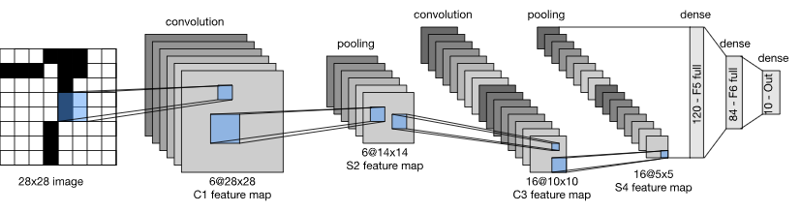
LeNet
(i) a convolutional encoder consisting of two convolutional layers; and (ii) a dense block consisting of three fully-connected layers
Each convolutional layer uses a 5×5 kernel and a sigmoid activation function. These layers map spatially arranged inputs to a number of two-dimensional feature maps, typically increasing the number of channels. The first convolutional layer has 6 output channels, while the second has 16. Each 2×2 pooling operation (stride 2) reduces dimensionality by a factor of 4 via spatial downsampling.

Slide 16
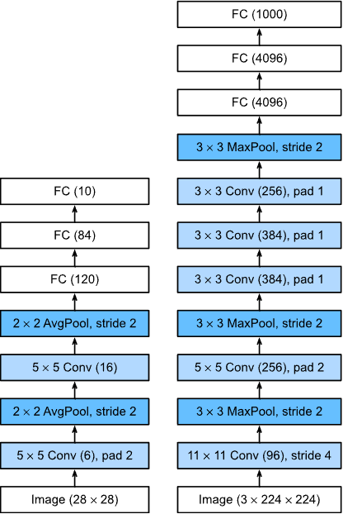
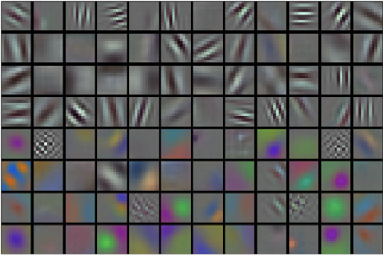
AlexNet
Code example model
Notes:
AlexNet has a similar structure to that of LeNet, but uses more convolutional layers and a larger parameter space to fit the large-scale ImageNet dataset.
Today AlexNet has been surpassed by much more effective architectures but it is a key step from shallow to deep networks that are used nowadays.
Although it seems that there are only a few more lines in AlexNet’s implementation than in LeNet, it took the academic community many years to embrace this conceptual change and take advantage of its excellent experimental results. This was also due to the lack of efficient computational tools.
Dropout, ReLU, and preprocessing were the other key steps in achieving excellent performance in computer vision tasks.

Slide 17
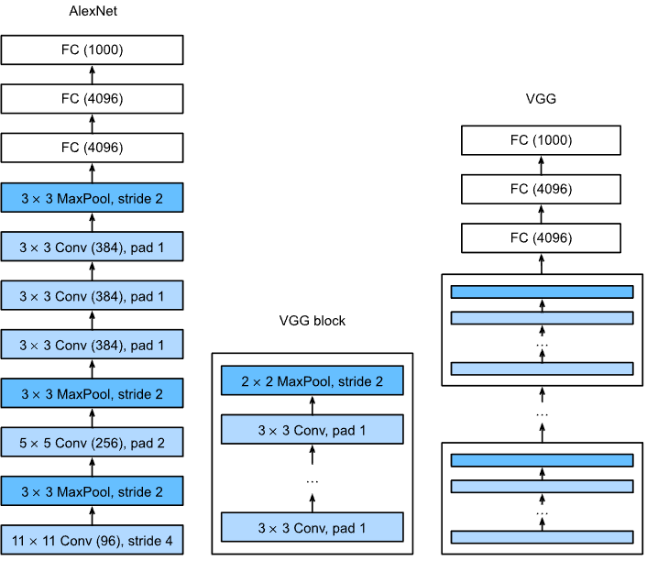
VGG
Code example model
Notes:
VGG-11 constructs a network using reusable convolutional blocks. Different VGG models can be defined by the differences in the number of convolutional layers and output channels in each block.
The use of blocks leads to very compact representations of the network definition. It allows for efficient design of complex networks.
In their VGG paper, Simonyan and Ziserman experimented with various architectures. In particular, they found that several layers of deep and narrow convolutions (i.e., 3×33×3) were more effective than fewer layers of wider convolutions.

Slide 18
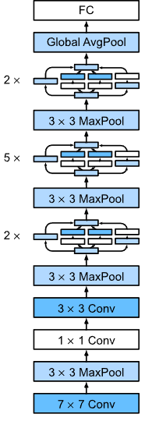
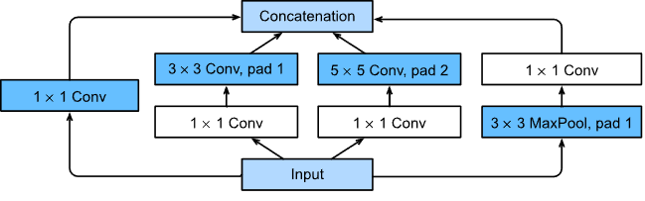
Inception blocks
Example code

Slide 19
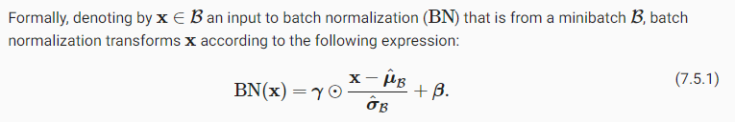
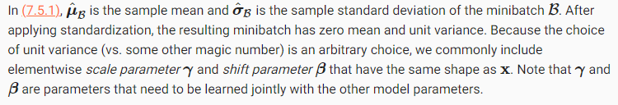
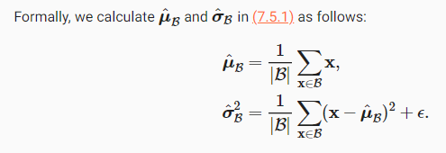

Batch norm layer
Notes:
During model training, batch normalization continuously adjusts the intermediate output of the neural network by utilizing the mean and standard deviation of the minibatch, so that the values of the intermediate output in each layer throughout the neural network are more stable.
The batch normalization methods for fully-connected layers and convolutional layers are slightly different.
Like a dropout layer, batch normalization layers have different computation results in training mode and prediction mode.
Batch normalization has many beneficial side effects, primarily that of regularization. On the other hand, the original motivation of reducing internal covariate shift seems not to be a valid explanation.

Slide 20
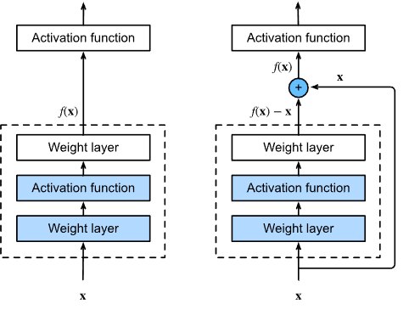
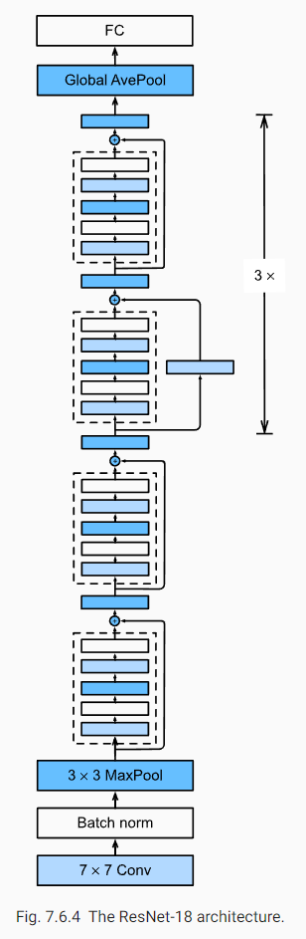
ResNet
Notes:
Nested function classes are desirable. Learning an additional layer in deep neural networks as an identity function (though this is an extreme case) should be made easy.
The residual mapping can learn the identity function more easily, such as pushing parameters in the weight layer to zero.
We can train an effective deep neural network by having residual blocks. Inputs can forward propagate faster through the residual connections across layers.
ResNet had a major influence on the design of subsequent deep neural networks, both for convolutional and sequential nature.

Slide 21
Implementation
Example code implementation of some model

Slide 22
Augmentation basics

Slide 23
Augmentation để làm gì?
Tổng quát model, tránh overfit trên tập train.
Các loại augmentation cơ bản:
Flip, rotate
Normalization

Slide 24


Resize

Slide 25


Flip, rotate

Slide 26

Jitter color

Slide 27
Notebook augmentation

Slide 28
Transposed convolution

Slide 29
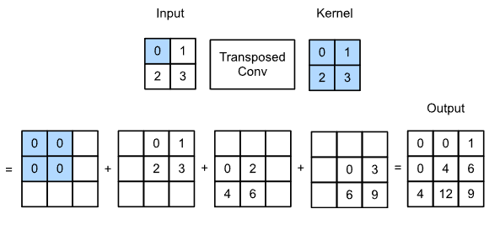
Operation
Notes:
https://d2l.ai/chapter_computer-vision/transposed-conv.html

Slide 30
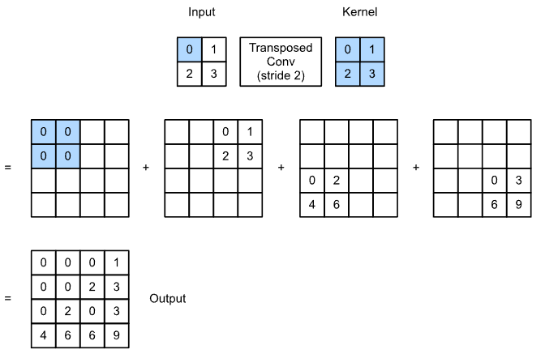
Padding strides and multiple channels
Notes:
https://d2l.ai/chapter_computer-vision/transposed-conv.html

Slide 31
Practice
Dog cat classification + fine tuning + augmentation
Flower classification
CIFAR classification

