Slide 1
Computer Vision

Slide 2
Pytorch

Slide 3
Tensor and gradient flow

Slide 4
Dataset and dataloader

Slide 5
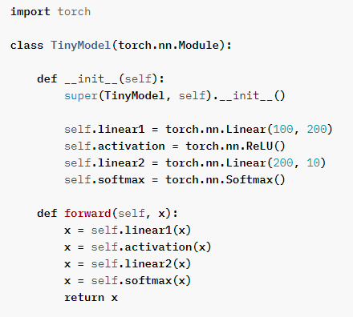
Model linear
Notes:
https://pytorch.org/tutorials/beginner/introyt/modelsyt_tutorial.html

Slide 6
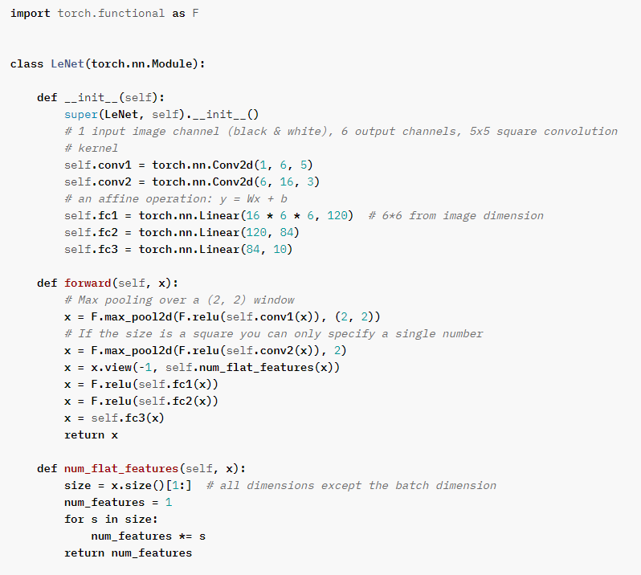
Model convolution
Notes:
https://pytorch.org/tutorials/beginner/introyt/modelsyt_tutorial.html

Slide 7
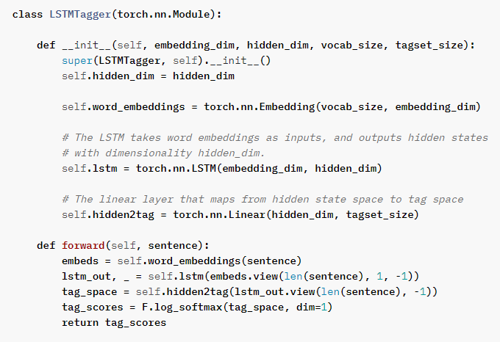
Model recurrent

Slide 8
Loss functions

Slide 9
Training loop

Slide 10
Image augmentation with torchvision
notebook
Notes:
https://www.analyticsvidhya.com/blog/2021/04/10-pytorch-transformations-you-need-to-know/

Slide 11
Segmentation

Slide 12
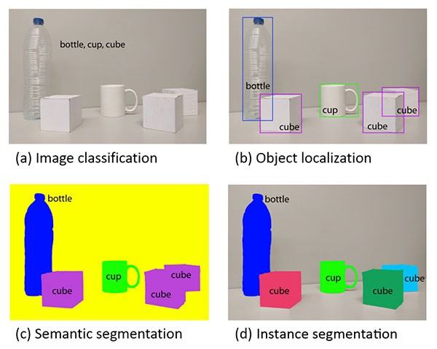
Problems

Slide 13
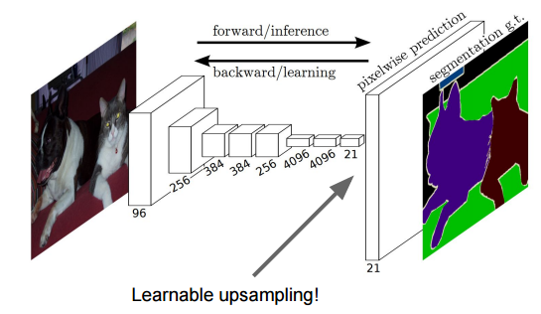
Fully Convolution Network

Slide 14
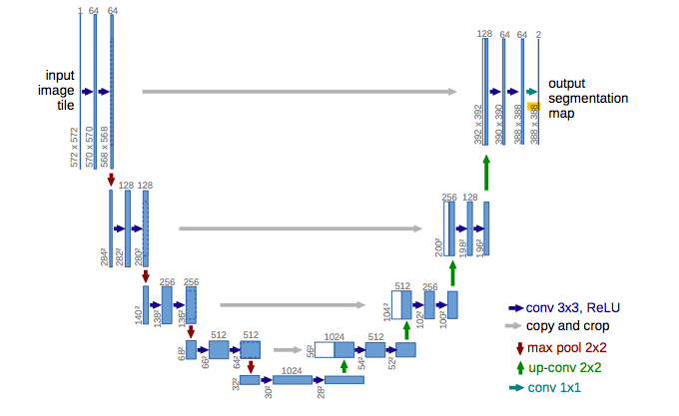
Unet

Slide 15
Practice
Pedestrian segmentation (semantic, instance)
Semantic segmentation with FCN on VOC dataset

