Slide 1


APPLIED AI CONSULTANCY
From complex workflows
to working AI systems.
ITT Digital Hub · ittdigitalhub.uk
Conference introduction

Slide 2


POSITIONING
Business understanding × systems thinking × AI engineering.
We combine business process expertise and hands-on software engineering to design and build AI solutions around real operations, existing systems and data.
AI is a capability, not the product.

Slide 3
JUDGEMENT
AI isn’t always the answer.
We start with the process, not the model. Depending on the problem, the right architecture may involve AI agents, deterministic automation, integrations, conventional software, existing enterprise tools, local AI — or a combination.

Slide 4
WHAT WE SOLVE
Problems, not a service catalogue.
01
02
03
Fragmented workflows
Knowledge-heavy work
Complex operations
Work split across people, systems, email, spreadsheets, manual handoffs and disconnected applications.
Skilled people spend too long finding, interpreting, preparing, validating and summarising information.
Settings where software, AI, data, operational context, physical systems and human decisions have to work together.

Slide 5
HOW WE WORK
Understand. Design. Build.
01
02
03
Understand
Design
Build
Workflow, people, systems, data, constraints and the actual business problem — before choosing a technology.
The right combination of AI, automation, software, integration, data and human control.
Hands-on implementation. The same senior people who understood the problem stay involved in building it.

Slide 6
WORK
Our stories
AI-Assisted Solar Operations
Applied AI around solar infrastructure: monitoring and operational support where they are verified. Status: in development.
Local AI Orchestration
Coordinating specialised local models, tools and services. Internal R&D / prototype — not a product being sold.
ATN Warranty Portal
Warranty registration and operator workflow. Working software, without forcing AI into the story. warranty.atneu.com

Slide 7
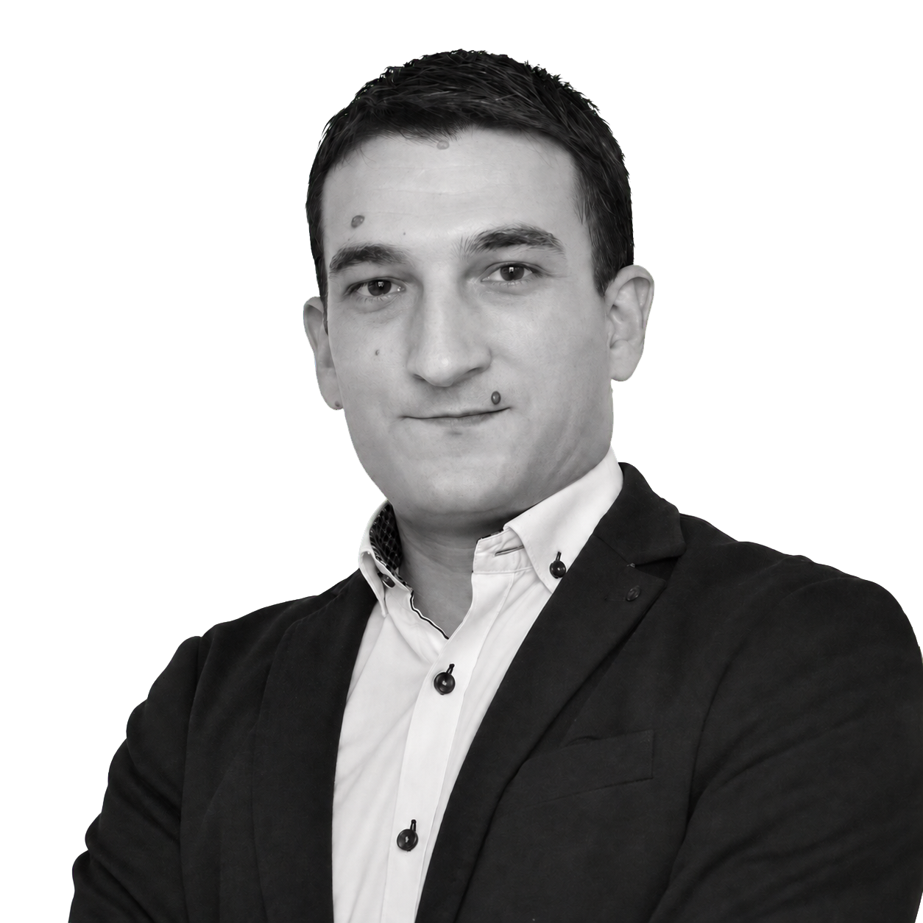
TEAM
Two complementary specialists.
Ivan Todorov
Ivan Tomchev
Business Systems & AI Solutions Consultant
AI Systems Architect & Software Engineer
Works from the process and business-systems side: how the work actually runs, where it breaks, and what is worth building.
Designs and builds complex software and AI systems, with a focus on local AI, orchestration, integrations and operational applications.

Slide 8
PARTNERS
Organisations with real operations.
Retail, manufacturing, logistics and public institutions — as shown on ittdigitalhub.uk. Not claimed as clients unless confirmed.
ATN
Merkanto
Tomchevi
UACG
UNWE
MG Klima
Nakra

Slide 9
CONTACT
Have a problem worth solving?
If you have a process, operation or system where AI might make sense — show us the problem.
ittdigitalhub.uk
LinkedIn: linkedin.com/in/ivan-todorov-30152428

Slide 10
SECTION LABEL
Section title

Slide 11
A short statement that carries the slide.
Optional attribution

Slide 12
LABEL
Two-column layout
Left heading
Right heading
Body copy. Keep to one idea per column.
Body copy. Keep to one idea per column.

Slide 13
ittdigitalhub.uk
Thank you.

