Slide 1
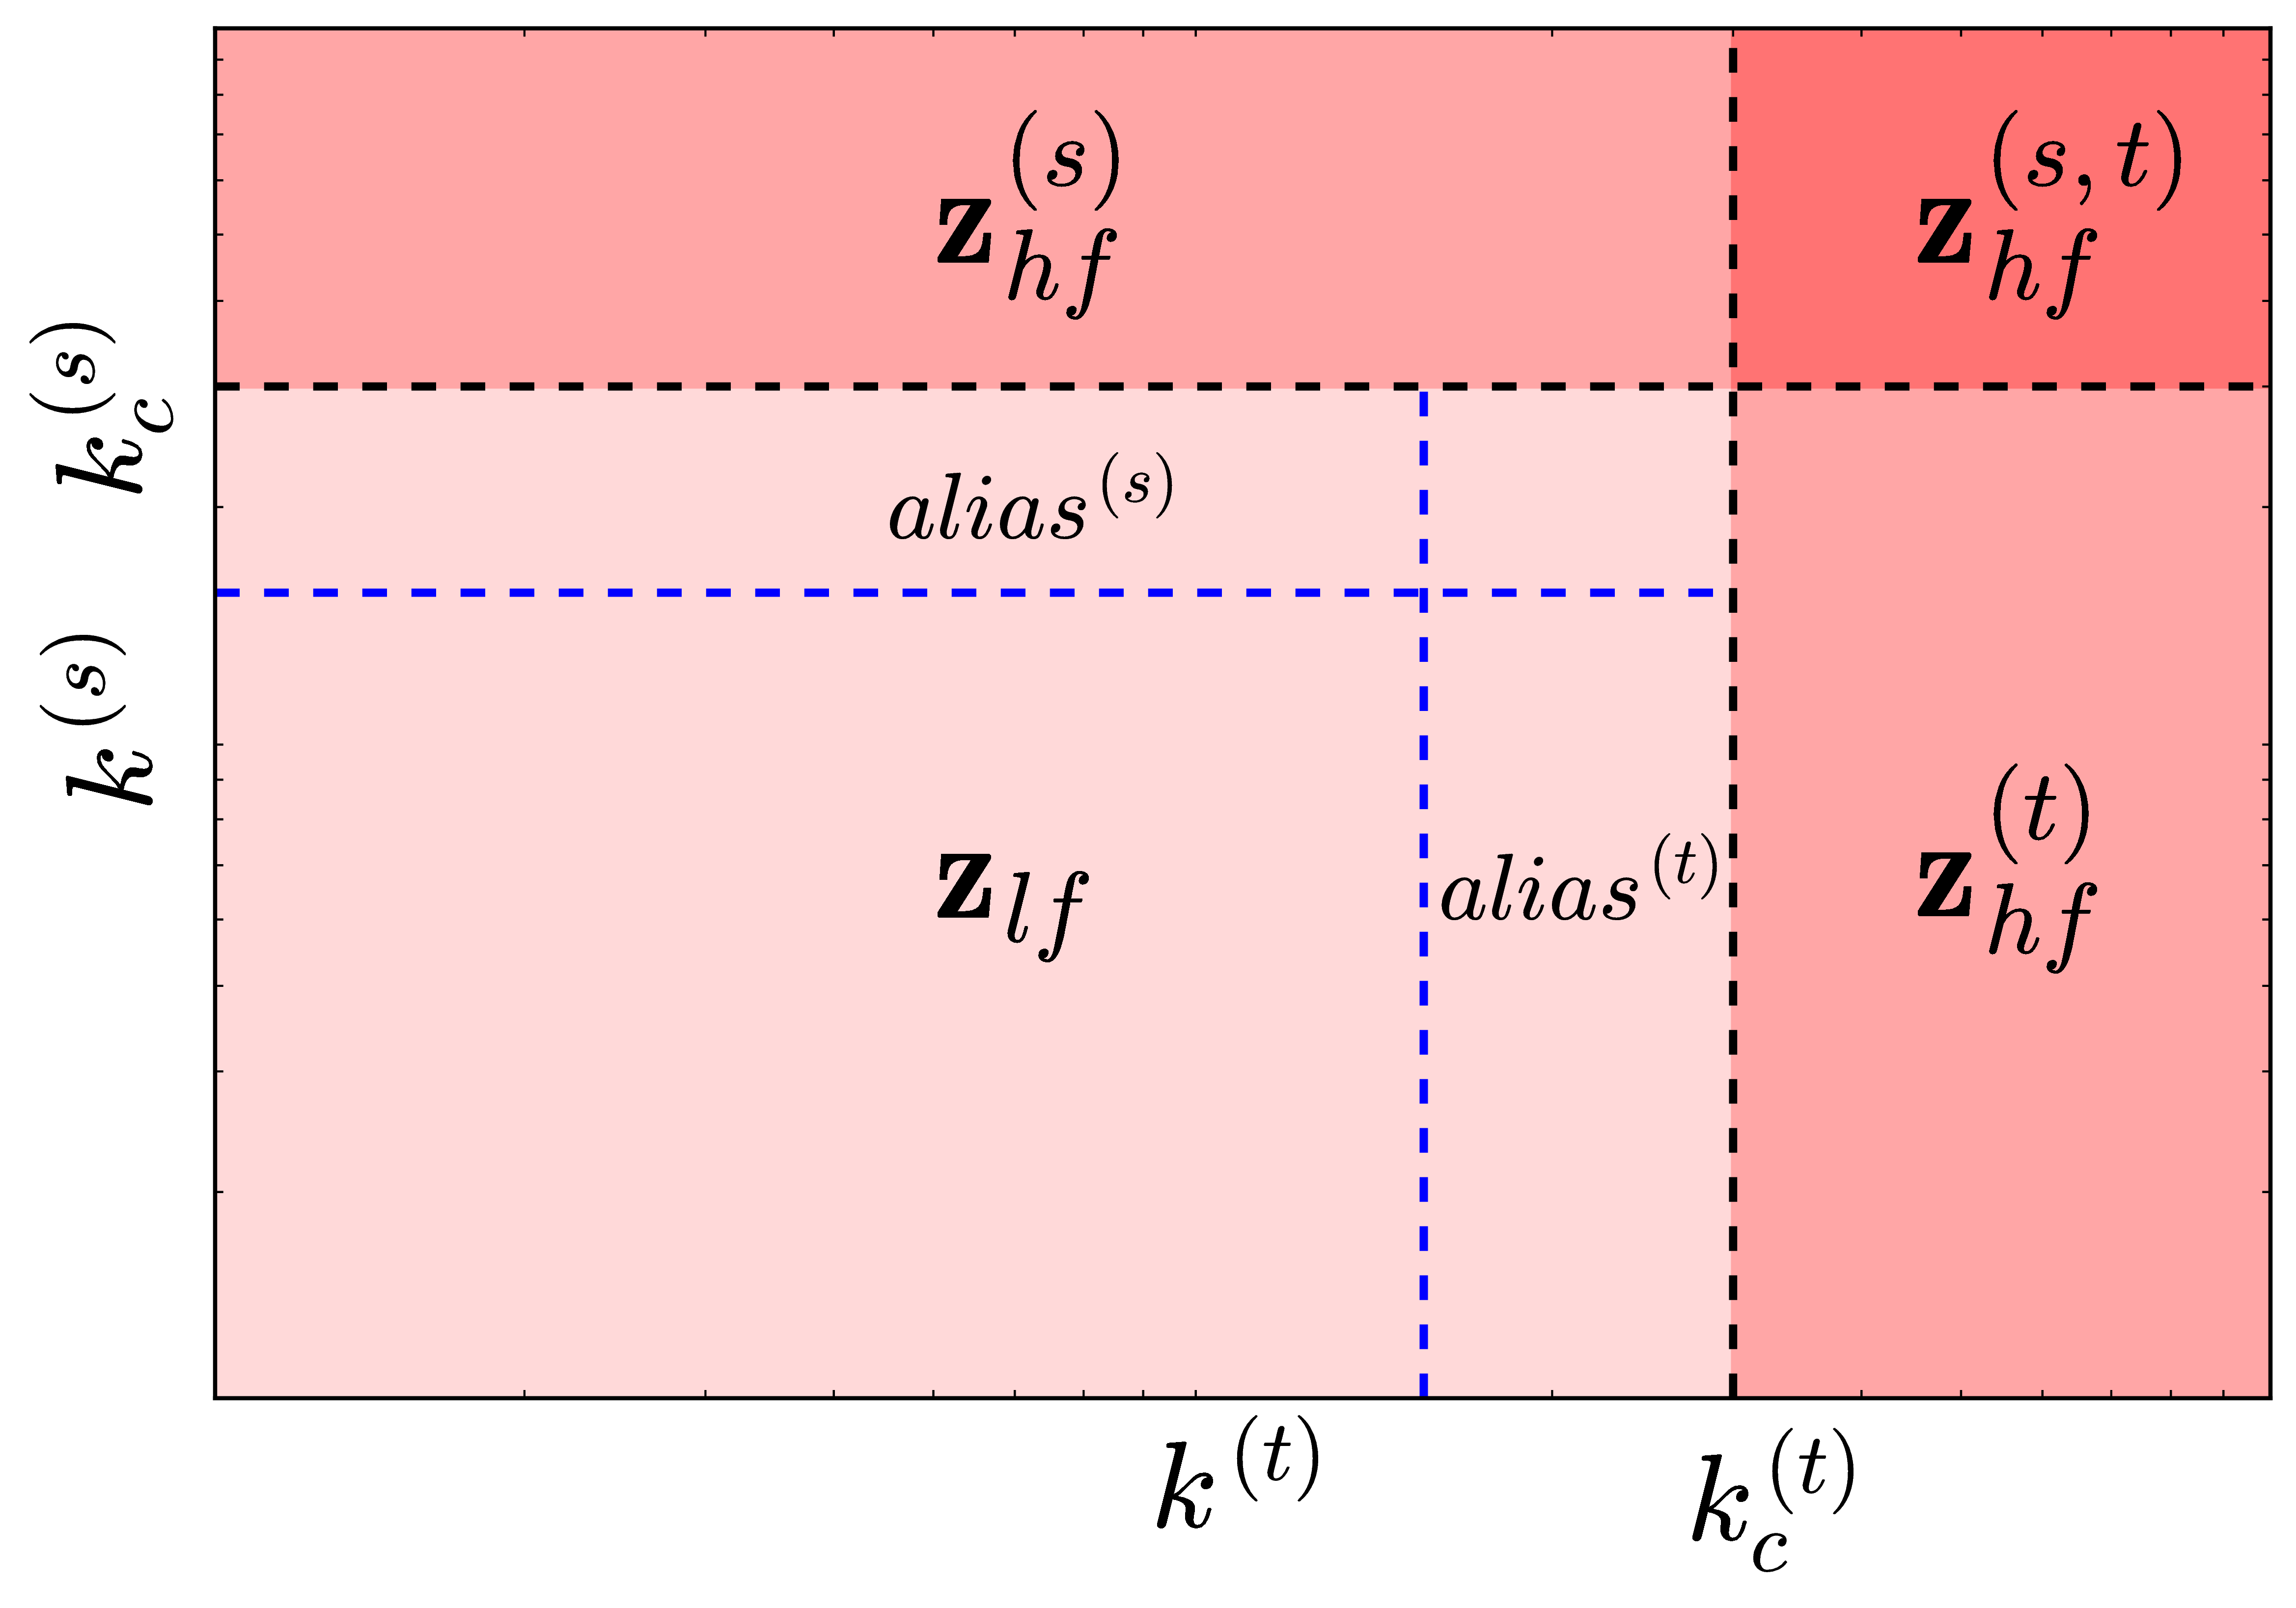
LTHS
HTLS

