Slide 1
GROUP 4
Phùng Ngọc Tân
Phùng Tấn Sang
Đoàn Minh Đức
Lưu Văn Mạnh
Nguyễn Văn Thành

Slide 2

INTERNET OF THINGS

Slide 3
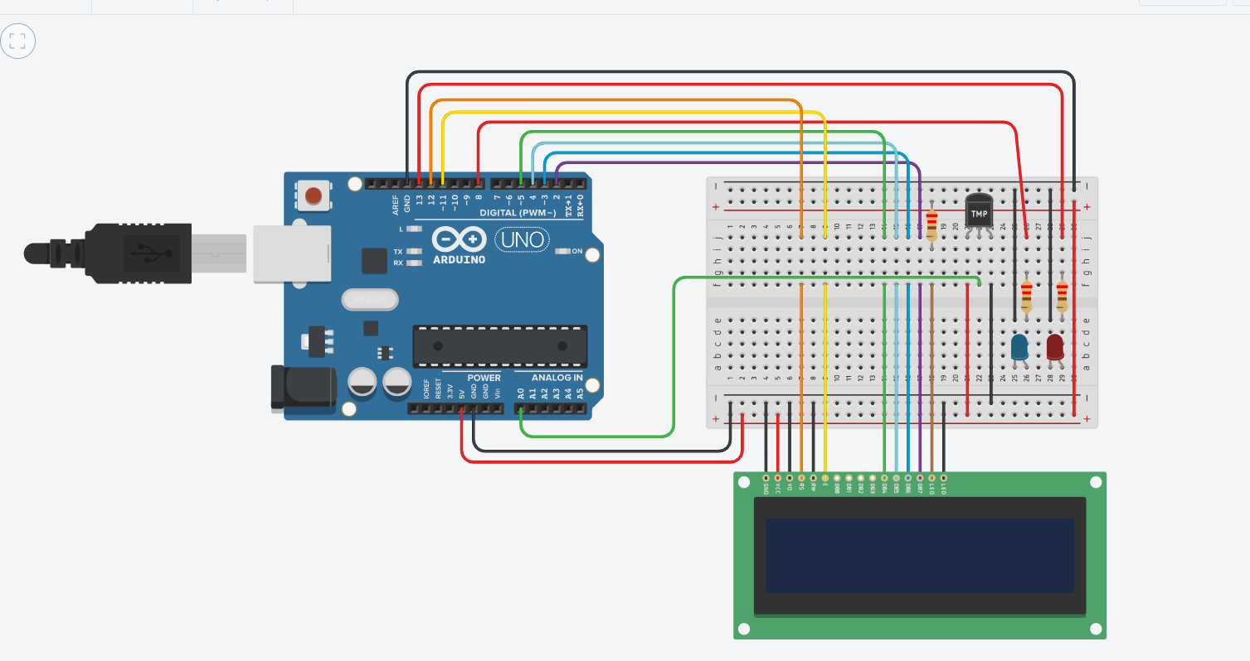

Slide 4
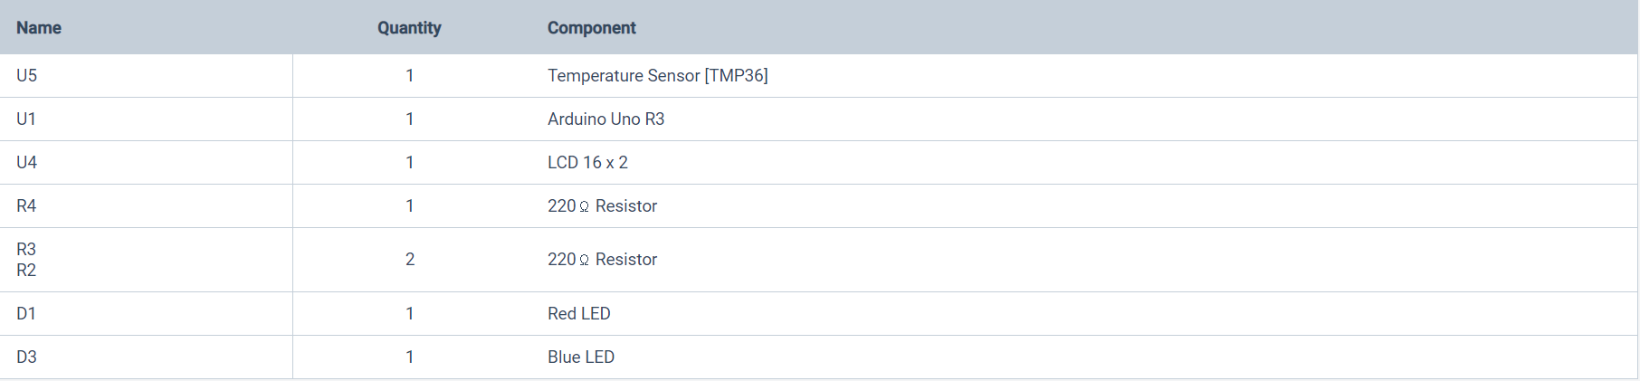
1. Components of Temperature sensor

Slide 5
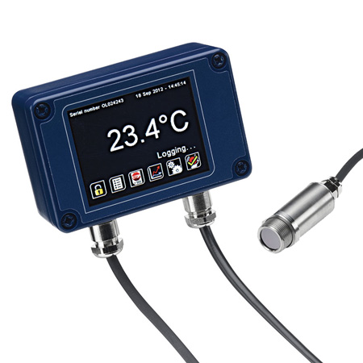
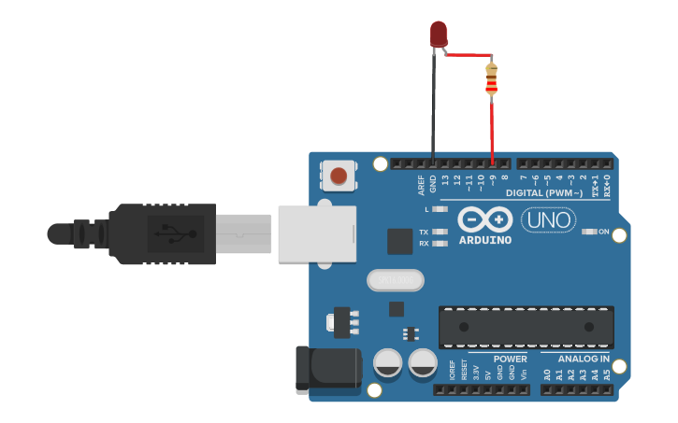
Temperature sensor Arduino Uno R3

Slide 6
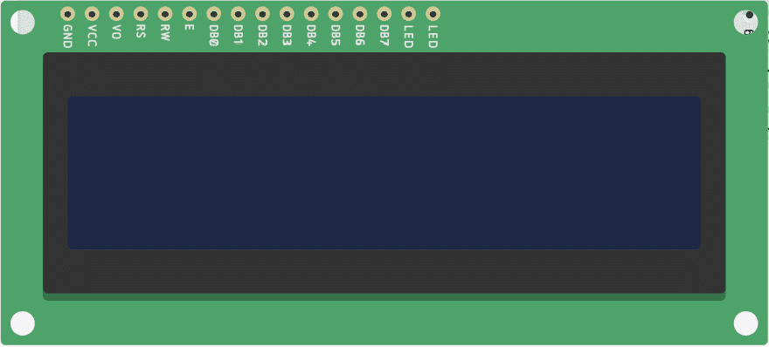
LCD 16x2

Slide 7
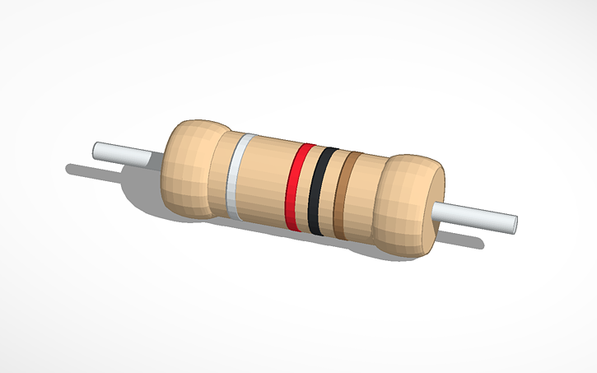
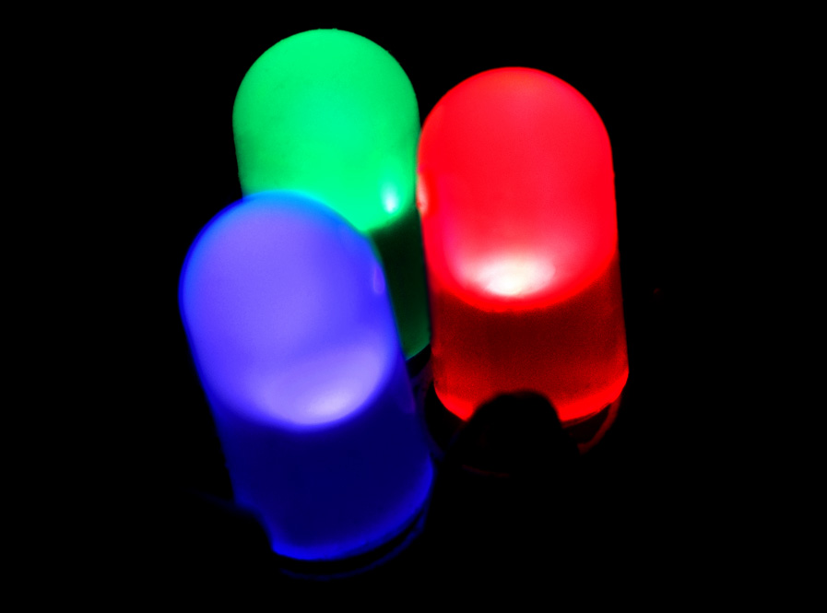
Resistor LED

Slide 8
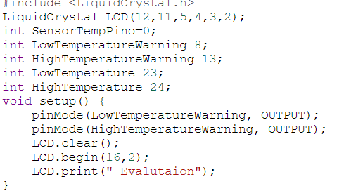
2. Codes
Set the values and how the LCD will show on the screen:

Slide 9
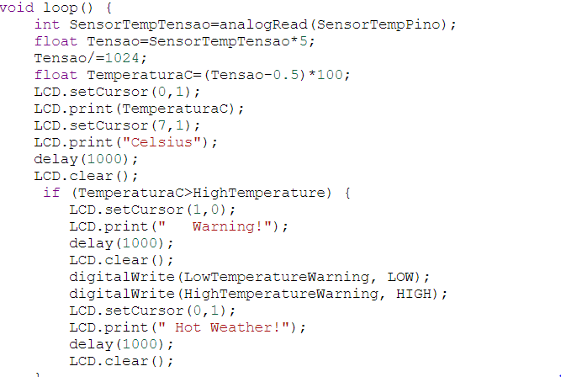
Set the loop for the LCD:

Slide 10
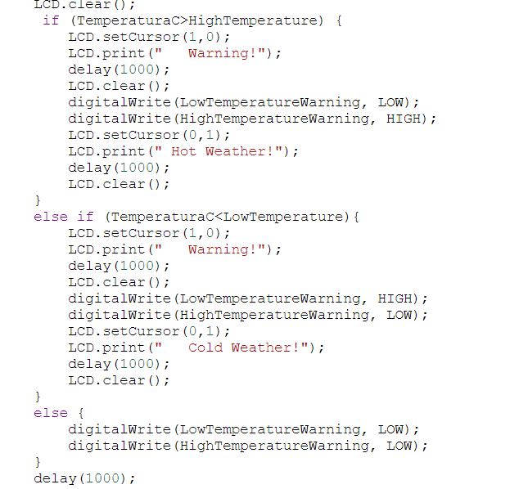
Code for the temperature display when each conditions happens:

Slide 11
3. Advantages and disadvantages of this system.
Advantages | Disadvantages
- Easy to set up | - If you don’t want it to turn on, and it does you have to go home and turn it yourself.
- Work efficiency, high communications between devices. | - Waste energy if you don’t come home on time.
- Small ( not that small), can be find easily. | - Internet errors can lead to debris connection.

Slide 12
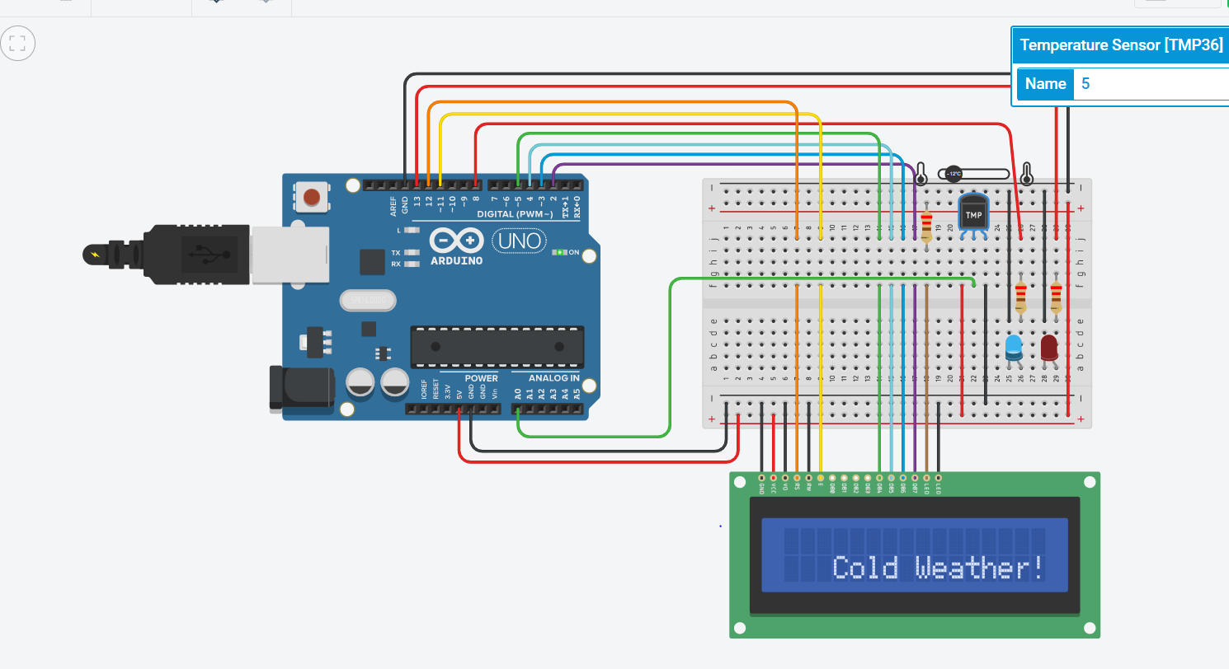
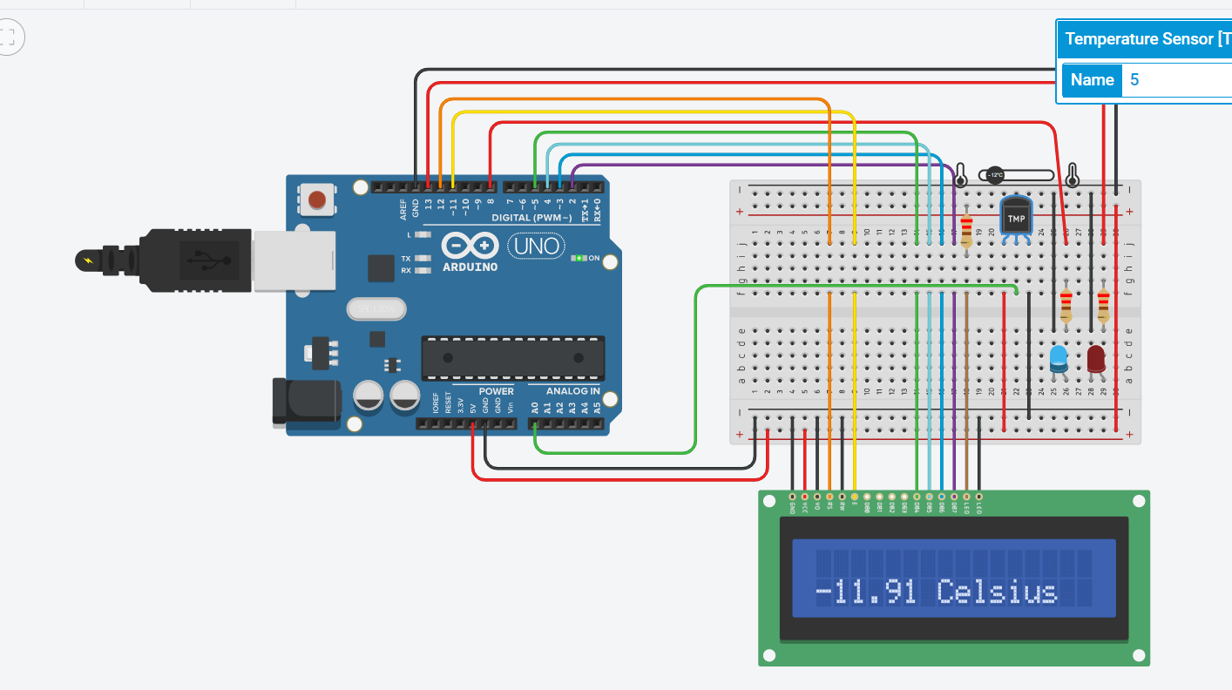

Slide 13
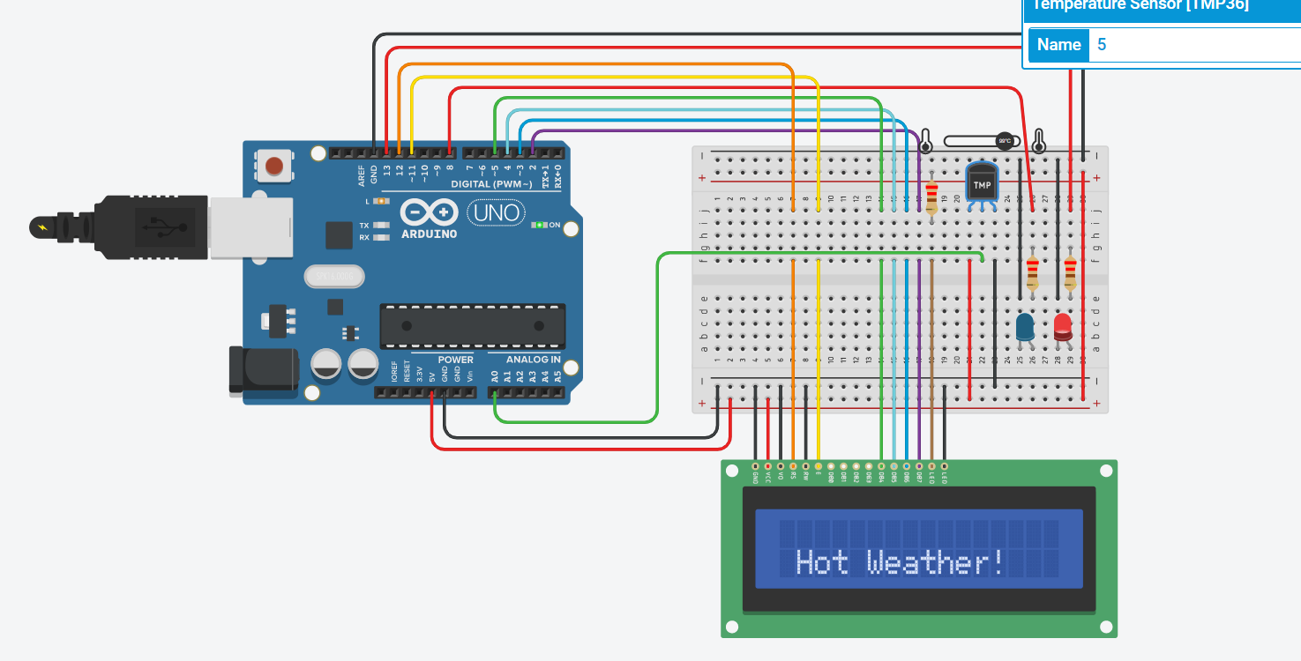
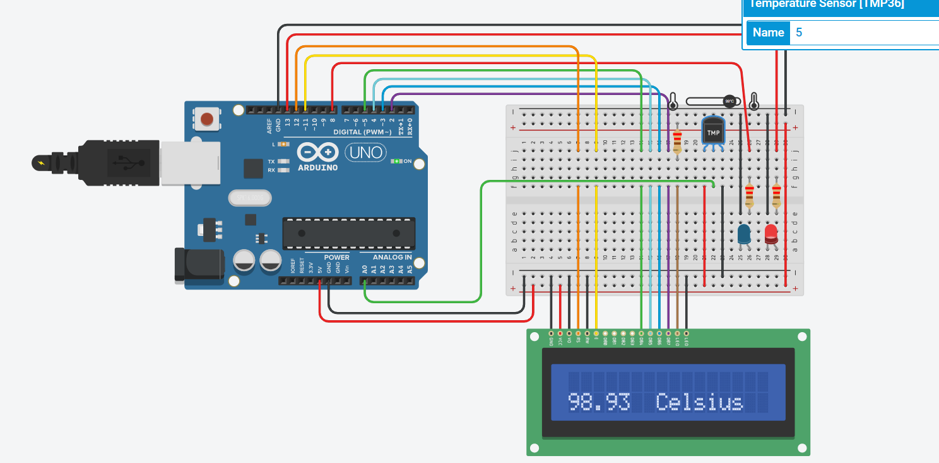

Slide 14



Slide 15


