Slide 1
Rasa 2.8 Installation

Slide 2
Frontend of Chatbot:
HTML
CSS
Java Script
Backend of Chatbot:
1- Python
2- Flask Framework of python.
Chatbot Training:
1- Rasa Nlu and Core
2- Deep Learning
3- Keras
4- Tensorflow

Slide 3
Installation Instructions
python -m venv myvenv
Note: If you have multiple python versions and you want to create env for specific python version then use this command(py -3.8 -m virtualenv myvenv)
myvenv\Scripts\activate
3. python -m pip install --upgrade pip
python --version #3.8.7
pip --version # 21.2.4
pip install rasa

Slide 4
Installation
7. pip install rasa[spacy]
8. python -m spacy download en_core_web_md
#spacy.load('en_core_web_md’)
9. pip install pyyaml
10. pip install flask
11. pip install responses
9. python -m spacy link en_core_web_md en

Slide 5
Commands to run Rasa Chatbot
To train rasa bot
rasa train
To run rasa bot (1st command): screenshot attached on next slide
rasa run --endpoints endpoints.yml --port 5005 --credentianls creentials.yml --cors "*“
To run rasa bot (2nd command)- screenshot attached on next slide
python web_app.py

Slide 6
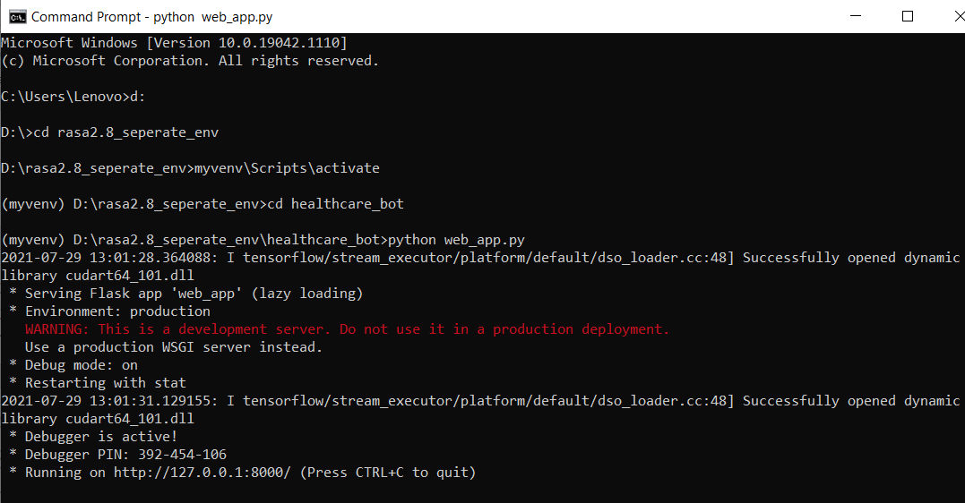
1st cmd
1
2
3
4
5

Slide 7
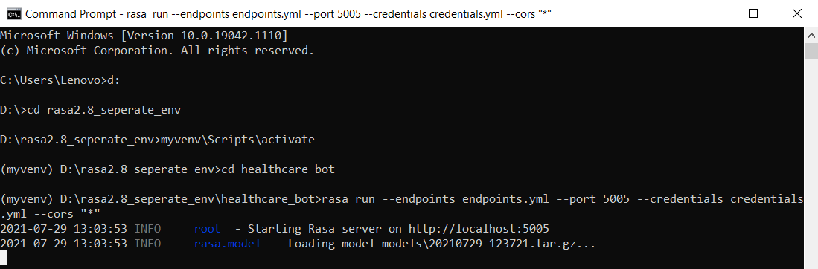
2nd cmd
1
2
3
4
5

