Slide 1
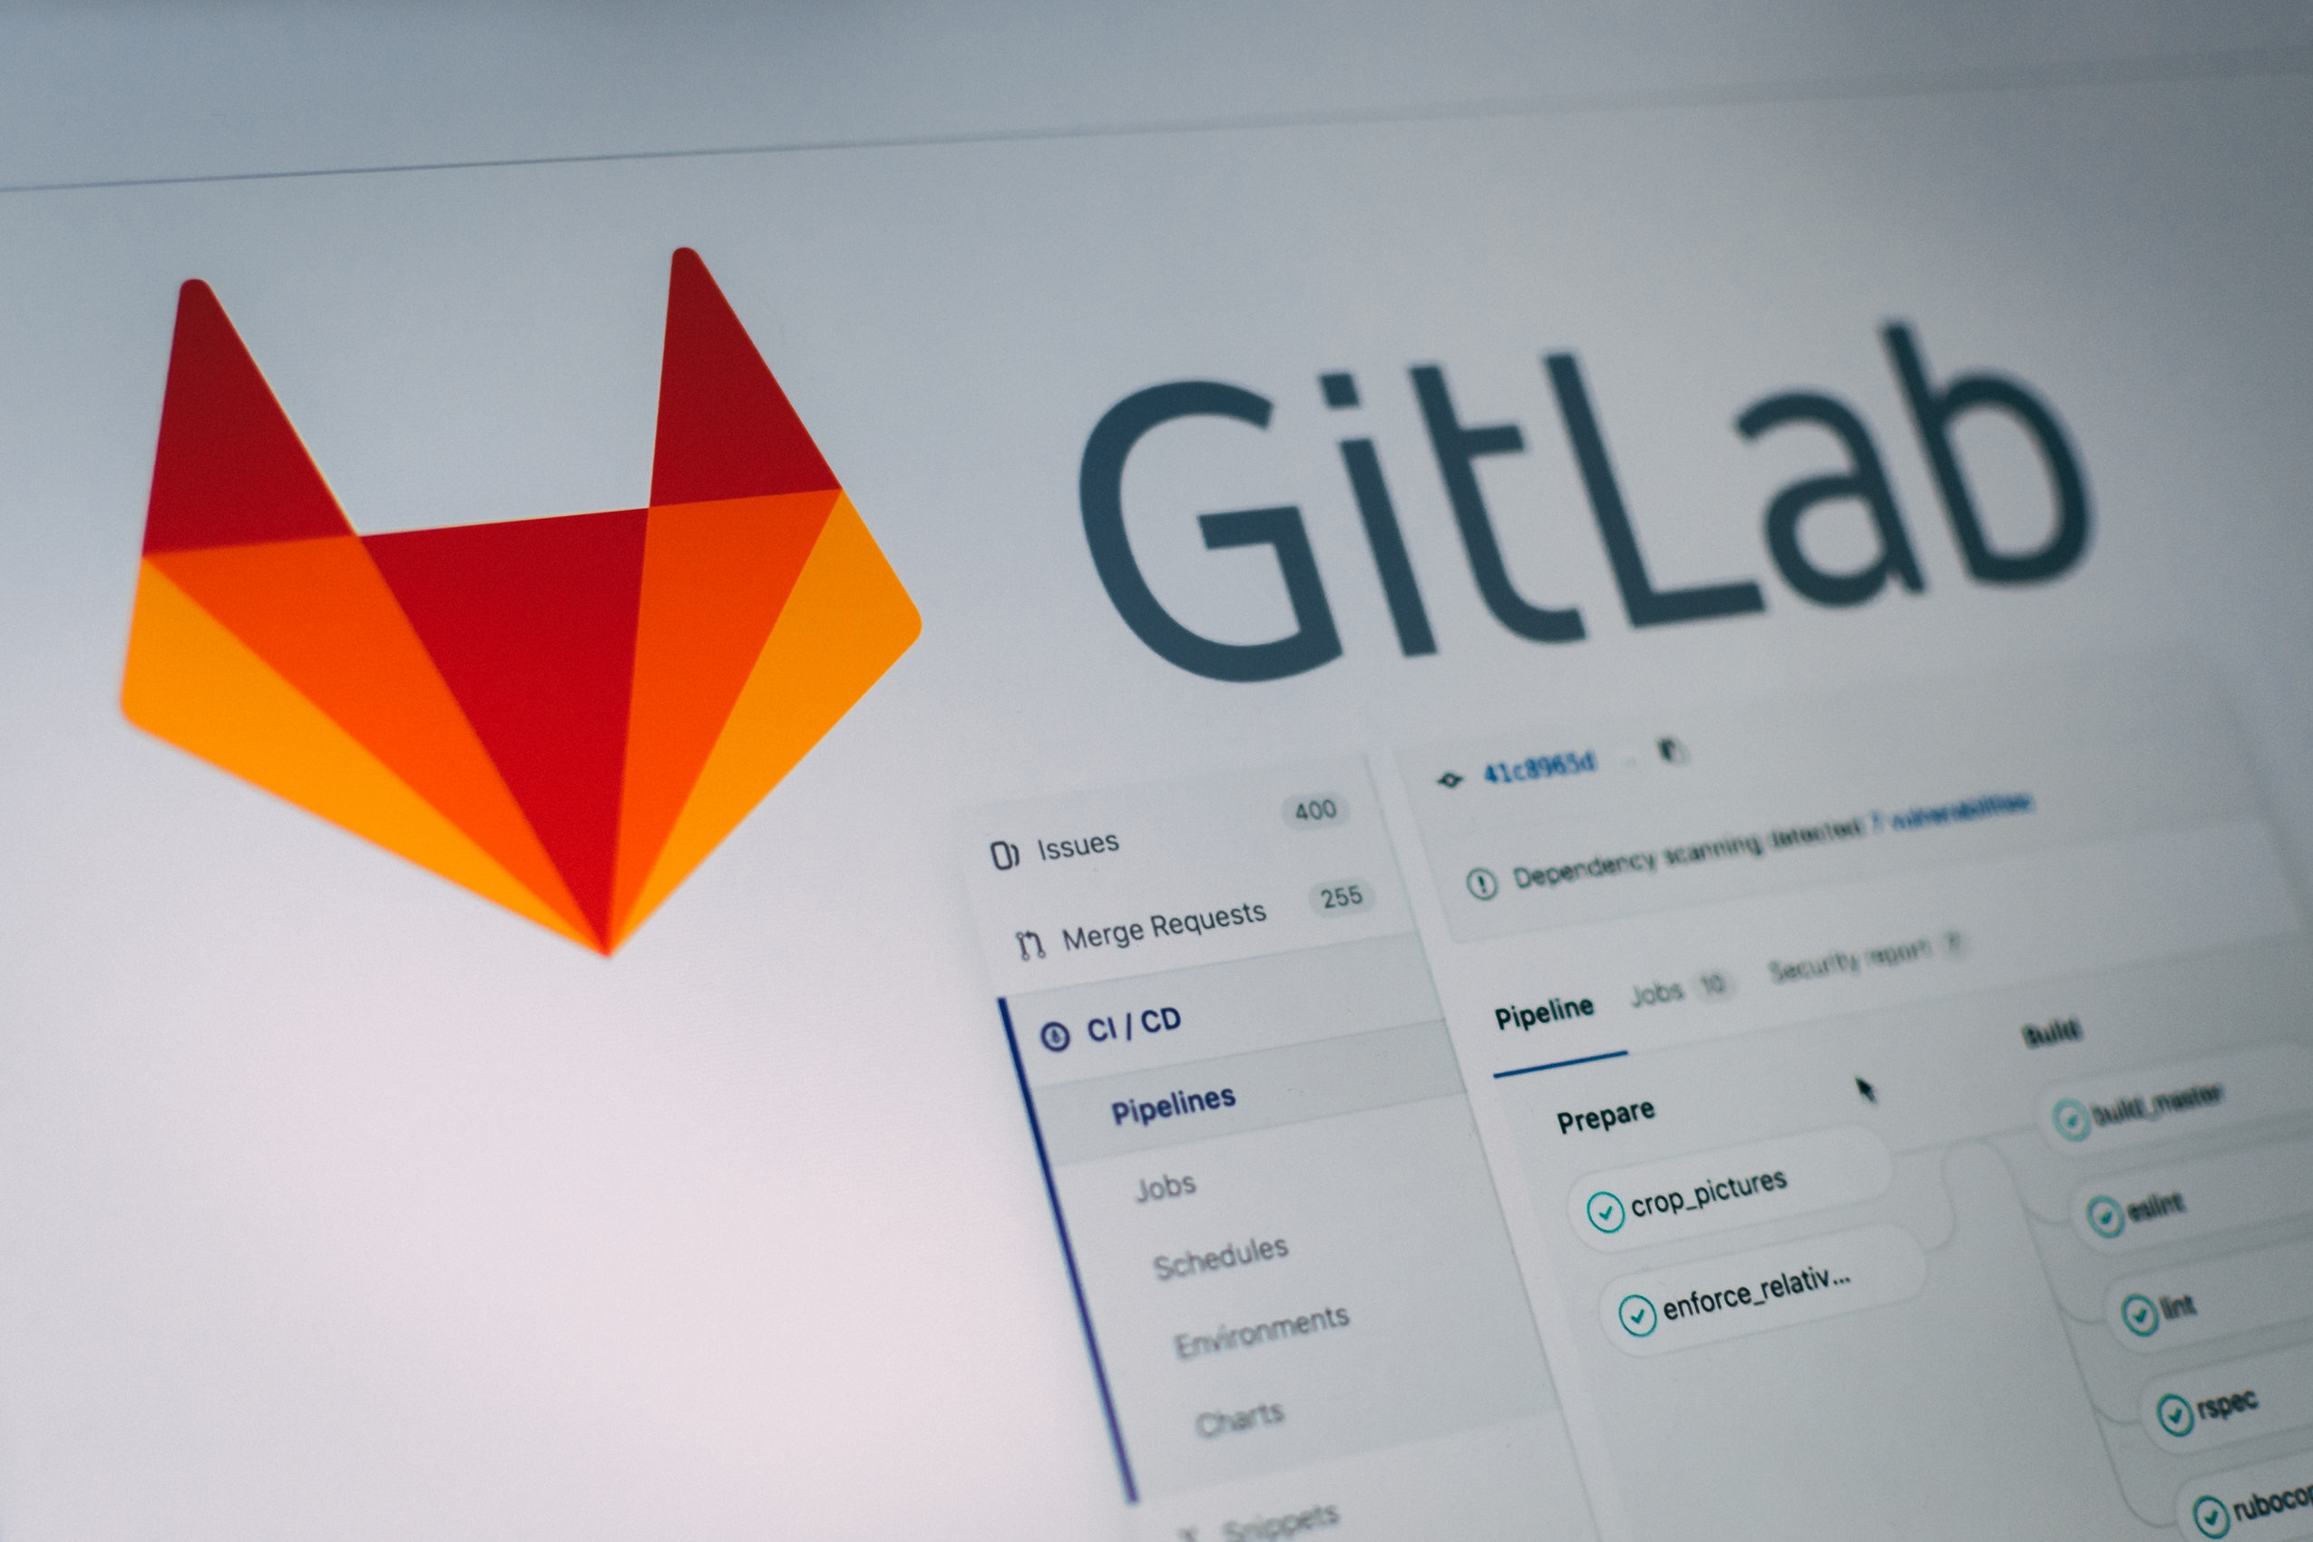
What
Is Git?
Server Side Development / Web Programming
Git
GitHub, GitLab, BitBucket

Slide 2
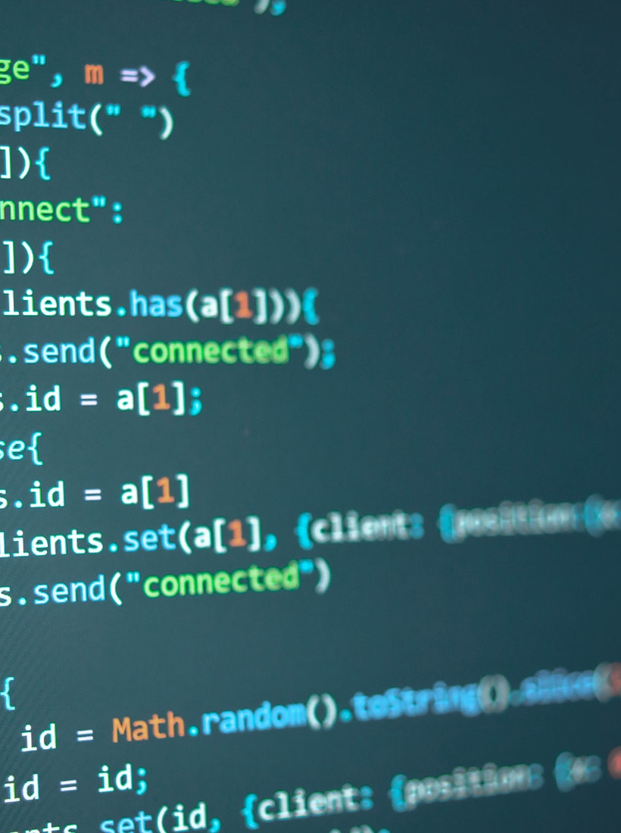
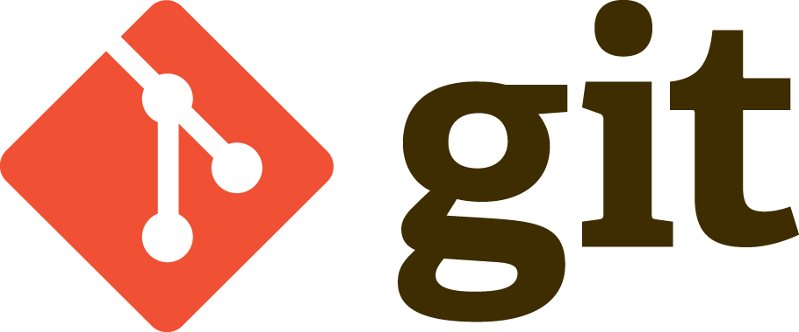
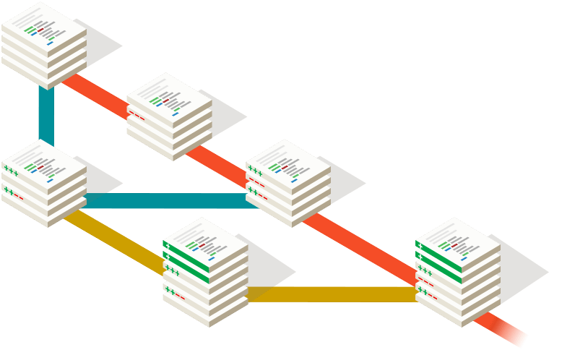
Git
Server Side Development / Web Programming
What is Git?
Git is a version control application
Different companies offer git as a service
Git can be used on it’s own with out the need for a web service using command line
But using a web service like GitHub makes the process easier and allows us to sync our application to an online repository to backup and collaborate

Slide 3
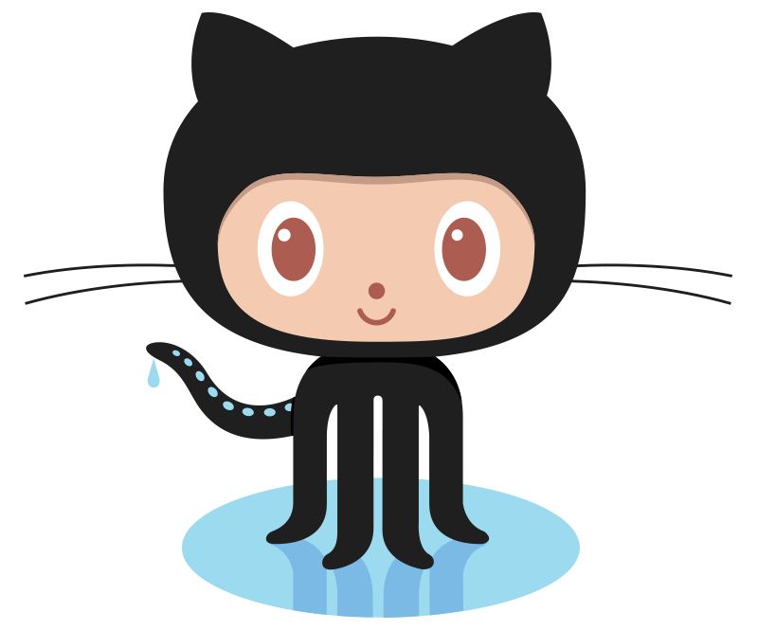


Git Platforms
Server Side Development / Web Programming
GitHub
GitLab
BitBucket
Free
Private Free Plans
Private Free Plans

Slide 4
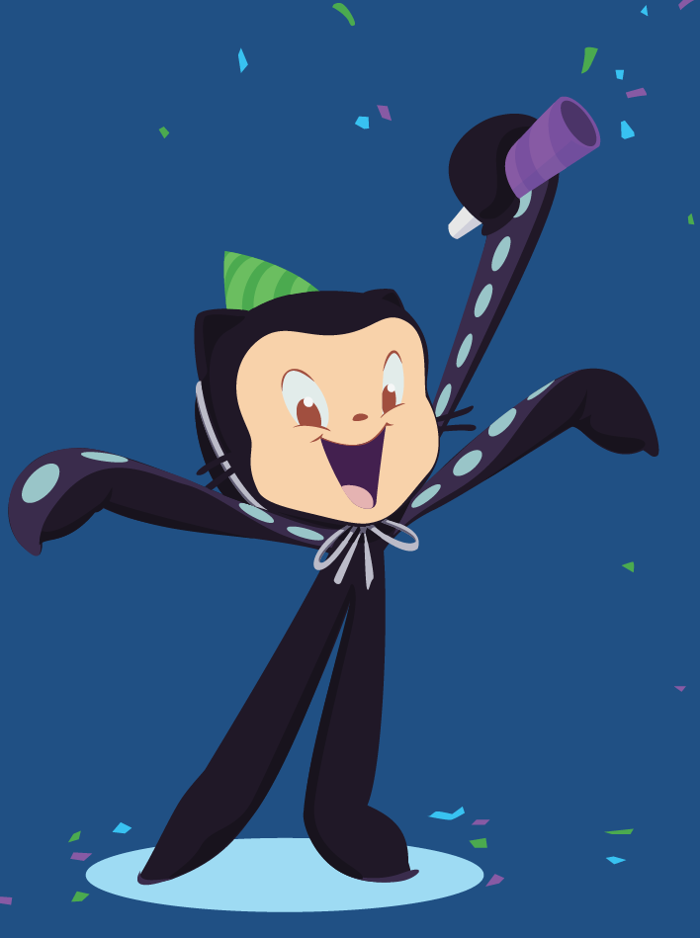

GitHub
Server Side Development / Web Programming
What is Git?
Git is the actual application
GitHub is a web service that runs the git application
We will be using GitHub to learn Git

Slide 5

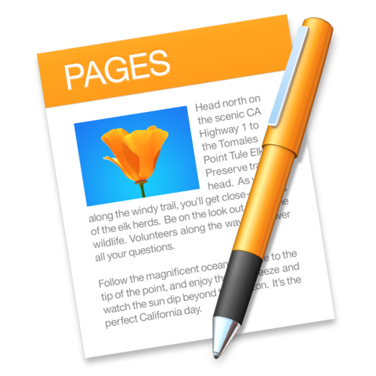
Have you ever had a folder
that looks like this?
A peep at some distant orb has power to raise and purify our thoughts like a strain of sacred music
Report
Report.doc
Report2.doc
Report3.doc
Report_Final.doc
Report_Final_Final.doc

Slide 6
GitHub
Server Side Development / Web Programming
What is Git?
Github is a collaboration tool largely used for software development
Github is designed to address this problem
One of it’s best features is version control
It also works really well for collaboration as it allows 2 people to work on the same file at the same time

Slide 7
Git Fixes This Problem
A peep at some distant orb has power to raise and purify our thoughts like a strain of sacred music
Report
Report.doc
Started Report
Rough draft
Finished
Spelling and Grammar Update
Added feedback from the boss
1 week age
3 days age
2 days age
1 days age
Today

Slide 8
Git Fixes This Problem
A peep at some distant orb has power to raise and purify our thoughts like a strain of sacred music
Report
Jens Suggestions
Added Illustrations
Report.doc
Started Report
Rough draft
Finished
Spelling and Grammar Update
Added feedback from the boss
Merged Jens Changes
1 week age
3 days age
2 days age
1 days age
Today
1hr ago

