Slide 1


Why write Functions?

Slide 2


What
Will We
Learn?
JavaScript
?
Functions
But what is the return?

Slide 3
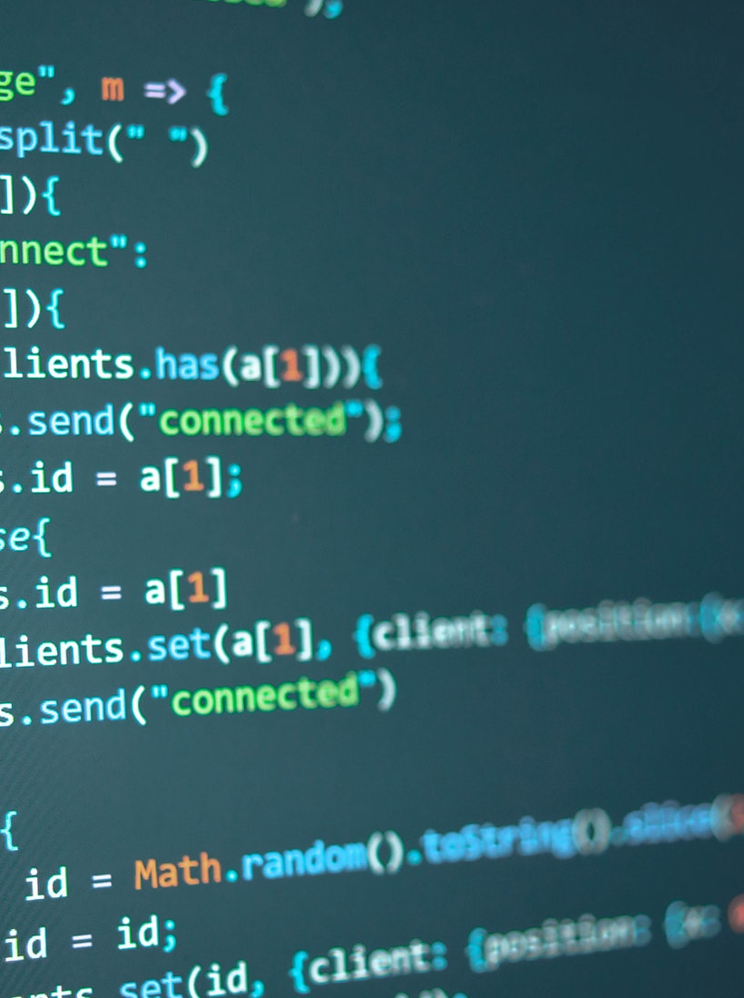

Functions
JavaScript
Advantages
Workflow
Reusable code
Maintainability

Slide 4
Workflow
JavaScript
Advantages
Productivity
Chunk code
Work on one part at a time
Write modules
Allows abstraction of the function logic from others
The use of parameters allows variables to remain unchanged from where the function is called.

Slide 5
Reusable Code
JavaScript
Advantages
Code can be reused
Creates modules to be reused
Code is in the one spot (not multiple)
Makes updating easier

Slide 6
Maintainability
JavaScript
Advantages
Allows easier updates
Reduces errors
Makes debugging easier
Maintainability

Slide 7
Summary
JavaScript
Functions allow us to write modular, reusable, easier to maintain and debug code.
This is core concept in programming and Object-oriented programming.

