Slide 1


Basic Data Structures

Slide 2


What
Will We
Learn?
Basic Data Structures
?
What is Basic?
Can we program it?

Slide 3

Basic Data Structures
Basic Data Structures
Which ones are we looking at?
Arrays
Objects
JSON

Slide 4
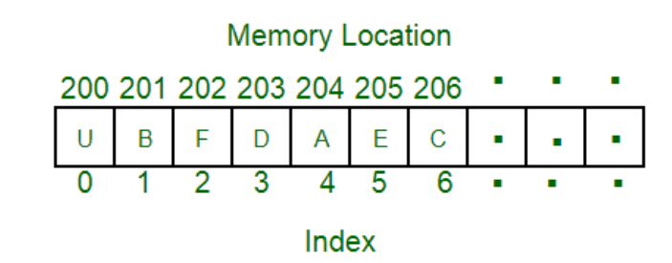
Arrays
Basic Data Structures
Arrays are stored in contiguous memory locations
Source: https://www.geeksforgeeks.org/array-data-structure/

Slide 5
Arrays
Basic Data Structures
s
In JavaScript arrays have the following properties:
Arrays are actually an Array object and not a primitive type
They can be resized
Can contain a mix of different data types
The array indexes must be accessed using integers not strings
The first index is always 0
The last element of the array is the value of the array’s length property
Sources: https://developer.mozilla.org/en-US/docs/Web/JavaScript/Reference/Global_Objects/Array

Slide 6
Array Functions
Basic Data Structures
There are many things we can do with arrays.
We can look at the MDN website to list all the functions we can use on arrays
https://developer.mozilla.org/en-US/docs/Web/JavaScript/Reference/Global_Objects/Array

Slide 7
Array Functions
Basic Data Structures
Other useful functions:
Array.forEach()
Array.pop() & Array.push() – end of the array
Array.shift() & Array.unshift() – beginning of the array
Array.slice() - Remove or change elements.
Array.splice() – changes array elements, can also add new ones

Slide 8
Arrays
Basic Data Structures
Arrays can also have multiple dimensions
1D
2D
3D

Slide 9
Arrays – 1D
Basic Data Structures
Arrays can also have multiple dimensions
JavaScript example:
Name of the array.
The list of values inside of [ ].
const choices = ['rock', 'paper', 'scissors’];
Example of mixed types:
const myArray = [1, 'here', {id: 3}, 'hello there', someVar];

Slide 10
Arrays – 2D
Basic Data Structures
Arrays can also have multiple dimensions
JavaScript example:
const my2DArray = [
[1,2,3],
[4,5,6],
[7,8,9]
];
Use [x][y] to access elements. i.e [1][1] = 5.
X = row, Y = column

Slide 11
Arrays – 2D
Basic Data Structures
Arrays can also have multiple dimensions
We can also declare 1d arrays, and then use them in another array like so:
const row1 = [1,2,3];
const row2 = [4,5,6];
const row3 = [7,8,9];
const board = [row1, row2, row3];

Slide 12
Arrays
Basic Data Structures
Array resources
https://www.geeksforgeeks.org/array-data-structure/
https://developer.mozilla.org/en-US/docs/Web/JavaScript/Reference/Global_Objects/Array
https://www.programiz.com/javascript/array

Slide 13
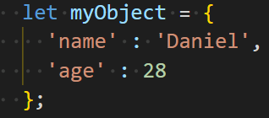
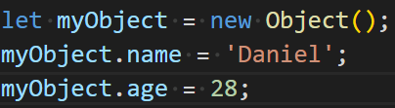
Objects
Basic Data Structures
Two ways to create objects in JavaScript
Object literal
new Object() Constructor.

Slide 14
Objects
Basic Data Structures
Able to add properties
Able to modify properties
Able to remove properties
Can check if an object has a property using hasOwnProperty()
Can loop through objects using a for … in loop.
Can merge objects
Can find the number of properties using Object.keys()
Can check if variable is an object

Slide 15
Objects
Basic Data Structures
Differences between {} and new Object()
{} notation is easier to read and is more concise
{} is faster and more efficient. New object has higher overheads
Both inherit from Object.prototype. New Object uses more abstraction however
{} syntax is useable and sufficient for most use cases.
New Object is only useful in rare scenarios.
Final note: use {} object literals

Slide 16
JSON Data
Basic Data Structures
JavaScript Object Notation
It is an array of objects
Starts with a [
Each {} is one object
Can be looped through
Can be use like any other object.
Can be displayed in raw form in a browser
Backbone of most web API’s

Slide 17
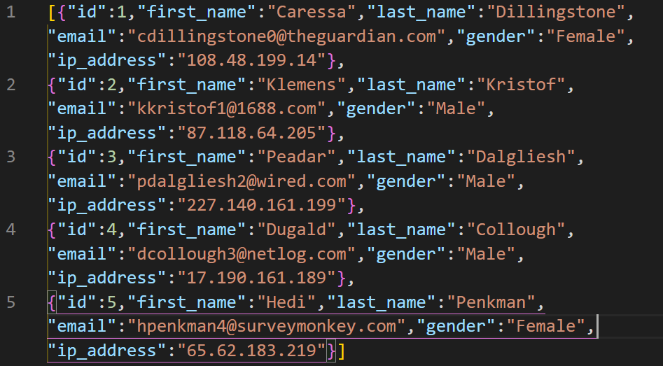
JSON Data
Basic Data Structures
Example

