Slide 1


Dynamic Data Structures

Slide 2


What
Will We
Learn?
Dynamic Data Structures
?
What is dynamic?
Is there a duo?

Slide 3

Dynamic Data Structures
Dynamic Data Structures
Which ones are we looking at?
Linked Lists / Double Linked Lists
Trees / Binary Trees
Hash Tables

Slide 4
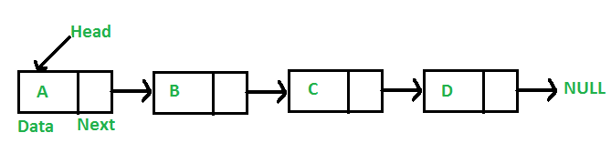
Linked lists
Dynamic Data Structures
Linked Lists are not stored in contiguous memory locations
https://www.geeksforgeeks.org/data-structures/linked-list/

Slide 5
Linked lists
Dynamic Data Structures
Linked lists contains nodes
The nodes contain a link or reference to the next node
New nodes can be added anywhere into a list
Lists are of a dynamic size.
Drawbacks
Searching is from the first node through the entire list
Need extra space to store the link
Not cache friendly.

Slide 6
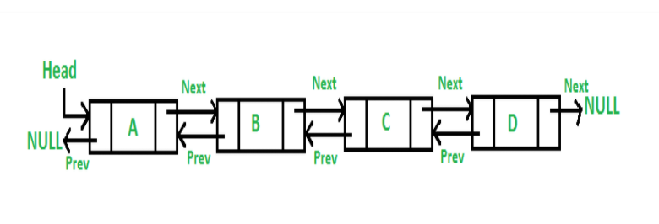
Double lists
Dynamic Data Structures
Each node now contains:
A link to the previous node
A link to the next node
Source: https://www.geeksforgeeks.org/doubly-linked-list/

Slide 7
Double lists
Dynamic Data Structures
The list can be traversed forwards and backwards
Deleting and adding new nodes is quicker
Drawbacks
Searching is from the first node through the entire list
Need extra space to store the links, next and prev.
Adding new nodes at different positions we need extra steps

Slide 8
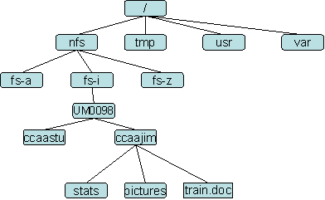
Trees
Dynamic Data Structures
An example, your directory structure on your HDD.

Slide 9
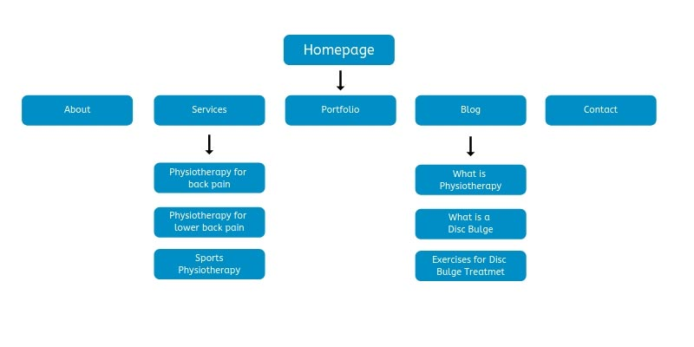
Trees
Dynamic Data Structures
Information Architecture on a website

Slide 10
Trees
Dynamic Data Structures
Also, the way we structure our projects and deploy our projects are all done with trees.
The HTML DOM is structure also a tree

Slide 11
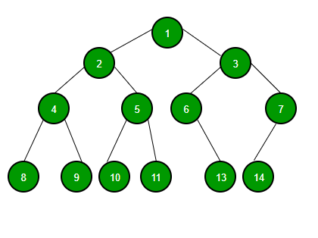
Binary Trees
Dynamic Data Structures
Binary Trees are:
Trees with at most 2 children
This has a quick search time.

Slide 12
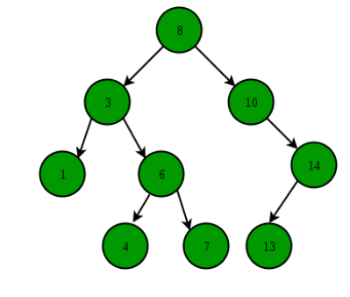
Binary Search Trees
Dynamic Data Structures
Binary Trees are:
Trees with at most 2 children
The nodes on the left must be less than the nodes on the right

Slide 13
Hash Tables
Dynamic Data Structures
You may not have noticed but these are used around us.
The phone book
Your contacts in your phone
The dictionary
A thesaurus

Slide 14
Hash Tables
Dynamic Data Structures
Example contacts in your phone

