Slide 1


Algorithms

Slide 2


What
Will We
Learn?
JavaScript
?
What is Recipe?
What are we makiing?

Slide 3
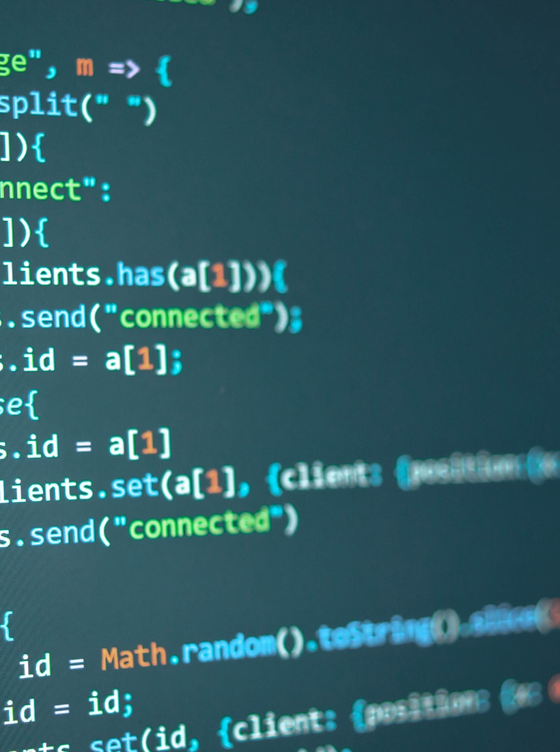
Algorithms
JavaScript
What is an algorithm?
Like a recipe
Lists the steps to follow to solve a problem
procedure to follow to solve a problem
Can be listed in steps or in a flow chart

Slide 4
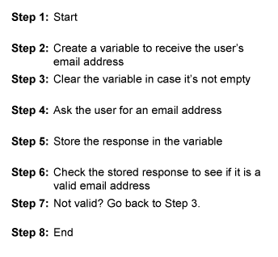
Algorithm Example
JavaScript
Procedure – list the steps
https://study.com/academy/lesson/what-is-an-algorithm-in-programming-definition-examples-analysis.html

Slide 5
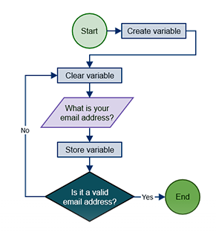
Algorithm Example
JavaScript
Flow Chart – Diagram
https://study.com/academy/lesson/what-is-an-algorithm-in-programming-definition-examples-analysis.html

Slide 6
Writing Algorithms
JavaScript
9 Steps
Know the goal of the algorithm.
Collect all relevant data
Preprocess the data
Select the algorithm type
Design the algorithm structure
Implement the algorithm
Test the algorithm
Fine-tune the algorithm
Deploy and monitor the algorithm
https://www.klipfolio.com/blog/algorithm-in-six-steps

Slide 7
Writing Algorithms
JavaScript
1. Know the goal of the algorithm
What is the purpose of this algorithm?
What problem are we solving?
Knowing the goal, helps with following steps
Goals should be clear and specific
Goals should address problem to be answered
Goals should address other questions to be solved
or task to be accomplished.
https://www.klipfolio.com/blog/algorithm-in-six-steps

Slide 8
Writing Algorithms
JavaScript
2. Collecting all the relevant data
What data is needed?
Where can we get the data?
Spreadsheet? File? Database? User? Variables?
https://www.klipfolio.com/blog/algorithm-in-six-steps

Slide 9
Writing Algorithms
JavaScript
3. Preprocess the data
Check that our data is accurate
Check for duplicates
Check for missing values
Replace missing values with averages
Delete rows or columns with missing values if not crucial
Normalize the data (Database or values to a range)
Encode text categories to numerical values (enum)
Feature engineering: creating features or modifying
existing ones, to better represent the problem
https://www.klipfolio.com/blog/algorithm-in-six-steps

Slide 10
Writing Algorithms
JavaScript
4. Select the algorithm type
The right type of algorithm can help solve the problem
Different algorithms are designed for different tasks
ARIMA (AutoRegressive Integrated Moving Average)
- predicting values based on past data
Anomaly detection – fraud, unusual trends
Regression – predicting/projecting values on inputs
Classification – using classes
https://www.klipfolio.com/blog/algorithm-in-six-steps

Slide 11
Writing Algorithms
JavaScript
5. Design the algorithm structure
Use a flow chart – plan the steps
Use pseudocode – plain English to get the logic
https://www.klipfolio.com/blog/algorithm-in-six-steps

Slide 12
Writing Algorithms
JavaScript
6. Implement the algorithm
Write the code using your steps in part 5
Investigate and use language library functions
To help implement your algorithm
https://www.klipfolio.com/blog/algorithm-in-six-steps

Slide 13
Writing Algorithms
JavaScript
7. Test the algorithm
Make sure it all works as expected!
Use cross-validation or A/B testing
Test the code.
https://www.klipfolio.com/blog/algorithm-in-six-steps

Slide 14
Writing Algorithms
JavaScript
8. Fine-tune Algorithm
From results of testing
Make changes to the algorithms
More efficient
Tweak algorithm learning
https://www.klipfolio.com/blog/algorithm-in-six-steps

Slide 15
Writing Algorithms
JavaScript
9. Deploy
Add the algorithm and its code to your project
https://www.klipfolio.com/blog/algorithm-in-six-steps

