Slide 1


Sorting Arrays

Slide 2


What
Will We
Learn?
Server Side Development / Web Programming
?
Ascending?
Which direction?

Slide 3


Array.sort()
JavaScript
Array method
In build array method to sort arrays.
Just use array_name.sort()
Can have parameters, will return the sorted array
Example:
const cars = ['Honda', 'BMW', 'Toyota', 'Mercedes-Benz', 'Ford', 'Audi'];
cars array:
[ 'Honda', 'BMW', 'Toyota', 'Mercedes-Benz', 'Ford', 'Audi’ ]
const sortedCars = cars.sort();
sortedCars array:
[ 'Audi', 'BMW', 'Ford', 'Honda', 'Mercedes-Benz', 'Toyota' ]

Slide 4
Array.sort()
JavaScript
Array method
Example 2:
const numbers = [40, 100, 1, 5, 25, 10];
sortedNumbers array:
[ 1, 10, 100, 25, 40, 5 ]
Seams like there is a problem here!
This is due to the sort method treating the numbers as strings.
We can fix this!

Slide 5
Compare function
JavaScript
.sort method parameter
We can fix our sort problem by creating a compare function.
We can use this function to sort in ascending order, a will be placed before b, if a is lower or less than
const sortedNumbersA = numbers.sort(function(a, b ){ return a - b });
Or in descending order, b will be placed before a if b is larger
or greater than
const sortedNumbersD = numbers.sort(function(a, b){ return b - a});
Numbers sorted ascending order:
[ 1, 5, 10, 25, 40, 100 ]
Numbers sorted descending order:
[ 100, 40, 25, 10, 5, 1 ]

Slide 6
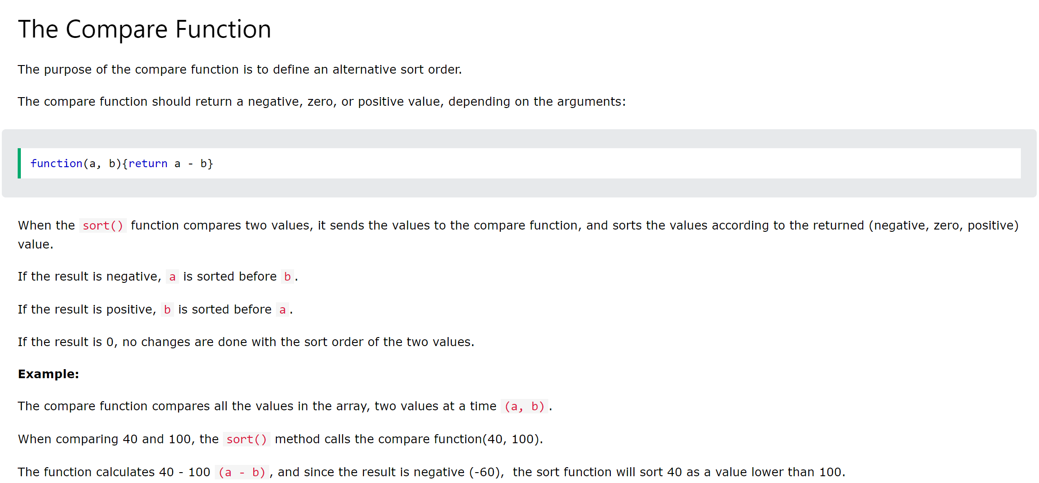
JavaScript
Source: https://www.w3schools.com/js/js_array_sort.asp

