Slide 1


Sequential / Linear Search

Slide 2


What
Will We
Learn?
JavaScript
?
Searching
But what is lost?

Slide 3


Search Algorithm
JavaScript
According to Wikipedia, a search algorithm is:
“Any algorithm which solves the search problem, namely, to retrieve information stored within some data structure, or calculated in the search space of a problem domain, either with discrete or continuous values”
It is a recipe we can use to code a solution.

Slide 4
Search Algorithms
JavaScript
Linear Search
Is defined as a sequential search
Starts at the start of the data structure
Looks through all elements of the data structure
Will return a -1 if the element is not found in the data structure
Note: Will search the whole data structure if the element is not there

Slide 5
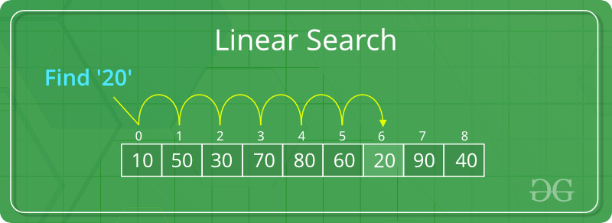
Search Algorithms
JavaScript
Linear Search
Source: https://www.geeksforgeeks.org/linear-search/

Slide 6
Search Algorithms
JavaScript
Linear Search
Taking the previous example:
Key = 20, this is what we are looking for.
Look at element 0.
Element 0 = 10
Compare element 0 to the key.
10 is not equal to 20.
Move to element 1

Slide 7
Search Algorithms
JavaScript
Linear Search
Key = 20, this is what we are looking for.
Look at element 1.
Element 1 = 50
Compare element 1 to the key.
50 is not equal to 20.
Move to element 2
Look at element 2.
Element 2 = 30
Compare element 2 to the key.
30 is not equal to 20.
Move to element 3
Repeat these steps till the number found or -1

Slide 8
Search Algorithms
JavaScript
Linear Search
Complexity of Linear Search
Best case, we find the value first go O(1)
Worst case, we need to search the whole structure to find our value: O(N)
Average case is O(N)

Slide 9
Search Algorithms
JavaScript
Linear Search
Space of Linear Search
Auxiliary space: Just the current element stored in memory. O(1)

Slide 10
Search Algorithms
JavaScript
Linear Search
Advantages
Works on unsorted and sorted arrays
Great for small datasets
Can be used on any data type

Slide 11
Search Algorithms
JavaScript
Linear Search
Disadvantages
Runs slow for large data sets
No good for large data sets

