Slide 1


Binary Search

Slide 2


What
Will We
Learn?
JavaScript
?
Searching
But what is lost?

Slide 3


Search Algorithm
JavaScript
According to Wikipedia, a search algorithm is:
“Any algorithm which solves the search problem, namely, to retrieve information stored within some data structure, or calculated in the search space of a problem domain, either with discrete or continuous values”
It is a recipe we can use to code a solution.

Slide 4
Search Algorithms
JavaScript
Binary Search
Is defined as a searching algorithm
Must be used on sorted data
It repeatedly divides the search interval in half
Will return a -1 if the element is not found in the data structure
Note: Will search the data structure and half it each time.

Slide 5
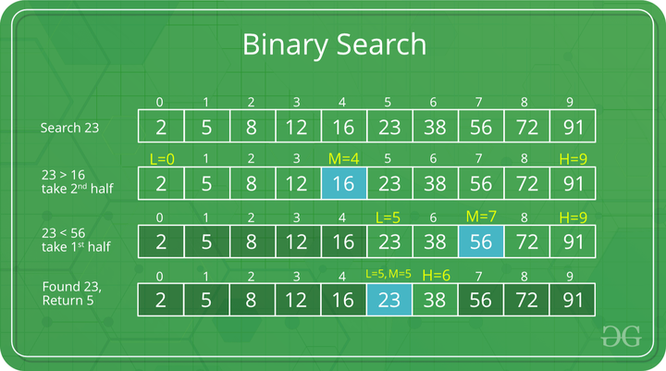
Search Algorithms
JavaScript
Binary Search
Source: https://www.geeksforgeeks.org/binary-search/

Slide 6
Search Algorithms
JavaScript
Binary Search
Taking the previous example:
Key = 23, this is what we are looking for.
We find the low point - 0
We find the high point - 9
We divide the search space with a mid point
Mid = (high – low /) + low – (9 – 0) /2 + 0 = 4 (round down)
Compare the key to the mid point

Slide 7
Search Algorithms
JavaScript
Binary Search
Key = 23, low = 0, mid = 4, high = 9
Compare key to mid point.
If key is higher than the mid, search the right side of the mid
If key is lower than the mid, search the left side of the mid
Adjust the low, mid and high values based on left or right

Slide 8
Search Algorithms
JavaScript
Binary Search
Key = 23, low = 0, mid = 4, high = 9
Mid point 4, contains 16.
16 is less then 23, we need to move to the right side.
New low = mid + 1 = 5.
High = 9
New mid = (9-5) /2 + 5 = 7
First check if the mid point 7 contains 23,
if yes finish, else
Repeat the check from previous steps
Move either left or right of the mid point.

Slide 9
Search Algorithms
JavaScript
Binary Search
Find target value
Find low point
Find high point
Find mid point: mid = low + (high – low) /2
Compare mid point to target value
If target value is higher the mid point value
Move to the right
New low point = mid point +1
High point stays the same
New mid point: mid = low + (high – low) /2
If target value is lower the mid point value
Move to the left
Low point stays the same
New High point = mid point – 1
New mid point: mid = low + (high – low) /2
Return to step 5

Slide 10
Search Algorithms
JavaScript
Binary Search
Complexity of Binary Search
Best case: O(1)
Average case: O(log N)
Worst case: O(log N)

Slide 11
Search Algorithms
JavaScript
Binary Search
Space of Binary Search
Auxiliary space: Just the current element stored in memory. O(1)
(If we use a recursive call, space is O(log N))

Slide 12
Search Algorithms
JavaScript
Binary Search
Advantages
Searches are much faster, especially for large arrays.
More efficient than other search methods with similar time complexity. (e.g. interpolation search, exponential search)
Is well suited for use in the cloud. Can use it on large data-sets stored in external memory, HDD or on the cloud.

Slide 13
Search Algorithms
JavaScript
Binary Search
Disadvantages
The data-set must be sorted
The data-set must be in contiguous memory locations (e.g. in an array)
The elements of the array must be comparable (e.g. a string or number, not an object)

