Slide 1


Functions – Revisited

Slide 2


What
Will We
Learn?
JavaScript
?
Functions?
Do they work?

Slide 3
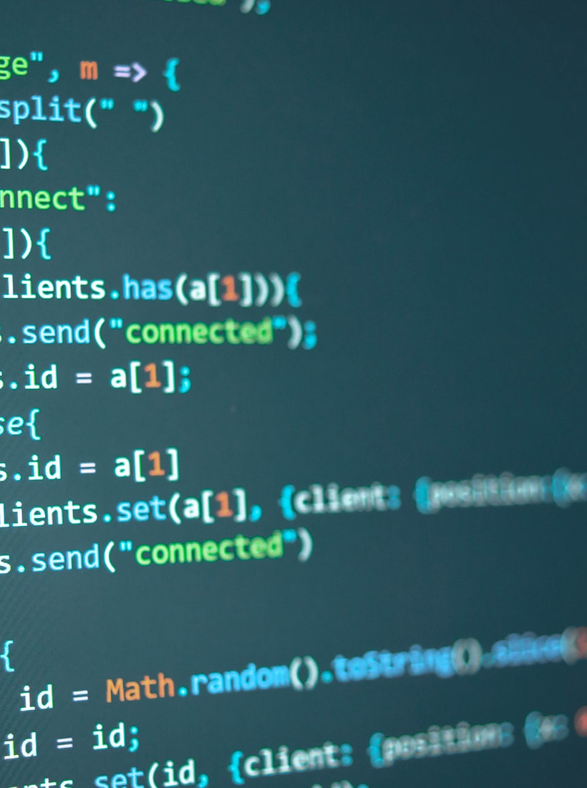
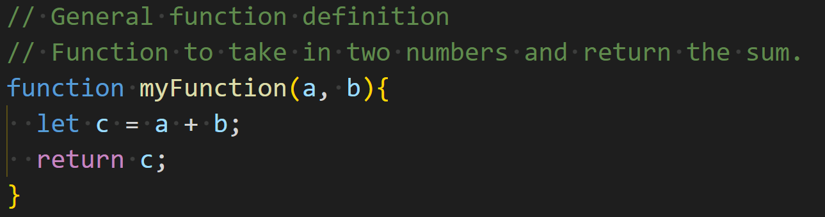
Functions
JavaScript
Definition
Defined using the function keyword

Slide 4
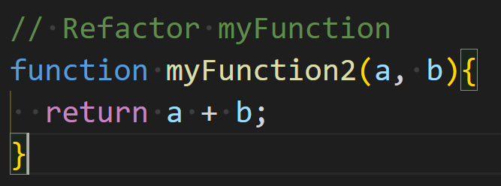
Functions
JavaScript
Definition - refactored
Return an expression

Slide 5
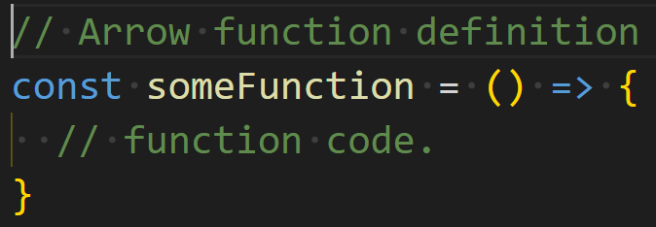

Functions
JavaScript
Arrow functions
Arrow functions are used in many frameworks
It is defined using () => syntax
Arrow functions are called like any other function

Slide 6
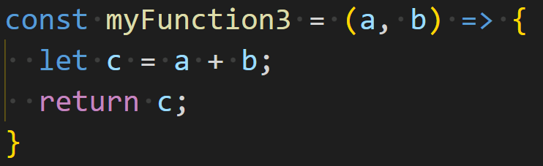
Functions
JavaScript
Arrow functions – refactor 1
Consider the following function:

Slide 7
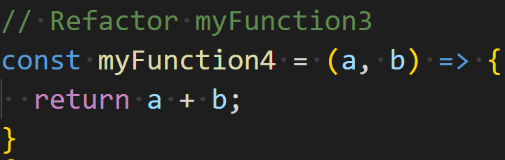
Functions
JavaScript
Arrow functions – refactor 1
We can refactor this like so:

Slide 8
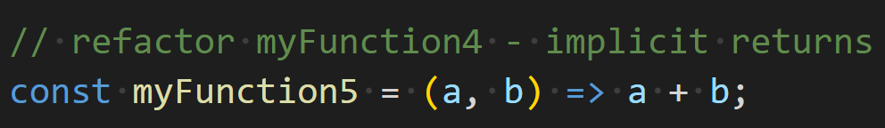
Functions
JavaScript
Arrow functions – refactor 2
We can also refactor like this:
This is known as an implicit return

Slide 9
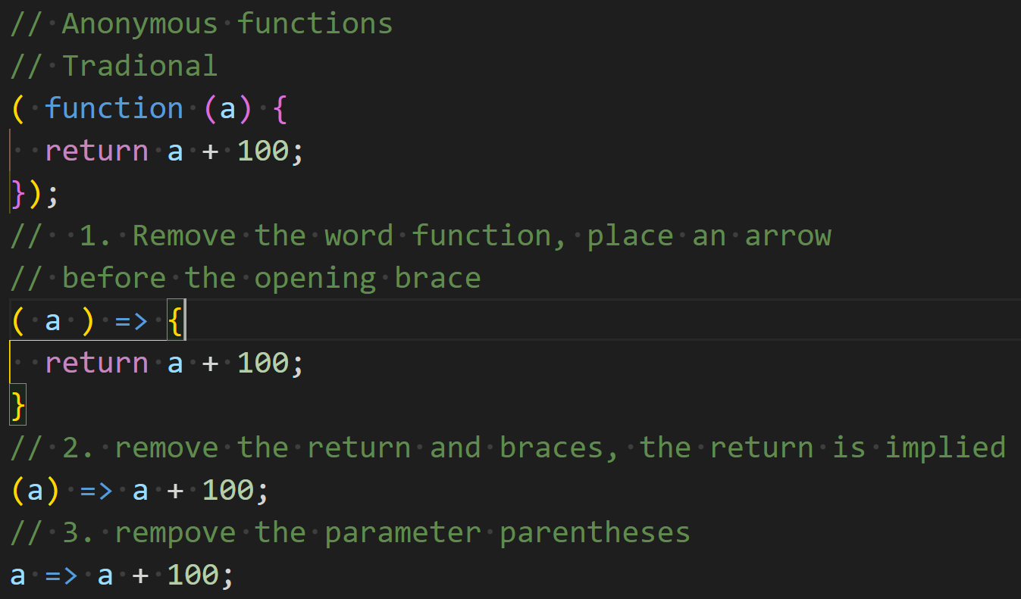
Functions
JavaScript
Anonymous functions

Slide 10
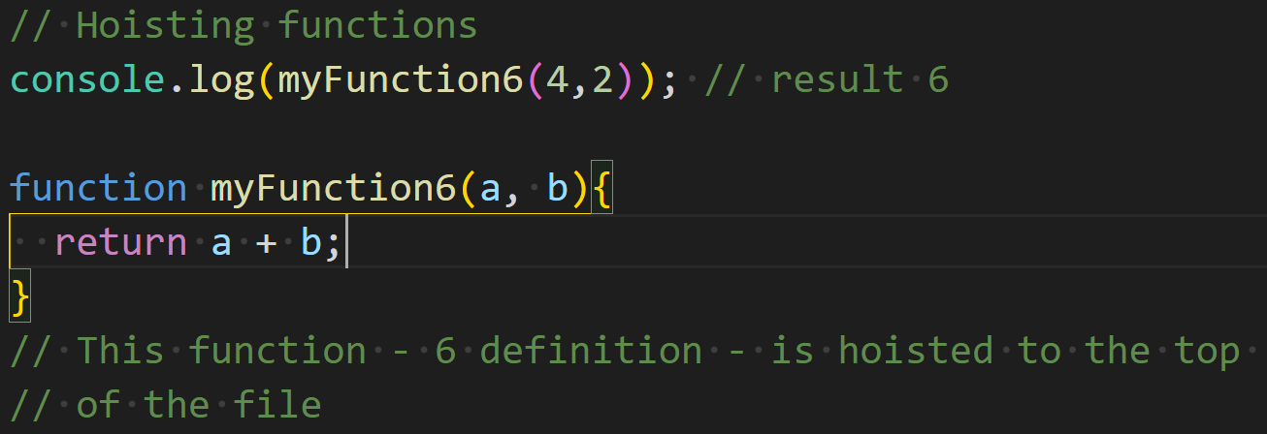
Functions
JavaScript
Anonymous functions

Slide 11
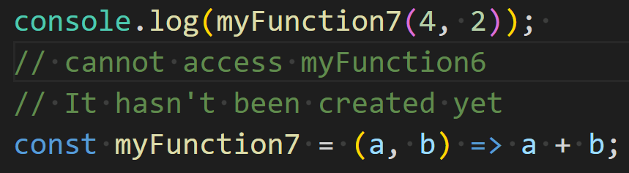
Functions
JavaScript
Hoisting functions – Part 2

