Slide 1


Using Node

Slide 2


What
Will We
Learn?
JavaScript
?
Node what?
Can we program it?

Slide 3
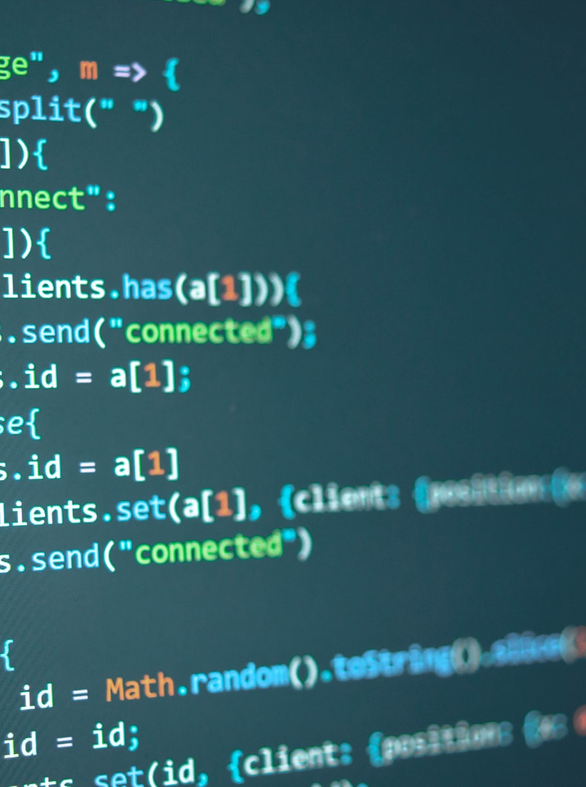
Node Projects
JavaScript
Creating a new project
Create a project folder
In a terminal window or command prompt issue the command
Npm init -y
This will create a package.json file for your project

Slide 4
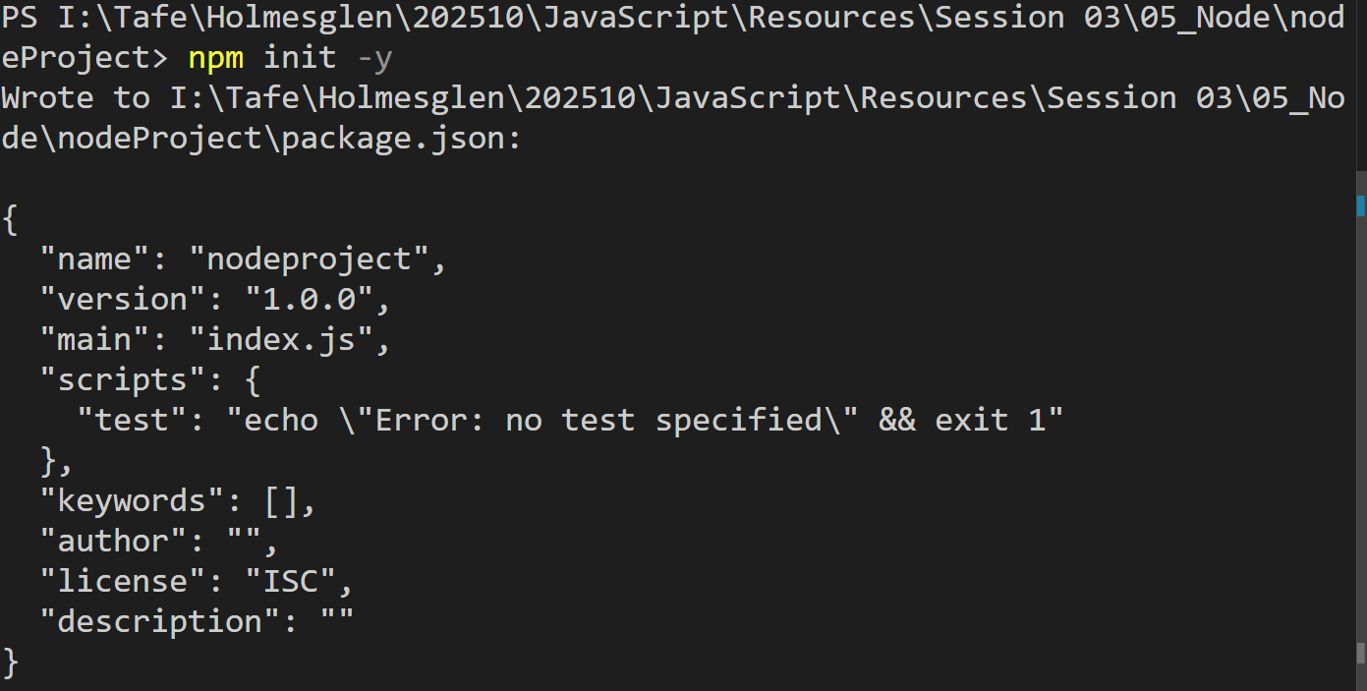
Node Projects
JavaScript
Creating a new project
Create a project folder
In a terminal window or command prompt issue the command
Npm init -y
This will create a package.json file for your project

Slide 5
Node Projects
JavaScript
Package.json
This file holds all the information about your project
The key thing here is the dependencies
This tells the system what packages you must have
For the project / app to run
At the moment this is empty

Slide 6
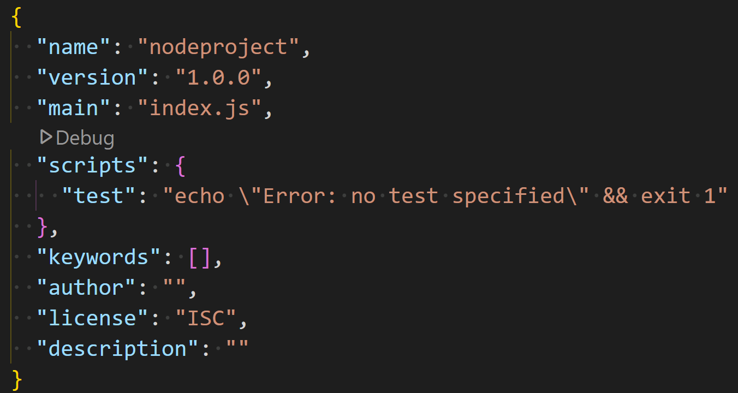
Node Projects
JavaScript
Package.json
This file holds all the information about your project
The key thing here is the dependencies
This tells the system what packages you must have
For the project / app to run
At the moment this is empty

Slide 7
Node Projects
JavaScript
Installing packages
We use npm install to install packages or npm i
We use npm i <packagename@version> to install anything
We can use npm uninstall or npm un to uninstall a package
After installing a node package we will get a node_modules folder
Also a new file package-lock.json will appear.
This new file holds all the information about which packages our installed packages need to function.

Slide 8
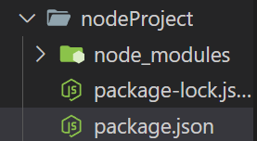
Node Projects
JavaScript
Installing packages
After installing a node package we will get a node_modules folder
Also a new file package-lock.json will appear.
This new file holds all the information about which packages our installed packages need to function.

Slide 9
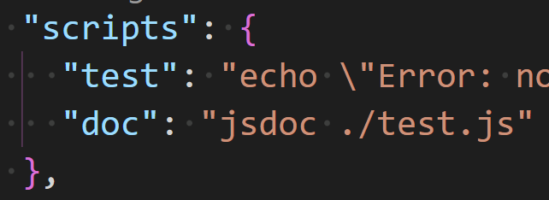
Node Projects
JavaScript
Scripts
In our package.json file we can set up scripts to run commands.
This can be useful if you do not install packages globally.
I.e. the JSDoc package installed.
Script becomes:

Slide 10

Node Projects
JavaScript
Running Scripts
To run a script, we just use
Npm run <scriptName>
That is it.
To run a node application
Node <filename.js>
We can also set up a script to run a node application.
All web applications will have “start” script set up.
Which will be

