Slide 1


Node.js Using Files

Slide 2


What
Will We
Learn?
JavaScript
?
Files?
Can we read it?

Slide 3

Starting a Node project
JavaScript
init
To start a node project:
Run: npm init
This should be done on an empty directory

Slide 4
File System module
JavaScript
Definition
Node has a few built-in libraries / modules
The file system module is one of these.
It is usually shortened to ‘fs’
To bring in a node module into your project you need to require it

Slide 5
writeFile Function
JavaScript
4 parameters
The writeFile function has 4 parameters
The file name
The data being written
The options (this is optional)
And a callback function

Slide 6
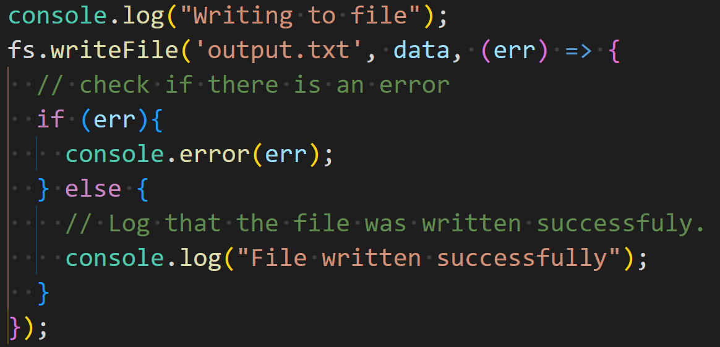
writeFile Function
JavaScript
4 parameters
The writeFile function has 4 parameters
The file name
The data being written
The options (this is optional)
And a callback function

Slide 7
readFile Function
JavaScript
3 parameters
The writeFile function has 4 parameters
The file name
The options (this is optional)
And a callback function

Slide 8
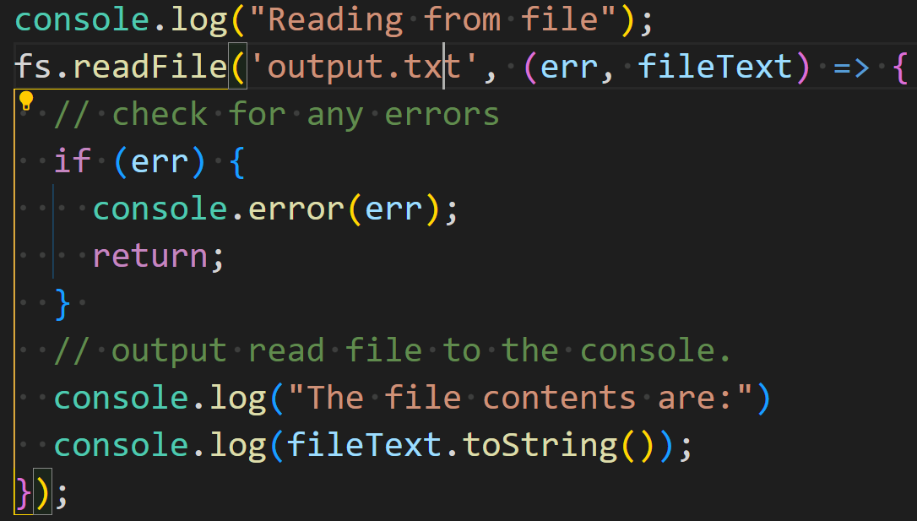
readFile Function
JavaScript

Slide 9
Final Notes
JavaScript
Other methods
In the file system module, there are other ways to do this.
fsPromises.writeFile() and fsPromises.readFile()
These functions are similar to the previous ones
However, there is no callback function
And they both return promises
There is also fs.writeFileSync() and fs.readFileSync()
This however and not asynchronous and are ‘blocking’ functions.
Feel free to experiment and test these other functions.
The methods we looked at are fine for small files
For larger datasets we want to look at using buffers instead

