Slide 1
FINAL PROJECT
E-COMMERCE
GROUP ONE
Free code

Slide 2
Member Of Group One
ADY CAHYO PUTRO
DEPOK
CHAUZAR VANNEEZA
BOGOR

Slide 3
E-COMMERCE
P A N C A K A K I
GOALS :
To provide a place to sell their phone
USERS :
Admins
Owners
Customers

Slide 4
01
ADMINS
02
OWNERS
Add Admin (CRUD)
Add Bank (CRUD)
Add Merk (CRUD)
Add Membership (CRUD)
Create Profile (CRUD)
Create Store (CRUD)
Add Product (CRUD)
E-COMMERCE
INTERNET SHOPPING
03
CUSTOMER
Manage Profile (CRUD)
Add Product To Chart (CRUD)
Create Transaction
USER
ACCESS RIGHTS

Slide 5
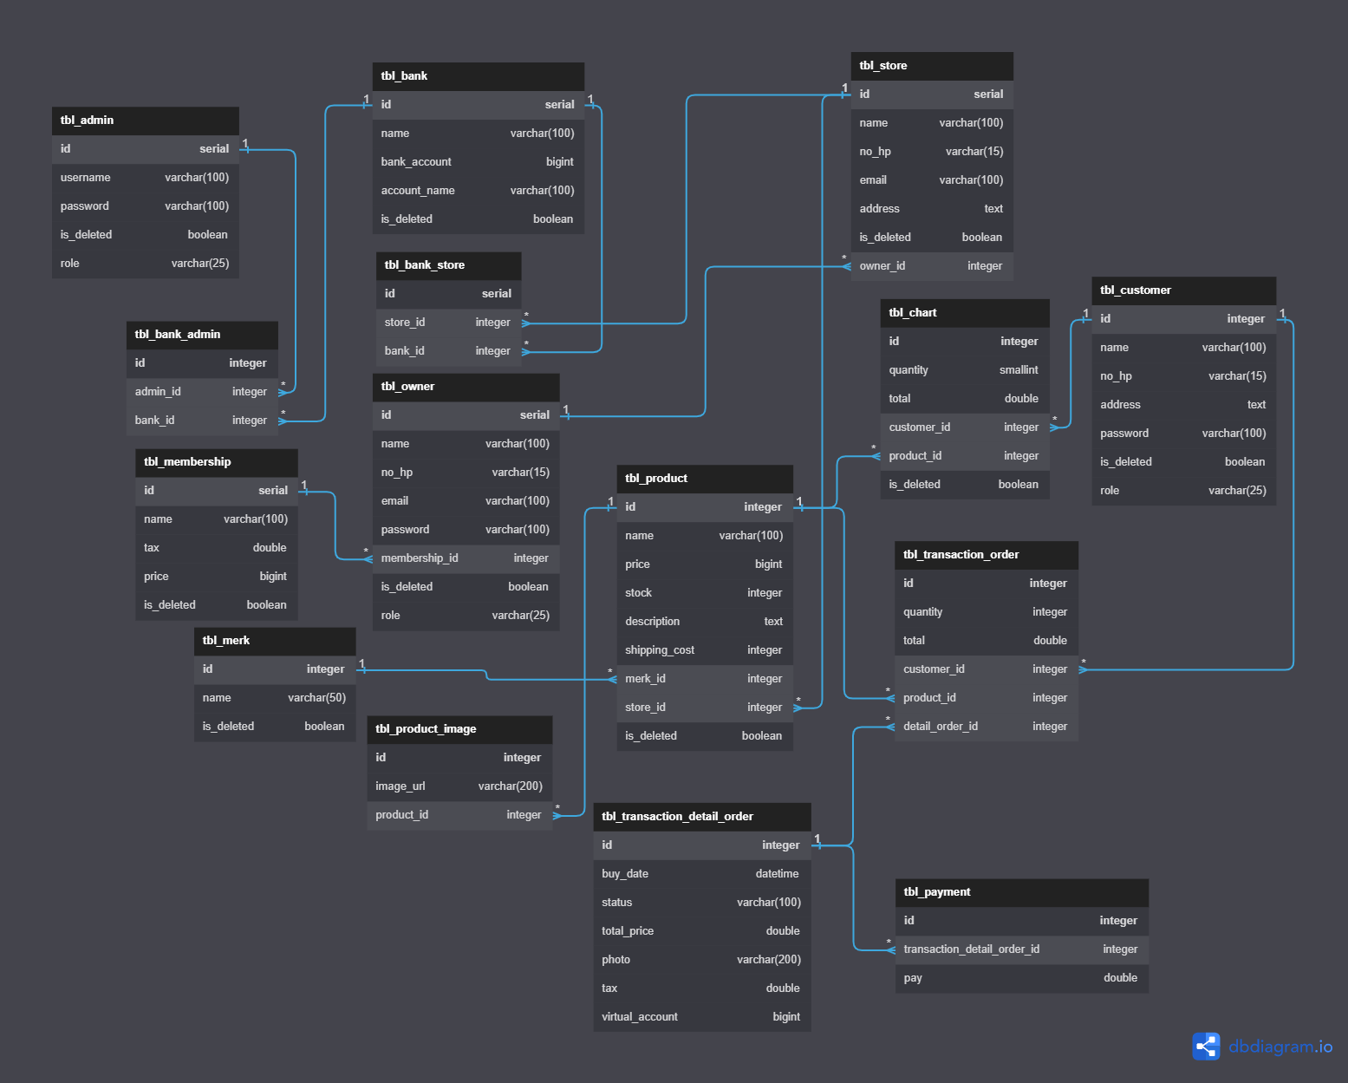
E
R
D

Slide 6
COVERRAGE UNIT TESTING

Slide 7
DEMO SYSTEM

