Slide 1

Text classification with natural language processing
Student: Thi Van Nguyen
Instructor : Professor Polunchenko

Slide 2
Content
1. Introduction
2. Procedure and Methodology
3. Results and discussion
4. Conclusion

Slide 3
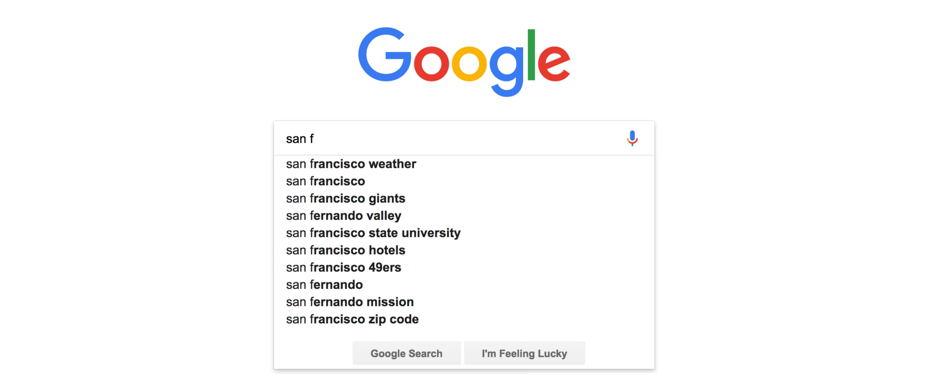


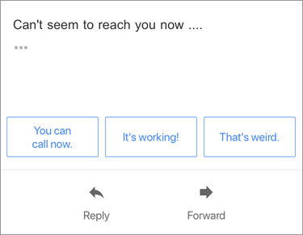
Introduction
Natural language processing tasks are everywhere around us
Suggest in search
Machine translation
Chat bot
Automatic Gmail

Slide 4
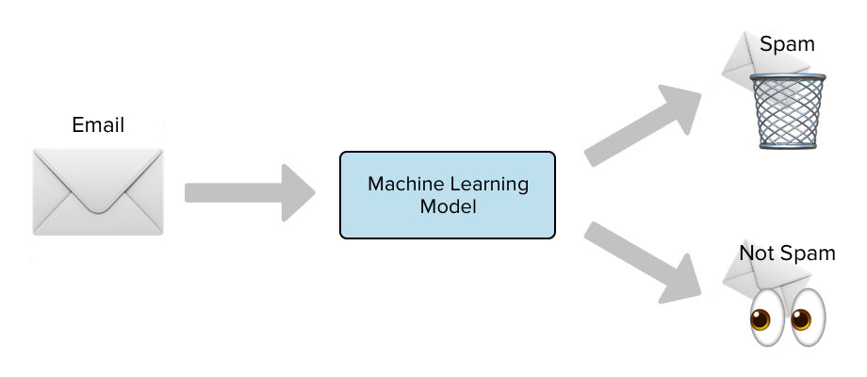
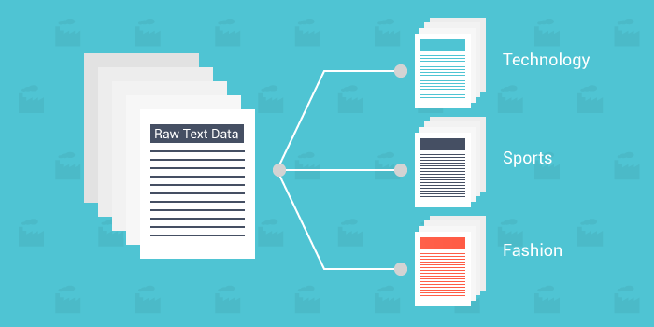


Detection of spam and non-spam emails
Text classification also known as text tagging or text categorization is the process of categorizing text into organized groups
Categorization of news articles into defined topics
Classification of movie reviews as positive or negative

Slide 5
2. Procedure and Methodology
2.1 Text preprocessing
Tokenization
Stemming and lemmatization
2.2 Transform tokens to features
Bag of word (BOW)
Term frequency – Inverse document frequency (TF-IDF)
2.3 Text classification model
Logistic regression
SVM, Navies Bayes, deep learning, ….

Slide 6
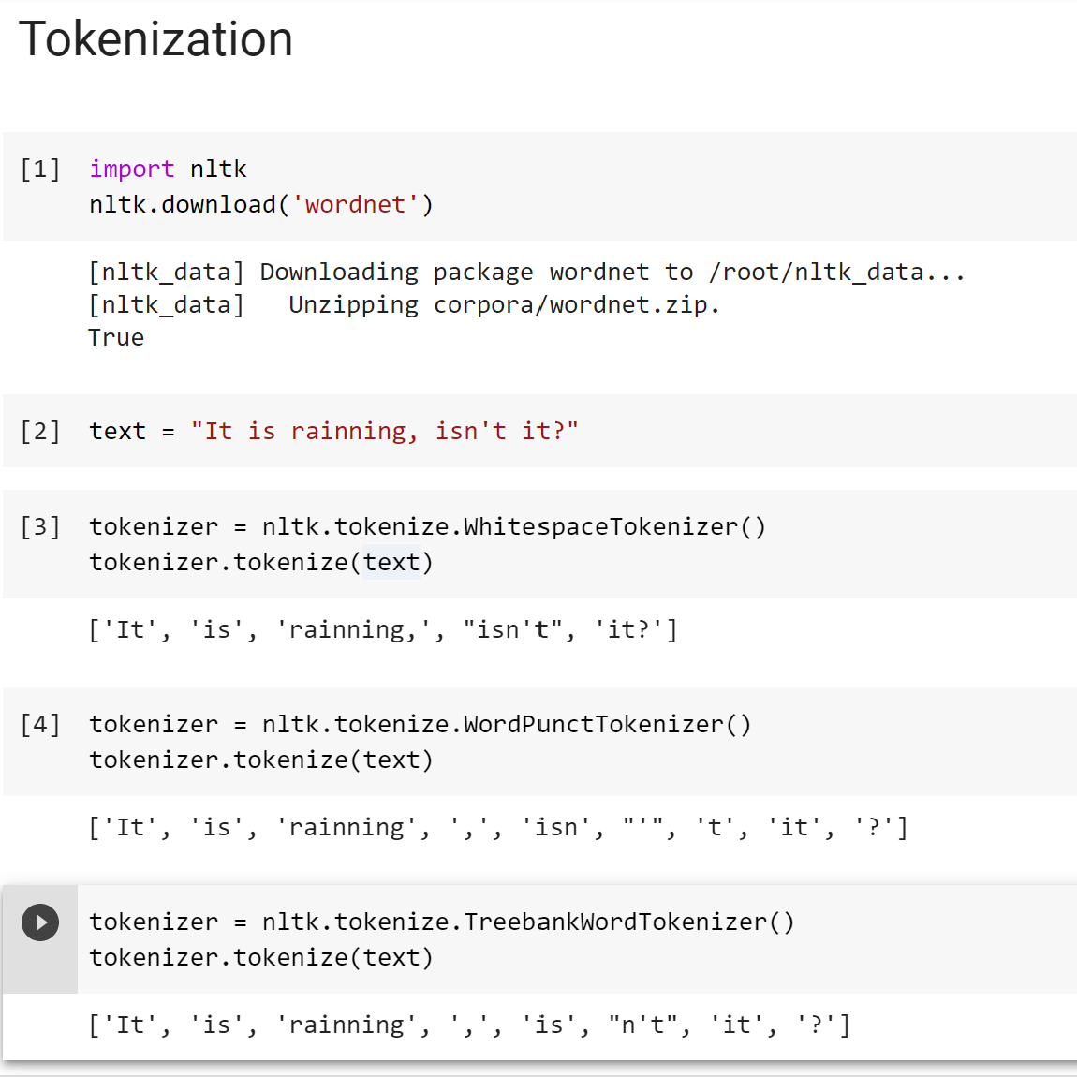
Step 1: Text preprocessing
Tokenization is a process that splits an input sequence into so-called tokens
• You can think of a token as a useful unit for semantic processing
• Can be a word, sentence, paragraph, etc.
Example: “It is raining, isn’t it?”
a/ Simple whitespace tokenizer
• Problem: “it” and “it?” are different tokens with same meaning
b/ Split by punctuation
• Problem: “isn”, “t” are not very meaningful
c/ Set of rules with TreebankWord tokenizer
• “is” and “n’t” are more meaningful for processing Tokenization

Slide 7
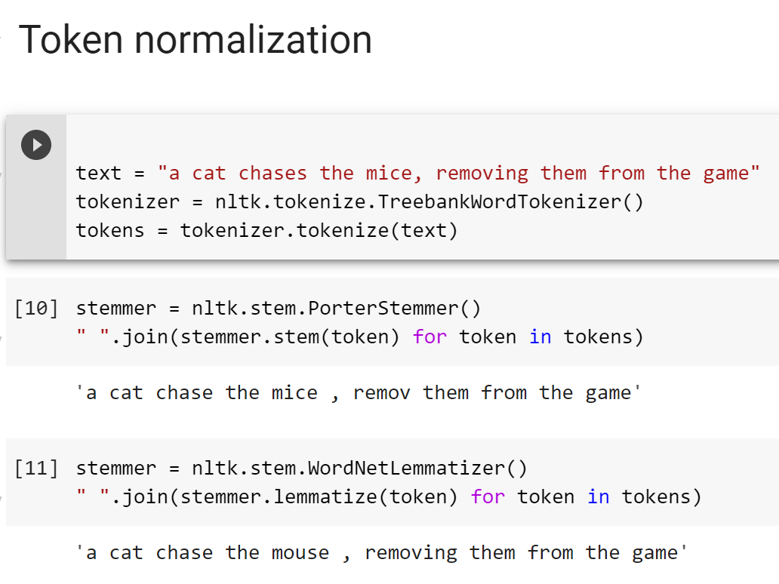
Token normalization
We may want the same token for different forms of the word
• dog, dogs -> dog
• mouse, mice -> mouse
a/ Stemming
• A process of removing and replacing suffixes to get to the root form of the word, which is called the stem
• Usually refers to heuristics that chop off suffixes
• Example: cats -> cat, talked -> talk, chases -> chase
• Problem: fails on irregular forms, produces non-words
(removing -> remov , mice -> mice)
b/ Lemmatization
• Usually refers to doing things properly with the use of a vocabulary and morphological analysis
• Returns the base or dictionary form of a word, which is known as the lemma
• Example: chases -> chase, mice -> mouse
• Problems: not all forms are reduced (removing -> removing)

Slide 8
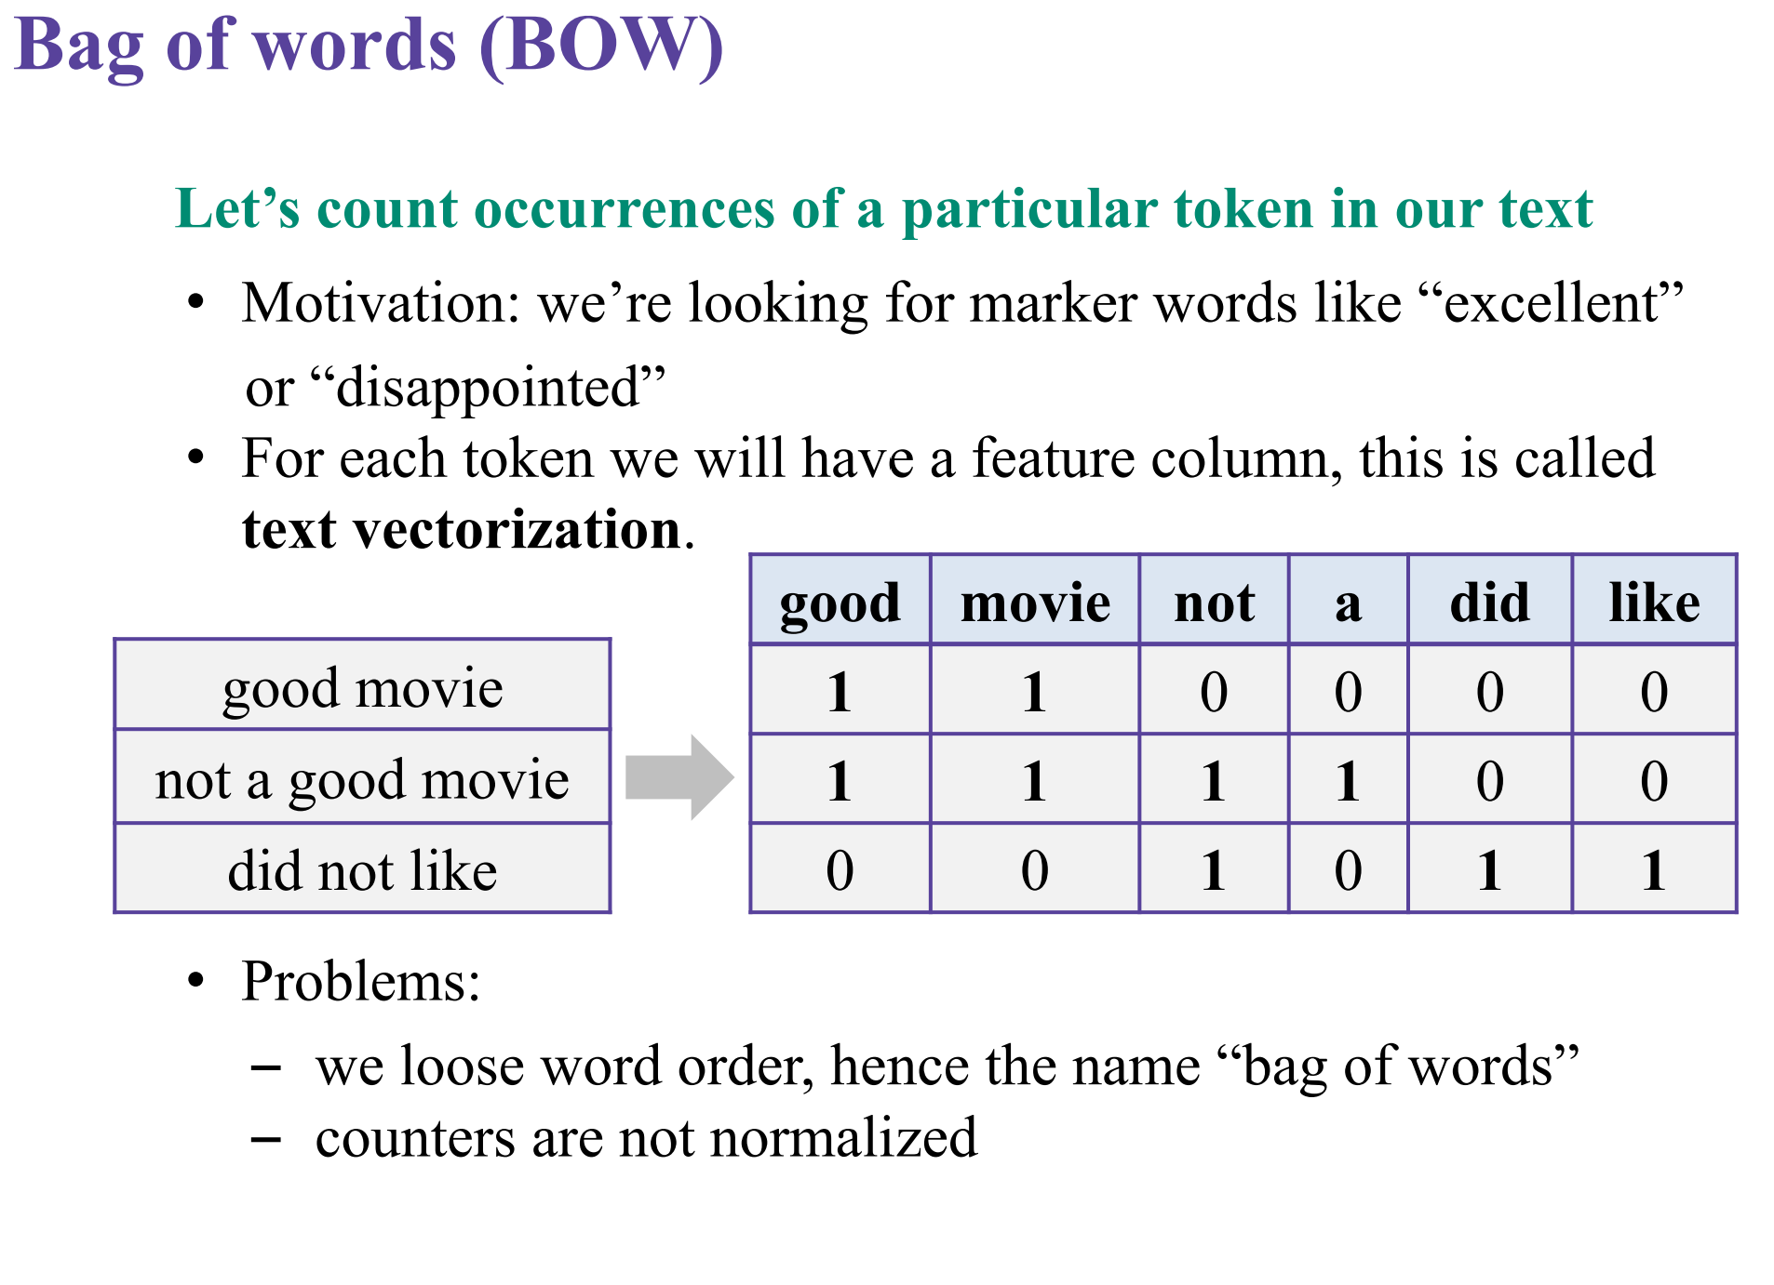
Step 2: Transform tokens to features
We also can count token pair (2-grams), triplet(3_grams), …, n-grams.
-> Problem : too many features

Slide 9
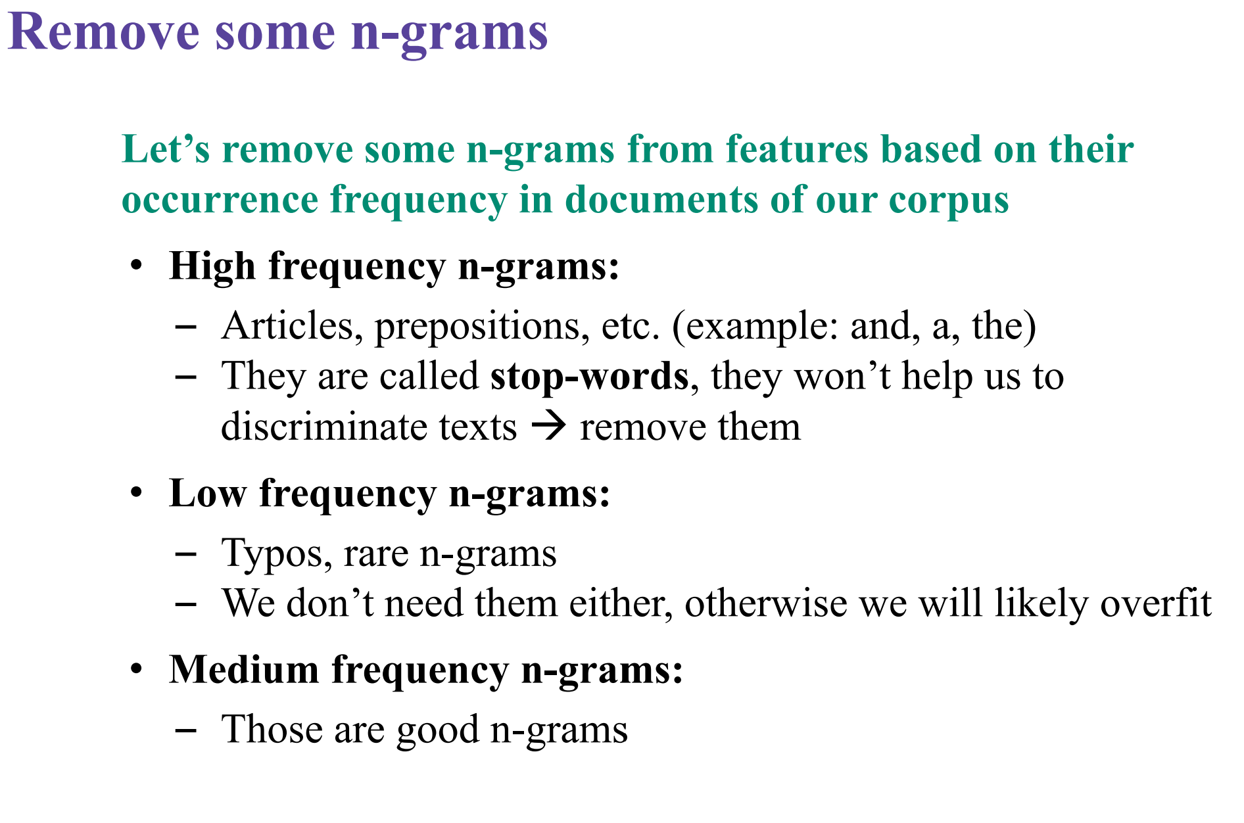

Slide 10
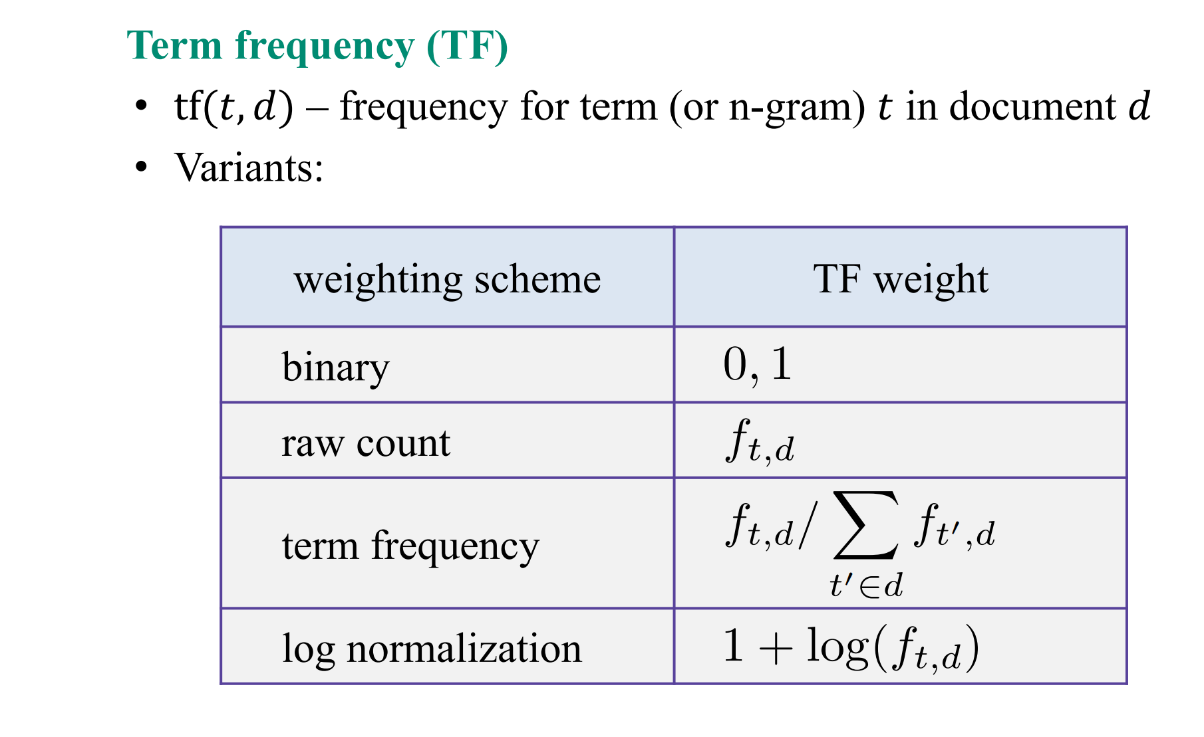
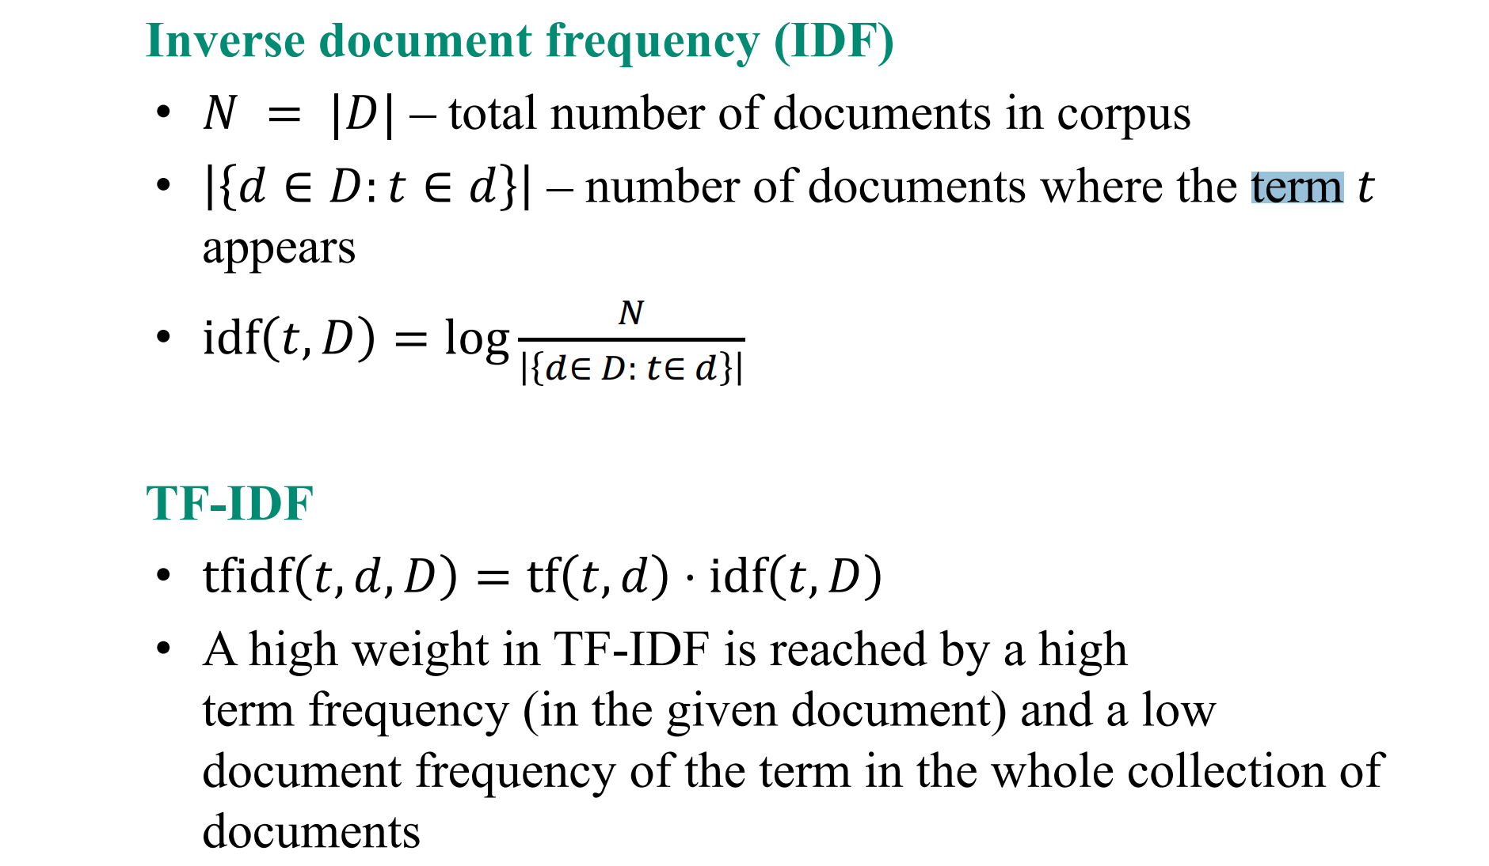
Term frequency (TF)- Inverse document frequency (IDF)
It measures the informativeness or reflect how important a word is to a document in a collection or corpus. It is often used as a weighting factor.

Slide 11
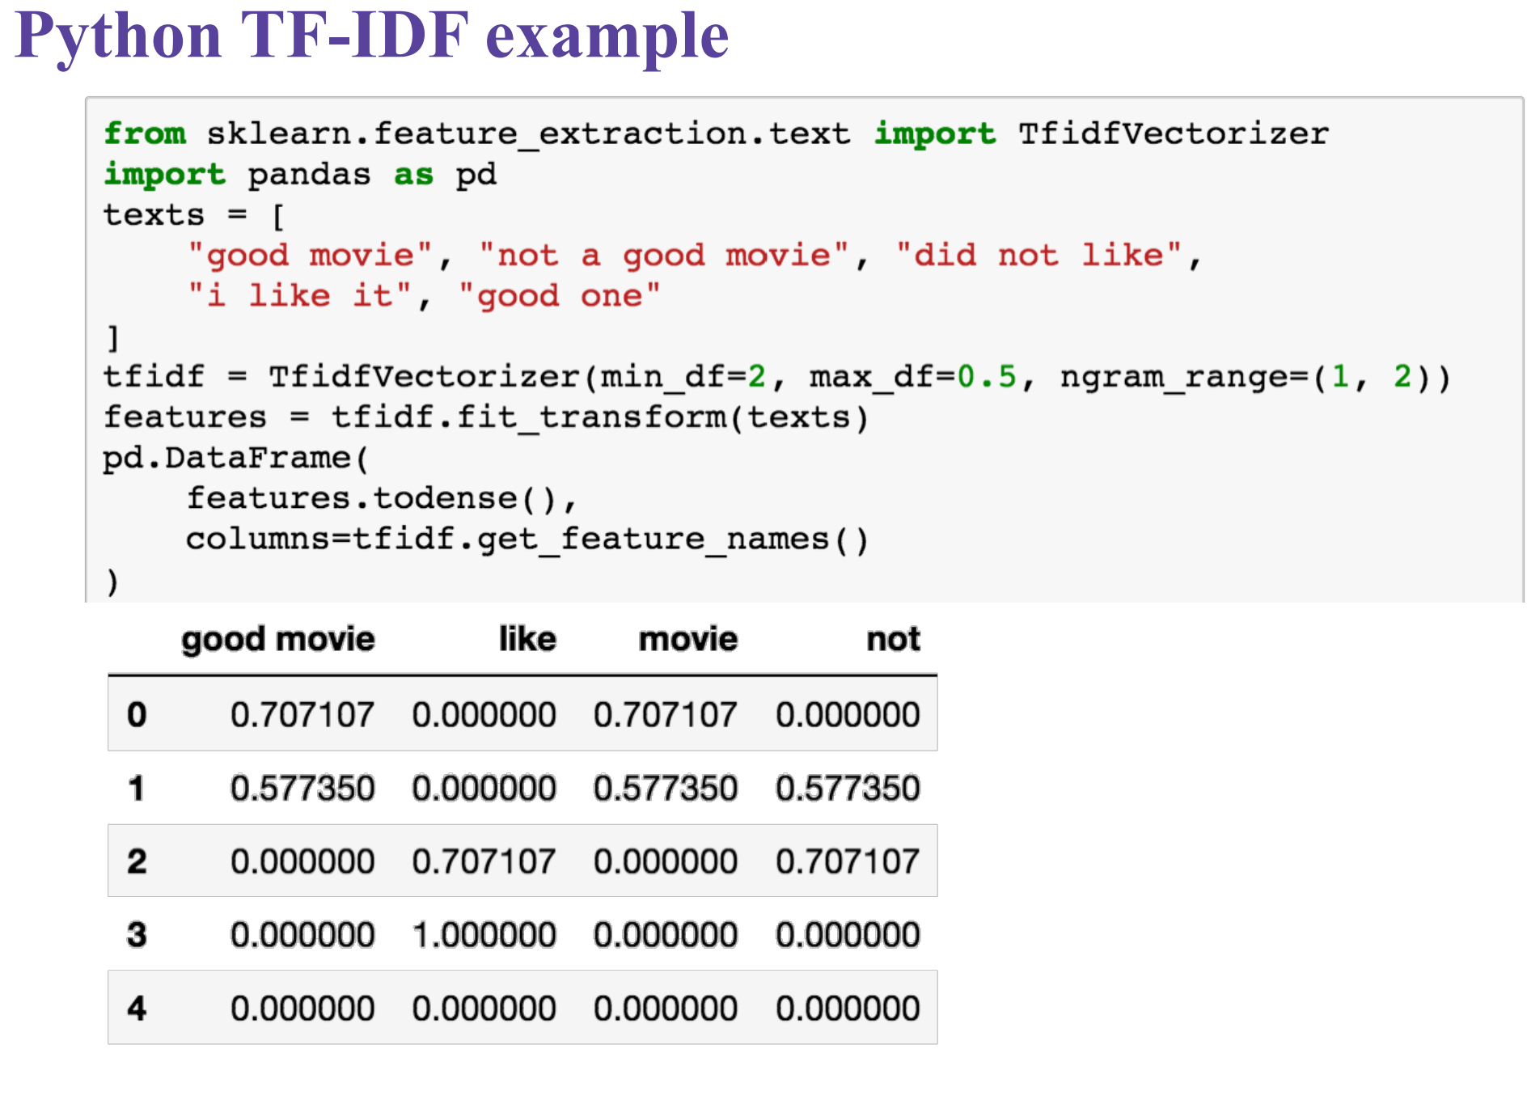

Slide 12
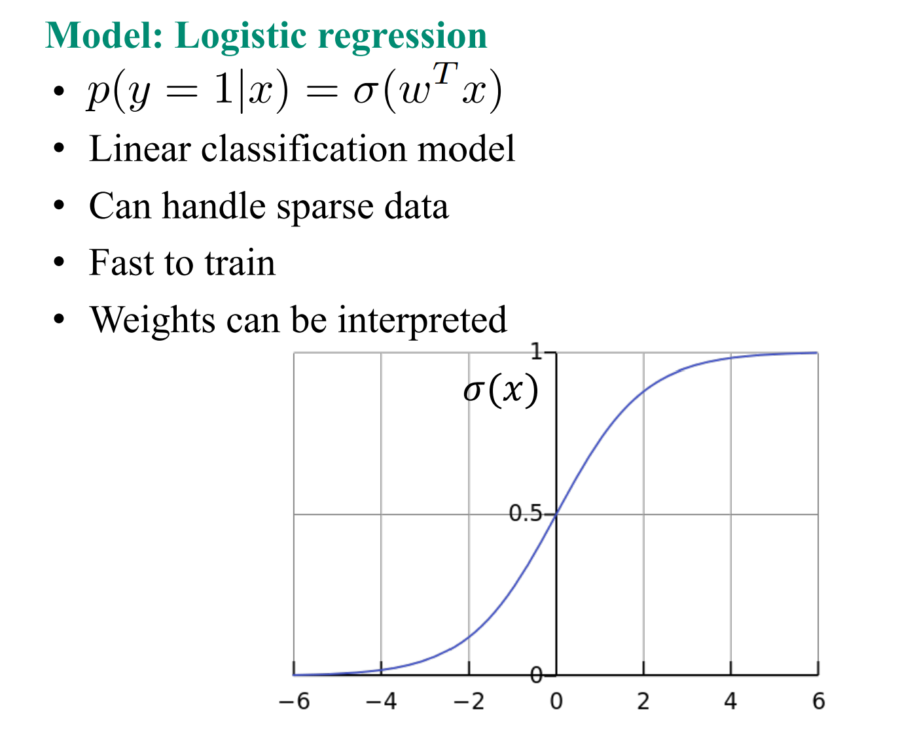
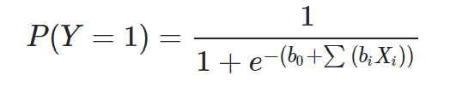
Step 3: Text classification model
The logistic regression model is of the form:
It is called a generalized linear model because the logit of the estimated probability response is a linear function of the parameters.

Slide 13
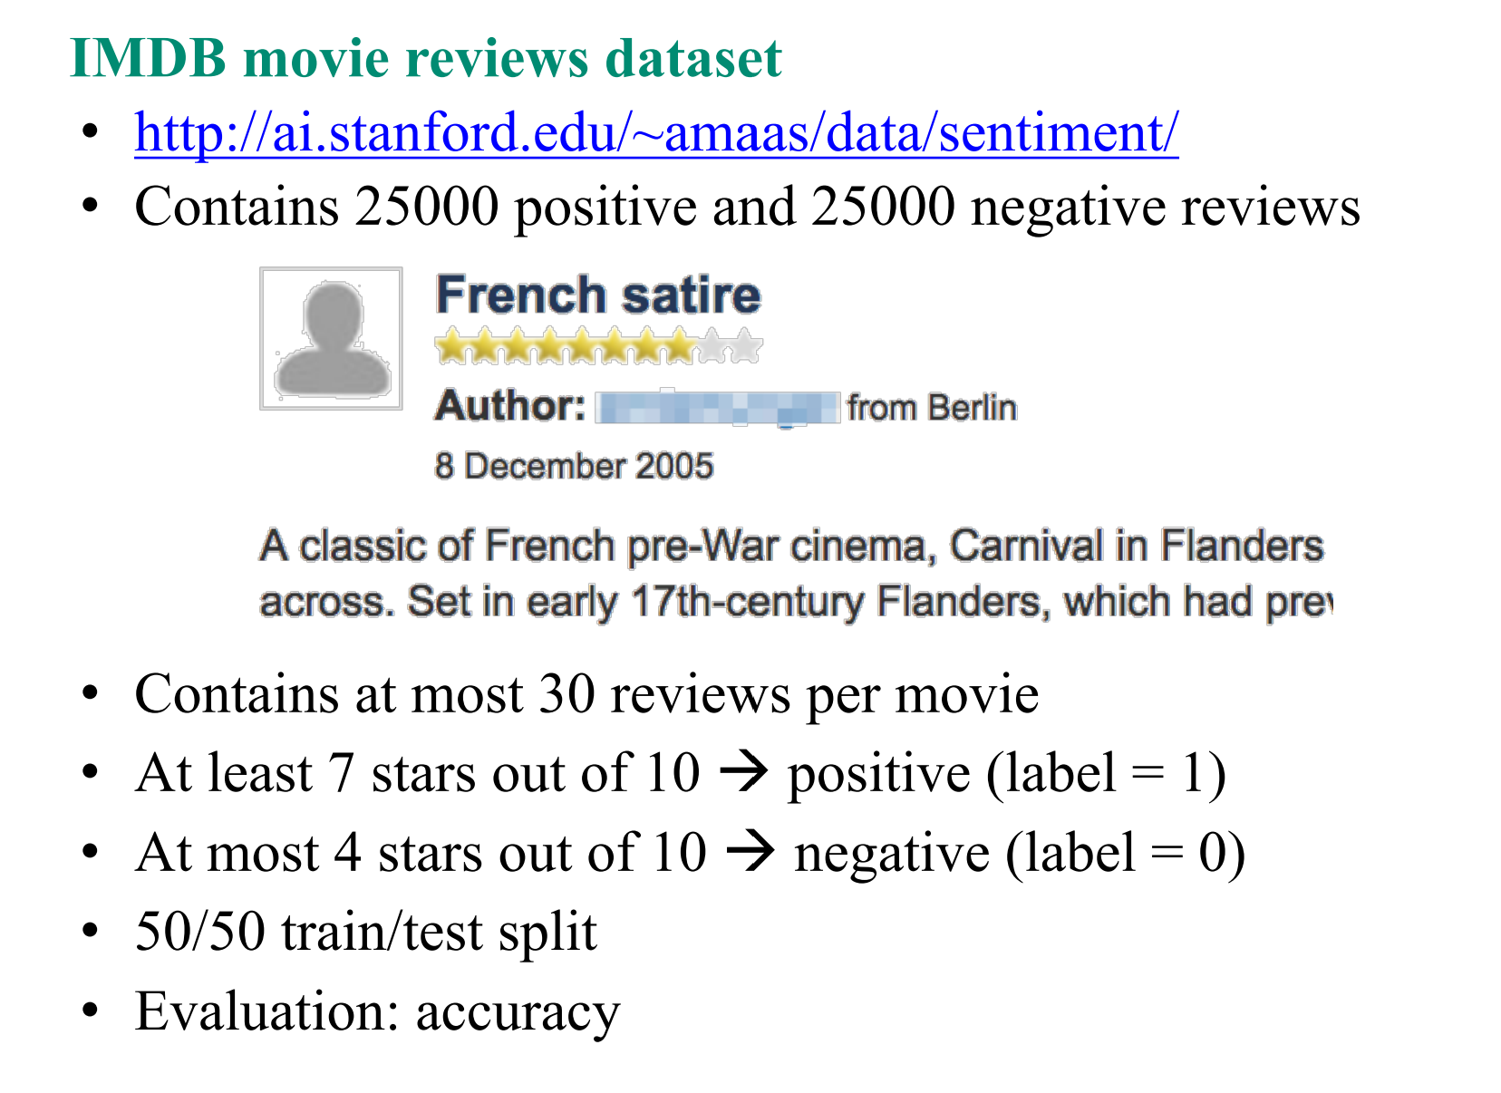
3. Results and discussion
Dataset
Review | Sentiment
“One of the other reviewers has mentioned that after watching just 1 episode you'll be hooked. They are right, as this is exactly what happened with me…..” | Positive
“A wonderful little production. The filming technique is very unassuming- very old-time-BBC fashion and gives a comforting, and sometimes discomforting, sense of realism to the entire piece….” | Positive
“…This movie is slower than a soap opera... and suddenly, Jake decides to become Rambo and kill the zombie….” | Negative
“…. At first it was very odd and pretty funny but as the movie progressed, I didn't find the jokes or oddness funny anymore….” | Negative
………. | ………..

Slide 14
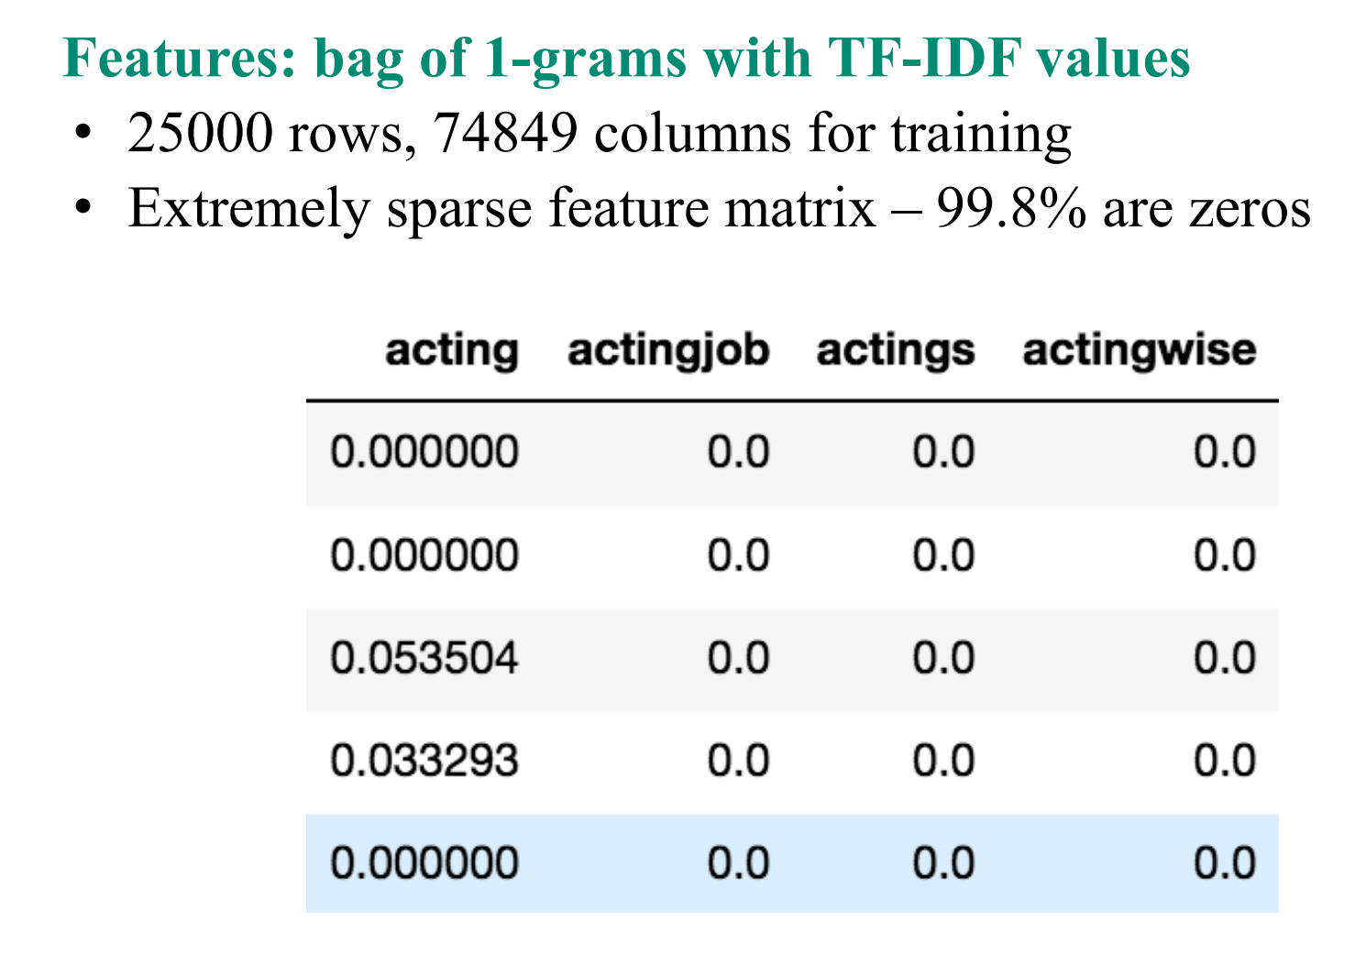
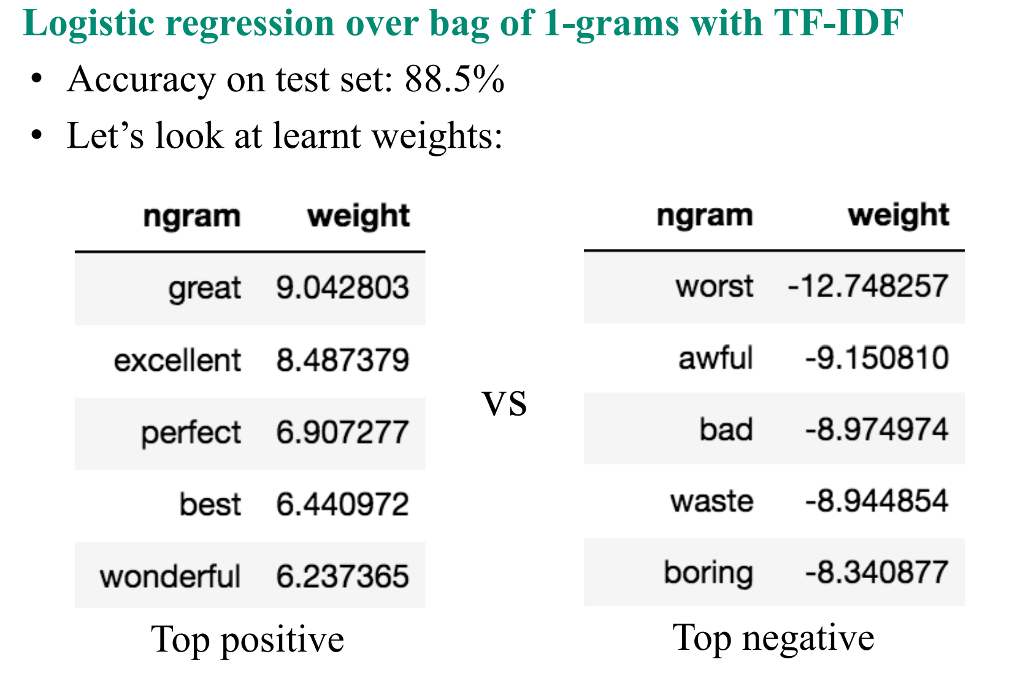
Result 1

Slide 15
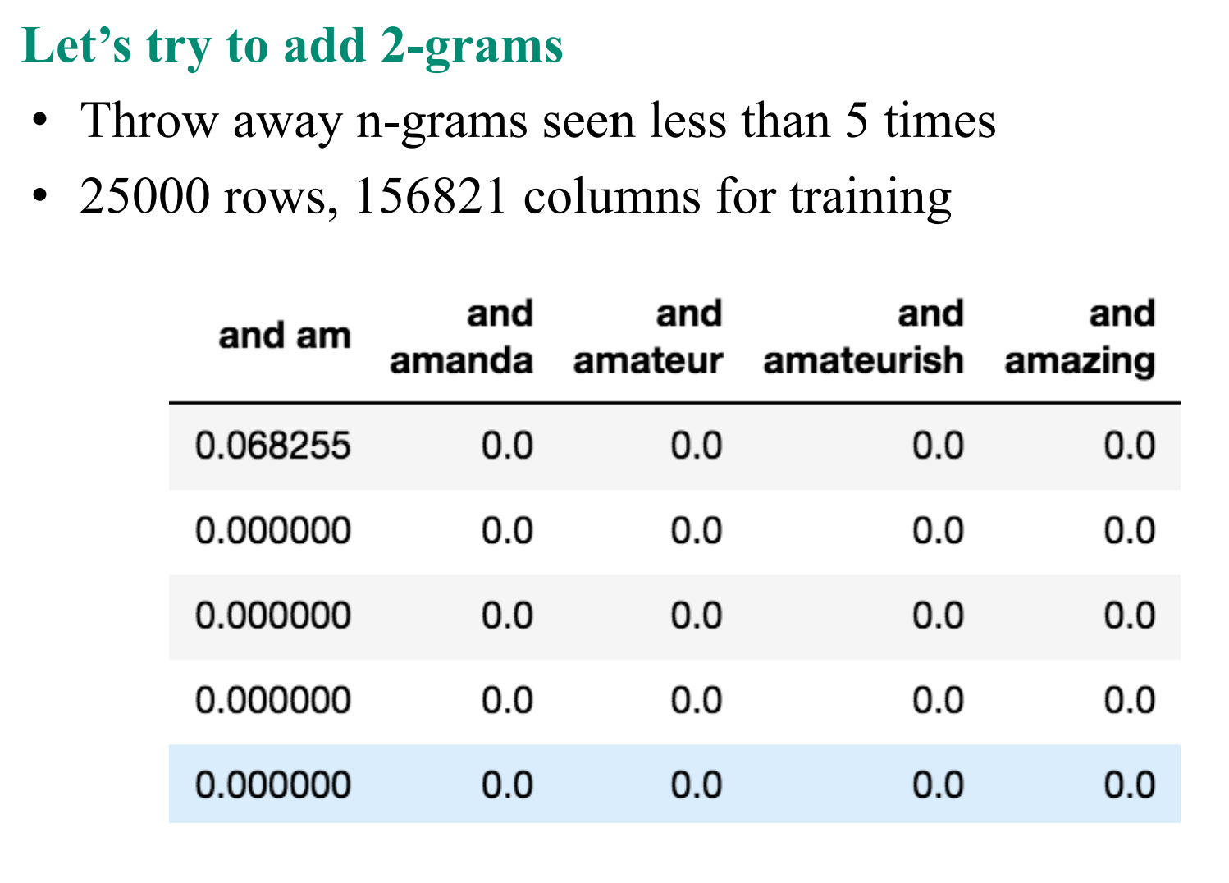
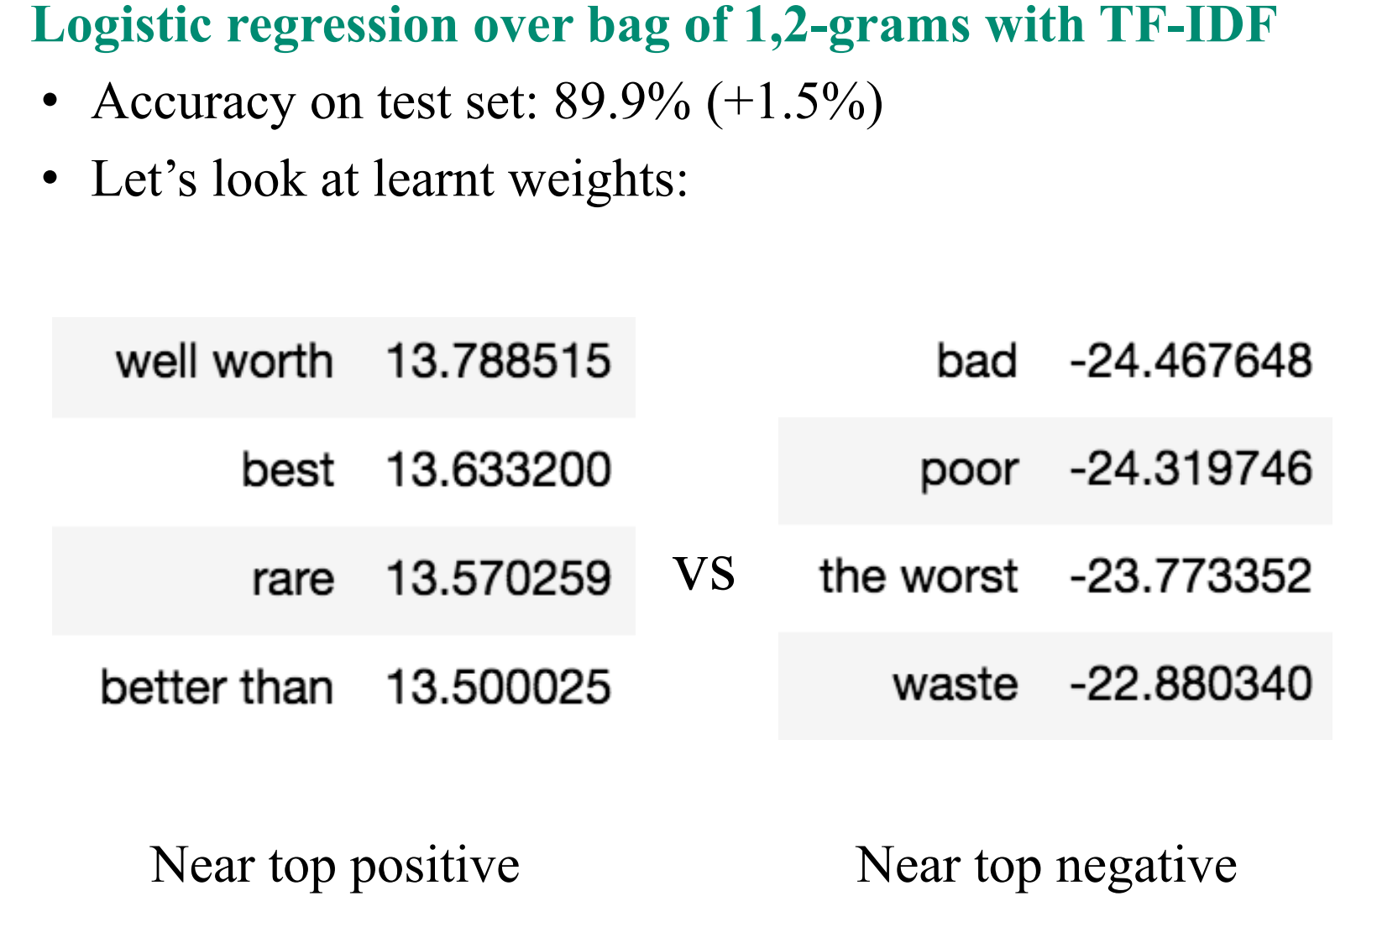
Result 2

Slide 16
4. Conclusion
Bag of words with TF-IDF and logistic regression models for text classification over that features work very well with accuracy nearly 90%.
We can try different models, like SVM or Naive Bayes, or any other model that can handle sparse features.
We can also use deep learning techniques to squeeze the maximum accuracy from that dataset

Slide 17
Reference
1. Natural Language Processing _HSE University https://www.coursera.org/learn/language-processing/home/info
2. IMDB movie reviews dataset http://ai.stanford.edu/~amaas/data/sentiment/

Slide 18

This Photo by Unknown Author is licensed under CC BY-SA-NC

