Slide 1
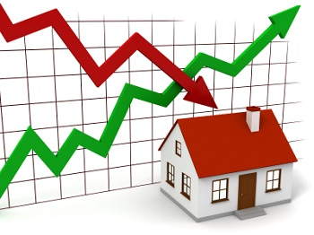
Predicting housing sales price in Ames, Iowa from 2006 to 2010 using machine learning
Presenter: Thi Van Nguyen
Binghamton University
Notes:
NOTE:
Matt P

Slide 2
Content
Introduction
Methodology
Data Exploration
Results and discussion

Slide 3
1. INTRODUCTION
Housing prices are an important reflection of the economy, and their ranges are of great interest for both buyers and sellers because they are interested in determine the right price.
Also, housing prices are affected by many factors such as physical condition, concept and location.
This research aims to predict housing price by utilizing regression as well as minimizing the difference between predicted and actual ratings (RMSE).

Slide 4
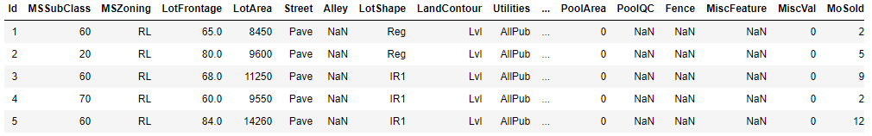
1. Dataset
Dataset: house price data describing the sale of individual residential property in Ames, Iowa from 2006 to 2010 . Source: Kaggle
The data set contains 2930 observations and 79 explanatory variables describing (almost) every aspect of residential homes (23 nominal, 23 ordinal, 14 discrete, and 19 continuous)
Data link : https://www.kaggle.com/c/house-prices-advanced-regression-techniques/overview

Slide 5

Linear regression, Ridge, Lasso, Elastic Net Stochastic Gradient Descent Gaussian Process regression Decision Tree regression Random Forest regression KNN regression

Slide 6
3. Data Exploration

Slide 7
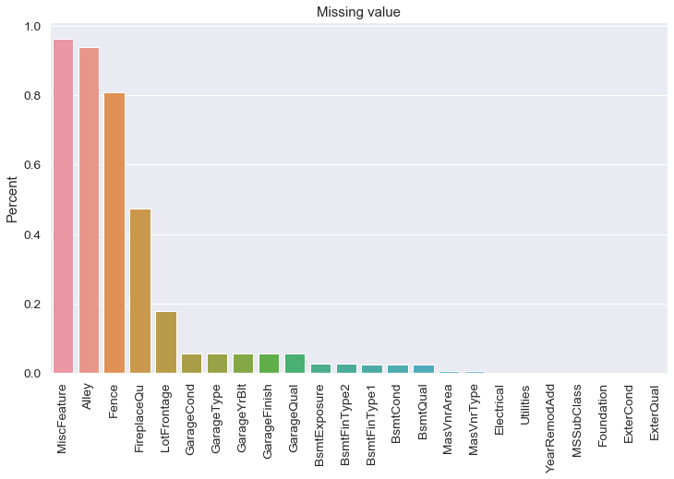
Missing values
Filling missing values
Number of Missing values
Train dataset: 6965
Test dataset : 7000
Number of features with NA
Train dataset: 19
Test dataset : 13
For a few columns there is lots of NaN entries. However, reading the data description we find this is not missing data:For Alley, NaN is not missing data but means no alley, likewise for MiscFeature, Fence, FireplaceQu etc. Fill missing values with “None”.
Fill missing values with mean for the remaining columns: LotFrontage, GarageYrBlt, MasVnrArea
Ratio of missing values of each feature

Slide 8
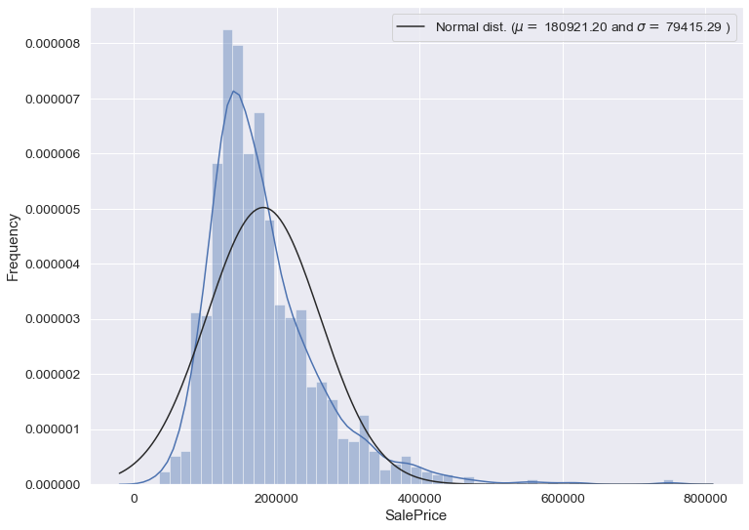
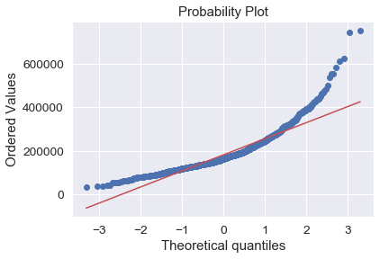
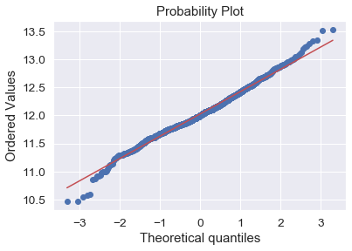
Transform “Sale Price” by Taking the Log for Normalization
Before transformation
After Log transformation

Slide 9
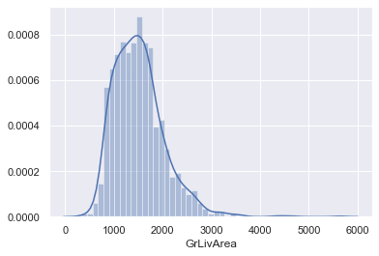
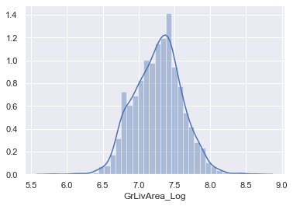
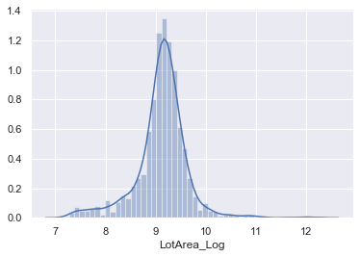
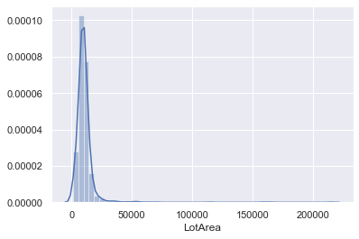
Transform some of the feature values by Taking the Log for Normalization
Before transformation
After Log transformation
'GrLivArea'
'LotArea'

Slide 10
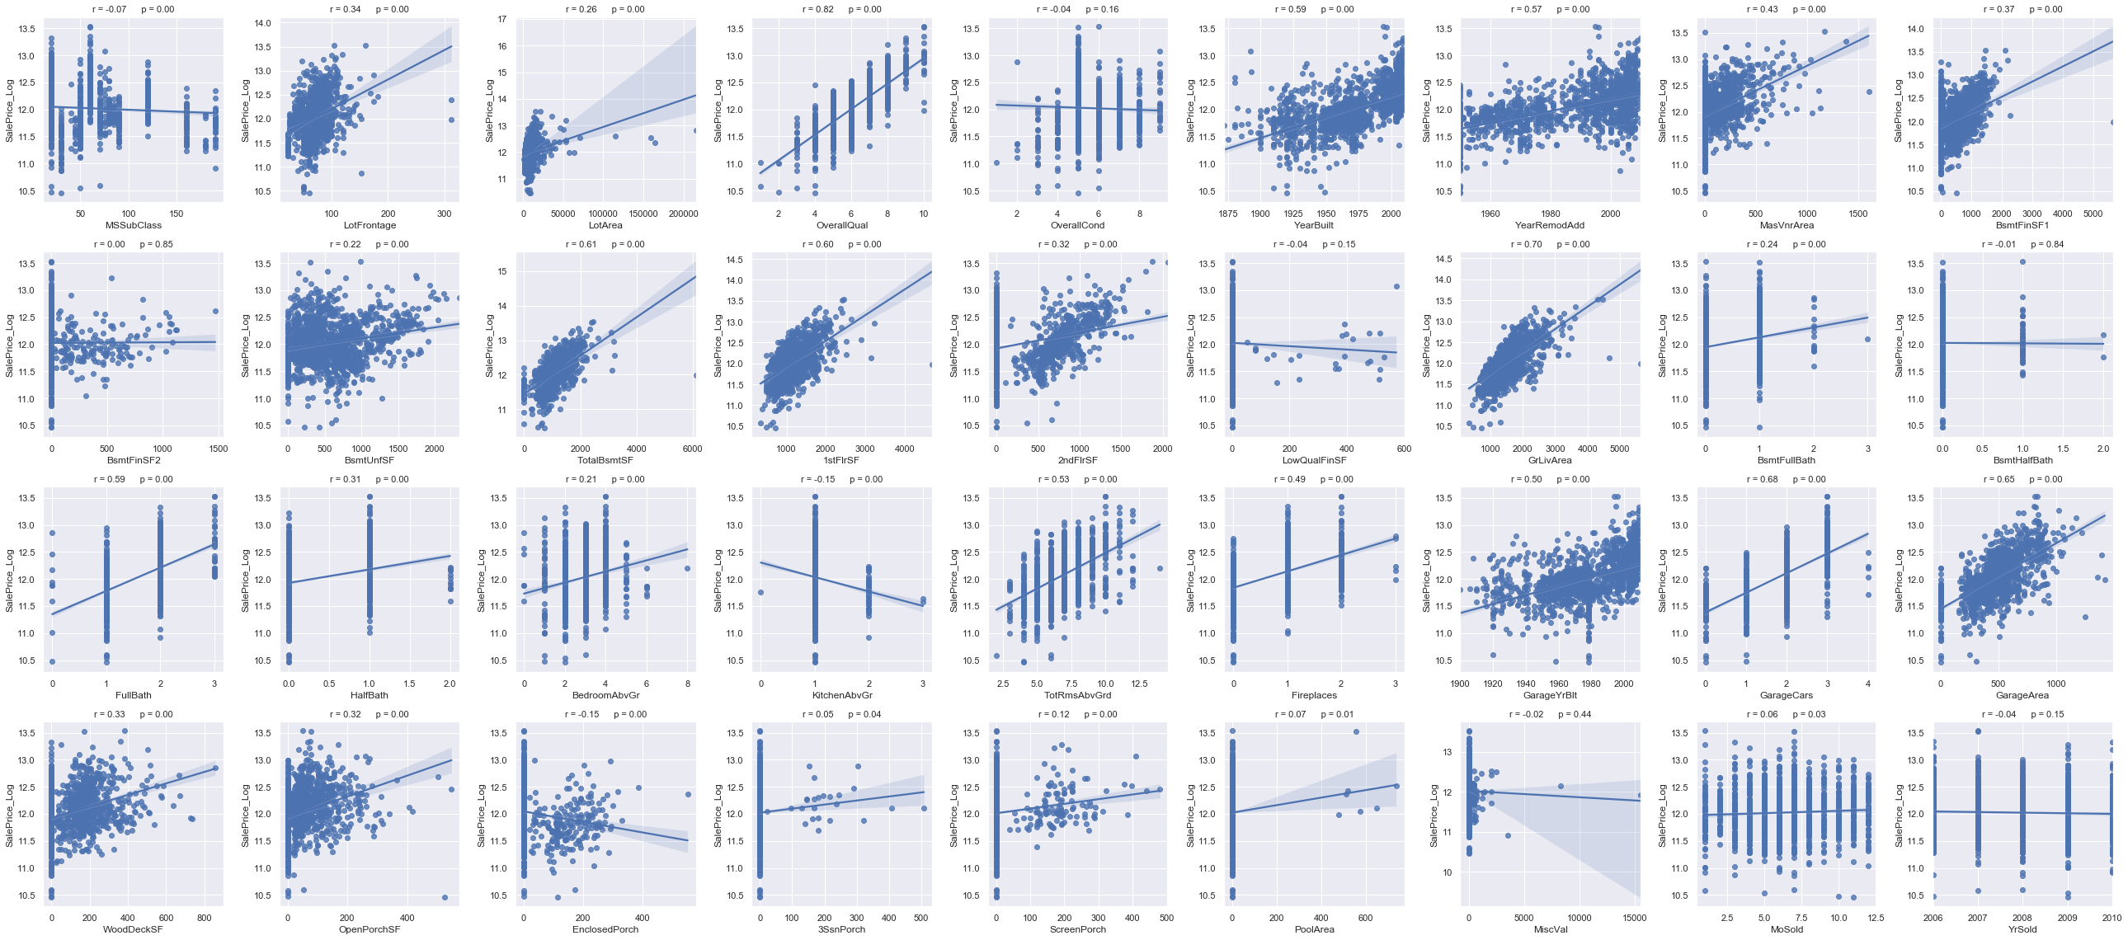
Relation of features to target (SalePrice_log)
Conclusion on numerical columns
Plots of relation to target for all numerical features and Pearson correlation coefficient
For some features like 'OverallQual' there is a strong linear correlation (0.82) to the target.
For other features like 'MSSubClass' the correlation is very weak.(0.07)
For this task, I use only those features that have a correlation larger than a threshold value to SalePrice for prediction.
This threshold value can be choosen in the settings : min_val_corr =0.4

Slide 11
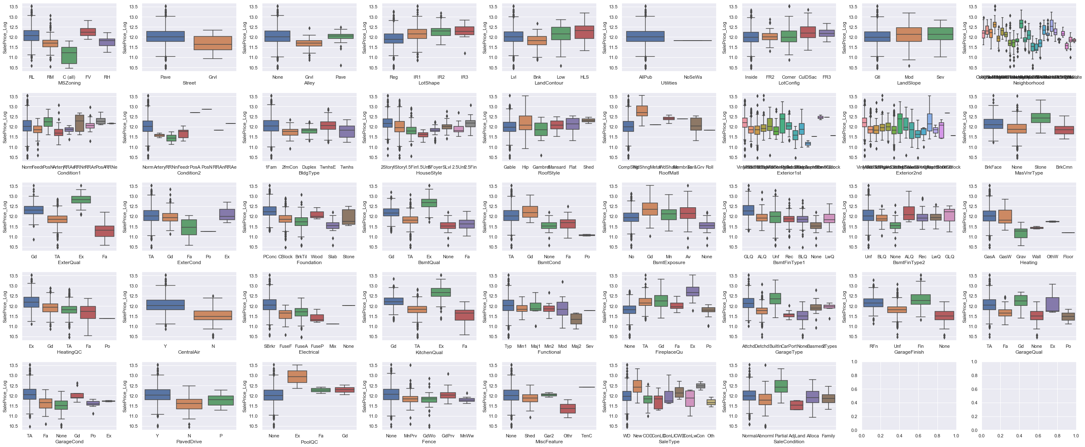
Box Plots of relation to SalePrice for all categorical features
For many of the categorical there is no strong relation to the target.
However, for some features, it is easy to find a strong relation.
From the figures above these are : 'MSZoning', 'Neighborhood', 'Condition2', 'MasVnrType', 'ExterQual', 'BsmtQual','CentralAir', 'Electrical', 'KitchenQual', 'SaleType’
For the categorical features, I used only those that show a strong relation to SalePrice and dropped the others. Then I transformed categorical variables to numerical variables

Slide 12
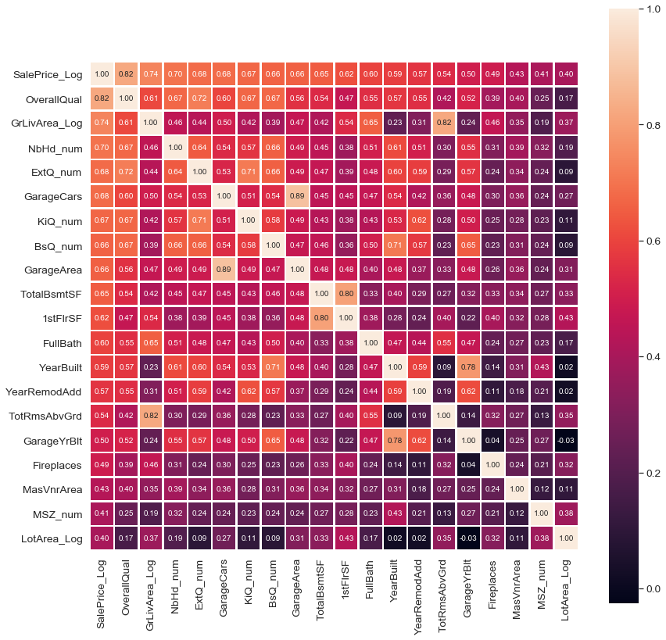
Correlation after dropping
Check for Multicollinearity
Correlation Matrix : All features with strong correlation to SalePrice
Strong correlation between
'GarageCars' and 'GarageArea'
'TotalBsmtSF' and '1stFlrSF'
'YearBuilt' and 'GarageYrBlt’
'GrLivArea_Log' and 'TotRmsAbvGrd'
Of those features we drop the one that has smaller correlation coefficient to Target

Slide 13
Modeling Process
'OverallQual’: Rates the overall material and finish of the house
'GrLivArea_Log’: Log of the above ground living area sq. ft
'NbHd_num’: Physical locations within Ames city limits (convert to numerical)
'ExtQ_num’: Evaluates the quality of the material on the exterior (convert to numerical)
'GarageCars’ :Size of garage in car capacity
'KiQ_num’: Kitchen quality (convert to numerical)
'BsQ_num’ : Evaluates the height of the basement (convert to numerical)
'TotalBsmtSF’ : Total square feet of basement area
'FullBath’: Number of Full bathrooms above grade
'YearBuilt’ :Original construction date
'YearRemodAdd’ :Remodel date
'Fireplaces’: Number of fireplaces
'MasVnrArea’ :Masonry veneer area in sq. ft
'MSZ_num’ :Identifies the general zoning classification of the sale (convert to numerical)
'LotArea_Log’: Log of the Lot size in sq. ft
List of features used for the Regression
Grid search CV (tune the parameters)
Linear regression
Ridge
Lasso
Elastic Net
Stochastic Gradient Descent
Gaussian Process regression
Decision Tree regression
Random Forest regression
KNN regression
Model fitting

Slide 14
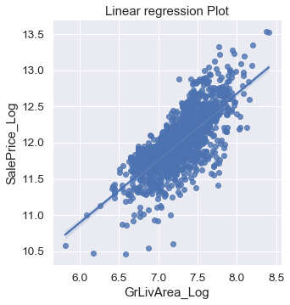
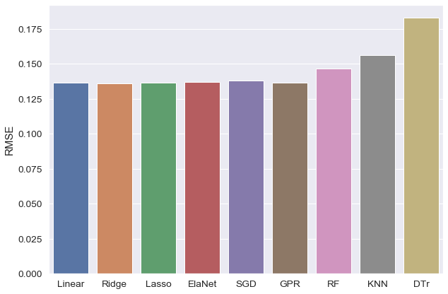
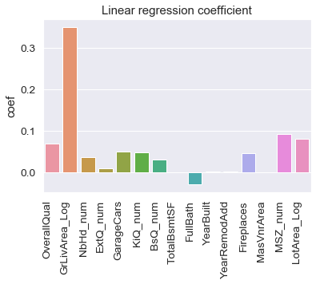
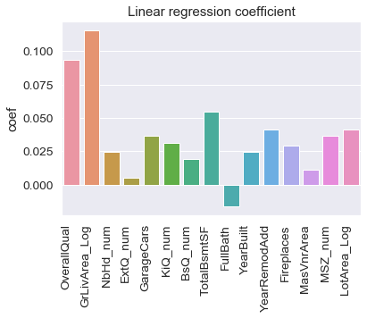
RMSE of all models
4. Results and discussion
We see that the Log of above ground living area sq. ft (“GrLivArea_Log”) and “OverallQual” are the most important features in the linear model.
The performance of all regression model is very similar, except for Decision Tree which has larger RMSE than the other models.
Before standardize the data
After standardize the data

