Slide 1
IBM Cloud
Enterprise network
Customer managed
(Onprem, any cloud provider)
Host
Customer account
Satellite Relay
Container
platform
Tunnel
Customer application
Connector
tunnel server
Satellite
Connector
agent
Firewall
Customer
Backend
application
IBM Cloud services

Slide 2
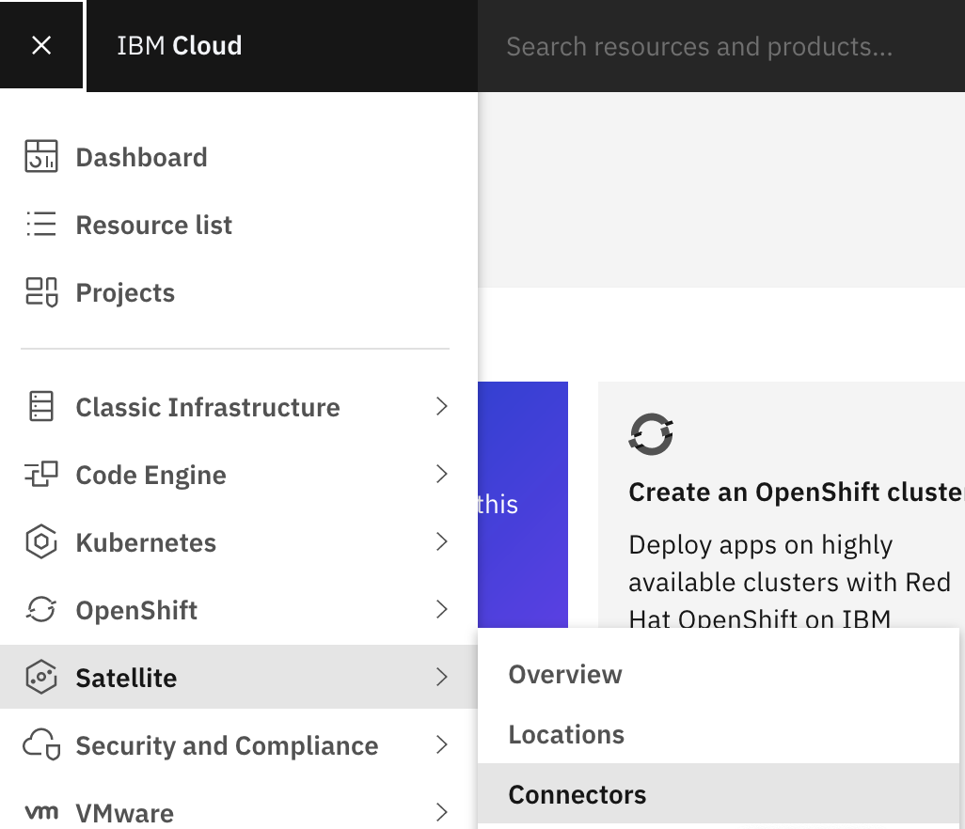

Slide 3
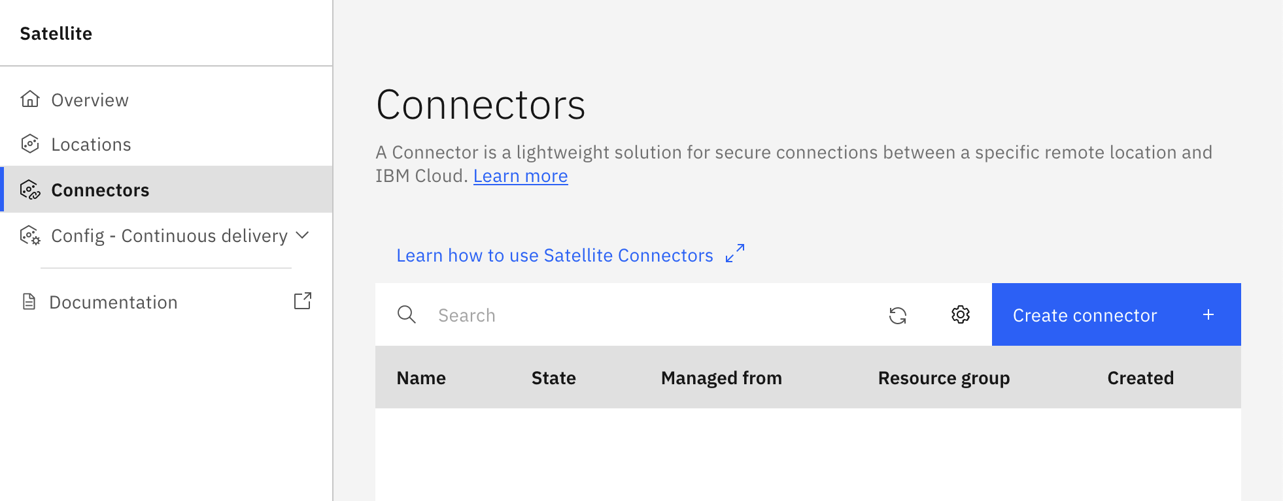

Slide 4
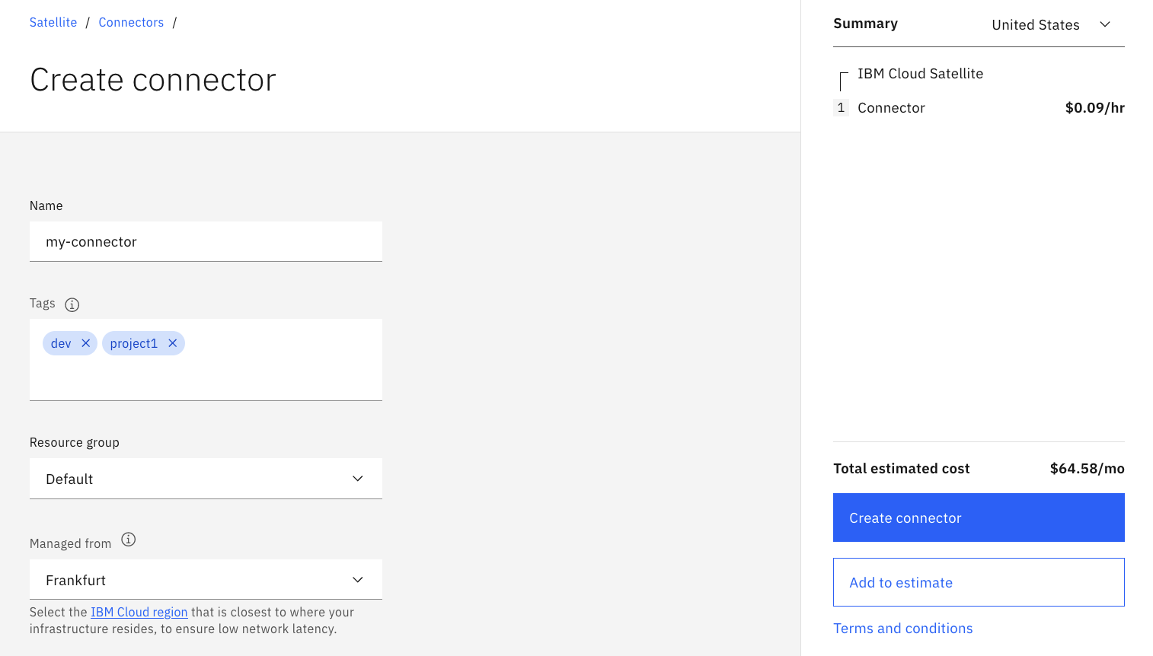
1. Choose a name
2. Input tags (optional)
3. Choose Resource group
5. Click
4. Choose Region

Slide 5
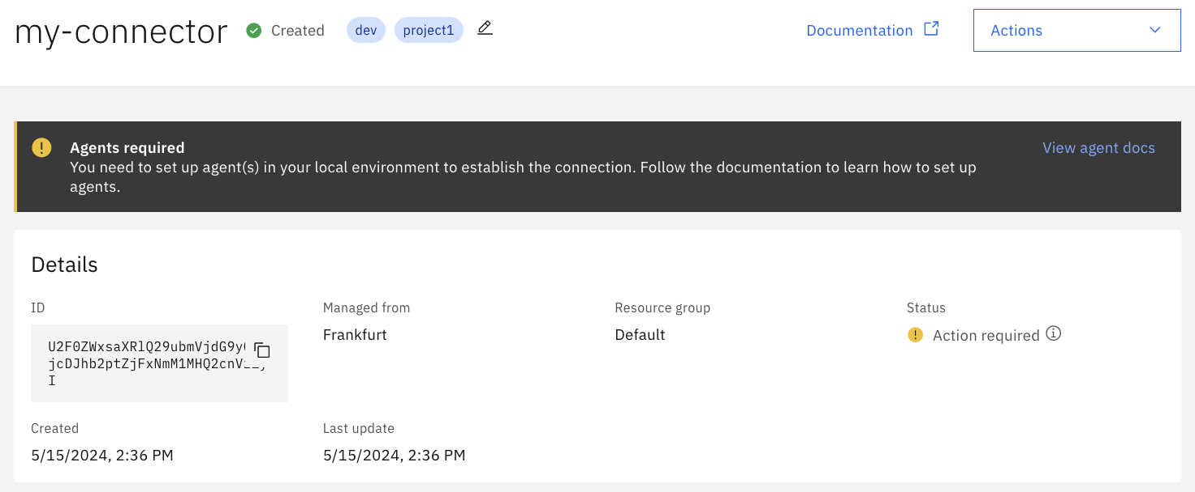
The connector is created and ready within a few seconds
Here is your Connector ID, needed to setup your agent

Slide 6
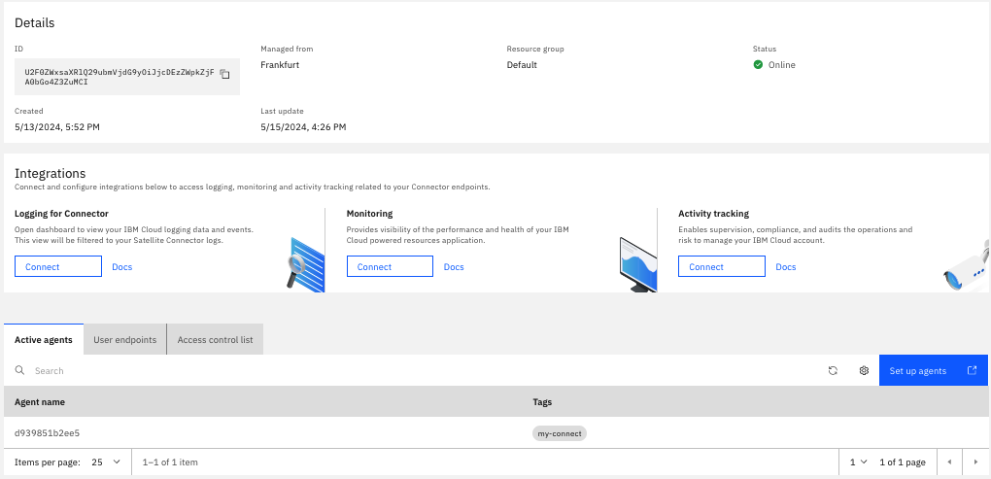
Agent is up and running, hence the tunnel is up and running between the agent and the Satellite Relay

Slide 7
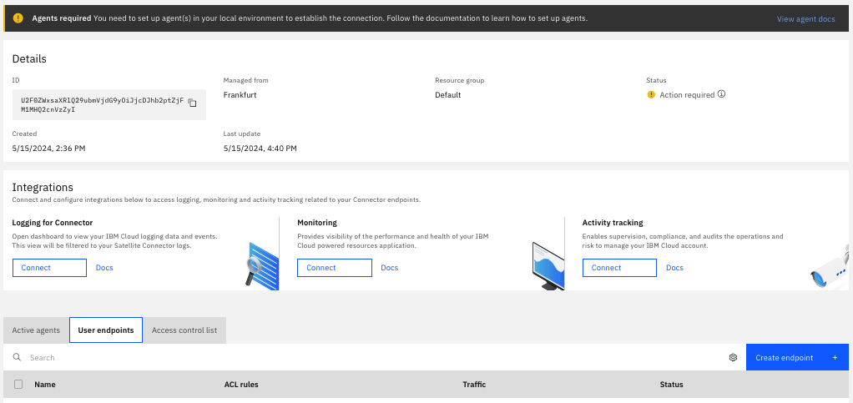
Click

Slide 8
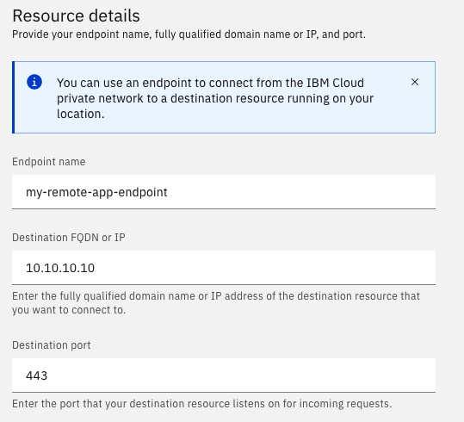
1. Choose a name
2. IP or FQDN of the target application reacheable
by agent connector (container)
3. Port of the target application

Slide 9
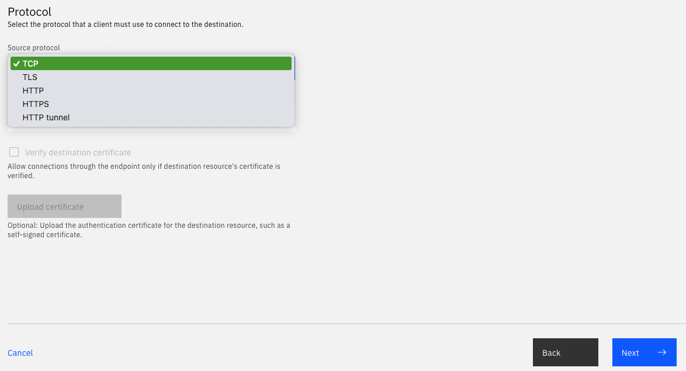
1. Choose your application protocol
2. Click

Slide 10
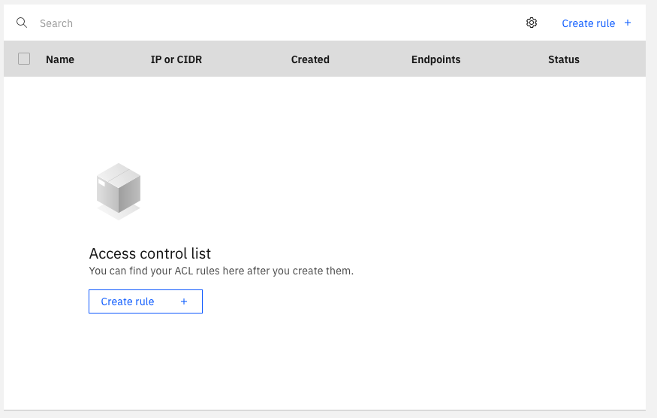
Click

Slide 11
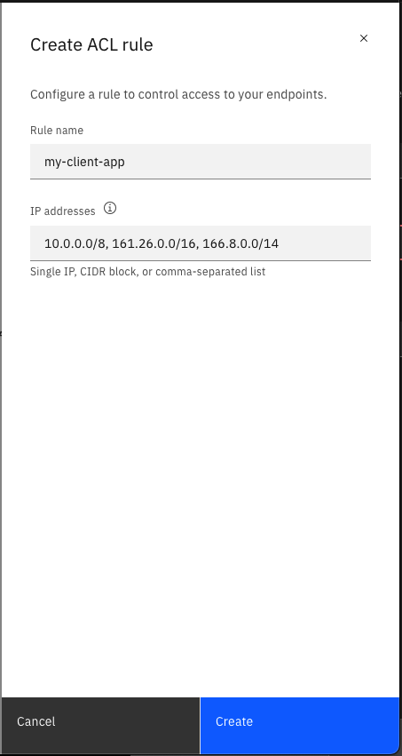
1. Choose a name
2. IP of the source application
3. Click

Slide 12
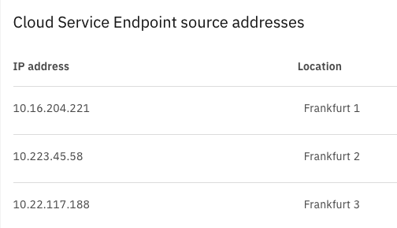
These are the IPs source coming from any resource in the VPC

Slide 13
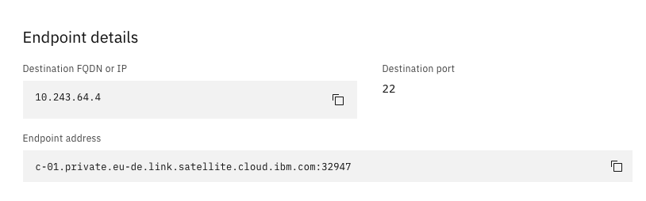
Your target application
Your endpoint URL

Slide 14
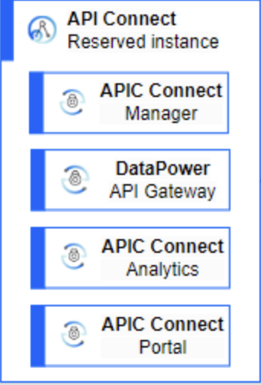
IBM Cloud
Frankfurt
Frankfurt
Client’s IBM Cloud account
APIC
Reserved Instance
account
Satellite Relay
Satellite Connector
Satellite Connector User Endpoint
ROKS
Cluster
Frankfurt
Frankfurt
Tunnel
APIC
Reserved
Instance
Connector
tunnel server
ACE
Backend
Application
10.20.30.40:443
Satellite
Connector
Agents
private network
public network inside IBM Cloud
APIC RI uses service endpoint c-<XX>.private.<region>.link.satellite.cloud.ibm.com:<port>
generated by the Satellite Connector User Endpoint which matches the Backend Application : 10.20.30.40:443
The Satellite Connector User Endpoint’s ACL rule contains IP address of the DataPower Gateway

