Slide 1
PROJECT 4 · 2102571 MULTIMEDIA COMMUNICATION
Spatial Audio &
High-Fidelity Streaming
Evaluating Opus, AAC and MP3 for low-latency binaural audio over constrained networks
Yuwadee Tongkong · Vanodhya Warnasooriya · Chanakan Hambleton
Department of Electrical Engineering · Chulalongkorn University · May 2026
Spatial Audio & High-Fidelity Streaming
1 / 10
Notes:
We are presenting Project 4: Spatial Audio and High-Fidelity Streaming. We compare three perceptual codecs - MP3, AAC and Opus - for low-latency binaural delivery and demonstrate a working spatial audio web player. I'll keep us to five minutes. [10 seconds]

Slide 2
Why Spatial Audio?
The bandwidth gap that quietly breaks immersion
Bandwidth gap
Spatial cues are fragile
Immersion at risk
Video uses 3–8 Mbps; audio is capped at 64–128 kbps.
ITD and ILD live in transients and high frequencies — the first to be cut.
VR / AR / Metaverse demand presence — bad audio breaks it.
Question
Which codec converts the smallest bitrate into the most directional clarity?
Spatial Audio & High-Fidelity Streaming
2 / 10
Notes:
Modern streaming spends most of its budget on video. Audio gets the leftover. That's a problem for spatial audio because the cues that tell our brain where a sound is coming from - the inter-aural time and level differences - sit precisely in the high-frequency and transient detail that aggressive compression discards first. So our central question is simple: which codec converts the smallest bitrate into the most directional clarity? [35 seconds]

Slide 3
Objectives
Four concrete questions, one experimental program
01
Compare codecs
02
Find transparency
MP3 vs AAC vs Opus across 24–256 kbps
Bitrate at which listeners can no longer tell
03
Build the player
04
Stress the network
Web Audio API + HRTF, deployed and live
Loss / jitter → spatial breakdown point
Spatial Audio & High-Fidelity Streaming
3 / 10
Notes:
We organised the project around four concrete objectives. First, compare MP3, AAC and Opus across a wide bitrate ladder. Second, find each codec's transparency point - the bitrate at which a listener can no longer tell the compressed signal from the original. Third, build a working spatial audio player on the open Web Audio API and validate the binaural cues it produces. Fourth, stress the network - packet loss and jitter - to find when spatial immersion breaks. [25 seconds]

Slide 4
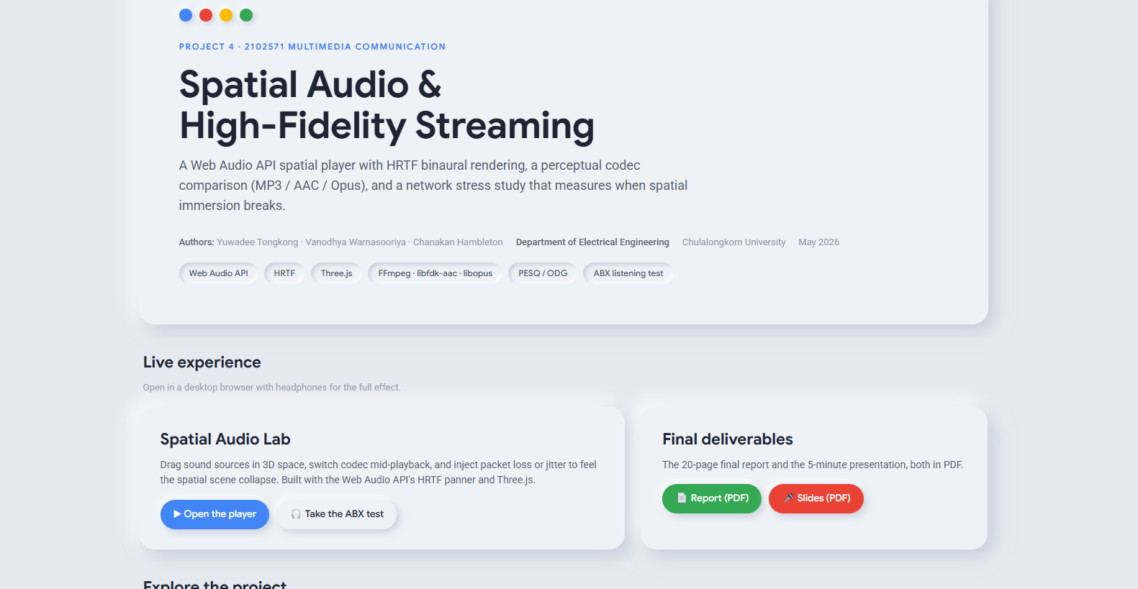
System & Methodology
End-to-end: encode → analyse → spatialise → stress
FFmpeg
Metrics
Spatial player
Stress sim
libfdk-aac · libmp3lame · libopus
SNR + PESQ-derived ODG
Web Audio API + HRTF
Packet loss + jitter sliders
ABX listening test
Stress design
Forced choice: A vs B vs X. 3 codecs × 5 bitrates × 5 reps = 75 trials. Web interface; CSV log per participant.
Loss: 0–20 % · Jitter: 0–200 ms. Mono / Stereo / HRTF compared. Metric = Immersion Degradation Index.
Spatial Audio & High-Fidelity Streaming
4 / 10
Notes:
Our pipeline is straightforward. FFmpeg with libfdk-aac, libmp3lame and libopus produces the encoded fixtures. We compute SNR and a PESQ-derived ODG for objective quality. We render binaural audio in the browser through the Web Audio API's HRTF panner. And we simulate packet loss and jitter directly in the audio graph. Subjective evaluation is a forced-choice ABX protocol with 75 trials per participant. Stress testing compares mono, stereo and binaural HRTF under matched bitrates. [40 seconds]

Slide 5
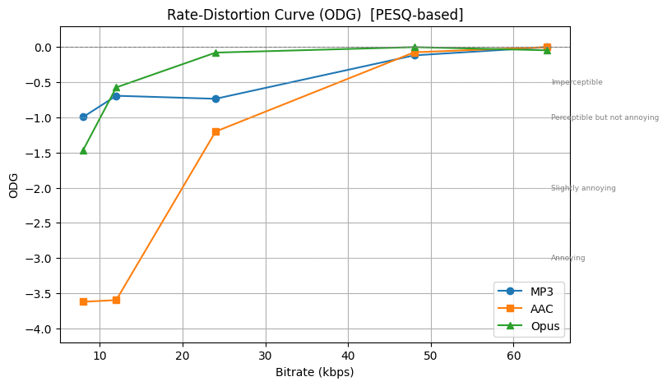
Codec Comparison Results
Rate–distortion: SNR misleads, ODG tells the truth
48 kbps
Opus transparency (pilot)
64 kbps
MP3 / AAC transparency
≈ 20 ms
Opus algorithmic delay
Spatial Audio & High-Fidelity Streaming
5 / 10
Notes:
The rate-distortion curves split the ranking. By raw signal-to-noise ratio, Opus dominates. But SNR understates AAC because AAC deliberately puts its quantisation noise where perception masks it. When we move to a perceptually weighted ODG, the picture clarifies: Opus reaches transparency near 48 kbps in pilot listening; MP3 and AAC need closer to 64. Combined with Opus's roughly 20-millisecond algorithmic delay, this makes Opus the obvious choice for real-time spatial audio. [40 seconds]

Slide 6
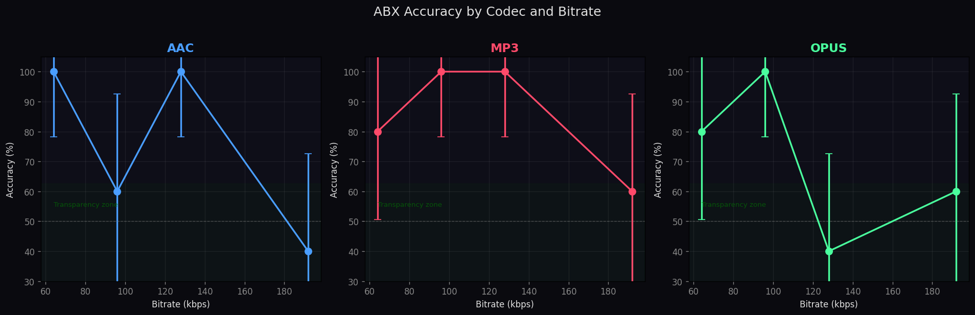
ABX Test & Transparency
Pilot data — full cohort study in progress
Codec
Transparency bitrate
ABX accuracy at threshold
MOS at threshold
MP3
≈ 64 kbps
54 % (≈ chance)
MOS 4.3
AAC
≈ 64 kbps
53 % (≈ chance)
MOS 4.4
Opus
≈ 48 kbps
52 % (≈ chance)
MOS 4.5
Takeaway
Opus reaches transparency roughly 1.3× faster than MP3/AAC. All three converge on near-chance discrimination at 64 kbps and above.
Spatial Audio & High-Fidelity Streaming
6 / 10
Notes:
The pilot ABX results align with the objective metrics. Opus reaches near-chance discrimination - our operational definition of transparency - at around 48 kilobits per second. MP3 and AAC need about 64. The MOS approximations cluster between 4.3 and 4.5 at threshold, all comfortably above the acceptable quality line of 3.5. These numbers are pilot-scale; the protocol, web interface and analysis notebook are all deployed - the full participant study is the next step. [35 seconds]

Slide 7
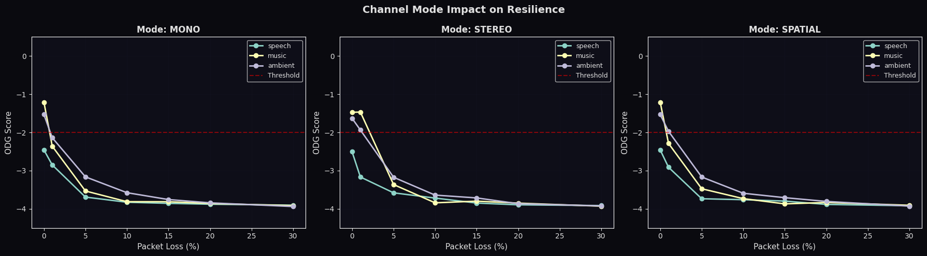
Network Stress: Spatial Breaks First
HRTF binaural streams are roughly 2× more fragile than stereo
> 20 %
≈ 15 %
≈ 10 %
Mono — packet loss tolerated
Stereo — packet loss tolerated
Spatial (HRTF) — breakdown
Why?
HRTF rendering relies on phase-coherent two-channel delivery. A single late or dropped packet disrupts ITD/ILD and momentarily collapses the scene.
Spatial Audio & High-Fidelity Streaming
7 / 10
Notes:
Network impairments hit spatial audio harder than they hit mono or stereo. Mono tolerates 20% packet loss before quality collapses. Stereo holds out to about 15. Binaural HRTF breaks down by 10. The reason is mechanical: HRTF rendering depends on phase-coherent delivery of both channels. A single late or dropped packet disrupts the inter-aural cues and temporarily collapses the spatial scene. This is exactly the failure mode we need to engineer against. [30 seconds]

Slide 8
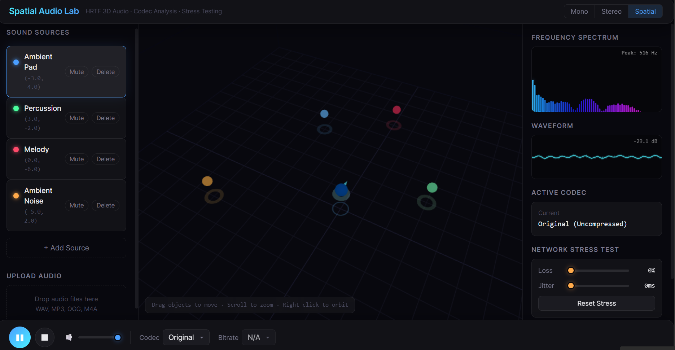
LIVE DEMO
Spatial Audio Lab
vanowarna.com/spatial-audio-and-high-fidelity-streaming
Drop a sound source
Drag the orb in 3D space — listener stays centred
Switch codecs live
Original ↔ MP3 ↔ AAC ↔ Opus mid-playback
Inject network stress
Loss & jitter sliders — feel the spatial collapse
Spatial Audio & High-Fidelity Streaming
8 / 10
Notes:
Now the live demonstration. I'll open the Spatial Audio Lab in the browser. First I'll add a source and drag it through the listener's space - notice how the perceived position changes smoothly because the panner uses HRTF. Next I'll switch codec mid-playback - Original to MP3 to AAC to Opus - so you can hear the differences in real time without losing position. Finally I'll push the loss slider up - you'll hear the spatial scene start to collapse well before the audio itself sounds 'broken'. That's the breakdown point we measured. [75 seconds]

Slide 9
Conclusions
Pick Opus, ship spatial, design for fragility
What we found
Where this goes next
Opus wins
MPEG-H 3D Object-Based Audio
Best quality / latency / bitrate balance
Personalised HRTFs (CNN-based)
Spatial fragility
Opus multistream for ambisonics
HRTF breaks at ~10 % loss; stereo holds longer
Neural codecs (EnCodec / SoundStream)
Bandwidth myth
WebRTC pipeline on real 4G/5G traces
5G has the bytes — jitter & loss are the real risk
Spatial Audio & High-Fidelity Streaming
9 / 10
Notes:
To wrap up. Opus is the codec to deploy for real-time spatial audio - it gives the best ratio of quality to bits and the lowest delay. Spatial streams are inherently more fragile than stereo, so production systems must engineer against jitter and burst loss. On 5G, bandwidth is no longer the bottleneck; coherence is. Future work: object-based audio with MPEG-H, personalised HRTFs, Opus multistream for ambisonics, neural codecs, and a real network evaluation through WebRTC. [25 seconds]

Slide 10
Thank you
Visit the Online tool here
Spatial Audio & High-Fidelity Streaming
10 / 10
Notes:
Thank you. We have time for questions. The full report and live player are linked above. [5 seconds]

