Slide 1
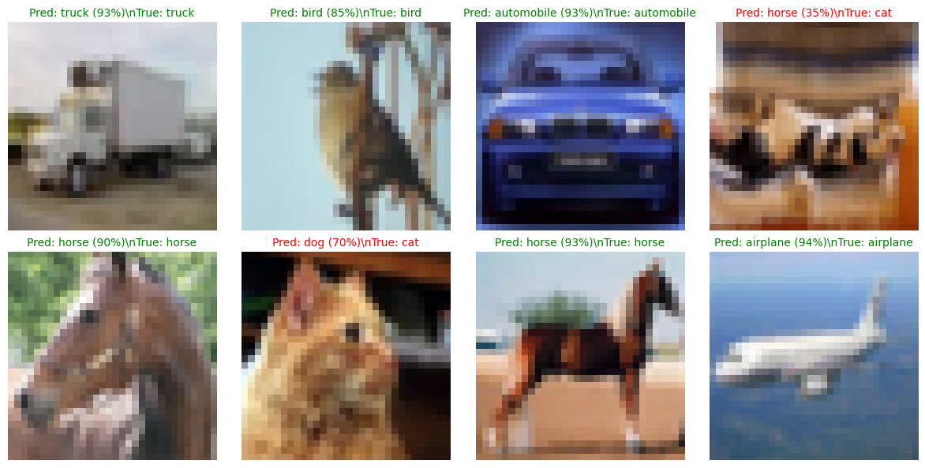
CSE620 | DEEP LEARNING WITH PYTORCH
01 PROBLEM / Image classification at 32 × 32
Can a Vision Transformer learn to recognize ten object categories from scratch?
10 classes
Airplanes, animals, vehicles, and more
32 × 32 pixels
Fine details are difficult to distinguish
60,000 images
45k train · 5k validation · 10k test
Goal: build, evaluate, and demo a ViT in PyTorch.
Actual CIFAR-10 images and predictions from the executed live demo
Van Q. Phung · Wanling Jiang · October 21, 2026
1/3

Slide 2
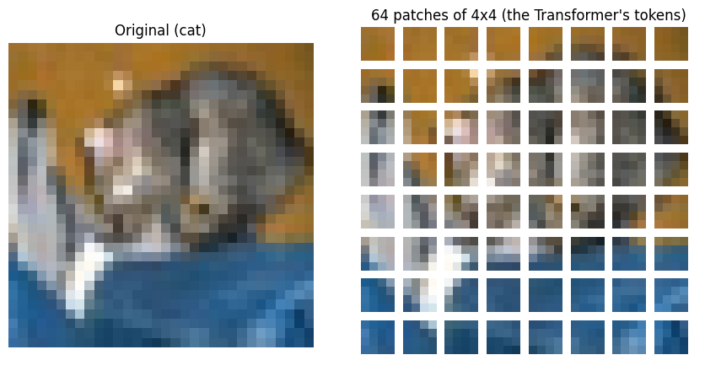
CSE620 | DEEP LEARNING WITH PYTORCH
02 SOLUTION / A Vision Transformer built in PyTorch
Patch embedding → attention-based feature learning → 10-class prediction
32 × 32 RGB image
Input image
64 patch tokens
4 × 4 patches · 192-d embeddings
65-token sequence
Add learned [CLS] token
6 Transformer blocks
6 attention heads · MLP + residual
10-class prediction
[CLS] → classification head
Actual patch-token visualization from notebook
Van Q. Phung · Wanling Jiang · October 21, 2026
2/3

Slide 3
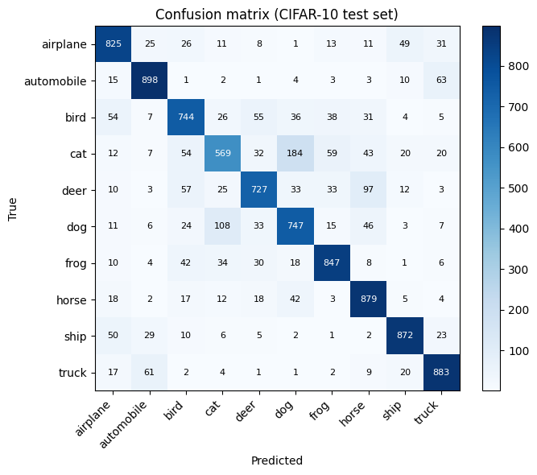
CSE620 | DEEP LEARNING WITH PYTORCH
03 RESULTS / Verified performance on CIFAR-10
Results reproduced from the uploaded, executed Google Colab notebook
79.91%
79.22%
2.69M
TEST ACCURACY · 7,991 / 10,000
BEST VALIDATION ACCURACY
TRAINABLE PARAMETERS
What the evaluation shows
Best recall: automobile 89.8%
Lowest recall: cat 56.9%
Top error: cat → dog (184)
LIVE DEMO VERIFIED
6/8 correct · 2.0 s · CUDA
Van Q. Phung · Wanling Jiang · October 21, 2026
3/3

