Slide 1

In 20 minutes

Slide 2
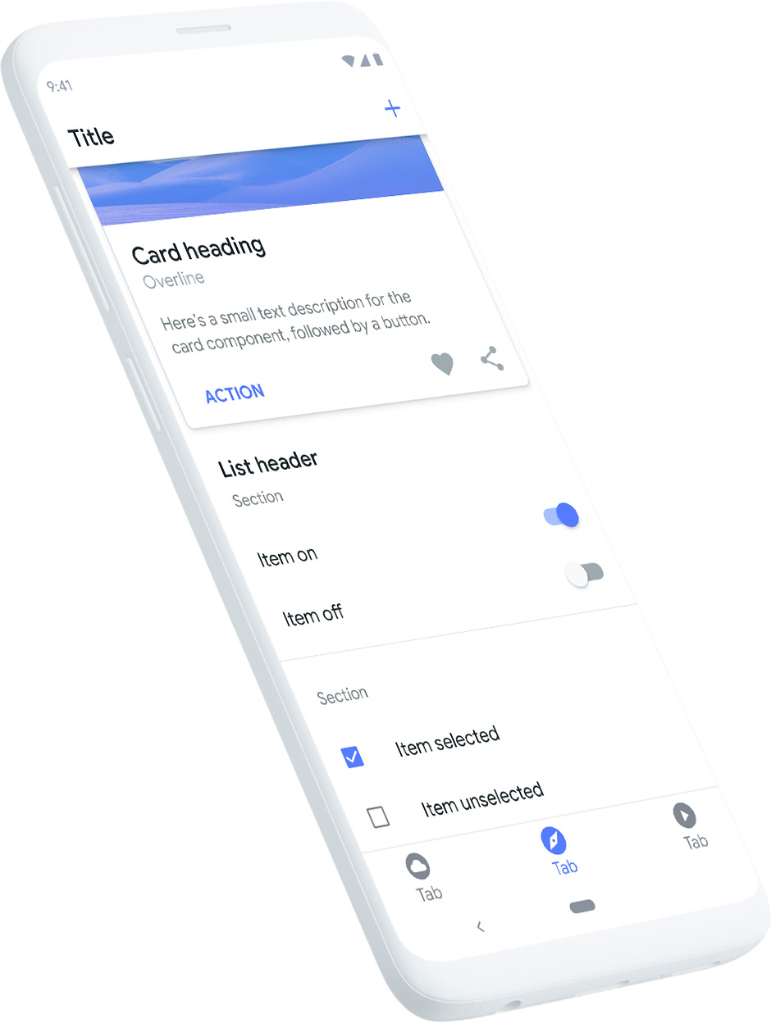
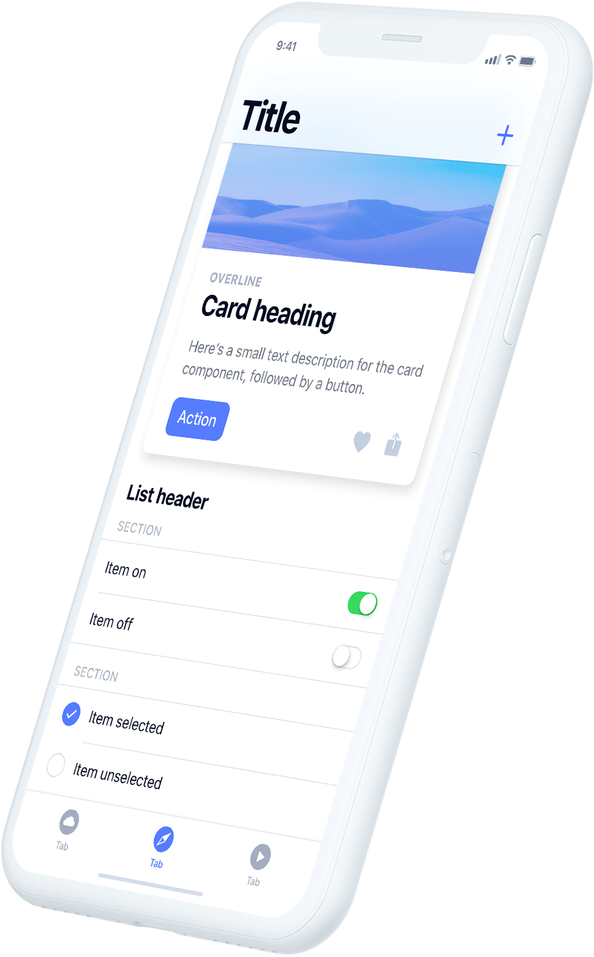
Ionic
Free open source mobile UI toolkit
High quality cross platform Apps
One codebase for native iOS, Android and Web

Slide 3







Ionic Ecosystem
Ionic CLI
Web components
Capacitor
Ionic Appflow
CLI
Appflow

Slide 4
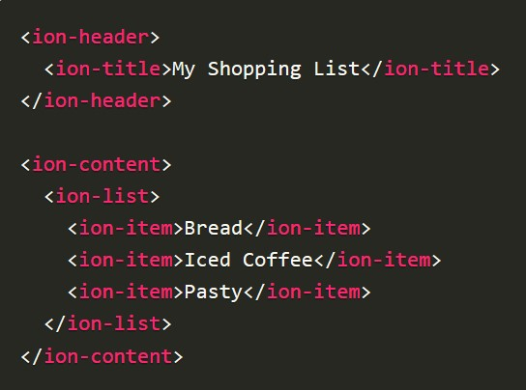
Ionic Web Components
Build with StencilJS
HTML5 valid
Platform specific styles
Example #cmp-basics

Slide 5
Ionic Alternatives
NativeScript
React Native
Flutter
Real native apps with one codebase
Javascript for Ionic, React Native, NativeScript
Dart for Flutter

Slide 6

Flutter
Dart code compiled to native code

Slide 7
React Native
Using pre-build components which will be compiled to native code

Slide 8
NativeScript
Different favors: pure JS/Typescript, Angular and Vue.js
Pre-build components partly compiled to native code

Slide 9
Ionic
Pretty easy to get started for Web Developers
Different approach then first three
Tons of official prebuild components
Create native by creating web app with HTML, JS and CSS

Slide 10
Detailed comparasion
Ionic vs NativeScript vs Flutter vs React Native

Slide 11

Ionic Example App

